Slide 1

Development of Low Cost Storage SYstemsfor Agricultural Products
P M V Subbarao
Professor
Mechanical Engineering Department
Head, CRDT
Better Earnings for Rural Producers….

Slide 2

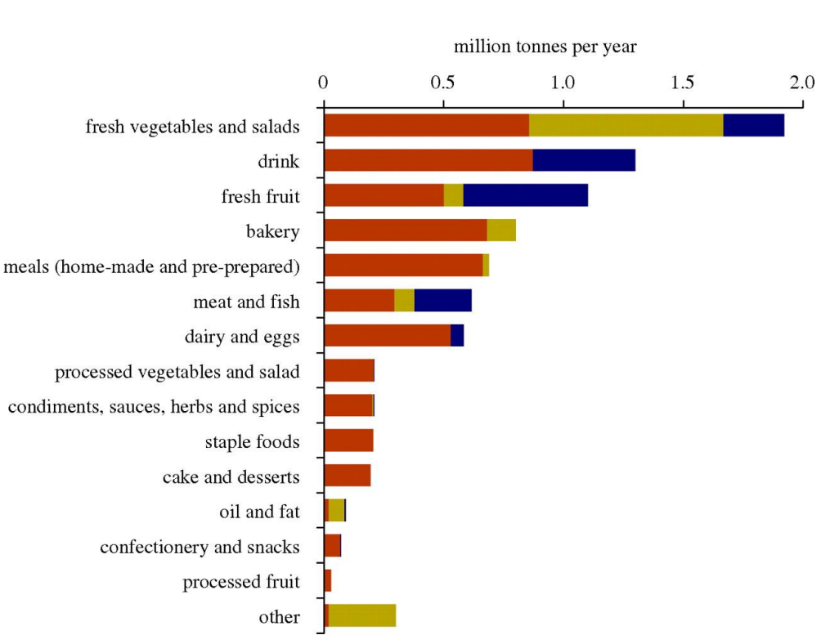
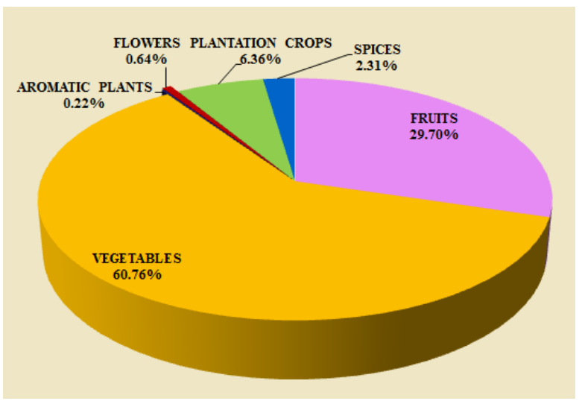
Preservation of Horticultural Products
Production of Horticultural Products
Wastage of Horticultural Products

Slide 3
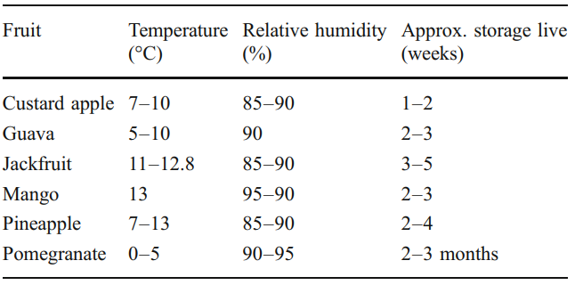
Preferred Storage Conditions for Fruits

Slide 4
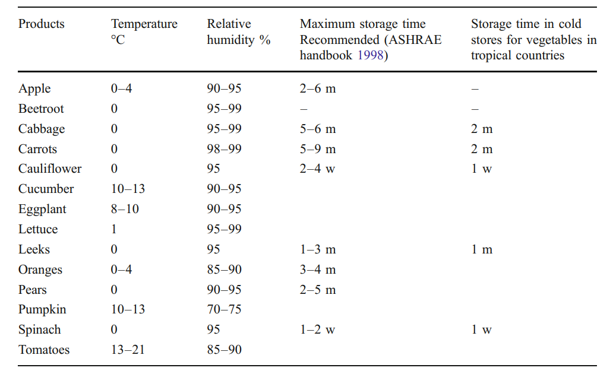
Preferred Storage Conditions for Vegetables

Slide 5
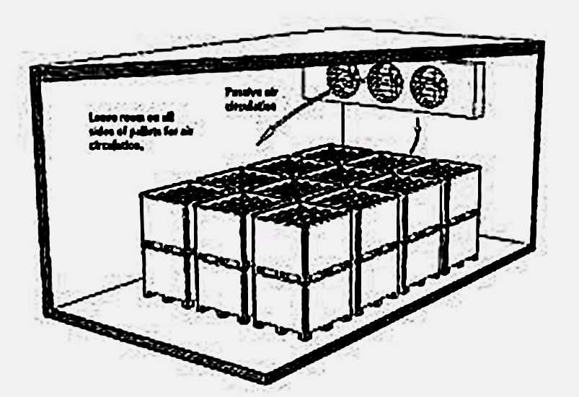
Structure of Cold Storage for Horticultural Products

Slide 6
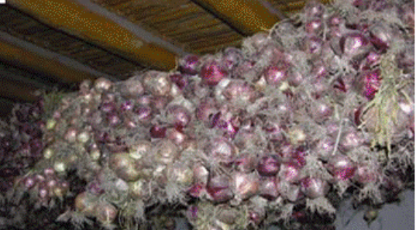
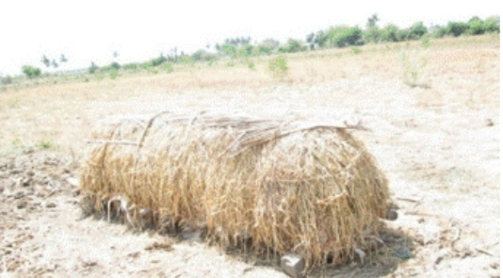
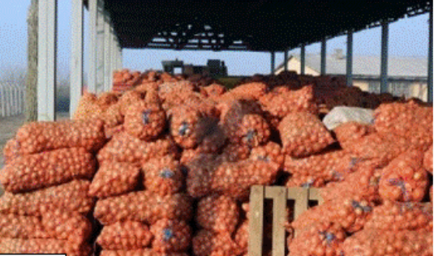
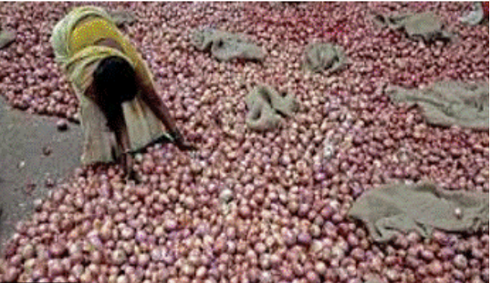
Traditional Storage Methods
Hanging method
Vengaya Pattarai
c
d
Bag storage,
Floor Storage

Slide 7
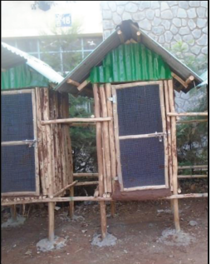
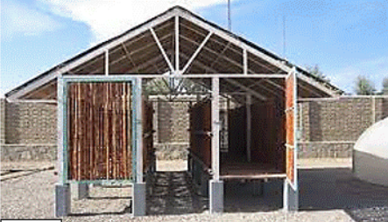
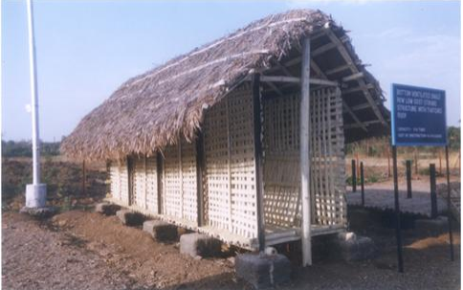
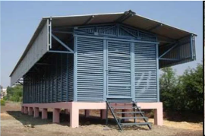
Advanced Storage Methods
Mud coated structure
Modified ventilated structure
Bottom Ventilated Structure
Bottom and Side ventilated Structure

Slide 8
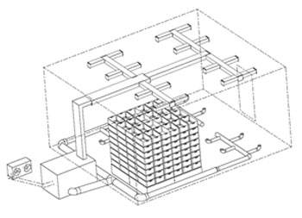
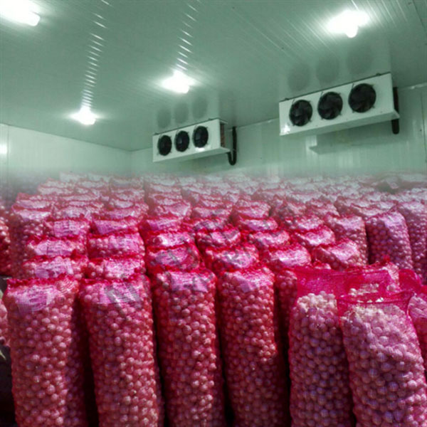
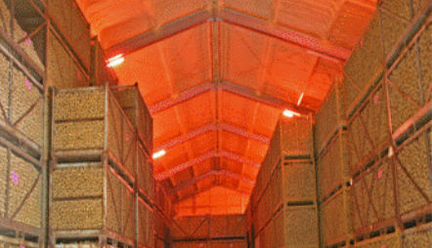
Urban Commercial Storage Methods
Controlled atmospheric storage

Slide 9
When to Prefer Evaporative Cooling ?
Ambient relative humidity:
  If the relative humidity is consistently high, evaporative cooling will not be a viable option, and therefore another system needs be considered.
  If the relative humidity is low, then evaporative cooling may be effective.
Windy area: where the cooling is needed. If there is little wind evaporative cooling may not be the way to go.
Availability of sufficient clean water.
If all above conditions are favorable, evaporative cooling may be feasible.

Slide 10
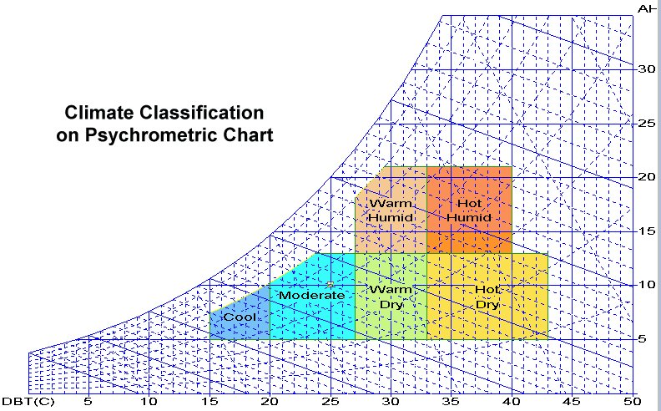
Types of Evaporative Cooling
Direct Evaporative Cooling system
Indirect Evaporative Cooling

Slide 11
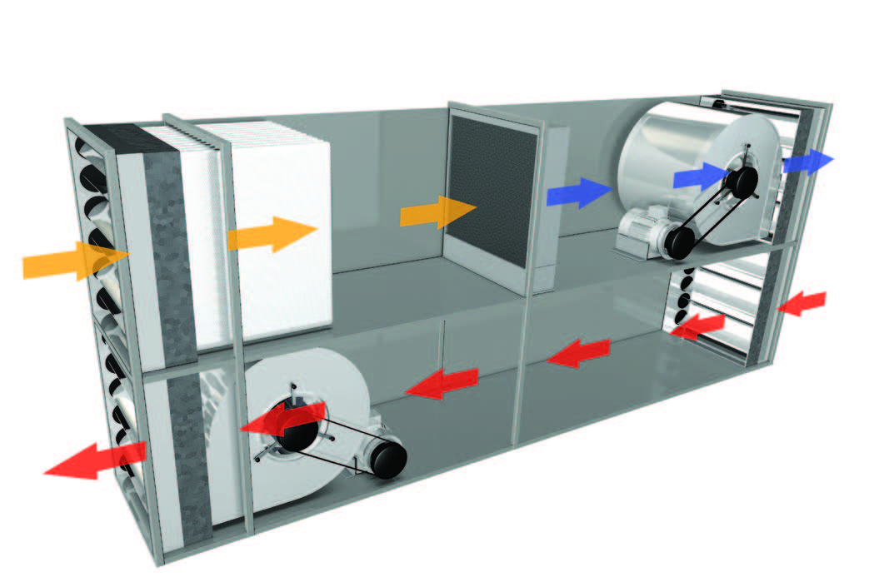
Direct Evaporative Cooling
Warm or Hot dry ambient air absorbs more moisture going in due to having lower initial relative humidity, the evaporative cooling effect will be stronger.
This method utilizes fresh ambient air.
Ambient air is sucked into the system and then brought through ventilation ductwork and met with humidity in a dedicated air handling unit.
This airstream with a higher moisture content (relative humidity) achieves an optimal temperature and just the right amount of hydration before being dispersed indoors.
That conditioned air is critical as, since a greater amount of existing room air is exhausted, it replaces it and helps to regulate indoor conditions.

Slide 12
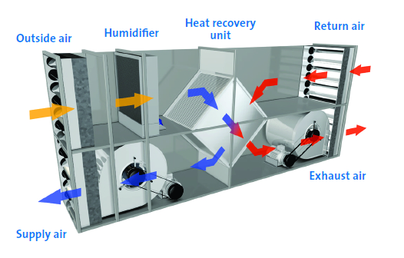
Indirect Evaporative Cooling
Indirect evaporative cooling solutions are useful even in seasonal environments or areas where the outside temperature is higher than indoors.
Fresh ambient air is run through the evaporative humidifier and used to cool the return air from room.
This heat exchanger is called as Heat Recovery Unit.
The return air from the room is run through the HR unit.
This method has the advantage of effectively cooling the airstream without over-humidifying the air.

Slide 13
Research at IIT Delhi: micro-scale Storage Structure for Onion
Food Security
Income Security
Nutritional Quality
Viable Storage
Foreign Exchange
Loss Minimization
Controlled Market Price
Market Demand
Export Demand

Slide 14
Various post-harvest losses of onion
Sprouting (Formation of shoots)
Rotting (Microbiological spoilage)
Respiration (Moisture loss and shrinkage)
Rooting (Elongation of roots)
Nutritional losses
Physiological loss in weight (PLW)

Slide 15
Losses control measures during storage
Pre-storage conditions
Temperature control
Relative humidity control
Ventilation
Application of desiccant materials
CA storage

Slide 16
Temperature control
There are two distinct temperature regimes where losses are minimum
High-temperature regime
(25-30 ⁰C)
Low-temperature regime
(0-2 ⁰C)
Issue(s)
Advantage(s)
Issue(s)
Advantage(s)
Storage cost is high
Difficult to afford by the rural people
Required trained manpower
Post-storage sprouting issue resulting in further losses
Minimum losses during storage
Long-duration storage
Comparatively higher weight loss
Low cost
Suitable for rural area
Comparatively more return
Less maintenance
No issue of post sprouting
N. B: Fluctuation in temperature and environmental interference must be avoided in any storage to minimize losses

Slide 17
Relative humidity control
Relative humidity, along with temperature, plays an important role in the shelf life and quality of onion and garlic during storage.
Moderate RH (65-70%) can protect bulb weight better than lower or higher RH.
65-70% RH is considered a balanced RH and is helpful for the equilibrium water content of onion and garlic skin.
Maintaining the relative humidity at such a lower level is difficult.
As a result, farmers in villages face numerous losses of onion and garlic due to fluctuating relative humidity.

Slide 18
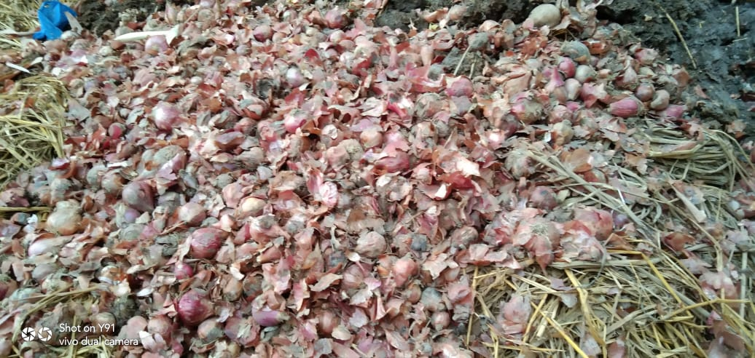
Spoilt onions just within 10 days of conventional storage
Location: Tanda, Akbarpur (Ambedkar Nagar), Uttar Pradesh
Storage duration: May 21, 2022 to May 30, 2022
Name of the farmer: Tulsi Ram
Total loss: 100 kg (Approximate) out of 300 kg

Slide 19
Underground storage structure for onion and garlic
Exhaust ventilation
Roof
Manhole opening
IoT Device
Blower
Solar chimney
Ground Surface
Sensors
Aeration pipeline
Desiccant bed
Air flow controlling valve
Storage rack

Slide 20
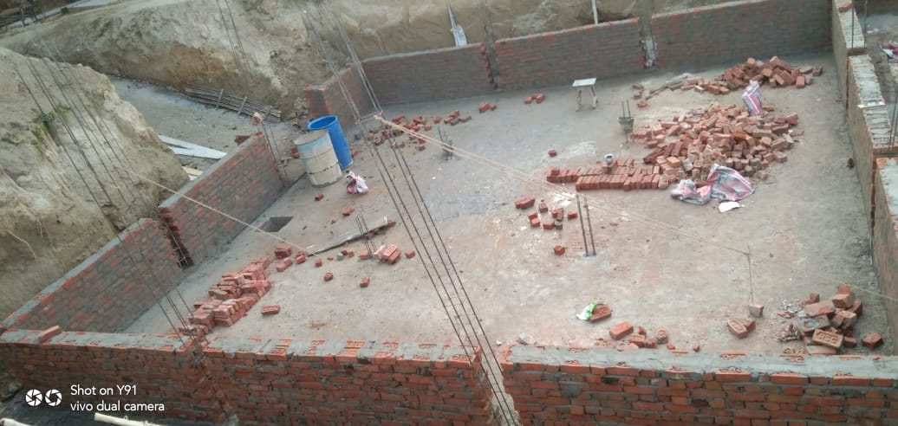
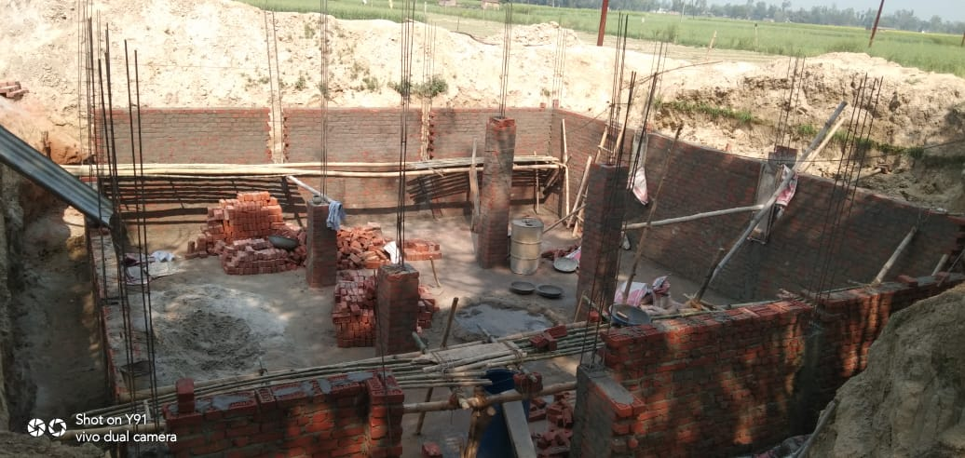
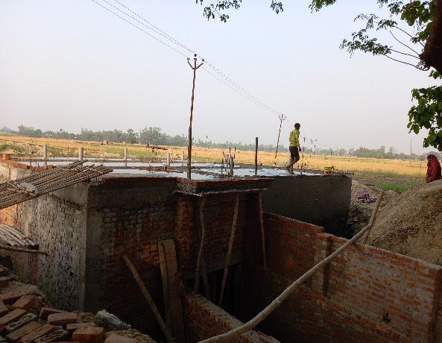
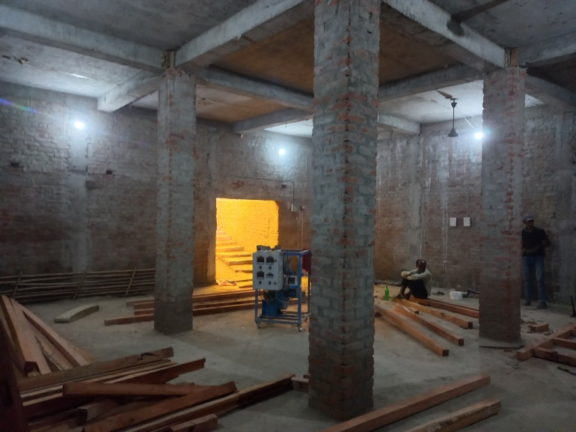
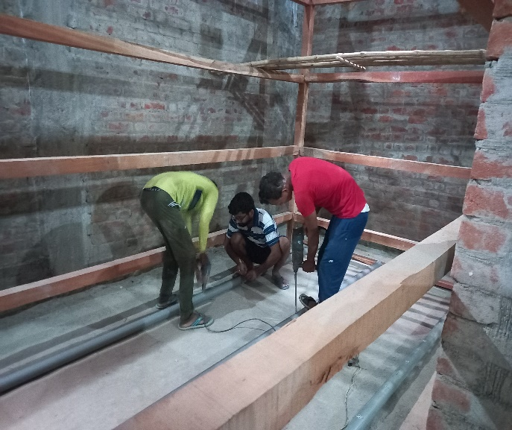
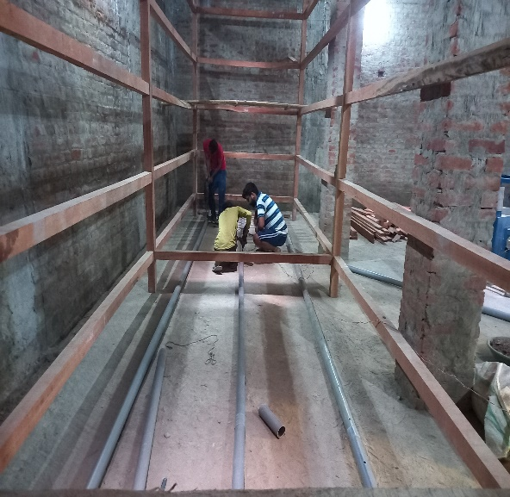

Slide 21
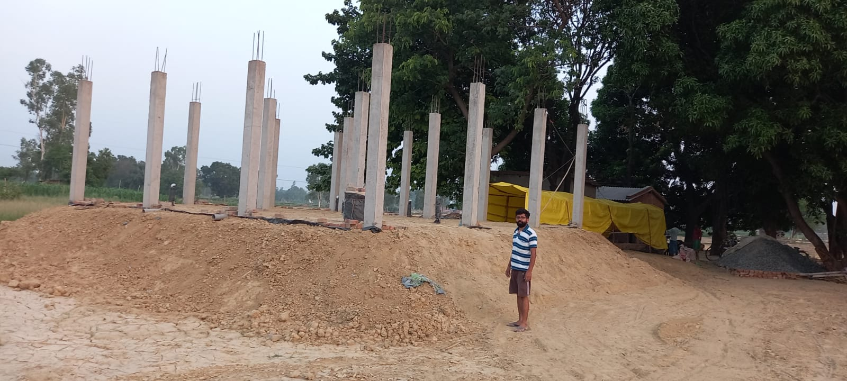
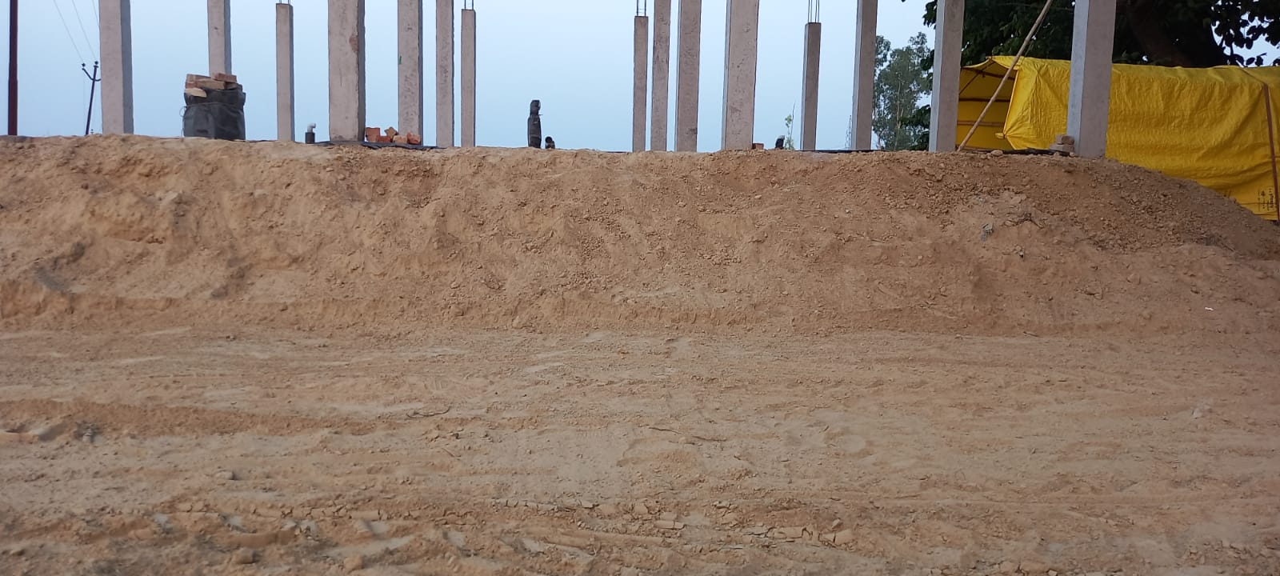
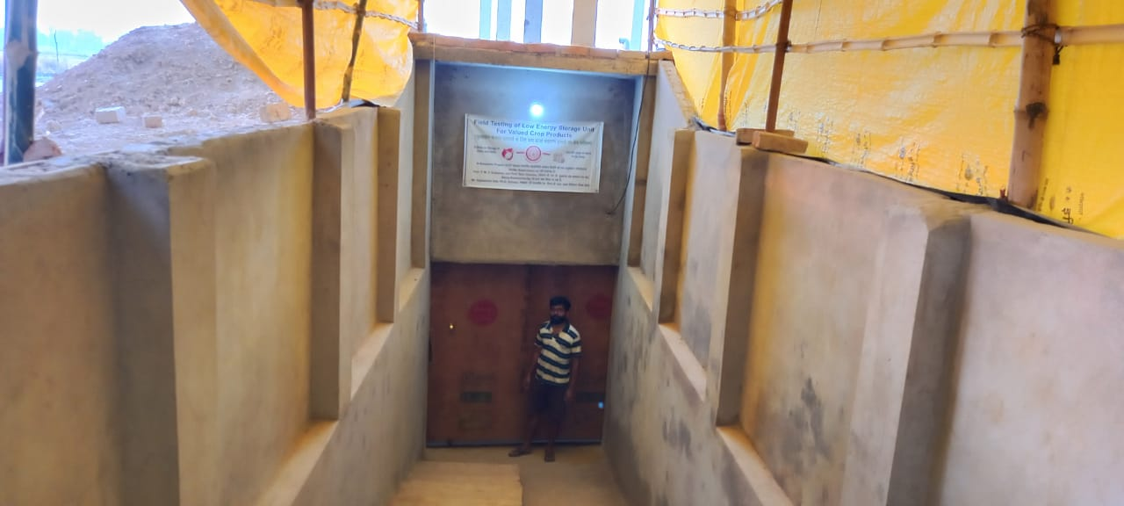
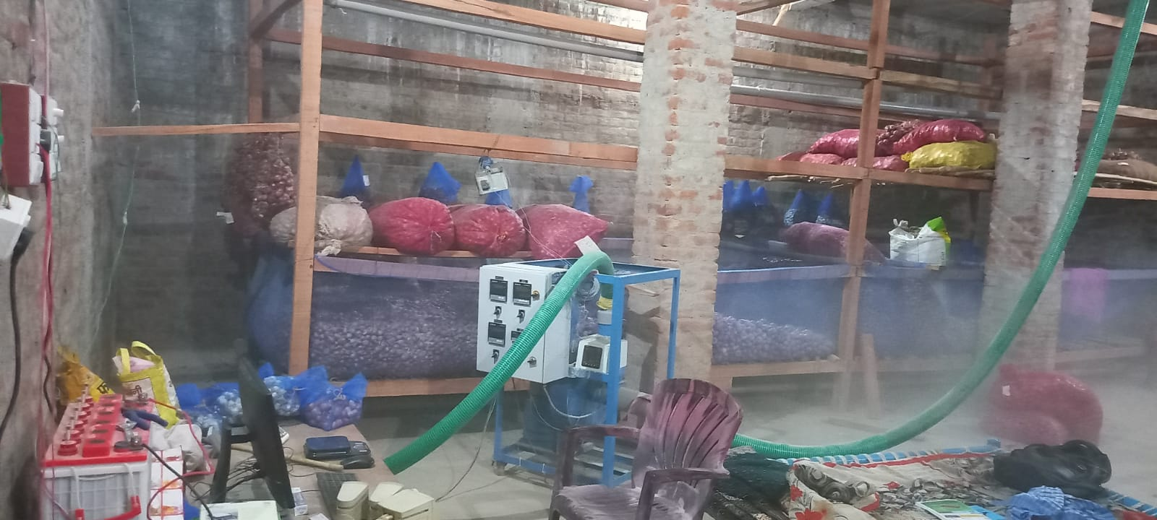

Slide 22
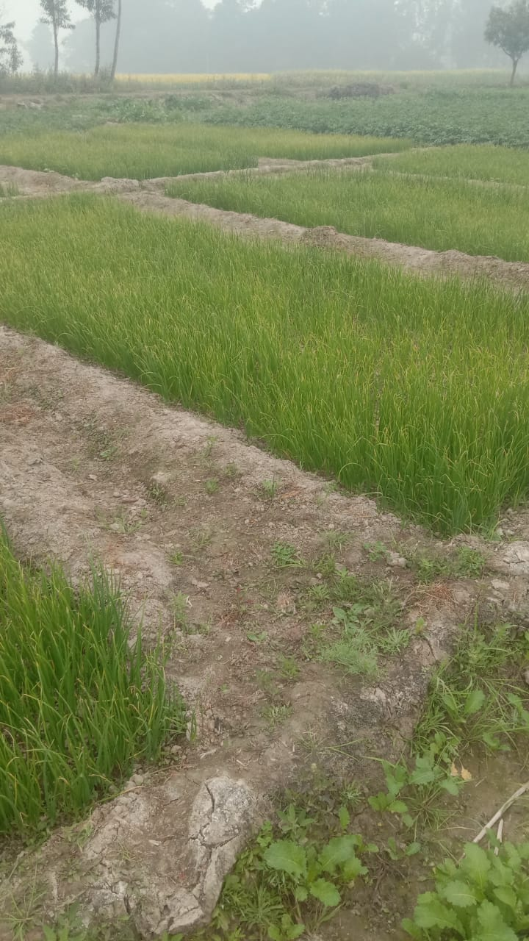
Raising of Onion Nursery: 01 Feb. 2022

Slide 23
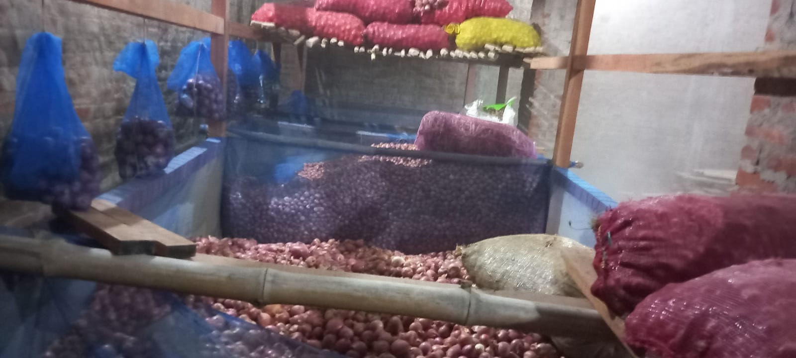
Loading of materials inside the underground storage structure
Bag Storage (Nylon Bag)
Total Number of Bags: 05
Total Sample: 20 kg
Sample per Bag: 5 kg
Bag Storage (Gunny Bag)
Total Number of Bags: 05
Total Sample: 200 kg
Sample per Bag: 40 kg
Bulk Storage
Stack Height (Exp. 1): 0.5 feet
Stack Height (Exp. 2): 1.0 feet
Stack Height (Exp. 3): 2.0 feet

Slide 24
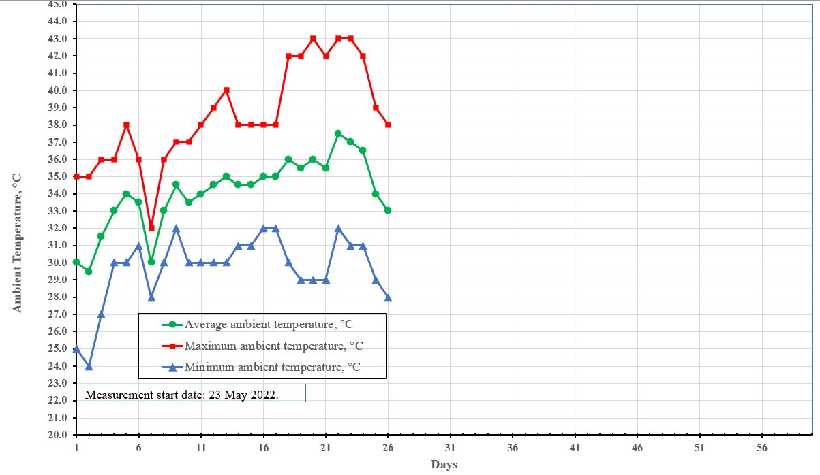
Preliminary performance study

Slide 25
Preliminary performance study

Slide 26
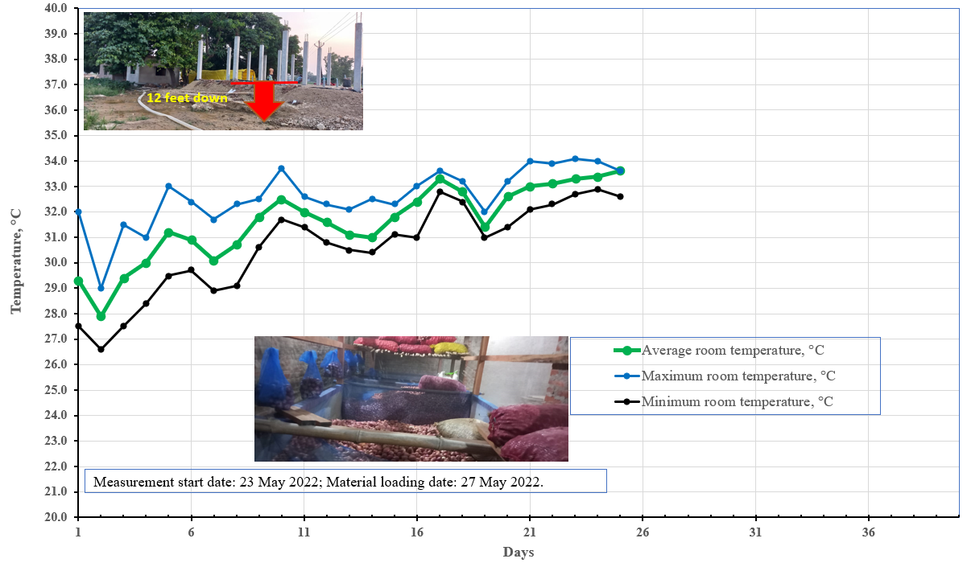

Slide 27
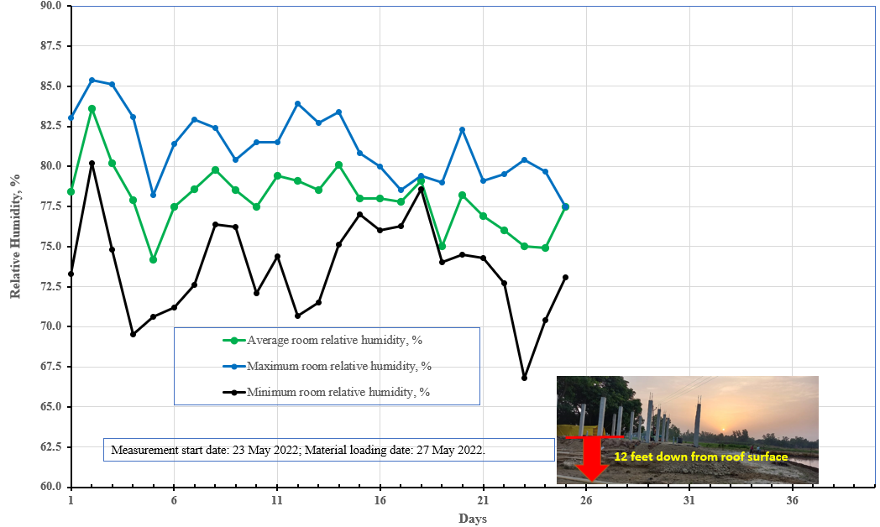

Slide 28
