Slide 1

Development and Testing of Solar Dryer for Agricultural Products
P M V Subbarao
Professor
Mechanical Engineering Department
Head, CRDT
Estimation and Supply of Solar Energy for Better Drying of Products….

Slide 2

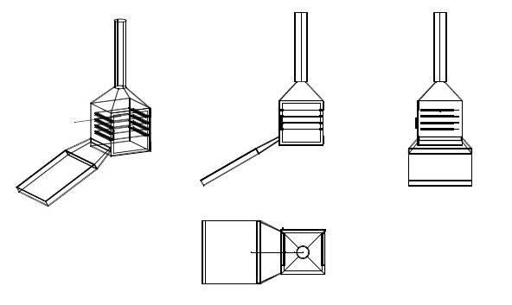
  Hot Air based Solar Dryer
Essential Organs:
1. An Inclined Black flat plate
2. A Glass cover & Rectangular channel.
3. Housing with grates to place the material to be dried.
4. Chimney hood to exhaust humid and cold air.
Air with temperatures of 50°C to 55°C is often best for food drying

Slide 3
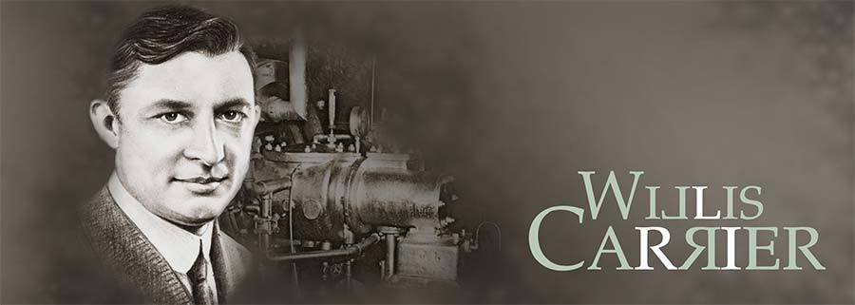
Psychrometric Chart & Processes
Psychrometrics is defined as the physics which deals with processes and properties of moist air (mixture of dry air and water vapor).
In 1903, Willis H. Carrier completed the world's first scientifically based air conditioning system for Sackett Wilhelm Lithographing Company situated in Brooklyn, New York., which was designed to control humidity.

Slide 4
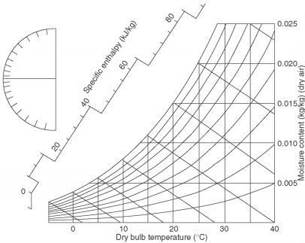
Psychrometric Chart

Slide 5
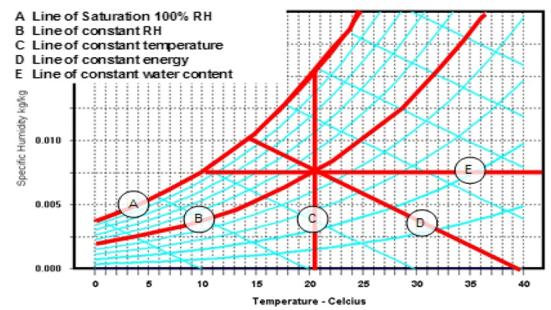
Psychrometric Chart

Slide 6
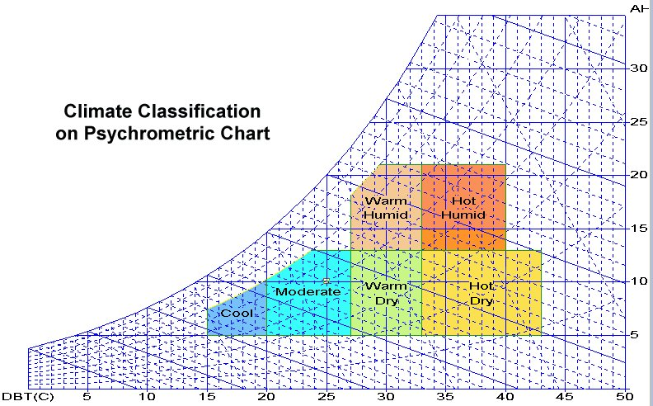
Specific Humidity
(gms of water vapour/kg of dry air)

Slide 7
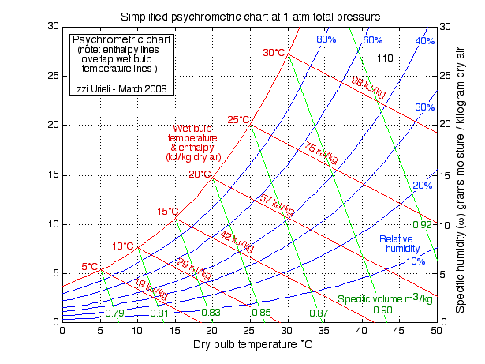
Heating of Air in Solar Air Heater

Slide 8
Drying of Slices in the Hood

Slide 9
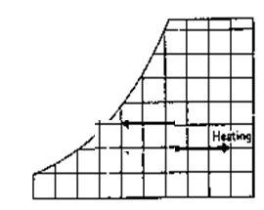
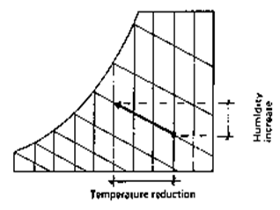
Psychrometric Processes
Sensible Heating of air in Asorber
Humidification air or Drying of Food

Slide 10
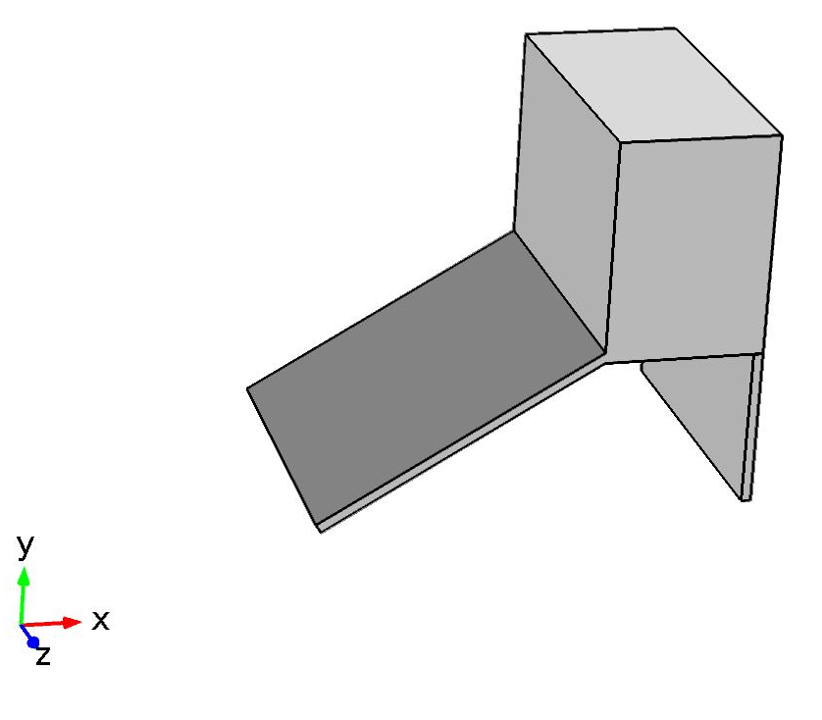
Energy balance equations for Solar Air Heater

Slide 11
Input Parameters
Ambient Temperature variation
Solar Flux variation

Slide 12
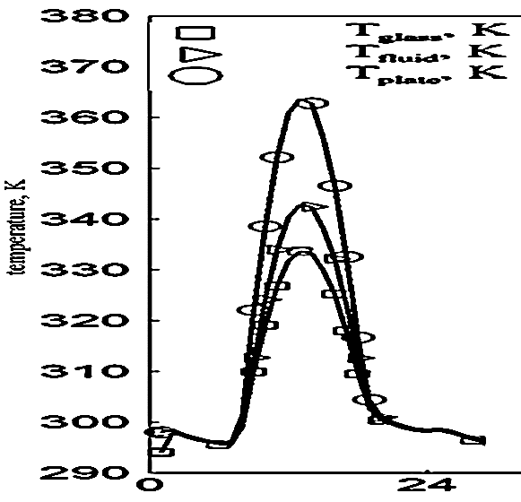
Results of Solar Natural Convection Air Heating

Slide 13
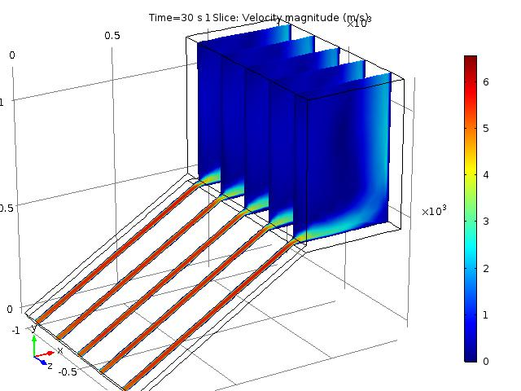
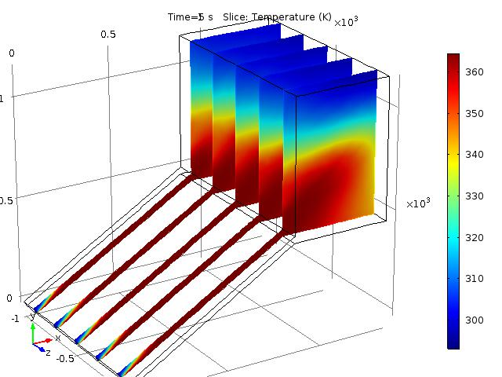
COMSOL Simulations
Velocity distribution for Conventional Solar Dryer
Temperature distribution for Conventional Solar Dryer

Slide 14
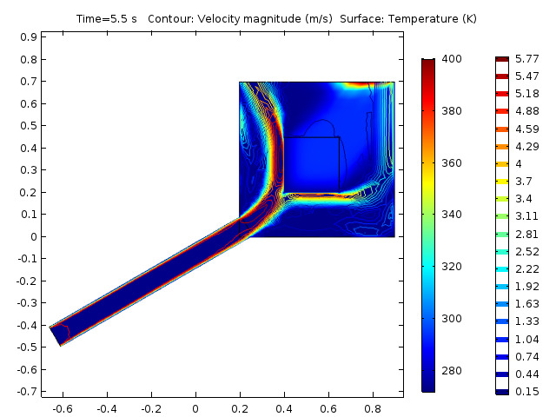
Mass flow rate of Hot Air
Temperature and velocity distribution due to density difference

Slide 15
Product Development Solar Dryer at CRDT IIT Delhi
Design, Development, Experimentation and Simulation of Solar Dryer
for Rural Application (Amchur Drying)
The design parameters:
Input Parameters :
Solar flux, air velocity, ambient temperature
Optimization Parameters :
Temperature values, collector area, gap between the collector
Output :
Different values of temperature for the day like
Air Temperature
Inner Glass Temperature
Outer Glass Temperature
Collector Basin Temperature
Product temperature | 65ºC
Amount of moisture to be removed | 3.947 kg
Latent heat of evaporation | 2347000 J/ kg
Energy required to evaporate the moisture | 9.2 MJ
Solar dryer Heat energy | 15 MJ
Maximum Solar Intensity | 800 W/m²
Area of the Solar collector | 1.4 m²
Basic design of conventional solar dryer

Slide 16
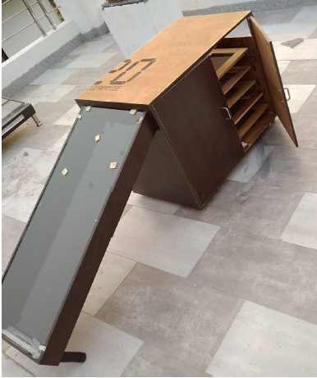
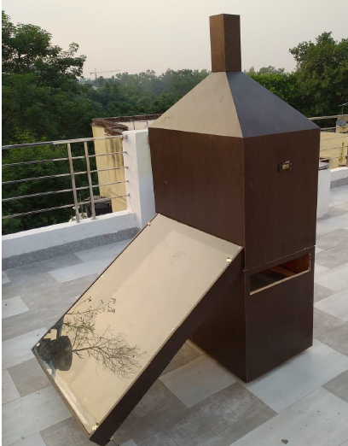
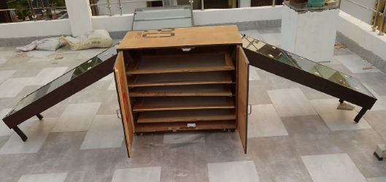
Design and Development of Multi-use 5 in One
Domestic Portable Indirect Type of Solar Dryer
(1)
(3)
(2)
Small version with Double Collector
Small Version with Single Collector
Medium Size Solar Dryer with Single Large Collector

Slide 17
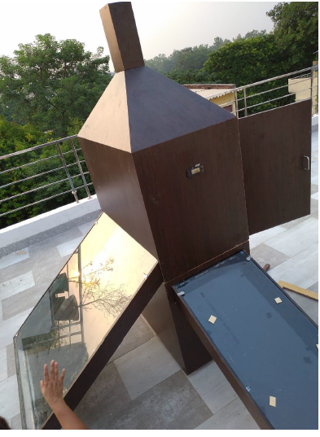
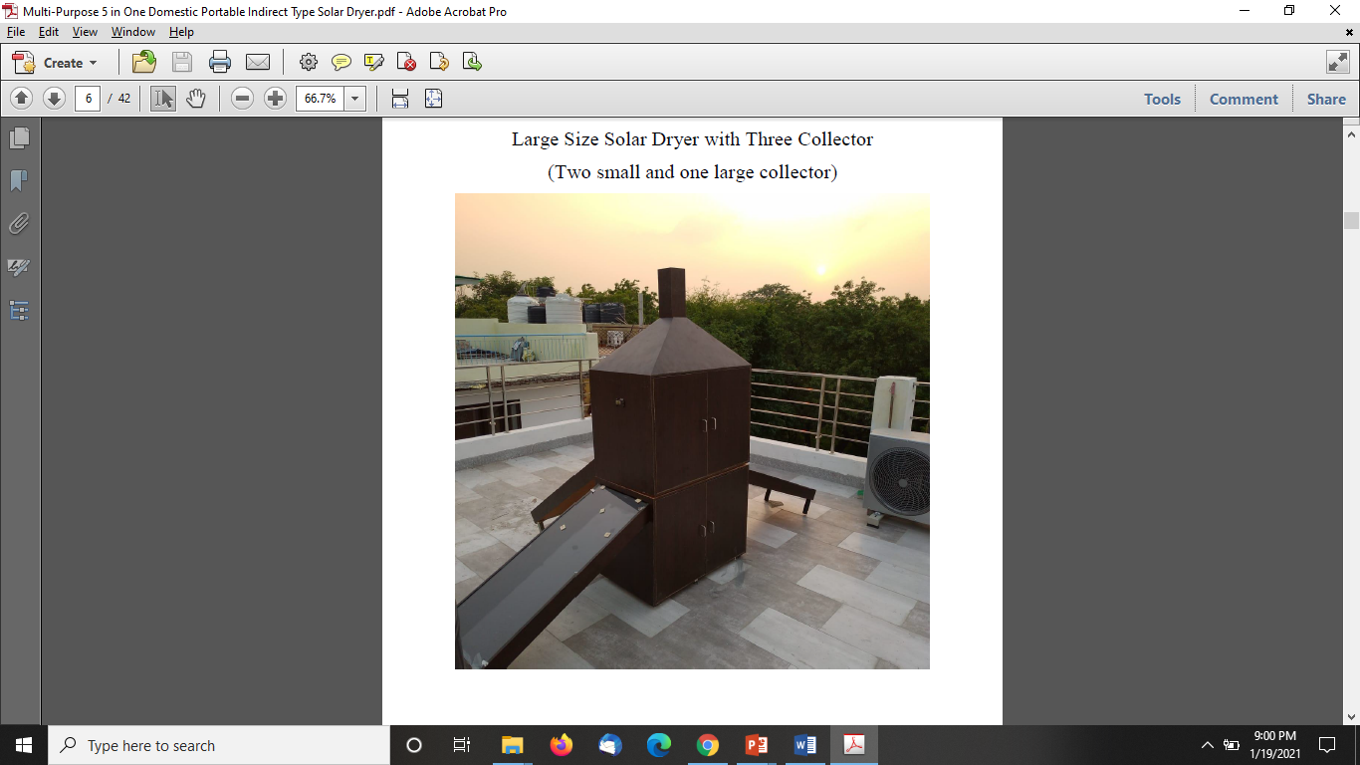
IIT Delhi Designs
Medium Size Solar Dryer with Two Collector
(One small and one large collector)
Large Size Solar Dryer with Three Collector
(Two small and one large collector)

Slide 18
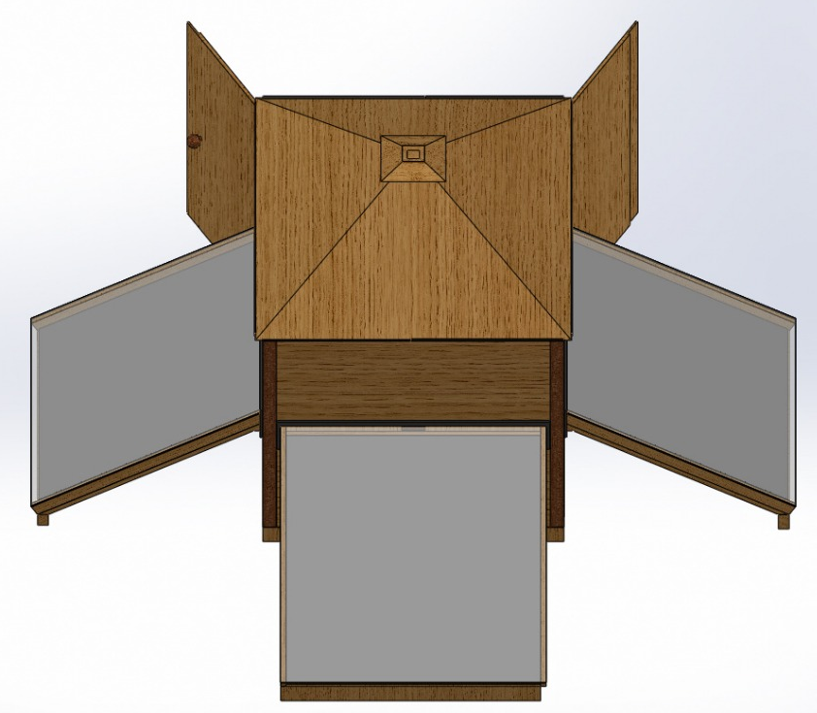
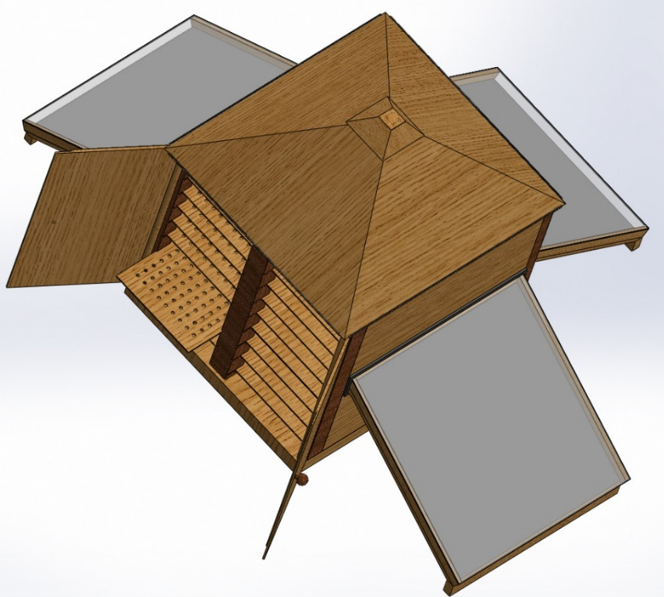
Product Development : 1. Multipurpose 5 in 1 Indirect Type of Solar Dryer

Slide 19
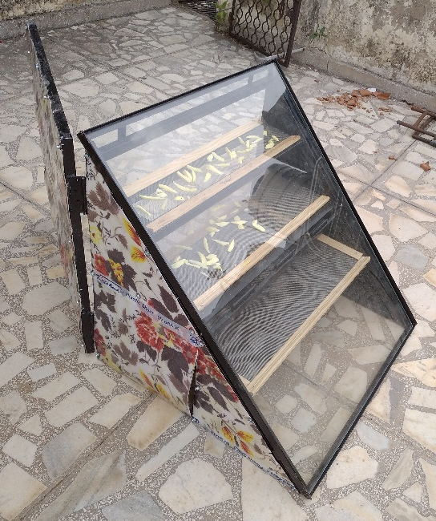
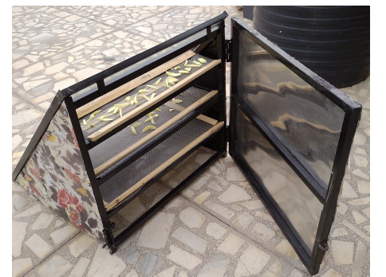
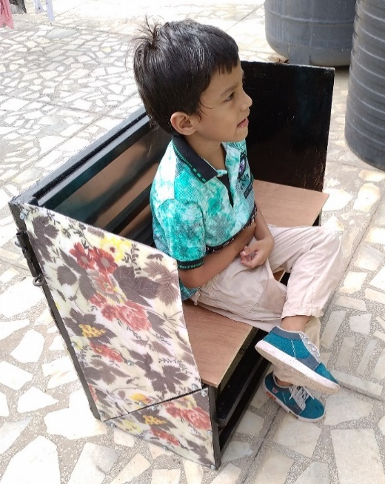
Product Development : 2.Direct type of Domestic Portable Solar Dryer cum Folding Chair

Slide 20
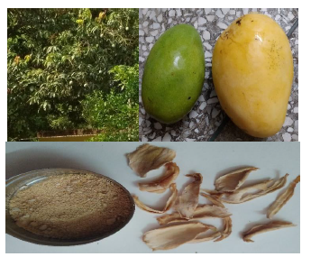
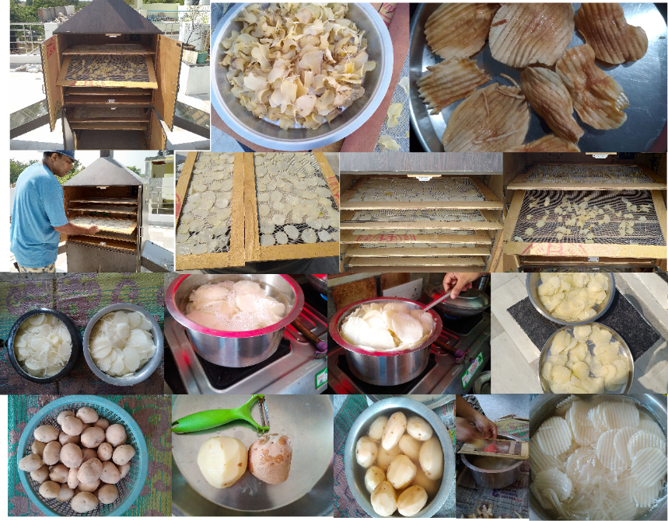
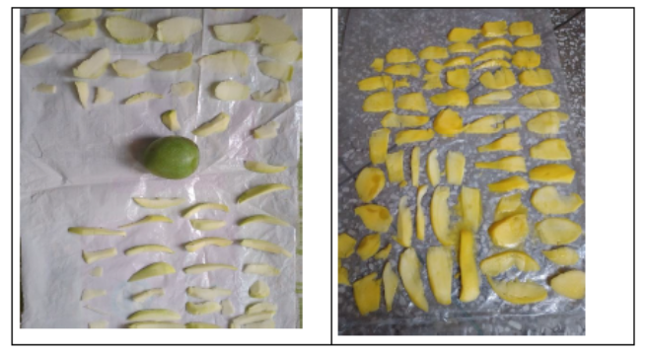
Mango Drying and Potato Drying
5 kg Potato Drying within 24 hours

Slide 21

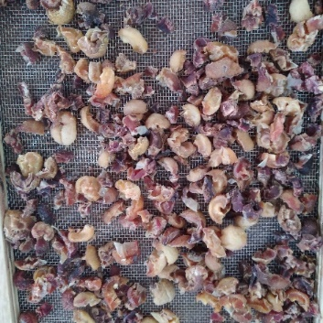
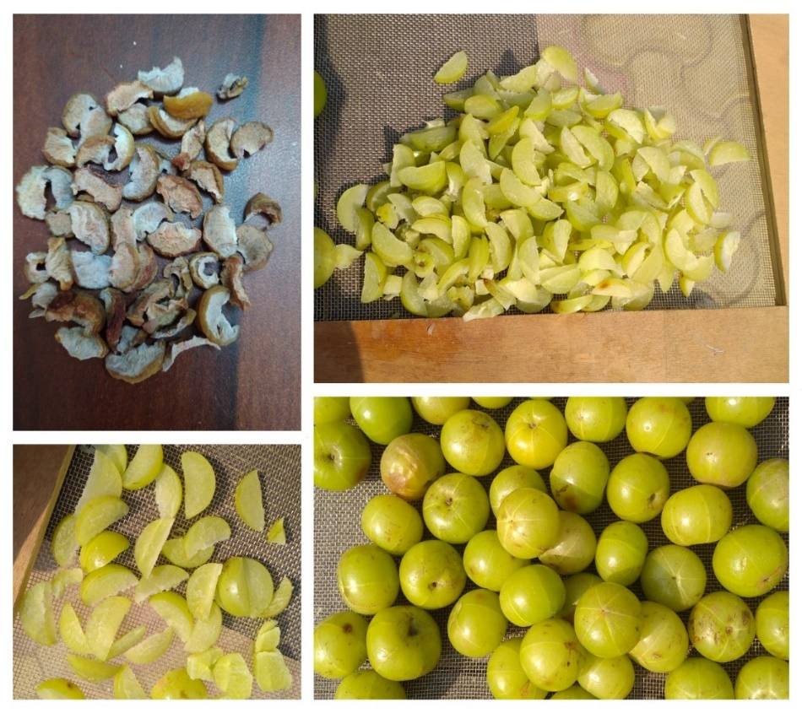

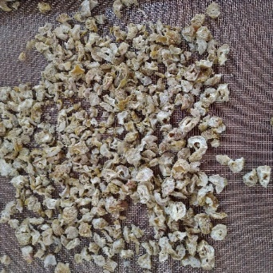
Reusts Solar Drying
Open Sun Drying
Solar Drying

Slide 22
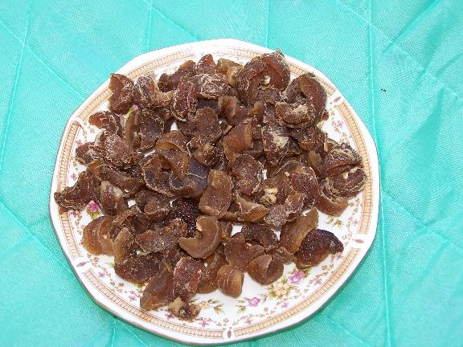
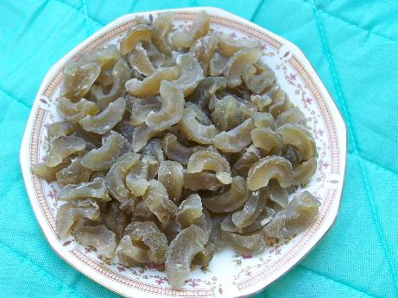
Quality Solar Air Dried Products
Open Sun dried Dried on Solar dryer
Main Product: Amla Candy: Excellent
Colour, Aroma and Taste

Slide 23
Other products
Coffee; Onion flakes; Garlic flakes; Grapes; Chilies; Ginger;Cabbage Tea; Cardamom (small); Pepper, Turmeric;Potato chips; Smashed tomato; Awala
List is never ending…….
It is extremely important to develop solar drying system preferably using local materials and skills.

Slide 24
POST HARVEST PROCESSING
Storage of Fruits and Vegetables
  Evaporative cooling and storage
  Controlled and modified atmosphere storage
Post Harvest Preliminary Processing Operations
  Sorting and grading
  Washing
  Size Reduction
  Blanching
  Ripening
Canning
Freezing
Drying

Slide 25
Specific Humidity
(gms of water vapour/kg of dry air)

Slide 26
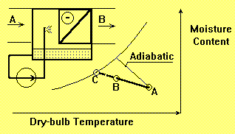
Evaporative Cooling of Air
The increase in moisture content of air is accompanied by sensible cooling in dry ambient conditions.
This cold and humid air is circulated in a storage building for safe storage of vegetables and fruits.

