Slide 1

Design Principles : Solar Dryer for Agricultural Products
P M V Subbarao
Professor
Mechanical Engineering Department
Head, CRDT
Estimation and Supply of Solar Energy for Better Drying of Products….

Slide 2

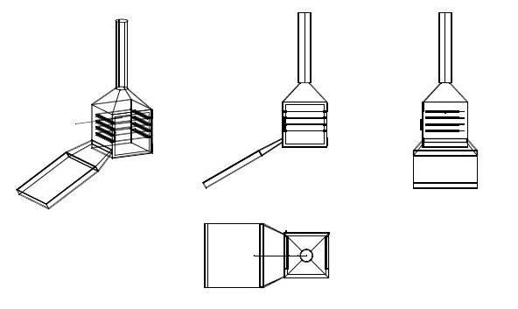
  Hot Air based Solar Dryer
Essential Organs:
1. An Inclined Black flat plate
2. A Glass cover & Rectangular channel.
3. Housing with grates to place the material to be dried.
4. Chimney hood to exhaust humid and cold air.
Air with temperatures of 50°C to 55°C is often best for food drying

Slide 3
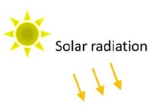
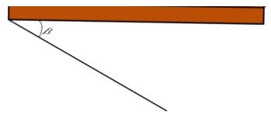
  Solar Heating of an Inclined Black Flat Plate
Inclined Black Plate
Insulation layer
Angle of Inclination

Slide 4
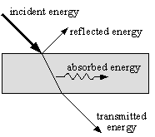
Radiative Properties of a Plate
When radiation strikes a surface, a portion of it is reflected, and the rest enters the surface.
Of the portion that enters the surface, some are absorbed by the material, and the remaining radiation is transmitted through.
The ratio of reflected energy to the incident energy is called reflectivity, ρ.
Transmissivity (τ) is defined as the fraction of the incident energy that is transmitted through the object.
Absorptivity (α) is defined as the fraction of the incident energy that is absorbed by the object.
The three radiative properties all have values between zero and 1.
Furthermore, since the reflected, transmitted, and absorbed radiation must add up to equal the incident energy, such that:
α + τ +ρ = 1

Slide 5
Black Body & Emissivity
A black body is an ideal Absorber (α=1) and(ρ=τ=0).
Absorption of solar radiation leads to increase in temperature of the black body.
A hot black body will emit maximum energy when compared to other bodies.
At a defined temperature, a black body has the highest monochromatic emissive power at all wavelengths.
In a dryer, the basic duty of an inclined black plate is to absorb all the incident radiation and transfer the same to air by natural convection.
The emission of a black plate will be reflected back by a special glass cover.

Slide 6
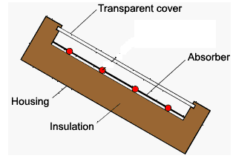
Semi Transparent Glass covered Black Plate

Slide 7
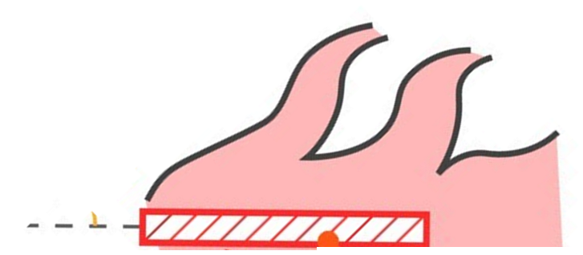
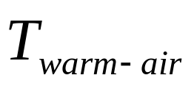
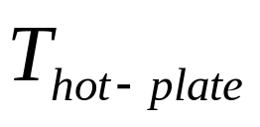
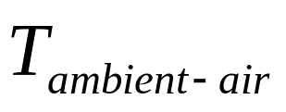
Natural Convection from a Hot Incline Plate
At steady state:
Net heat absorbed by inclined black plate = Increase in Enthalpy of air.
Finally, solar radiation has generated mass flow rate of hot air:

Slide 8
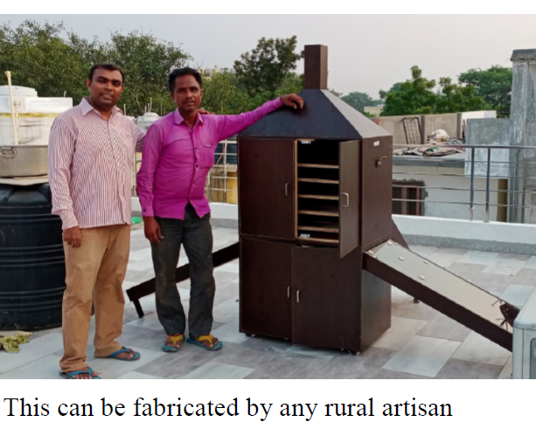

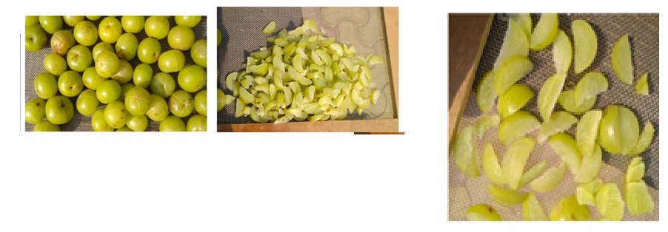
Housing for Drying of Products
Video Animation

Slide 9
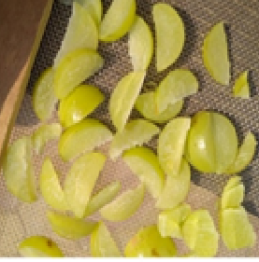

Mechanism of drying of vegetable slice using hot air
Initial Stage:
Figure shows how the drying process occurs when the moist apple slices are first placed in the dryer.

Slide 10
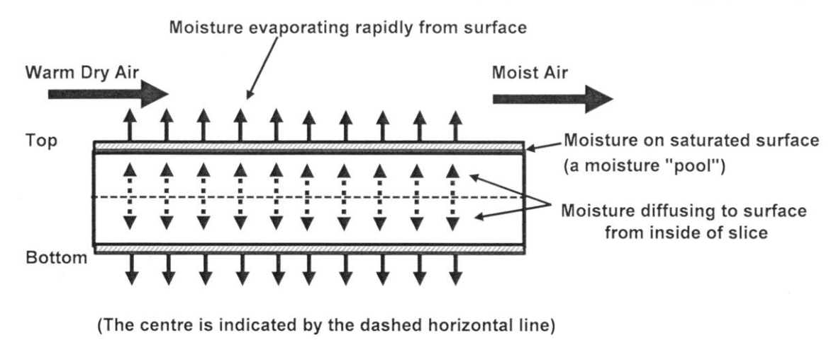
Drying Mechanism
Initial Stage:
The surface is considered to be saturated with moisture which is like having a “pool” of moisture there from which evaporation can take place.
Moisture evaporates from the “pool” at a uniform or constant rate.

Slide 11
Drying Mechanism
Initial Stage:
At the start of the drying process, the combination of a wet surface and additional moisture coming to the surface makes the rate at which the water is removed quite high.

Slide 12
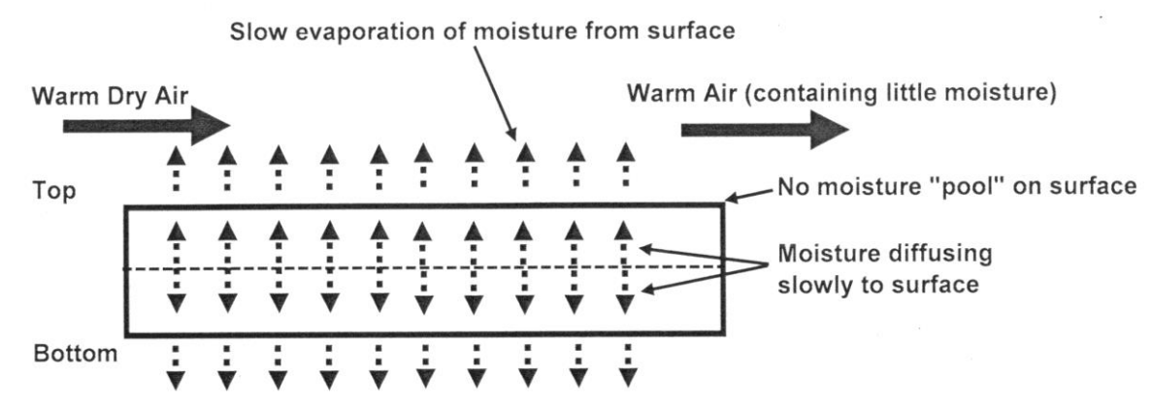
Drying Mechanism
Later Stage:
Eventually, a point will be reached where the surface no longer looks wet, since there is no visible moisture present.
Moisture will still be travelling from the centre of the slice to the surface, but it will be removed as soon as it gets there.
As more and more moisture is removed, the rate of water removal gets slower and slower.

Slide 13
Drying Mechanism
Later Stage:
Figure shows that there is no pool of moisture on the surface of the apple slice.
Slow diffusion of moisture to the surface has become the only way in which moisture can be removed.
The rate of drying is controlled by diffusion of moisture to the surface after the surface moisture pool has been evaporated.

Slide 14
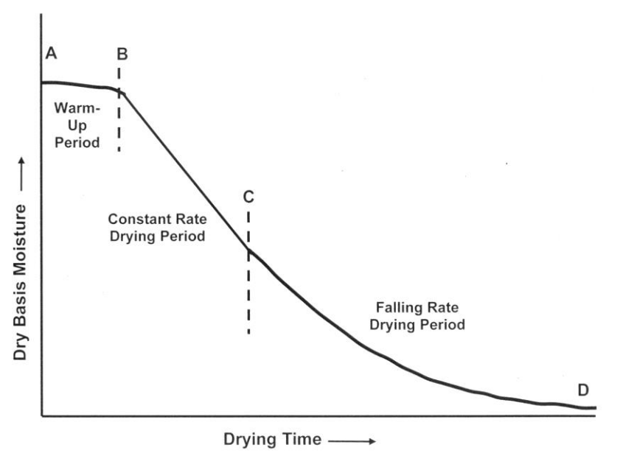
Stages of Drying

Slide 15
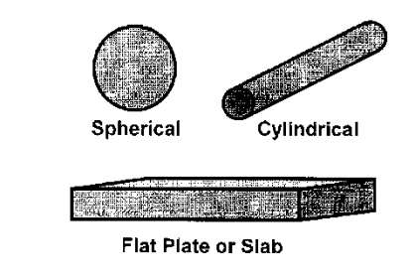
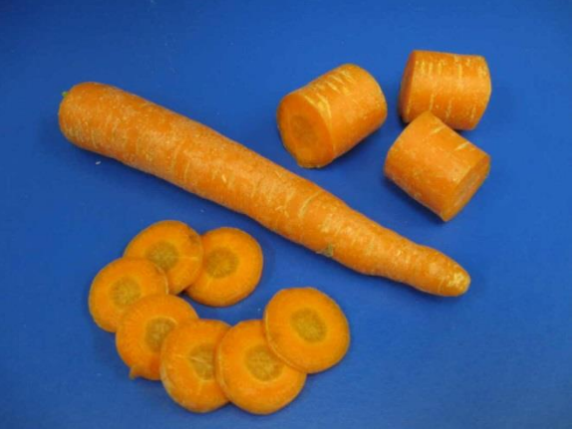
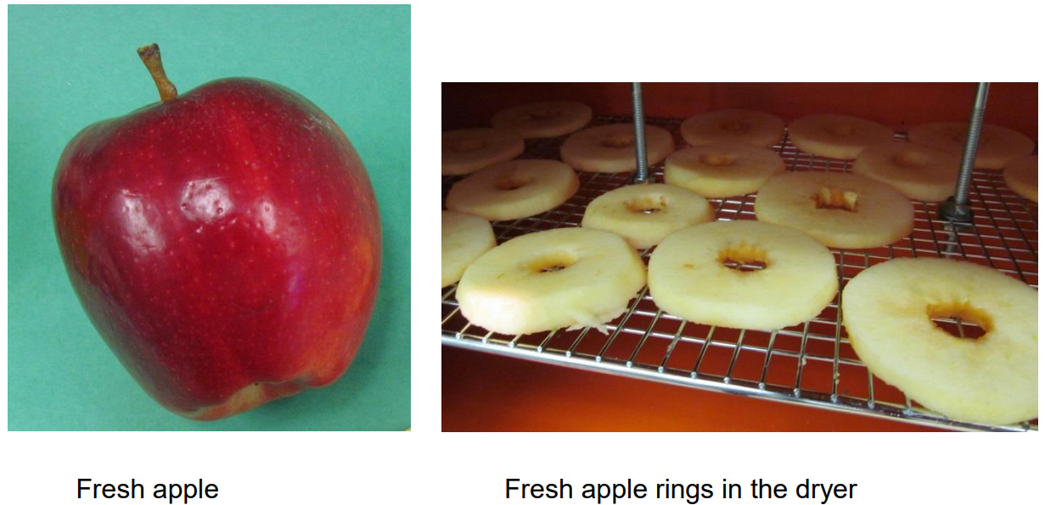
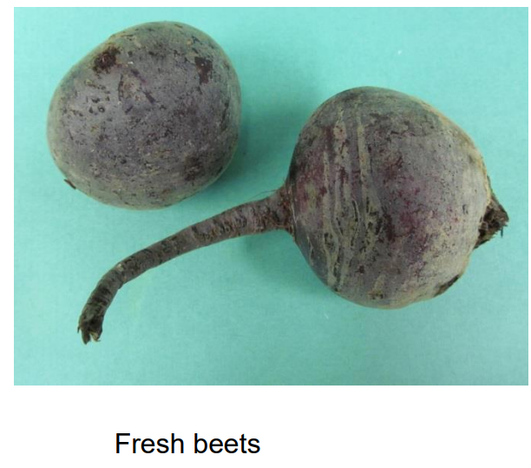
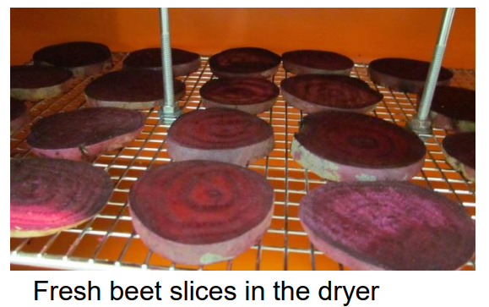
Factors Affecting Drying Rate
Shape of the Material:

Slide 16
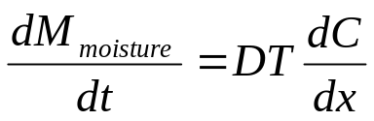
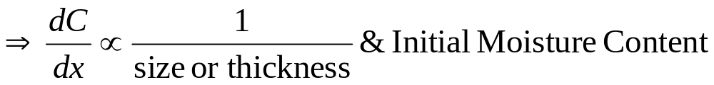
Factors Affecting Drying Rate
Size or Thickness of the Material:
The drying process is controlled by rate of diffusion of moisture from inside of slice to outer surface.
This diffusion process is described by Fick's equation:

Slide 17
Factors Affecting Drying Rate
Diffusivity, D, depends on
Composition, Structure, and Porosity:

Slide 18
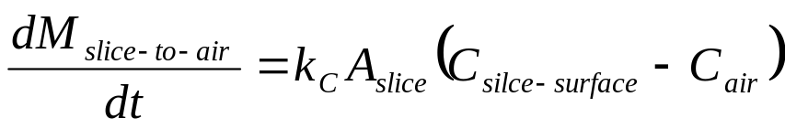
Factors Affecting Drying Rate
Convection mass transfer process: Analogous to Newton’s law of cooling
k_{C} : Convection mass transfer coefficient.
Relative Humidity of the Air entering the housing of Dryer

Slide 19
Psychrometric Properties of Ambient Air
Dry-bulb temperature.
Wet-bulb temperature.
Saturated Vapour Pressure.
Vapour Pressure.
Relative Humidity.
Specific Humidity.
Mixing Ratio.
Dew point temperature.

Slide 20
Maximum Moisture Holding Capacity of Air to
Specific Humidity
(gms of water vapour/kg of dry air)
Air Temperature °°C

