Slide 1

Basics of Drying : Agricultural Products
P M V Subbarao
Professor
Mechanical Engineering Department
Head, CRDT
Use of Solar Energy for Better Dried Products….

Slide 2

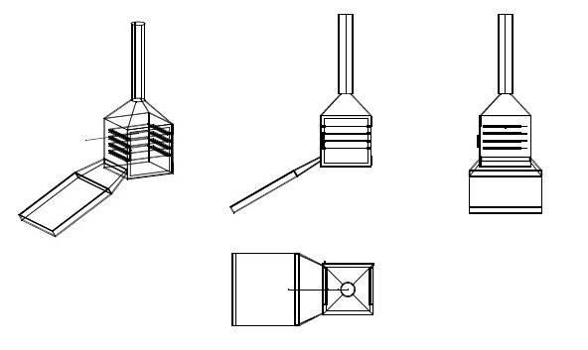
  Solar Dryer
Basic design of A Improved Solar dryer
The design parameters:
Specifications of fruits and vegetables
Amount of product to be dried.
Amount of thermal energy required.
Duration of drying.
Design Input Parameters :
Solar flux, air velocity, ambient temperature
Investigating Parameters :
Product Temperature, collector area, gap between the collector and glass.
Output: Different values of temperature for the day like
Air Temperature
Inner Glass Temperature
Outer Glass Temperature
Collector Basin Temperature

Slide 3
Basics of Drying
Drying has been and continues to be a major method of preserving agricultural products.
It is an integral part of agricultural processing and is usually the last step of operation before storage.
Defined as the removal of moisture by heat from a substance which yields a solid product at an acceptable moisture level (AML).
This acceptable limit is the one which prevents deterioration within a certain period of time for marketing, safe storage, processing, or transportation.
Drying consists of;
the process of heat transfer to the product from the heating source,
mass transfer of moisture from the interior of the product to its surface and from this surface to the surrounding air.

Slide 4
Physics of Drying
Inherent water is vaporized in the product matrix by heated air resulting in a phase change which involves high energy consumption and eventually gross product drying.
With drying, weight and volume of products are reduced, packing and storage spaces are minimized, transport cost is lessened
Drying enables the product to store well under ambient conditions.
Agricultural products are characterized with high initial moisture content of about 70% to 90% (wb) at harvest.
They are classified as highly perishable commodities which require to be dried to a safe moisture level of about 7% – 15% (wb).
The AML depends on the crop variety, slice thickness, length of time in storage, storage structure, geographical location and product’s end use.
Proper long term storage demands suppression of the activities of the microorganisms, enzymes or ferments in the material.

Slide 5
Requirement of Thermal Energy
Considerable amounts of thermal energy is required;
to heat the drying air so as to vaporize the internal water to the crop surface, and
to transfer to the ambient air.
The theoretical energy for dehydration of sliced fruits and vegetables varies for each variety.
The average value is 1.5 x 10⁶ kJ/ton of water removed.
Sliced crop energy requirement for drying have been found to vary due to the type of crop, moisture content at harvest, desired moisture content’
Crop specific heat capacity, latent heat of vaporization of water, intended use, gross mass, size, shape, and
biological characteristics such as surface texture, crop porosity, nutritional content,
drying times, production capacity, drying temperatures as well as operating pressure and the efficiency of the drying equipment.
Long drying periods tend to increase the energy requirement for the production of a unit dried product due to the losses.

Slide 6
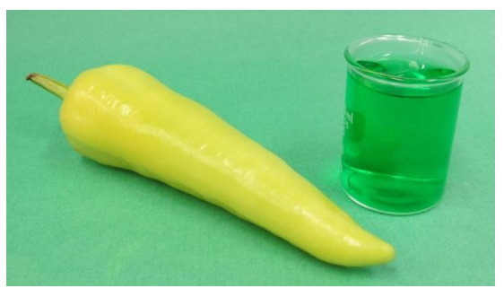
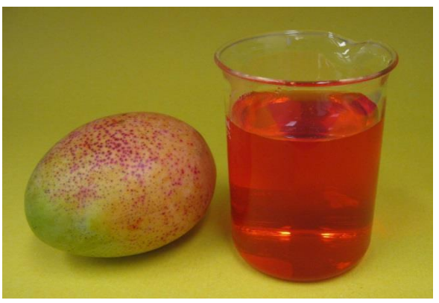
Moisture Content
A hot yellow pepper weighing 56.4 grams contains 52.9 grams of water
300 grams of water is present in amango which weighs 353 grams

Slide 7
Reduction of Weight
Drying makes a very large difference between the weight of the fresh and the dried.
A benefit of the weight reduction is that dried products can be shipped at a lower cost.
For example: 100 kg of fresh peppers with a moisture content of 93% by weight can be dried to give about 7.8 kg of dried pepper slices.
This includes the 7.0 kg of solids plus 0.8 kg of water that is left in the dried slices.
Only the solids portion of the peppers are transported and a small amount of water, thereby reduction of transportation avoiding the expenses.

Slide 8
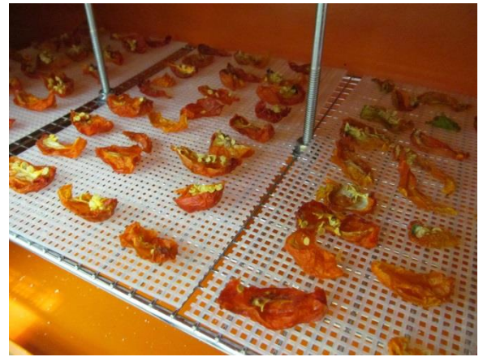
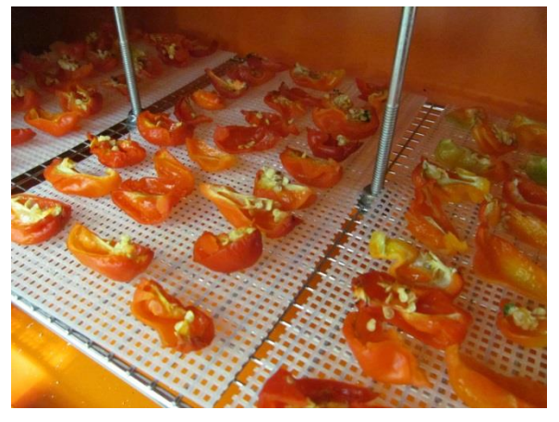
Reduction of Volume
Removing the water from fleshy produce to shrink in size.
Therefore, the dried products take less volume to store or transport than their fresh counterparts.

Slide 9
Taste and Texture
Taste and texture are two other things to consider when comparing fresh and dried produce.
This is especially true in regard to sweet fleshy fruits and berries.
When water is removed from them, the sugars that were dissolved in their juice remain in the dried flesh.
This means that the dried slices of fruit or the dried berries will contain a high concentration of natural sugars.
Dried will have a very pleasant sweet taste with a somewhat stronger flavour than the fresh “wet” fruit.
Drying also tends to make the flesh take on a leathery texture which creates a pleasant chewy snack.
The overall change in moisture content, volume, and sweetness can have an effect on the consumption of these snacks.

Slide 10
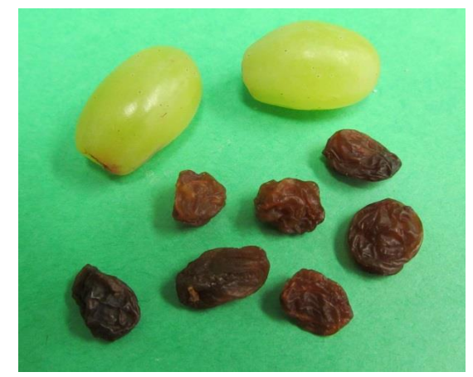
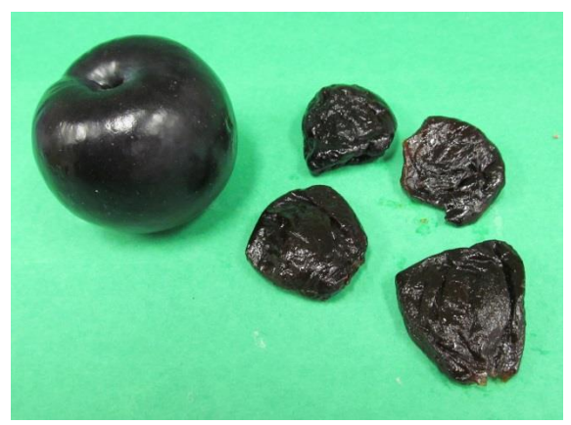
Form Changes
When some fruits and berries are dried, the final product has such a significant change in properties from the initial material that their dried form is given an entirely different name.
Dried grapes become raisins, and dried plums become prunes.

Slide 11
Factors Influencing Product Quality: Starting Material
All starting materials need to pass a visual inspection before they can be given any additional consideration.
They should be free from blemishes such as bruises and insect damage.
They may need to be of a certain size or weight to make handling easier.
Colour may assist in determining the desired degree of ripeness.
Ensuring that the starting material is clean is only one of the steps necessary to prevent many problems related to food quality.

Slide 12
Factors Influencing Product Quality: Starting Material
All starting materials need to pass a visual inspection before they can be given any additional consideration.
They should be free from blemishes such as bruises and insect damage.
They may need to be of a certain size or weight to make handling easier.
Colour may assist in determining the desired degree of ripeness.
Ensuring that the starting material is clean is only one of the steps necessary to prevent many problems related to quality.

Slide 13
Factors Influencing Product Quality
Aroma: It is often possible to pick the desired starting material by examining how it smells.
Many fruits, such as mangoes, have a characteristic aroma that may help in assessing the quality of the starting material.
In general, any fruit with an uncharacteristic or suspicious odour should be avoided.
Source: Were they sprayed with insecticides or pesticides?
Were any fertilizers used, and if so, were they appropriate?
What were the general conditions under which the materials were grown?
Are there any potential health risks imposed by the growing, harvesting, or storage and handling conditions?

Slide 14
Factors Influencing Product Quality
Taste: Dried fruits and vegetables will end up as a food product, it is a good idea to taste the starting material.
Fruits and berries which are not sufficiently sweet or have an undesirable texture, or “mouth-feel”, should not be used.
This is a difficult point to describe or define.
Basic descriptions outlining examples of desirable flavour attributes can go a long way to assuring a higher quality finished product.

Slide 15
Factors Influencing Product Quality
Variety: Certain varieties of fruits such as mangoes or apples may have better properties for drying than others.
Some mangoes are large and juicy with a high level of sweetness.
Others may be smaller with a higher fibre content and lower sweetness level.
There is also the need to understand which varieties will give you the best finished product to meet the needs of your customers.
You may need to process a number of different varieties to satisfy the different preferences of the consumers.

