Slide 1

Rural Needs of Solar Energy in A Sub-tropical India
P M V Subbarao
Professor
Mechanical Engineering Department
Head, CRDT
Solar Energy for Post Harvesting ….

Slide 2

Post Harvest Management of Fruits and Vegetables
Fruits and vegetables, fresh or processed, form an important component of rural economy.
These are an essential component in human diet.
There is an ever-increasing demand for these.
India being the top producer of both fruits and vegetables in the world, more emphasis is needed to minimize post harvest losses.
At present about 70-80% of our production goes waste mainly during transportation and storage.
A clear understanding of biochemical and physiological changes in fruits and vegetables during post harvest operations is first step to develop sustainable systems.
Persons involved in handling, transportation and storage operation must be trained to understand critical parameters and use of local energy systems.

Slide 3
Maturity of Harvesting
Products must be at a stage which will allow it to be at its peak condition when it reaches the consumer.
Should be at a maturity that allows it to develop as acceptable flavour or appearance.
Should be at a size required by the market.
Should not be toxic.
Should have an adequate shelf-life.
Maturity indices:
Quantitative Indices: Average weight per piece, fullness of finger, total soluble solids, sugar to acid ratio
Qualitative Indices: Colour, Available Calories, and period after blooming.

Slide 4
POST HARVEST PROCESSING
Storage of Fruits and Vegetables
  Evaporative cooling and storage
  Controlled and modified atmosphere storage
Post Harvest Preliminary Processing Operations
  Sorting and grading
  Washing
  Size Reduction
  Blanching
  Ripening
Canning
Freezing
Drying

Slide 5
Mechanism of Drying
Traditional Indian Rural communities have acquired deep knowledge and experience in solar drying methods.
They have understanding of the chemical and biochemical changes that occur during dehydration and to develop methods for preventing undesirable quality losses.
Direct solar drying (“sun drying”): the product is heated directly by the sun's rays and moisture is removed by natural circulation of air due to density differences.
Modern Scientific Drying method is:
Convective drying: drying by blowing heated air circulating either over the upper side, bottom side or both, or across the products.

Slide 6
Drying & Internal Mechanism of Liquid Flow
The movement of moisture within the solid result from a concentration gradient which is dependent on the characteristics of the solid, that may be porous or nonporous
(a) diffusion in continuous, homogeneous solids,
(b) capillary flow in granular and porous solids,
(c) flow caused by shrinkage and pressure gradients,
(d) flow caused by gravity, and
(e) flow caused by a vaporization-condensation sequence.

Slide 7
Factors Affecting Drying Rate
The properties of the material to be dried,
Its size, length, width and air gap
Drying air temperature
Solar flux and
Moisture content

Slide 8
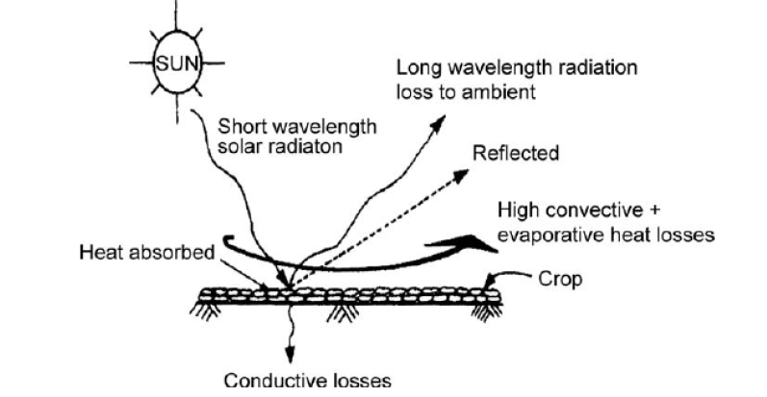
Open Sun Drying
Working principle of open sun drying:
Huge heat losses

Slide 9
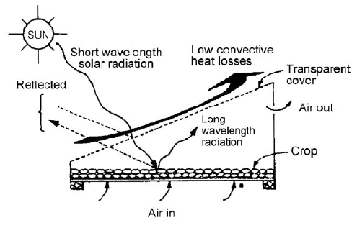
Direct Solar Drying (DSD)
Working principle of direct solar drying:

Slide 10
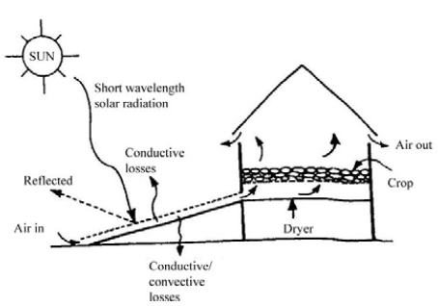
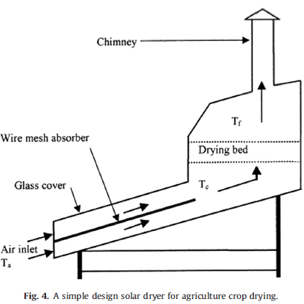
Indirect solar drying system
Working principle of indirect solar drying

Slide 11
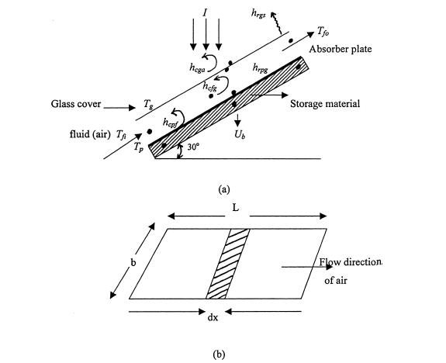
Air heater
Schematic view of the air heater; .thermocouple position
cross-section view of the surface over which air is flowing.

