Slide 1

Development of Rural Electricity Generation Systems using Solar Resources
P M V Subbarao
Professor
Mechanical Engineering Department
Head, CRDT
Quick Utilization of Solar Radiation for Rural Development….

Slide 2


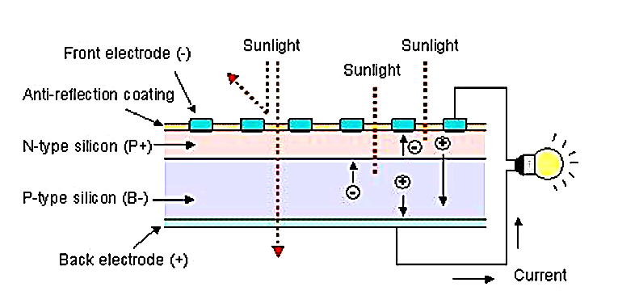
A Researcher is Blind to Novel Innovation
Must be open to all possible interpretations…..

Slide 3
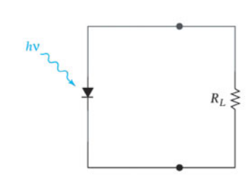
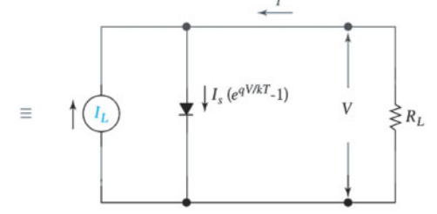
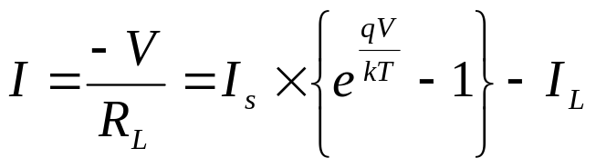
Idealized Equivalent circuit of a Solar Cell
Physical Circuit
Equivalent Functional Circuit
Net Current in the load
Each photon with energy greater than E_{g} = hν_{g} produces one electronic charge q at a voltage of V_{g} =hν_{g} /q.

Slide 4
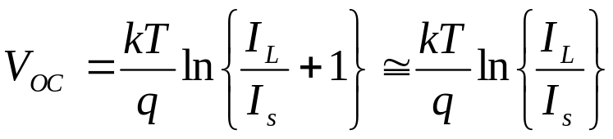
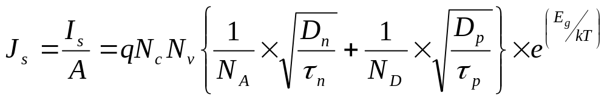
Capacity of a Solar Cell
The ideal I-V characteristics of a solar cell are given by
The source I_{L} results from the excitation of excess carriers by solar radiation, I_{s} is the diode saturation current, and R_{L} is the load resistance.
The current Density of a P-N Junction cell is

Slide 5
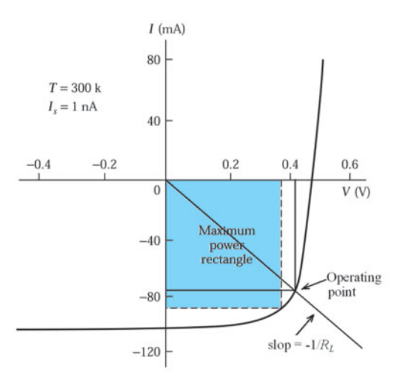
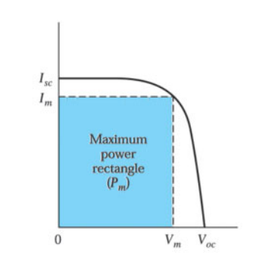
PV Cell as an Engine-Generator System
Current-voltage characteristics of a solar cell under solar radiation
The curve passes through the fourth quadrant, and therefore power can be extracted from the device.
The I-V curve is more generally represented by
A load RL is connected to the solar cell as shown in Figure.
The current through the R_{L} is in the opposite direction to the conventional current flow.
Notes:
I will introduce the principle to begin with.
Solar cell, invented in the USA in 1954, is a kind of semiconductor to convert energy of light directly into electricity. Most semiconductor used for solar cell are silicon semiconductors and it is composed of P-type semiconductor and N-type semiconductor.
Sunlight hitting the cell produces two types of electrons, negatively charged and positively charged electrons in the semiconductors. Negatively charged electrons gather around N-type semiconductor while positively charged electrons gather around P-type semiconductor.
When youconnect loads such as a light bulb or motor, electric current occurs between two electrodes.

Slide 6
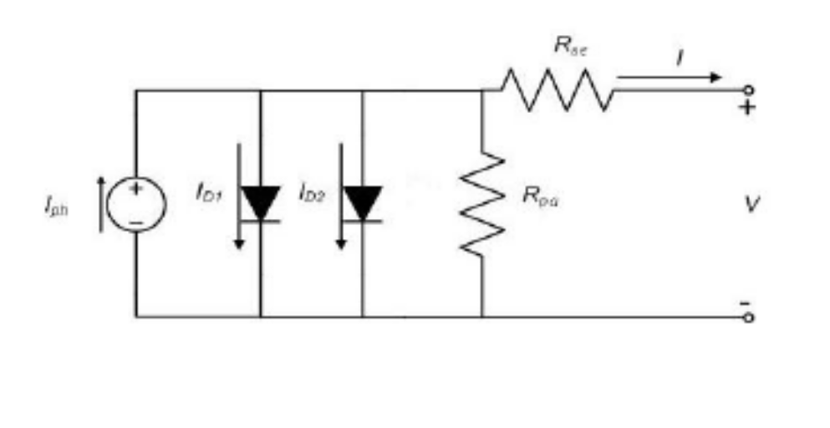




Performance A Real PV Cell with Losses
Notes:
I will introduce the principle to begin with.
Solar cell, invented in the USA in 1954, is a kind of semiconductor to convert energy of light directly into electricity. Most semiconductor used for solar cell are silicon semiconductors and it is composed of P-type semiconductor and N-type semiconductor.
Sunlight hitting the cell produces two types of electrons, negatively charged and positively charged electrons in the semiconductors. Negatively charged electrons gather around N-type semiconductor while positively charged electrons gather around P-type semiconductor.
When youconnect loads such as a light bulb or motor, electric current occurs between two electrodes.

Slide 7
Voltage and Current of PV cell ( I-V Curve )
P
A
(A)
N
Short Circuit
Current(I)
P
V
N
Open Circuit
(V)
Voltage(V)
about 0.5V (Silicon)
Notes:
I will introduce the principle to begin with.
Solar cell, invented in the USA in 1954, is a kind of semiconductor to convert energy of light directly into electricity. Most semiconductor used for solar cell are silicon semiconductors and it is composed of P-type semiconductor and N-type semiconductor.
Sunlight hitting the cell produces two types of electrons, negatively charged and positively charged electrons in the semiconductors. Negatively charged electrons gather around N-type semiconductor while positively charged electrons gather around P-type semiconductor.
When youconnect loads such as a light bulb or motor, electric current occurs between two electrodes.

Slide 8
Isothermal Performance of A Solar cell
I-V Curve
(A)
Depend on cell-size
5.55A
Max. Power Depend on
Solar intensity (insolation)
Standard insolation 1.0 kW/m²
4.95A
Depend on
type of cell or cell-material
( Si = 0.5V )
Current(I)
Voltage(V)
0.49 V
0.62 V
Notes:
I will introduce the principle to begin with.
Solar cell, invented in the USA in 1954, is a kind of semiconductor to convert energy of light directly into electricity. Most semiconductor used for solar cell are silicon semiconductors and it is composed of P-type semiconductor and N-type semiconductor.
Sunlight hitting the cell produces two types of electrons, negatively charged and positively charged electrons in the semiconductors. Negatively charged electrons gather around N-type semiconductor while positively charged electrons gather around P-type semiconductor.
When youconnect loads such as a light bulb or motor, electric current occurs between two electrodes.

Slide 9

Harvesting of Maximum Power from A Cell
To obtain maximum power, current control (or voltage control) is very important.
A
P
V
(A)
N
“Power conditioner” (mentioned later) will adjusts to be most suitable voltage and current automatically.
PMAX
P1
I_{pmax}
I/V curve
P- Max control
Power curve
Current(I)
I x V = W
P2
(V)
Voltage(V)
V_{pmax}

Slide 10
Operational Point of A Cell
Current depend on
- Intensity of solar radiation.
- Size of cell
(A)
Voltage on normal operation point
0.5V (in case of Silicon PV)
Normal operation point
(Maximum Power point)
Current(I)
I x V = W
(V)
Voltage(V)
about 0.5V (Silicon)
Notes:
I will introduce the principle to begin with.
Solar cell, invented in the USA in 1954, is a kind of semiconductor to convert energy of light directly into electricity. Most semiconductor used for solar cell are silicon semiconductors and it is composed of P-type semiconductor and N-type semiconductor.
Sunlight hitting the cell produces two types of electrons, negatively charged and positively charged electrons in the semiconductors. Negatively charged electrons gather around N-type semiconductor while positively charged electrons gather around P-type semiconductor.
When youconnect loads such as a light bulb or motor, electric current occurs between two electrodes.

Slide 11

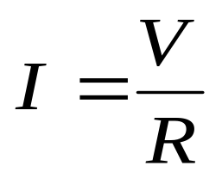

Selection of Load for Maximum Power Harvest
Estimate obtained power by I / V curve
A
If the load has 0.05 ohm resistance,
cross point of resistance character and
PV-Character will be following point.
Then power is 10x0.5=5 W
P
N
(A)
12
10
8
6
4
2
0
PV character
( I/V curve )
Ohm’s theory
Current(I)
Resistance character
(V)
0 0.1 0.2 0.3 0.4 0.5 0.6
Voltage(V)

Slide 12

Types and Conversion Efficiency of Solar Cell
Electric Energy Output
Conversion Efficiency =
x
100%
Energy of Insolation on cell
Conversion Efficiency of Module
Single crystal
10 - 17%
Crystalline
Silicon Semiconductor
Poly crystalline
10 - 13%
Non-crystalline
Amorphous
7 - 10%
Solar
Cell
Compound
Semiconductor
Gallium Arsenide (GaAs)
18 - 30%
Dye-sensitized Type
7 - 8%
Organic
Semiconductor
Organic Thin Layer Type
2 - 3%
Notes:
Variety of solar cell and conversion efficiency
There are 2 major types of solar cell: one using silicon semiconductor and one using compound semiconductor. Solar cell using silicon semiconductor is further divided into crystalline and non-crystalline or amorphous semiconductor.The crystalline type silicon semiconductor is widely used for its high conversion rate and reliability track record. The amorphous type semiconductor performs well even under a fluorescent lamp, so, it is used as a source of power for calculators and wrist watches.
Compound semiconductor’s conversion rate is very high. But it is difficult to obtain.
Organic semiconductor is under development for further reducing cost.

Slide 13
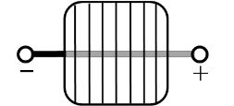
SOLAR PV MODULE
A solar PV module is a device in which several solar cells are connected together to generate more power than a single solar cell.
Single solar cell
Solar PV module

Slide 14
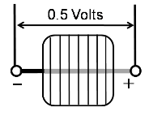
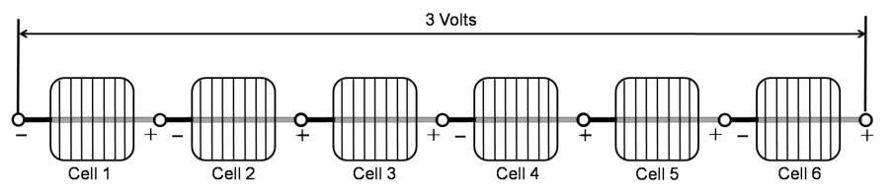
Solar Cell to Solar PV Module Why ?
Series connection ⇒ Voltage is additive
Single solar cell power = 5.0 Watts
6 cells in series connection ⇒ 30 Watts

Slide 15
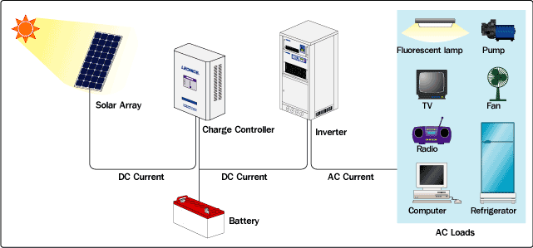
STAND ALONE PV SYSTEM

Slide 16

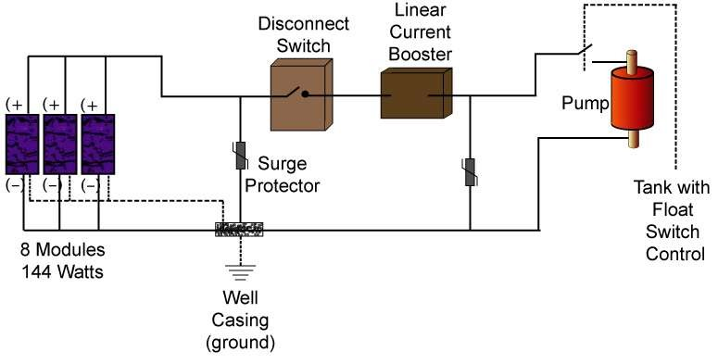
Standalone PV Water Pumping System
Water pumping system

Slide 17
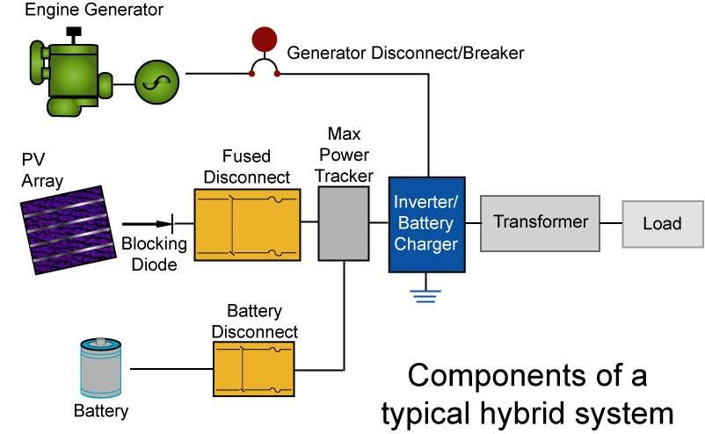
HYBRID PV SYSTEM

Slide 18
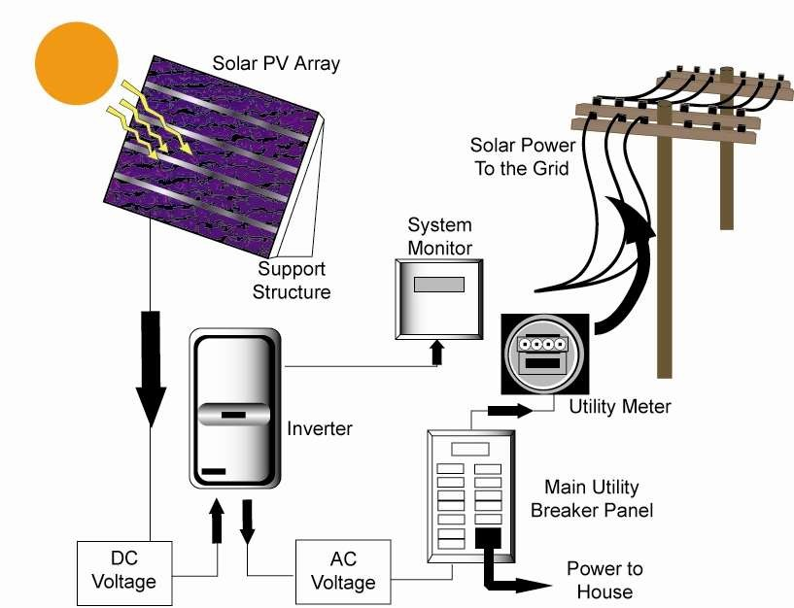
GRID-TIED PV SYSTEM

Slide 19
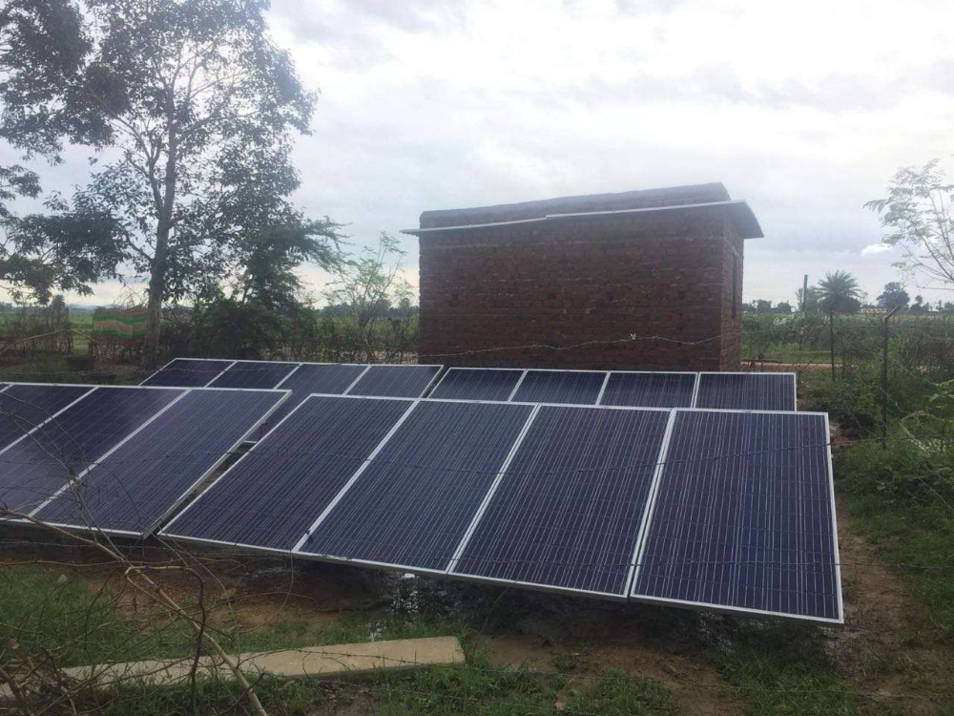
CASE STUDY: “Off-grid Electrification of Village Khaira BegiDistrict -Chatra, Jharkhand, India”.

Slide 20
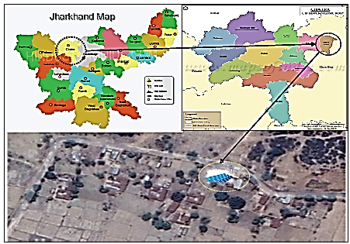
Village Khaira Begi
District -Chatra, Jharkhand, India”.

Slide 21

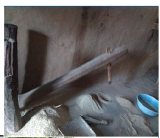
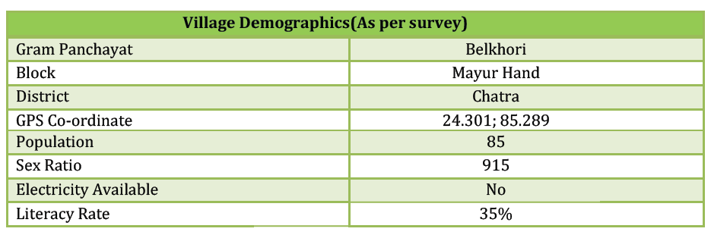

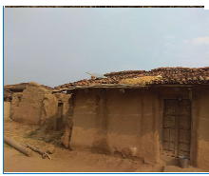
VILLAGE AT A GLANCE
Economy of the village is mainly depended on the agricultural activities.
Paddy is main crop of this village.

Slide 22
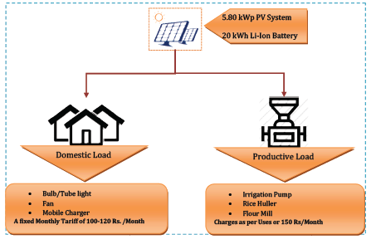
Plant Layout

Slide 23
PROJECT BRIEF
Installation of a 5.80 kWp stand alone Solar PV Plant
20kWh Panasonic make Lithium Ion battery for energy storage.
Mini Grid has been installed in the villages and each household are through localized distribution line.
During the day time, surplus power will be utilized to run productive load such as rice huller and solar water pumps.
Each house is having a provision of Lighting, Fan and Mobile charging.

Slide 24
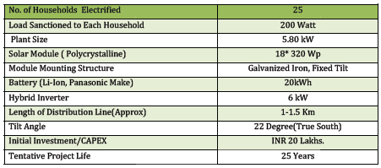
Project Summary

Slide 25
Tariff Fixation and Revenue Collection
Based on the preliminary interaction, it was found that villagers are willing to pay for the use of power supplied by solar mini grid.
A fixed tariff of 100 Rs. /Months for domestic use
A tariff of 150 Rs./Month for livelihood useslike pump and rice huller.
A village energy committee has been constituted a five members including 2 Male and 3 Female.
To monitor/manage the operational and financial issues.
Village energy committee will also circulate the annual income to all household so that every consumer can know the financial status.

Slide 26

Present Status

Slide 27
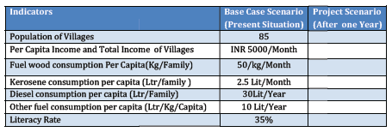
Measureable Impacts

