Slide 1

Design, Development & Testing of Drag type Pico-size Wind Turbine
P M V Subbarao
Professor
Mechanical Engineering Department
Head,CRDT
Towards Rural Sector Skill Development ….

Slide 2

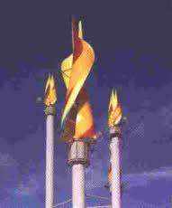
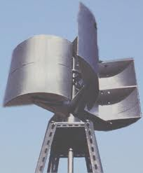
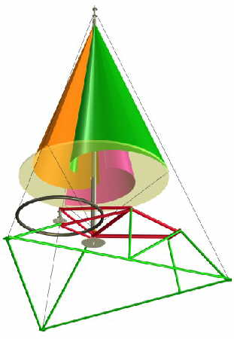
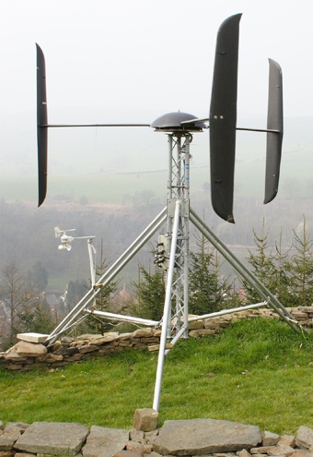
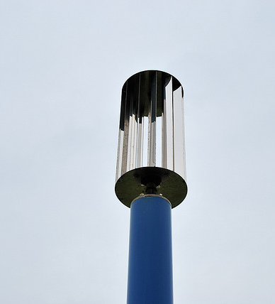
Wind Turbine Designs using Drag Principle

Slide 3
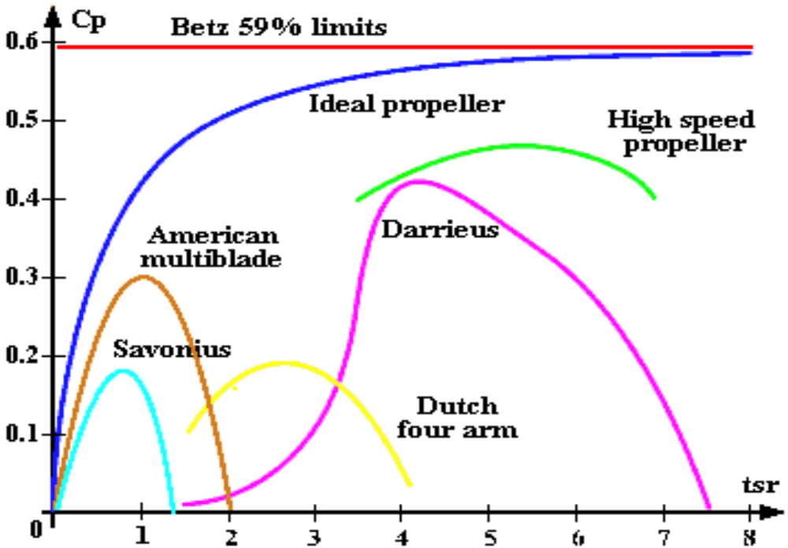
Technological View of Drag Wind Turbine :

Slide 4
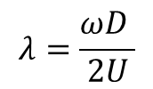
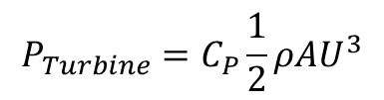

Recapitulation of Design Variables
The actual power captured by the turbine is given as
$$P_{Turbine}=C_{P}\frac{1}{2}ρAU^{3}$$
The power coefficient wind turbine the tip-speed ratio (TSR). The expression of TSR is given as:
$$λ=\frac{ωD }{2U}$$
The expression for outlet power extraction (Pout) is given as:
$$P_{out}=Tω$$
The torque coefficient (Cm) is generally expressed as:
$$C_{m}=\frac{T}{\frac{1}{2}ρAU^{2}R}$$
The power coefficient (C_{p}) is defined as the ratio of power output and power input. Its expression in case of a SHKT can be reduced to:
$$C_{p}=C_{m}λ$$

Slide 5
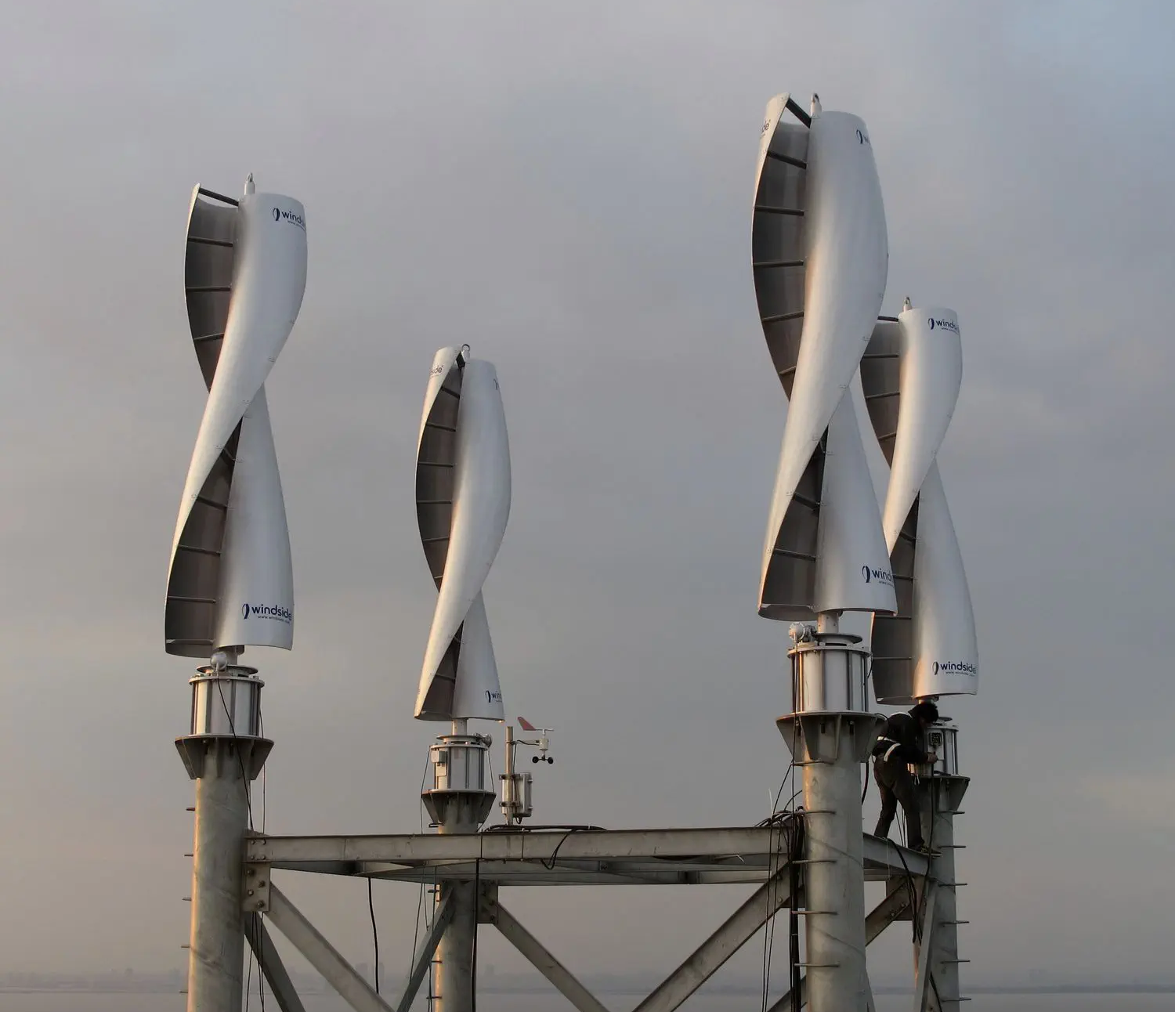
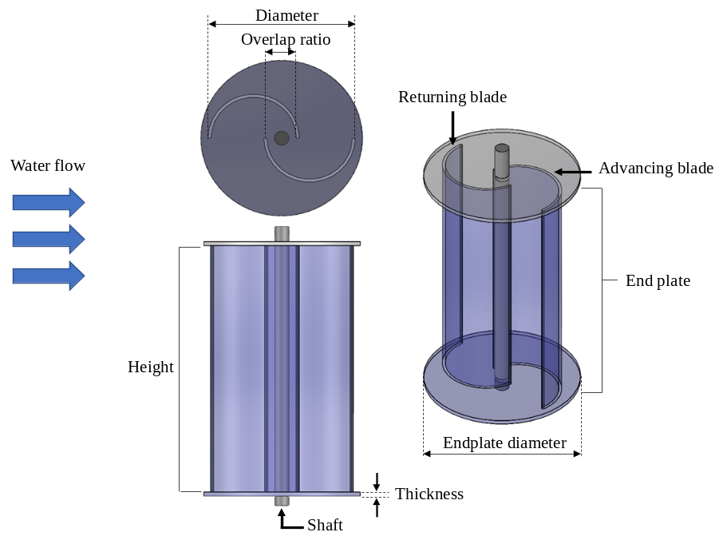
Savonius wind turbine : A Promising Drag Turbine for RES
This turbine was developed by S.J Savonius in the year 1920.
Its best qualities are the simplicity, the reliability and the very low noise production.
It has self starting capability and can operate well also at low wind speed because the torque is very high especially in these conditions.
Components of Savonius turbine
Advanced Savonius wind turbine

Slide 6
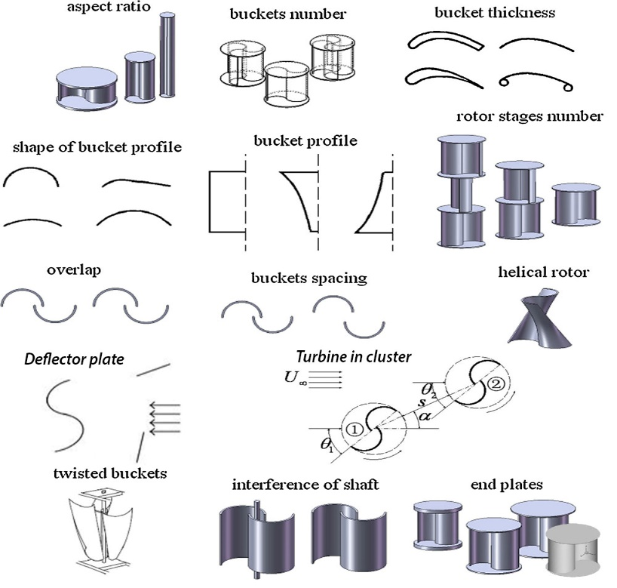
Geometrical Variations of Savonius Turbine

Slide 7
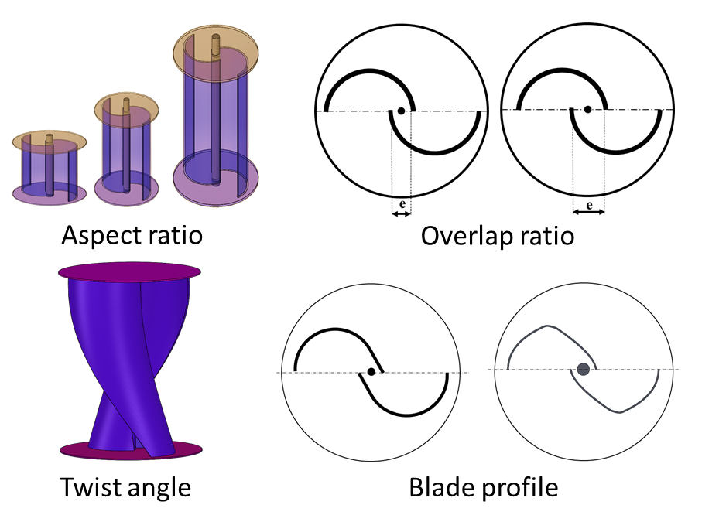
Level -1 Geometric Parameters
Overlap ratio
Aspect ratio

Slide 8
Level -2 Geometric Parameters
Twisted blades
Blade profile

Slide 9
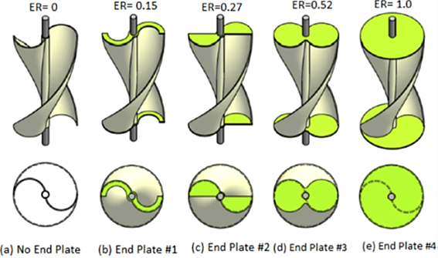
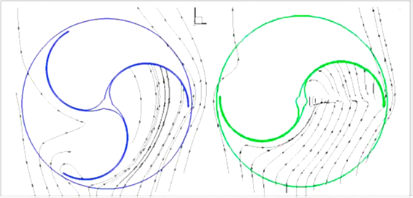
Level -3 Geometric Parameters
End plate
Number of blades

Slide 10
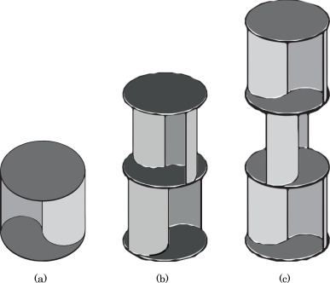
Level -4 Geometric Parameters
Turbine staging

Slide 11
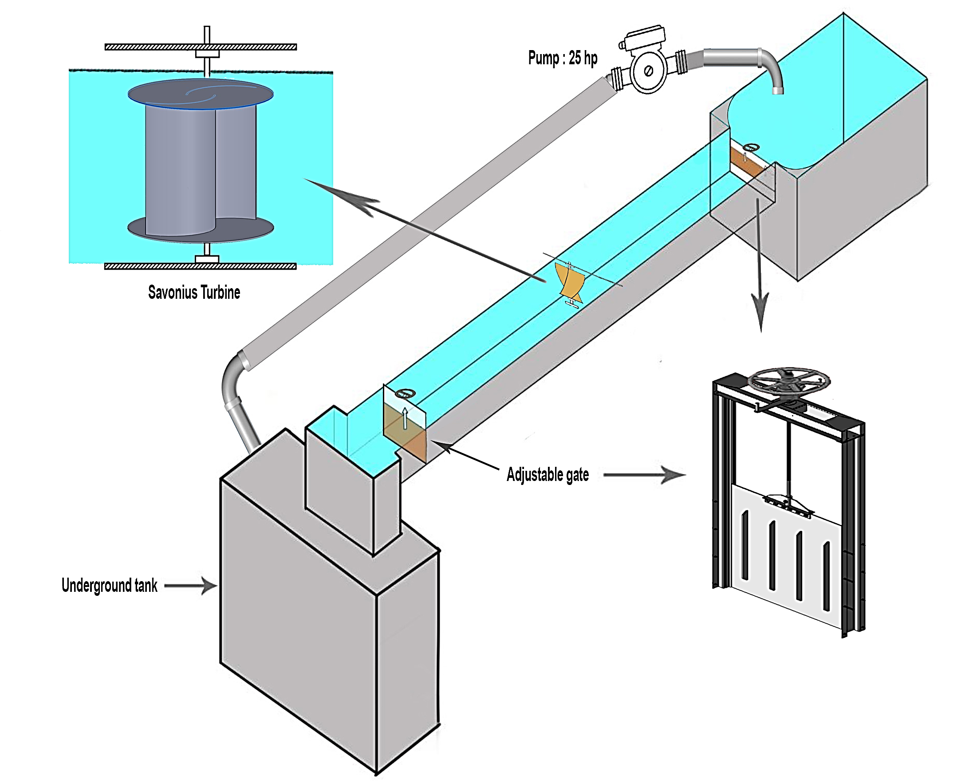
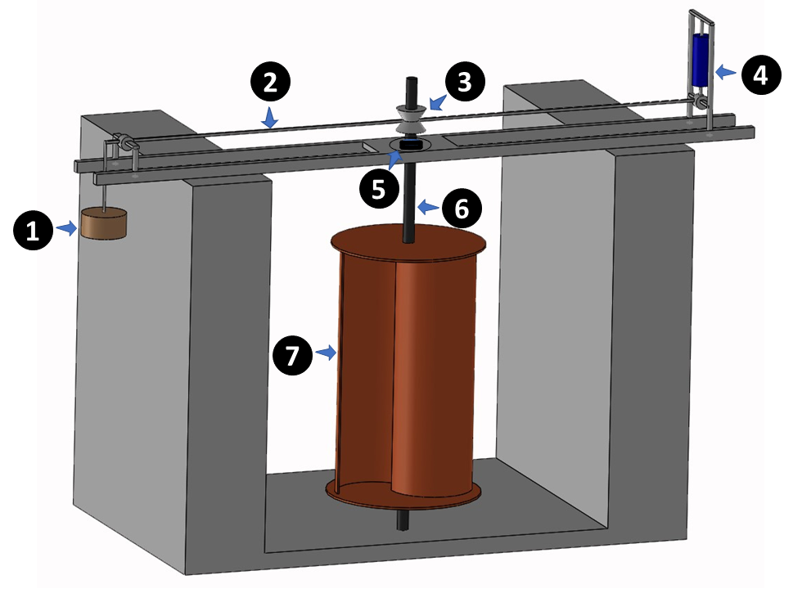
Planning of Experimental Water Channel facility at IIT Delhi
Weight, (2) Nylon rope, (3) Pulley, (4) Spring balance,
(5) Bearing, (6) Shaft and (7) Turbine

Slide 12
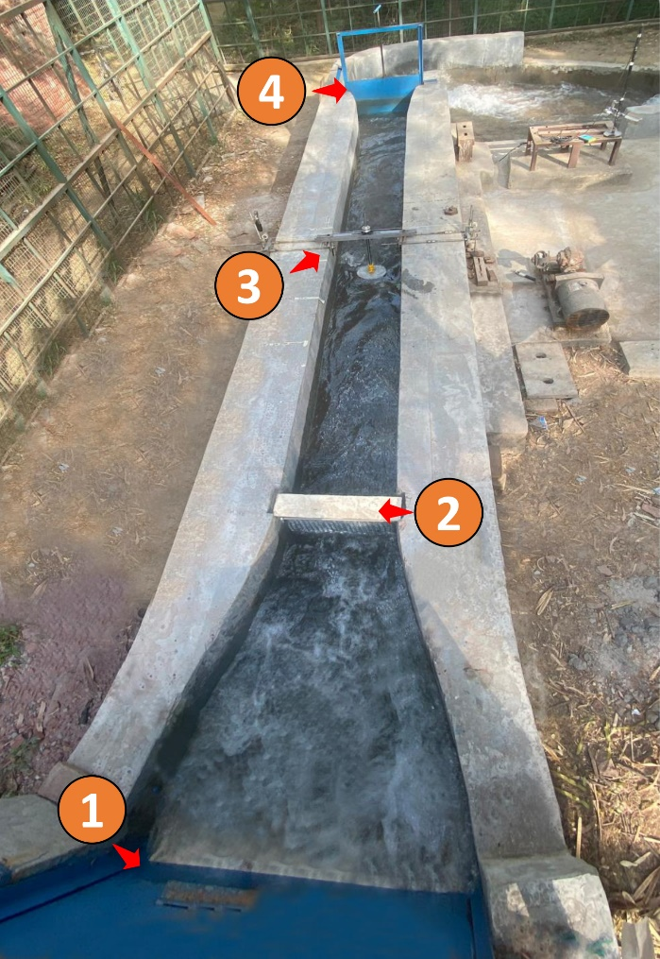
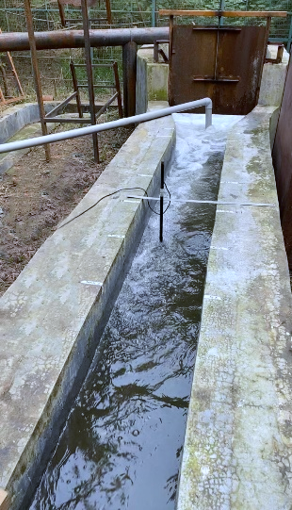
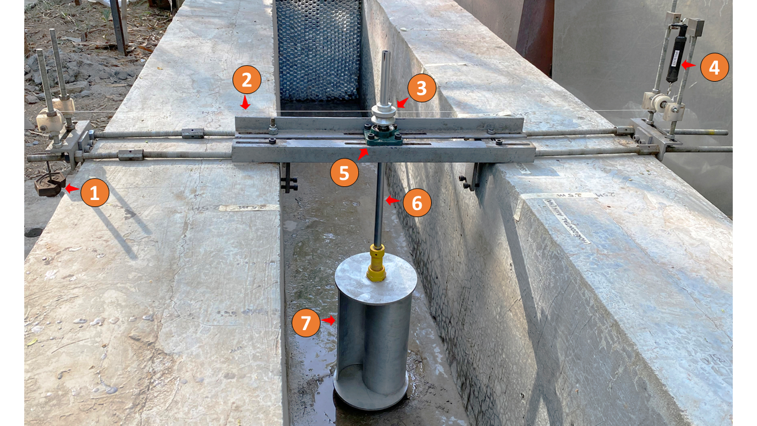
Experimental facility @ IIT Delhi
(5) Cup type water current meter
5
(1) Inlet gate, (2) Honeycomb structure, (3) Test specimen and (4) Outlet gate
(1) Weight, (2) Nylon rope, (3) Pulley, (4) Spring balance, (5) Bearing, (6) Shaft and (7) Turbine

Slide 13
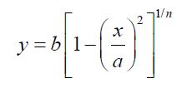
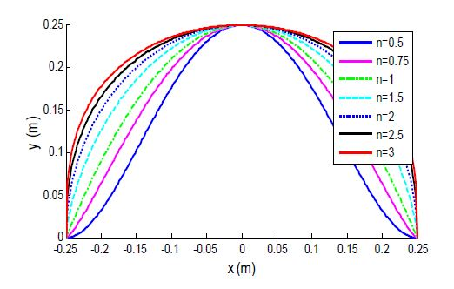
Myring Shape for Savonius Blades
The Myring Equation is given by:

Slide 14
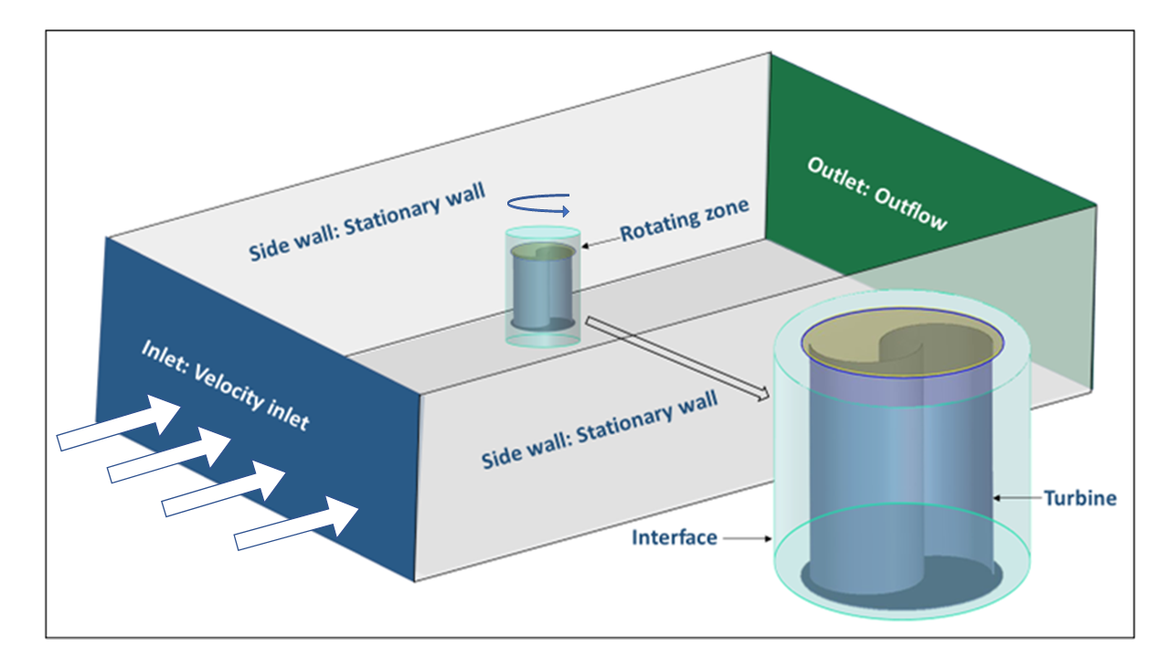
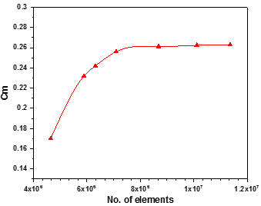
Computational Methodology
Mesh generation
Computational domain
Grid independency test
Turbulence Model selection
Boundary condition of the channel
Name | Boundary condition
Inlet | Velocity inlet: 0.6 m/s
Outlet | Outflow
Channel top surface | Symmetry
Side and bottom wall | No slip wall
Rotating zone | MRF
Turbine | No slip
Notes:
poly(p-phenylene-2,6-benzobisoxazole)

Slide 15
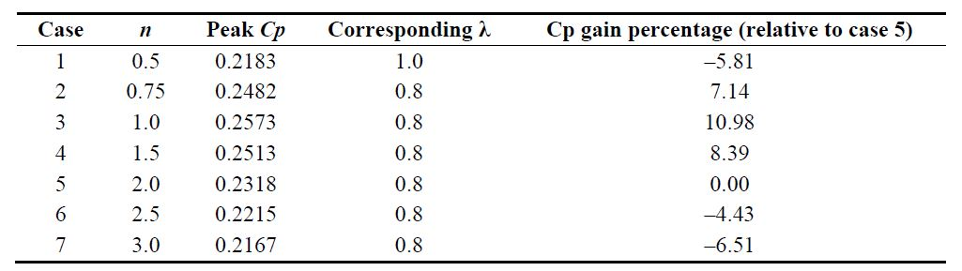
Myring Shape as Savonius Blades
The Myring Equation is given by:

Slide 16
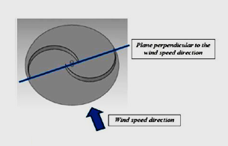
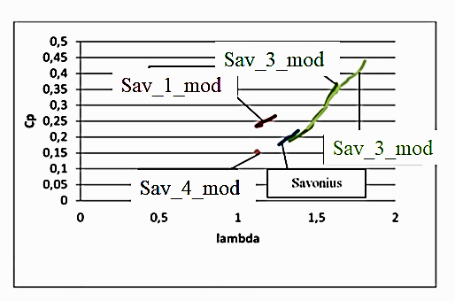
Myring Shape as Savonius Blades

Slide 17
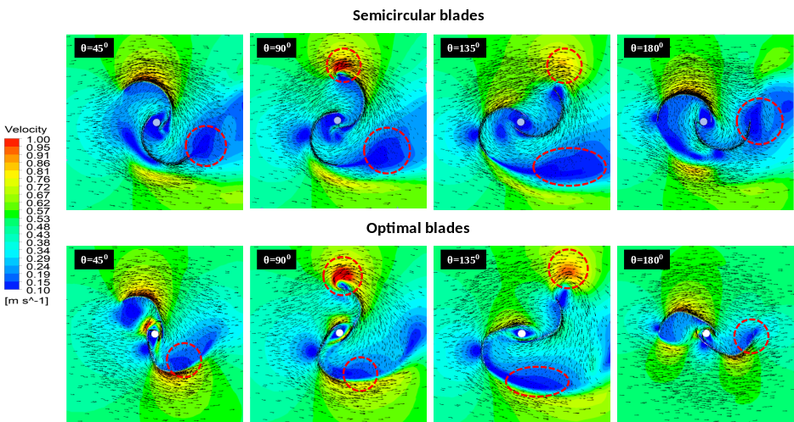
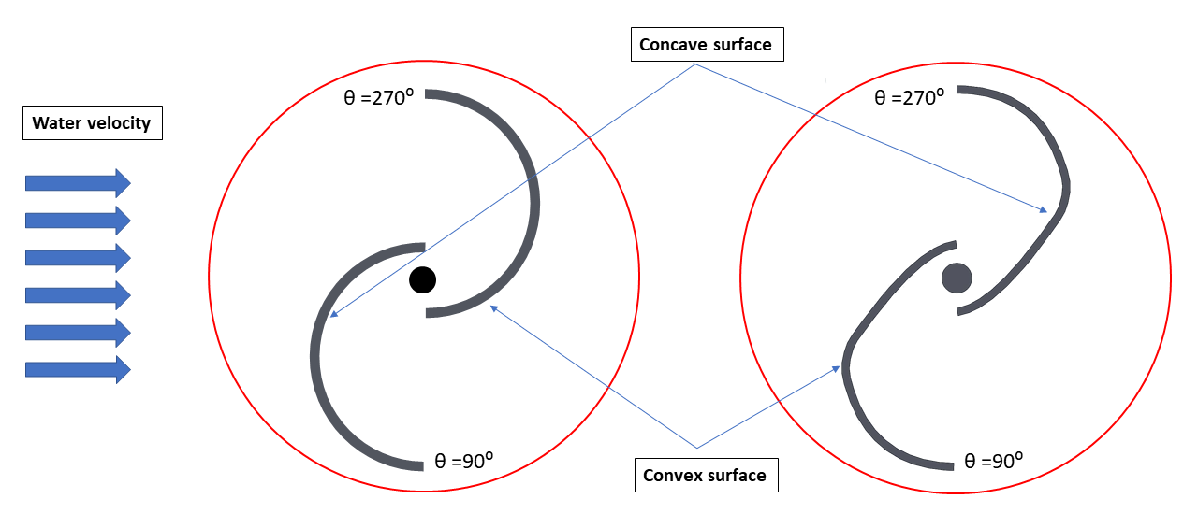
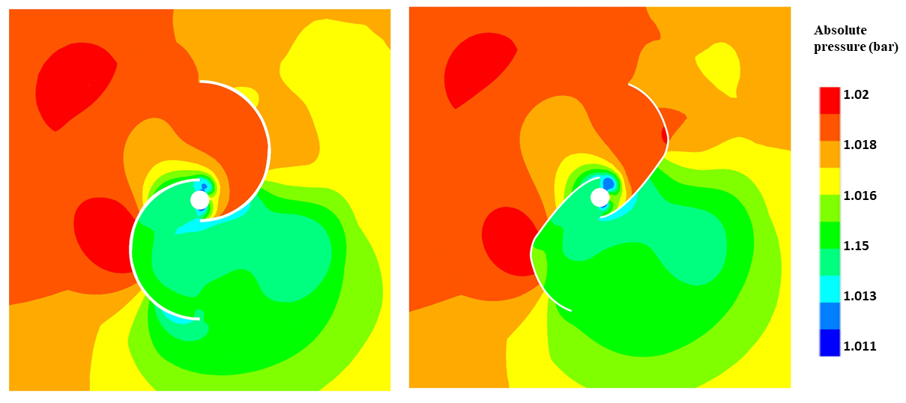
Computational modelling of Savonius hydrokinetic turbine
Semicircular blade
Novel blade profile
0
270
90
0

Slide 18
Library of Turbine Models
OBJECTIVE 4
No Twist angle
Twist 60 degree
Twist 90 degree
Twist 120 degree
Twist 150 degree
Twist 180 degree

Slide 19
Impact of Twist on Turbine Performance
OBJECTIVE 4
TSR= 0.8

Slide 20
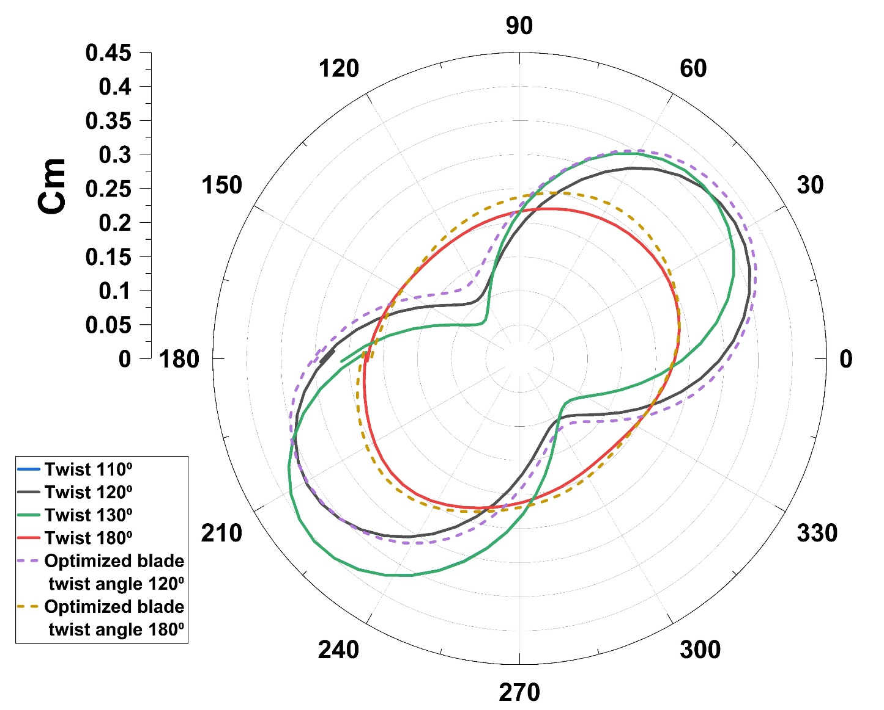
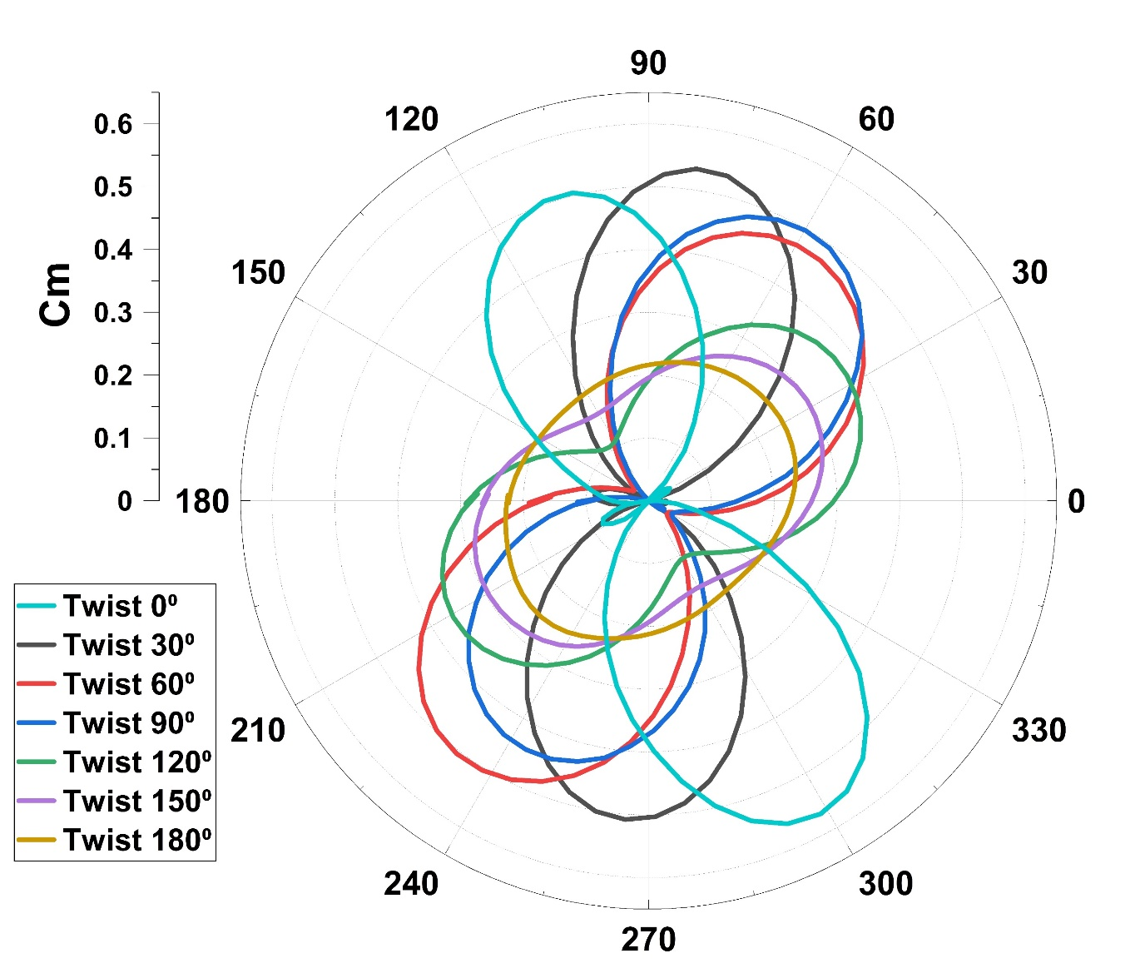
Uniformity of Torque Vs Twist Angle
Comparison of twist angle : Circular Blade
Comparison of twist angle with optimized blade

Slide 21
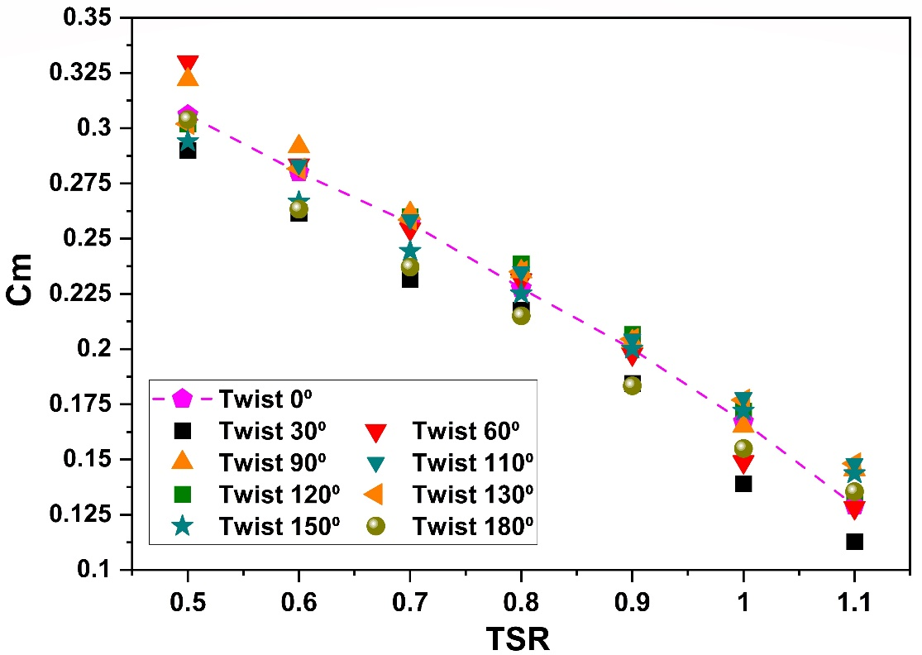
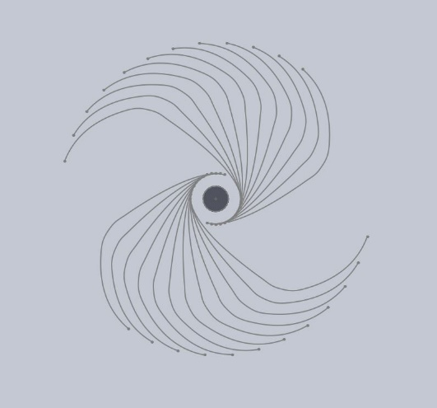
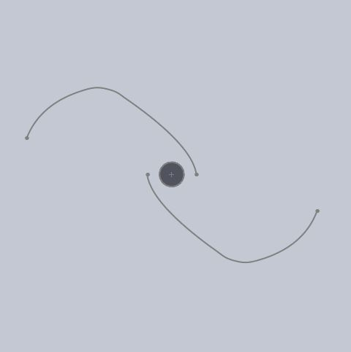
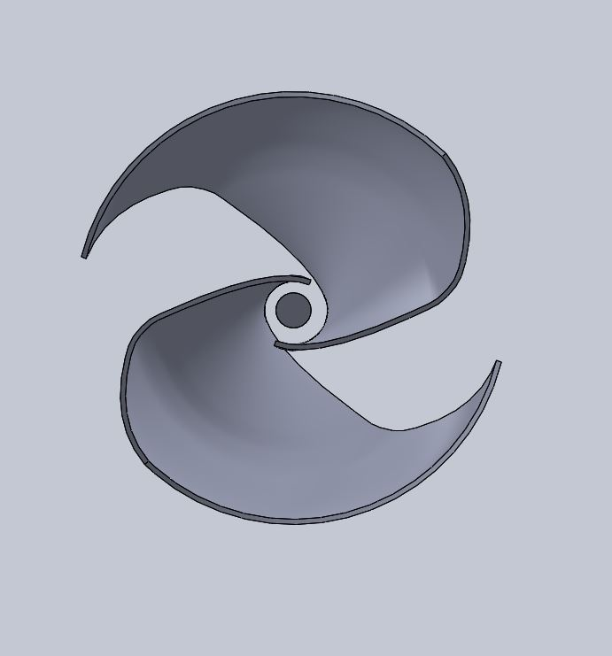
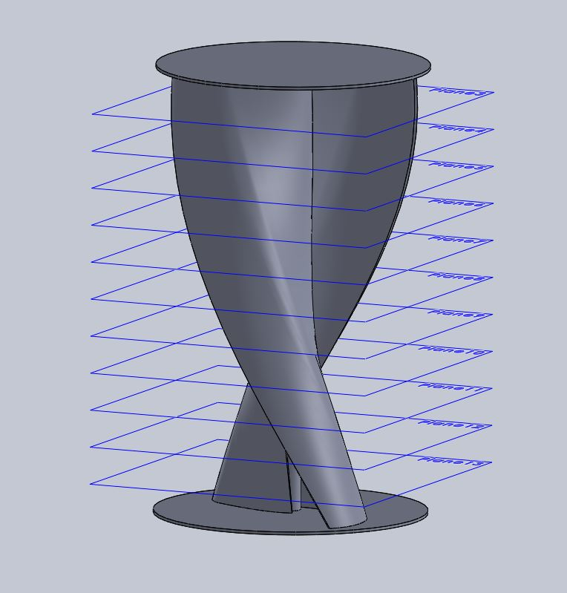
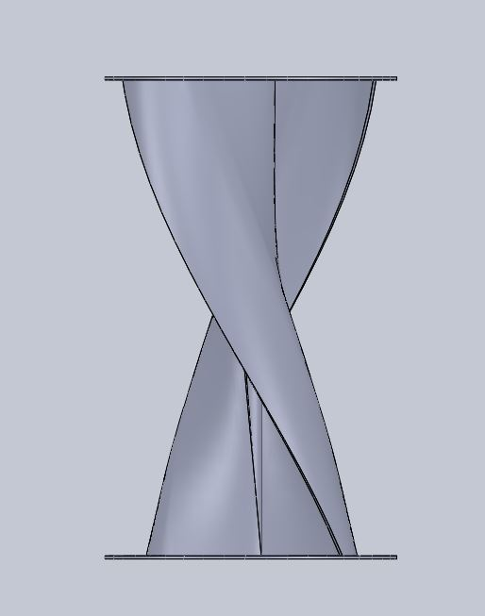
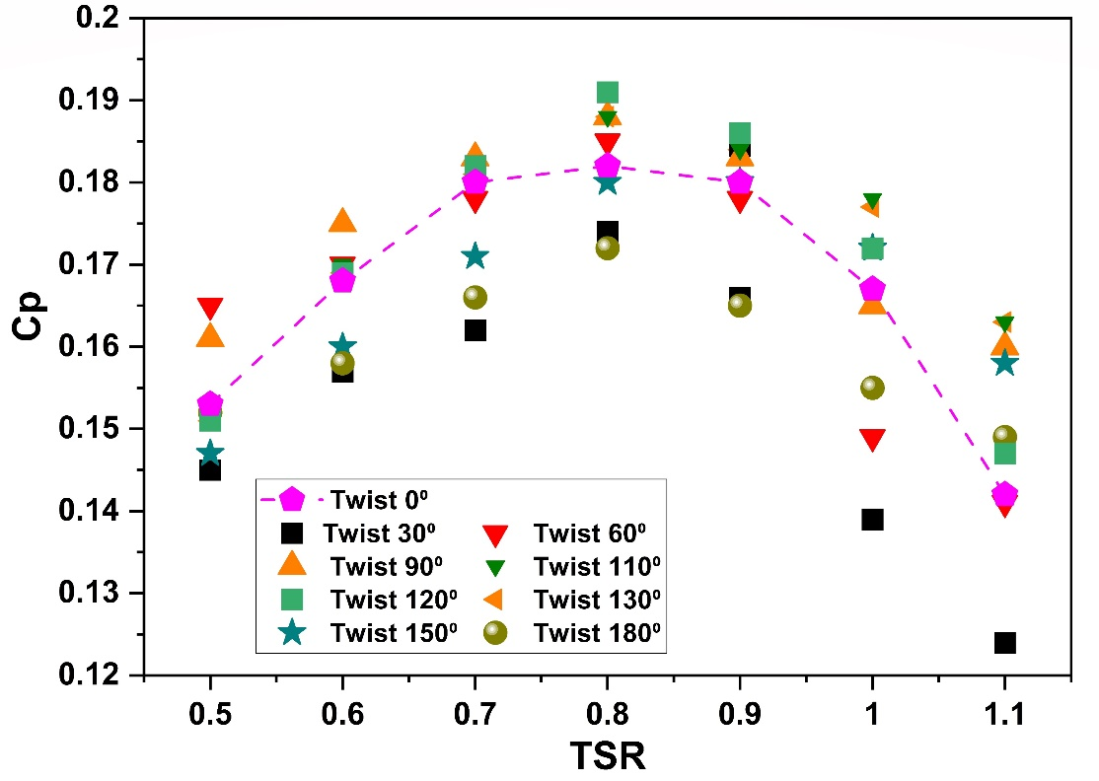
IIT Delhi Design: Optimized blade with 120° Twist

Slide 22
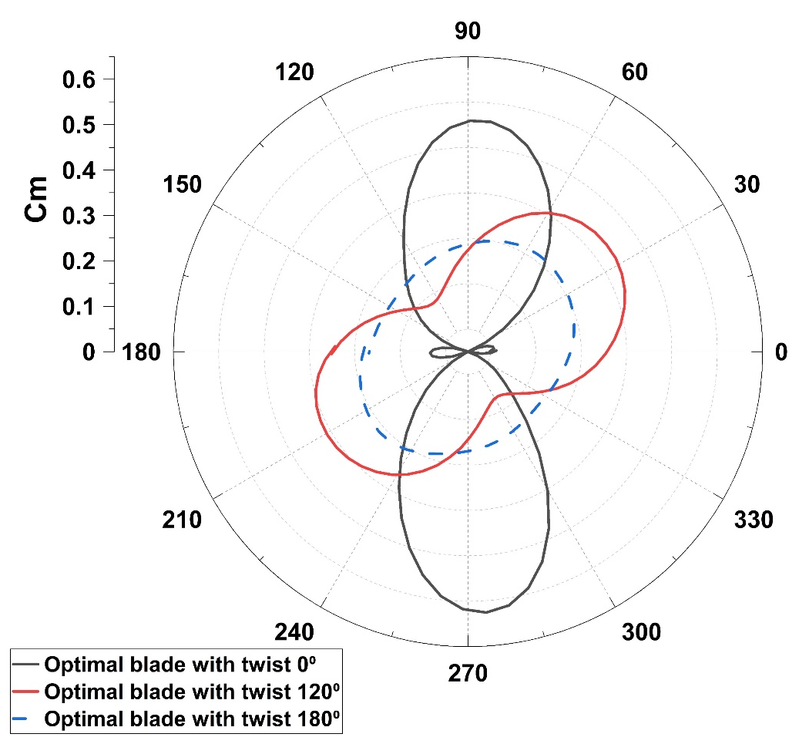
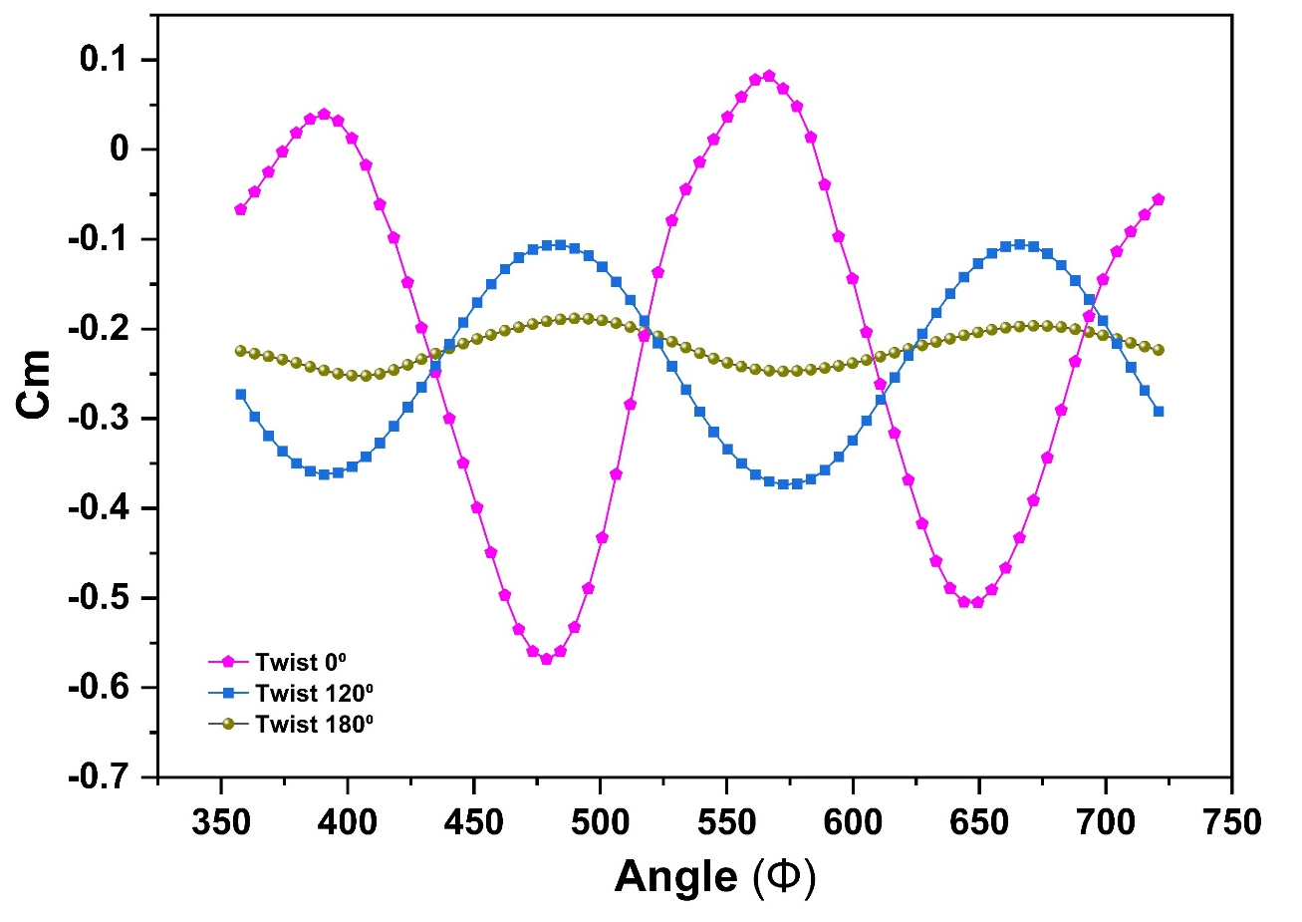
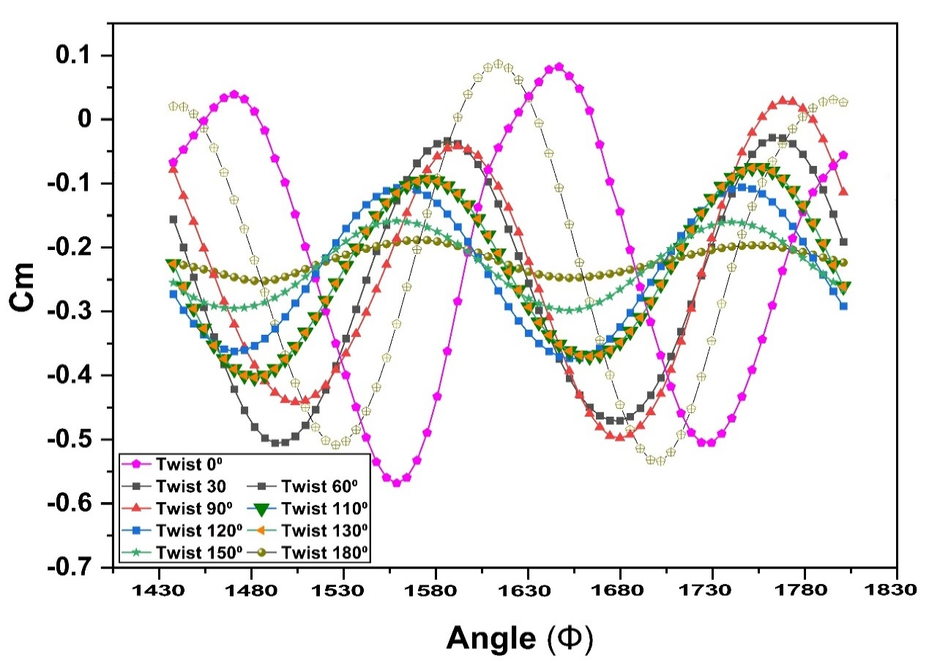
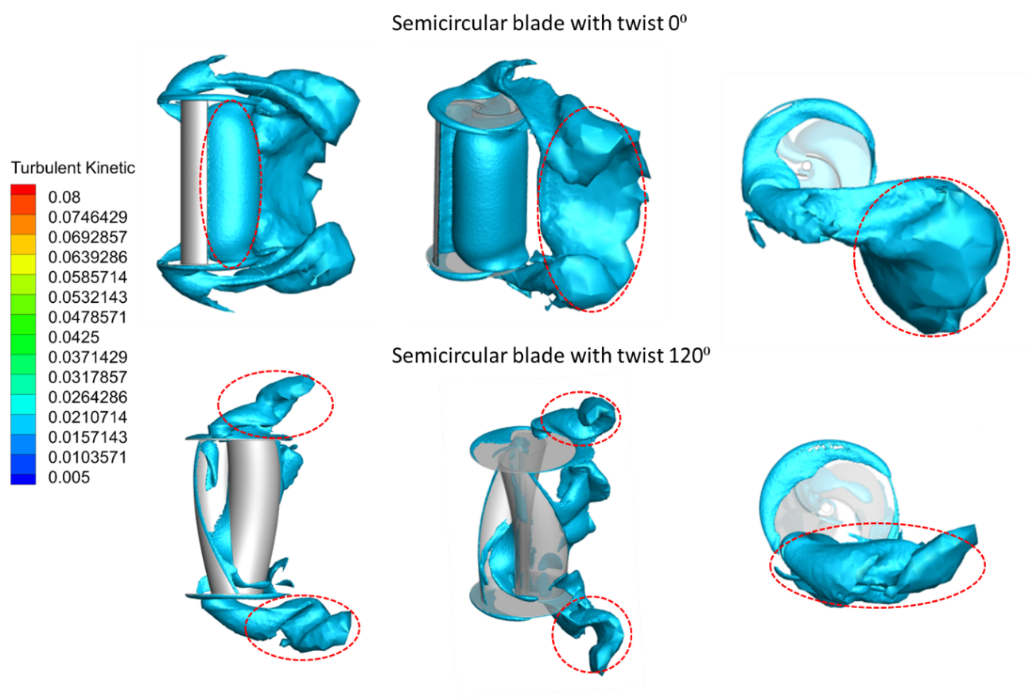
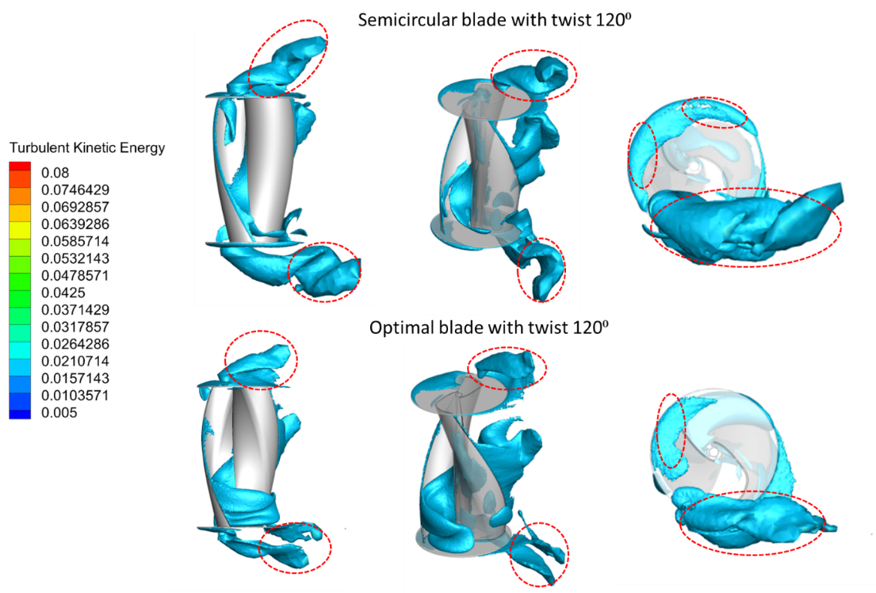
Computational modelling of twisted Savonius hydrokinetic turbine

Slide 23
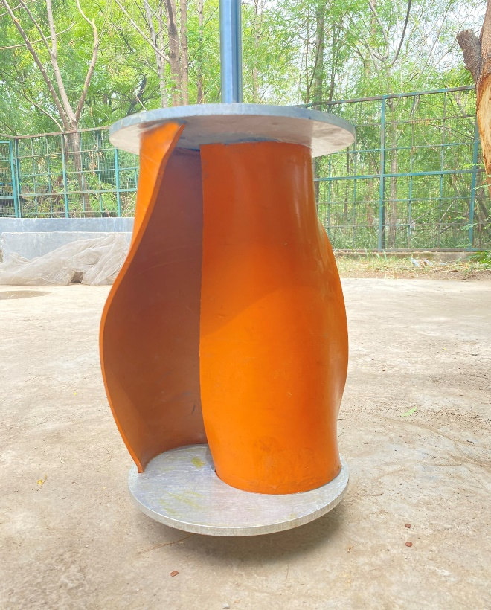
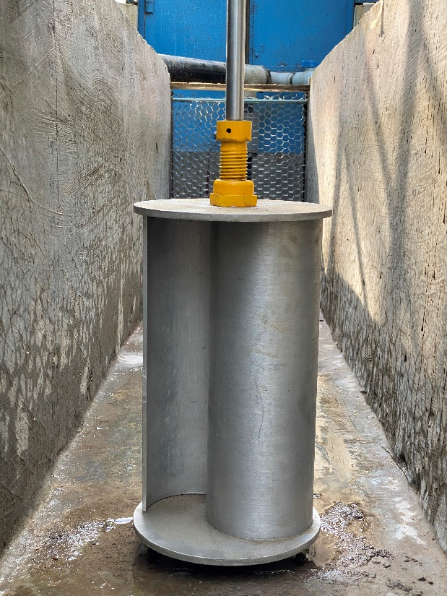
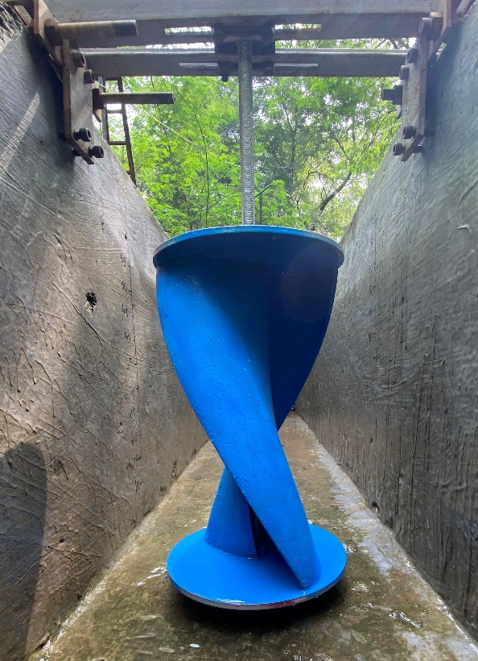
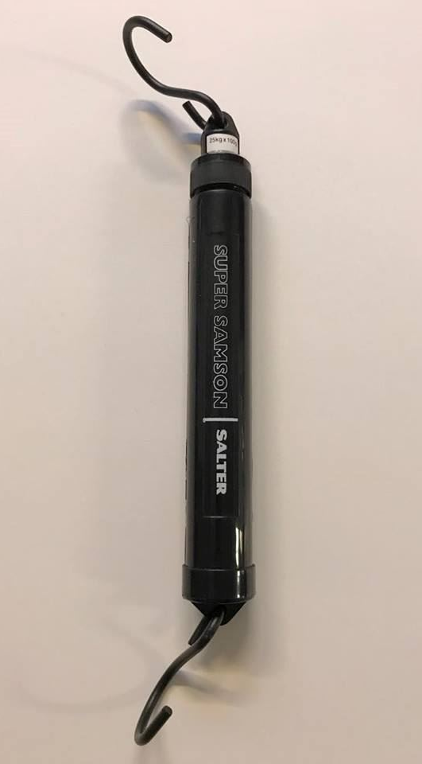
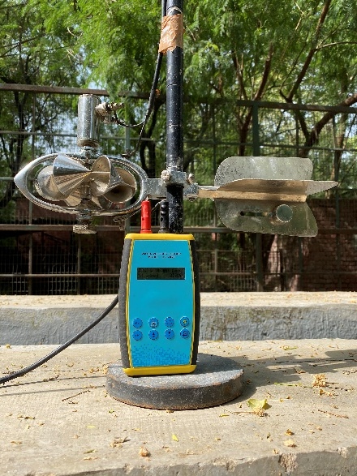
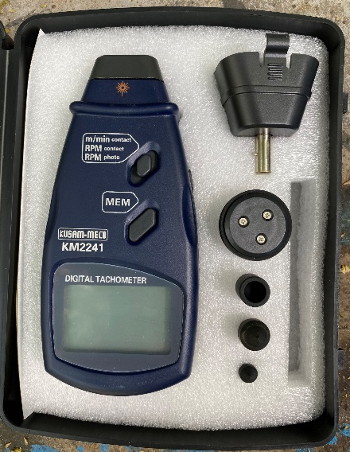
Turbine tested for experimental analysis
Straight semicircular blade
Twisted semicircular blade
Twisted bezier profile blade
Instruments used during experimental analysis
Cup type water current
Tachometer
Spring balance

Slide 24

Comparison of Computational Results with Experimental results
OBJECTIVE 4
Channel configuration | Methods | C_{pmax} | TSR | Relative error (%)
Channel width and height (0.5x0.55)m² | Experimental | 0.29 | 0.98 | 4.2 %
 | Computational | 0.308 | 1

Slide 25
Wind to Water
OBJECTIVE 4
Existing companies in this area
Market Survey
Turbine cost ( Lakhs)
Turbine efficiency

