Slide 1

Design of Wind Turbine Rotors for RES
P M V Subbarao
Professor
Mechanical Engineering Department
Head,CRDT
Easy to Develop and Maintain Locally….

Slide 2

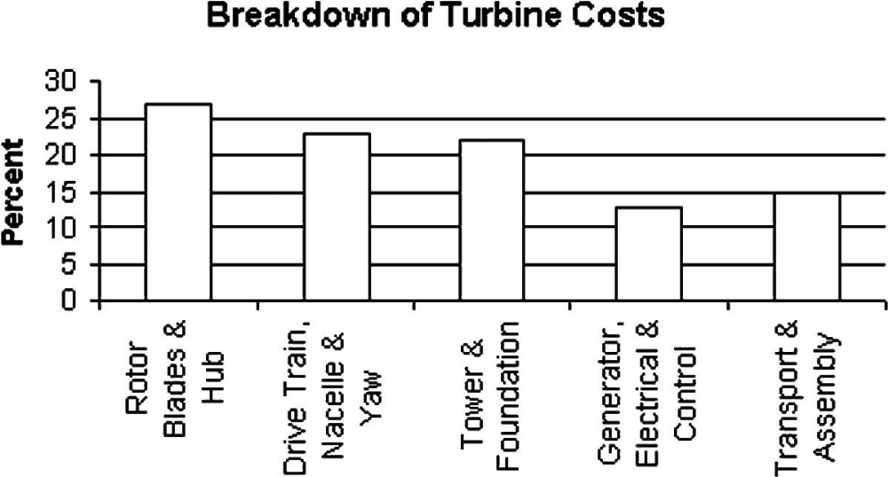
The Cost of Wind Turbine

Slide 3
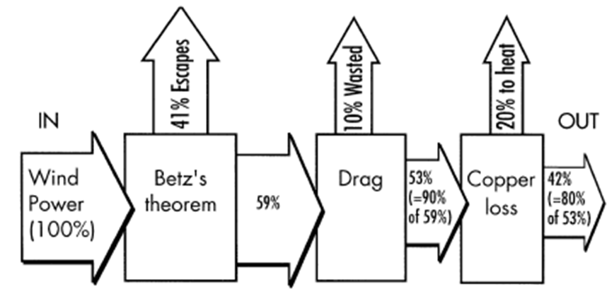
The Power Extraction Analysis for Wind Turbines

Slide 4
Mechanical Power Extraction :The Fundamental Aerodynamic Phenomena
All bodies exposed to an airflow experience aerodynamic force.
This force generated on a wind turbine rotor is responsible for
generation of change in tangential velocity across a rotor &
Axial induction in upstream wind.
The components of which are defined as
aerodynamic drag (in the direction of flow), and
as aerodynamic lift (at a right angle to the direction of flow).
The component of force responsible for above effects, greatly influences the actual power developed by a wind turbine.

Slide 5
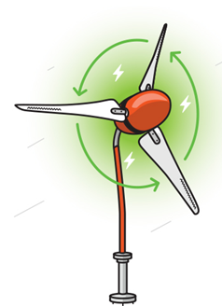
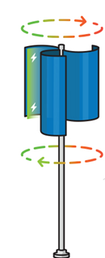
Basic Principle of Changing Angular Momentum/ Axial Induction
Drag driven WT
Lift driven WT

Slide 6
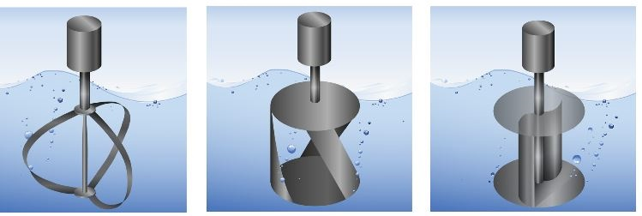
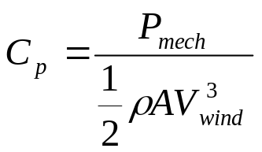
Types of vertical axis Wind turbines
Three Popular VAWTs
Darrieus | Gorlov | Savonius
Vertical axis turbines (M. J. Khan et al. 2009)
Power Coefficient

Slide 7
A Holistic Analysis of VAWTs
Parameter | Savonius | Gorlov | Darrieus
Power Coefficient | 0.15 - 0.2 | 0.35 | 0.4
Blade profile | Simple | Complicated | Complicated
Tip Speed Ratio | Low | Moderate | Moderate
Noise | Low | Low | Moderate
Blade area | Large | Low | Low
Self-starting | Yes | Yes | Yes, if helical
Overall structure | Simple | Complicated | Complicated
Manufacturing | Simple | Complicated | Complicated
Cost price | Low | High | High
Debris issue | Low | High | High

Slide 8
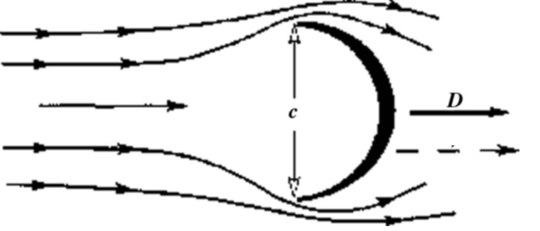
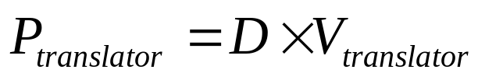
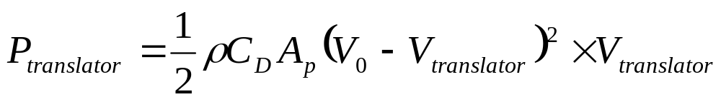
Drag Translator
Drag results from the relative velocity between the wind and the device.
The power extracted by an elementary drag is the product of the drag force and the translation velocity.

Slide 9
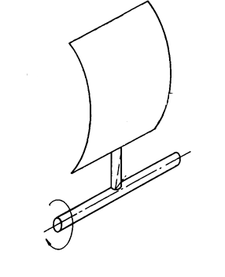

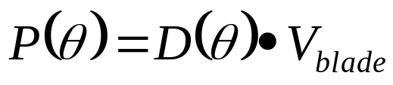
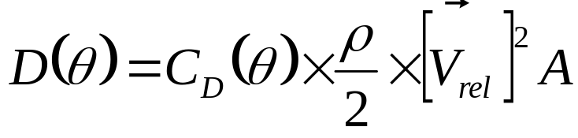
Simple Drag Device
The simplest type of wind energy conversion can be achieved by means of pure drag surfaces.
The air impinges on the surface A with velocity V₀.
The instantaneous power capture P from the aerodynamic drag D, and the velocity V_{blade} with which it moves is expressed as :
V₀
Define coefficient of drag:

Slide 10
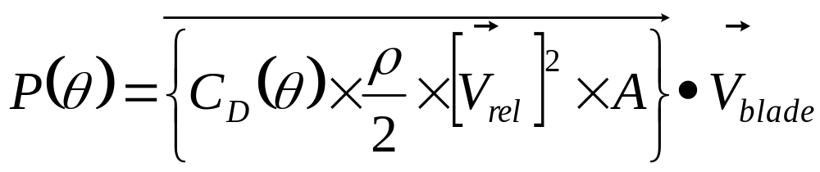
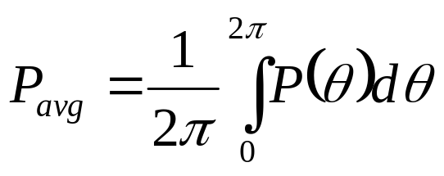
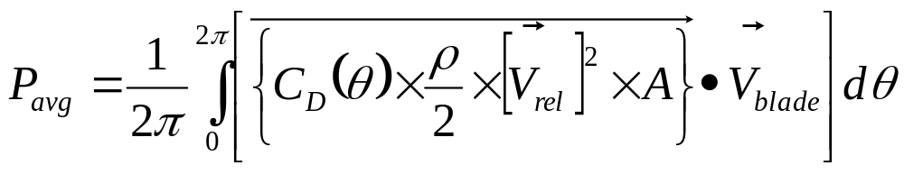
Capacity of Drag Device
Instantaneous Power Developed by a drag device
Average Power Developed by a drag device

Slide 11
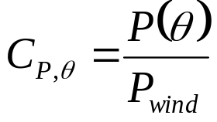
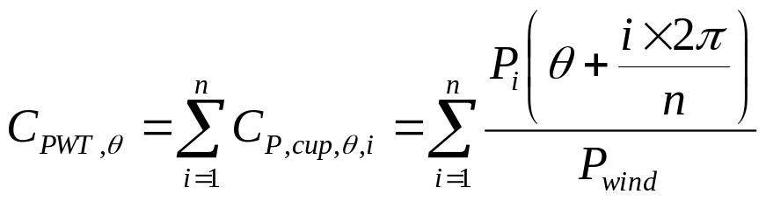
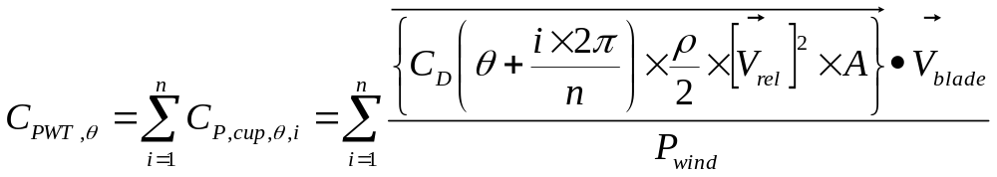
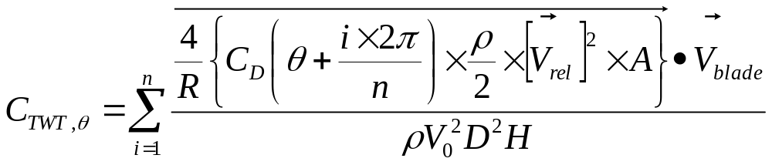
Power Coefficient of A multi-Cup Drag Wind Turbine
The instantaneous power coefficient of reference cup:
The instantaneous power coefficient of multi cup turbine:
The instantaneous torque coefficient of multi cup turbine:

Slide 12
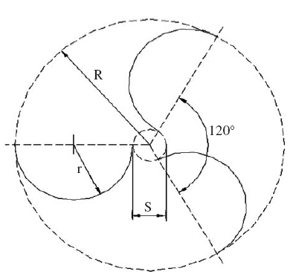
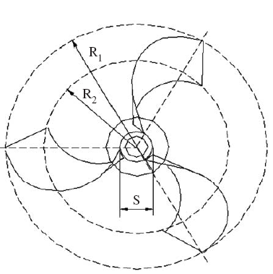
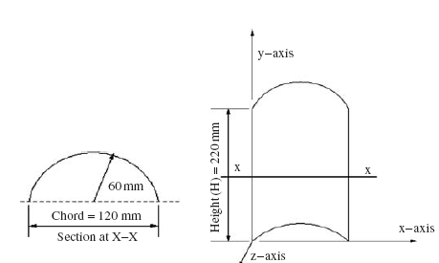
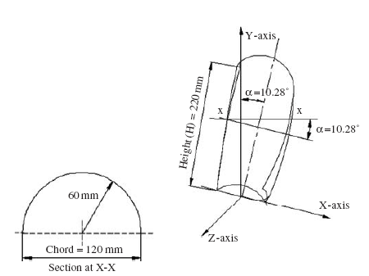
Savonius Rotor Wind Turbine

Slide 13
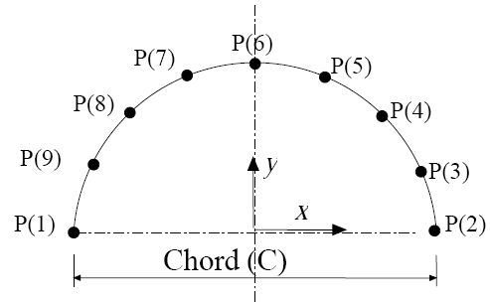
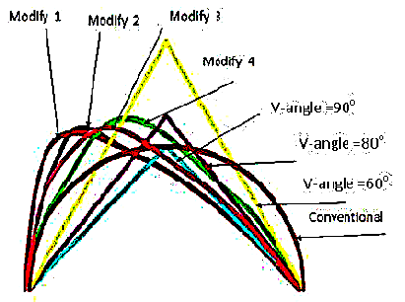
Design of Blade for Savonius Rotor Wind Turbine

Slide 14
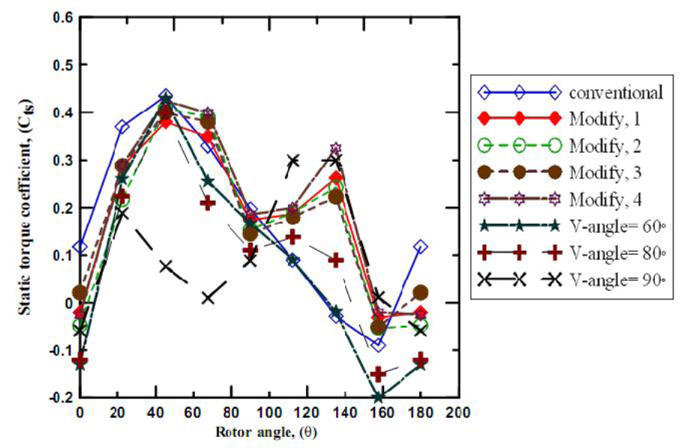
Local Static Coefficient of Torque

Slide 15
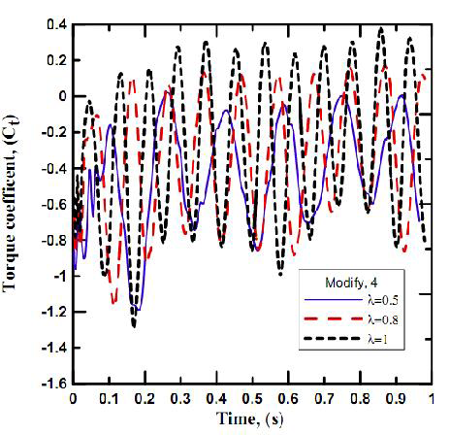
The cyclic torque coefficients with the time for modify 4 rotor at different

Slide 16
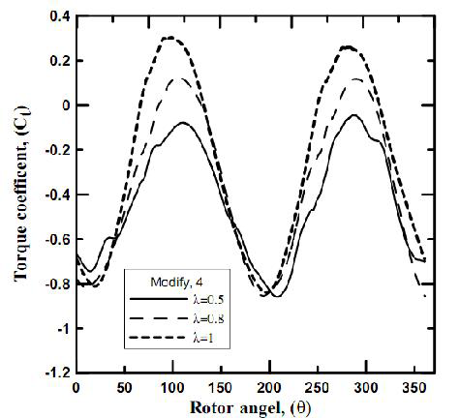
Ensemble Average torque coefficient versus the instantaneous location of the rotor at different tip speed ratios.

Slide 17
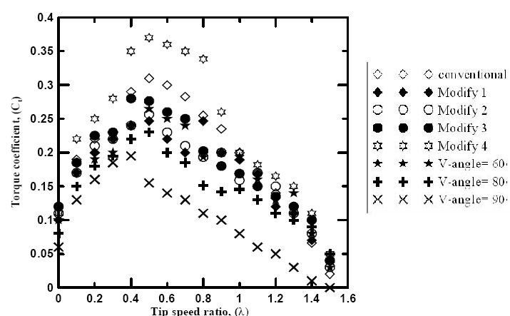
Savonius Turbine : Average Coefficient of Torque

Slide 18
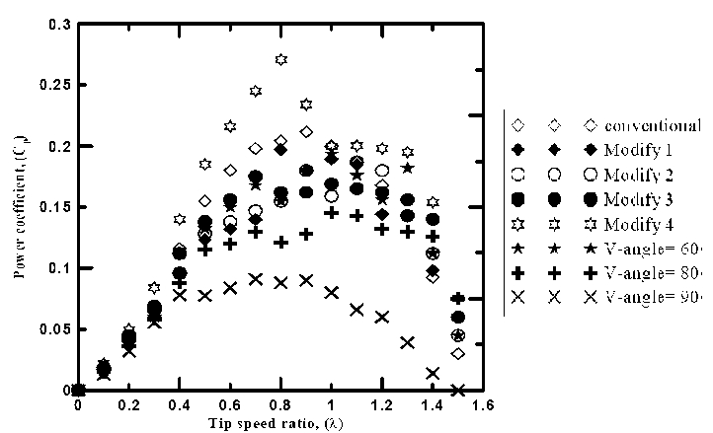
Savonius Turbine : Average Power Coefficient

Slide 19
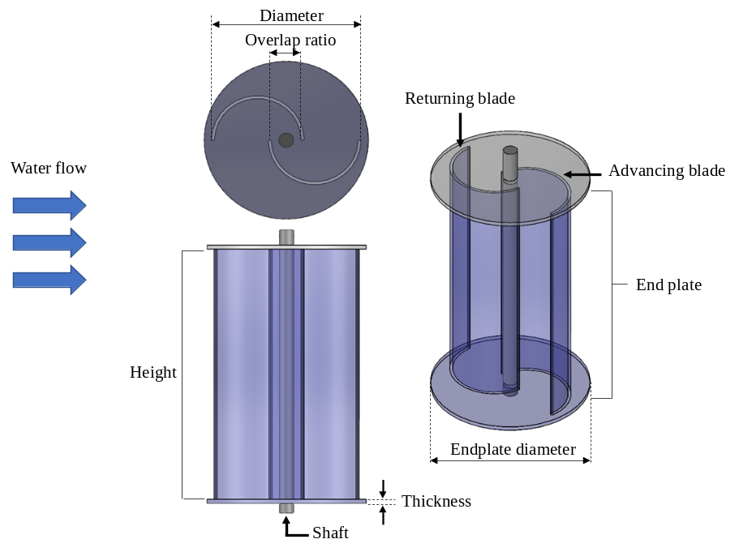
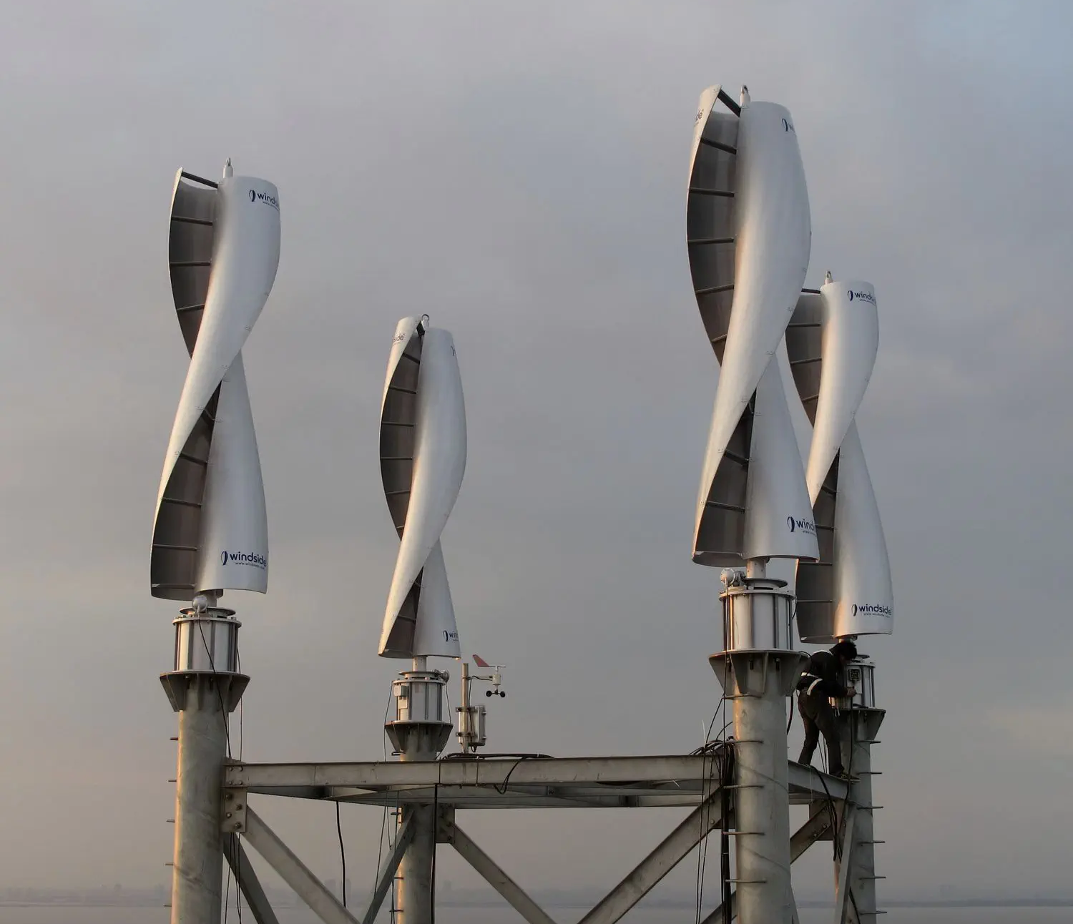
IIT Delhi : Savonius wind turbine
Advanced Savonius wind turbine

Slide 20
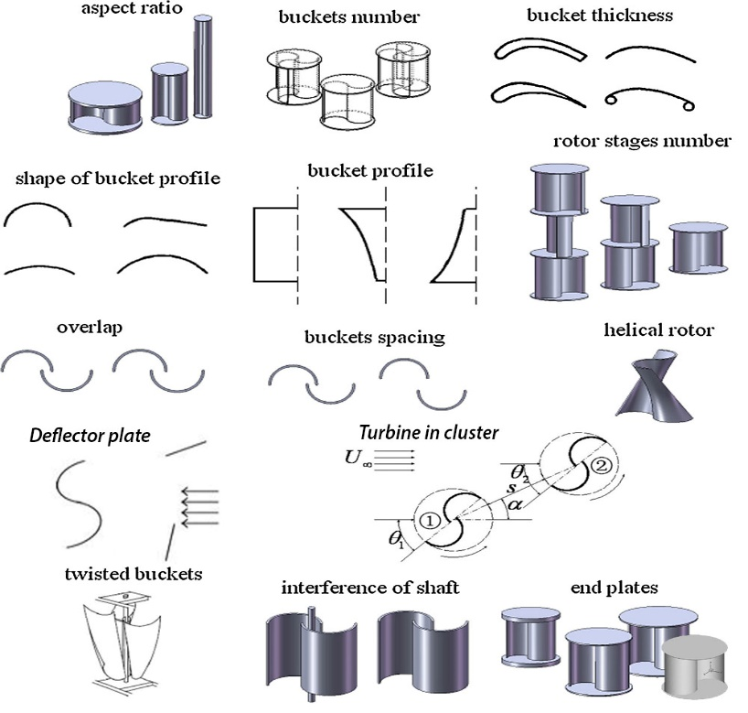
Geometrical Variants of Savonius turbine

