Slide 1

Estimated & Design Wind Potential
P M V Subbarao
Professor
Mechanical Engineering Department
Head,CRDT
Statistical Understanding of Random Resource

Slide 2

Probability Distribution Functions for Wind
The behavior of wind velocity at a given site can be specified as a probability distribution function, f(V).
The quantity f(V)dV represents the fraction of the wind speeds that lie within a range, dV, about the given velocity, V.
Basic ideas of probability distribution functions with specific application to wind velocity and energy distributions is essential to develop Micro scale rural wind units.

Slide 3
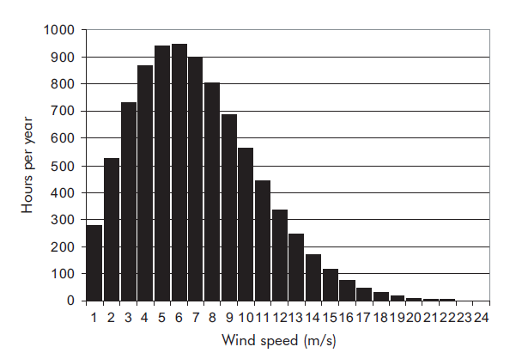
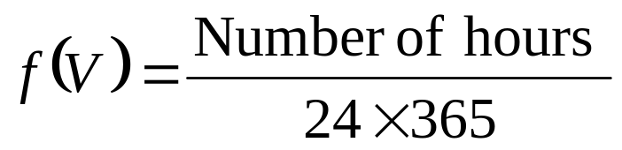
Statistical Nature of Wind at a given height
Frequency of Occurrence of Speed V

Slide 4
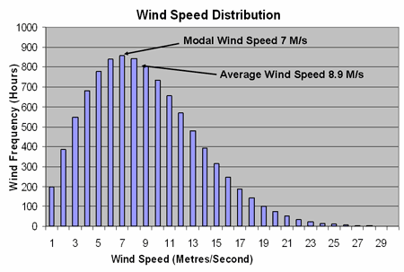
PDF for of Measured Wind Speed at a Site
A single variable PDF can be generated using wind speed as a primary variable.
This function shows probability of occurrence of wind of a given speed in all possible directions.

Slide 5
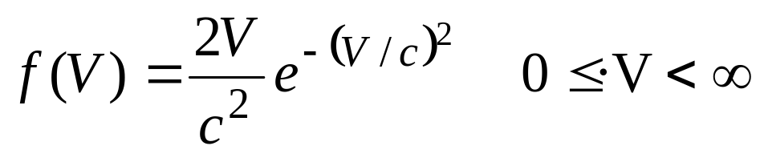
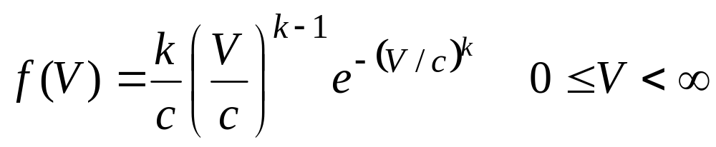
Simple Models for Distribution of Wind Speed
Two probability distribution functions are commonly used for wind speed.
The simpler of the two is the Rayleigh distribution which has a single parameter c.
The Weibull distribution shown below has two parameters k and c.
c = Empirical Weibull scale factor (m/s)
The Rayleigh distribution is actually a special case of the Weibull distribution with k = 2.

Slide 6
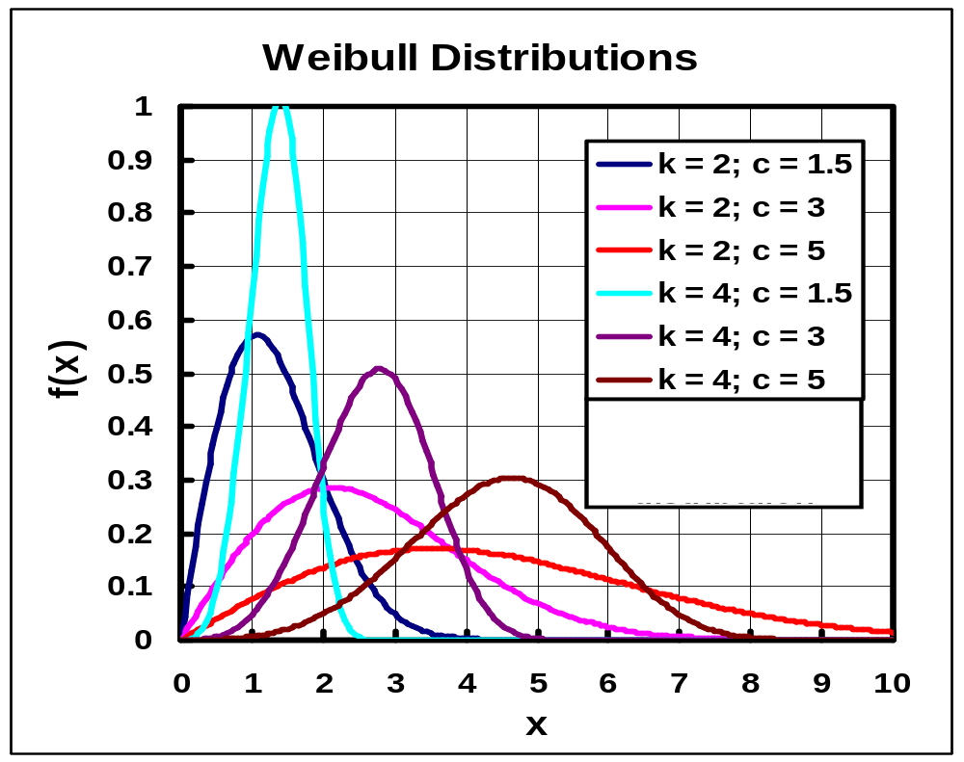

Slide 7
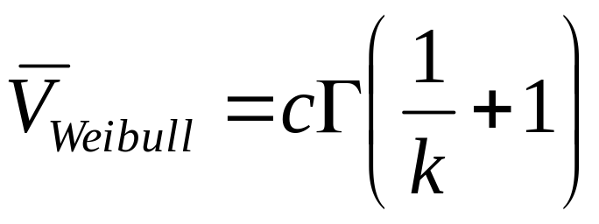
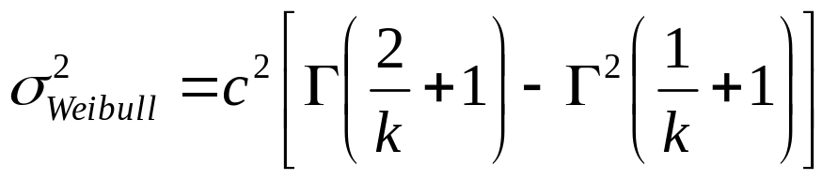
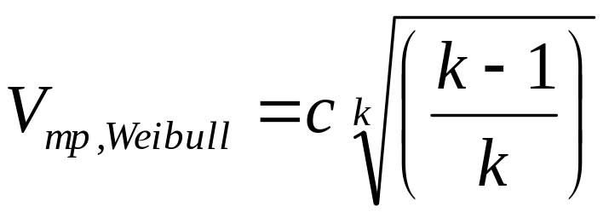

Statistical Moments of Weibull distribution
Average value:
Most probable value of velocity
The maximum wind speed

Slide 8
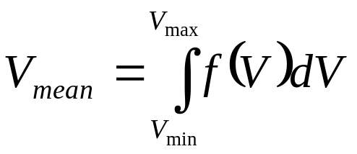
Statistical Nature of Wind at a given height
V (m/s) | f(V)
1 | 0.0319
2 | 0.0593
3 | 0.08219
4 | 0.0993
5 | 0.1073
6 | 0.10844
7 | 0.1027
8 | 0.0919
9 | 0.0776
10 | 0.0651
11 | 0.514
V (m/s) | f(V)
12 | 0.0388
13 | 0.0285
14 | 0.0194
15 | 0.0136
16 | 0.009
17 | 0.005
18 | 0.004
19 | 0.003
20 | 0.002
21 | 0.001
22 | 0.001
Frequency of Occurrence of Speed V

Slide 9
Design Capacity of Wind Turbine
V (m/s) | f(V) | Number of hours/year
1 | 0.0319 | 279.4
2 | 0.0593 | 519.5
3 | 0.08219 | 720.0
4 | 0.0993 | 869.9
5 | 0.1073 | 939.9
6 | 0.10844 | 949.9
7 | 0.1027 | 899.7
8 | 0.0919 | 805.0
9 | 0.0776 | 679.8
10 | 0.0651 | 570.3
11 | 0.0514 | 450.3
12 | 0.0388 | 339.9
13 | 0.0285 | 249.7
14 | 0.0194 | 169.9
15 | 0.0136 | 119.1
16 | 0.009 | 78.8
17 | 0.005 | 43.8
18 | 0.004 | 35.0
19 | 0.003 | 26.3
20 | 0.002 | 17.5
21 | 0.001 | 8.8
22 | 0.001 | 8.8

Slide 10
Design Capacity of Wind Turbine
V (m/s) | f(V) | Number of hours/year | v³
1 | 0.0319 | 279.4 | 1
2 | 0.0593 | 519.5 | 8
3 | 0.08219 | 720.0 | 27
4 | 0.0993 | 869.9 | 64
5 | 0.1073 | 939.9 | 125
6 | 0.10844 | 949.9 | 216
7 | 0.1027 | 899.7 | 343
8 | 0.0919 | 805.0 | 512
9 | 0.0776 | 679.8 | 729
10 | 0.0651 | 570.3 | 1000
11 | 0.0514 | 450.3 | 1331
12 | 0.0388 | 339.9 | 1728
13 | 0.0285 | 249.7 | 2197
14 | 0.0194 | 169.9 | 2744
15 | 0.0136 | 119.1 | 3375
16 | 0.009 | 78.8 | 4096
17 | 0.005 | 43.8 | 4913
18 | 0.004 | 35.0 | 5832
19 | 0.003 | 26.3 | 6859
20 | 0.002 | 17.5 | 8000
21 | 0.001 | 8.8 | 9261
22 | 0.001 | 8.8 | 10648

Slide 11
Design Capacity of Wind Turbine
V (m/s) | f(V) | Number of hours/year | V³ | V³ × Number of hours
1 | 0.0319 | 279.4 | 1 | 279.4
2 | 0.0593 | 519.5 | 8 | 4155.7
3 | 0.08219 | 720.0 | 27 | 19439.6
4 | 0.0993 | 869.9 | 64 | 55671.6
5 | 0.1073 | 939.9 | 125 | 117493.5
6 | 0.10844 | 949.9 | 216 | 205185.8
7 | 0.1027 | 899.7 | 343 | 308580.6
8 | 0.0919 | 805.0 | 512 | 412182.5
9 | 0.0776 | 679.8 | 729 | 495556.7
10 | 0.0651 | 570.3 | 1000 | 570276.0
11 | 0.0514 | 450.3 | 1331 | 599301.4
12 | 0.0388 | 339.9 | 1728 | 587326.5
13 | 0.0285 | 249.7 | 2197 | 548503.0
14 | 0.0194 | 169.9 | 2744 | 466326.3
15 | 0.0136 | 119.1 | 3375 | 402084.0
16 | 0.009 | 78.8 | 4096 | 322928.6
17 | 0.005 | 43.8 | 4913 | 215189.4
18 | 0.004 | 35.0 | 5832 | 204353.3
19 | 0.003 | 26.3 | 6859 | 180254.5
20 | 0.002 | 17.5 | 8000 | 140160.0
21 | 0.001 | 8.8 | 9261 | 81126.4
22 | 0.001 | 8.8 | 10648 | 93276.5

Slide 12
Capacity Factor of A Wind Turbine
One important consideration to make for wind turbines (or any energy source) is something called capacity factor.
Capacity factor indicates how much energy is generated by a source relative to the maximum amount of energy it could provide.
This is expressed as a percentage, and is usually determined over the course of a single year.
This provides insight into how well-sited the turbine is, but in general indicates how available an energy source is throughout the year.

Slide 13
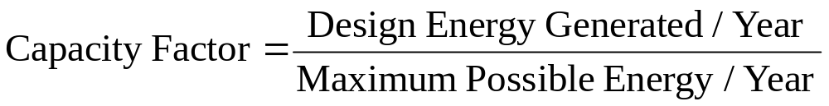
Selection of Capacity Factor
The closer to 100%, the more the energy source is available throughout the year.
The average capacity factor of the U.S. wind fleet hovers around 32% - 34%.
It's not unusual to see 40% and up capacity factors for well-sited wind farms.

Slide 14
Determination Design Capacity Factor for A Wind Turbine
V (m/s) | f(V) | Number of hours/year | V³ | Available Energy | T Design Limit V³ | Design Energy
1 | 0.0319 | 279.4 | 1 | 279.4 | 1 | 279.4
2 | 0.0593 | 519.5 | 8 | 4155.7 | 8 | 4155.7
3 | 0.08219 | 720.0 | 27 | 19439.6 | 27 | 19439.6
4 | 0.0993 | 869.9 | 64 | 55671.6 | 64 | 55671.6
5 | 0.1073 | 939.9 | 125 | 117493.5 | 125 | 117493.5
6 | 0.10844 | 949.9 | 216 | 205185.8 | 216 | 205185.8
7 | 0.1027 | 899.7 | 343 | 308580.6 | 343 | 308580.6
8 | 0.0919 | 805.0 | 512 | 412182.5 | 512 | 412182.5
9 | 0.0776 | 679.8 | 729 | 495556.7 | 729 | 495556.7
10 | 0.0651 | 570.3 | 1000 | 570276.0 | 1000 | 570276.0
11 | 0.0514 | 450.3 | 1331 | 599301.4 | 1331 | 599301.4
12 | 0.0388 | 339.9 | 1728 | 587326.5 | 1728 | 587326.5
13 | 0.0285 | 249.7 | 2197 | 548503.0 | 1728 | 431412.5
14 | 0.0194 | 169.9 | 2744 | 466326.3 | 1728 | 293663.2
15 | 0.0136 | 119.1 | 3375 | 402084.0 | 1728 | 205867.0
16 | 0.009 | 78.8 | 4096 | 322928.6 | 1728 | 136235.5
17 | 0.005 | 43.8 | 4913 | 215189.4 | 1728 | 75686.4
18 | 0.004 | 35.0 | 5832 | 204353.3 | 1728 | 60549.1
19 | 0.003 | 26.3 | 6859 | 180254.5 | 1728 | 45411.8
20 | 0.002 | 17.5 | 8000 | 140160.0 | 1728 | 30274.6
21 | 0.001 | 8.8 | 9261 | 81126.4 | 1728 | 15137.3
22 | 0.001 | 8.8 | 10648 | 93276.5 | 1728 | 15137.3

Slide 15
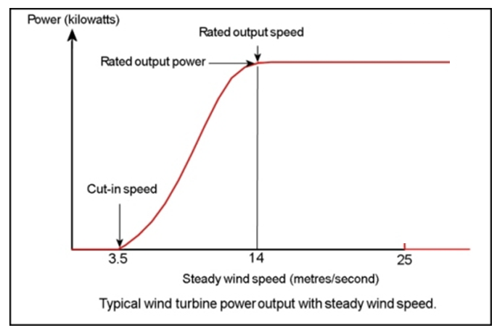
Operational Regime of A Wind Turbine
Cut-in speed : At very low wind speeds, there is insufficient torque exerted by the wind on the turbine blades to make them rotate.
The speed at which the turbine first starts to rotate and generate power is called the cut-in speed and is typically between 3 and 4 metres per second.

Slide 16
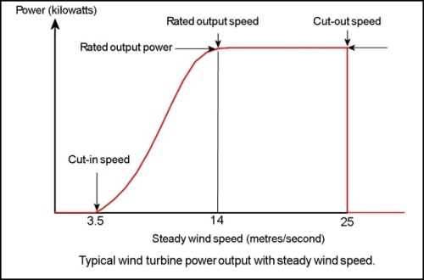
Operational Regime of A Wind Turbine
Cut-out speed : As the speed increases above the rated output wind speed, the forces on the turbine structure continue to rise and, at some point, there is a risk of damage to the rotor.
A braking system is employed to bring the rotor to a standstill.
This is called the cut-out speed and is usually around 25 metres per second.

Slide 17
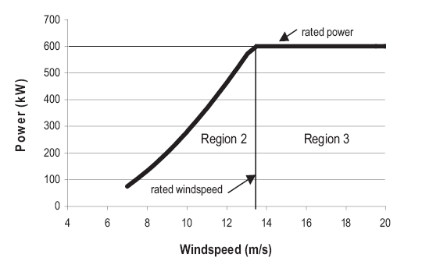
Typical Regions of WT Operation
Region 1
Region 4

Slide 18

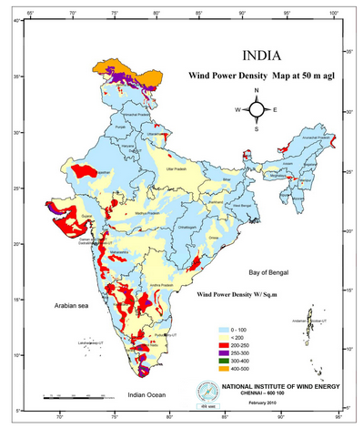

Wind Power Density Map at 50 m Altitude
Wind Power Density W/m²

Slide 19
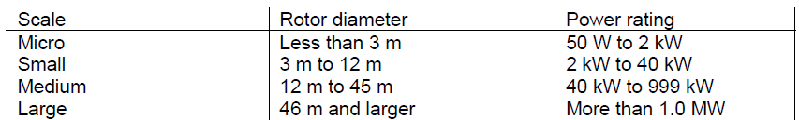
Scale of Wind Turbines

Slide 20
Wind generation for developing countries
Unlike the trend toward large-scale grid connected wind turbines seen in the West.
The more immediate demand for rural energy supply in developing countries is for smaller machines in the 5 - 100 kW range.
These can be connected to small, localized micro-grid systems and used in conjunction with diesel generating sets and/or solar photovoltaic systems.
The main area of growth being for very small battery charging wind turbines (50 - 150 Watts).
In Inner Mongolia there are over 30,000 such machines used by herders for providing power for lighting, televisions, radios, etc.
Other applications for small wind machines include water pumping, telecommunications power supply and irrigation.

