Slide 1

Introduction to Micro Wind Turbines
P M V Subbarao
Professor
Mechanical Engineering Department
Head,CRDT
“The pessimist complains about the wind;
the optimist expects it to change;
the realist adjusts the sails.”
-- William Arthur Ward

Slide 2

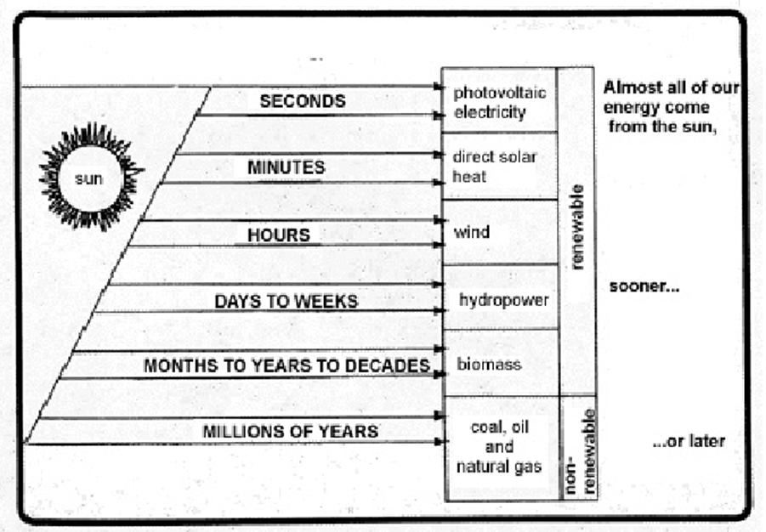
All Energy Sources are Renewable
The Sun provides 175 million million watts of energy to the Earth’s atmosphere each hour.
Of this, approximately 1-2% is converted to wind energy.

Slide 3
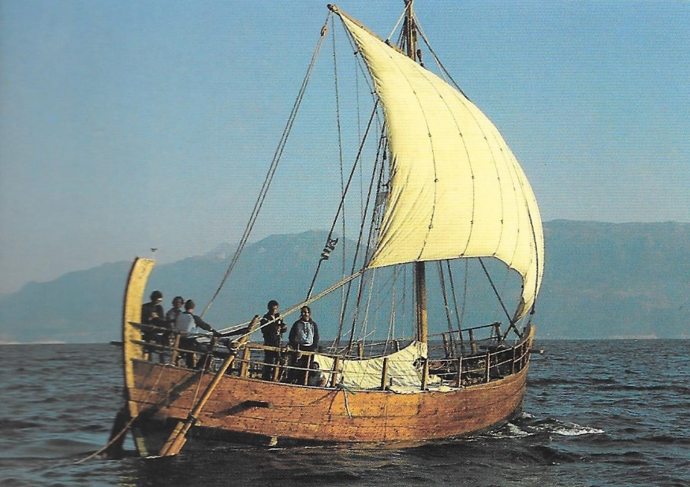
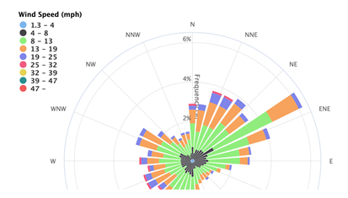
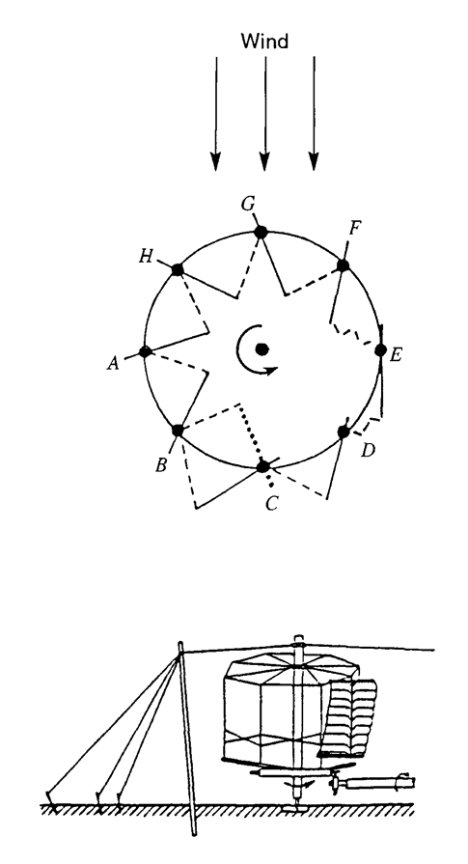

The Bountifulness of Wind as Mobility

Slide 4
Evolution of Wind Turbines
Wind is a clean, safe, renewable form of energy.
Although the use of wind power in sailing vessels appeared in antiquity, the widespread use of wind power for grinding grain and pumping water was delayed until
  the 7th century in Persia,
  the 12th century in England, and
  the 15th century in Holland.
17th century, Leibniz proposed using windmills and waterwheels together to pump water from mines in the Harz Mountains.
Dutch settlers brought Dutch mills to America in the 18th century.
This led to the development of a multiblade wind turbine that was used to pump water for livestock.
Wind turbines were used in Denmark in 1890 to generate electric power.
Early in the 20th century American farms began to use wind turbines to drive electricity generators for charging storage batteries.

Slide 5
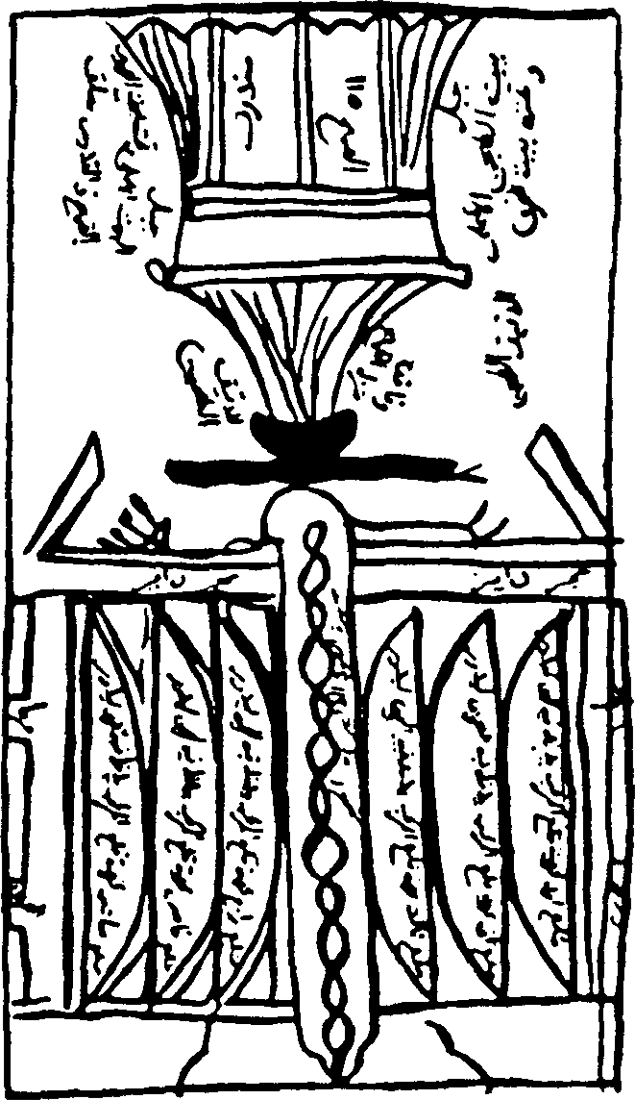
A Persian vertical-axis windmill in Sıstan
The two storied,walled structure had millstones at the top and a rotor at the bottom.
The latter consisting of a spoked reel with 6 to 12 upright ribs, each covered with cloth to form separate sails.
The sketch shows the bellying of the cloth coverings as they catch the wind and push the reel around.
Each wall had an offset opening the height of the rotor, with its perimeter beveled to decrease the free area through the thickness of the wall and hence accelerate the wind from any direction.

Slide 6
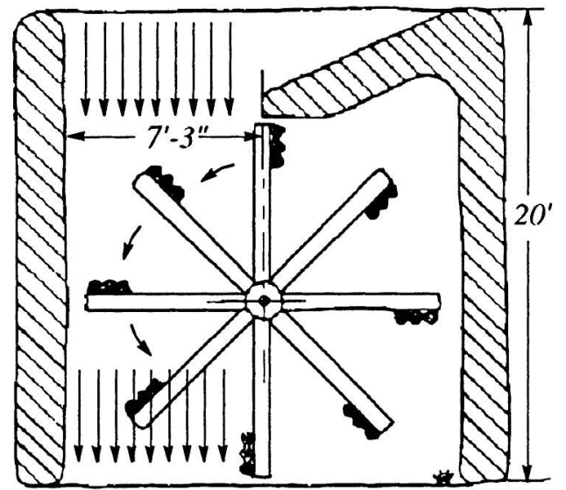
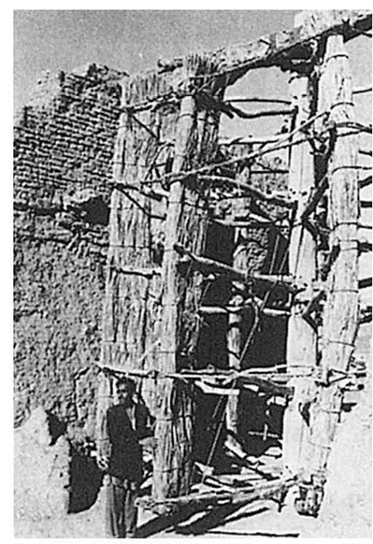
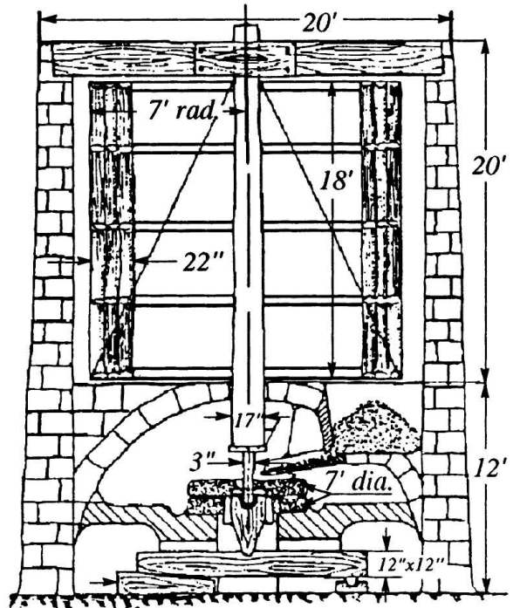
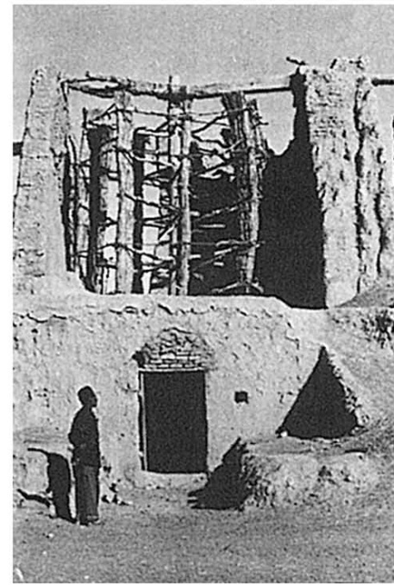
The Windmills of Neh

Slide 7
Performance of Persian Mills : 1963
In 1963, 50 mills were still operating.
Each milled an average of a ton of grain in 24 hours, so in a 120day windy season, they were said to produce a total output of 6,000 tons.
Based on a wind speed of about 30 m/s, an effective exposure at any time of 1.5 blades
The mill efficiency was of 50 percent, with a power output of about 75 hp per mill.
It is difficult to accept this high figure!!!
The basic design of these primitive vertical axis mills has lasted at least 1,000 years

Slide 8
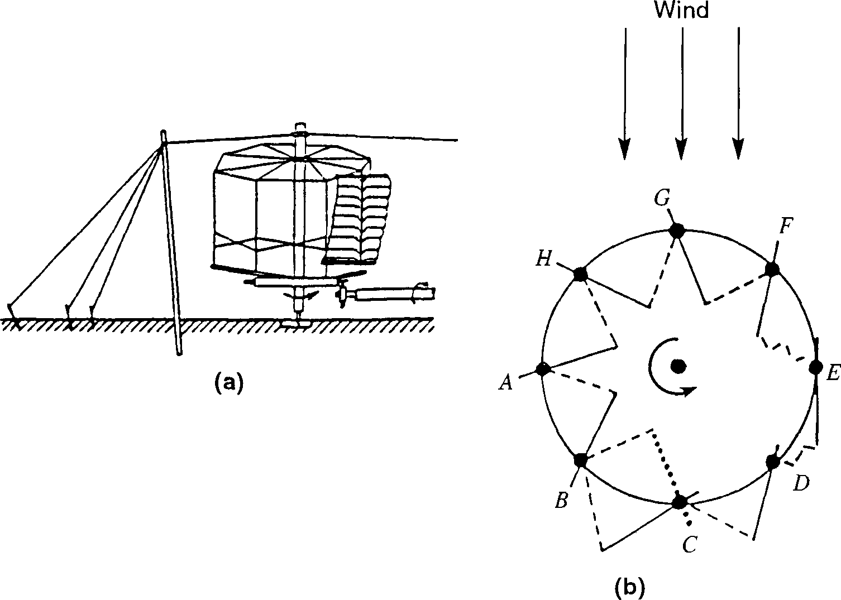
The vertical-axis Chinese windmill

Slide 9
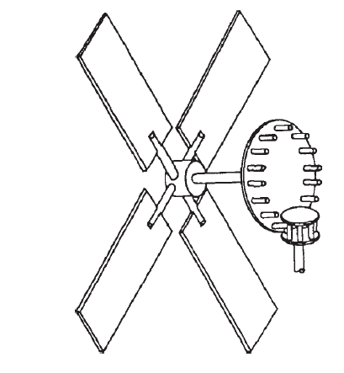
The Horizontal-Axis European Windmill
Conversion of the Roman watermill with its horizontal wheel shaft to the ordinary windmill with a horizontal shaft.
All the essentials of a windmill were ready to hand except the sails which replace the blades and rim on the water wheel.
The mechanism is is like that of an early watermill turned upside down,
The watermill drive being from below upwards and the windmill drive from above downwards.

Slide 10
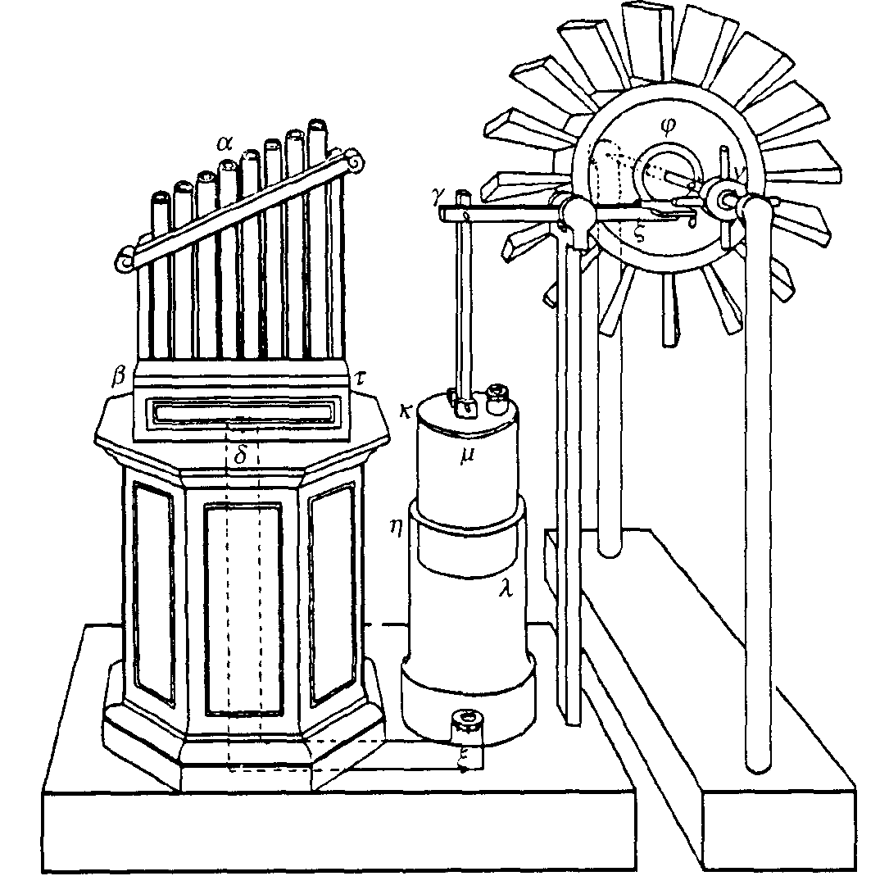
Modern Wind Turbine as A Musical Instrument

Slide 11
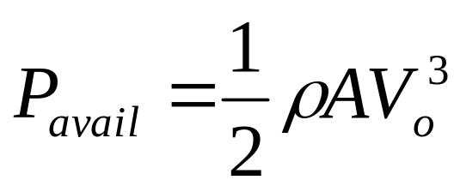
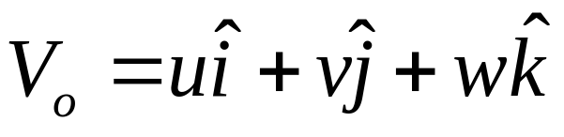
The Scientific Evaluation of Wind Potential
The power in the wind is proportional to:
  the area of windmill being swept by the wind
  the cube of the wind speed
  the air density - which varies with altitude
The formula used for calculating the power in the wind is shown below:
where, P is power in watts (W)
ρ is the air density in kilograms per cubic meter (kg/m³)
A is the swept rotor area in square meters (m²)

Slide 12
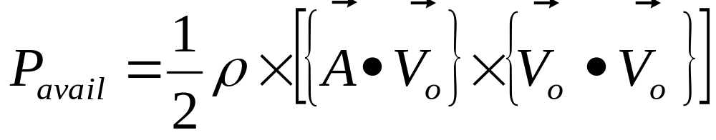
How To Facilitate Availability of Wind Potential
Velocity is a vector variable!!!
A source must be expressed in terms of Vector variables:

Slide 13
Advanced Sciences to Highlight the Superiority of Rural Sites for Wind Turbines

Slide 14
Fundamental Force Fields responsible for Wind
Pressure gradient force
Viscous force
Gravitational force
Apparent forces: Centrifugal and Coriolis
Can you think of other classical forces ?
Would they be important in the generation and control of wind?
Electromagnetic force
Total Force field is the vector sum of all of these fields.

Slide 15
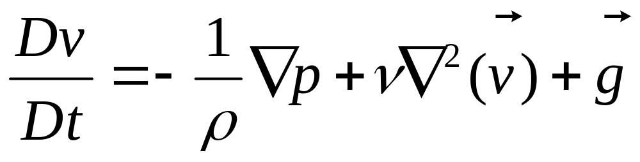

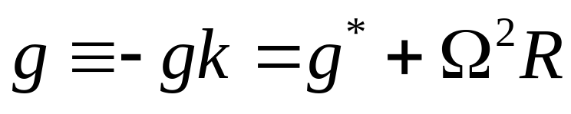
The Momentum Equation of Real Wind
+ other forces
Material
derivative of the velocity vector
Pressure
gradient
force
Viscous
force
Gravity force =
gravitational force +
centrifugal force
with g = 9.81 m s⁻²

Slide 16
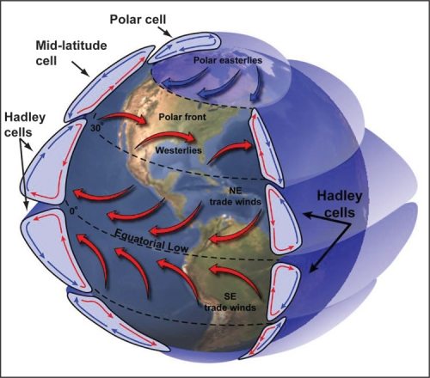
Convection Cells in Earth’s Atmosphere

