Slide 1

Design Variations of Water Wheels
P M V Subbarao
Professor
Mechanical Engineering Department
Head,CRDT
Respect & Optimize the Diversity of Traditional Systems …

Slide 2

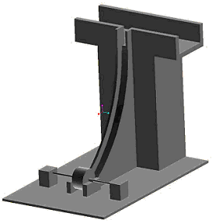

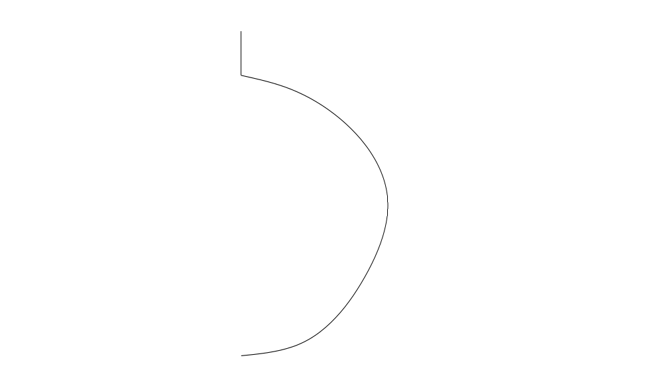
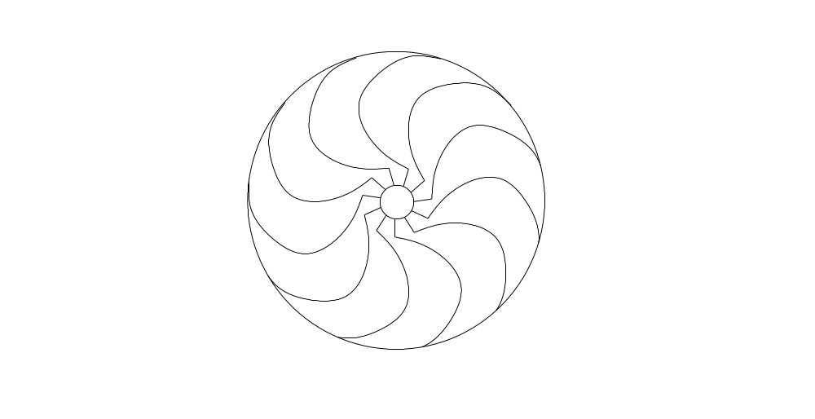
Undershot Horizontal axis turbine
B
β₂
D_{o}
T

Slide 3


Slide 4
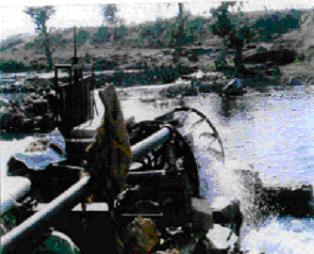
Photograph of IIT Delhi Design

Slide 5
Comparative study on development of Micro hydro water wheel
Specification
Farmer
’
s version
New Design
Bhailoni Village
(Semera Village)
Lalitpur,UP
Lalitpur,UP
Diameter in m
4
1.26
Head at site in m
1.5
1.5
Power developed
6kw
6kw
Water utilized to
1800l/s
400l/s
run
Pump discharge
22 l/s
22l/s
efficiency
40%[t] 20%[p]
72%[t] 68%[p]
No. of blades
24
14
Principle
impulse
impulse
Cost of wheel
$1800
$160
Cost of gear box
$2700
$320

Slide 6
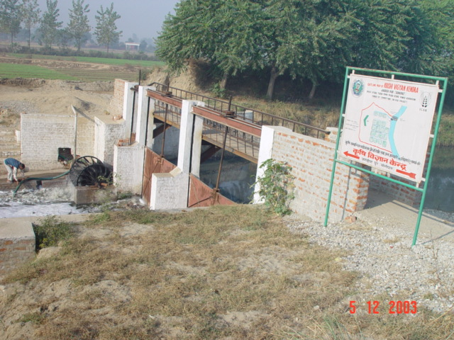
Design II : Krishi Vigyan Kendra ,Jagdishpur, Sonipat
5KW design with 3.7KW Irrigation Pump

Slide 7
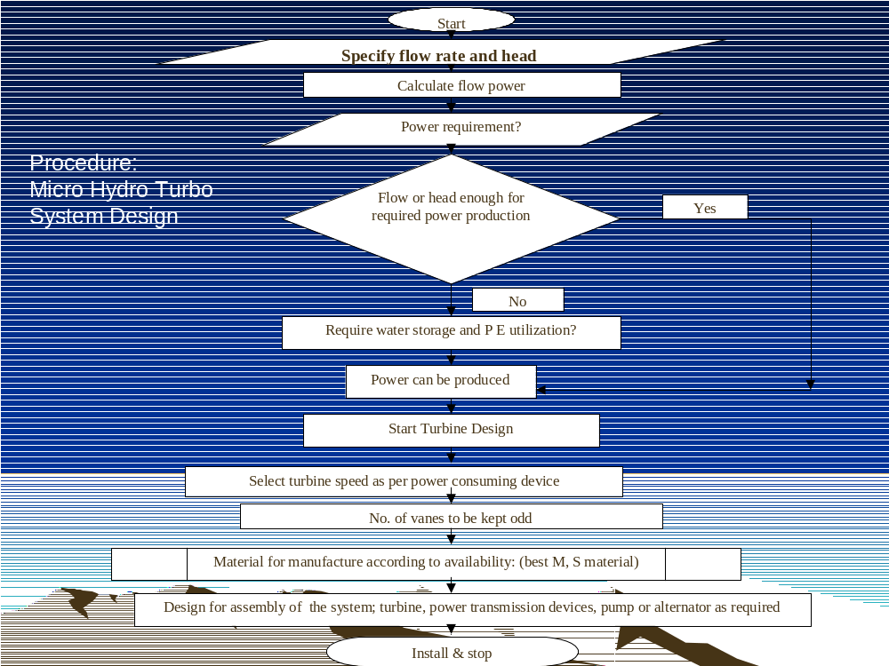

Slide 8
IIT Delhi Contributions
Design, Fabrication and Erection of 5 kW Horizontal Axis Hydro-Turbo Pump on a small river near Jhansi.
Design , Fabrication and Testing of 3.5 kW Horizontal Axis Hydro-Turbo Pump cum Generator on a Drainage Canal at Sonipat.
Design, Fabrication of 3.5 kW Vertical Axis Hydro-Turbo Atta Chakki cum Alternator at Lacchiwala, near Dehradun.
Design and Development of 5 KW Horizontal Axis Hydro-Turbo Pump cum Generator at Pokhri, Uttaranchal.
Design and Development of 5 KW Horizontal Axis Hydro Generator at Halflong, Assam.

Slide 9
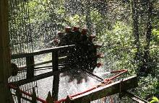
Assam, India: Micro Hydro Power Project to Benefit 38 Families

Slide 10
Peace thru Technology
Inhabitants of a remote village in the rugged, mountainous terrain of North Cachar Hills are getting uninterrupted power supply even though it is not connected by conventional power grid.
This has been made possible by the State’s first micro hydro-electricity.
The project generates 6.8 KVA power from a hilly stream called Boro Robi nullah near the hamlet.
It has a 12-foot-high water reservoir and a turbine.
“This was started as a pilot project with support from the Army, and following its successful implementation, we plan to set up more such micro hydel projects in similar terrain in the district,” HP Rajkumar, Project Director, District Rural Development Agency (DRDA), NC Hills, said, adding that a couple of sites had already been identified for the purpose.
Rajkumar said that the Army engineers designed the turbine, which cost Rs 1.25 lakh. “The Army has been very enthusiastic about the project and extended every possible cooperation to us.
We got technical expertise from the IIT-Delhi as well,” he said.
At the moment the project is illuminating 38 households of the village besides a school, a church, a temple and an auditorium. “The households have two bulbs each.

Slide 11
Traditional Vertical Axis Water Wheels
A
Source of power in Rural Uttaranchal

Slide 12
Suggested layouts for Uttaranchal Units
Gear Box
Generator
Main Shaft
Canal
Forbay
Grinding Wheel
Bush Bearing
12” Pulley
10” Pulley
Grinder adjusting lever
Penstock
Water Wheel
New Design
Wooden Base

Slide 13
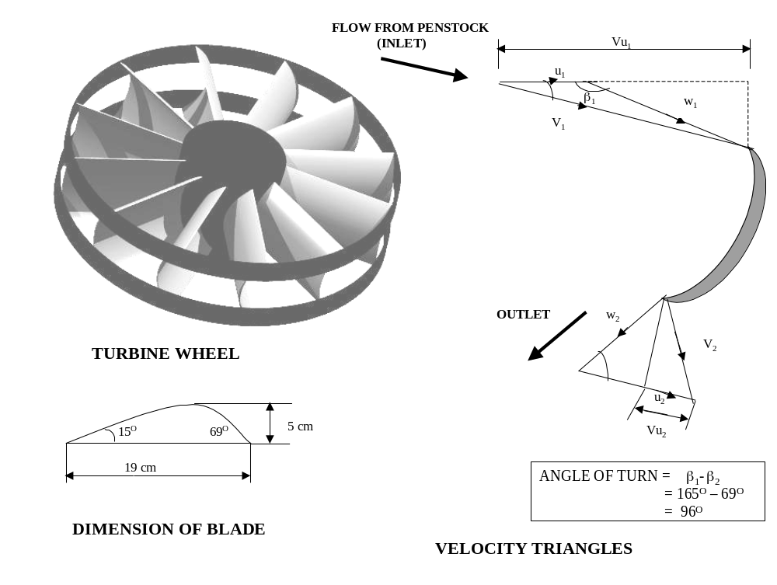
Specification of upgraded wheel for Garwhal area

Slide 14
National Workshop on
Development of Man-Power in
Ultra Micro Hydel Turbines for
Rural Energy Systems
20th March to 28th March 2004.

Slide 15
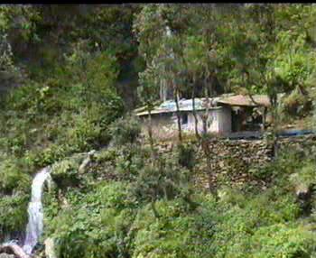

Slide 16
Enhancement of Livelihood Security through Sustainable Farming Systems and Related Farm Enterprises in North-West Himalaya
“Sustainable Rural Livelihood Security”
Objectives of IIT Delhi
Energy security: Micro-hydel systems and energy plantations will impart energy security by improving availability and reducing cost of expenditure.

Slide 17
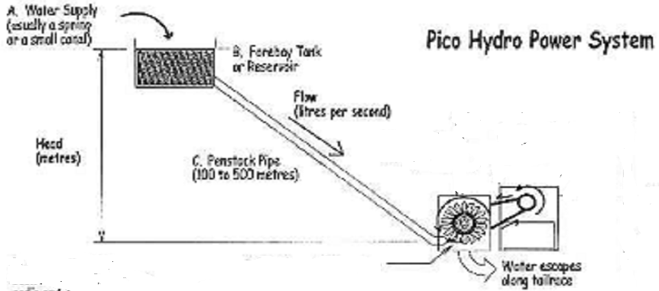
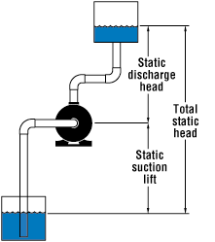
Proposed Layouts : Model -- I

Slide 18
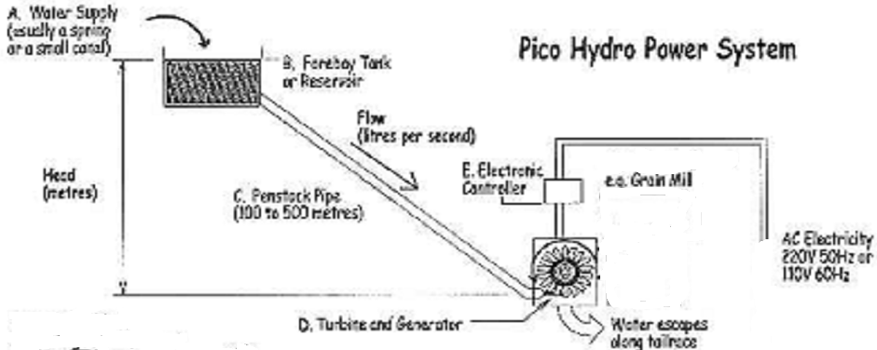
Proposed Layouts : Model -- II

Slide 19

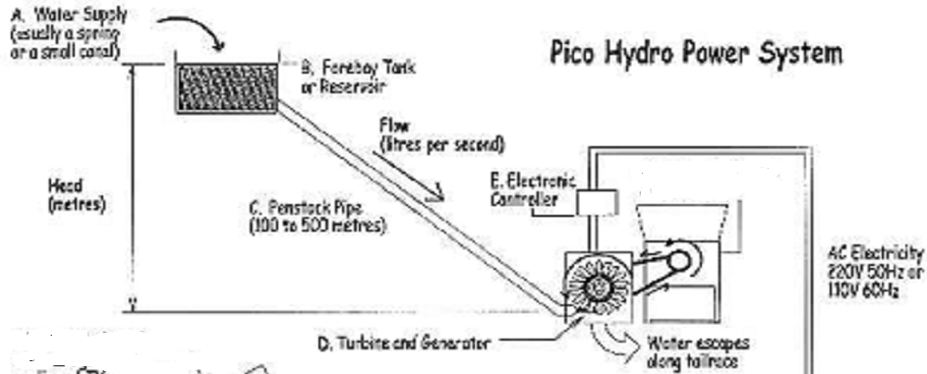
Proposed Layouts : Model -- III
Agricultural Utility

Slide 20
Salient Features of Ultra Micro Hydel Units
Capacity of wheel < 10 kW.
No standard technology or manufacturer.
Matching transmission and utility equipment.
Designed to suit Agricultural applications.
Simple design and easy to manufacture.
Easy to operate and maintain.
Persons with ITI or diploma can be trained as hydro technicians.

Slide 21
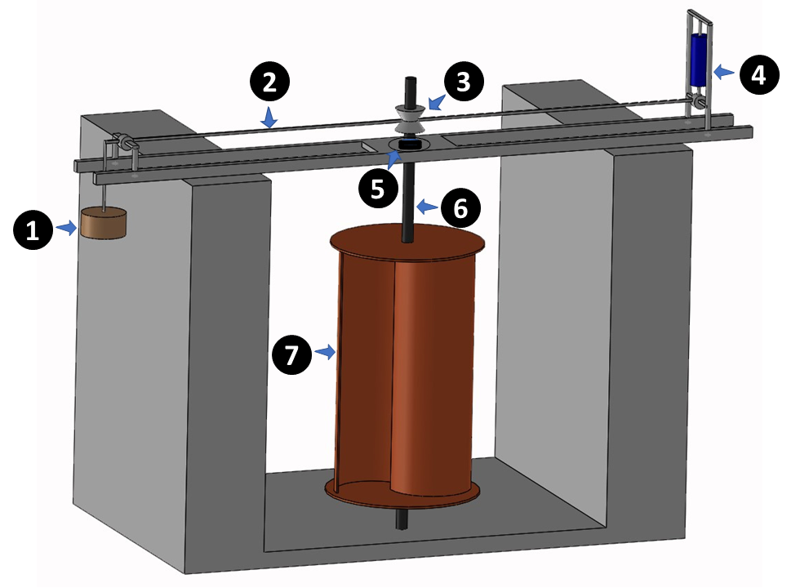
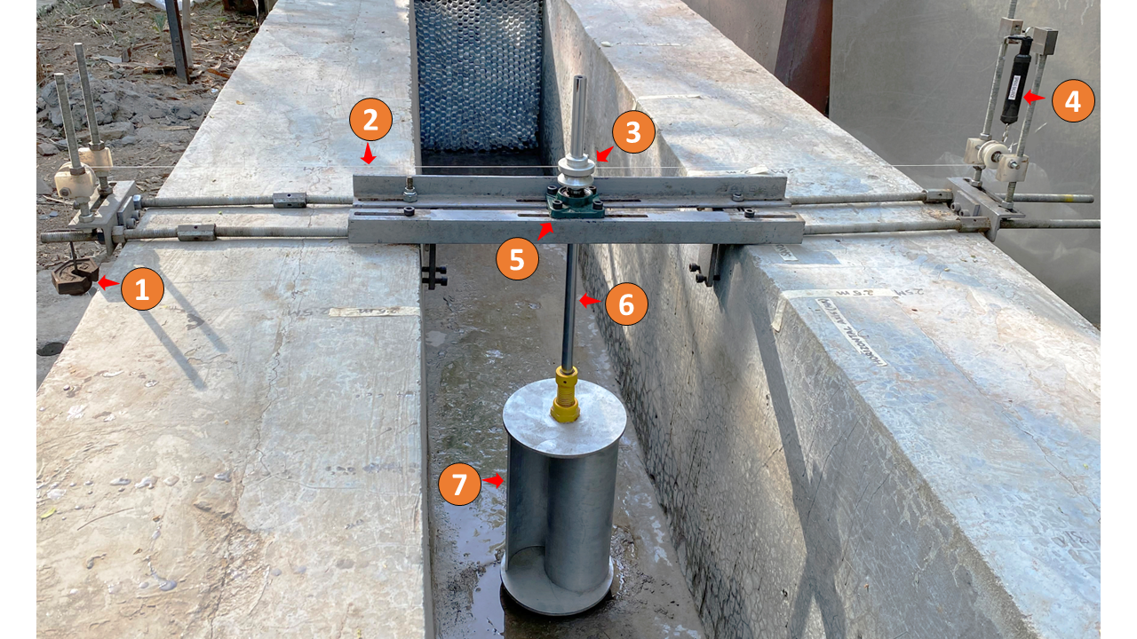
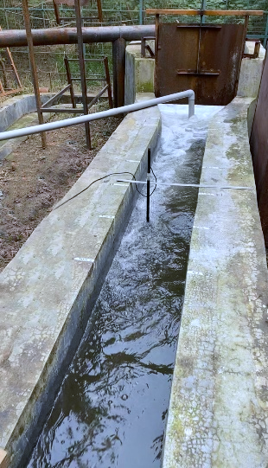
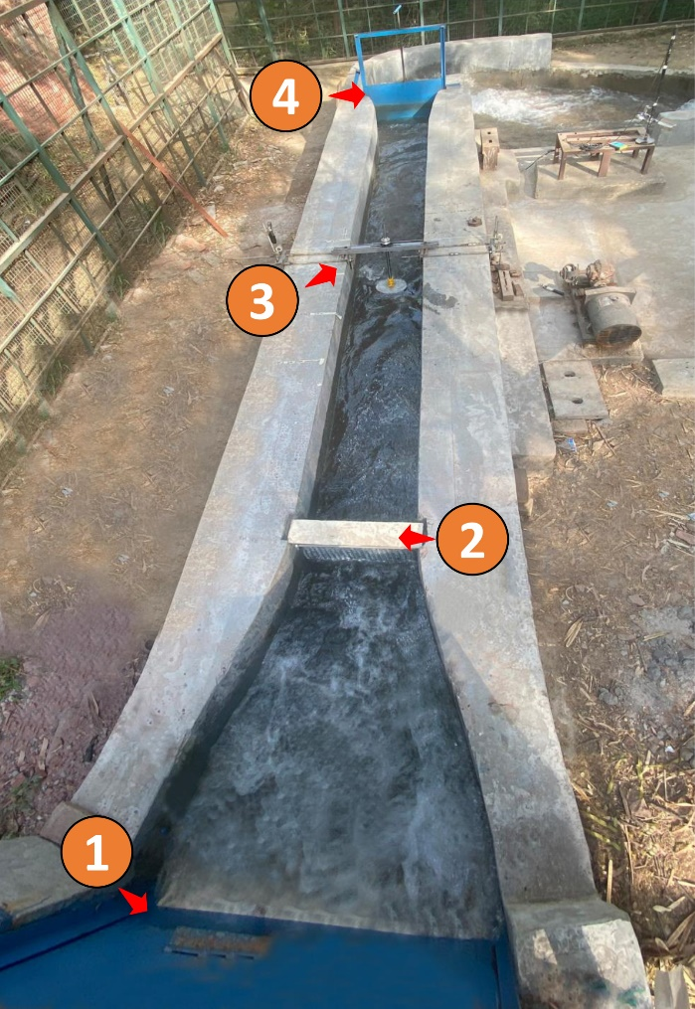
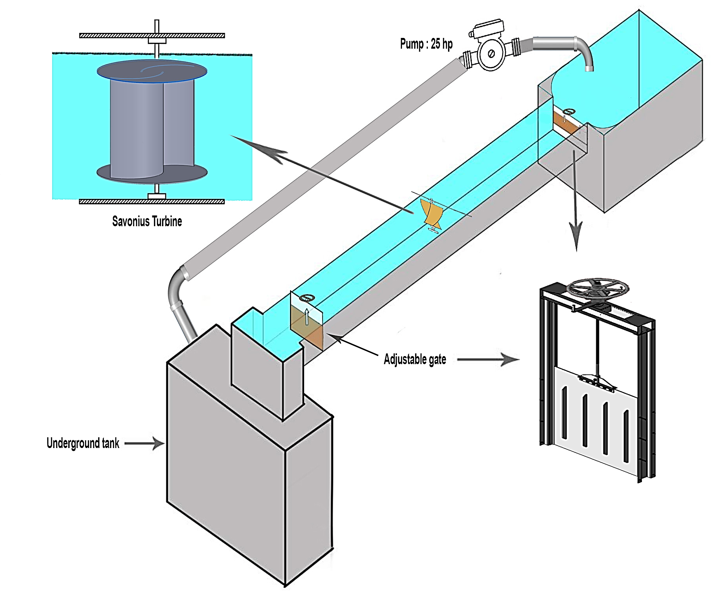
Experimental facility at IIT Delhi : Sketch
(1) Weight, (2) Nylon rope, (3) Pulley, (4) Spring balance, (5) Bearing, (6) Shaft and (7) Turbine
Experimental Method
5
(1) Inlet gate, (2) Honeycomb structure, (3) Test specimen and (4) Outlet gate (5) Cup type water current meter

Slide 22
Experimental Water Channel facility at IIT Delhi
Weight, (2) Nylon rope, (3) Pulley, (4) Spring balance,
(5) Bearing, (6) Shaft and (7) Turbine

Slide 23
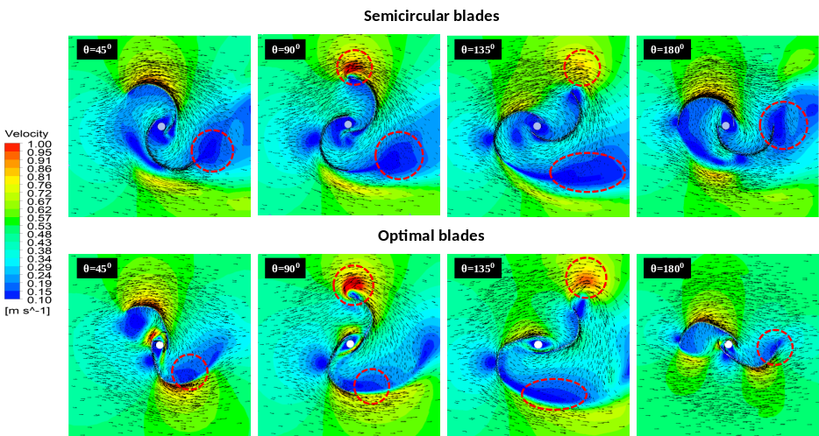
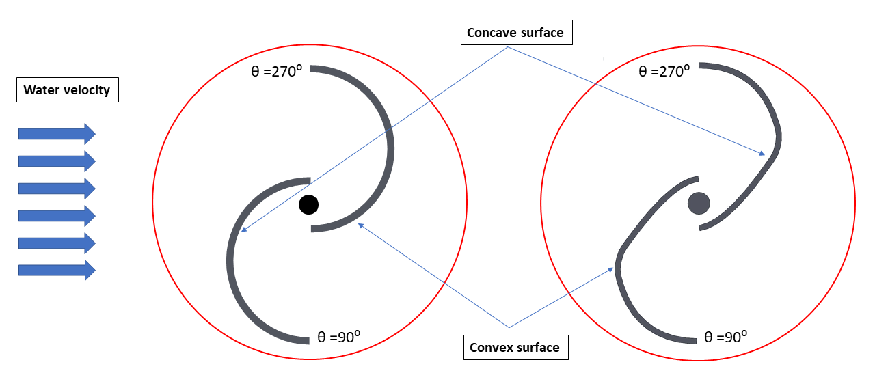
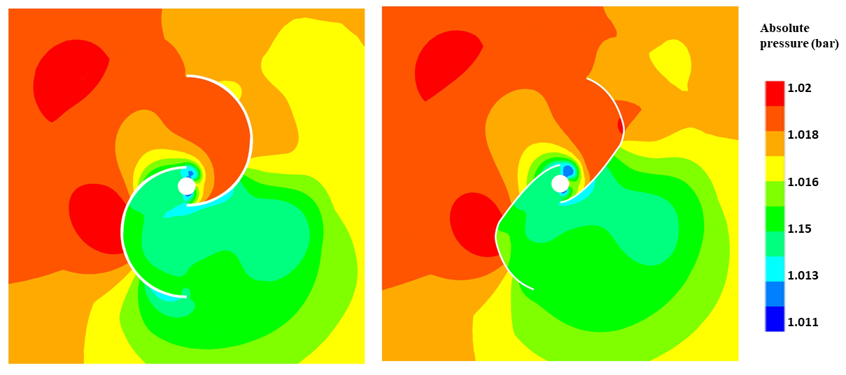
Computational modelling of Savonius hydrokinetic turbine
Semicircular blade
Novel blade profile
0
270
90
0

Slide 24
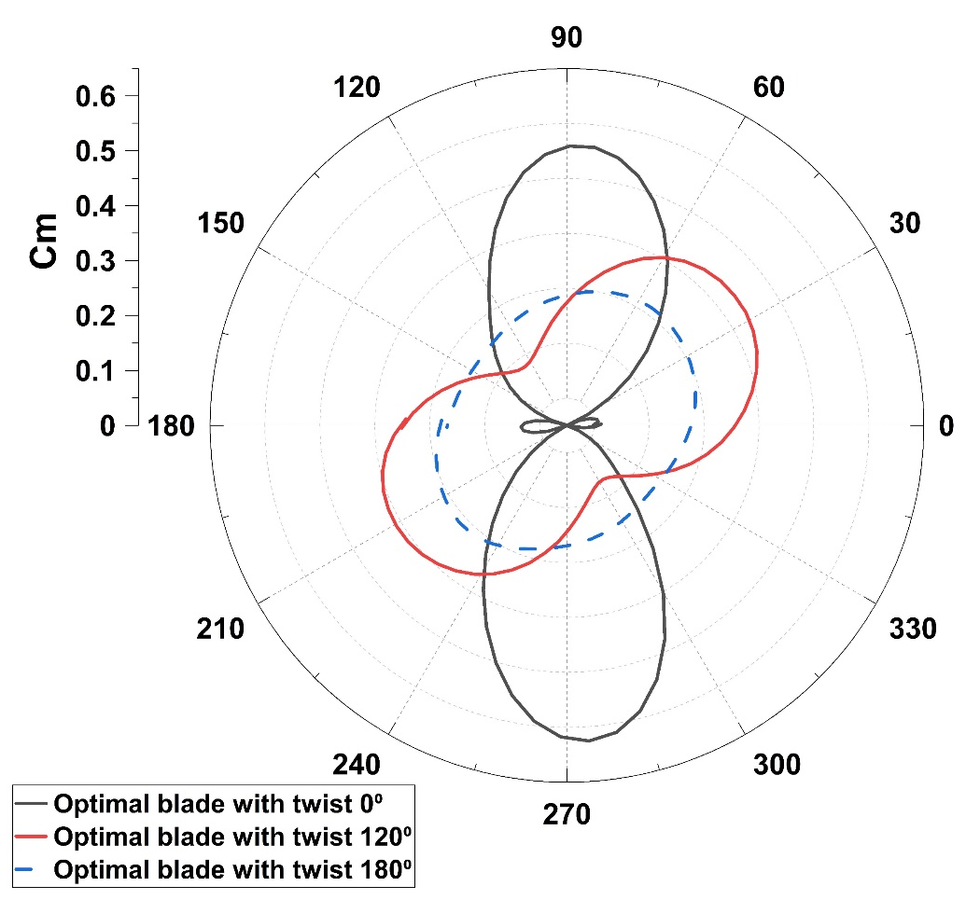
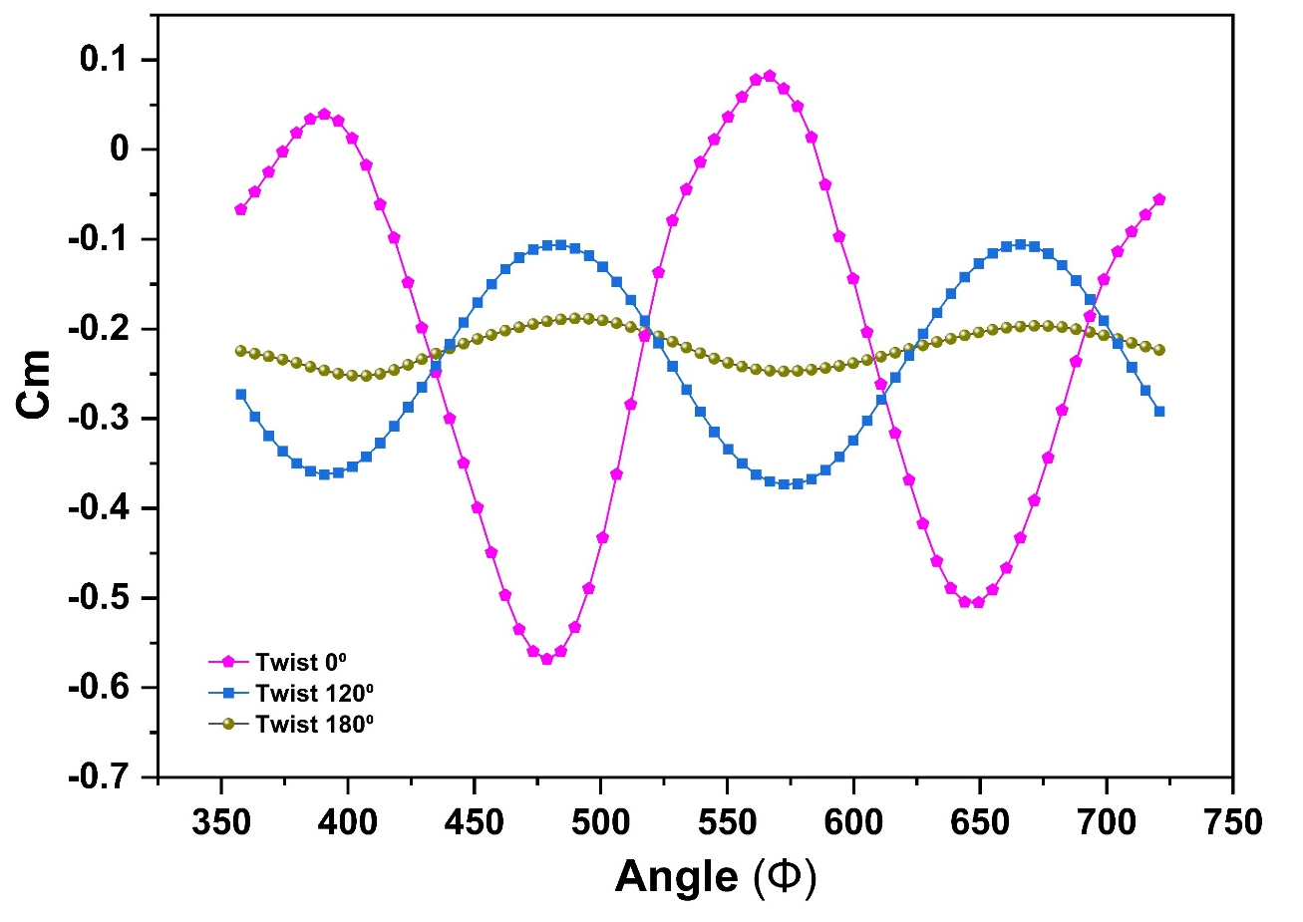
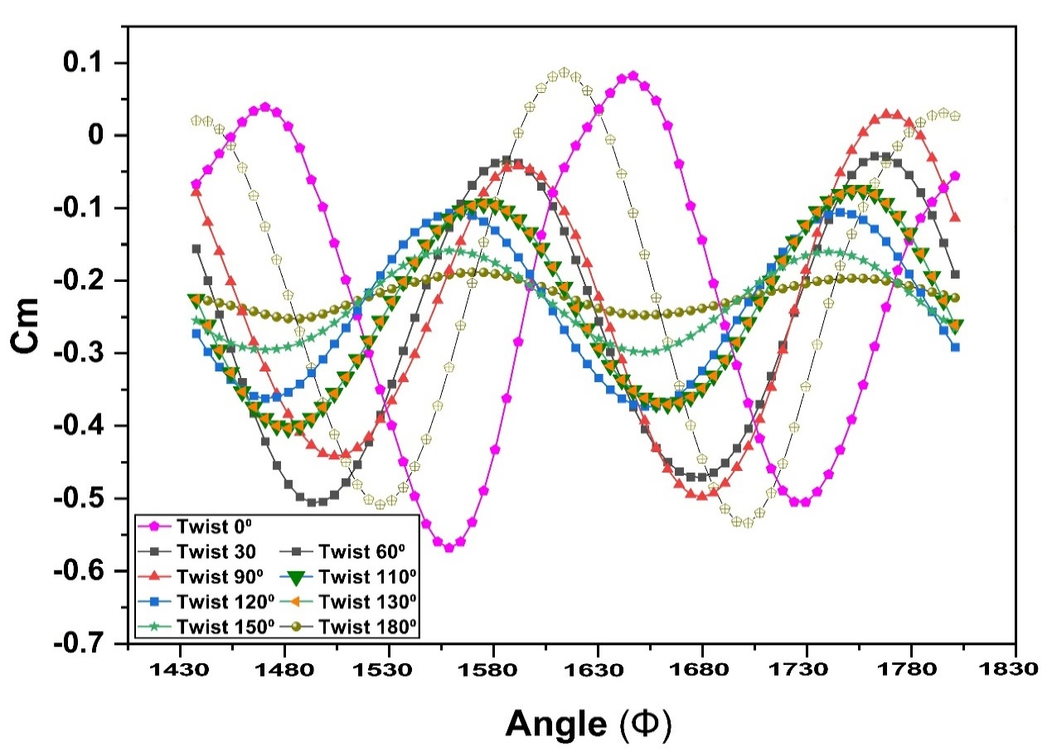
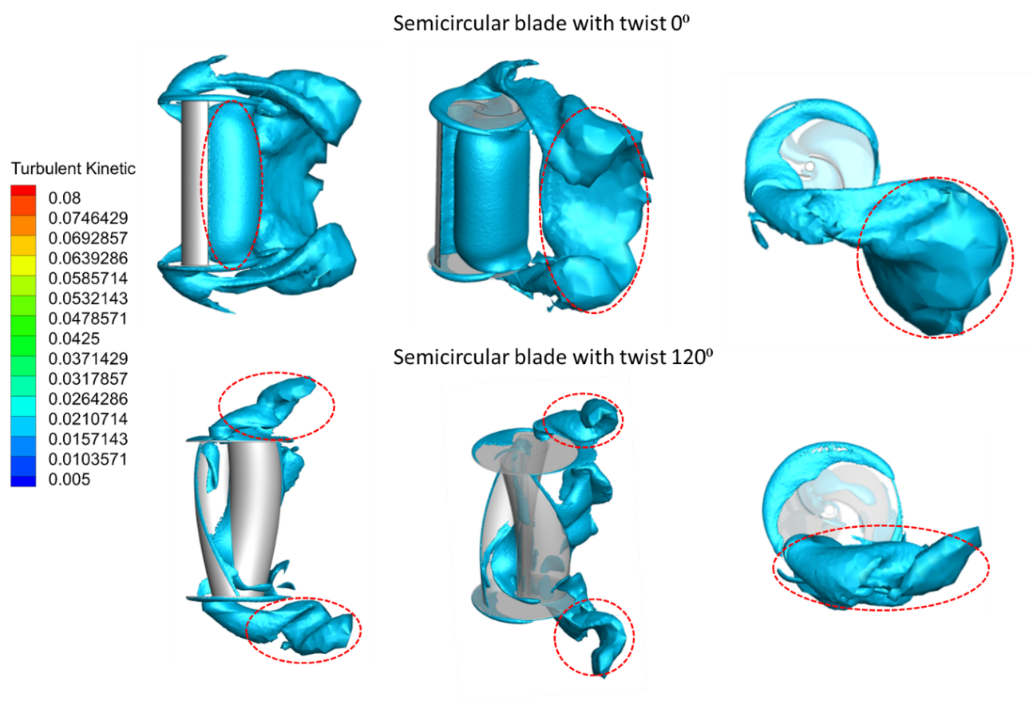
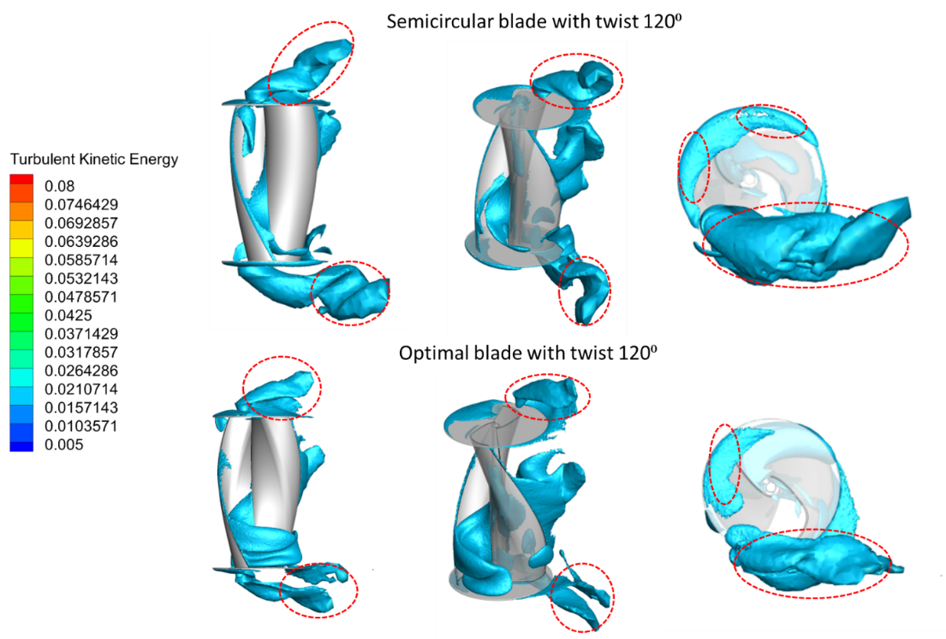
Computational modelling of twisted Savonius hydrokinetic turbine

Slide 25
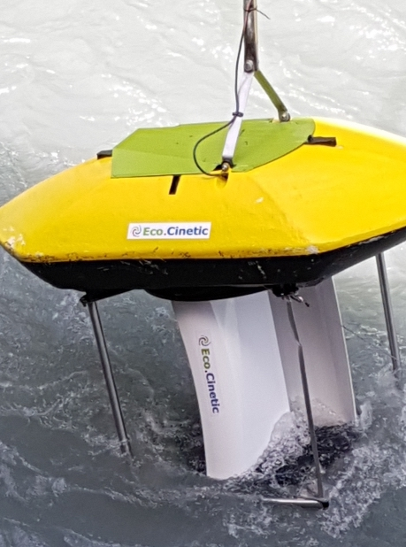
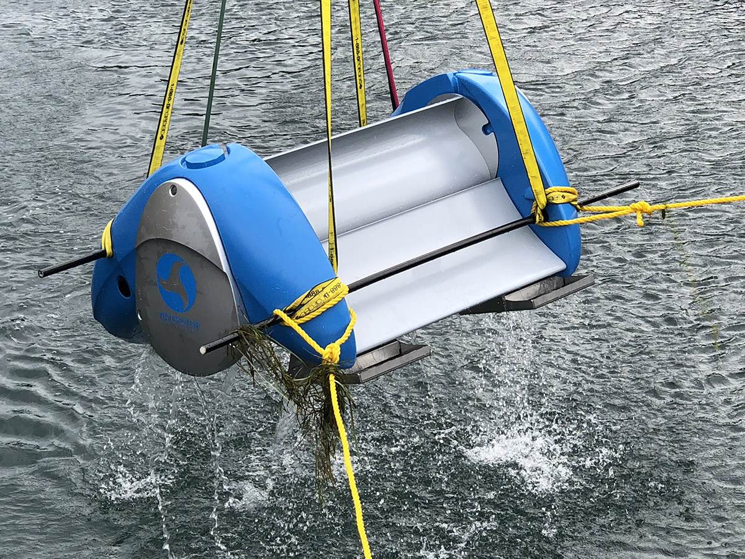
Savonius Type water turbines
This turbine works on the same principle as the Savonius wind turbine.
Installation of Eco Cinetic turbine
Installation of water rotor turbine

