Slide 1

Fluid Dynamic Design of Water Wheels
P M V Subbarao
Professor
Mechanical Engineering Department
Head,CRDT
Match the Design Appropriately to the Resource and Demand…

Slide 2

Minimum Number of Buckets
t_{j} : Time taken bye the jet to travel l_{j}
t_{b}: Time taken by first bucket to travel ψ
δ
R_{p}
ω
R_{e}
θ
ψ
d_{j}, V_{j}
l_{j}
For better working t_{j} < t_{b}

Slide 3
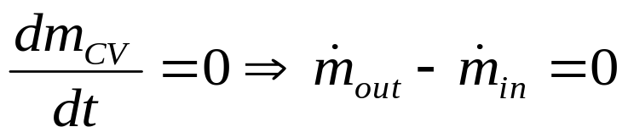
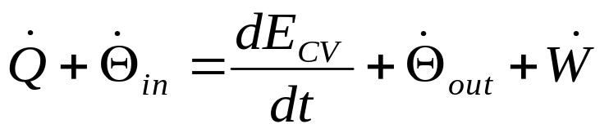
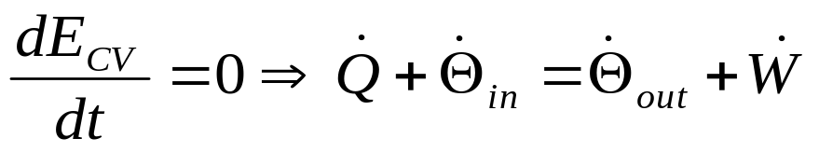
First Law for A CV: Steady State Steady Flow
Properties of CV are Invariant: not varying with time.
Conservation of mass:
NO accumulation or depletion of mass of a CV.
First Law:
NO addition or removal of energy for a CV.

Slide 4
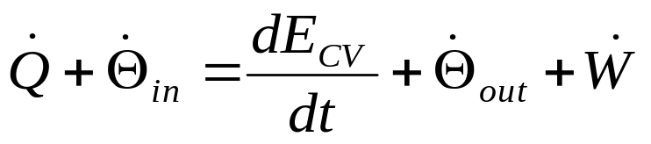
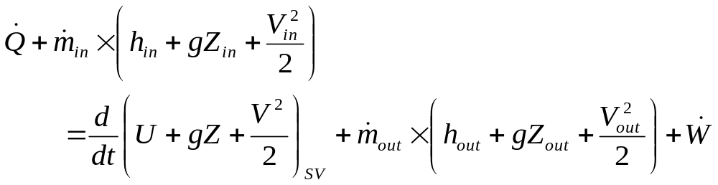
Energy of A Simple Flowing Thermodynamic System
The first law of thermodynamics for a CV:
Rate of Heat Transfer
Rate of Work Transfer
Outflow Rate of Methalpy
Inflow Rate of Methalpy
Rate of Change in Total Energy of SV of CV

Slide 5
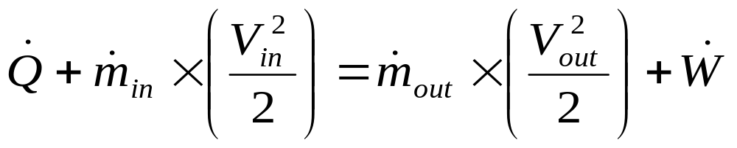
Minimum Number of Buckets
δ
R_{p}
ω
R_{e}
θ
ψ
d_{j}, V_{j}
l_{j}

Slide 6
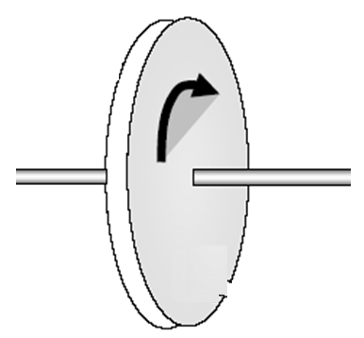
Fluid Dynamics of A Turbo-machine
A Turbo-machine
Fluid in
Fluid out

Slide 7
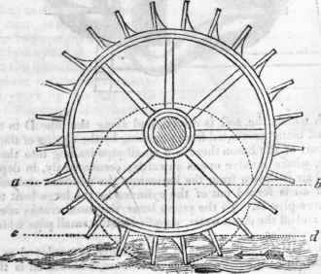
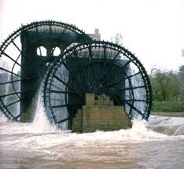
The Ancient Design : Undershot Water Wheel : 4000BC

Slide 8
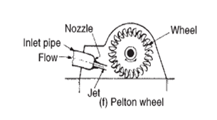
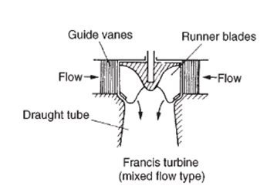
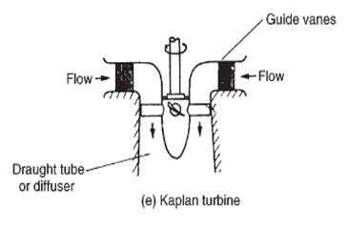
Various Types of Modern Turbomachine

Slide 9
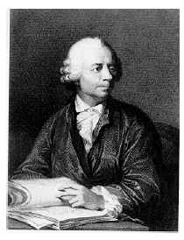
Leonhard Euler
Leonhard Euler (1707-1783) was arguably the greatest mathematician of the eighteenth century.
One of the most prolific writer of all time; his publication list of 886 papers and books fill about 90 volumes.
Remarkably, much of this output dates from the last two decades of his life, when he was totally blind.
Euler's prolific output caused a tremendous problem of backlog: the St. Petersburg Academy continued publishing his work posthumously for more than 30 years.

Slide 10
Theoretical and Rigorous Work of French
Bernoulli and Leonhard Euler.
1750:Euler offered a memoir containing analysis and equations for hydraulic turbines.
1754: An idealized theoretical application of Newton’s Law to centrifugal impellers.
Known as Euler Equation.
Did much to help the development of hydraulic machinery.
1767: Relation between Torque and Change in moment of momentum of the fluid as it passed through the machine.

Slide 11
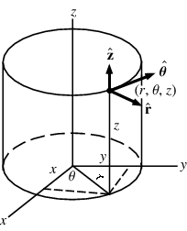
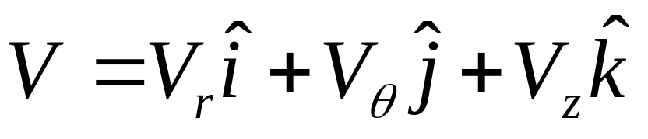
The Superiority of Vector Parameters

Slide 12
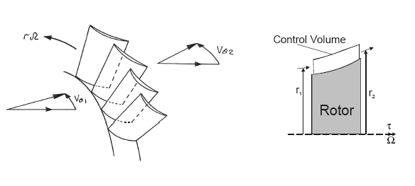
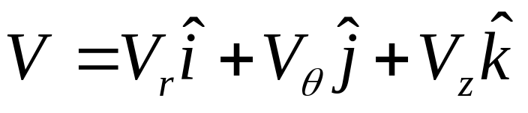
Euler’s Work Equation
Euler Theory:
Torque exerted by flow on blade row = shaft output torque = Rate of change of Angular momentum of fluid = τ

Slide 13
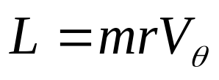
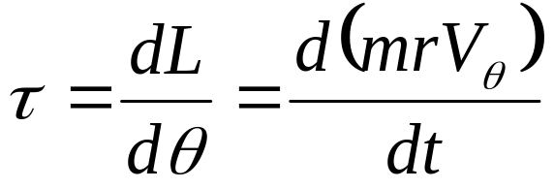
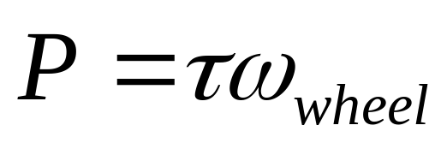
Mathematical Model for Euler Theory
Angular momentum is moment of linear momentum of angular velocity, V_{θ}
Define, L as Angular momentum
Amount of torque developed is:
Mechanical Power donated by the riverine bounty to the wheel:

Slide 14
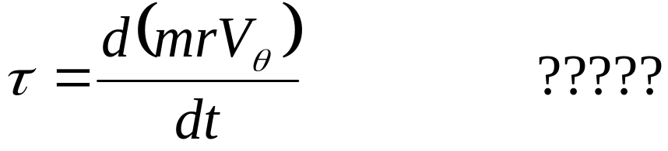
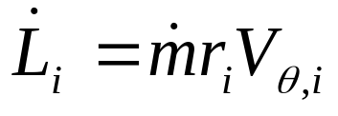
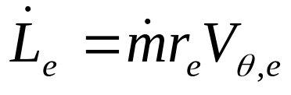
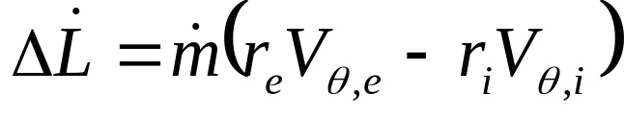
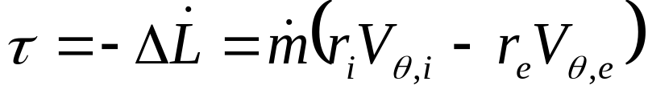
Pragmatic Modification of Euler Theory
For a steady flow through a turbo-machine:
Inlet rate of angular momentum :
Exit rate of angular momentum :
Change in Rate of angular momentum:
Reaction to Change in Rate of angular momentum ia torque generated by the wheel

Slide 15
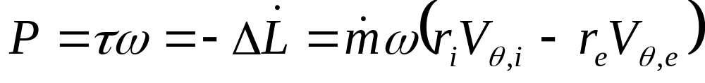
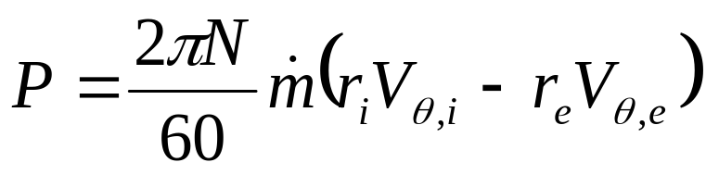
Power Generated by a Constant Speed Wheel
Shaft Power :
A change in Whirl/Angular Velocity of fluid can only establish Power Exchange between fluid and rotor in a turbo-machine !

Slide 16

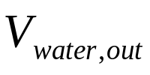
Kinematics of the Ancient Design : Undershot Water Wheel

Slide 17
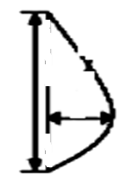
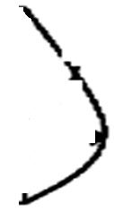
Design of Blade Geometry
Blade Cross Section
Kinematics of Blade & Jet
Outlet Jet
Inlet jet

Slide 18
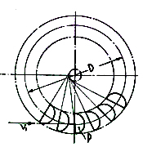
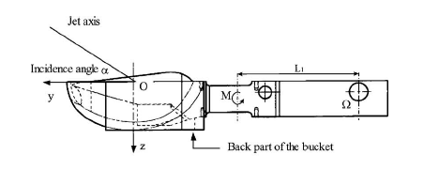
Transient Kinetics of the Blade-Jet Interactions
V_{jet}

Slide 19
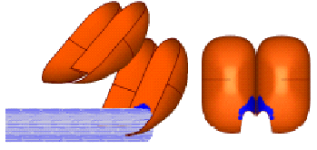
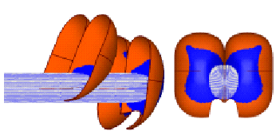
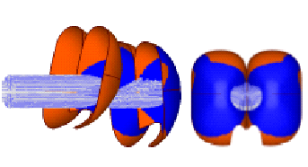
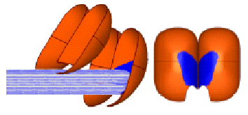
Sequence of Jet Bucket Interactions
Δθ=5⁰
Δθ=25⁰
V_{jet}
V_{jet}
U_{blade}
U_{blade}
Δθ=35⁰
Δθ=15⁰
V_{jet}
U_{blade}

Slide 20
Profile of Blade

Slide 21

Design of Blade Profile : Computational Fluid Dynamics Simulations
W : width of blade
d : depth of blade
h : Height of Channel

Slide 22
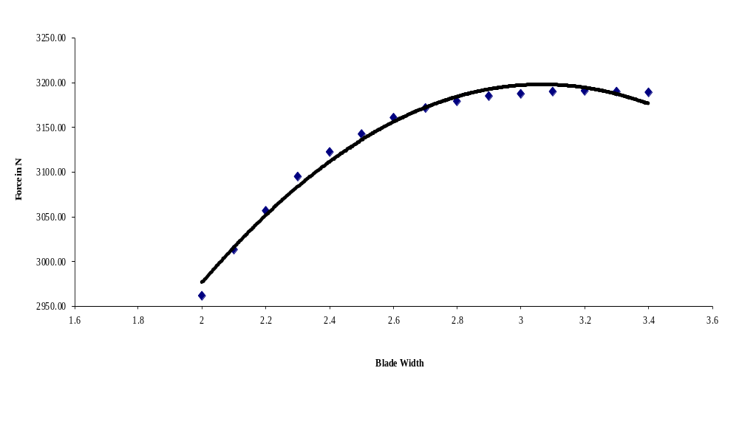
Selection of Blade Width

Slide 23
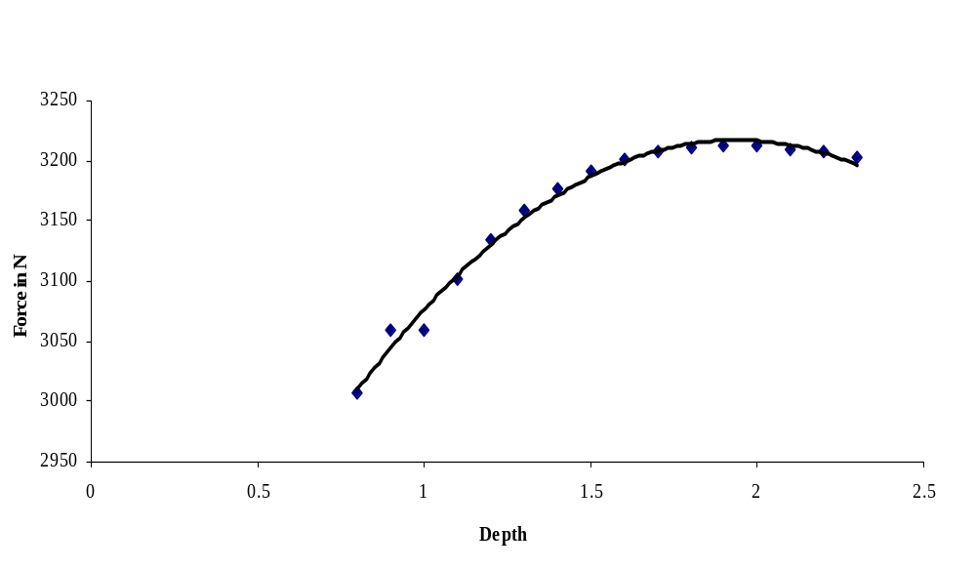
Selection of Blade Width

Slide 24
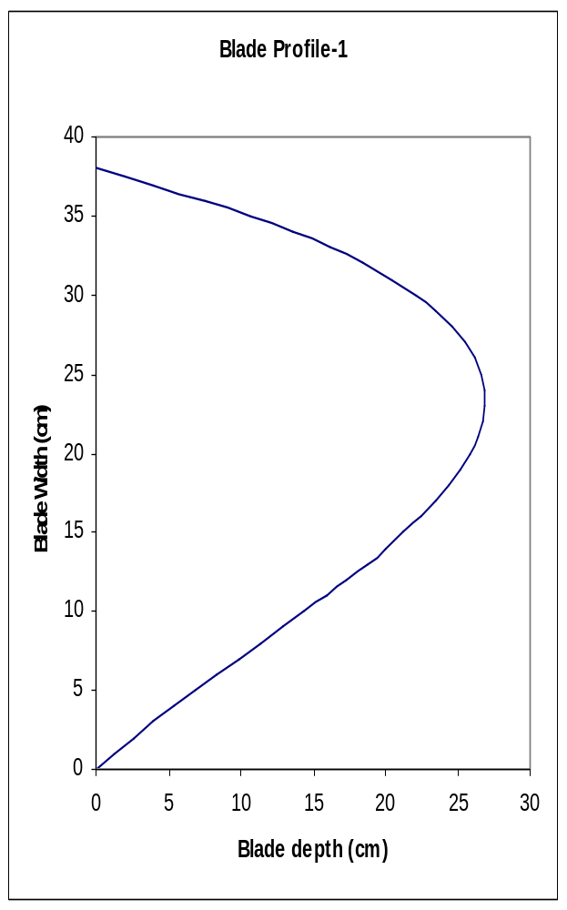
Optimal Blade Shape Created by Computational Flow Analysis

Slide 25
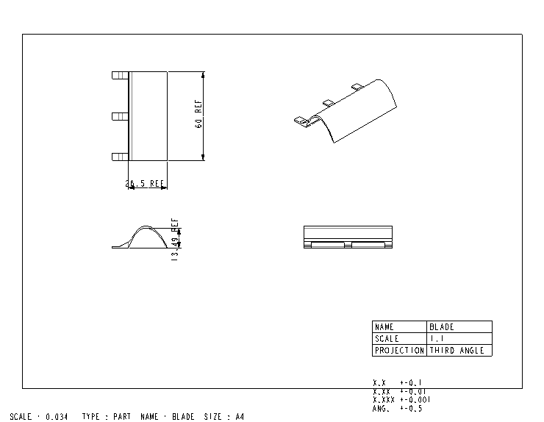
CAD Model of 3D Blade

Slide 26
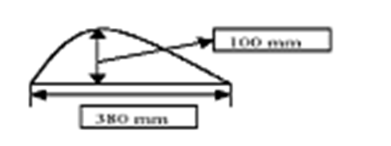
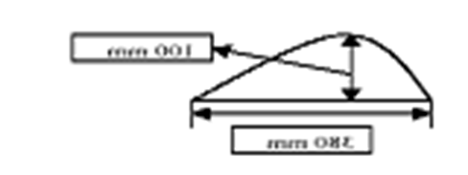
Construction of Wheel
Blade Cross Section

Slide 27
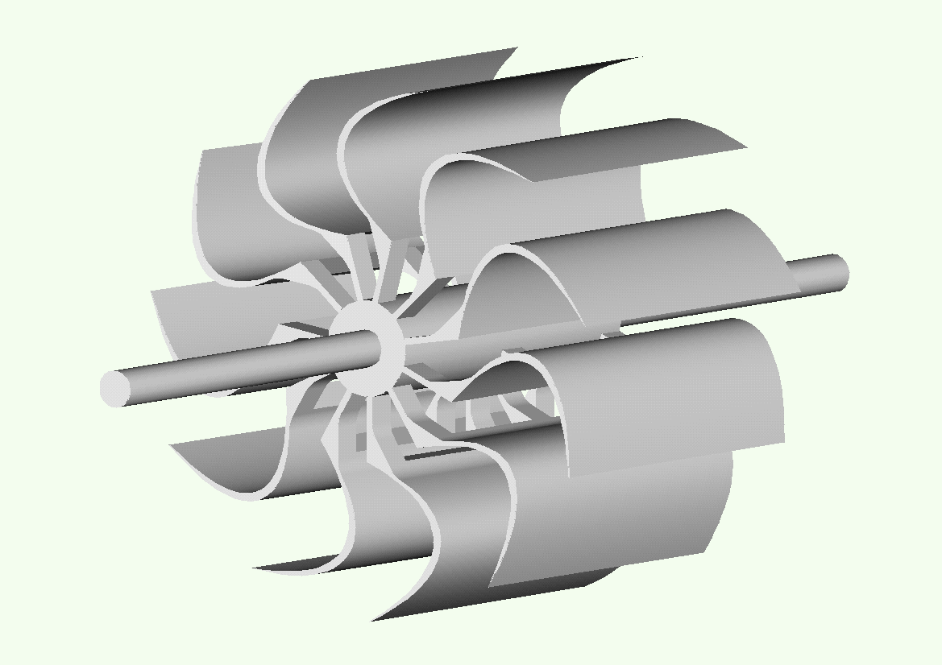
Assembled Wheel

Slide 28
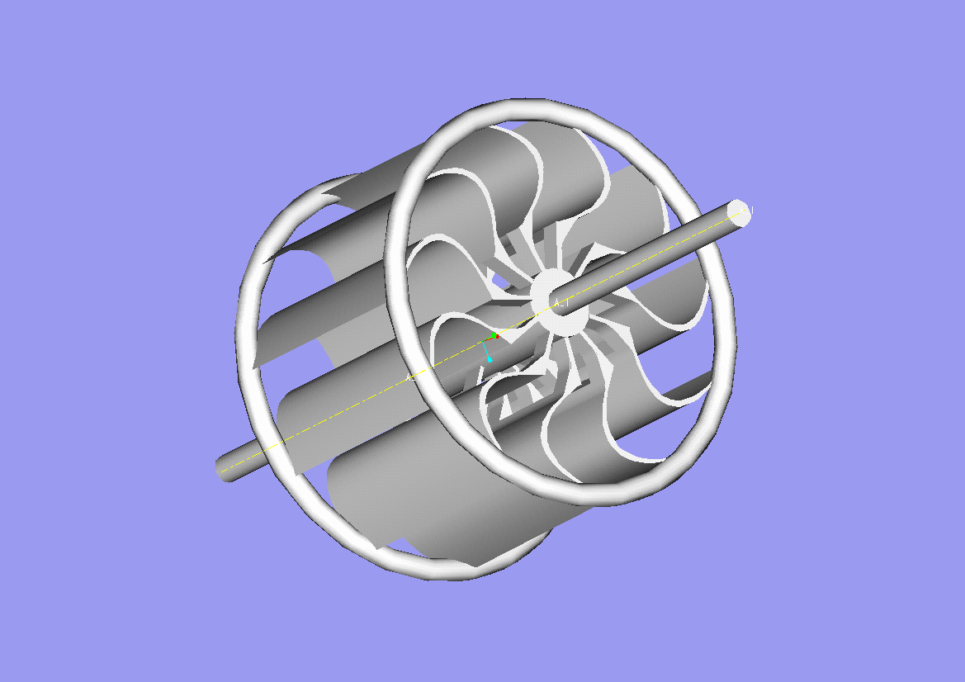
Assembled Wheel

Slide 29
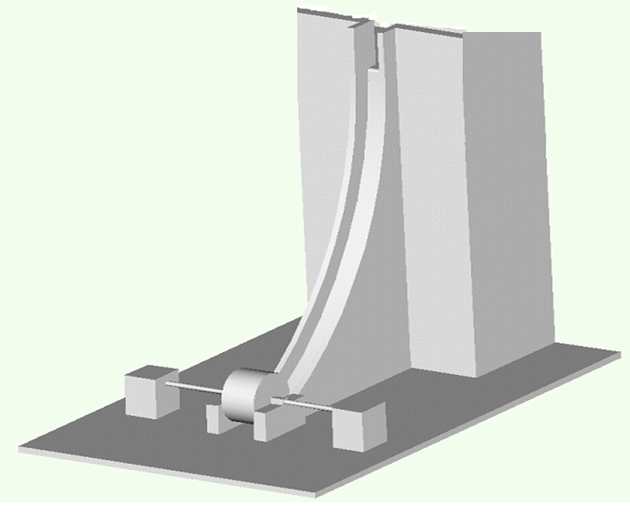
Turbine System Layout & Civil Construction Layout

Slide 30
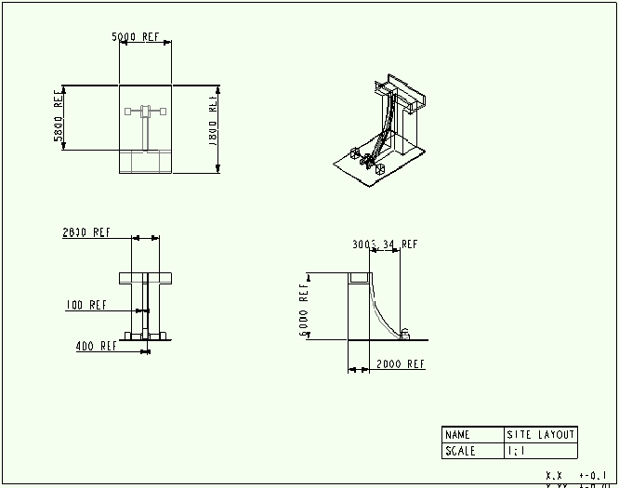
Design of Check Dam and Spillway

Slide 31
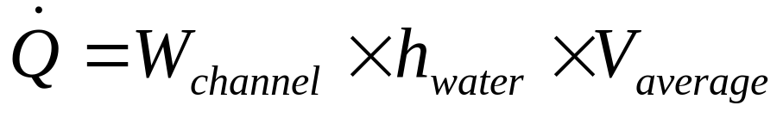
Channel for flow of water
h_{channel}
h_{water}
W_{channel}
Flow rate of water:

Slide 32
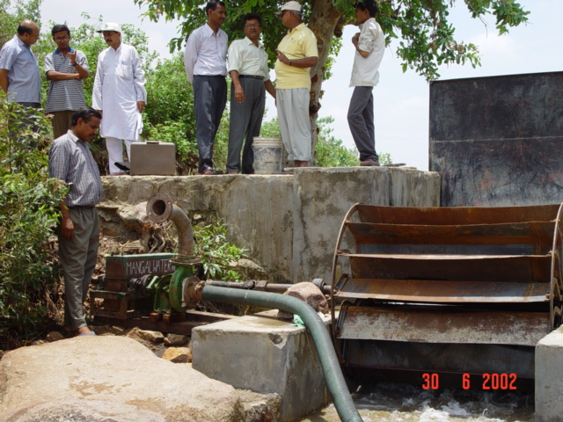
Fabricated IIT Delhi Design

Slide 33
