Slide 1

Design and Development of Water Wheels for Rural Energy Needs
P M V Subbarao
Professor
Mechanical Engineering Department
Head,CRDT
Harvesting Energy Fruits out of Riverine Bounty …

Slide 2

Classification Hydro Power Plants : Capacity
Large- hydro More than 100 MW and usually feeding into a large electricity grid
Medium-hydro 15 - 100 MW - usually feeding a grid
Small-hydro 1 - 15 MW - usually feeding into a grid
Mini-hydro Above 100 kW, but below 1 MW; either stand alone schemes or more often feeding into the grid Micro-hydro
From 5kW up to 100 kW; usually provided power for a small community or rural industry in remote areas away from the grid.
Pico-hydro From a few hundred watts up to 5kW

Slide 3
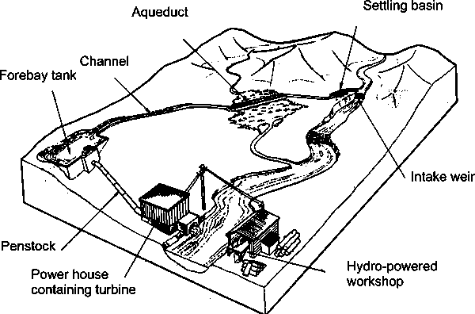
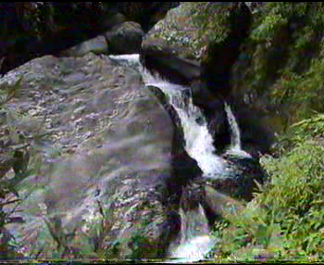
Layout of a Typical Micro/Pico Hydro Scheme
A Rural Set-up

Slide 4

Samantara akSha-rekhA Jhal Chakra

Slide 5
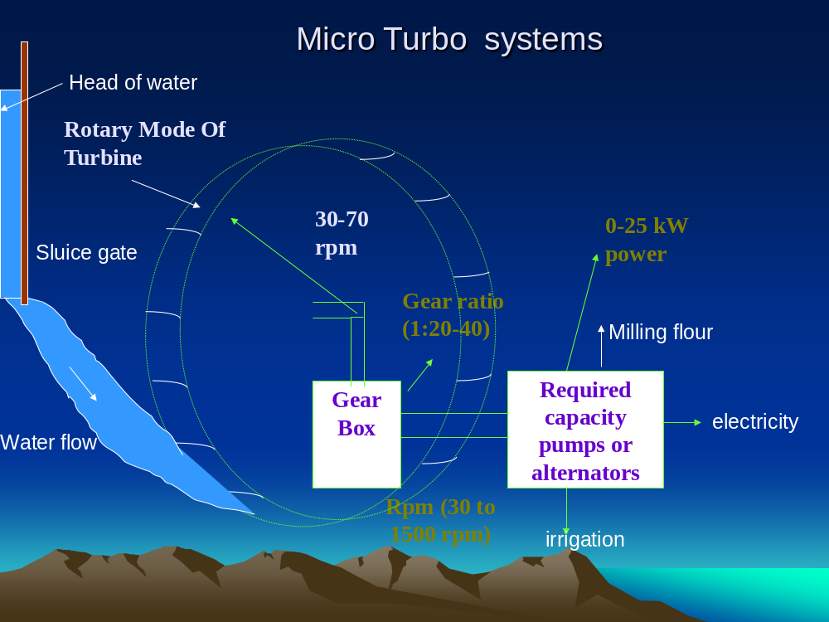

Slide 6
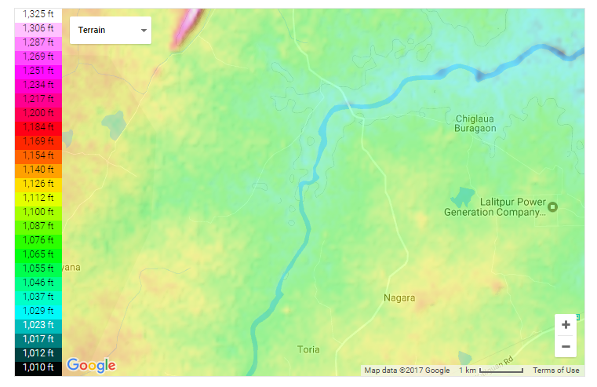
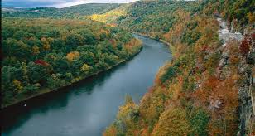
My First Exposure to Rural Needs: Native Energy System
Shri Mangal Singh
Water Wheel on River Sajnam, Bhailoni Lod Village
Lalitpur Dist.

Slide 7
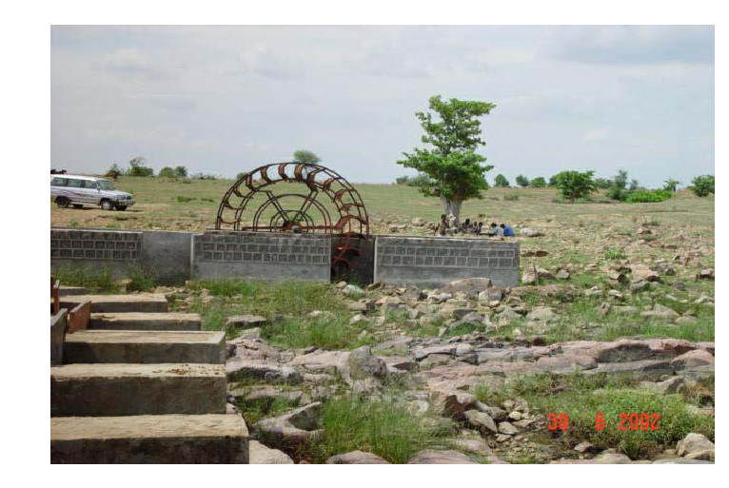
Photograph of Mangal Turbine

Slide 8
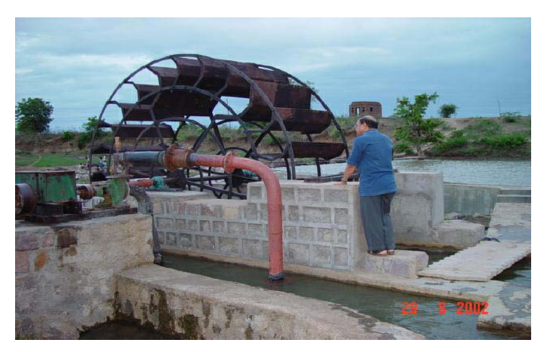
Photograph of Mangal Turbine

Slide 9
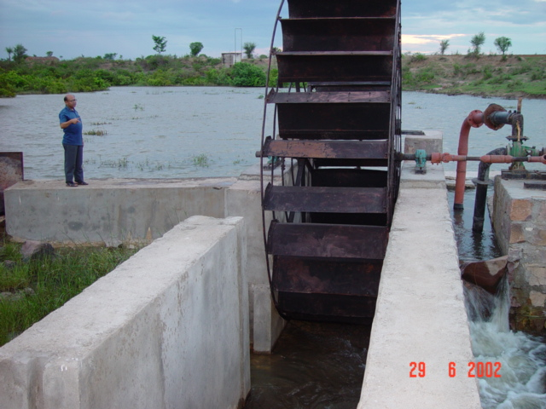
Photograph of Mangal Turbine

Slide 10
Analysis of the Local Design
Diameter of the wheel : 4m.
Speed of the wheel: 13 RPM.
24 blades !
Huge Diameter !
Very Low Speed!
Weighing more than a ton!
Huge material cost!
The speed of A common pump or Generator is 1500 RPM.
A gear box is required to Increase the speed 120 times!
Very costly gear box.
Basic Limitation is Poor Blade Design

Slide 11
Explanation by Shri Mangal Singh
We tried small wheels: They could not develop enough torque at all.
Large diameter produced enough torque to drive the pump.
Large diameter : Large Perimeter: More number of blades.
Result :Heavy and costly wheel !!!
Large diameter : Low RPM for same flow velocity.
Heavy and costly gear box.

Slide 12
My Harsh Reaction
It is very non-scientific work.
Unreasonable design and cost.
One can decrease cost to one fourth, with little science and engineering.
!!!!!!!!
A Sponsored Project : 3.6 lakhs & One and Half years.
IIT Delhi design should be fabricated by same person and should be installed at same site.

Slide 13
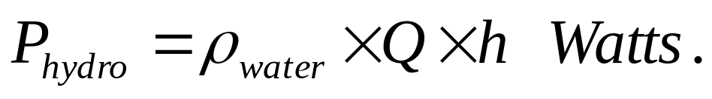
Site Analysis
Measure head and flow rate : h (in meters) & Q (in Cumecs).
Determine Hydropower.
Mechanical Power, P_{mechanical}
Decide various design factors of turbine For maximum efficiency.
Efficiency Achieved : 60 – 70%.
Select a suitable pump.
Design a suitable gearbox & Transmission system.

Slide 14


Slide 15
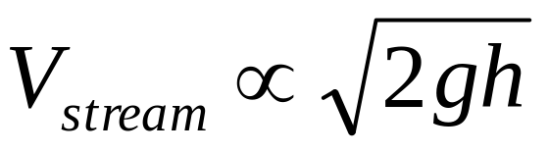
Analysis of the Problem
Water is falling form a height H, called Head.
The velocity of the stream when reaches down most point is:
Newton’s Second Law applied for present problem:
Any Obstacle, which changes the direction of the steam (of given mass flow rate) will experience a force.
If the agent is fixed to a shaft, it can generate a torque.
The product of torque and speed of the agent is Power.

Slide 16
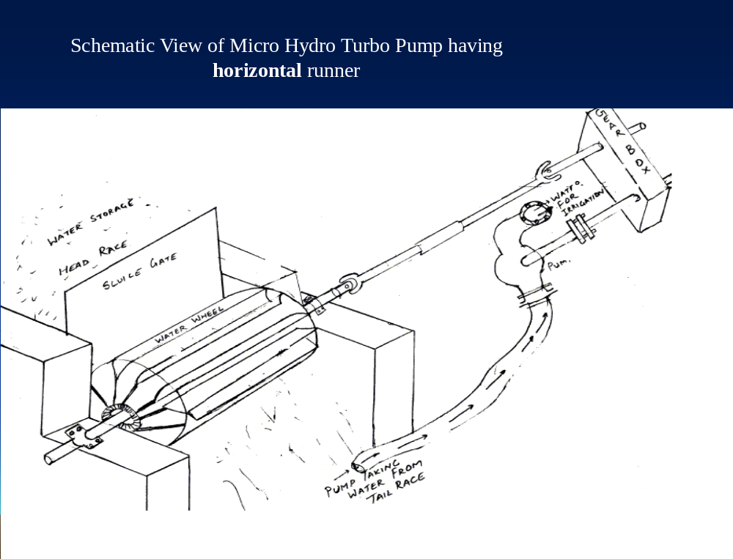
Feasibility Constraint:
The peripheral Velocity of the wheel should be lower than the velocity of the water

Slide 17
Scientific Model of The Turbine
δ
R_{p}
ω
R_{e}
2ϕ
1D
d_{j}, V_{j}
1A
1C
1B

Slide 18
Minimum Number of Buckets
t_{j} : Time taken bye the jet to travel l_{j}
t_{b}: Time taken by first bucket to travel
δ
R_{p}
ω
R_{e}
θ
ψ
d_{j}, V_{j}
l_{j}
For better working t_{j} < t_{b}

