Slide 1

21st Century Sustainable Rural Biogas Generation Systems
P M V Subbarao
Professor
Mechanical Engineering Department
Head, CRDT
Bi0logical Harvesting as an alternate Rural Industry to Mining & Chemical Refining….

Slide 2

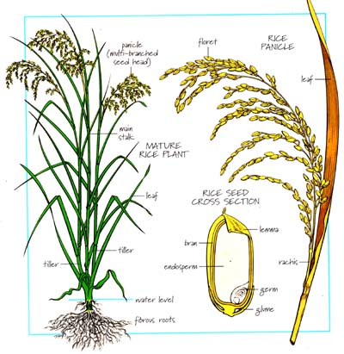
Bioenergy As a Main Rural Energy Resource
Agriculture is the Most Sustainable Invention….
An Inclusive Harvesting of Carbon Energy Reservoirs….

Slide 3
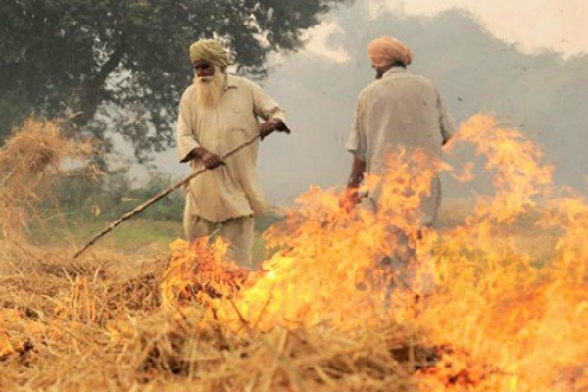
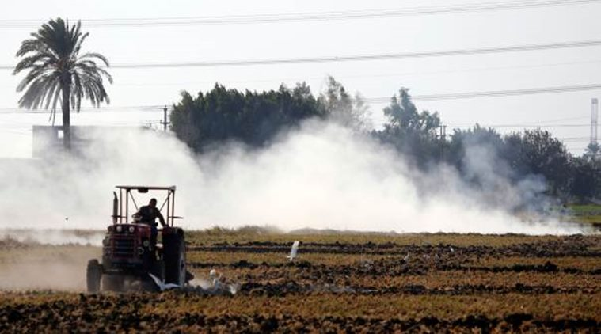
Agricultural residues
Respect Waste product as By-product.
Amount of crop residues amounted to about 3.5 to 4 billion tones annually.
An energy content representing 65 EJ, or 1.5 billion tones oil equivalent.
Over 2 billion tones of agricultural residues were burned annually world-wide, producing 1.1 to 1.7 billion tones/yr of CO₂.
The most promising residues from the sugar cane, pulp and paper, and sawmill rural industrial sectors are energy sources.
Estimates are that about 1200 TWh/yr of electricity can be produced from this source.

Slide 4
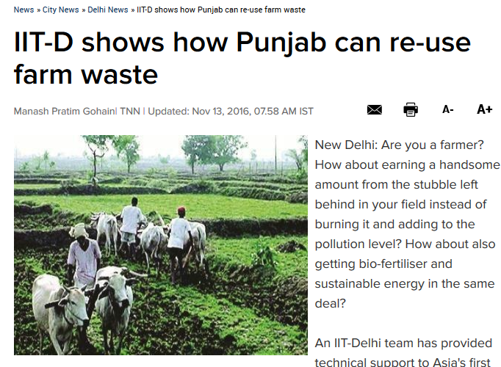
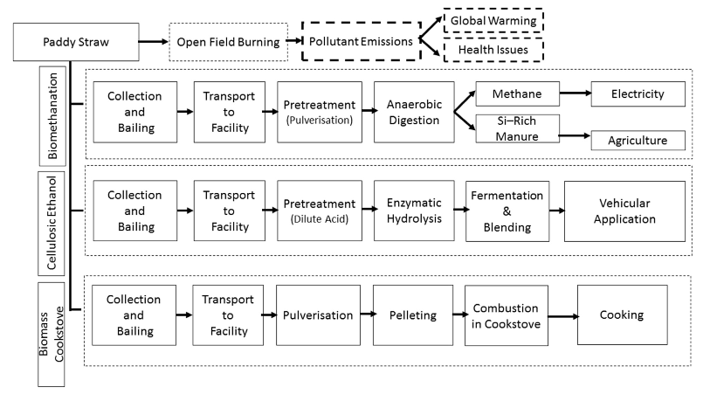
Paddy Straw to Bio Gas

Slide 5
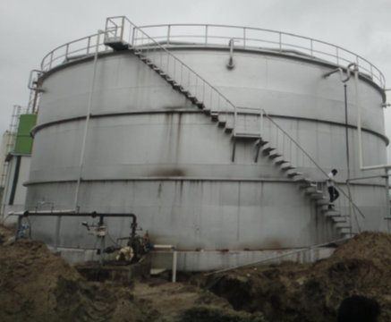
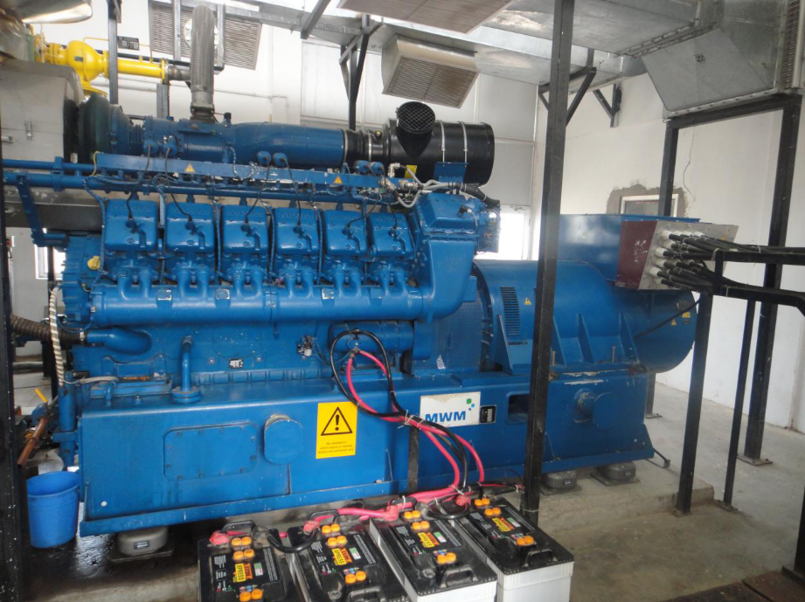
Agricultural residues to Biogas
10 tonnes/day of agricultural waste (paddy straw) is used to generate biogas.
Biogas from paddy straw which is being used for operation of electrical generator to produce electricity of 1.0 MW

Slide 6
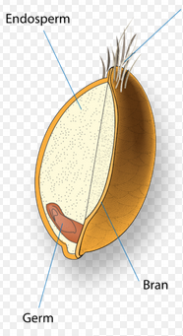
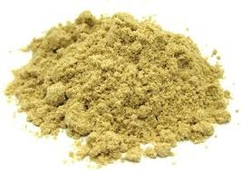
De-Oiled Rice Bran
Bran is the hard outer layers of any cereal grain (rice, corn etc.). Along with germ, it is an integral part of whole grain and produced as a by–product of milling in the production of refined grains.
India is the world’s largest rice bran oil producer and promotions for rice bran oil are happening both at the domestic and global level.
With world wide rice bran annual production of about 50–60 MMT, and India alone produces around 10–11 MMT.

Slide 7
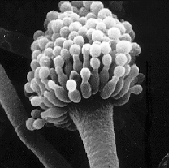
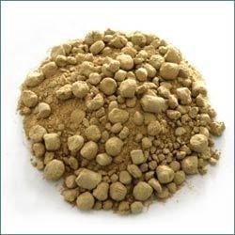
Aflatoxin and its presence in DORB: Unfit for consumption
Aflatoxins are mycrotoxins produced as secondary metabolites by filamentous fungi that grow on seeds, grains, and feed in the field, or in storage.
The DORB which generally goes into processed cattle feed contained a considerable amount of aflatoxin (Jayaraman and Kalyanasundaram, 1996).
The presence of aflatoxin in cattle feed is a matter of concern, as AF B, in the feed of milch cows is known to come out as AFM, in milk which is consumed by human.

Slide 8
No research has been done so far on biogas production from de–oiled rice bran!!!

Slide 9
Analysis of DORB
S. No | Samples | Moisture content % (wb) | Total solid % (wb) | Volatile solids % (db) | Ash content % (db)
1. | De-oiled rice bran | 12.2 | 87.8 | 85.8 | 14.2
2. | Cattle dung | 81.2 | 18.8 | 78.3 | 21.7
Proximate analysis
S. No | Feed material | C (%) | H (%) | N (%) | C/N
1. | De-oiled rice bran | 45.33 | 6.76 | 2.743 | 16.52
2. | Cattle Dung | 35.20 | 4.60 | 1.55 | 22.7
Ultimate analysis

Slide 10
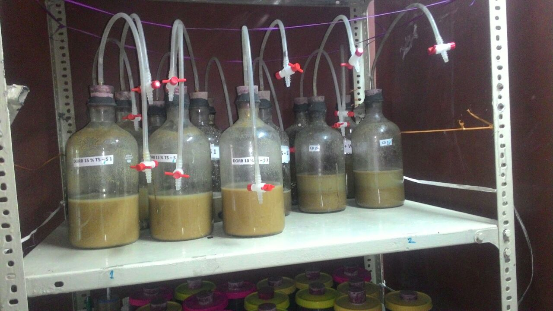
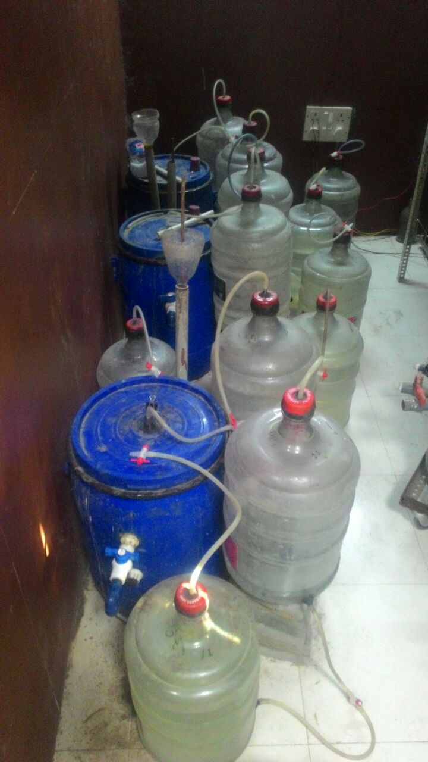
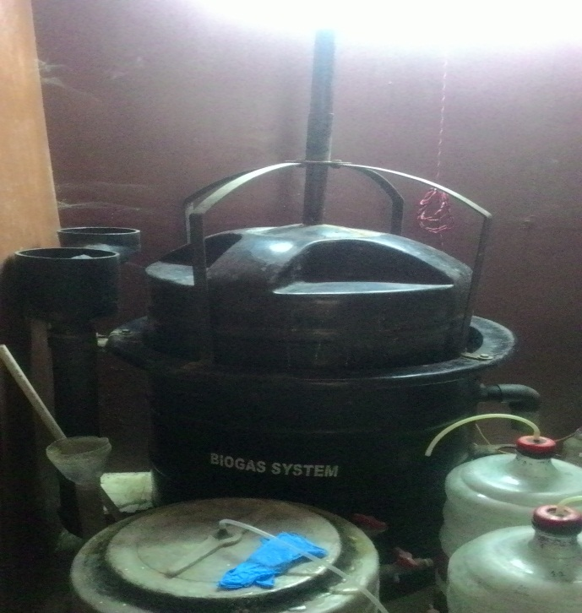
Experiments were carried out in 2 L bottle (batch mode) followed by the 60 L & 300 L continuous biogas plans
2L capacity DORB based Experimental digester setup of DORB based running on batch mode
60L DORB based Experimental digester setup of DORB based running on continuous mode
300L DORB based Experimental digester setup of DORB based running on continuous mode

Slide 11
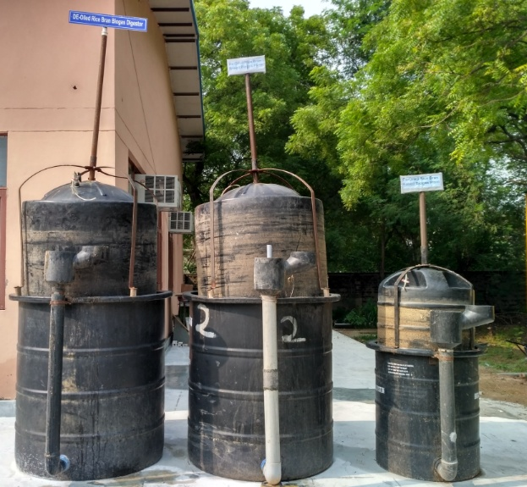
Biogas plant running solely on De–oiled Rice Bran at Micromodel
1 m³/day
1 m³/day
0.3 m³/day

Slide 12
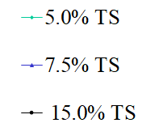
pH variations during the hydrolysis stage at various TS Concentration
pH
Days

Slide 13
Optimum TS concentration and HRT

Slide 14
Cumulative biogas, methane and carbon dioxide production volume at STP
The cumulative volume of biogas, methane and carbon dioxide produced were found as 2870.0 L, 1628.32 L and 1089.63 L, respectively from 4.067 kg of input volatile solids.

Slide 15
Methane and Carbon Dioxide content in produced biogas
The average Methane and Carbon dioxide percentage were recorded as 55.8% and 38.67% respectively

Slide 16
Total volatile solids mass removal efficiency of anaerobic digestion process
The total volatile solid removal efficiency was estimated to be 67.5%

Slide 17
Hydrogen sulfide concentration in the generated biogas
The optimization of % TS, the concentration of H2S was managed to be around 2000-2500 ppm

Slide 18
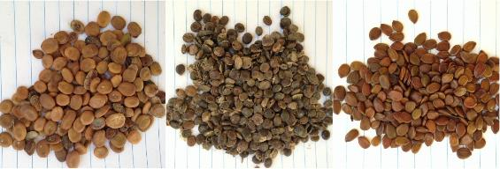
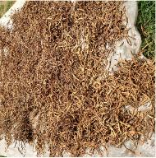
Alternate feed material : Locally Available Seeds for Biogas Production
Seeds of following different Trees which are widely distributed across India are selected.
Albizia lebbeck | Acacia nilotica | Leucaena leucocephala | Prosopis juliflora

Slide 19
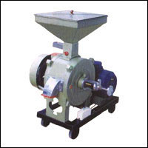
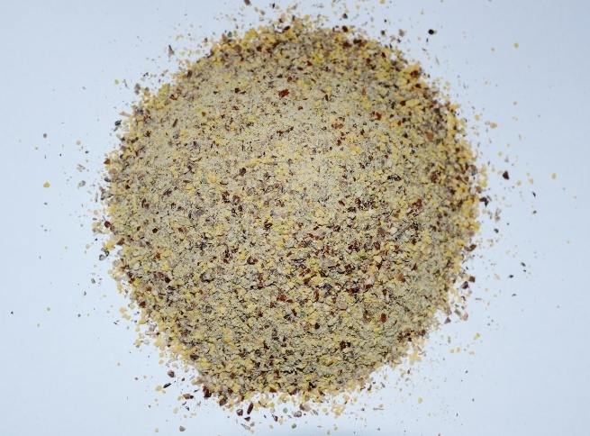
Grinding of Seeds

Slide 20
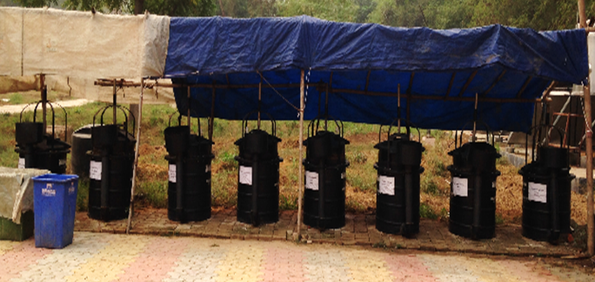
Biogas Plants running on different substrates in IIT
Plants on Tree Seeds and Crop Residues

Slide 21
Variation of total volatile solids mass removal efficiency of different feedstocks (TVSMRE)

Slide 22
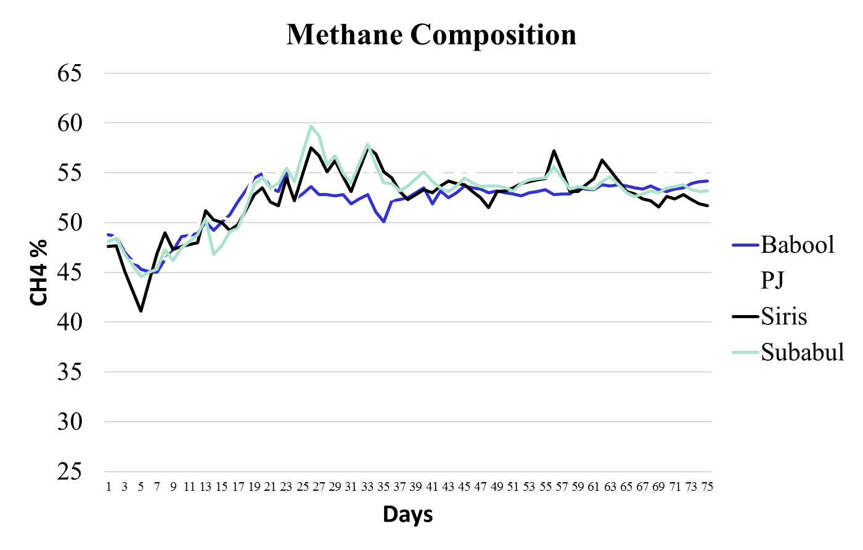
Methane content in Biogas from Seeds

Slide 23
Resource Potential
Resource | Specific Biogas Yield
 | m3/kg TS | m3/kg VS
Babool (Acacia nilotica) | 0.407 | 0.444
Subabul (Leucaena leucocephala) | 0.421 | 0.445
Siris (Albizia lebbeck) | 0.433 | 0.460
Vilayati Kikar (Prosopis julifora) | 0.430 | 0.476

Slide 24
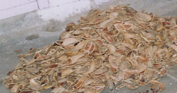
The Final Residue: Shells

