Slide 1

Special Method to Develop Inoculum for Anaerobic Digestion of De-oiled Cake of करंजक
P M V Subbarao
Professor
Mechanical Engineering Department
Head, CRDT
Process of training Parasitic Microbes for acclimatization to new Feed material….

Slide 2

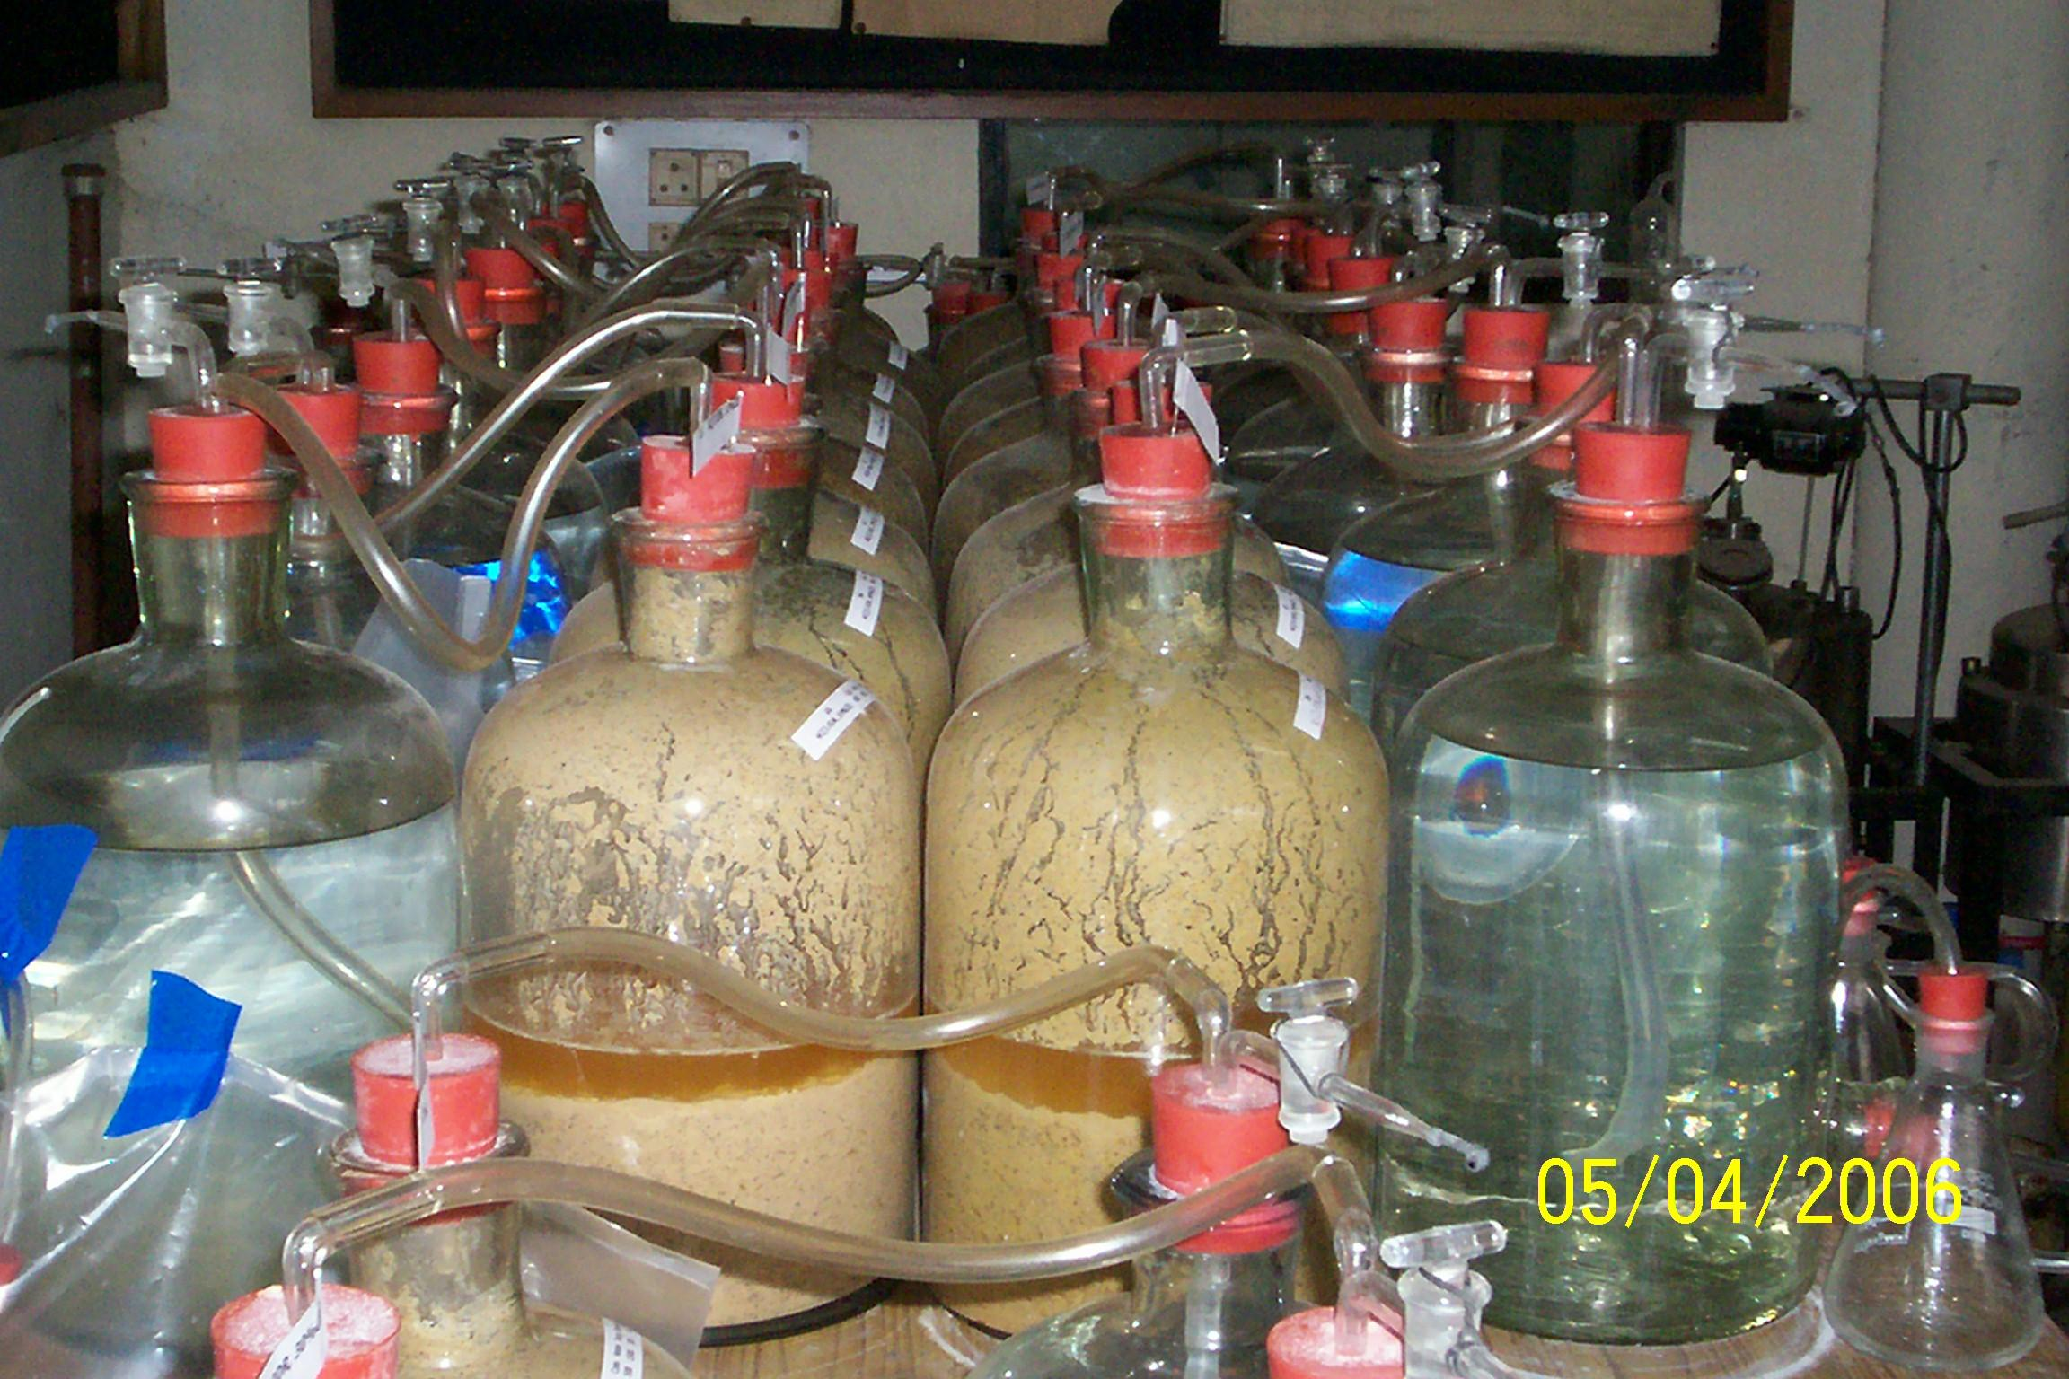
Micro Digester Systems : Preliminary Batch Study
2
2
Notes:
2

Slide 3
Results & Analysis of Failures
Low yield and very poor quality of biogas was observed during the preliminary batch biomethanation study.
The static agents present in slurry of de-oiled cake environment created an inhibition in microbes.
This was responsible for continuous drop in population of microbes in this environment.
This proves that the microbial community(cattle dung slurry) used in Micro-digester systems are affected by static agents.
How to control the influence of static agents?
Can we train microbes to rearrange their digestive resourcesto overcome the influence of static agents?

Slide 4
Methane Fermentation: Microbial Growth & Inhibition
Control of microbial growth usually decided by the presence of physical or chemical (natural) agents in the feed material.
These natural agents which either kill or prevent the growth of microorganisms.
Agents which kill cells are called Cidal agents.
Agents which inhibit the growth of cells (without killing them) are referred to as static agents.
The static agents present in slurry of de-oiled cake environment created an inhibition in microbes.
This was responsible for continuous drop in population of microbes in this environment.
This proves that the substrates used in Micro-digester systems are affected by static agents.
How to control the influence of static agents?
Can we train microbes to rearrange their digestive resourcesto overcome the influence of static agents?

Slide 5
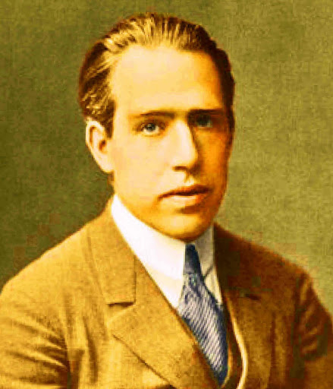
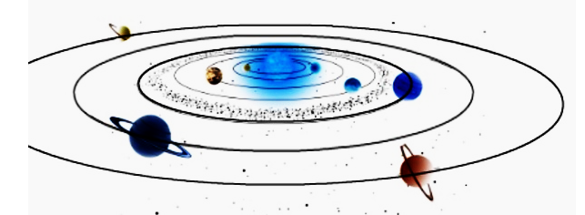
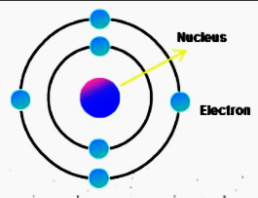
A Confident Scientist
  Develop a strong sense of trust in your instincts
How wonderful that we have met with a paradox. Now we have some hope of making progress.
Niels Henrik David Bohr
287.46 billion km
348 pm
This is known as “Extreme Art of Miniaturization”
287.46 billion km

Slide 6
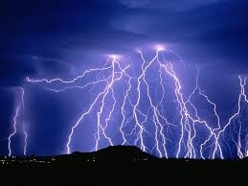
An Confident Scientist vs Engineer
The average lightning bolt measures about an inch wide and five miles long.
The temperature of lightning can reach around 30,000 K.
The electricity in a single bolt can reach 200 million volts.
An average duration of time for a stroke of lightning is about 30 microseconds.
The average peak power of a stroke of lightning is about 10¹² watts.
A single bolt of lightning carries an energy 5 billion joules.

Slide 7
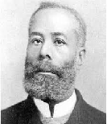
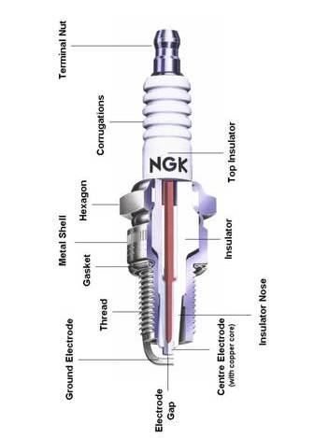
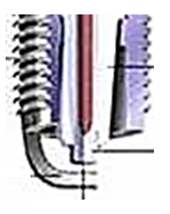

An Ingenious Scientist vs Engineer
Edmond Berger
Spark plugs in automobiles generally have a gap between 0.6 and 1.8 mm.
~15kV
~ 1micro second
~ 10mJ

Slide 8
Noble Prize in Medicine - 2016
The Nobel Prize in Physiology or Medicine 2016 was awarded to Yoshinori Oshumi "for his discoveries of mechanisms for autophagy".
When the body is on a fast, it tells the brain there is not enough food.
This allows for autophagy — where cells attack old and junky proteins in the body.
Fasting has two very good benefits for us.
It helps in self-destruct — keeping the body in good condition.
The other benefit is that when the self-destruction occurs, there is the inducement of the growth hormone which allows for the generation of new cells.
Fasting is the basic Arsha samskaram.

Slide 9
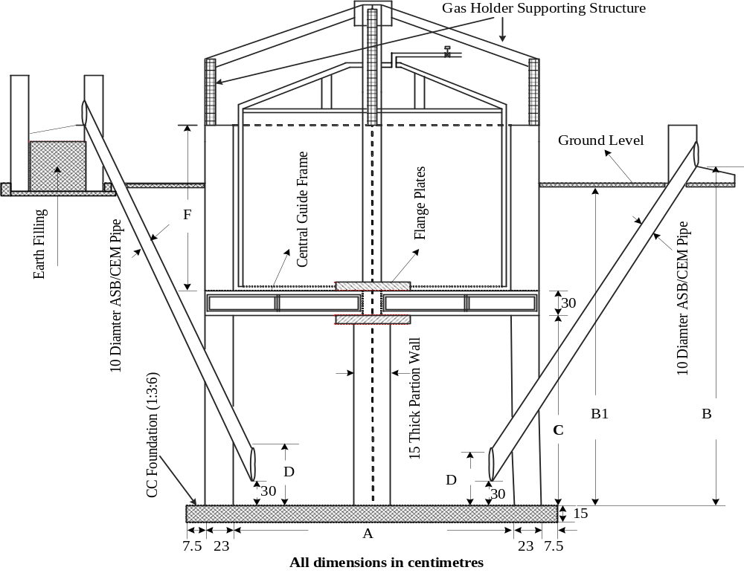
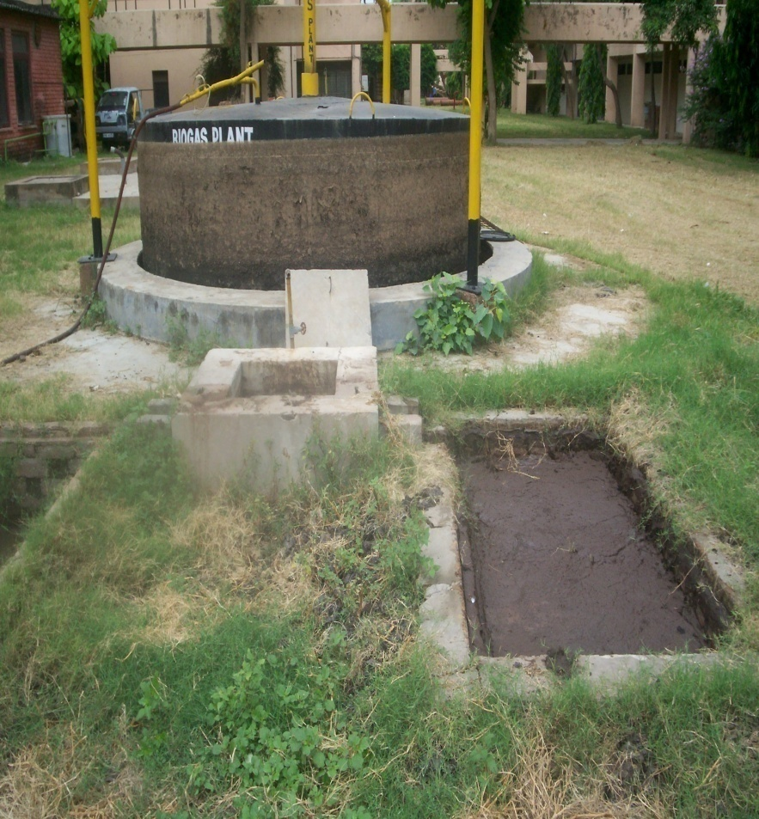
Biogas plant (20 m³/day) Available at IIT Delhi
This plant was almost continuously running for past several years (>20 years) using a slurry of Cattle dung and water ::1:1 by mass.

Slide 10

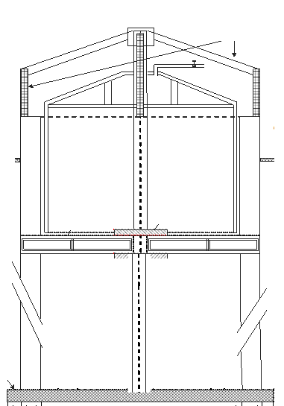
Biological Digester

Slide 11
Biological Structure of A running Biogas Digester (Capacity : 20 m³/day)
Day 1

Slide 12
Biological Structure of A running Biogas Digester (Capacity : 20 m³/day)
Day 1
Day 2

Slide 13
Biological Structure of A running Biogas Digester (Capacity : 20 m³/day)
Day 1
Day 2
Day 3

Slide 14
Biological Structure of A running Biogas Digester (Capacity : 20 m³/day)
Day 1
Day 2
Day 3
Day …
Day K

Slide 15
Biological Structure of A running Biogas Digester (Capacity : 20 m³/day)
Day K
Day K+1
Day …
Day 3
Day 2
Day N
Day 1

Slide 16
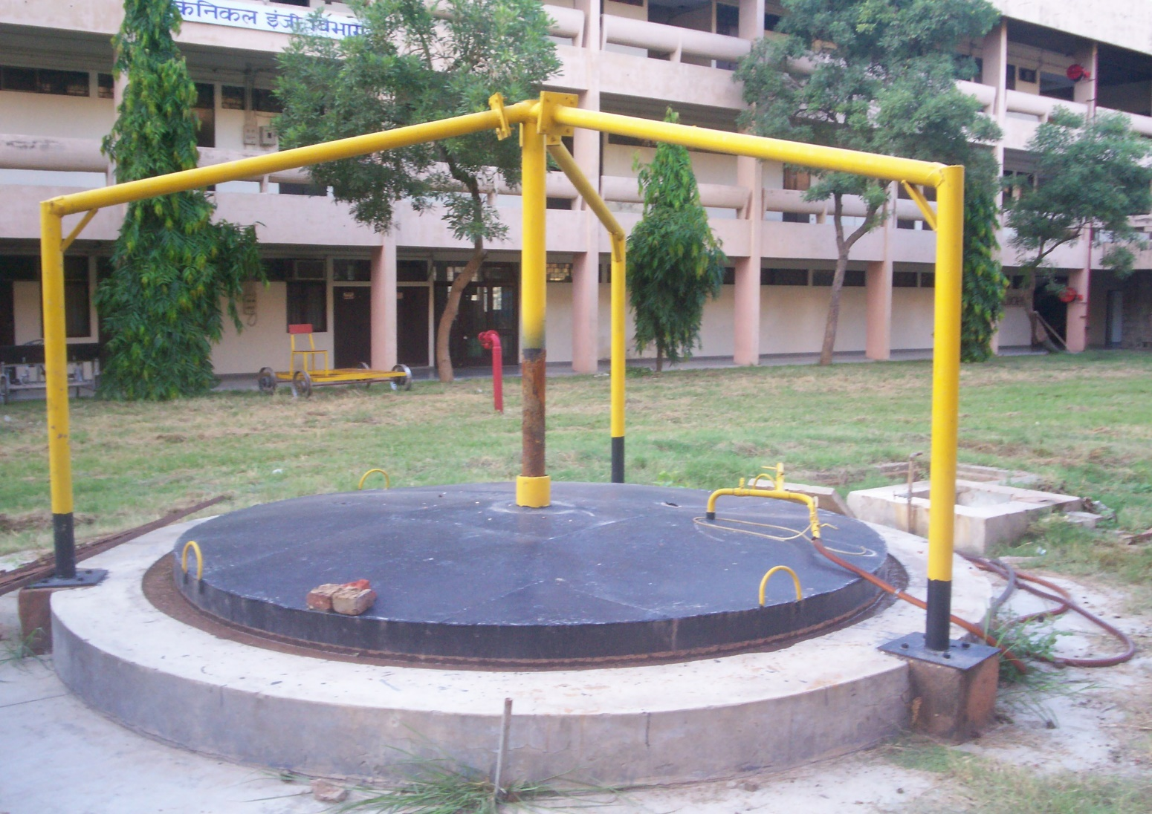
Development of Special Secondary Inoculum – Phase -1
About 12 m³ CD inoculum
A
Running
20 m³/d BGP
Nearly 30 tons of unprocessed and semin-processed slurry
Continuous Drop in
Gas Quantity & Quality
No feeding of CD for
3 months
No Gas Production in nearly last 10 days

Slide 17
Development of Special Inoculum – Phase 2
About < 12 m³ CD inoculum
With starving Microbes
Start Feeding of slurry with pongamia deoiled cake : water :: 1:3
20 m³/d BGP
Start of gas production
Continued
1 2 3 4 5
Schedule I
2 kg pongamia oil cake with 6 kg water for 5 days
10 cm height/day
Schedule II
5 kg pongamia oil cake with 15 kg water for 10 days
6 7 8 9 10 11 12 13 14 15
Effective Secondary Inoculum is generated
Drop in gas yield
Increase in gas yield
Constant gas yield
(10-15 day) at 30 cm height

Slide 18
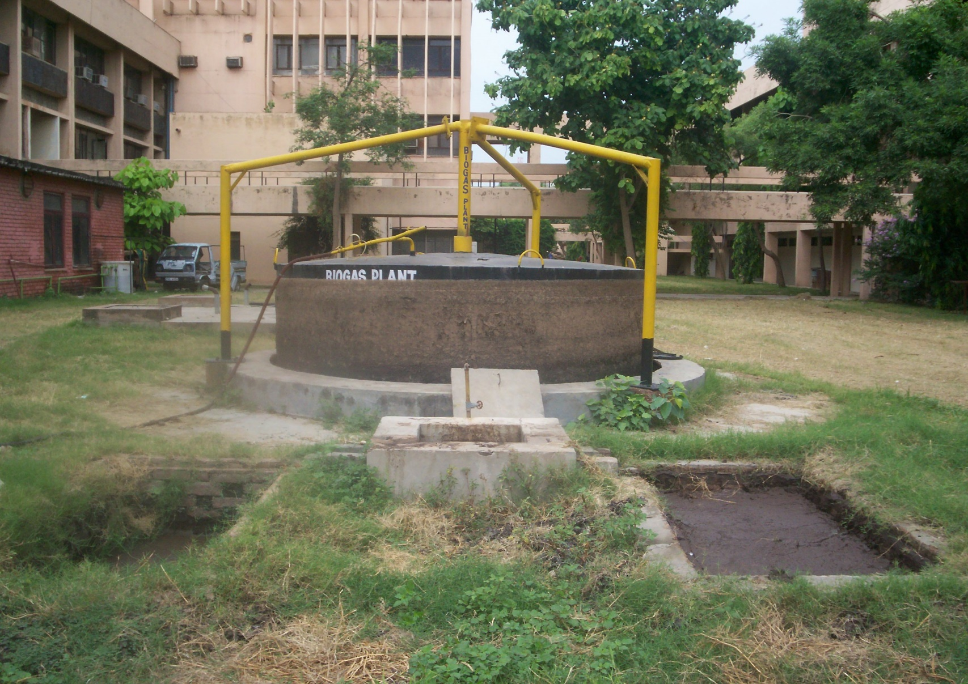
Biogas Plant Running on Oil Cake Slurry

Slide 19
Evolution of New Strain of Microbes
This shows the adaptation of microbes to the environment offered by new substrates, possibly by developing into a suitable strain.
This acclimatization is due to fact that,
Slow increase in the concentrations of inhibitory materials within the established environment influenced many microorganisms in rearrangement of their metabolic resources.
This needs sufficient time..
The slurry of the biogas plant stabilized with pongamia deoiled cake can be declared as Secondary inoculum.
This inoculum may be used as primary inoculum for further studies.

Slide 20
Phases in Development of Biomethanation process for New Feed Materials using a Valid Inoculums
Phase | Phase description | Period of experimentation
I | Thorough experimentation on selected batch treatments (5 L digester capacity) | 60 days
II | Continuous feeding experimental investigation on selected treatments in digester of 300 litre capacity | 30 days
III | Continuous feeding experimental investigation in floating drum biogas plant of 20 m³/d capacity | 30 days

Slide 21
Total solids and volatile solids concentration in the substrates under Phase I
Thorough experimentation on selected batch treatments (5 L digester capacity)
Sl. No. | Treatment | Substrate concentration
 |  | Total solids |  | Volatile solids
 |  | kg | % | kg | %
1 | KC (3.5 DR, 0 % CD) | 0.45 | 19.9 | 0.43 | 19.0
2 | KC (3.5 DR, 50 % CD) | 0.54 | 19.6 | 0.50 | 18.1
3 | KC (10 DR, 0 % CD) | 0.22 | 8.1 | 0.21 | 7.8
PHASE-I

Slide 22
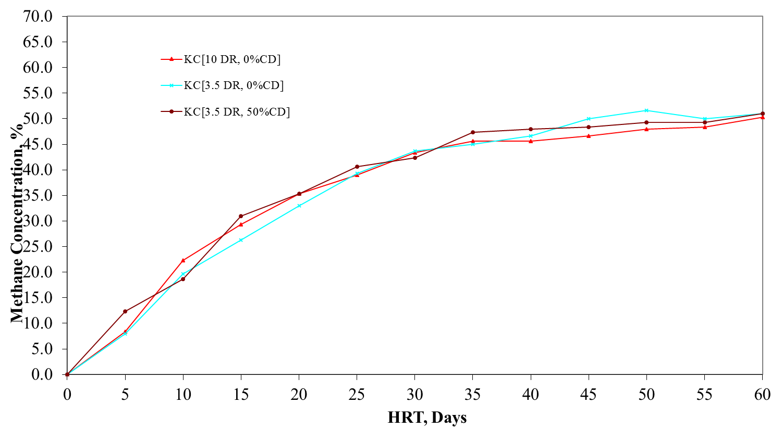
Variation of methane concentration in generated biogas
Pongamia Oil Cake Substrates
22
22
22
Notes:
22

Slide 23
Specific Biogas Yield
Treatments | Phase- I
 | L/kg TS | L/kg VS
PC [10.0 DR, 0 % CD] | 347.08 | 351.97
PC [3.5 DR, 0 % CD] | 313.32 | 316.99
PC [3.5 DR, 50 % CD] | 470.31 | 493.49
Notes:
23

Slide 24
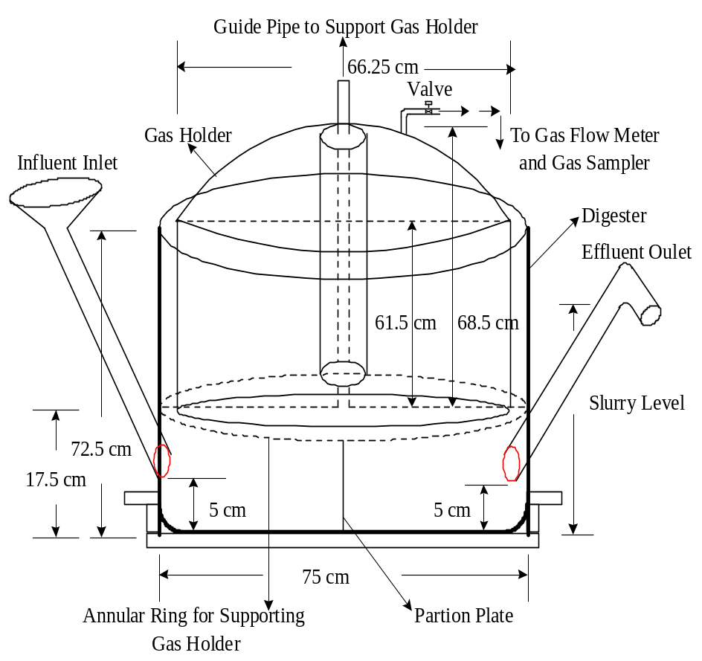
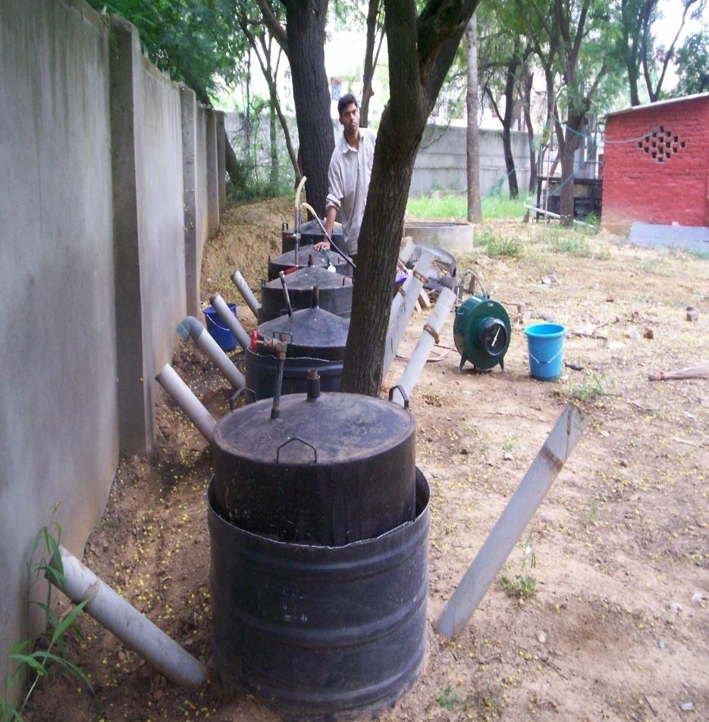
Continuous Feeding Experimental Investigation on Selected Treatments
Digester of 300 L Capacity
PHASE-II

Slide 25
Total solids and volatile solids concentration in the substrates under Phase II
 | Treatment | Substrate concentration of the daily feed material
 |  | Total solids |  | Volatile solids
 |  | kg/d | % | kg/d | %
1 | CD [1.0 DR] | 0.922 | 9.2 | 0.605 | 7.2
2 | KC(3.5DR, 0 % CD) | 0.448 | 19.9 | 0.427 | 19.0
3 | KC(3.5 DR, 50 % CD) | 0.54 | 19.6 | 0.498 | 18.1

Slide 26
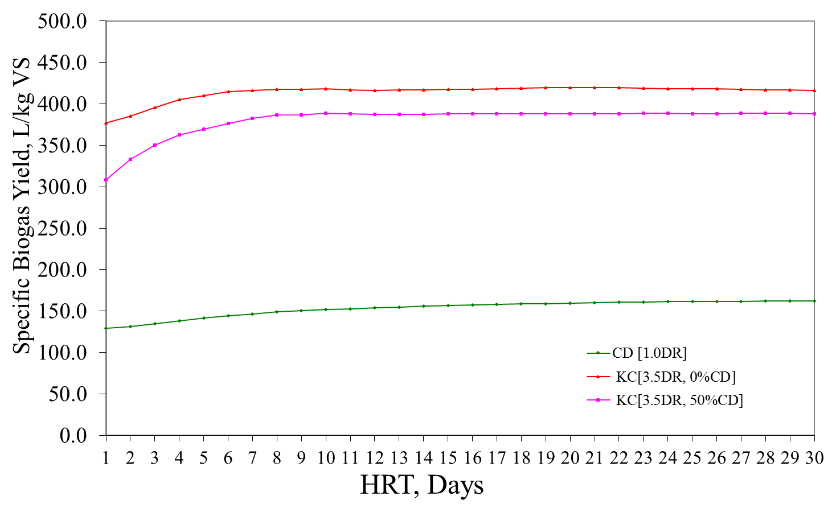
Variation of specific biogas yield based on total volatile solid contents of the substrates
Pongamia Oil Cake Substrates
Notes:
26

Slide 27
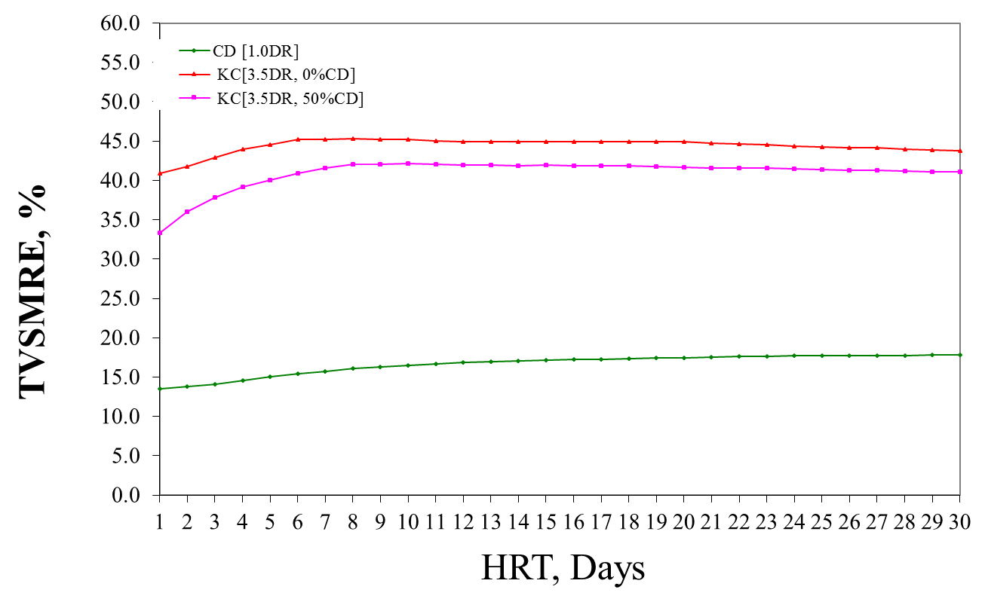
Variation of total volatile solid mass removal efficiencies of the substrates
Pongamia Oil Cake Substrates
Notes:
27

Slide 28

Continuous Feeding Experimental Investigation in Floating Drum Biogas Plant of 20 m³/d Capacity
Biogas plant (20 m³/day) being fed with jatropha & pongamia oil seed cakes
PHASE-III

Slide 29
Total solids and volatile solids concentration in the substrates under Phase III
Treatment | Substrate concentration of the daily feed material
 | Total solids |  | Volatile solids
 | kg/d | % | kg/d | %
PC (3.5 DR,0 % CD) | 8.95 | 19.9 | 8.53 | 19.0

Slide 30
Daily Biogas Production
Pongamia Oil Cake
KC [3.5 DR, 0 % CD]
Range of ambient temperature variation 30.7 to 36.6 °C
Notes:
30

Slide 31
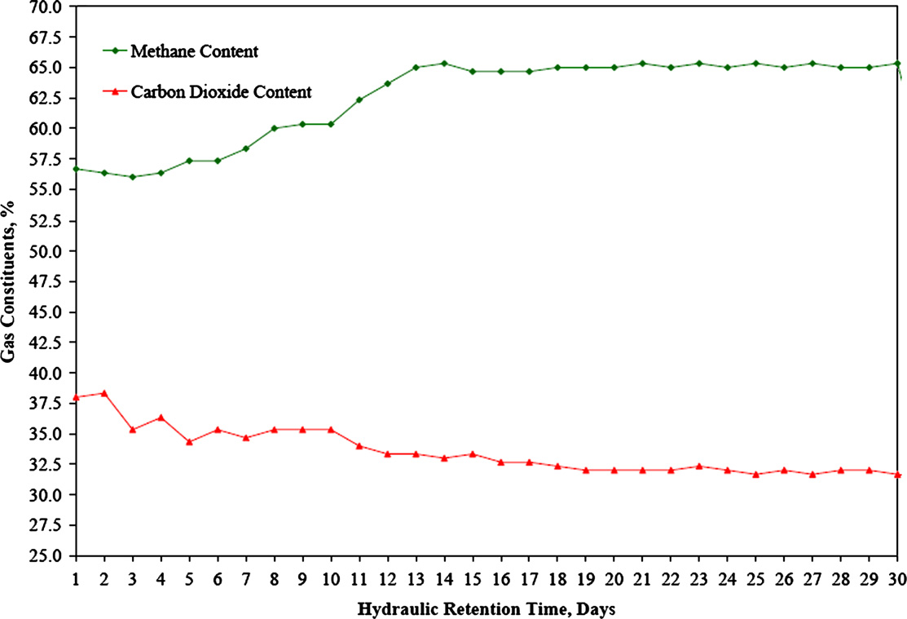
Variation of methane and carbon dioxide content in produced biogas from pongamia deoiled cake substrate

Slide 32
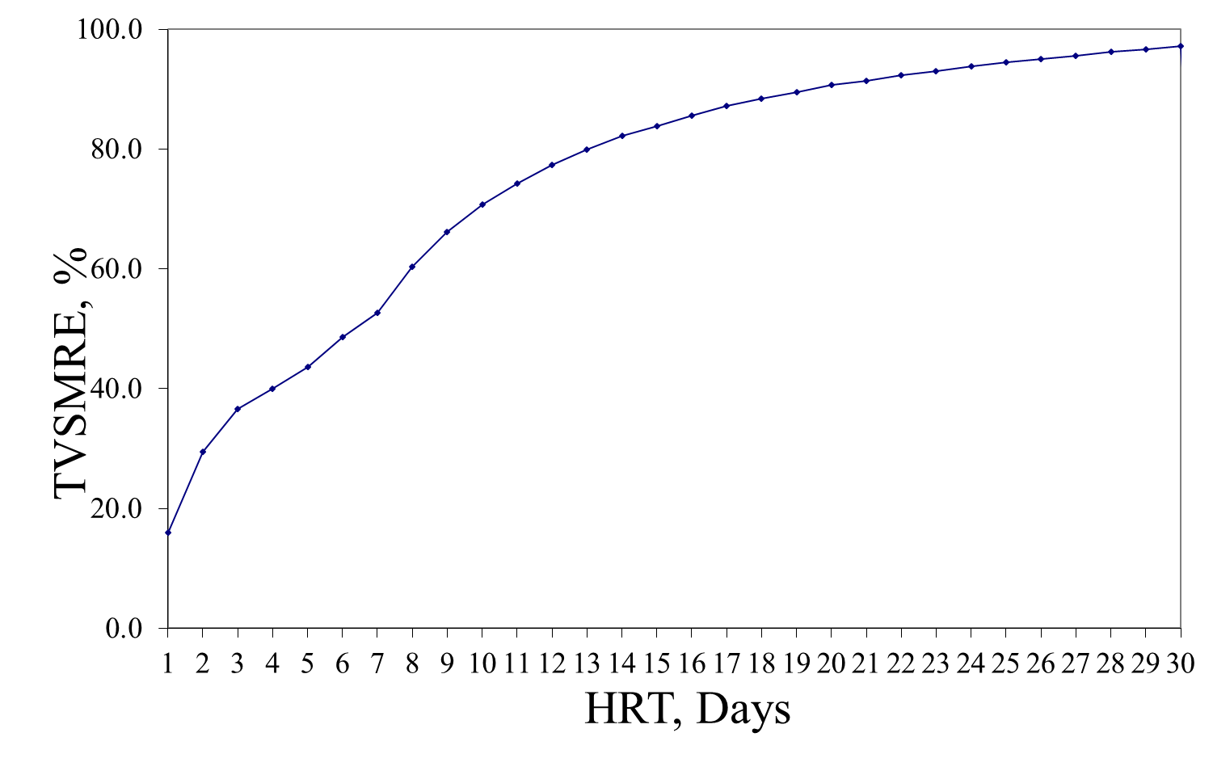
Total Volatile Solid Mass Removal Efficiency
Pongamia Oil Cake
KC [3.5 DR, 0 % CD]
Notes:
32

Slide 33
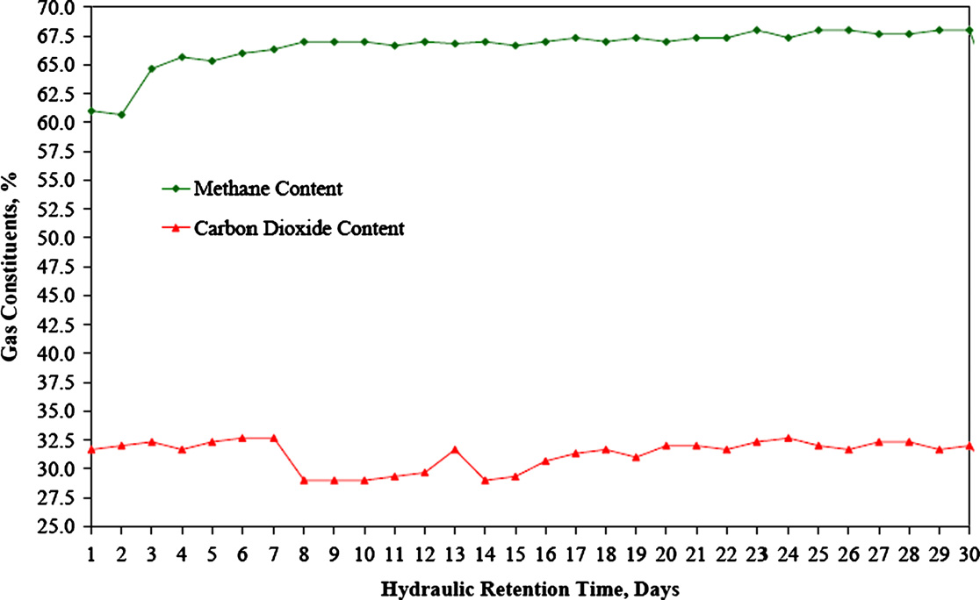
Variation of methane and carbon dioxide content in produced biogas from jatropha oil seed cake substrate.

Slide 34
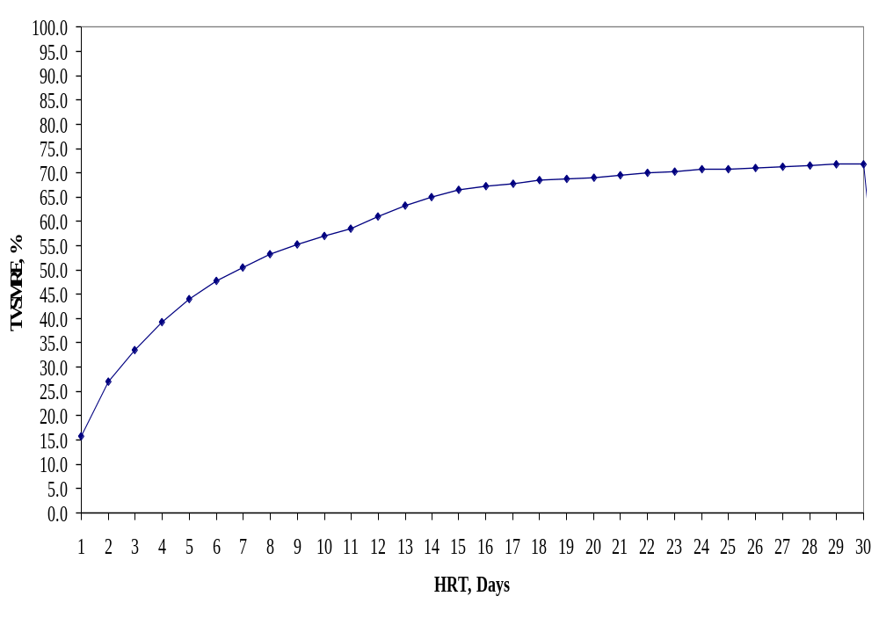
Total Volatile Solid Mass Removal Efficiency
Jatropha deOiled Cake
JC [4.0 DR, 0 % CD]
34
Notes:
34

Slide 35
N, P & K Contents of Biogas Spent Slurry
Sl. No. | Treatment | N, % | P, % | K, %
1 | CD [1.0 DR] | 1.48 | 0.66 | 1.64
Jatropha oil cake biogas spent slurry
2 | JC (4.0 DR, 0 % CD) | 3.60 | 2.20 | 1.72
3 | JC (4.0 DR, 50 % CD) | 3.30 | 2.10 | 1.69
Pongamia oil cake biogas spent slurry
4 | PC (3.5 DR, 0 % CD) | 5.40 | 1.20 | 1.32
5 | PC (3.5 DR, 50 % CD) | 5.20 | 1.33 | 1.65
35
35
35
Notes:
35

Slide 36
Agricultural residues
Conversion of Waste product into By-product.
Amount of crop residues amounted to about 3.5 to 4 billion tones annually.
An energy content representing 65 EJ, or 1.5 billion tones oil equivalent.
Over 2 billion tones of agricultural residues were burned annually world-wide, producing 1.1 to 1.7 billion tones/yr of CO₂.
The most promising residues from the sugar cane, pulp and paper, and sawmill industrial sectors.
Estimates are that about 1200 TWh/yr of electricity can be produced from this source.

Slide 37
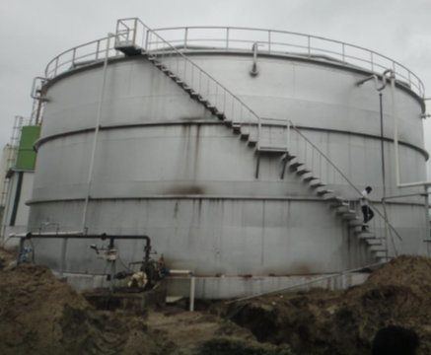
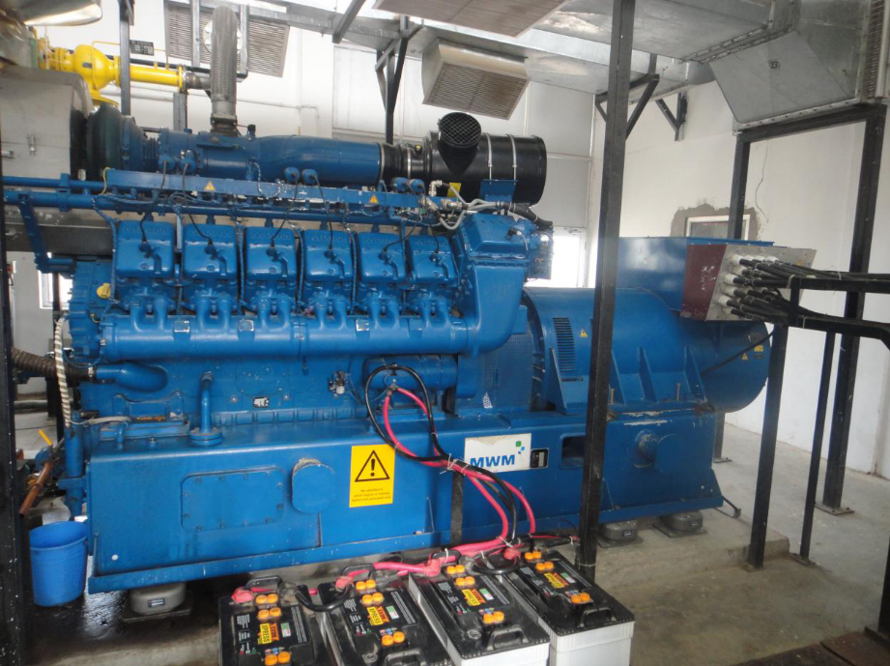
Agricultural residues to Biogas
10 tonnes/day of agricultural waste (paddy straw) is used to generate biogas.
Biogas from paddy straw which is being used for operation of electrical generator to produce electricity of 1.0 MW

