Slide 1

Microbiology of Anaerobic Digestion of De-oiled Cake of करंजक
P M V Subbarao
Professor
Mechanical Engineering Department
Head, CRDT
Training of Non-Native Parasitic Microbes….

Slide 2

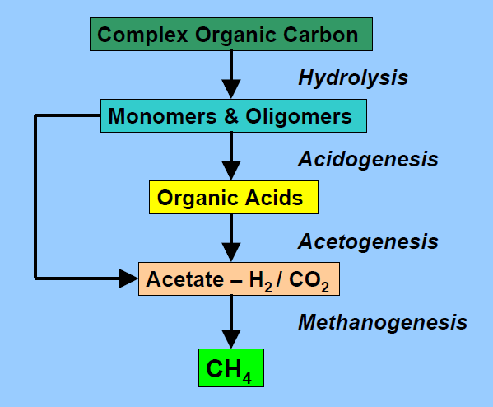
Major Biological Events in Anaerobic Digestion
hydrolytic bacteria

Slide 3
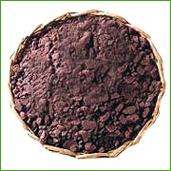
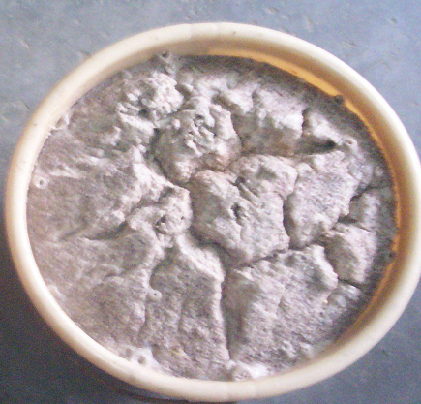
Fitness of Non-Edible Oil Seed Cakes for Hydrolysis
Seed Cakes
soaked in water
Dry Pongamia Seed Cake

Slide 4
Bio-Methanation : Microbial Transformation Overview
Homo acetogens
Biodegradable solids
Acetate
Large organic molecules
Hydrogen producing acetogens
Org acids alcohols
CH₄ and CO₂
Fermenters
H₂ and CO₂
Methane producers
Aacetate oxidizers
Several bacteria

Slide 5
Bio-Methanation : Mass Balance During Transformation
70%
Biodegradable waste
Acetate
51%
19%
100%
Large organic molecules
Org acids alcohols
CH₄ and CO₂
19%
11%
H₂ and CO₂
30%

Slide 6
Ultimate Analysis and carbon-nitrogen Ratio
Sr. No. | Feed material | C (%) | H (%) | N (%) | C/N ratio
1 | Cattle Dung | 35.20 | 4.60 | 1.55 | 22.7
2 | Jatropha oil seed cake | 48.80 | 6.20 | 3.85 | 12.7
3 | Pongamia oil seed cake | 47.80 | 6.50 | 5.50 | 8.7

Slide 7
Preparation of Substrates for Methane Fermentation
The most important quality of anaerobic fermentation is the fact that there is no need of pure culture of organisms.
It is not necessary to maintain purified cultures for inoculation or reinoculation.
Any decaying vegetable matter, excreta, black mud contain the required bacteria and are fit for primary inoculum
Mixing of de-oiled cake with Inoculum in optimal proportion.
Addition of water to maintain optimal dilution ratio and solids concentration.
TSC in the range 18-22 % maintain fluidity of substrates.
Sufficient surface for Bacterial hydrolysis.

Slide 8
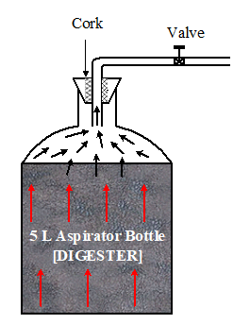
Preliminary Batch Biomethanation Study
Experimental setup for batch biomethanation study
Soaked de-oiled cake + Water + Cattle dung (Inoculum)

Slide 9
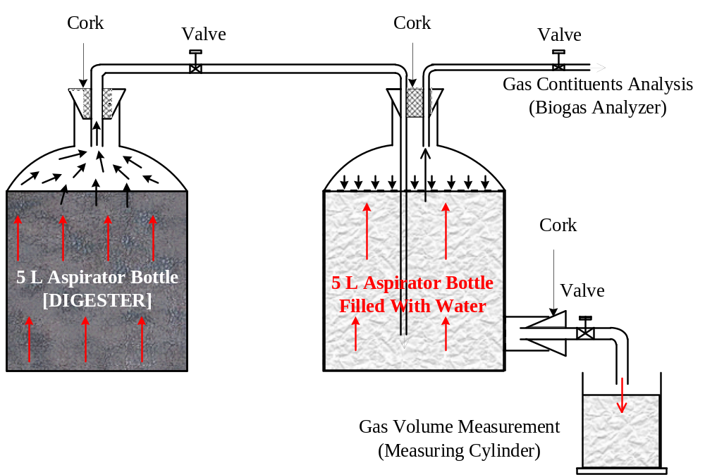
Preliminary Batch Biomethanation Study
Experimental setup for batch biomethanation study

Slide 10
Strategy of Substrate Preparation
Preparation of a substrate using de-oiled cake, water and inoculum.
Selection of various proportions.
Control of TS in between 18-22 % and to maintain flow ability of substrates.
An overall inoculation ratio of 1:10.
Two different groups of substrates : With and with out cow dung.
Anaerobic digestion of substrate in a micro-batch-digester system.

Slide 11
Details of Prepared Substrates
Sl. No. | Treatment | Substrate constituents
 | designation
 |  | Cake | Water | Dung | Inoculum
 |  | g | ml | g | g
1 | 1.0 DR [CD] | 0 | 2000 | 2000 | 200
2 | 3.0 DR [5PC:0CD] | 500 | 1500 | 0 | 50
3 | 3.0 DR [5PC:1CD] | 500 | 1500 | 100 | 50
4 | 3.0 DR [5PC:2CD] | 500 | 1500 | 200 | 50
5 | 3.0 DR [5PC:3CD] | 500 | 1500 | 300 | 50
6 | 3.0 DR [5PC:4CD] | 500 | 1500 | 400 | 50
7 | 3.0 DR [5PC:5CD] | 500 | 1500 | 500 | 50
8 | 3.5 DR [5PC:0CD] | 500 | 1750 | 0 | 50
9 | 3.5 DR [5PC:1CD] | 500 | 1750 | 100 | 50
10 | 3.5 DR [5PC:2CD] | 500 | 1750 | 200 | 50
11 | 3.5 DR [5PC:3CD] | 500 | 1750 | 300 | 50
12 | 3.5 DR [5PC:4CD] | 500 | 1750 | 400 | 50
13 | 3.5 DR [5PC:5CD] | 500 | 1750 | 500 | 50
Notes:
11

Slide 12
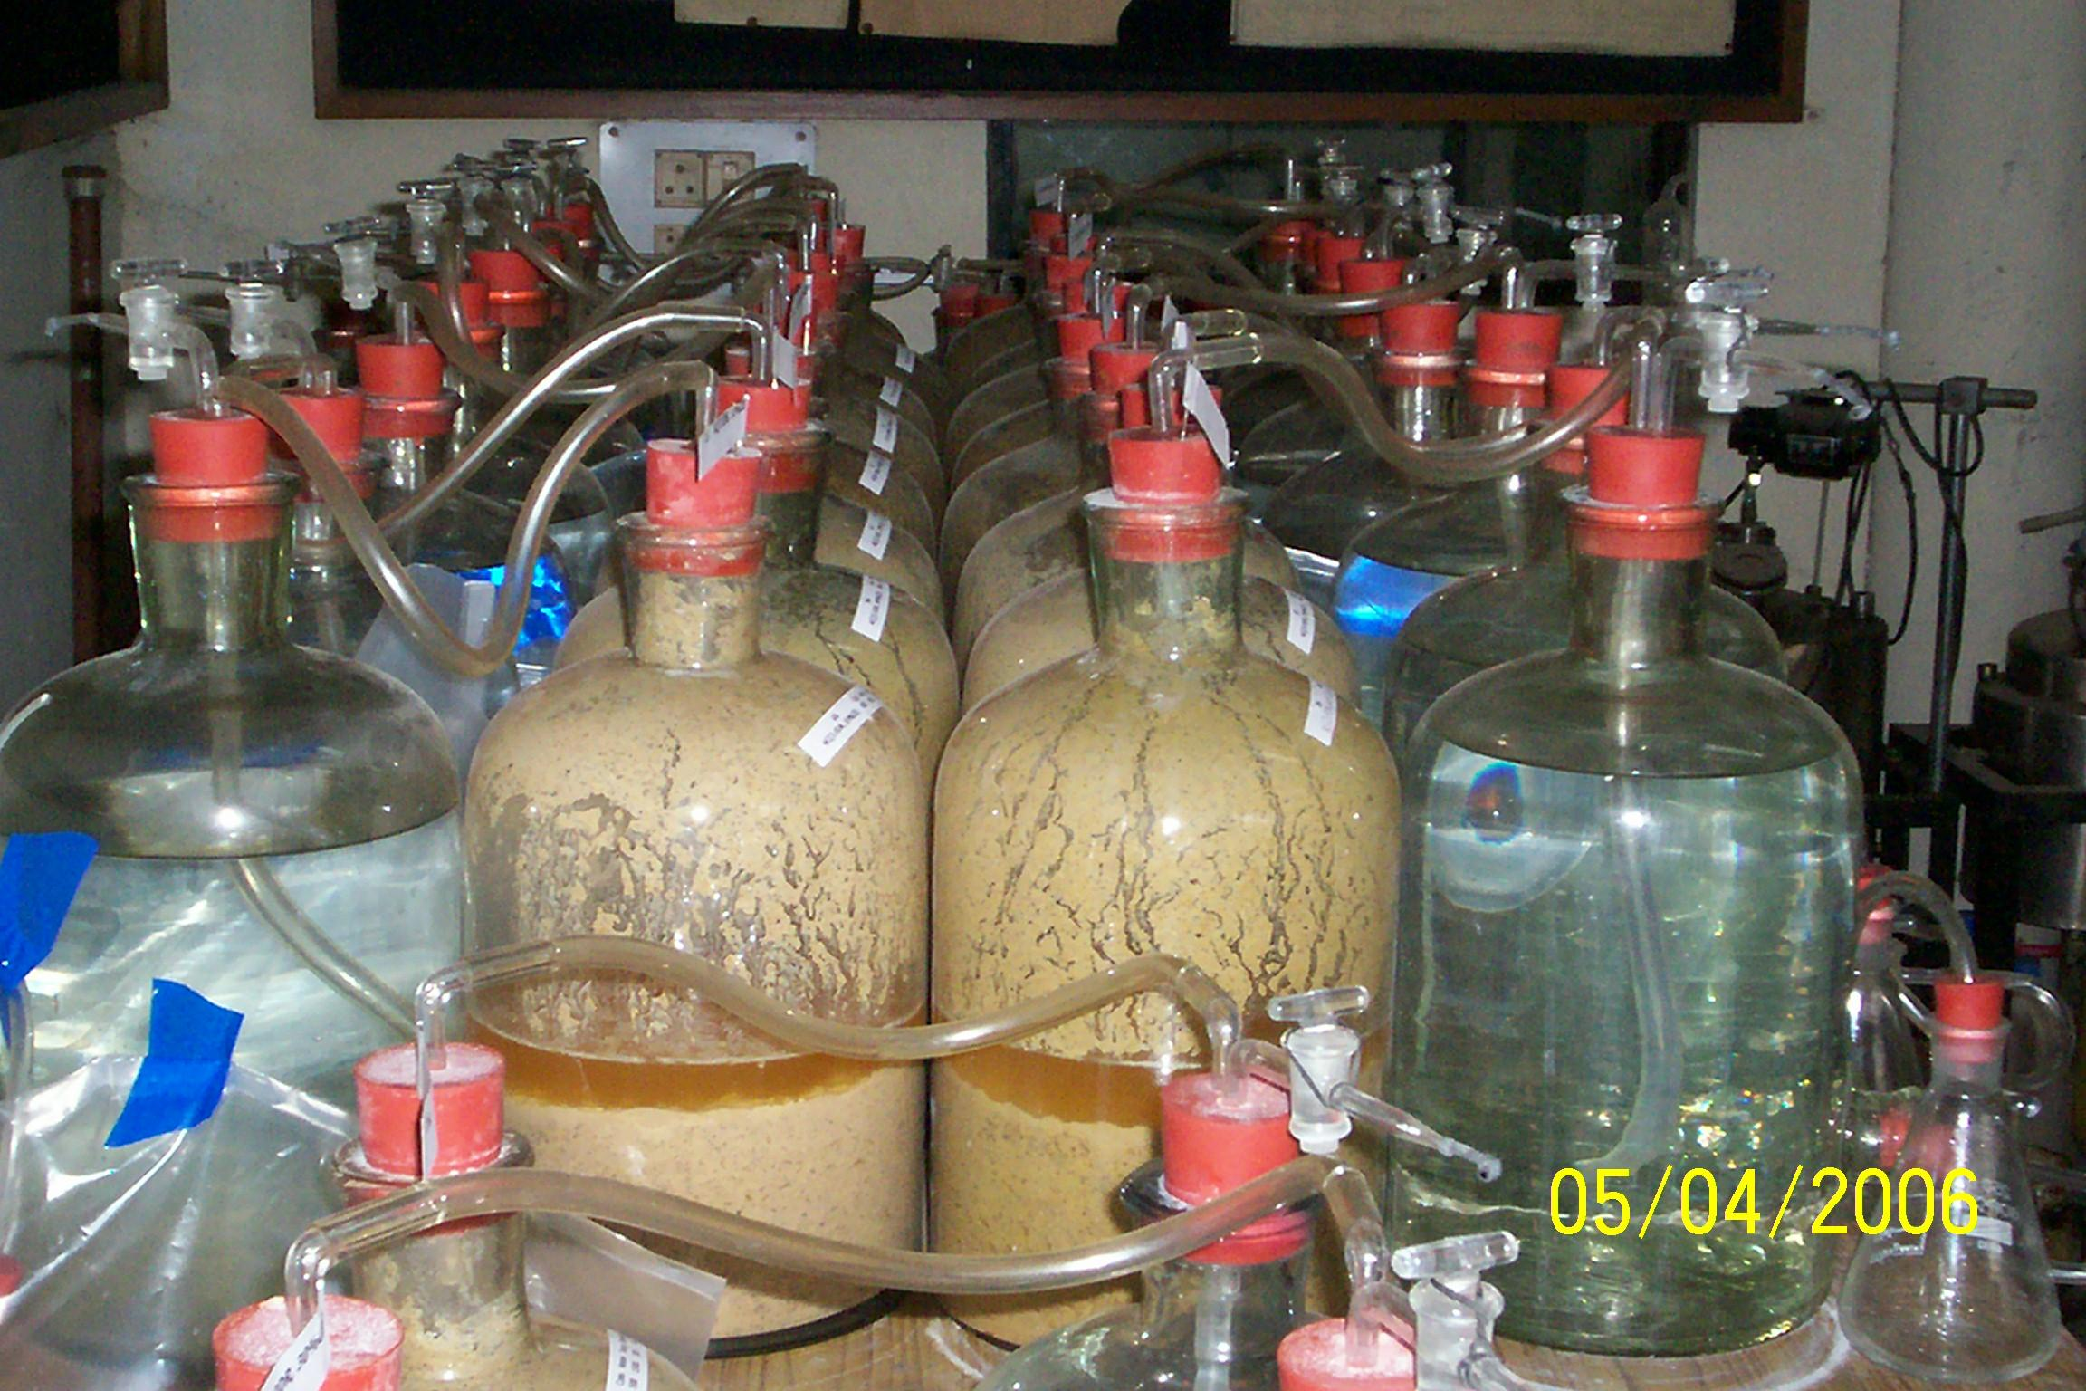
Micro Digester Systems : Preliminary Batch Study
12
12
Notes:
12

Slide 13
Results of Preliminary Trials & Analysis of Failures
Low yield and very poor quality of biogas was observed during the preliminary batch biomethanation study.
A major challenge in biomethanation of these deoiled cakes is lacking of inherent bacteria like cattle dung.
Lack of these inherent bacteria demands a special attention for operation of digester with cake.
Other major deficiency of cake is the presence of long chain free fatty acids, which are prone to destroy the population of bacteria.
Placement of Cattle dung microbes in the substrates of pongamia de-oiled cake is a sudden and drastic change in environment for the microbial activity.
The microbes present in cattle dung inoculums could not survive in de-oiled cake-water environment.
There may be a continuous drop in population of bacteria in the inoculum.

Slide 14
Methane Fermentation: Microbial Growth & Inhibition
Control of microbial growth usually decided by the presence of physical or chemical (natural) agents in the feed material.
These natural agents which either kill or prevent the growth of microorganisms.
Agents which kill cells are called Cidal agents.
Agents which inhibit the growth of cells (without killing them) are referred to as static agents.
The static agents present in slurry of de-oiled cake environment created an inhibition in microbes.
This was responsible for continuous drop in population of microbes in this environment.
This proves that the substrates used in Micro-digester systems are affected by static agents.
How to control the influence of static agents?
Can we train microbes to rearrange their digestive resourcesto overcome the influence of static agents?

Slide 15
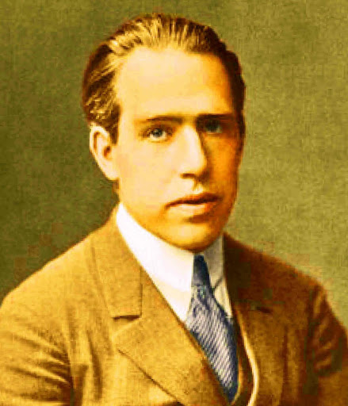
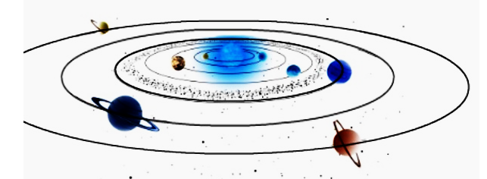
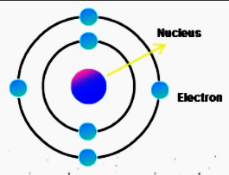
An Confident Scientist vs Engineer
  Develop a strong sense of trust in your instincts
How wonderful that we have met with a paradox. Now we have some hope of making progress.
Niels Henrik David Bohr
287.46 billion km
348 pm
This is known as “Extreme Art of Miniaturization”
287.46 billion km

