Slide 1

Processing of Biomolecules : De-oiled Cake of करंजक
P M V Subbarao
Professor
Mechanical Engineering Department
Head, CRDT
The Art of Contaminating of Biomass with Non-Native Parasitic Microbes….

Slide 2


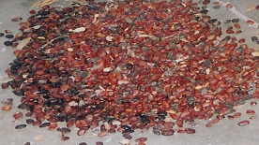
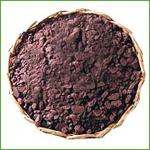
Energy Content Distribution of Pongamia Kernels
35 GJ
40.8 GJ

Slide 3
De-oiled Cake of करंजक : Proximate analysis
Feed material | Moisture content % | Oil content % | Total solids % | Volatile solids % | Non-volatile solids %
Cattle dung | 81.6 | Nil | 18.4 | 14.4 | 4.0
Pongamia de-oiled seed cake | 10.5 | 7.2 | 89.5 | 85.3 | 05.2

Slide 4
De-oiled Cake of करंजक : Ultimate Analysis
Feed material | C (%) | H (%) | N (%) | C/N ratio
Cattle Dung | 35.20 | 4.60 | 1.55 | 22.7
Pongamia de-oiled seed cake | 47.80 | 6.50 | 5.50 | 8.7

Slide 5
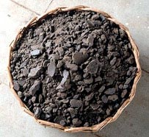
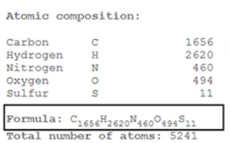
De-oiled Cake of करंजक : Ultimate Analysis
De-oiled cake

Slide 6
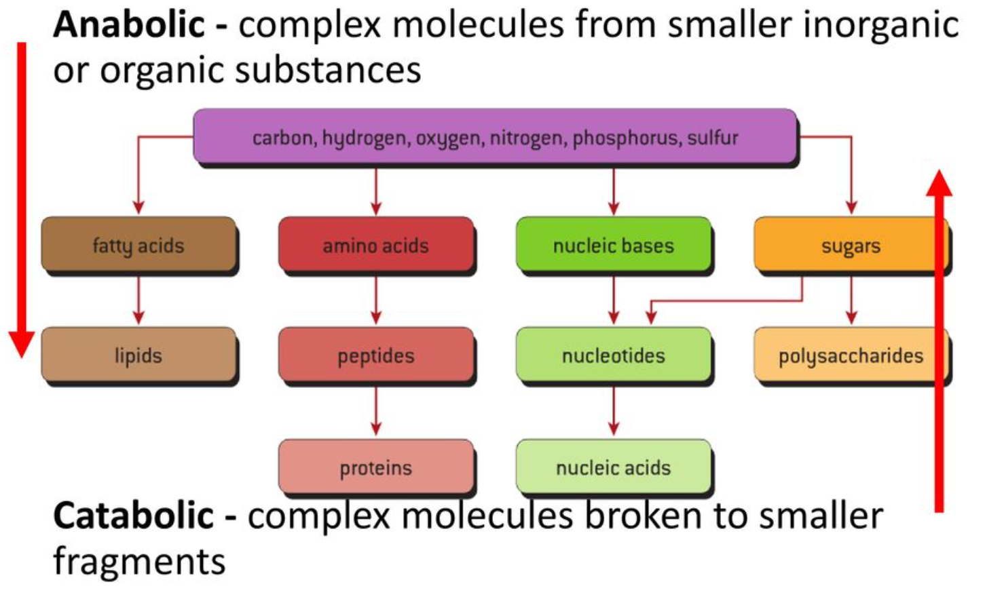
Classification of Biomolecule

Slide 7
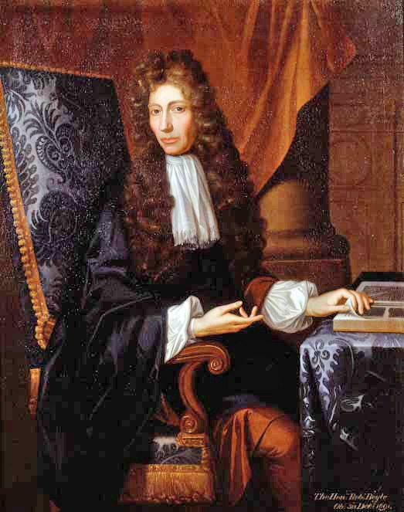
Robert Boyle
17th-century natural philosopher, chemist, physicist, and inventor, also noted for his writings in theology.
Unlike most scientists of the day, Boyle did not seek to discover new things by arguing matters logically.
Instead he was interested in making observations and drawing conclusions based on these.
It was Boyle who started the practice of conducting controlled experiments.
He used to publish his experiments while noting down his practices and the various apparatus that he used.

Slide 8
History of Biogas
Scientific interest in the gases produced by the natural decomposition of organic matter, was first reported in the sixteenth century by Robert Boyle and Stephen Hale.
They noted that inflammable gas was released by disturbing the sediment of streams and lakes.
In 1808, Sir Humphry Davy determined that methane was present in the gases produced by cattle manure.
The first anaerobic digester was built by a leper colony in Bombay, India in 1859.
In 1895 the technology was developed in Exeter, England, where a septic tank was used to generate gas for street lighting.

Slide 9
History of Biogas
England, in 1904, the first dual purpose tank for both sedimentation and sludge treatment was installed in Hampton.
1907, in Germany, a patent was issued for the Imhoff tank, an early form of digester.
Anaerobic digestion gained academic recognition in the 1930s.
This research led to the discovery of anaerobic bacteria, the microorganisms that facilitate the process.
Further research was carried out to investigate the conditions under which methanogenic bacteria were able to grow and reproduce.
This work was developed during World War II where in both Germany and France there was an increase in the application of anaerobic digestion for the treatment of manure.

Slide 10
Methane Fermentation
“When moist organic matter is allowed to decompose under restricted oxygen conditions (Anaerobic Digestion), it yields hydrogen, carbon dioxide, methane, and a variety of organic acids in greater or less amounts”
Hydrocarbons, ethers, and lignin have not been found to be fermentable.
With these exceptions the fermentation appears to proceed smoothly and continuously regardless of the chemical composition of the substrate.
Complete conversion of substrate to the two simple products, methane and carbon dioxide, is the culmination and a unique characteristic of the process.
It is important to understand, “Bacteriology of methane fermentation”.

Slide 11
Superior Biochemistry of Methane Fermentation
The most important quality of anaerobic fermentation is the fact that there is no need of pure culture of organisms.
It is not necessary to maintain purified cultures for inoculation or reinoculation.
Any decaying vegetable matter, excreta, black mud contain the required bacteria and are fit for primary inoculum.

Slide 12
Natural Bio-methanation & The Inoculum
Cattle manure contains inherent parasitic microbes, which grow in population by consuming energy available in volatile solids.
Hence cattle manure is a two in one feed material and easy to engineer the bio-mthanation (digestion) system or digester.
The other feed material (de-oiled cake) need a source of parasitic microbes to start the processes.
These feed materials must be receptive to parasitic microbes added through inoculum.
Living element(s) of the parasite can contaminate a host feed material.
It is the "primary inoculum" that enters the host and induces the degradation.
The "secondary inoculum", resulting from the fructification of part of the contaminated host population, causes the spread in the host population
Notes:
12

Slide 13
Theoretical Methane Potential of Biomolecules Requirement
The reaction is an oxidation-reduction one involving water, represented by the empirical equation by Buswells, 1952
C_{a}H_{b}O_{c}N_{d} + X H₂O → Y CH₄ + Z CO₂ + d NH₃
X = (4a – b - 2c + 3d)/4
Number of moles per mole of ’organic matter’
Y = (4a + b – 2c – 3d)/8
Z = (4a – b + 2c + 3d)/8
C₁₆₅₆H₂₆₂₀O₄₉₄N₄₆₀ + X H₂O → Y CH₄ + Z CO₂ + d NH₃

Slide 14
Maximum Methane Potential
22.4 Nl/mol * (4a + b – 2c – 3d) mol
B_{max} =
1000 l/m³ 8 * (12a + b + 16c + 14d)g
[Nm³/g]
[Nm³] = one cubic meter of gas at standard state: 1 atm and 0 ºC
(1/2a + 1/8b – 1/4c – 3/8d)
B_{max} = 22400 *
(12a + b + 16c + 14d)
[Nm³/ton]

Slide 15
Physico-chemical Characterization of Pongamia de-Oiled Cake
De-oiled cake

Slide 16
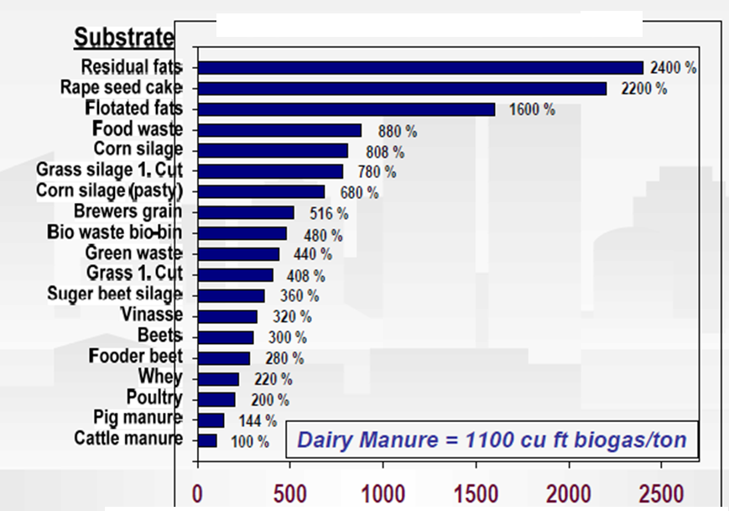
Biogas Potential of Bio-degradable Solids
Dairy Manure = 31 m³/ton

Slide 17
Practical Methane Production
Disolvability of biomass in water.
Biological degration/digestion of Volatile solids (VS) leads to production of methane
Entire VS in feed material cannot be degraded/digested.
The degradable material can only be completely converted to gas if a longer Hydraulic Retention Time (HRT) is used.
Part of the input material is inorganic (even though it may contain H).
The digestion process may not reach optimal conditions (inhibition).

Slide 18
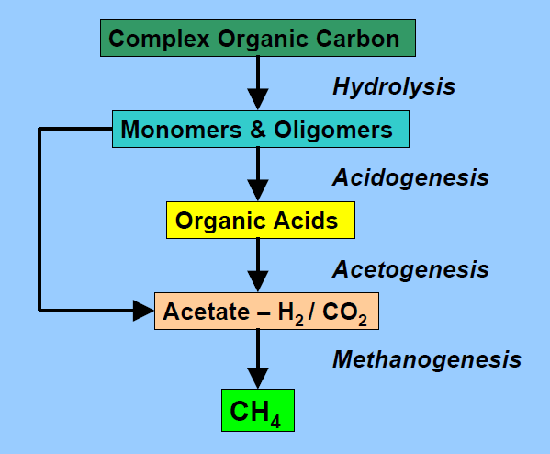
Major Biological Events in Anaerobic Digestion
hydrolytic bacteria

