Slide 1

Axiomatic Analysis of First Law
P M V Subbarao
Professor & Head
Mechanical Engineering Department
I I T Delhi
Analytics for Geometrization of thermodynamics…

Slide 2

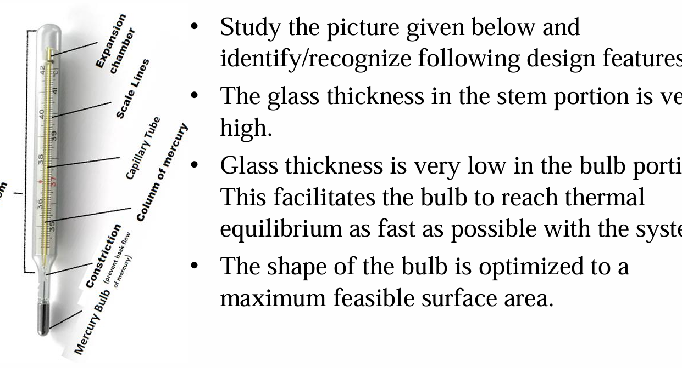
Problem Statement & sample Solution: Part -1
Prove that dynamics of equilibrium leads to design and selection of a thermometer with an appropriate value of time constant for each application

Slide 3
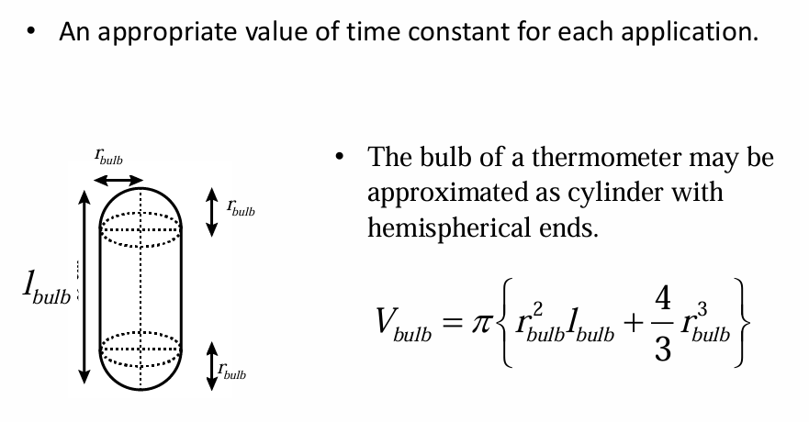
Technical Information

Slide 4
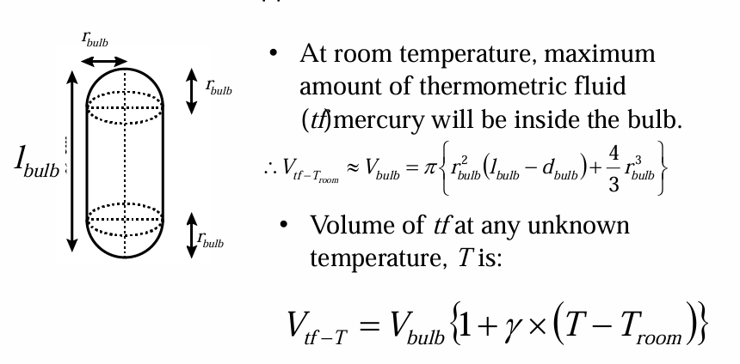
Volume of Bulb

Slide 5
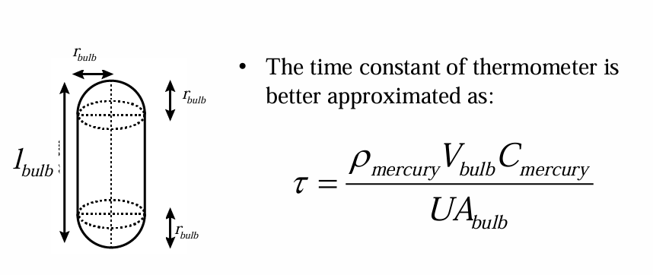
Time Constant

Slide 6
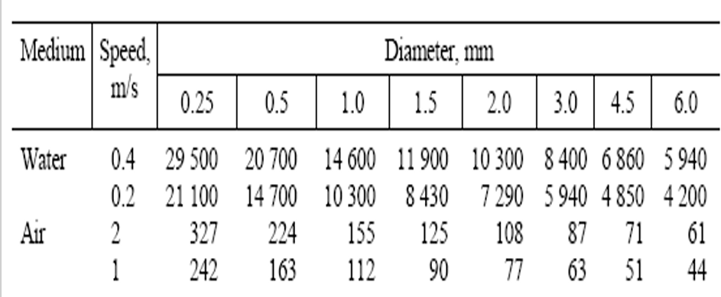
System heat transfer coefficients (U) in W/m2K @ 20 °C

Slide 7
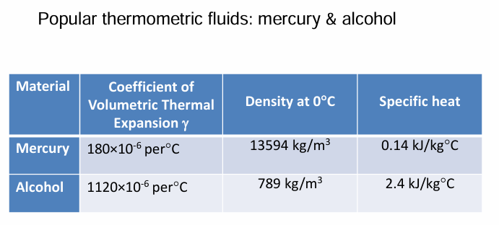
Properties of Thermometric Fluids

Slide 8
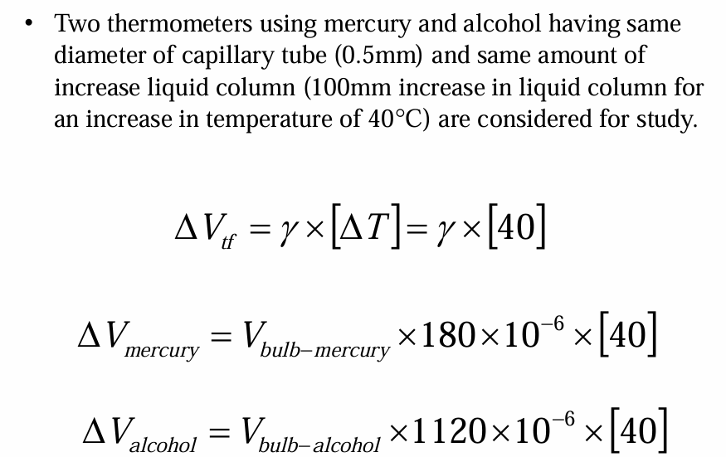
Solution : Step 1

Slide 9
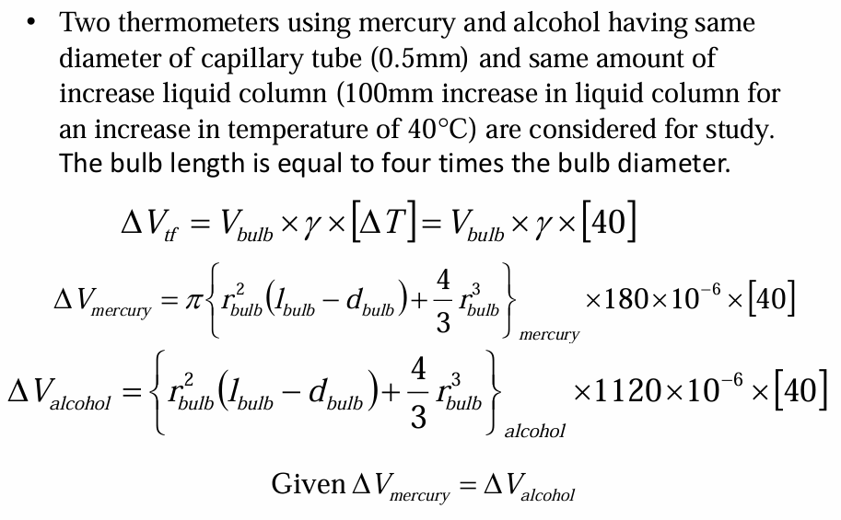
Solution : Step 1

Slide 10
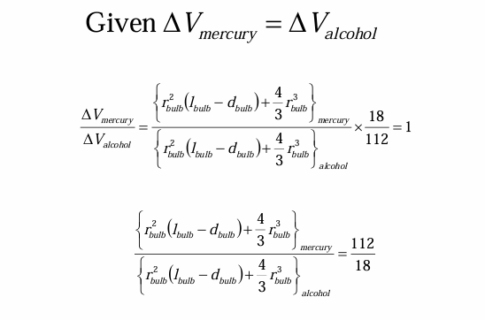
Solution : Step 2

Slide 11
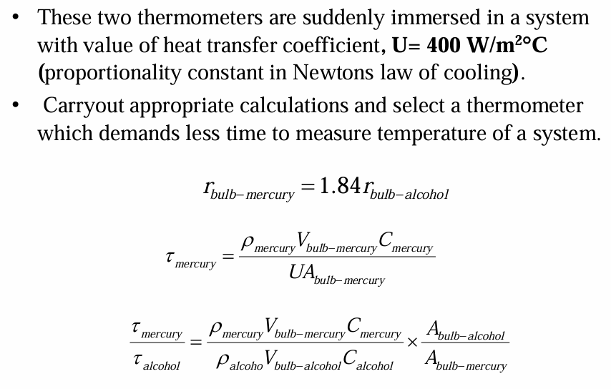
Solution : Step 3

Slide 12
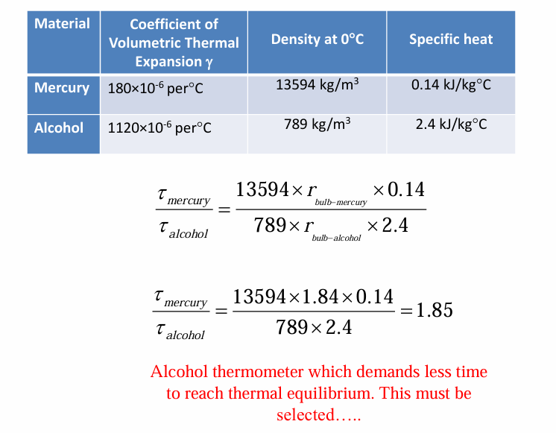
Solution : Step 3

