Slide 1

Axiomatic Thermodynamic: Work & Internal Energy
P M V Subbarao
Professor
Mechanical Engineering Department
I I T Delhi
Geometrization of thermodynamics…
Accurate Engine Modelling was A Geometry for Rankine…

Slide 2

Axiomatic System
An axiomatic system is an ensemble of declarations (statements)
These axioma are the starting elements of a mathematical project,
Axioms are held to be self-evident.
Axioms are considered like mathematical propositions even if during the development of the project they are not cited.
They can be either geometric, arithmetic and logical.

Slide 3
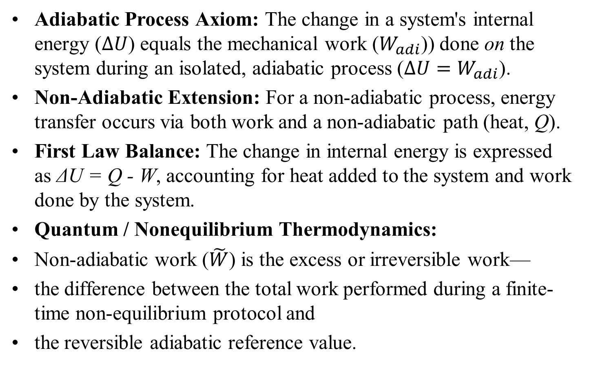
Axiom for General Thermodynamic Work
Adiabatic Process Axiom: The change in a system's internal energy ($∆U$) equals the mechanical work ($W_{adi}$)) done on the system during an isolated, adiabatic process ($∆U=W_{adi}$).
Non-Adiabatic Extension: For a non-adiabatic process, energy transfer occurs via both work and a non-adiabatic path (heat, Q).
First Law Balance: The change in internal energy is expressed as ΔU = Q - W, accounting for heat added to the system and work done by the system.
Quantum / Nonequilibrium Thermodynamics:
Non-adiabatic work ($\tilde{W}$) is the excess or irreversible work—
the difference between the total work performed during a finite-time non-equilibrium protocol and
the reversible adiabatic reference value.

Slide 4
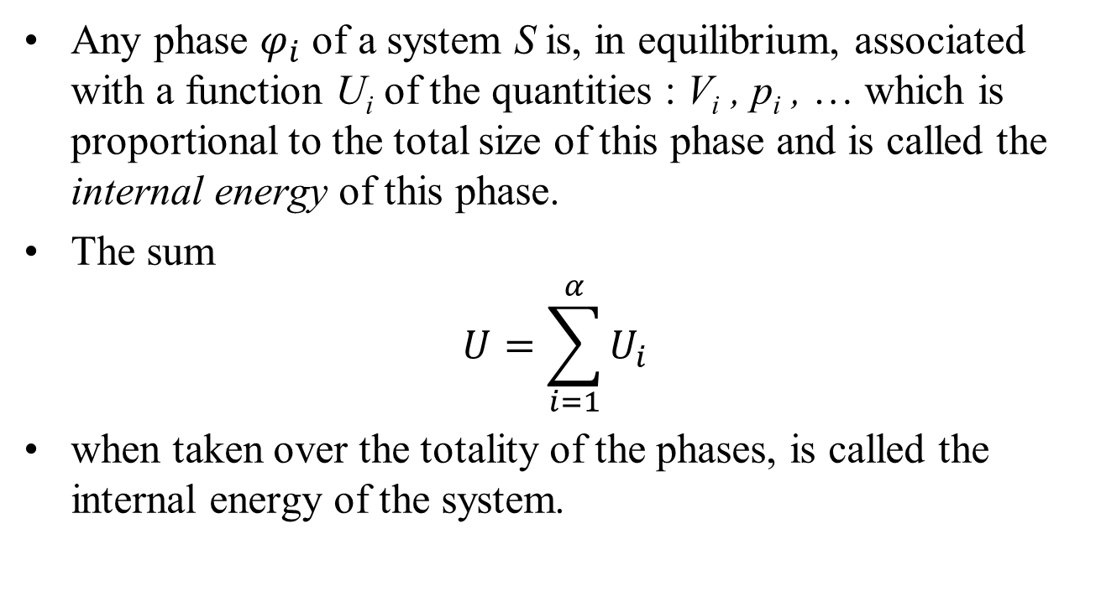
Axiom for Internal Energy
Any phase $φ_{i}$ of a system S is, in equilibrium, associated with a function U_{i} of the quantities : V_{i} , p_{i} , … which is proportional to the total size of this phase and is called the internal energy of this phase.
The sum
$$U=\sum_{i=1}^{α}{U_{i}}$$
when taken over the totality of the phases, is called the internal energy of the system.

Slide 5
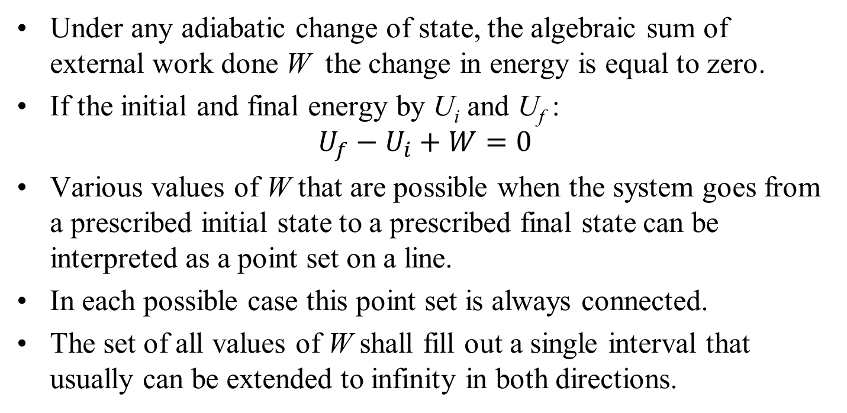
Axiom for Adiabatic Thermodynamic Work
Under any adiabatic change of state, the algebraic sum of external work done W the change in energy is equal to zero.
If the initial and final energy by U_{i} and U_{f} :
$$U_{f}−U_{i}+W=0$$
Various values of W that are possible when the system goes from a prescribed initial state to a prescribed final state can be interpreted as a point set on a line.
In each possible case this point set is always connected.
The set of all values of W shall fill out a single interval that usually can be extended to infinity in both directions.

Slide 6
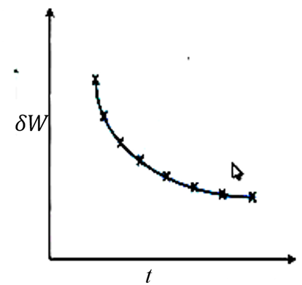
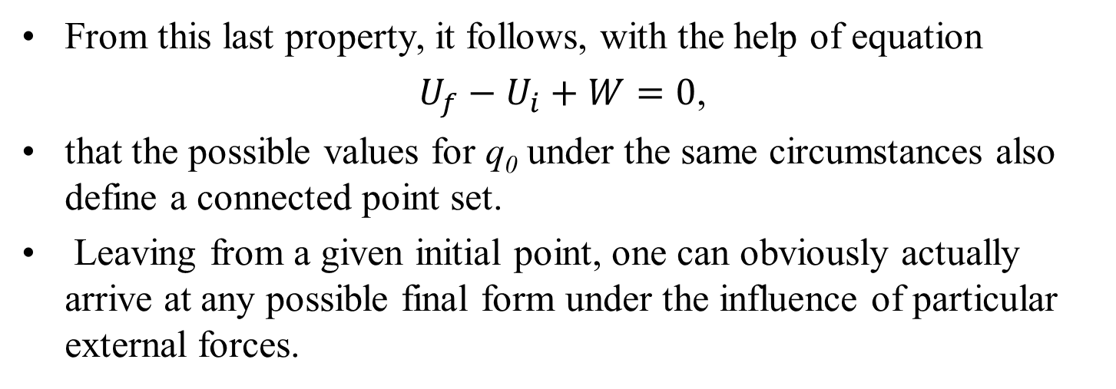
Third Property of Simple Thermodynamic System
From this last property, it follows, with the help of equation
$U_{f}−U_{i}+W=0$,
that the possible values for q₀ under the same circumstances also define a connected point set.
Leaving from a given initial point, one can obviously actually arrive at any possible final form under the influence of particular external forces.
Initial Equilibrium Point
Final Equilibrium Point

Slide 7
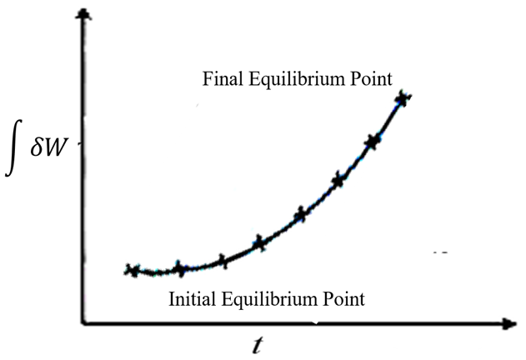
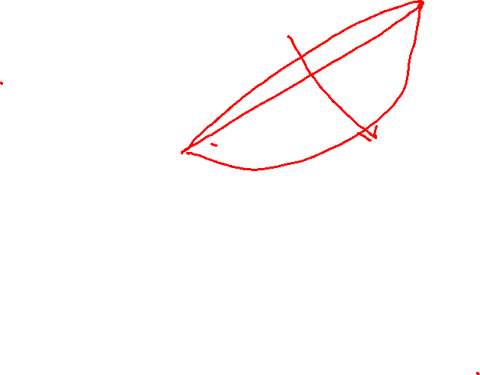
Third Property of Simple Thermodynamic System
Initial Equilibrium Point
Final Equilibrium Point

Slide 8
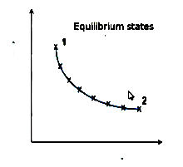
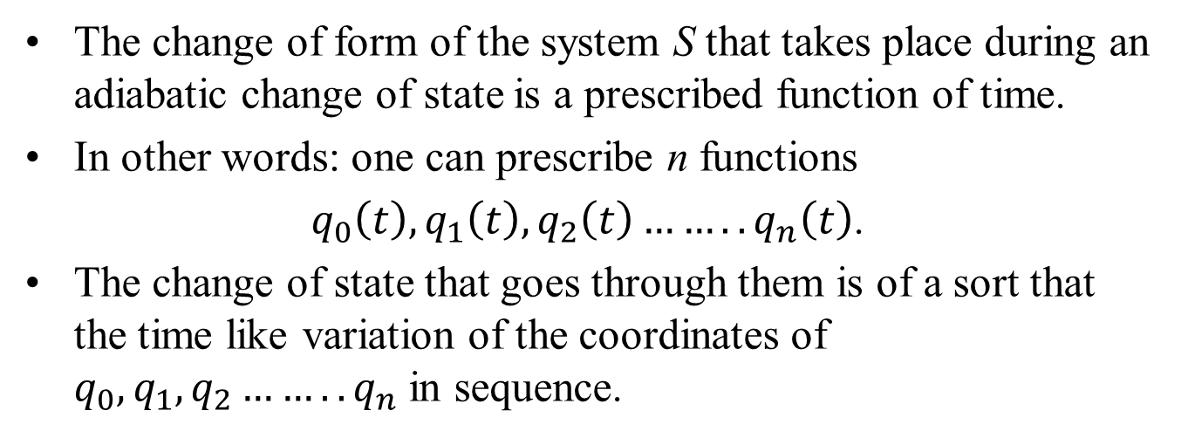

Sequence of Point Sets
The change of form of the system S that takes place during an adiabatic change of state is a prescribed function of time.
In other words: one can prescribe n functions
$q_{0}\left(t\right),q_{1}\left(t\right),q_{2}\left(t\right)……..q_{n}\left(t\right)$.
The change of state that goes through them is of a sort that the time like variation of the coordinates of $q_{0},q_{1},q_{2}……..q_{n}$ in sequence.
$$q_{i}$$
t
Geometrization of thermodynamics…

Slide 9
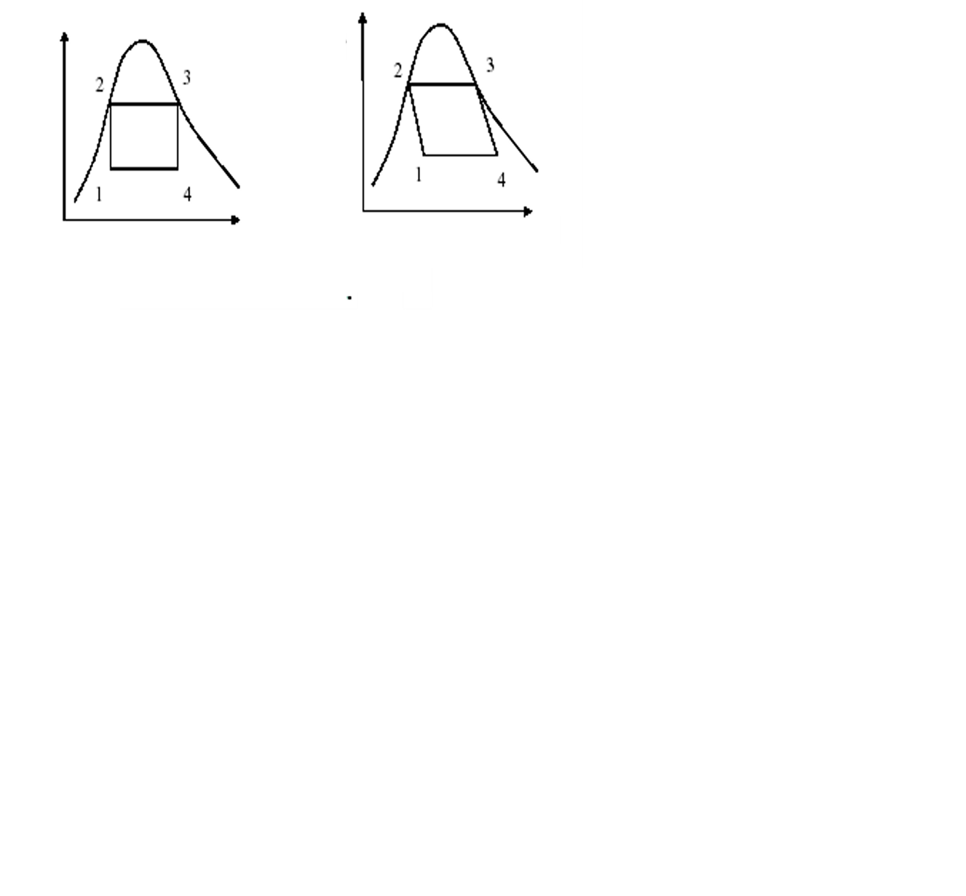
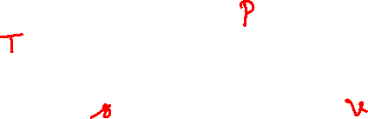
Geometrization of Carnot’s Model
for Watt’s Engine
1 – 2 : Compressor : Isentropic Compression : s₂ = s₁
2 – 3 : Boiler: Isothermal Heating : T₃ = T₂
3 – 4 : Turbines : Isentropic Expansion : s₄ = s₃
4 – 1 : Condenser: Isothermal Cooling : T₁ = T₄

Slide 10
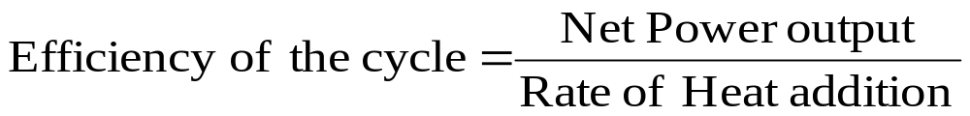
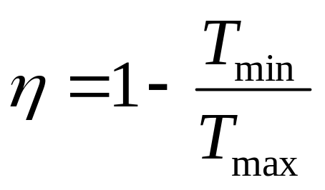
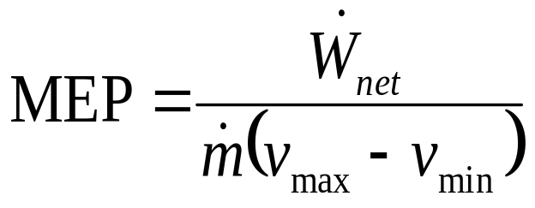
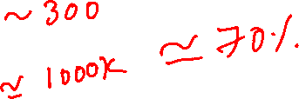
Cost to Benefit Ratio Analysis of James Watt Engine using Carnot’s Model for Cycle
Work done per unit volume of the engine: Mean Effective Pressure

Slide 11
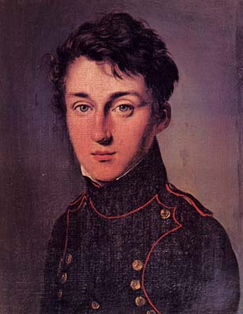
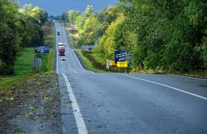

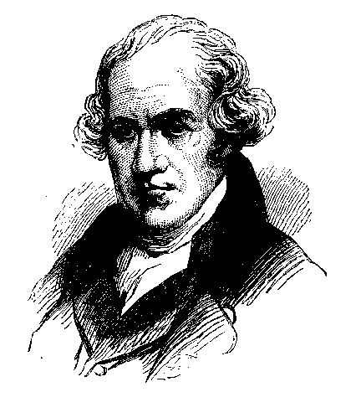
A Major Confusion: How to go from <6% to 70% Efficiency ???????

Slide 12

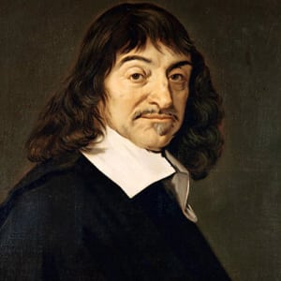
Rightly Reasoning the Change of State
Selection of A Perspective for Description of Ideas….
René Descartes
Academic, Philosopher, Mathematician, Scientist (1596–1650)
Discourse on;
The Method of Rightly Conducting the Reason and Seeking Truth in the Sciences.
Published in 1637.

Slide 13
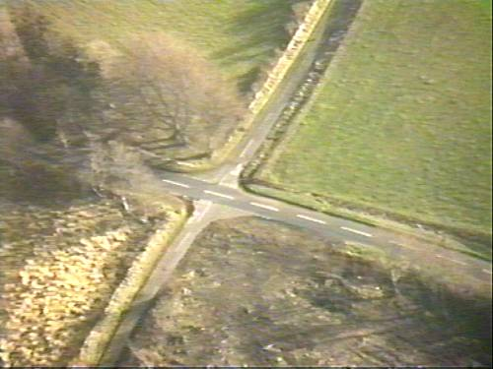
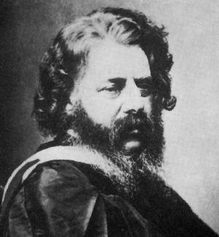
A Major Crossroad Confusion: How to go from <6% to 75% Efficiency ???????

Slide 14
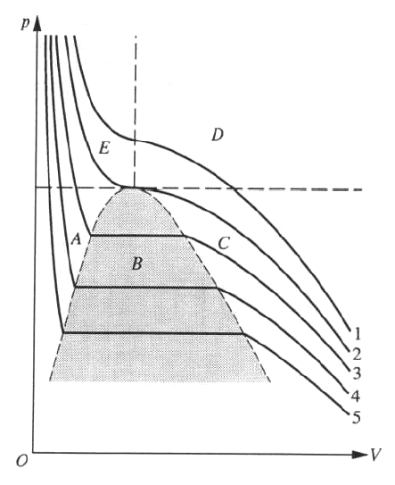
Geometrical Modelling of An Engine
Isotherms

Slide 15
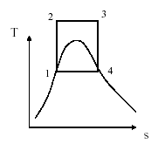
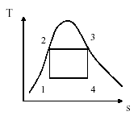
Geometrical Variations of
Carnot Model for Optimization of Power Plant
Μinimize the capital & running costs.
Compact and efficient.

Slide 16
Rankine, William John Macquorn
(1820-1872)
In 1849 he delivered two papers on the subject of heat, and in 1849 he showed the further modifications required to French physicist Sadi Carnot's theory of thermodynamics.
“A Manual of the Steam Engine and other Prime Movers 1859”

Slide 17
A MANUAL of the STEAM ENGINE and other PRIME MOVERS 1859 Rankine
The conventional name “work of the thermodynamics ” by Rankine.
Harmony meaning of this work becomes " the manual of the steam engine and the other motive for action machines.’’
Rankine is the largest meritorious person who in addition raises the technology of the steam engine to science, the word, "energy " is something due to him.
This was related to the policy of researching the steam engine theoretically, brought the progress of the steam engine.

Slide 18
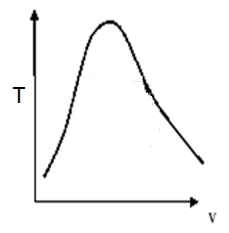
Rankine’s Geometrization Individual Change of states of Carnot Cycle : Step 1
W J M Rankine ~ 1859
To avoid transporting and compressing two-phase fluid, try to condense all fluid exiting from the turbine into saturated liquid
s

Slide 19
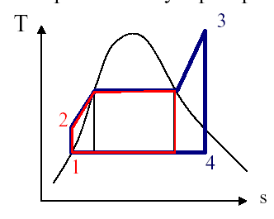
How about a modified cycle thru Geometry:
A Rankine cycle
when the saturated vapor enters the turbine, its temperature and pressure decrease and liquid droplets will form by condensation.
These droplets can produce significant damages to the turbine blades due to corrosion and impact.
x
One possible solution: superheating the vapor.
It can also increase the thermal efficiency of the cycle.

Slide 20
Rankine’s Geometrization Individual Change of states of Carnot Cycle : Step 2
2C
3C
W J M Rankine ~ 1859
1R
4C
1C
The condensed liquid is pumped back into the boiler.
s

Slide 21
Rankine’s Geometrization Individual Change of states of Carnot Cycle : Step 3
2C
3C
W J M Rankine ~ 1859
2R
1R
4C
1C
Rankine explained how a liquid in the boiler vaporized by the addition of heat
s

Slide 22
Ideal Rankine Cycle : Variable Temperature Heat Addition

Slide 23
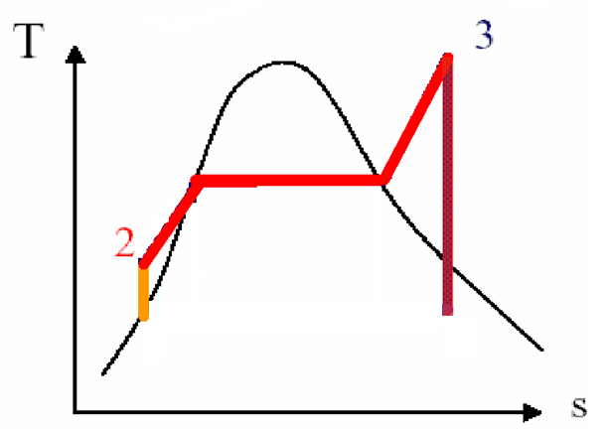
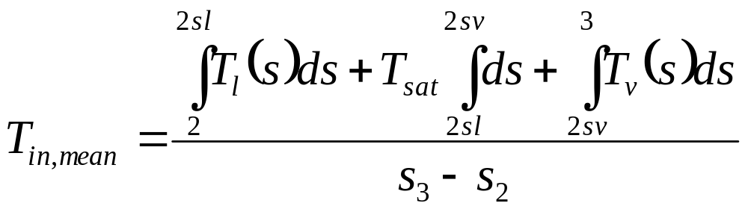
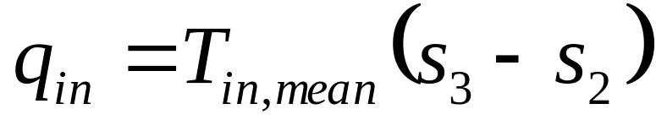
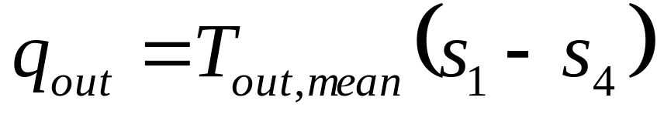
Carnot Temperatures in A Rankine Cycle
Mean Temperature of Heat Addition:

Slide 24
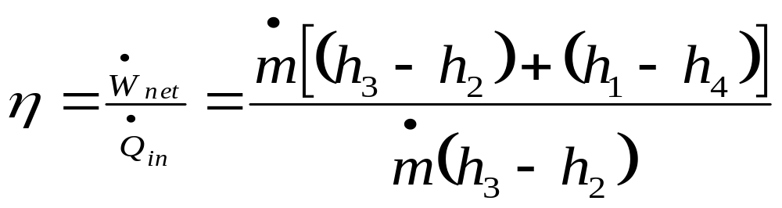
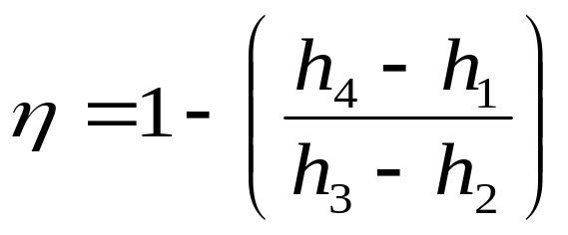
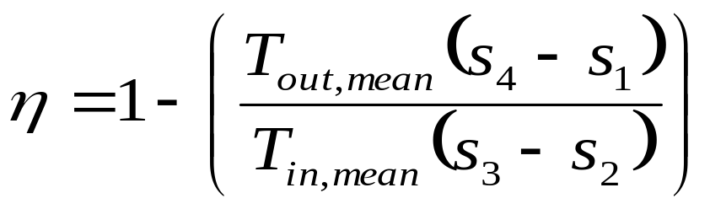
Performance Analysis of Rankine Cycle

Slide 25

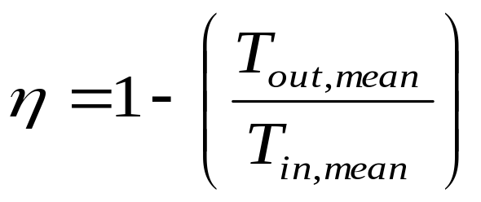
Carnot Model of The Rankine Cycle
s_{min}
s_{max}
Modified Carnot Theory: Higher the Mean effective temperature of heat addition, higher will be the cycle efficiency.
The working substance and operating conditions must be selected to enhance MET of HA.

Slide 26
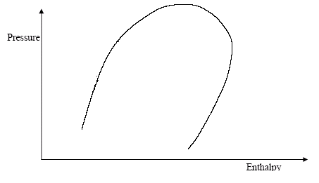
Increasing of Mean Temperature of Heat Addition
p_{max}=17Mpa
η=42.05%
T_{in,mean}=284.4⁰C
T_{max}=550⁰C
3
2
3
2
p_{max}=5Mpa
η =37.8%
T_{in,mean}=246.3⁰C
1
1
4
4

Slide 27
Progress in Rankine Cycle
Year | 1907 | 1919 | 1938 | 1950 | 1958 | 1959 | 1966 | 1973 | 1975
MW | 5 | 20 | 30 | 60 | 120 | 200 | 500 | 660 | 1300
p,MPa | 1.3 | 1.4 | 4.1 | 6.2 | 10.3 | 16.2 | 15.9 | 15.9 | 24.1
T_{max} ºC | 260 | 316 | 454 | 482 | 538 | 566 | 566 | 565 | 538
Pc,kPa | 7.5 | 7.5 | 7.5 | 7.5 | 7.5 | 7.5 | 7.5 | 7.5 | 7.5
η,%
Year | 1907 | 1919 | 1938 | 1950 | 1958 | 1959 | 1966 | 1973 | 1975
MW | 5 | 20 | 30 | 60 | 120 | 200 | 500 | 660 | 1300
p,MPa | 1.3 | 1.4 | 4.1 | 6.2 | 10.3 | 16.2 | 15.9 | 15.9 | 24.1
T_{max} ºC | 260 | 316 | 454 | 482 | 538 | 566 | 566 | 565 | 538
Pc,kPa | 13.5 | 5.1 | 4.5 | 3.4 | 3.7 | 3.7 | 4.4 | 5.4 | 5.1
η,% | -- | ~17 | 27.6 | 30.5 | 35.6 | 37.5 | 39.8 | 39.5 | 40

