Slide 1

Mathematical Description of Thermodynamic
Change of State
https://web.ist.utl.pt/berberan/data/68.pdf
P M V Subbarao
Professor
Mechanical Engineering Department
I I T Delhi
Turning Thermodynamic systems into clear equations
Initiated by Constantin Carathéodory

Slide 2

Infusion of Analytical Ideas into Creation of Artificial Animals
Sir James Watt is an ingenious engineering scientist, who carried out most useful hardware research and development.
He was not aware of many of the thermodynamic quantities.
Later engineers used Charles and Boyle laws in sizing of cylinder.
Prof. James Black carriedout research to determine specific heats of steam and water.
There was a gradual infusion of analytical and theoretical research into basic hardware development.
Analytical methods helped in removal of uncertainty in engine operation.
Many theoreticians got motivated to work on theory of James Watt Engine.

Slide 3
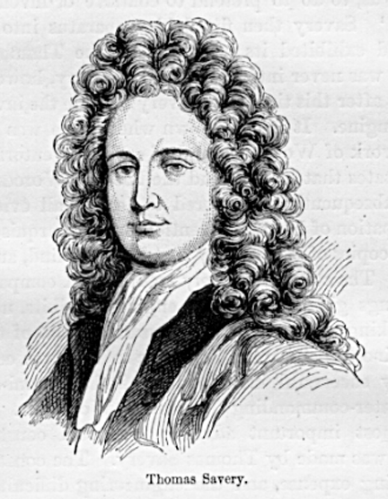
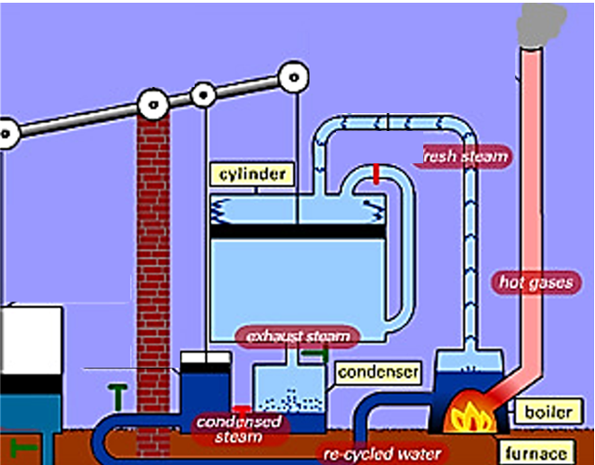
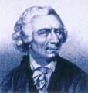
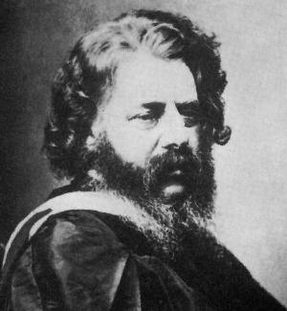
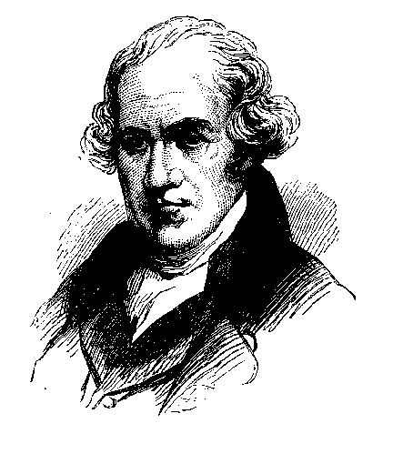
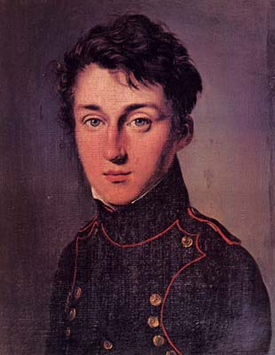
A Help Provided by Two Systems On their Way To Reach Equilibrium

Slide 4
Outlines of the Science of Energetics (1855) by William John Macquorn Rankine
Proceedings of the Royal Philosophical Society of Glasgow, Volume 3, by Royal Philosophical Society of Glasgow, 1855. pp.121-141.
The object of the present paper is, to present the principles, forming part of a science whose subjects are, material bodies and physical phenomena in a more systematic form.
It is proposed to call the Science Of Energetics.
Definition of new terms: Substance, Property, Mass, Accident, Effort, or Active Accident, Passive Accident, Radical Accident, Effort as a Measure of Mass, Work. Energy, Actual and Potential.
Carnot theory is a special case of “Science of Energetics”

Slide 5
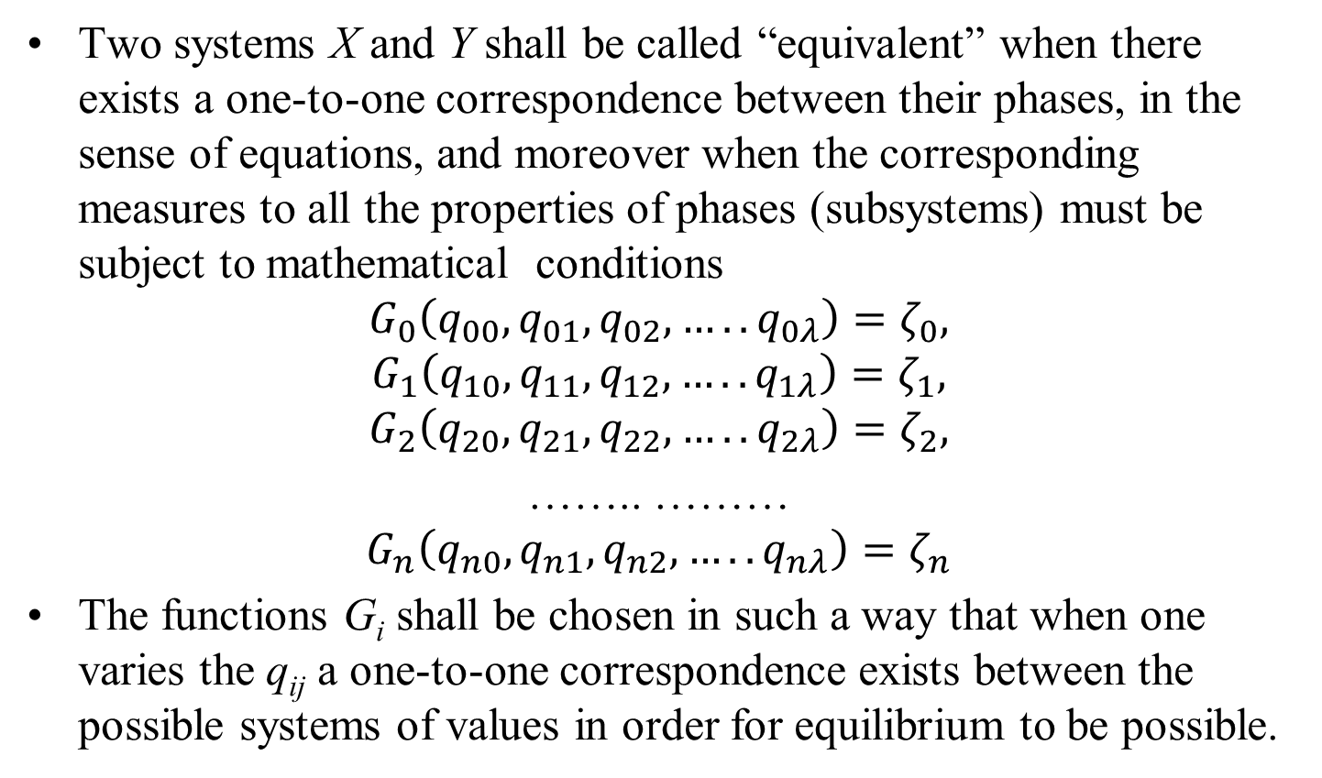
Equivalent Macrosystems
Two systems X and Y shall be called “equivalent” when there exists a one-to-one correspondence between their phases, in the sense of equations, and moreover when the corresponding measures to all the properties of phases (subsystems) must be subject to mathematical conditions
$$G_{0}\left(q_{00},q_{01},q_{02}, …..q_{0λ}\right)=ζ_{0},$$
$$G_{1}\left(q_{10},q_{11},q_{12}, …..q_{1λ}\right)=ζ_{1},$$
$$G_{2}\left(q_{20},q_{21},q_{22}, …..q_{2λ}\right)=ζ_{2},$$
…….. ………
$$G_{n}\left(q_{n0},q_{n1},q_{n2}, …..q_{nλ}\right)=ζ_{n}$$
The functions G_{i} shall be chosen in such a way that when one varies the q_{ij} a one-to-one correspondence exists between the possible systems of values in order for equilibrium to be possible.

Slide 6
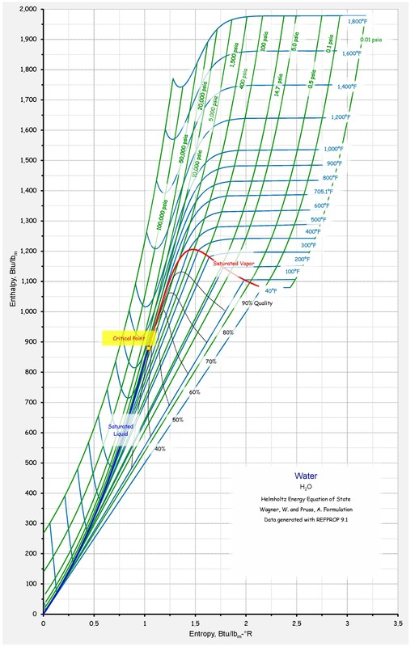
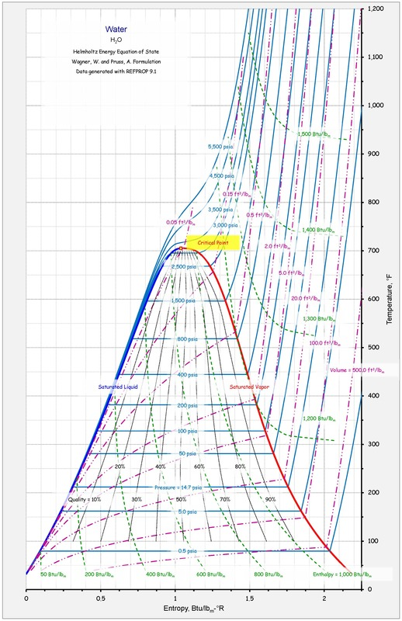
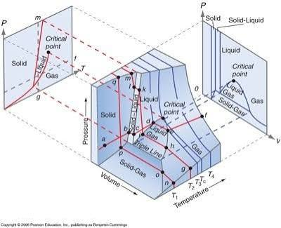
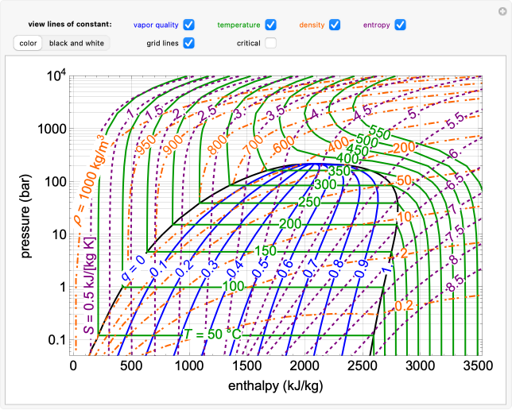
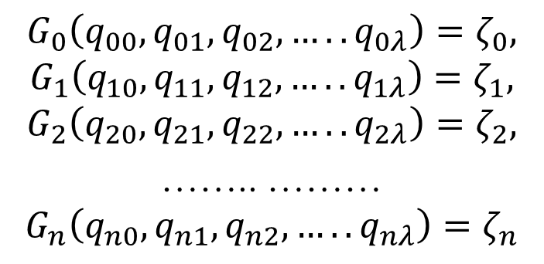
Equivalent Macrosystems
$$G_{0}\left(q_{00},q_{01},q_{02}, …..q_{0λ}\right)=ζ_{0},$$
$$G_{1}\left(q_{10},q_{11},q_{12}, …..q_{1λ}\right)=ζ_{1},$$
$$G_{2}\left(q_{20},q_{21},q_{22}, …..q_{2λ}\right)=ζ_{2},$$
…….. ………
$$G_{n}\left(q_{n0},q_{n1},q_{n2}, …..q_{nλ}\right)=ζ_{n}$$

Slide 7
Equivalent Macrosystems
Definition II:
In order to characterize the equilibrium points of a system, the state coordinates come into consideration exclusively, and two equivalent systems for which these quantities agree shall be identical objects from the thermodynamic standpoint.
“Changes of States” of two equivalent systems are transitions of these systems from one equilibrium point into another.
The coordinates of the initial state and final state are to be regarded in this way.
There exist a quantity that is associated with each change of state, and which one calls the external work.

Slide 8
Change of State & External Work
This new quantity, which we denote by W, shall originate in the systems that are considered here exclusively from the deformations of the external form of X or Y or S.
This quantity shall be identical with the mechanical work that any force delivers when it is exerted by any bodies that lie on the exterior of S (but contact the system) during the change of state considered.
The physical meaning of these forces is clear, and one can also measure W at any time by means of certain mechanical devices.
Technology for testing steam and gas motors is an important example.

Slide 9

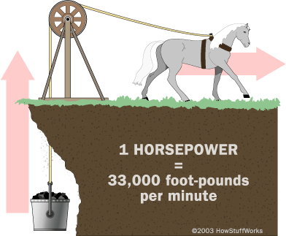
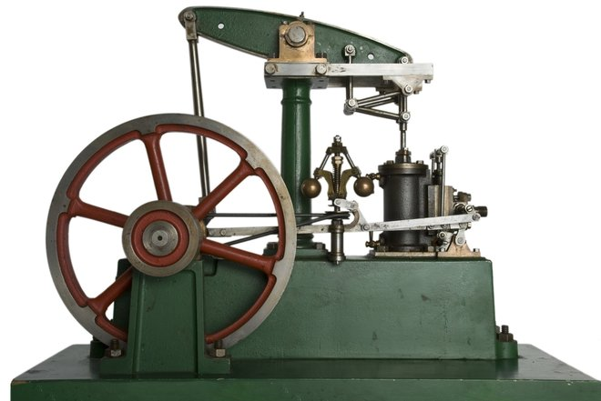
James Watts Evaluation of An Artificial Horse

Slide 10
Change of State & External Work
Finally, the change of state is associated with a special feature.
Namely, when the system W is adiabatically isolated during the entire time interval of a change of state one calls that change of state itself adiabatic.
The adiabatic changes of state shall define a particular class.
Definition III:
Each change of state will be characterized by the coordinates of the initial state and the final state, the external force that is applied to them, and the given of whether they are adiabatic or not.

Slide 11
Need for Special Axioms
Axioms are basic rules or starting truths.
Every logical system, math problem, or argument must start with Axiom(s).
Without a starting point, you would chase an endless loop of trying to prove every single reason behind a previous reason.
Stop infinite regress: They prevent an endless chain of "why?" questions by giving a clear starting point.
Build a solid base: They act like foundation blocks for a house; all complex proofs and laws safely rest on top of them.
Set the rules of the game: They define how a specific math system or logical world works (for example, changing one basic geometry axiom changes whether your space is flat or curved).

Slide 12
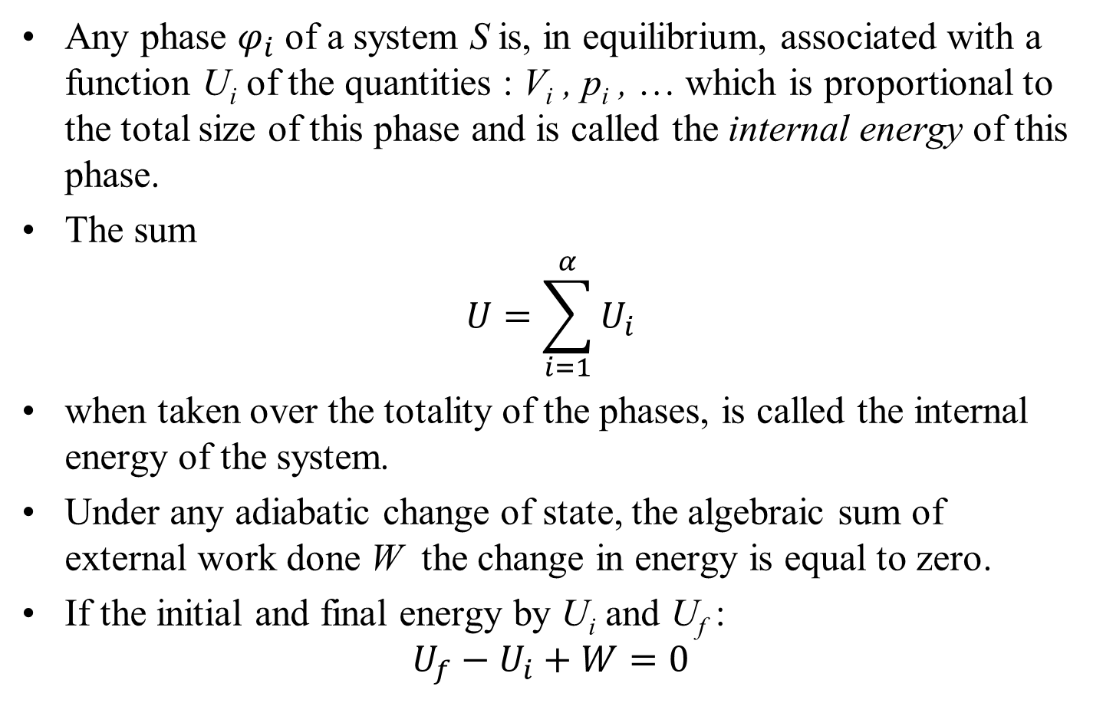
Axioms for Derived State Properties
Any phase $φ_{i}$ of a system S is, in equilibrium, associated with a function U_{i} of the quantities : V_{i} , p_{i} , … which is proportional to the total size of this phase and is called the internal energy of this phase.
The sum
$$U=\sum_{i=1}^{α}{U_{i}}$$
when taken over the totality of the phases, is called the internal energy of the system.
Under any adiabatic change of state, the algebraic sum of external work done W the change in energy is equal to zero.
If the initial and final energy by U_{i} and U_{f} :
$$U_{f}−U_{i}+W=0$$

Slide 13
Simple Thermodynamic System
The properties that characterize “simple systems” are of a diverse nature.
First, all of the state coordinates of S except for one shall depend upon only the external form of the system.
These coordinates that establish the external form deformation coordinates.
A second assumption that shall be valid for simple systems is that the external work that is done during an adiabatic change of state shall not be uniquely determined in terms of the initial and final states alone.
This assumption has the consequence that the energy U, when regarded as a function of the coordinates q_{i}, includes that coordinate that does not depend upon the external form of S.

Slide 14
Simple Thermodynamic System
Let q₀ be energy coordinate, and, by contrast, let q₁, q₂, ., …, q_{n} be the coordinates of the deformation of the system.
Let us consider the various values of W that are possible when the system goes from a prescribed initial state to a prescribed final state.
It can be interpreted the totality of all these values as a point set on a line.
As a third property of simple systems, we would like to assume that in each possible case this point set is always connected.
The set of all values of W shall fill out a single interval that usually can be extended to infinity in both directions.

