Slide 1

Mathematical Description of Thermodynamic Equilibrium, State …
P M V Subbarao
Professor
Mechanical Engineering Department
I I T Delhi
Methods to Develop Accurate Models for A Material …

Slide 2

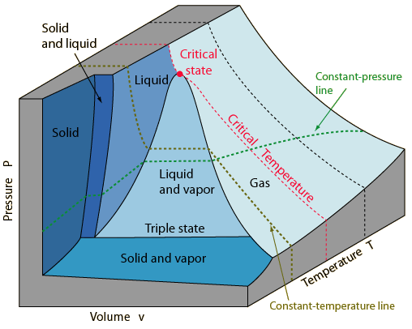
Long Lasting Equilibrium Conditions

Slide 3

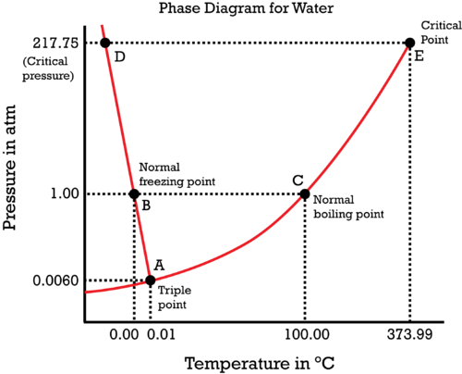
A (Easy) collection of Equilibrium States for Water: p-T Projection

Slide 4
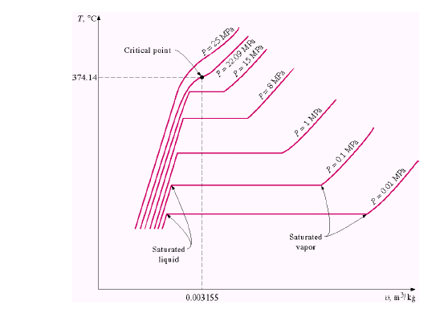
T-v Projection
The saturated liquid line:
If Macrosystem contains only one chemical matter,
Saturation Pressure is function of temperature or vice versa.
T = F(p)
The saturated vapor line:
These two lines intersect at the critical point and form what is often called the “steam dome.”
The critical point of water is 374.14ºC, 22.09 MPa

Slide 5
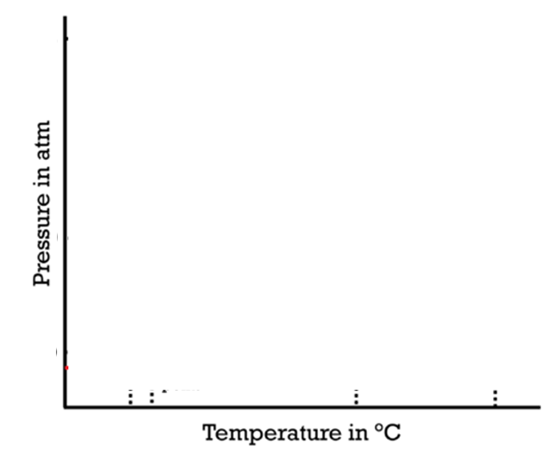
A (Easy) collection of Equilibrium States for Water: p-T Projection
Critical Point, B
Critical Point, A
Critical Point, C
Triple Point, C
Triple Point, A
Triple Point, B

Slide 6
It is possible to Create A Mathematics for Macrosystem

Slide 7
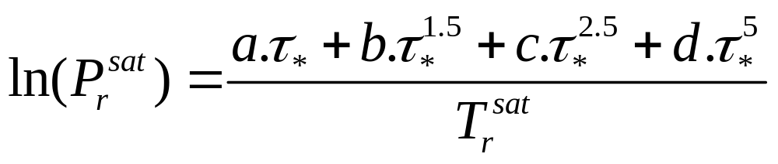
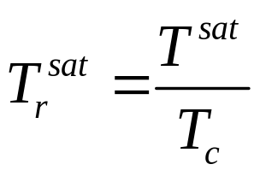
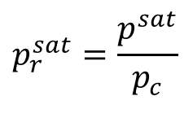
A Universal (Easy) collection of Equilibrium States : p-T Projection
1
Critical Point
The Wagner-Ambrose equation
$$p_{r}^{sat}=\frac{p^{sat}}{p_{c}}$$
~ 0
Triple Point

Slide 8
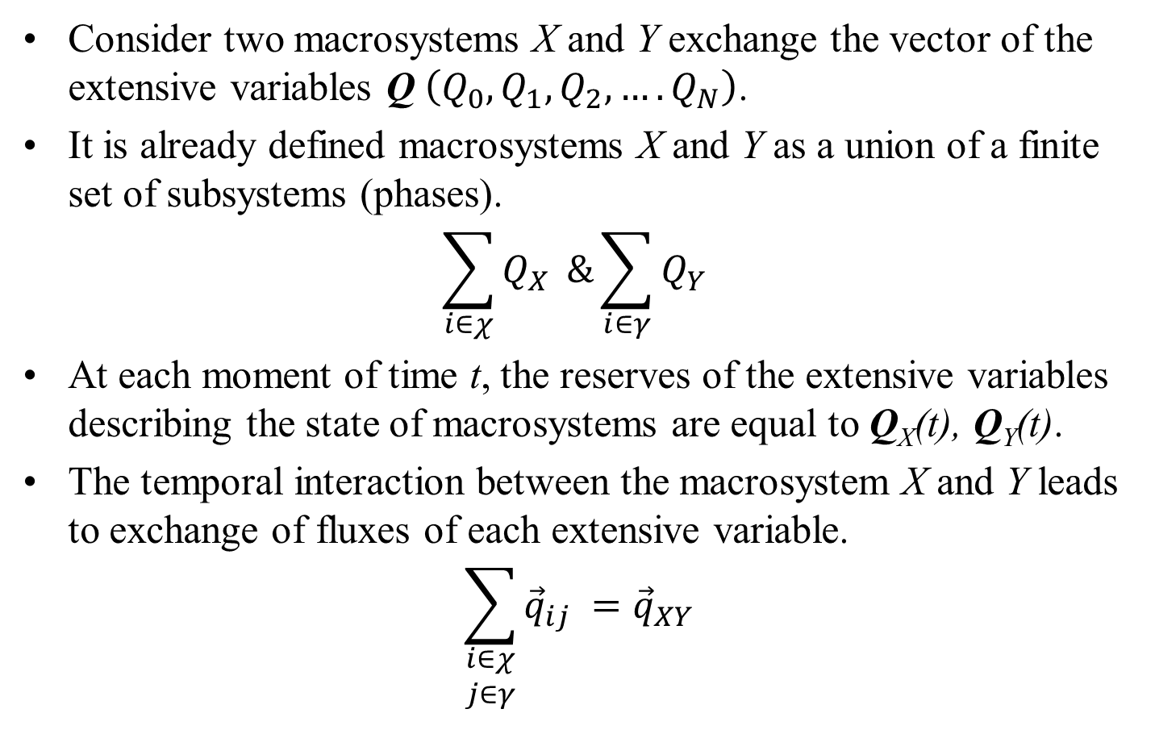
Equilibrium State of the Macrosystem
Consider two macrosystems X and Y exchange the vector of the extensive variables Q $\left(Q_{0},Q_{1},Q_{2},….Q_{N}\right)$.
It is already defined macrosystems X and Y as a union of a finite set of subsystems (phases).
$$\sum_{i∈χ}{Q_{X} }\&\sum_{i∈γ}{Q_{Y} }$$
At each moment of time t, the reserves of the extensive variables describing the state of macrosystems are equal to Q_{X}(t), Q_{Y}(t).
The temporal interaction between the macrosystem X and Y leads to exchange of fluxes of each extensive variable.
$$\sum_{\begin{aligned}i∈χ \\ j∈γ\end{aligned}}{{\vec{q}}_{ij} }={\vec{q}}_{XY}$$

Slide 9
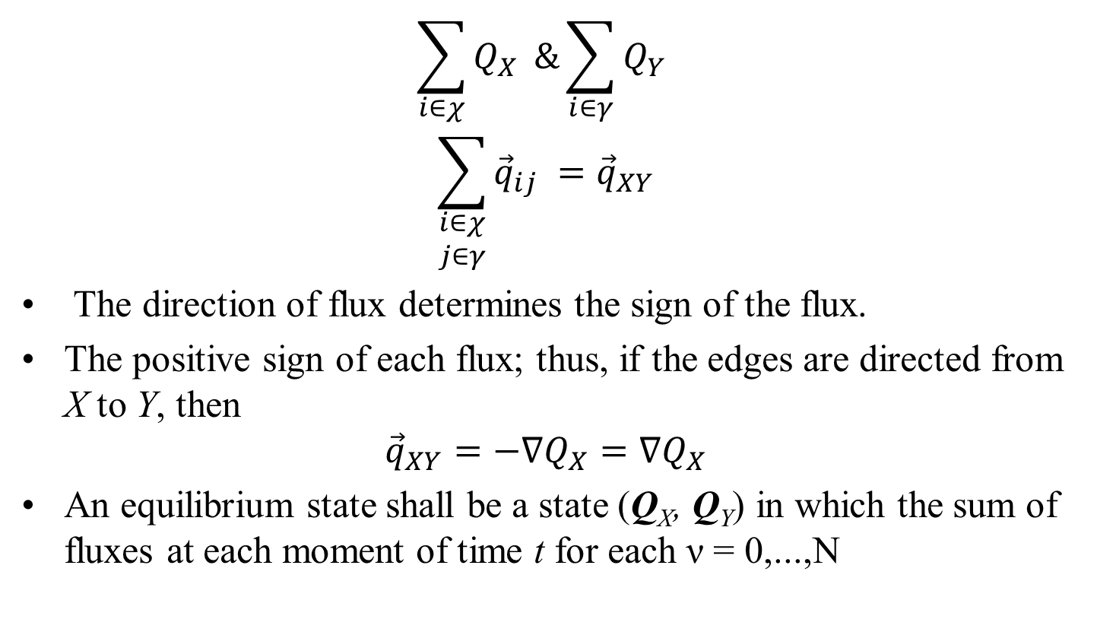
Equilibrium State of the Macrosystem
$$\sum_{i∈χ}{Q_{X} }\&\sum_{i∈γ}{Q_{Y} }$$
$$\sum_{\begin{aligned}i∈χ \\ j∈γ\end{aligned}}{{\vec{q}}_{ij} }={\vec{q}}_{XY}$$
The direction of flux determines the sign of the flux.
The positive sign of each flux; thus, if the edges are directed from X to Y, then
$${\vec{q}}_{XY}=−∇Q_{X}=∇Q_{X}$$
An equilibrium state shall be a state (Q_{X}, Q_{Y}) in which the sum of fluxes at each moment of time t for each ν = 0,...,N

Slide 10
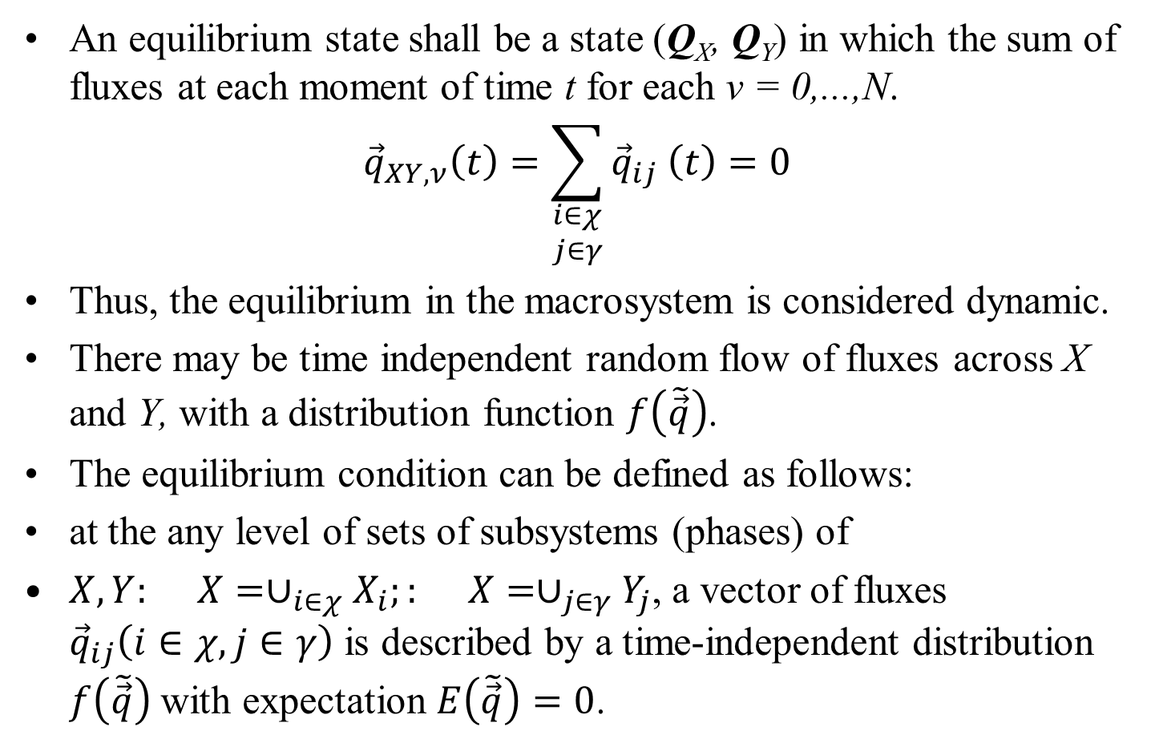
Equilibrium State of the Macrosystem
An equilibrium state shall be a state (Q_{X}, Q_{Y}) in which the sum of fluxes at each moment of time t for each ν = 0,...,N.
$${\vec{q}}_{XY,ν}\left(t\right)=\sum_{\begin{aligned}i∈χ \\ j∈γ\end{aligned}}{{\vec{q}}_{ij} \left(t\right)}=0$$
Thus, the equilibrium in the macrosystem is considered dynamic.
There may be time independent random flow of fluxes across X and Y, with a distribution function $f\left(\tilde{\vec{q}}\right)$.
The equilibrium condition can be defined as follows:
at the any level of sets of subsystems (phases) of
$X,Y: X=∪_{i∈χ}X_{i};: X=∪_{j∈γ}Y_{j}$, a vector of fluxes ${\vec{q}}_{ij}\left(i∈χ,j∈γ\right)$ is described by a time-independent distribution $f\left(\tilde{\vec{q}}\right)$ with expectation $E\left(\tilde{\vec{q}}\right)=0$.

Slide 11
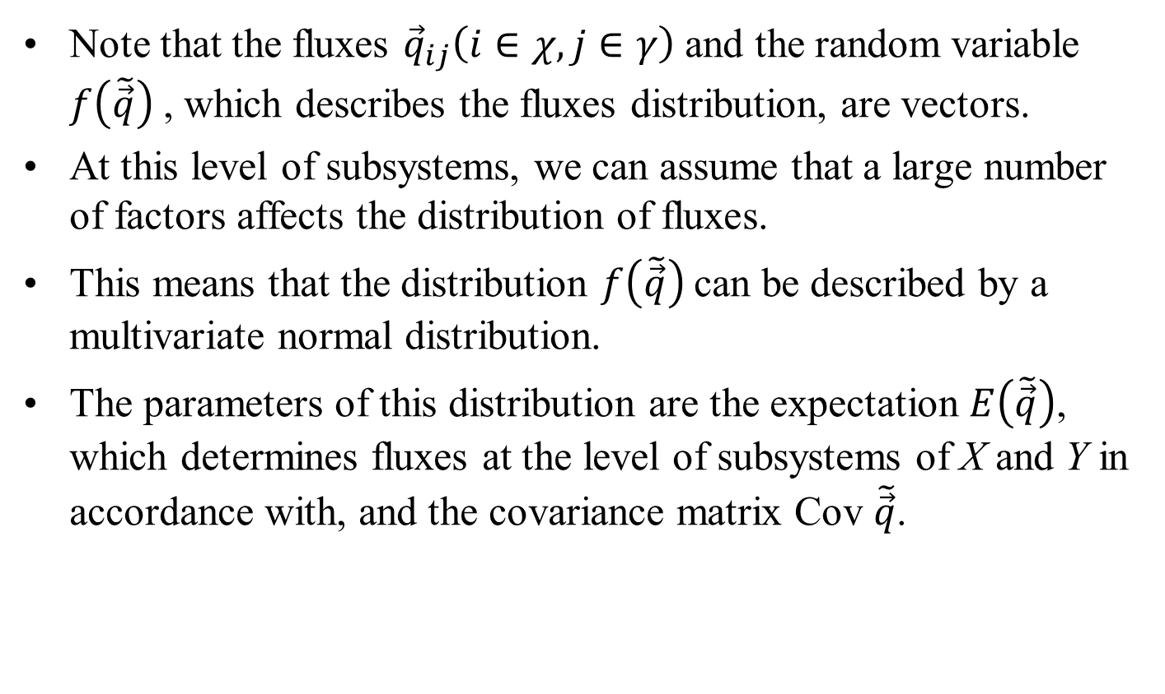
Equilibrium State of the Macrosystem
Note that the fluxes ${\vec{q}}_{ij}\left(i∈χ,j∈γ\right)$and the random variable $f\left(\tilde{\vec{q}}\right)$ , which describes the fluxes distribution, are vectors.
At this level of subsystems, we can assume that a large number of factors affects the distribution of fluxes.
This means that the distribution $f\left(\tilde{\vec{q}}\right)$can be described by a multivariate normal distribution.
The parameters of this distribution are the expectation $E\left(\tilde{\vec{q}}\right)$, which determines fluxes at the level of subsystems of X and Y in accordance with, and the covariance matrix Cov $\tilde{\vec{q}}$.

Slide 12
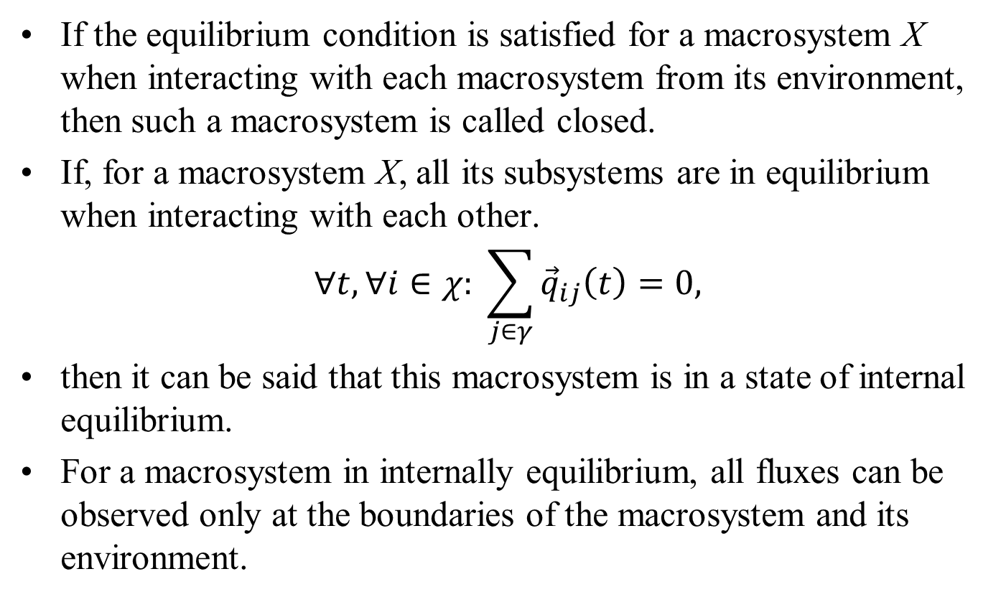
Equilibrium State of the Macrosystem
If the equilibrium condition is satisfied for a macrosystem X when interacting with each macrosystem from its environment, then such a macrosystem is called closed.
If, for a macrosystem X, all its subsystems are in equilibrium when interacting with each other.
$$∀t,∀i∈χ: \sum_{j∈γ}{{\vec{q}}_{ij}\left(t\right)}=0,$$
then it can be said that this macrosystem is in a state of internal equilibrium.
For a macrosystem in internally equilibrium, all fluxes can be observed only at the boundaries of the macrosystem and its environment.

Slide 13
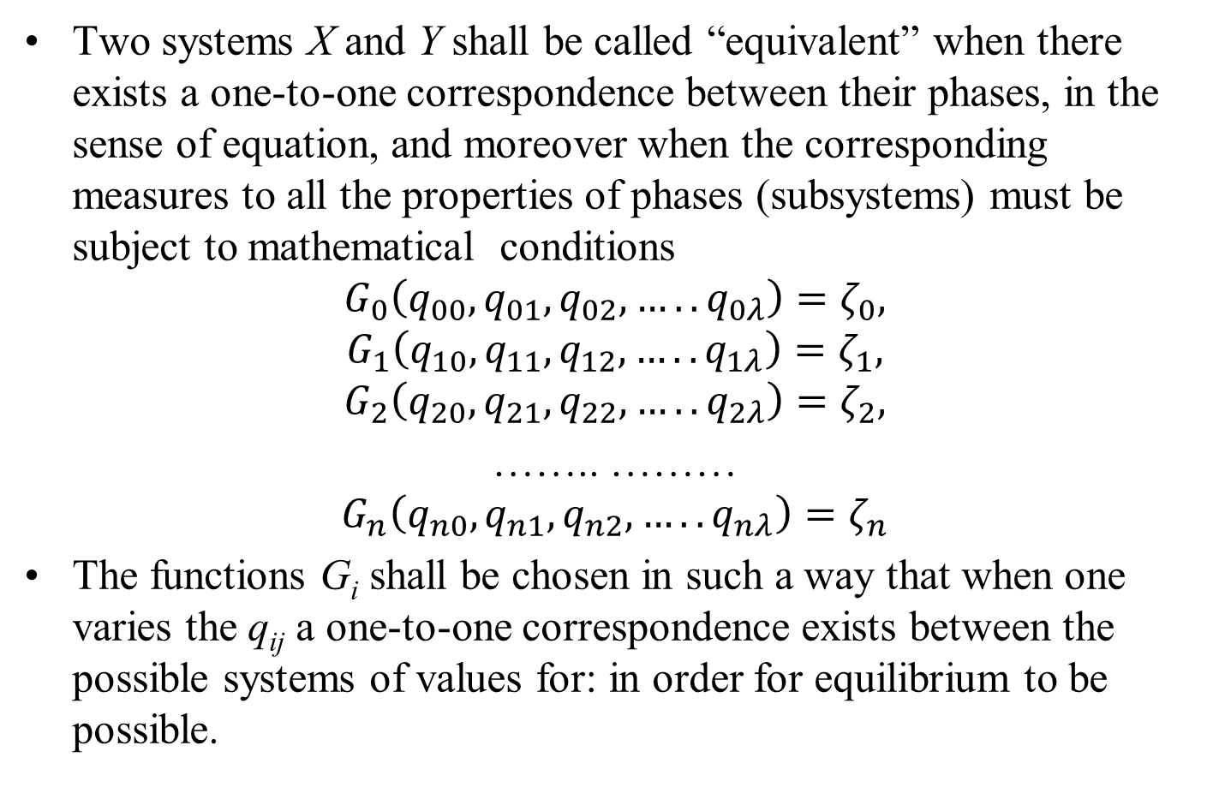
Equivalent Macrosystems
Two systems X and Y shall be called “equivalent” when there exists a one-to-one correspondence between their phases, in the sense of equation, and moreover when the corresponding measures to all the properties of phases (subsystems) must be subject to mathematical conditions
$$G_{0}\left(q_{00},q_{01},q_{02}, …..q_{0λ}\right)=ζ_{0},$$
$$G_{1}\left(q_{10},q_{11},q_{12}, …..q_{1λ}\right)=ζ_{1},$$
$$G_{2}\left(q_{20},q_{21},q_{22}, …..q_{2λ}\right)=ζ_{2},$$
…….. ………
$$G_{n}\left(q_{n0},q_{n1},q_{n2}, …..q_{nλ}\right)=ζ_{n}$$
The functions G_{i} shall be chosen in such a way that when one varies the q_{ij} a one-to-one correspondence exists between the possible systems of values for: in order for equilibrium to be possible.

Slide 14
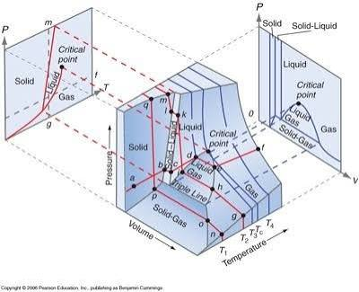
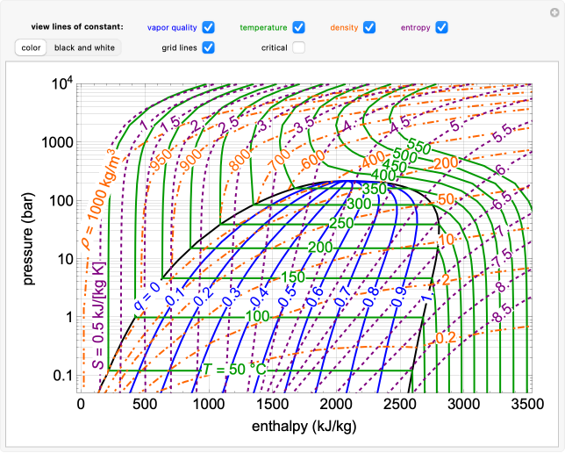
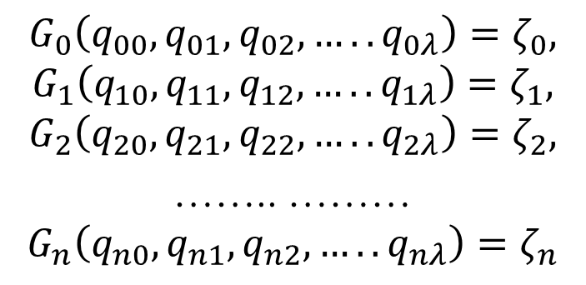
Equivalent Macrosystems
$$G_{0}\left(q_{00},q_{01},q_{02}, …..q_{0λ}\right)=ζ_{0},$$
$$G_{1}\left(q_{10},q_{11},q_{12}, …..q_{1λ}\right)=ζ_{1},$$
$$G_{2}\left(q_{20},q_{21},q_{22}, …..q_{2λ}\right)=ζ_{2},$$
…….. ………
$$G_{n}\left(q_{n0},q_{n1},q_{n2}, …..q_{nλ}\right)=ζ_{n}$$

