Slide 1

Need for Mathematical Description of Thermodynamic Equilibrium
P M V Subbarao
Professor
Mechanical Engineering Department
I I T Delhi
A Philosophy to Develop Accurate Models for A Material …

Slide 2

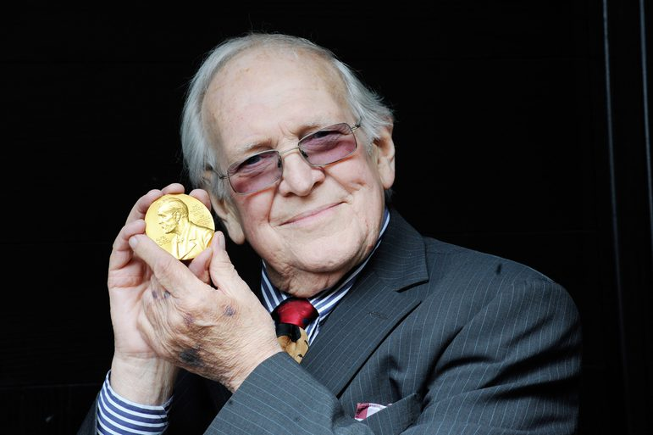
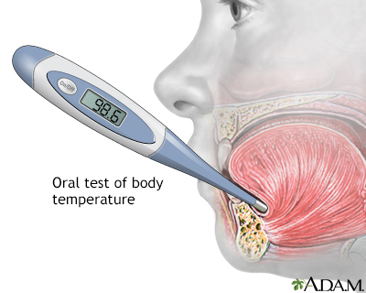
When to Not the Number as A Representative of System Temperature?

Slide 3
Scottish physicist Joseph Black in his 1786
Lectures on Chemistry, as such:
“[There exists] a tendency of heat to diffuse itself from any hotter body to the cooler around, until it be distributed among them, in such a manner that none of them are disposed to take any more heat from the rest.
The heat is thus brought into a state of equilibrium.
This equilibrium is somewhat curious.
We find that when all mutual action is ended, a thermometer, applied to any one of the bodies, acquires the same degree of expansion: therefore the temperature of them all is the same, and the equilibrium is universal.”

Slide 4

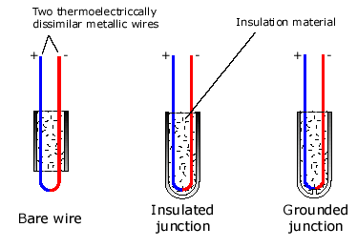
Common Thermometers
Liquid in Glass Thermometer
Thermocouple Thermometer

Slide 5

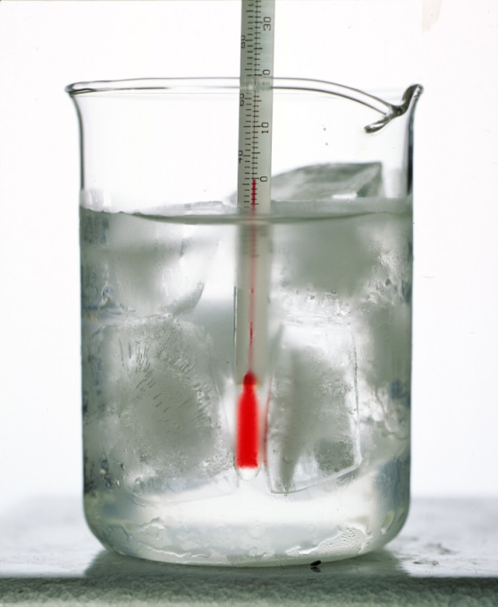
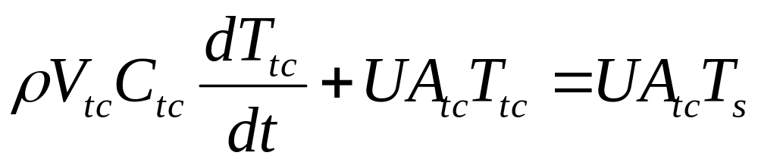
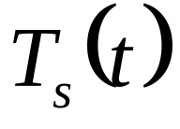
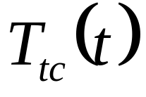
How Long it takes to Satisfy Zeroth Law?
Conservation of Energy during a time dt
Heat in = Change in energy
of thermocouple

Slide 6
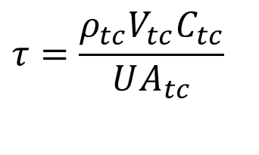
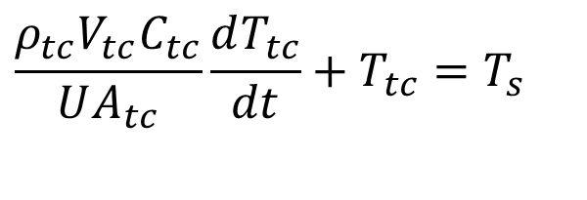
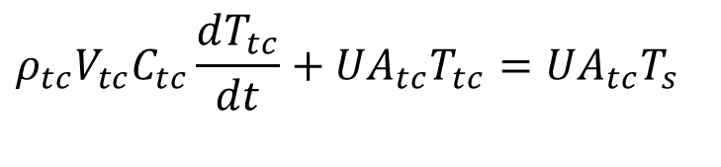
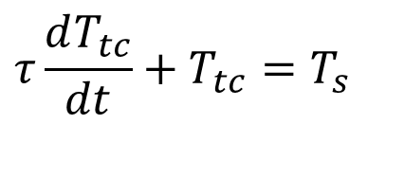
Sudden contacting of Sensor with a Known Constant Temperature Chip
$$ρ_{tc}V_{tc}C_{tc}\frac{dT_{tc}}{dt}+UA_{tc}T_{tc}=UA_{tc}T_{s}$$
$$\frac{ρ_{tc}V_{tc}C_{tc}}{UA_{tc}}\frac{dT_{tc}}{dt}+T_{tc}=T_{s}$$
$$τ=\frac{ρ_{tc}V_{tc}C_{tc}}{UA_{tc}}$$
Define Time constant
$$τ\frac{dT_{tc}}{dt}+T_{tc}=T_{s}$$

Slide 7
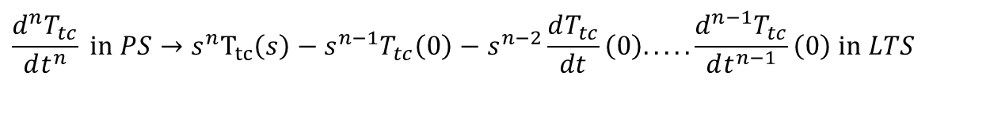
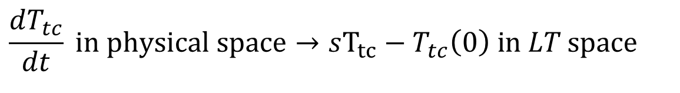
Solution thru Laplace Transforms
$$τ\frac{dT_{tc}}{dt}+T_{tc}=T_{s}$$
Space of Laplace Transform is free of derivatives!
$$\frac{dT_{tc}}{dt} \text{in} \text{physical} \text{space}→sΤ_{tc}−T_{tc}\left(0\right) \text{in} LT \text{space}$$
$$\frac{d^{n}T_{tc}}{dt^{n}} \text{in} PS→s^{n}Τ_{tc}\left(s\right)−s^{n−1}T_{tc}\left(0\right)−s^{n−2}\frac{dT_{tc}}{dt}\left(0\right).....\frac{d^{n−1}T_{tc}}{dt^{n−1}}\left(0\right) \text{in} LTS$$

Slide 8
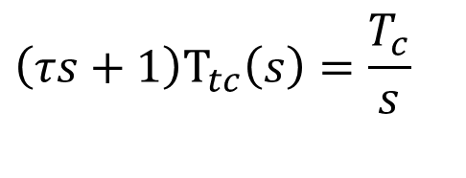
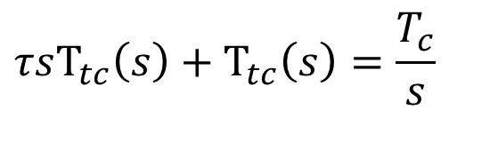
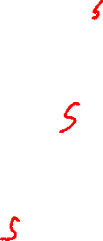
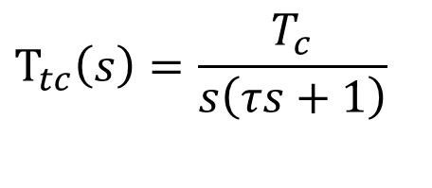
Solution thru Laplace Transforms
$$τ\frac{dT_{tc}}{dt}+T_{tc}=T_{s}$$
Apply Laplace Transform to above FO-ODE
$$τsΤ_{tc}\left(s\right)+Τ_{tc}\left(s\right)=\frac{T_{c}}{s}$$
$$\left(τs+1\right)Τ_{tc}\left(s\right)=\frac{T_{c}}{s}$$
$$Τ_{tc}\left(s\right)=\frac{T_{c}}{s\left(τs+1\right)}$$

Slide 9
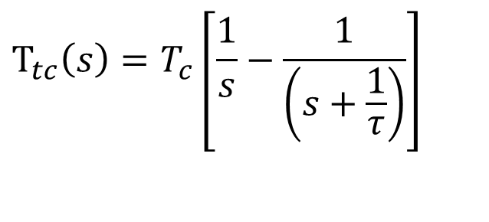

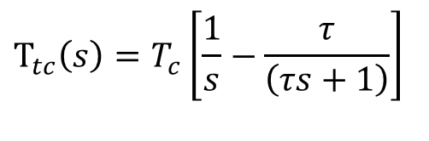
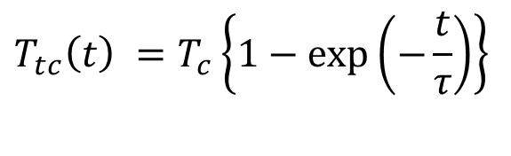
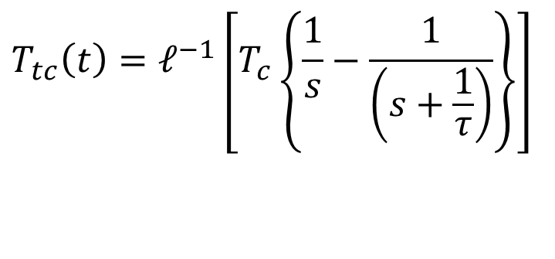
Inversion of Laplace Transform of FO-ODE
$$Τ_{tc}\left(s\right)=\frac{T_{c}}{s\left(τs+1\right)}$$
$$T_{tc}\left(t\right)=ℓ^{−1}\left[T_{c}\left\{\frac{1}{s}−\frac{1}{\left(s+\frac{1}{τ}\right)}\right\}\right]$$
$$Τ_{tc}\left(s\right)=T_{c}\left[\frac{1}{s}−\frac{τ}{\left(τs+1\right)}\right]$$
$$Τ_{tc}\left(s\right)=T_{c}\left[\frac{1}{s}−\frac{1}{\left(s+\frac{1}{τ}\right)}\right]$$
$$T_{tc}\left(t\right) =T_{c}\left\{1−\exp\left(−\frac{t}{τ}\right)\right\}$$

Slide 10
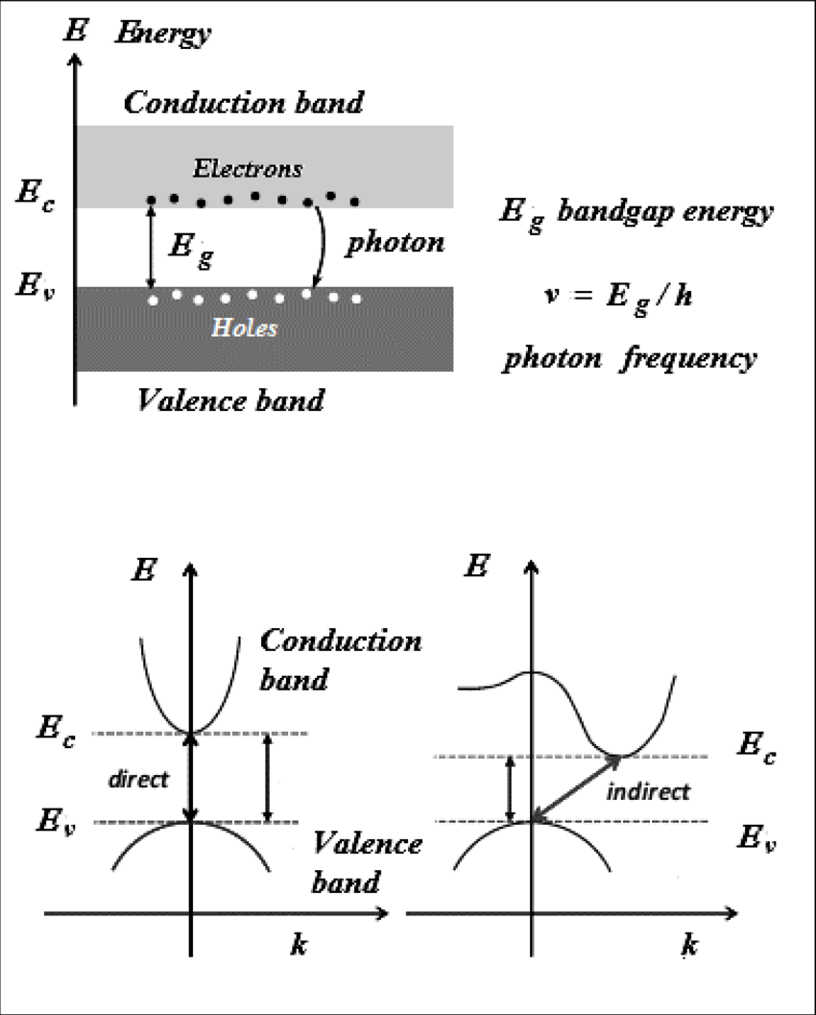
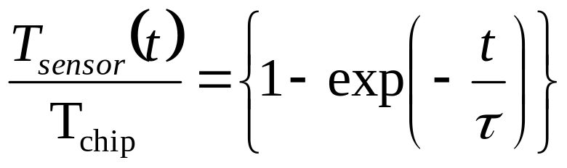
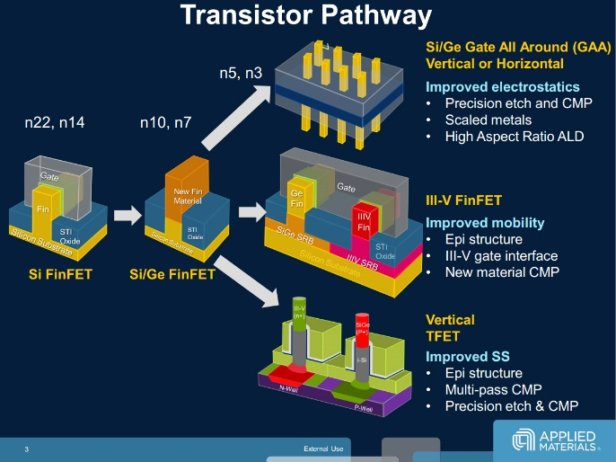
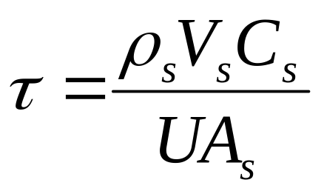
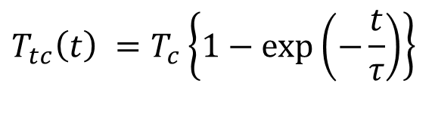
Step Response of A Temperature Sensor
$$T_{tc}\left(t\right) =T_{c}\left\{1−\exp\left(−\frac{t}{τ}\right)\right\}$$

Slide 11
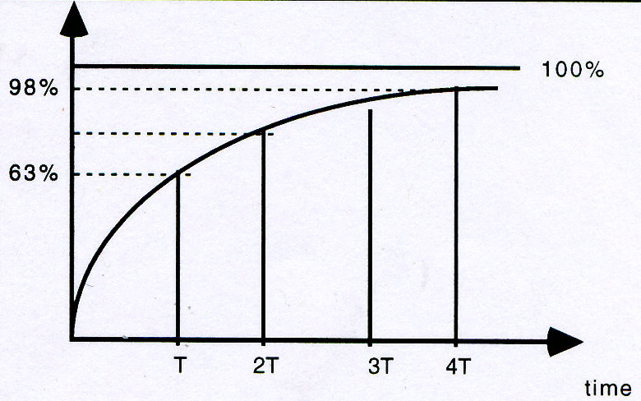
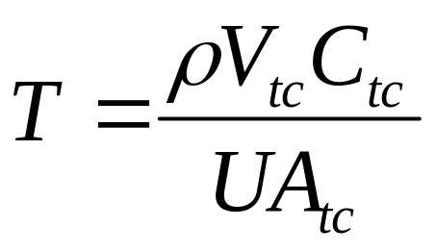
Response of Thermo-couple
Define Time constant

Slide 12
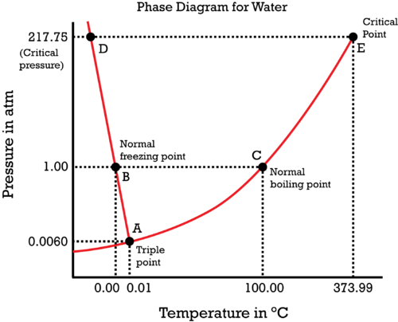
A (Easy) collection of Equilibrium States for Water

Slide 13

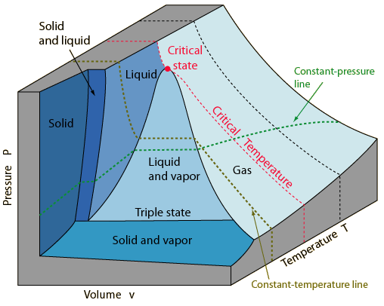
Model of A Substance thru Log Lasting Equilibrium Conditions

Slide 14
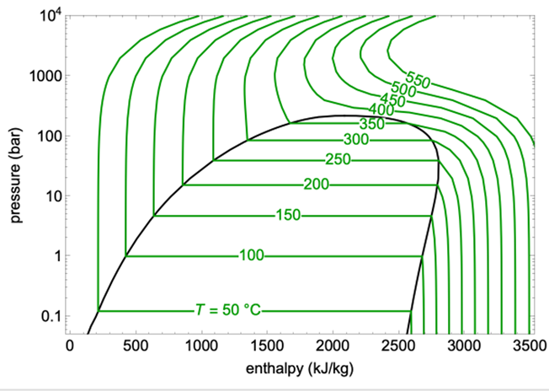
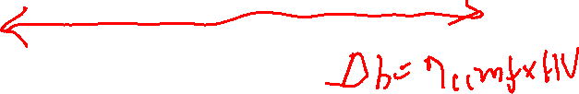
Enthalpy Model of Vapour Dome for water

Slide 15
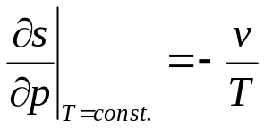

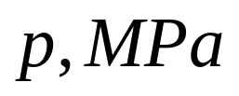
Superiority of Entropy Information

Slide 16
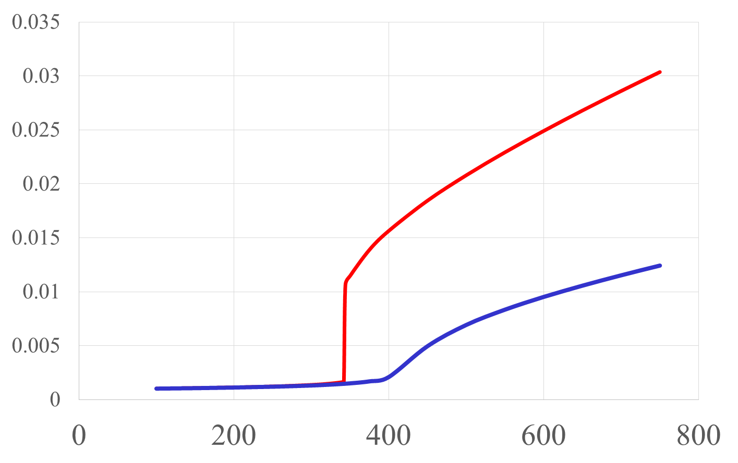



Specific Volume vs Temperature
@15MPa
@35MPa

Slide 17
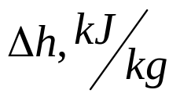
Less Fuel for Creation of Same Temperature

Slide 18
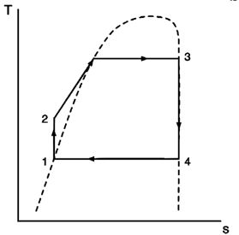
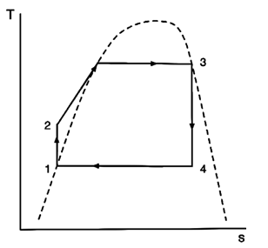
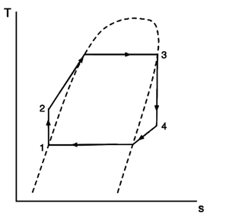

Characterization of Vapour Domes for General Substance

Slide 19
Development of a Generalized Mathematical Theory for Equilibrium is essential to develop a comprehensive nature of any substance….

