Slide 1

Mathematical Description of Material in A Thermodynamic Systems
P M V Subbarao
Professor
Mechanical Engineering Department
I I T Delhi
Quantification of Features for Better Analysis…

Slide 2

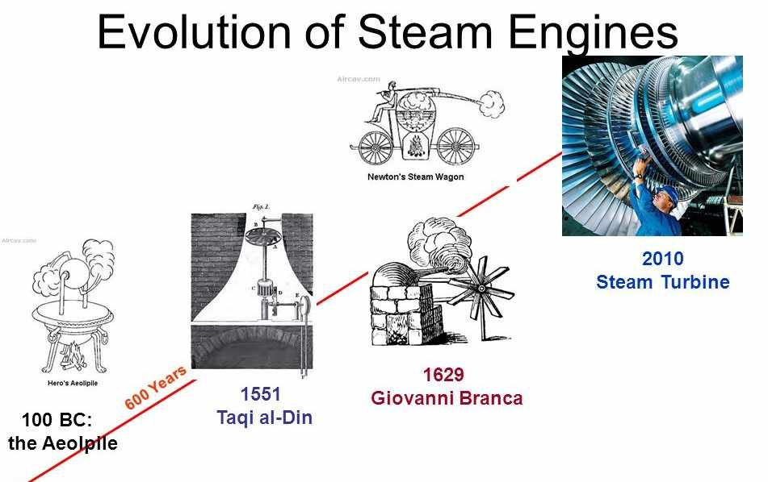
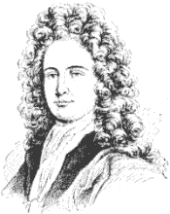
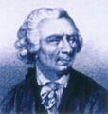
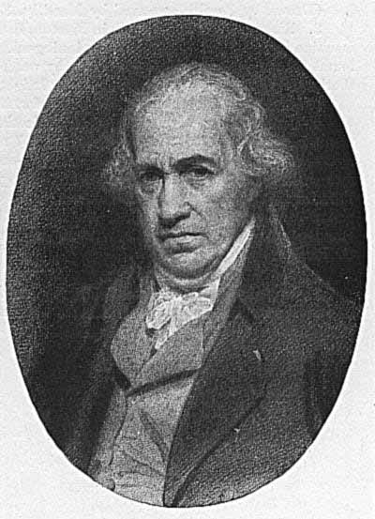
Slow Innovation for Essential Needs
Savery Mine Pump
July 2, 1698
NewComen Engine
1712
Watts Engine
1769

Slide 3

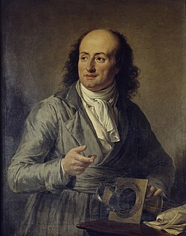
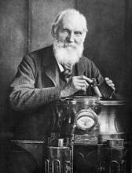
Slow Innovation of Fundamental Concepts
Boyle's law was discovered and first published by Robert Boyle in 1662
Charles's law was discovered by Jacques Charles in 1787 and later published by Joseph Louis Gay-Lussac in 1802
The Kelvin scale was proposed in 1848 by British physicist William Thomson (Lord Kelvin)

Slide 4
“ When you can measure what you are speaking about, and express it in numbers, you know something about it;
but when you cannot measure it in numbers, your knowledge is of a meagre and unsatisfactory kind . . . ”.
-- Lord Kelvin

Slide 5
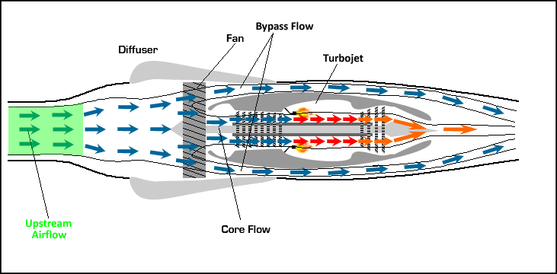
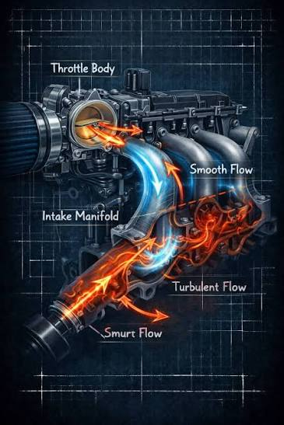
What does a system consist of ?

Slide 6
Macroscopic View of A Thermodynamic System
Macrosystem approach is advisable during analysis of patterns that arise in the exchange processes in systems of various.
Macrosystems are systems in which the following conditions are satisfied:
Macrosystems consist of a large number of elementary objects, and this number is so large that any macrosystem can be considered as a continuum.
Each macrosystem can be divided into any finite number of subsystems.
Size of subsystem can be sufficient to determine the statistical characteristics of any given accuracy.

Slide 7
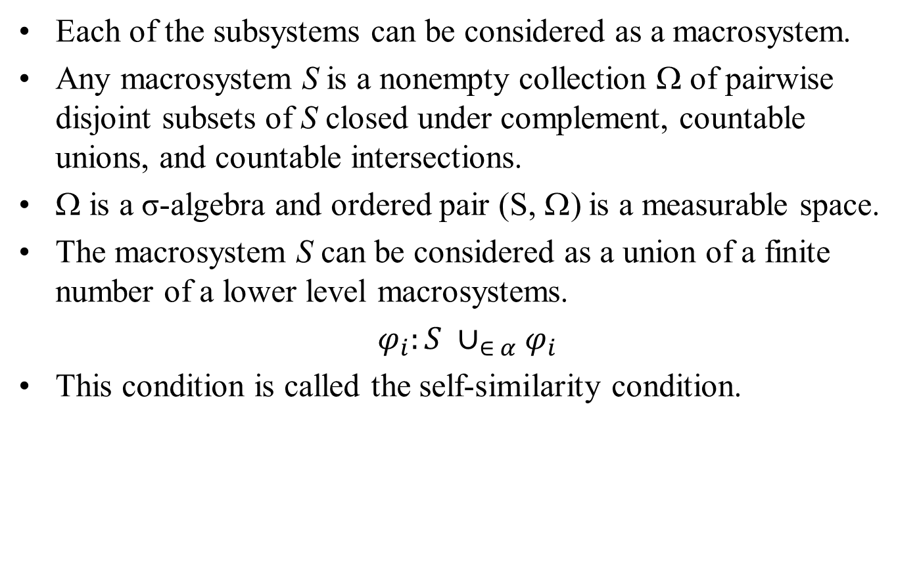
A Thermodynamic Subsystem (Phase)
Each of the subsystems can be considered as a macrosystem.
Any macrosystem S is a nonempty collection Ω of pairwise disjoint subsets of S closed under complement, countable unions, and countable intersections.
Ω is a σ-algebra and ordered pair (S, Ω) is a measurable space.
The macrosystem S can be considered as a union of a finite number of a lower level macrosystems.
$φ_{i}:S ∪_{∈ α}φ_{i}$
This condition is called the self-similarity condition.

Slide 8
State of A Macrosystem
The macrosystem state is determined by the vector Q of state variables.
It is assumed that the state variables satisfy the conservation law.
Therefore, we can consider vector Q as a vector of extensive variables.
Because of non-negativity and countable additivity, vector Q is a vector measure and (S,Ω,Q) is a measure space.
In thermodynamic macrosystems, the extensive variables are internal energy, mol number, and volume …..

Slide 9
What does a system consist of ?
Components: Distinct chemical species.
  single component – pure substance
  two components – binary system
A pure substance can become a binary system:
  example: water or steam under normal conditions is a single component; but at very high temperatures, H₂O dissociates and becomes a two-component system – the components are H and O (binary)
A binary system can be treated as a single component:
  O₂ and N₂ in air under normal conditions can be considered as a single component, “air”.
Multi-component systems: three or more interacting chemical species

Slide 10
The Methodology of Classical Thermodynamic Analysis
Thermodynamics deals with changes in the system.
Measures for identifying these changes are necessary.
This will help in estimating the ability of the system.
The measures of generally based on some characteristics.
The numerical values of characteristics will completely describe the system.

Slide 11
Thermodynamic Property
Any suitable characteristic whose value depends on the condition of a system, and which is relevant to our thermodynamic study is known as a Thermodynamic Property.
When nothing happens to this system , each of the properties of a system (substance) has only one definite value.
These properties always have the same value for a given condition, regardless of how the substance arrived at the condition.

Slide 12
Classification of Properties
Based on method of Measurement:
Primitive Property -- Directly observable -- With simple experiments -- No change in system.
Derived Property -- Vigorous experiments -- To be calculated using observations.
Computational basis:
Intensive property -- Local property -- Independent of mass or size of the system.
Extensive property -- depends on the extent of the system –
Obey Colligative Law.

Slide 13
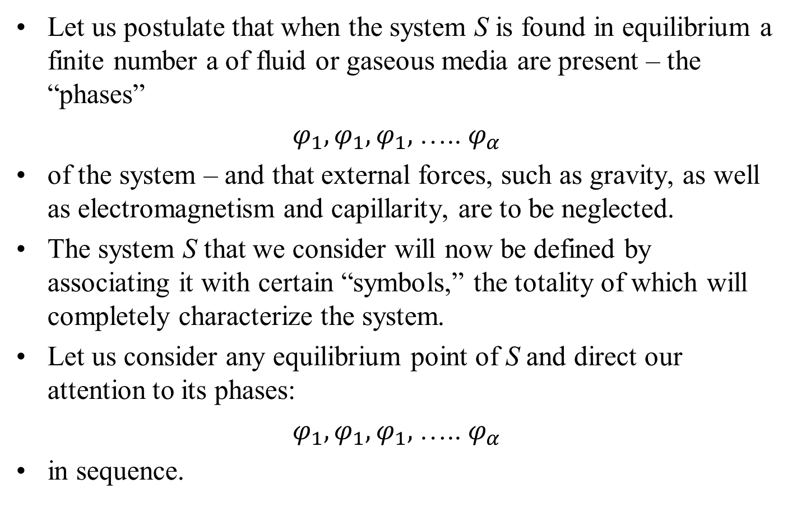
System: Function of Several Variables
Let us postulate that when the system S is found in equilibrium a finite number a of fluid or gaseous media are present – the “phases”
$φ_{1},φ_{1},φ_{1},$….. $φ_{α}$
of the system – and that external forces, such as gravity, as well as electromagnetism and capillarity, are to be neglected.
The system S that we consider will now be defined by associating it with certain “symbols,” the totality of which will completely characterize the system.
Let us consider any equilibrium point of S and direct our attention to its phases:
$φ_{1},φ_{1},φ_{1},$….. $φ_{α}$
in sequence.

Slide 14
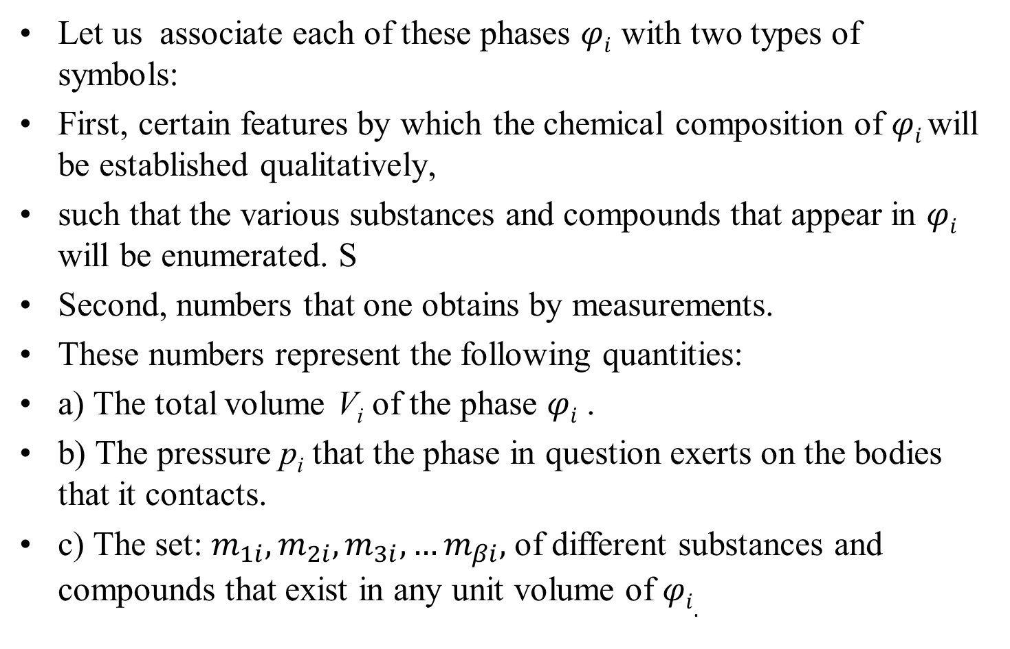
Recognition of Phase
Let us associate each of these phases $φi$ with two types of symbols:
First, certain features by which the chemical composition of $φi$will be established qualitatively,
such that the various substances and compounds that appear in $φi$ will be enumerated. S
Second, numbers that one obtains by measurements.
These numbers represent the following quantities:
a) The total volume V_{i} of the phase $φi$ .
b) The pressure p_{i} that the phase in question exerts on the bodies that it contacts.
c) The set: $m_{1i},m_{2i},m_{3i},…m_{βi},$ of different substances and compounds that exist in any unit volume of $φi.$

Slide 15
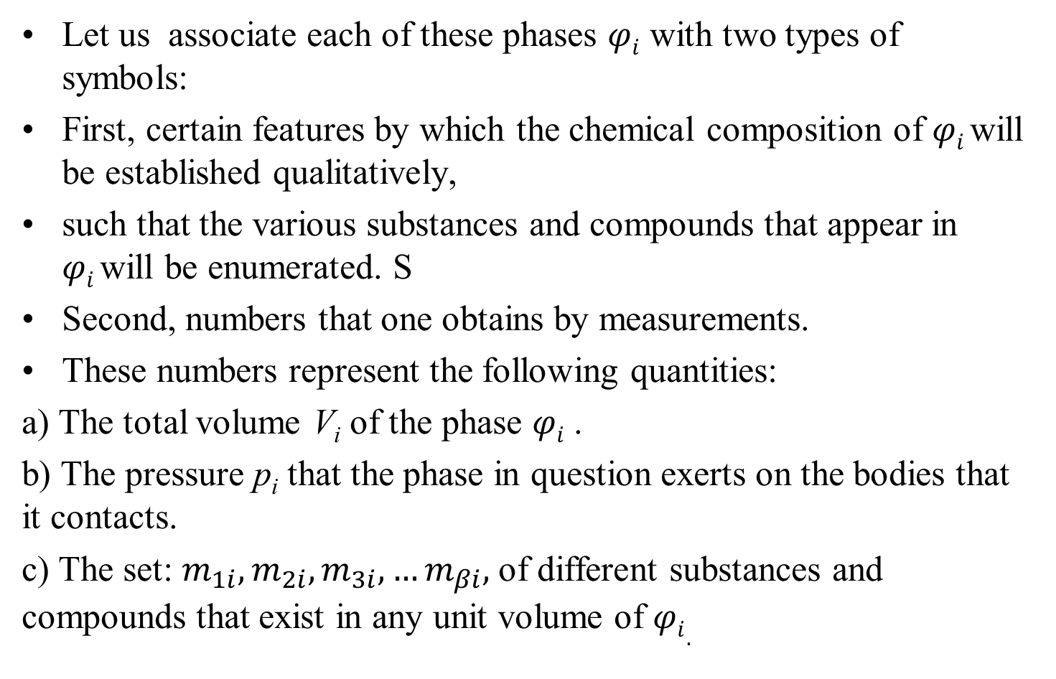
Functions of Several Variables
Let us associate each of these phases $φi$ with two types of symbols:
First, certain features by which the chemical composition of $φi$will be established qualitatively,
such that the various substances and compounds that appear in $φi$will be enumerated. S
Second, numbers that one obtains by measurements.
These numbers represent the following quantities:
a) The total volume V_{i} of the phase $φi$ .
b) The pressure p_{i} that the phase in question exerts on the bodies that it contacts.
c) The set: $m_{1i},m_{2i},m_{3i},…m_{βi},$ of different substances and compounds that exist in any unit volume of $φi.$

Slide 16
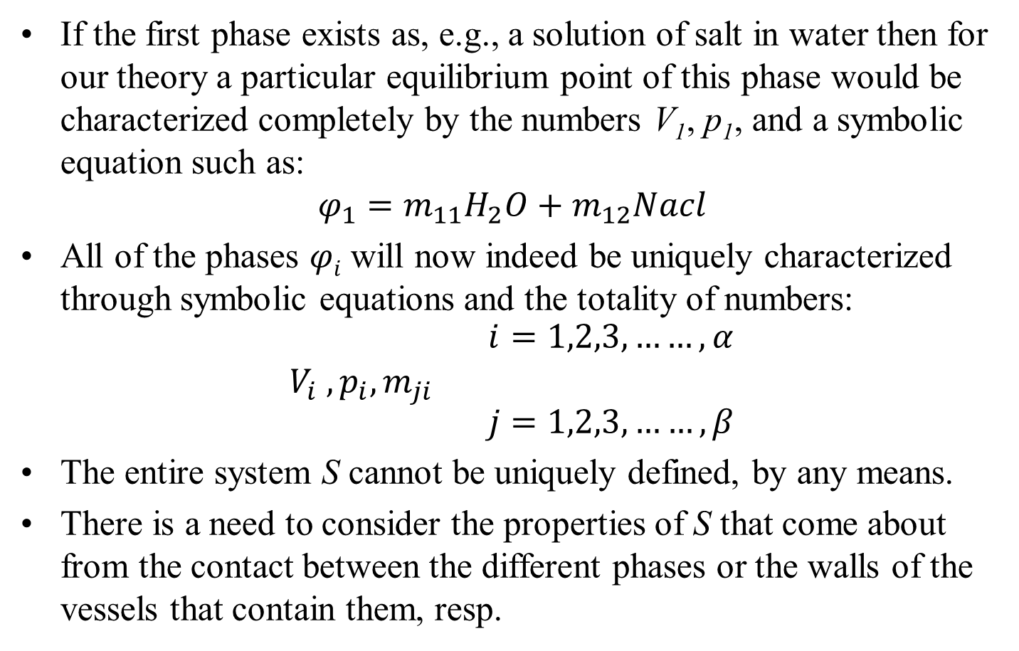
Description of Each Phase
If the first phase exists as, e.g., a solution of salt in water then for our theory a particular equilibrium point of this phase would be characterized completely by the numbers V₁, p₁, and a symbolic equation such as:
$$φ_{1}=m_{11}H_{2}O+m_{12}Nacl$$
All of the phases $φi$ will now indeed be uniquely characterized through symbolic equations and the totality of numbers:
$$V_{i} , p_{i}, m_{ji} \begin{matrix}i=1,2,3,……, α \\ \\ j=1,2,3,……, β\end{matrix}$$
The entire system S cannot be uniquely defined, by any means.
There is a need to consider the properties of S that come about from the contact between the different phases or the walls of the vessels that contain them, resp.

Slide 17
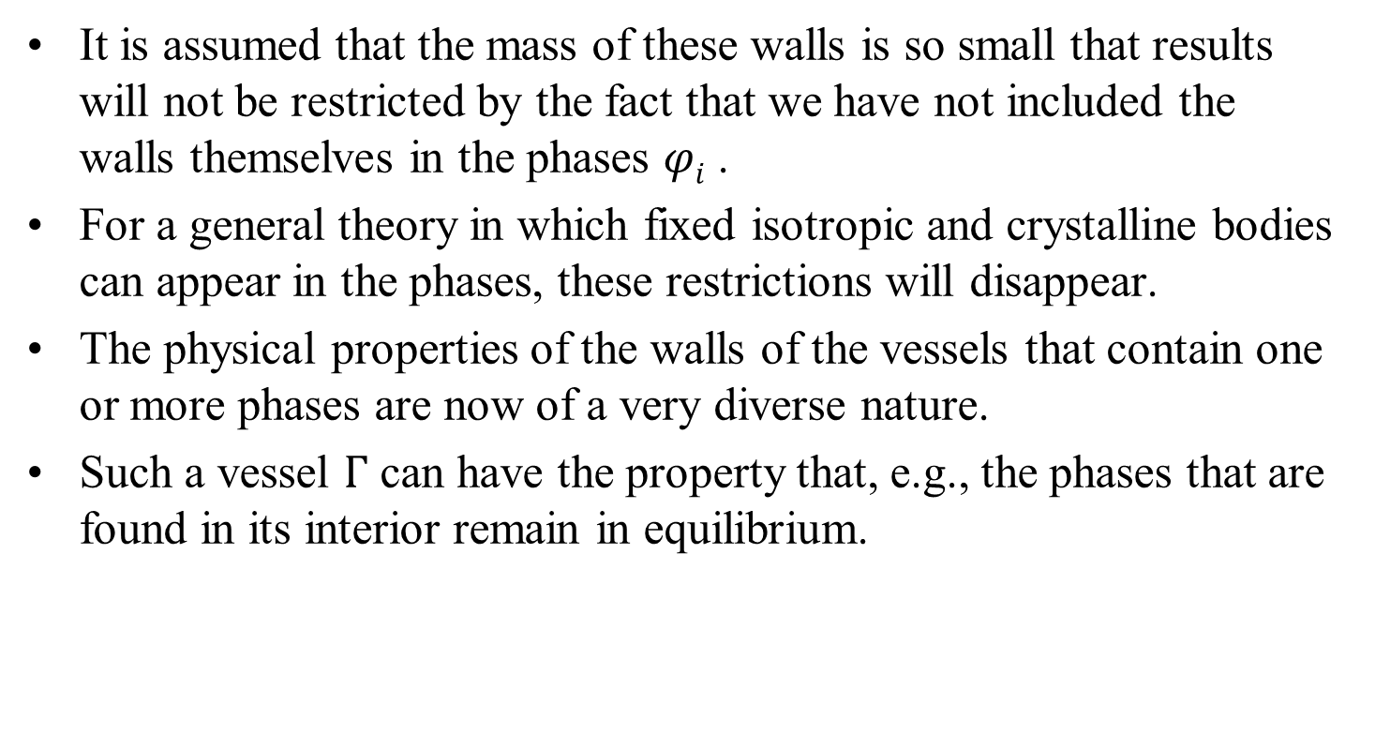
Description of Each Phase
It is assumed that the mass of these walls is so small that results will not be restricted by the fact that we have not included the walls themselves in the phases $φi$ .
For a general theory in which fixed isotropic and crystalline bodies can appear in the phases, these restrictions will disappear.
The physical properties of the walls of the vessels that contain one or more phases are now of a very diverse nature.
Such a vessel $Γ$ can have the property that, e.g., the phases that are found in its interior remain in equilibrium.

