Slide 1

Universal Energy Representative
P M V Subbarao
Professor
Mechanical Engineering Department
Root Cause for Every Natural & Engineering Process!!!!

Slide 2

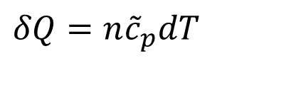
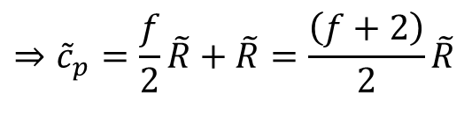


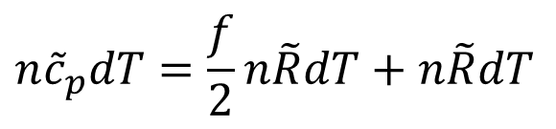
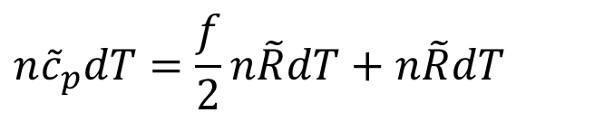
Derivation of Mayer’s Equation
The molar specific heat at constant pressure is defined by
$$δQ=n{\tilde{c}}_{p}dT$$
Using the first law of thermodynamics for a constant pressure process this can be written in the form
$$δQ=dU+δW=ΔU+pdV$$
From an ideal gas ( pV=nRT) under constant pressure conditions it can be seen that
$$n{\tilde{c}}_{p}dT=\frac{f}{2}n\tilde{R}dT+n\tilde{R}dT$$
$$n{\tilde{c}}_{p}dT=\frac{f}{2}n\tilde{R}dT+n\tilde{R}dT$$
$$⇒{\tilde{c}}_{p}=\frac{f}{2}\tilde{R}+\tilde{R}=\frac{\left(f+2\right)}{2}\tilde{R}$$
$${\tilde{C}}_{p}\left(T\right)={\tilde{C}}_{v}\left(T\right)+\tilde{R}$$

Slide 3
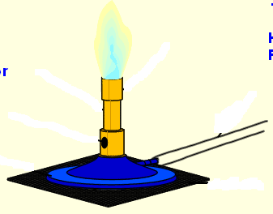
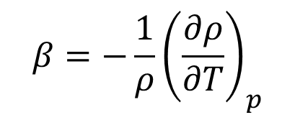
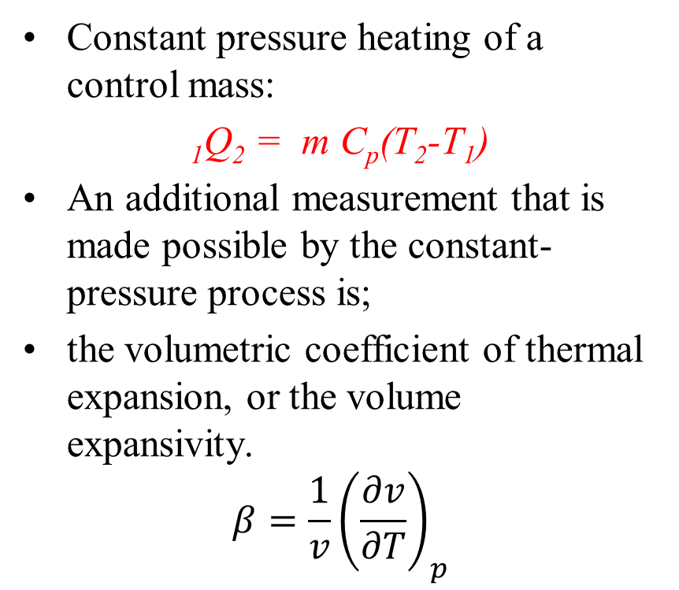
Reversible Constant Pressure Heating Process : Discovery of Clue for Natural Process
Constant pressure heating of a control mass:
₁Q₂ = m C_{p}(T₂-T₁)
An additional measurement that is made possible by the constant-pressure process is;
the volumetric coefficient of thermal expansion, or the volume expansivity.
$$β=\frac{1}{v}{\left(\frac{∂v}{∂T}\right)}_{p}$$
Constant Pressure Heating
The same quantity occurs in the study of buoyancy-induced (natural) convection, where it is defined in terms of density,
$$β=−\frac{1}{ρ}{\left(\frac{∂ρ}{∂T}\right)}_{p}$$

Slide 4
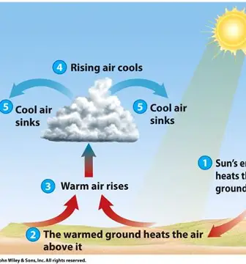
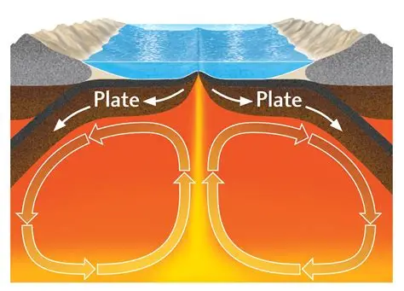
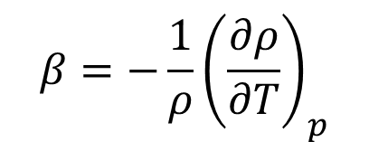
The volumetric coefficient of thermal expansion & Natural Convection
$$β=−\frac{1}{ρ}{\left(\frac{∂ρ}{∂T}\right)}_{p}$$

Slide 5
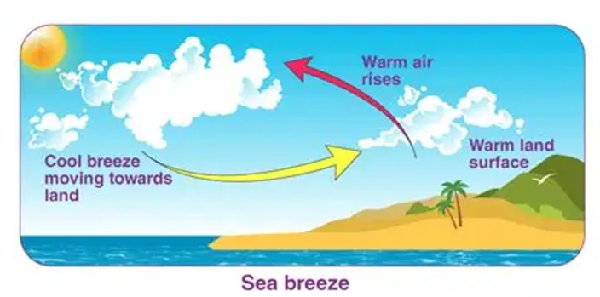
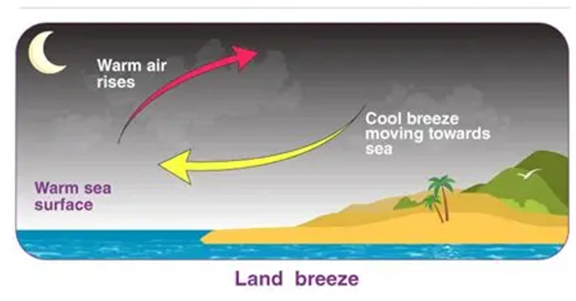
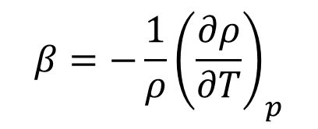
The volumetric coefficient of thermal expansion & Natural Convection
$$β=−\frac{1}{ρ}{\left(\frac{∂ρ}{∂T}\right)}_{p}$$

Slide 6
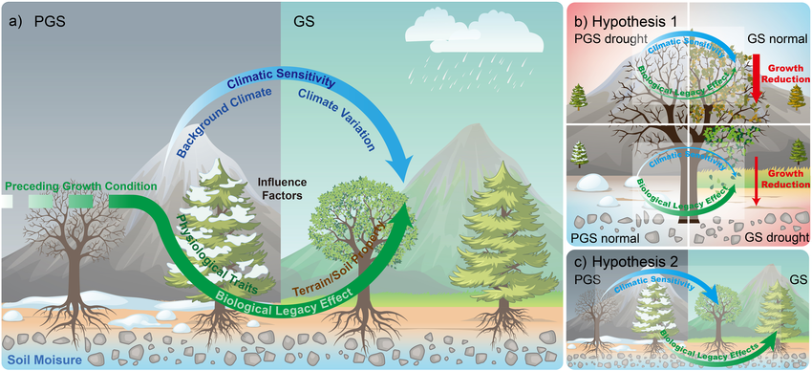
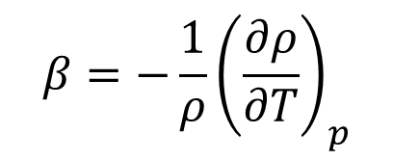
The volumetric coefficient of thermal expansion & Natural Convection
$$β=−\frac{1}{ρ}{\left(\frac{∂ρ}{∂T}\right)}_{p}$$

Slide 7
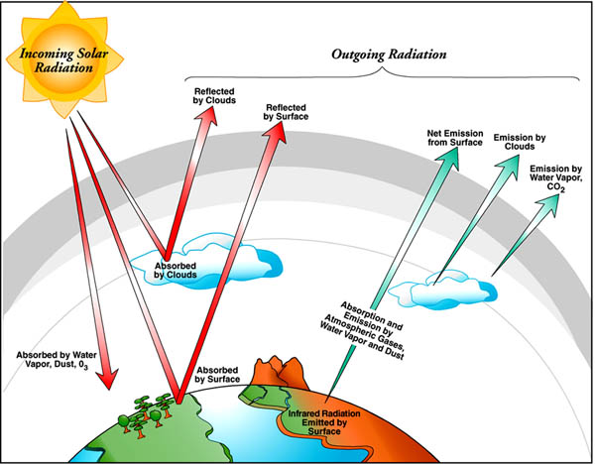
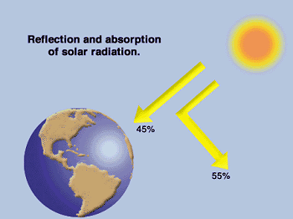
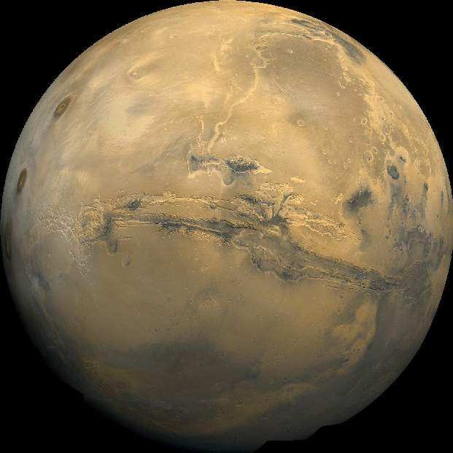
The flow of energy from a source to a sink through an intermediate system orders that system.
The Earth : A System to Create Diversity in Energy Source
Morowitz [1992]

Slide 8
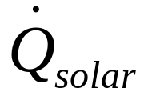

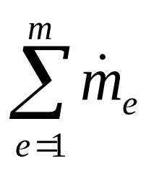
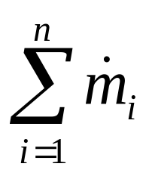
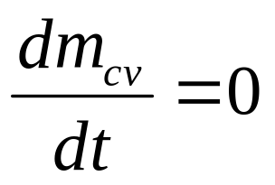
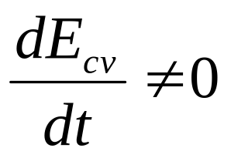
First Law Analysis of Generation of Energy Sources on Earth

Slide 9

ONE TIME RESOURCE
INCOMING
RESOURCE
SOLAR ENERGY
CO₂ + H₂O
PHTOSYNTHESIS
WINDS
VEGETATION
SOLAR
RADIATION
CLOUDS
VELOCITY
RAINS
CHEMICAL ENERGY
THERMAL
WAVE
WIND ENERGY
Fallls, Rivers & Reservoirs
OCEAN
THERMAL
ENERGY
FOSSILIZATION
VELOCIT/Head
HYDRO ENERGY
COAL
FOSSIL FUEL
PETROLEUM
NATURAL GAS

Slide 10
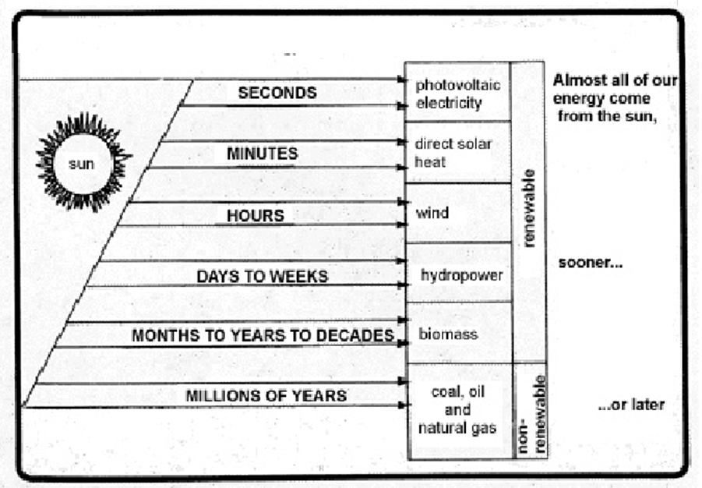
Solar Energy is Responsible for Emergence of All the Energy Sources

Slide 11
The Theology of Sun & Solar Energy
If a theorem cannot be proven within a certain set of axioms, it may be referred to as "undecidable" or "unprovable" in mathematical logic.
Gödel's incompleteness theorems illustrate that certain statements in a formal system are true but cannot be proven within that system.

Slide 12

The Sun Enlightens Every Life
Kowsalya supraja Rama poorva sandhya pravarthathe
Uthishta narasardoola karthavyam daivamahnikam

Slide 13

Vedic Description of Surya
सप्ताश्व रथमारूढम् प्रचंडम् कश्यपात्मजम्
श्वेत पद्मधरम् देवम् तम् सूर्यम् प्रणमाम्यहम्
Pankti
Anushtubha
Gayatri,
Trishtubha
Brihati
Ushnih
Jagati

Slide 14
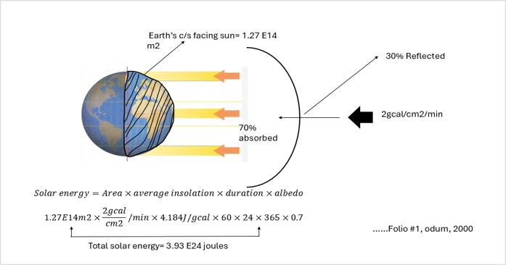
Emergy: A Universal Energy Representative

Slide 15
Baselines till date
The Earth’s Solar Energy baseline has been stable over the past 0.555 × 10⁹ y, i.e., 1.00 ÿ× 10²⁵ ± 11%.
8.0 × 10²⁴ seJ y⁻¹ …………………….. Odum, 1996
9.44 × 10²⁴ seJ y⁻¹ …………….. Odum, 1996
10.57 × 10²⁴ seJ y⁻¹ …………………. Campbell, 1998
15.83 × 10²⁴ seJ y⁻¹ …………….. Odum, et.al , 2000
1.2 × 10²⁵ seJ y⁻¹ …………..Campbell, 2016

Slide 16
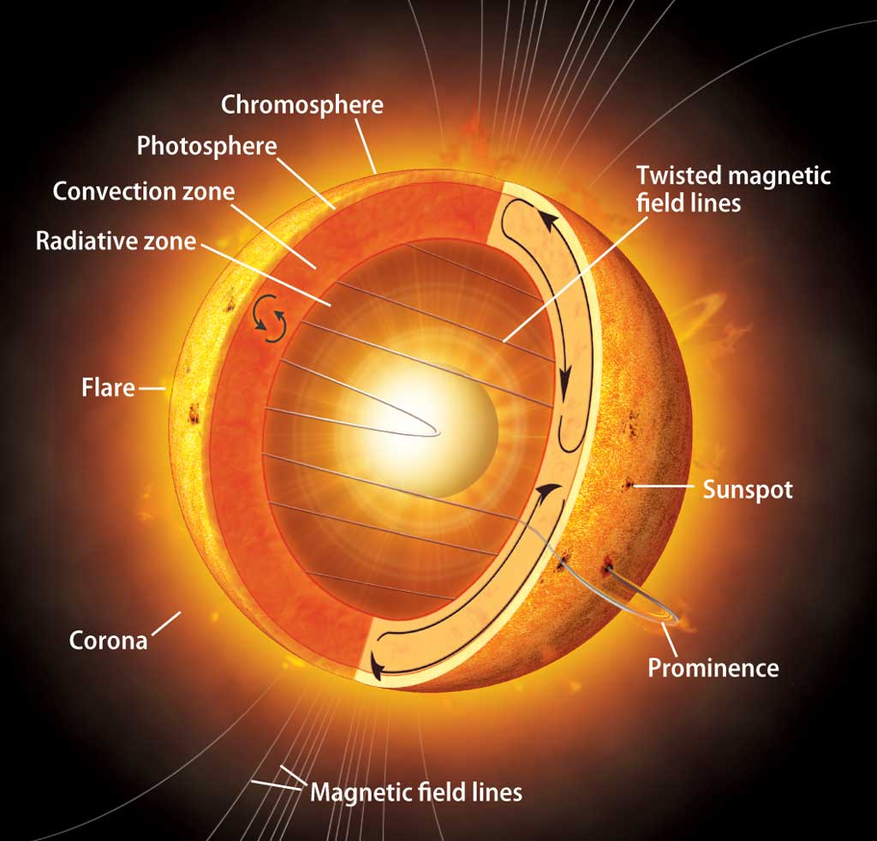
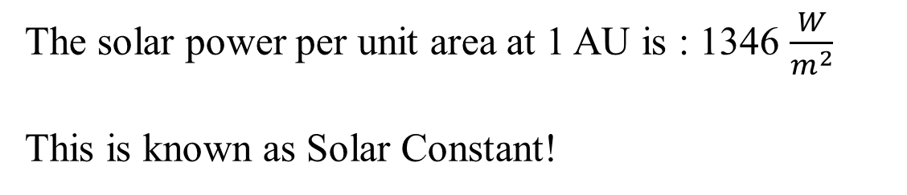

A Universal Energy Representative
All the energy per unit that comes out of the Sun, must also come out of a sphere of 1 AU radius.
This is the basis for conservation of energy!!!
$$1 AU≅1.5×{10}^{11}m$$
The solar power per unit area at 1 AU is : 1346 $\frac{W}{m^{2}}$
This is known as Solar Constant!

Slide 17
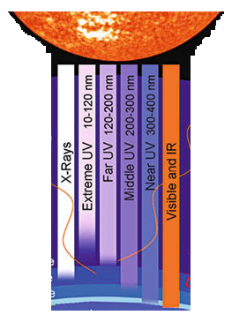

Solar Heating of Soil on other Planets: Wastage of Solar Energy ???

Slide 18
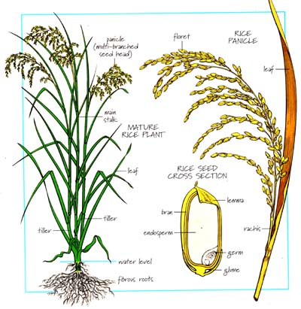

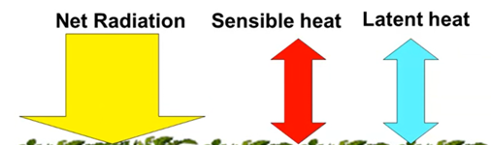
Conversion of Emergy to Biomass Energy by Biosphere
Is it possible to estimate total solar energy utilized to create a unit Bioenergy product ???
Name it as “Emergy”

Slide 19
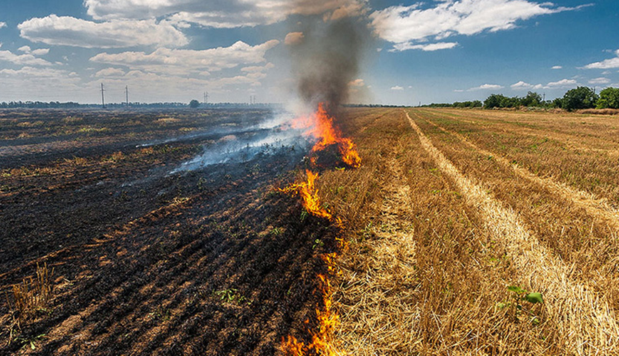
Irresponsible Wastage of Emergy and Carbon Burden on Environment

Slide 20
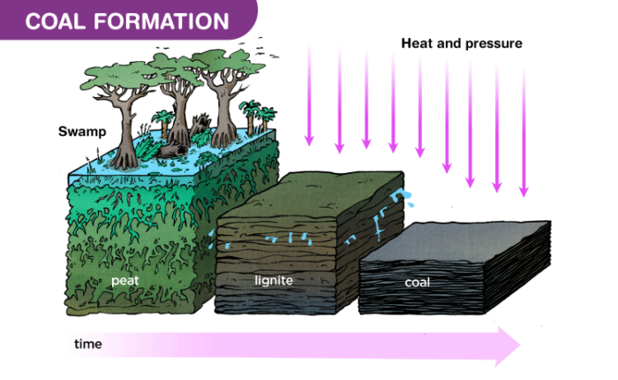
Conversion of Emergy to Fossil Fuel Energy

Slide 21
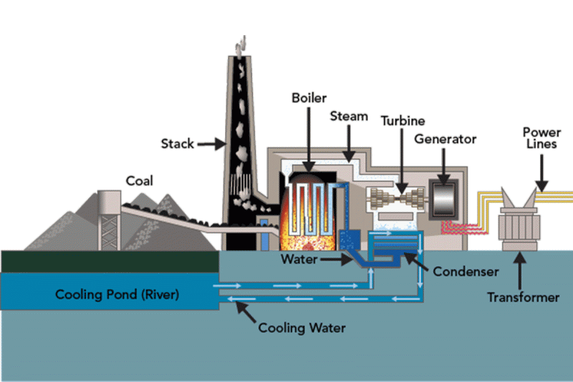
Conversion of Emergy to Fossil fuel Energy to Electricity (Net Exergy)
Double Carbon Burden on Environment

Slide 22
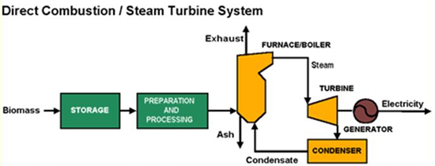

Conversion of Emergy to Biomass Energy to Electricity (Net Exergy)
A Means to Annual Carbon Neutrality

