Slide 1

Maxwell Relations to Design Special Processes
P M V Subbarao
Professor
Mechanical Engineering Department
Methods to Measure/Estimate Energy Representatives!!!!

Slide 2

Mixed Derivatives for A Closed System
Among the four mixed derivatives, following two relations
$${\left(\frac{∂S}{∂V}\right)}_{T}={\left(\frac{∂p}{∂T}\right)}_{V} \& −{\left(\frac{∂S}{∂p}\right)}_{T}={\left(\frac{∂V}{∂T}\right)}_{V}$$
are especially useful because, as their right-hand terms were calculated directly from volume expansivity and isothermal compressibility measurements.
Foundation for development of Thermometers and strain/pressure sensors.

Slide 3
Closed System : Special Processes to Measure Relations
The empirical information on how the system behaves as it shifts to a new state of equilibrium is stored in a few special relations.
Focus is on the behavior of a system whose equilibrium with the environment is restricted to the equality of temperature and pressure only.
Through direct (p,V,T) measurements that go back to the pre-thermodynamics era of thermometry and calorimetry, the most accessible relation has been the one between pressure, temperature, and volume, or, on a per-unit-mass basis, the p = f(v,T) surface.

Slide 4
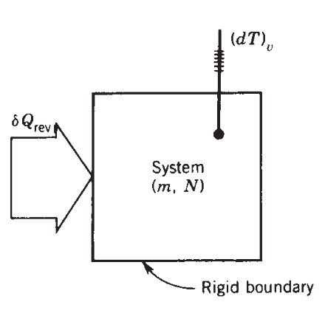
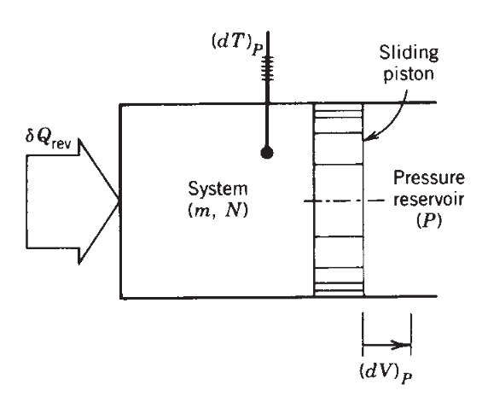
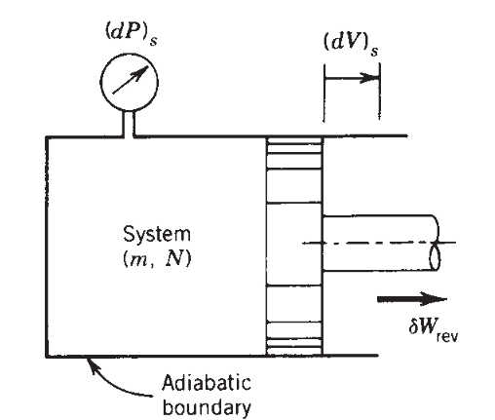
Special Processes to Measure Relations
A separate class of relations has been developed by combining the changes measured during special processes with the requirements posed by the first and second laws.
Constant Volume Reversible Heating
Constant Pressure Reversible Heating
Reversible Adiabatic Volume Changing

Slide 5
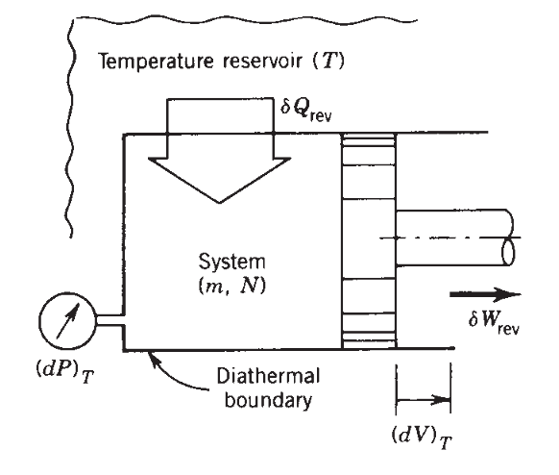
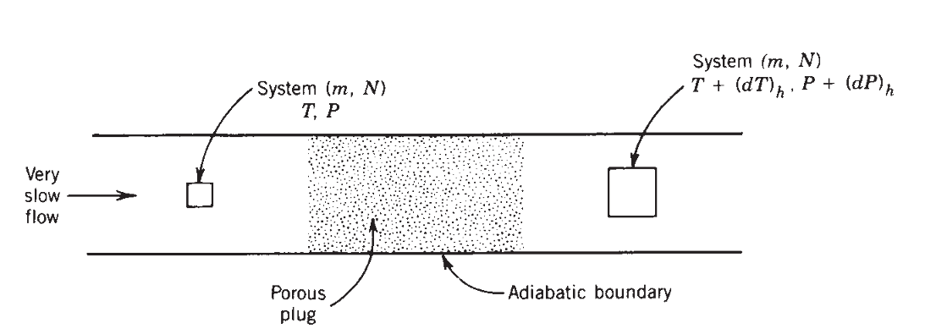
Special Processes to Measure Relations
Isothermal Reversible Heating
Isoenthalpy Expansion

Slide 6
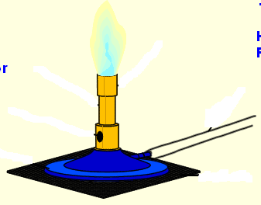
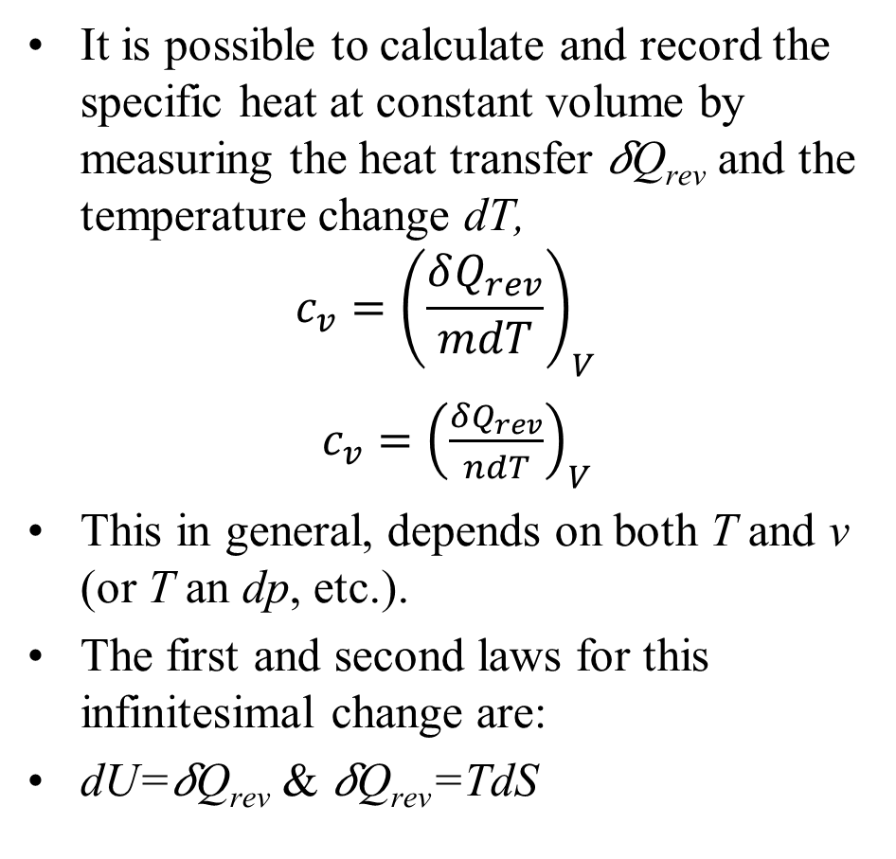
Reversible Heating at Constant Volume
It is possible to calculate and record the specific heat at constant volume by measuring the heat transfer 𝛿Q_{rev} and the temperature change dT,
$$c_{v}={\left(\frac{δQ_{rev}}{mdT}\right)}_{V}$$
$c_{v}={\left(\frac{δQ_{rev}}{ndT}\right)}_{V}$
This in general, depends on both T and v (or T an dp, etc.).
The first and second laws for this infinitesimal change are:
dU=𝛿Q_{rev} & 𝛿Q_{rev}=TdS
Constant Volume Heating

Slide 7
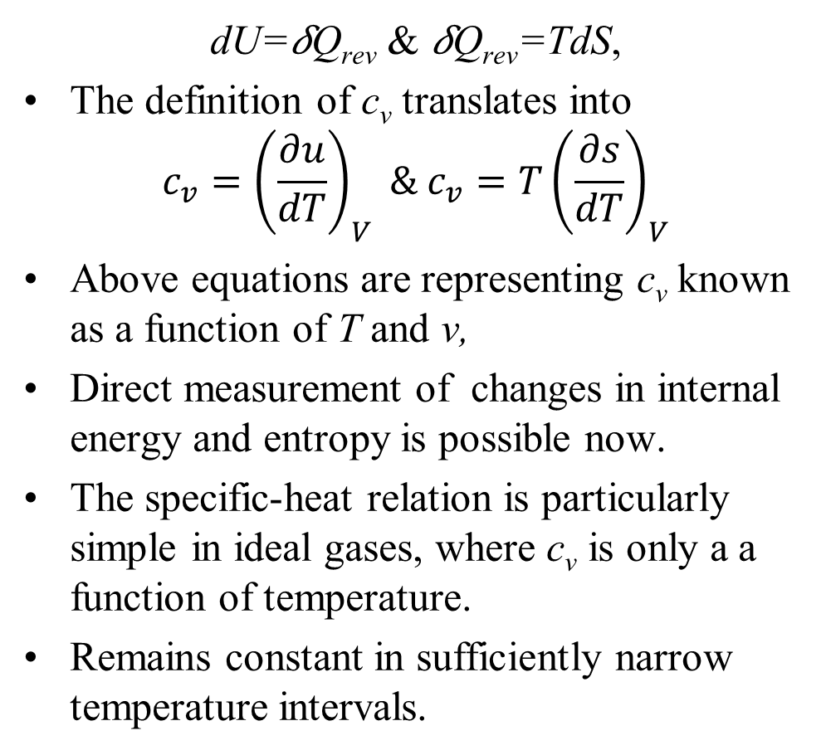
Reversible Heating at Constant Volume
dU=𝛿Q_{rev} & 𝛿Q_{rev}=TdS,
The definition of c_{v} translates into
$$c_{v}={\left(\frac{∂u}{dT}\right)}_{V} \& c_{v}=T{\left(\frac{∂s}{dT}\right)}_{V}$$
Above equations are representing c_{v} known as a function of T and v,
Direct measurement of changes in internal energy and entropy is possible now.
The specific-heat relation is particularly simple in ideal gases, where c_{v} is only a a function of temperature.
Remains constant in sufficiently narrow temperature intervals.
Constant Volume Heating

Slide 8
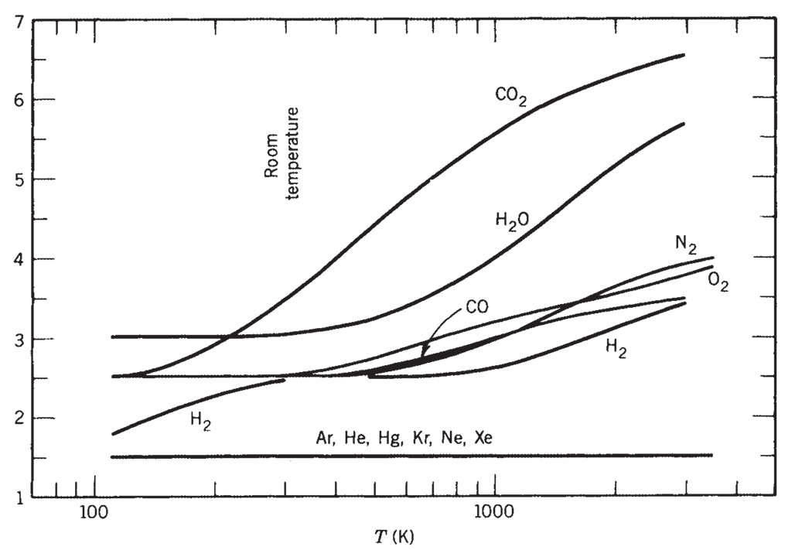

Constant Volume Reversible Heating
$$\frac{c_{v}}{R}$$

Slide 9
Internal Energy: U
This energy is defined as the energy associated with the random, disordered motion of molecules and due to intermolecular forces.
It is separated in scale from the macroscopic ordered energy associated with moving or stationary objects;
It refers to the invisible microscopic energy on the atomic and molecular scales.
Popularly known as Internal Energy, U.

Slide 10
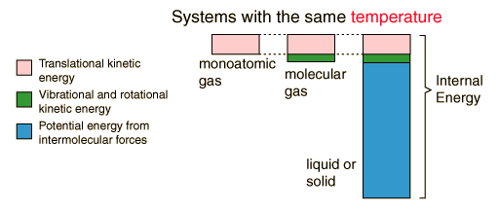
Internal (Microscopic) Energy
Internal energy involves energy on the microscopic scale.
For an ideal monoatomic gas, this is just the translational kinetic energy of the linear motion of the "hard sphere" type atoms
For polyatomic gases there is rotational and vibrational kinetic energy as well.
Then in liquids and solids there is potential energy associated with the intermolecular attractive forces.

Slide 11
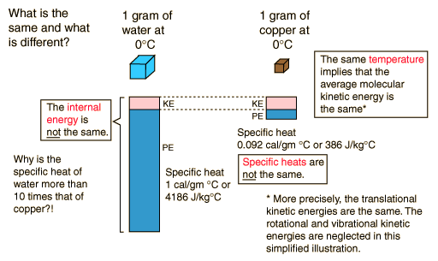
Internal Energy

Slide 12
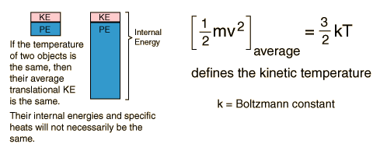
Internal Energy and Temperature

Slide 13
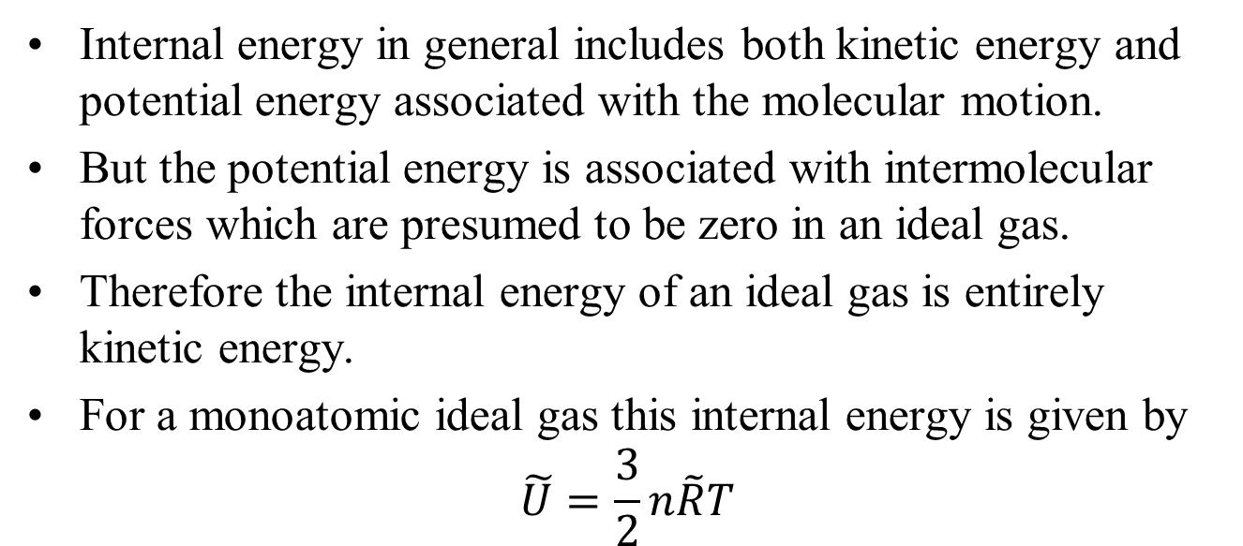
Internal Energy for Ideal Gas
Internal energy in general includes both kinetic energy and potential energy associated with the molecular motion.
But the potential energy is associated with intermolecular forces which are presumed to be zero in an ideal gas.
Therefore the internal energy of an ideal gas is entirely kinetic energy.
For a monoatomic ideal gas this internal energy is given by
$$\tilde{U}=\frac{3}{2}n\tilde{R}T$$
If rotation and vibrational kinetic energies are involved (polyatomic molecules) then
$\tilde{U}=\frac{f}{2}n\tilde{R}T$: Where e is the number of active degrees of freedom.

Slide 14
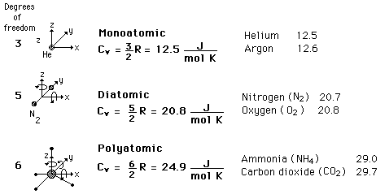
Selected Specific Heats

Slide 15
Gas
Constant Volume Heat Capacity
C_{V}(J/mol K)
C_{V}/R
Ar
12.5
1.50
He
12.5
1.50
CO
20.7
2.49
H2
20.4
2.45
HCl
21.4
2.57
N₂
20.6
2.49
NO
20.9
2.51
O2
21.1
2.54
Cl2
24.8
2.98
CO2
28.2
3.40
CS2
40.9
4.92
H2S
25.4
3.06
N2O
28.5
3.42
SO2
31.3
3.76

Slide 16

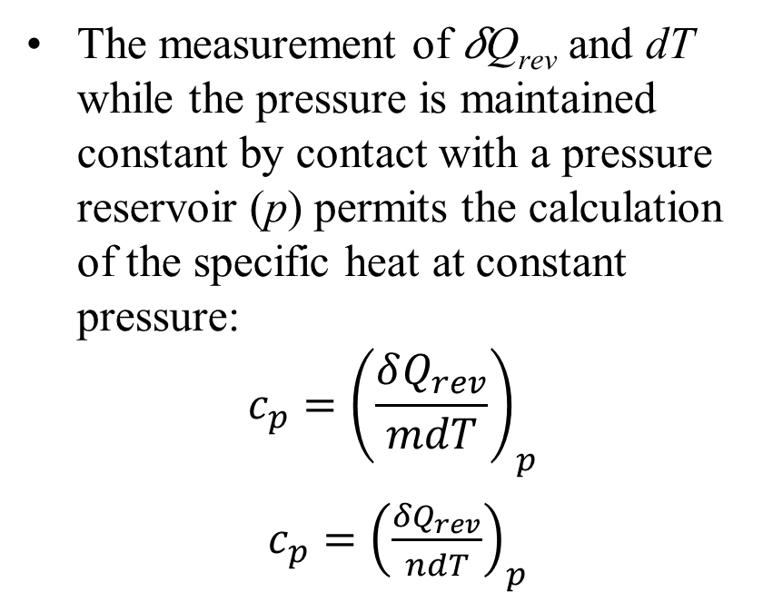
Reversible Heating at Constant Pressure
The measurement of 𝛿Q_{rev} and dT while the pressure is maintained constant by contact with a pressure reservoir (p) permits the calculation of the specific heat at constant pressure:
$$c_{p}={\left(\frac{δQ_{rev}}{mdT}\right)}_{p}$$
$c_{p}={\left(\frac{δQ_{rev}}{ndT}\right)}_{p}$
W
Constant Pressure Heating
The reversible heating process executed by the closed system of above figure is also accompanied by work transfer, 𝛿W_{rev}=pdV.

Slide 17
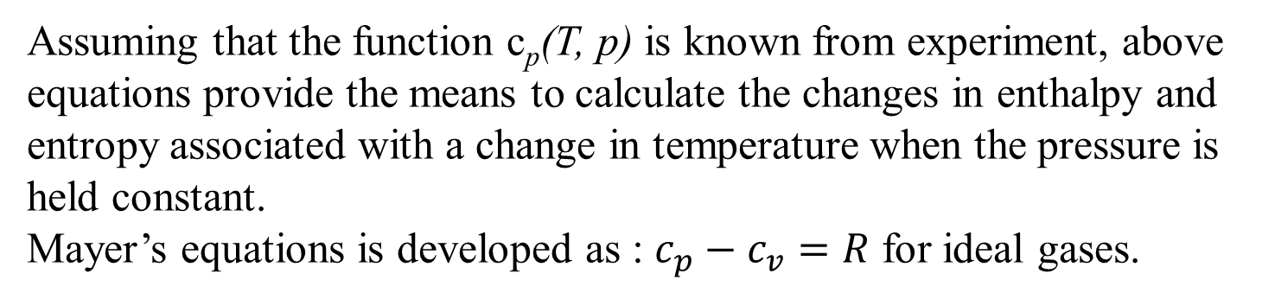
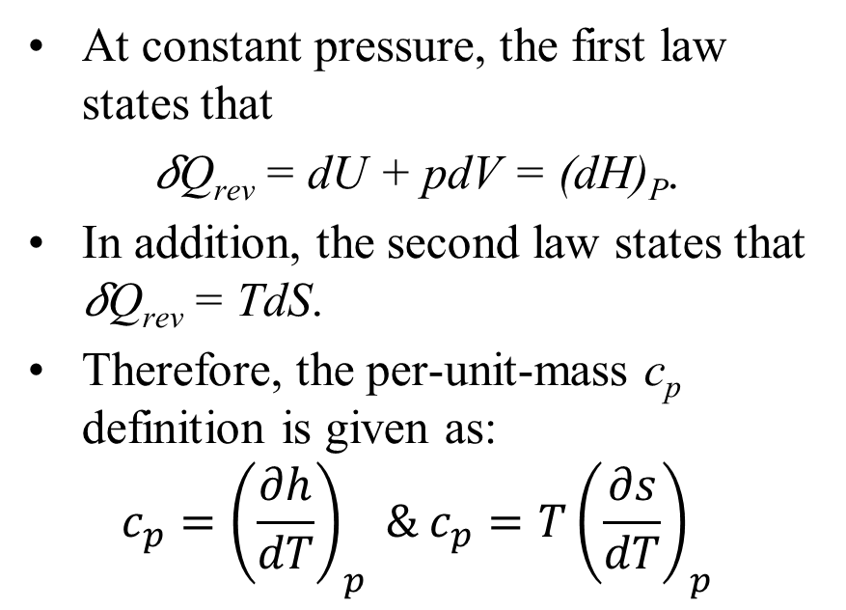
Reversible Heating at Constant Pressure
At constant pressure, the first law states that
𝛿Q_{rev} = dU + pdV = (dH)_{P}.
In addition, the second law states that 𝛿Q_{rev} = TdS.
Therefore, the per-unit-mass c_{p} definition is given as:
$$c_{p}={\left(\frac{∂h}{dT}\right)}_{p} \& c_{p}=T{\left(\frac{∂s}{dT}\right)}_{p}$$
W
Constant Pressure Heating
Assuming that the function c_{p}(T, p) is known from experiment, above equations provide the means to calculate the changes in enthalpy and entropy associated with a change in temperature when the pressure is held constant.
Mayer’s equations is developed as : $c_{p}−c_{v}=R$ for ideal gases.

