Slide 1

Creation of Energy Representatives thru Transformation
P M V Subbarao
Professor
Mechanical Engineering Department
Framework to Create More Variants of Energy Representatives!!!!

Slide 2

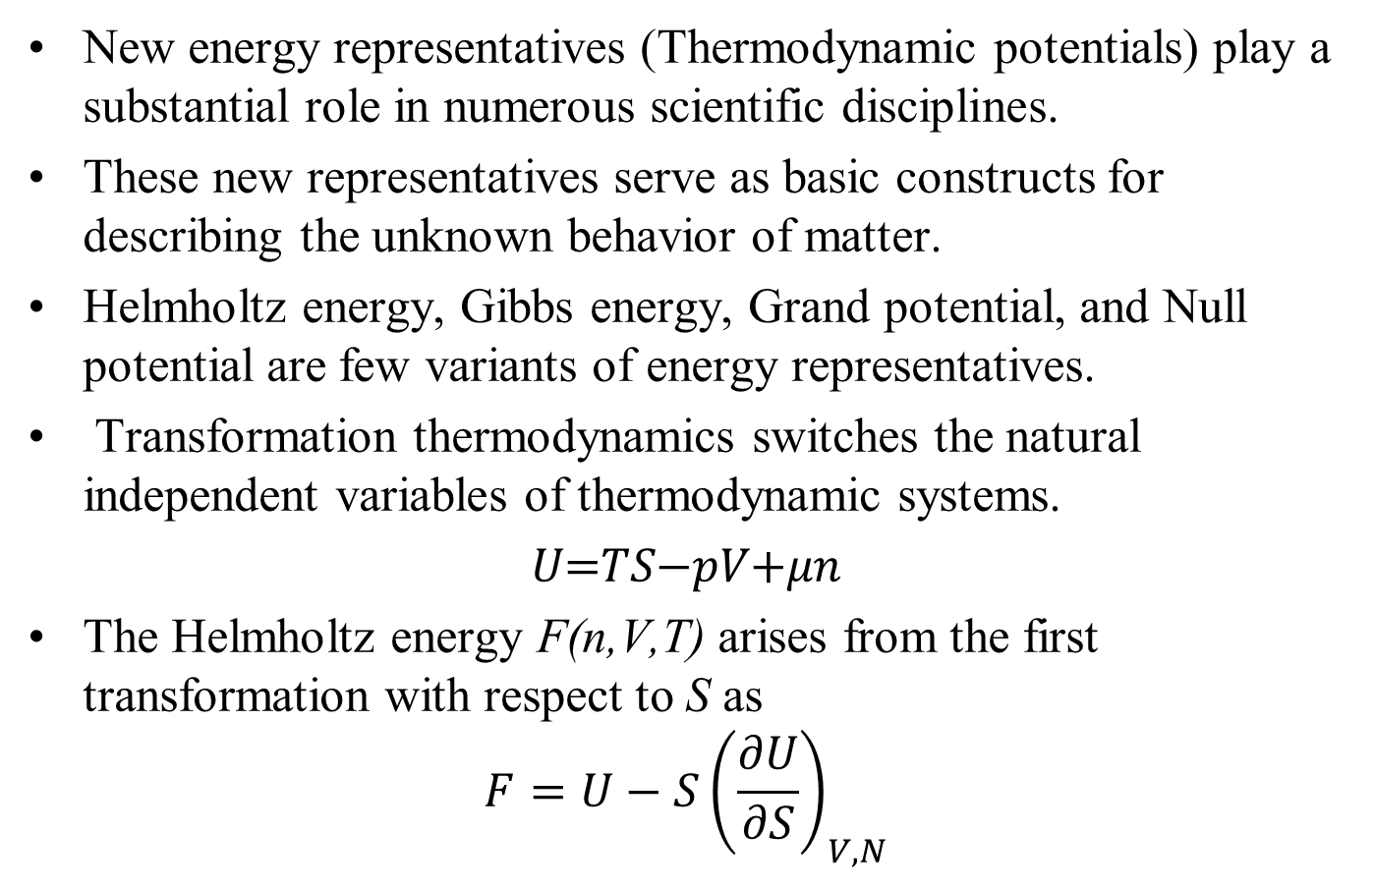
Transformation Thermodynamics
New energy representatives (Thermodynamic potentials) play a substantial role in numerous scientific disciplines.
These new representatives serve as basic constructs for describing the unknown behavior of matter.
Helmholtz energy, Gibbs energy, Grand potential, and Null potential are few variants of energy representatives.
Transformation thermodynamics switches the natural independent variables of thermodynamic systems.
𝑈=𝑇𝑆−𝑝𝑉+𝜇𝑛
The Helmholtz energy F(n,V,T) arises from the first transformation with respect to S as
$$F=U−S{\left(\frac{∂U}{∂S}\right)}_{V,N}$$

Slide 3
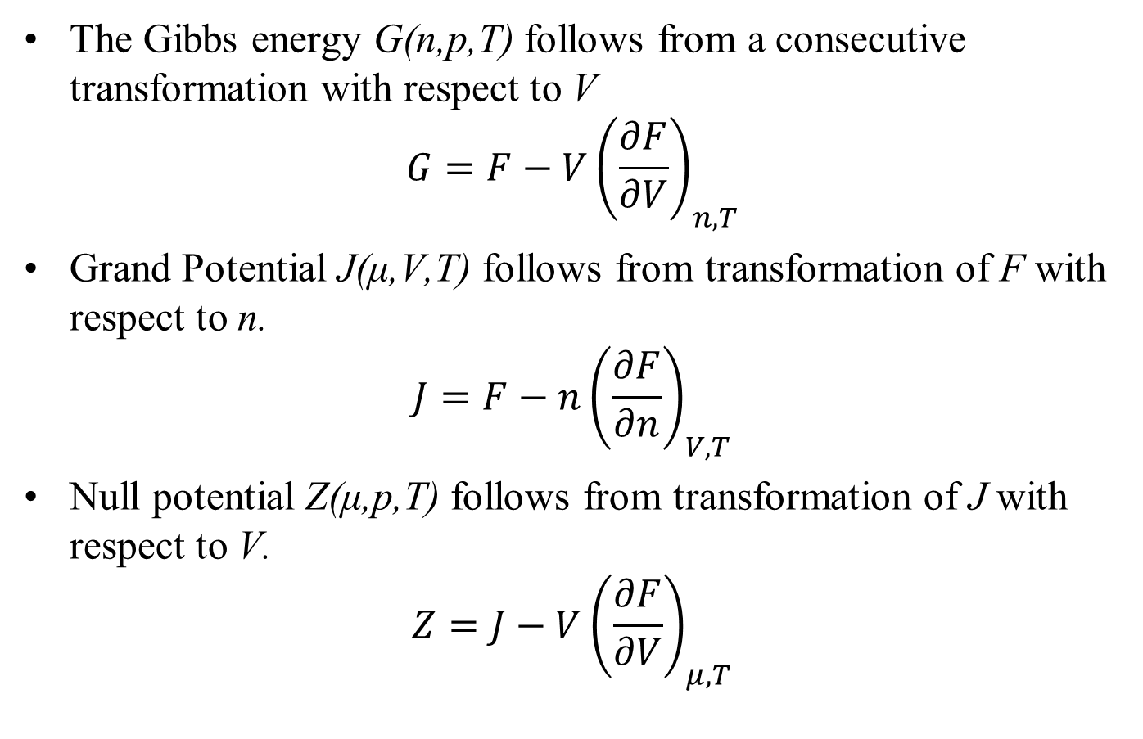
TRANSFORMS for Thermodynamics
The Gibbs energy G(n,p,T) follows from a consecutive transformation with respect to V
$$G=F−V{\left(\frac{∂F}{∂V}\right)}_{n,T}$$
Grand Potential J(μ,V,T) follows from transformation of F with respect to n.
$$J=F−n{\left(\frac{∂F}{∂n}\right)}_{V,T}$$
Null potential Z(μ,p,T) follows from transformation of J with respect to V.
$$Z=J−V{\left(\frac{∂F}{∂V}\right)}_{μ,T}$$
A Legendre transform is a mathematical operation that converts a function of one set of variables into a new function of a conjugate set of variables (such as slopes or derivatives) without losing any information

Slide 4
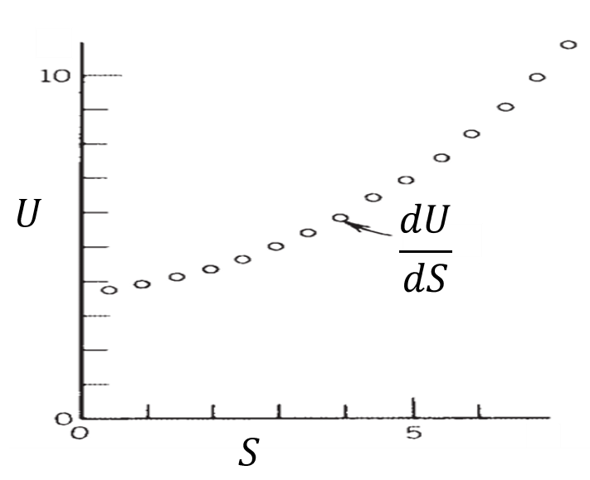
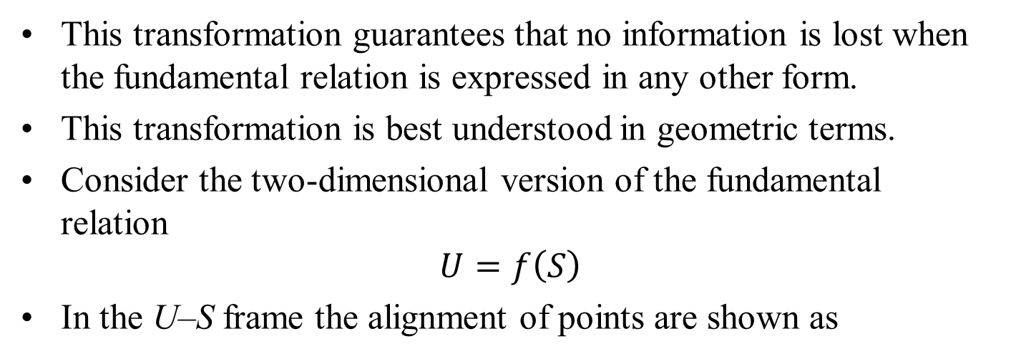
LEGENDRE TRANSFORMS
This transformation guarantees that no information is lost when the fundamental relation is expressed in any other form.
This transformation is best understood in geometric terms.
Consider the two-dimensional version of the fundamental relation
$$U=f\left(S\right)$$
In the U–S frame the alignment of points are shown as
A wish to replace the extensive property (S) with an intensive property T or p needs the slope.

Slide 5
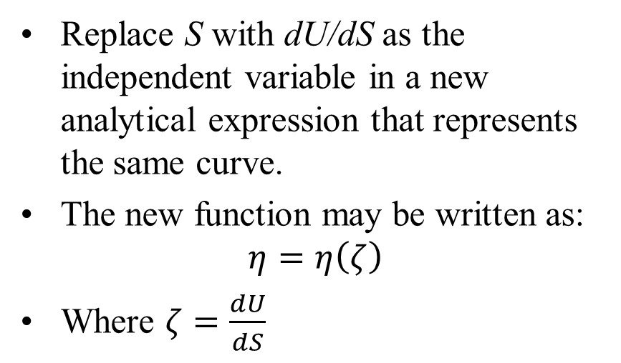
LEGENDRE TRANSFORMS
Replace S with dU/dS as the independent variable in a new analytical expression that represents the same curve.
The new function may be written as:
$$η=η\left(ζ\right)$$
Where $ζ=\frac{dU}{dS}$
Such that to each (U,S) point corresponds only one point(𝜁,𝜂), and vice versa.

Slide 6
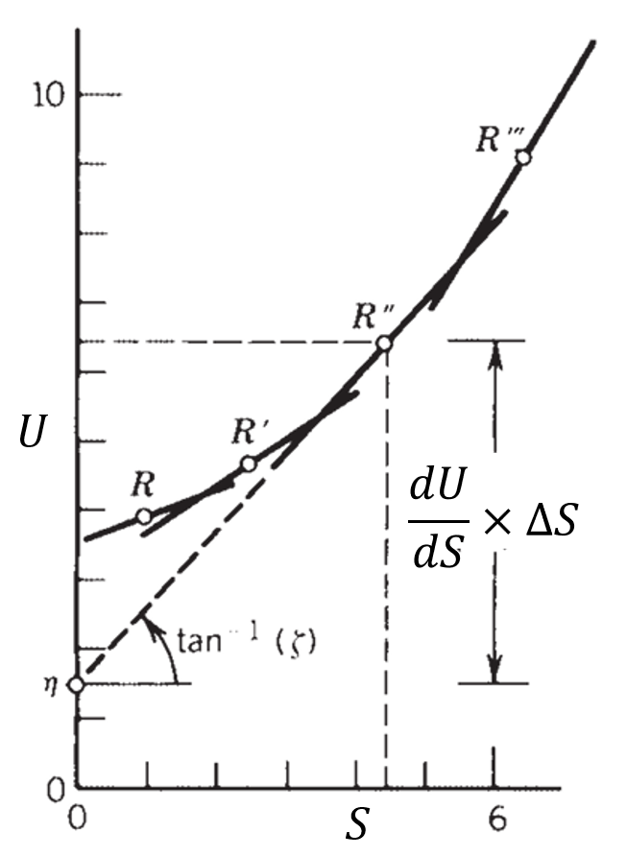
LEGENDRE TRANSFORMS
The analytical form of 𝜂(𝜁) the original curve can also be drawn as the envelope of the straight lines that have the slope dU/dS while passing through each point [S, f(S)].
The curve can be drawn by means of tangent lines.

Slide 7
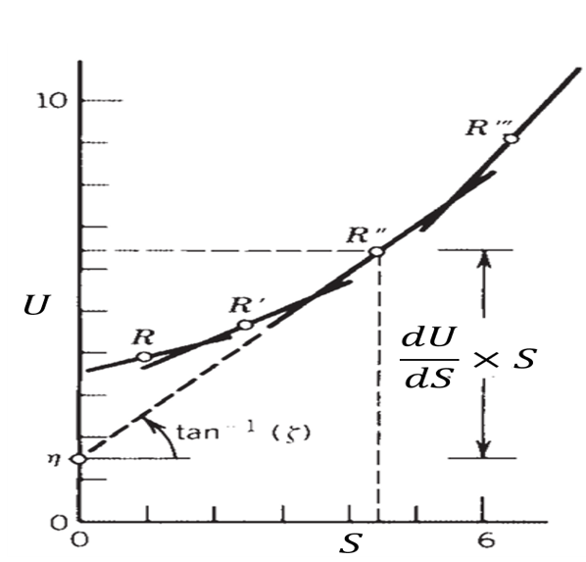
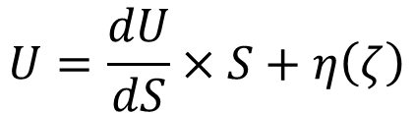

LEGENDRE TRANSFORMS
To “describe” the curve means to vary the intercept on the ordinate (𝜂) in a certain way relative to the slope of each line (𝜁).
The original curve will emerges as the envelope of tangent lines.
This special relation between 𝜂 and 𝜁 is the condition that each straight line that passes through point [S, f(S)] must be tangent to original curve U = f(S).
$$U=\frac{dU}{dS}×S+η\left(ζ\right)$$
$$η\left(ζ\right) =U\left(S\right)−ζS$$

Slide 8
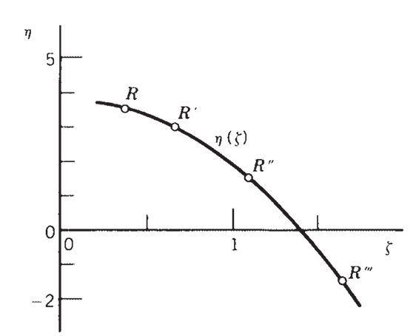

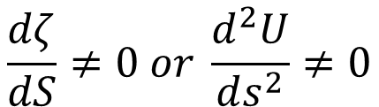
LEGENDRE TRANSFORMS
$$η\left(ζ\right) =U\left(S\right)−ζS$$
Eliminate S from above equations yields the new function 𝜂 = 𝜂(𝜁), which is shown as
The elimination is possible as long as the new variable 𝜁 is not independent of S.
That is, when
$$\frac{dζ}{dS}≠0 or \frac{d^{2}U}{ds^{2}}≠0$$
If the original function is a straight line, d²U∕dS² = 0, the tangents would fall on top of each other and the entire [U, f(S)]curve would collapse into a single point in the 𝜁–𝜂 plane.

Slide 9
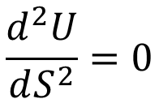
LEGENDRE TRANSFORMS
$$\frac{d^{2}U}{dS^{2}}=0$$
In this extreme, to each (𝜁,𝜂) would correspond more than one point in the U–S plane, and the 𝜂(𝜁) does not exist.
It turns out that in simple system the condition is satisfied as long as the equilibrium is stable.
The function 𝜂(𝜁) is the Legendre transform of U=f(S) or any y(x).

Slide 10
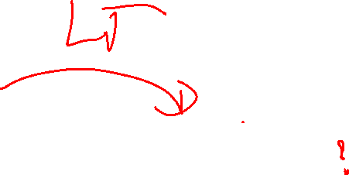
LEGENDRE TRANSFORMS
The functions are exact.
Although graphically (and also analytically) U(S) and 𝜂(𝜁) can be quite different.
But they do represent same system.

Slide 11
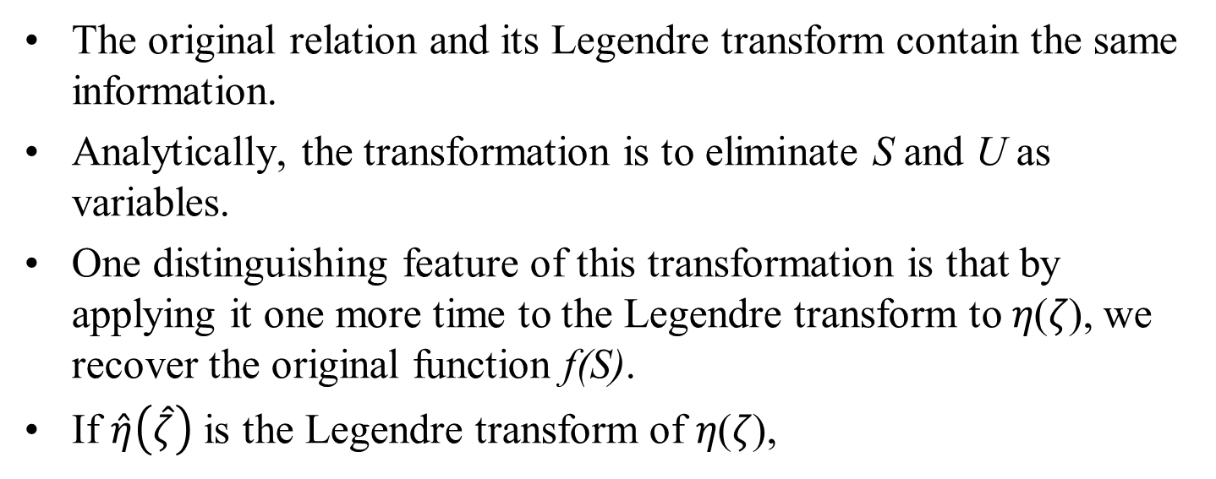



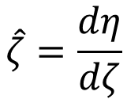
LEGENDRE TRANSFORMS
The original relation and its Legendre transform contain the same information.
Analytically, the transformation is to eliminate S and U as variables.
One distinguishing feature of this transformation is that by applying it one more time to the Legendre transform to 𝜂(𝜁), we recover the original function f(S).
If $\hat{η}\left(\hat{ζ}\right)$ is the Legendre transform of 𝜂(𝜁),
$$\hat{ζ}=\frac{dη}{dζ}$$
$$\hat{η}=η−\hat{ζ}ζ$$
The derivative d𝜂∕d𝜁 is equal to −S; therefore,
$$\hat{ζ}=−S$$
$$\hat{η}=f\left(S\right)$$
Except for the minus sign, the successive application of two Legendre transformations leads back to the original function f(S).

Slide 12
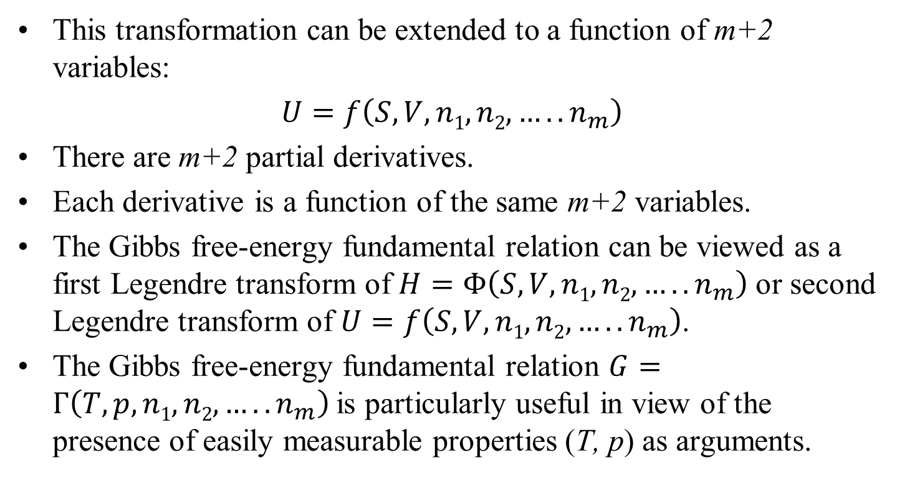
LEGENDRE TRANSFORMS
This transformation can be extended to a function of m+2 variables:
$U=f\left(S,V,n1, n2, …..n_{m}\right)$
There are m+2 partial derivatives.
Each derivative is a function of the same m+2 variables.
The Gibbs free-energy fundamental relation can be viewed as a first Legendre transform of $H=Φ\left(S,V,n1, n2, …..n_{m}\right)$ or second Legendre transform of $U=f\left(S,V,n1, n2, …..n_{m}\right)$.
The Gibbs free-energy fundamental relation $G=Γ\left(T,p,n1, n2, …..n_{m}\right)$is particularly useful in view of the presence of easily measurable properties (T, p) as arguments.

Slide 13
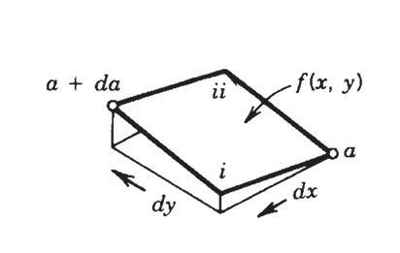
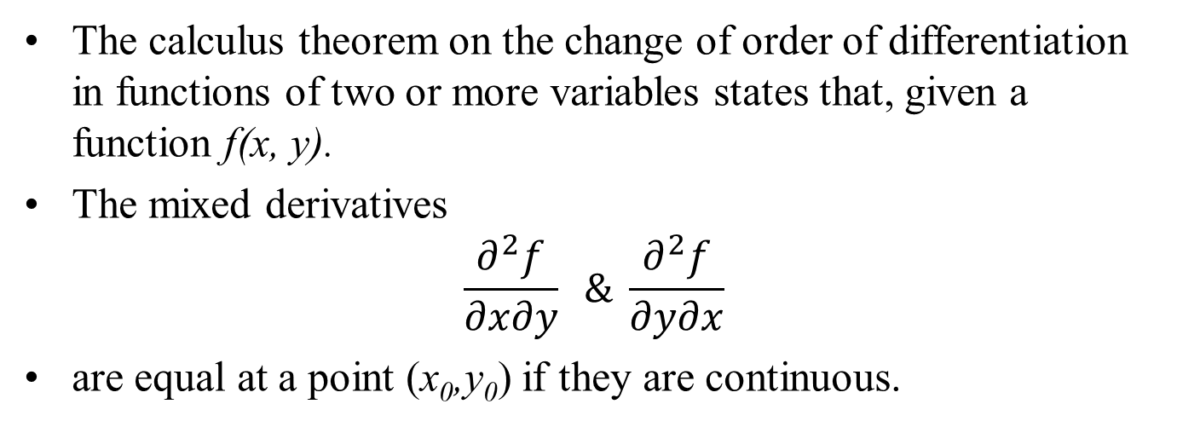
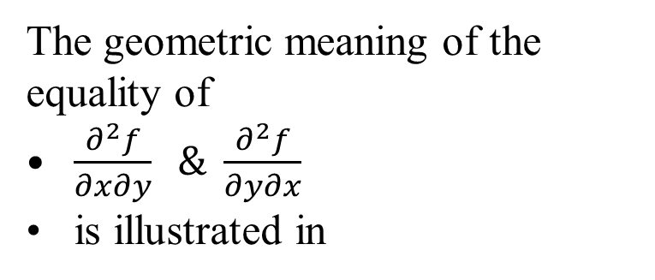
Maxwell’s Relations
The calculus theorem on the change of order of differentiation in functions of two or more variables states that, given a function f(x, y).
The mixed derivatives
$$\frac{∂^{2}f}{∂x∂y} \& \frac{∂^{2}f}{∂y∂x}$$
are equal at a point (x₀,y₀) if they are continuous.
The geometric meaning of the equality of
$\frac{∂^{2}f}{∂x∂y} \& \frac{∂^{2}f}{∂y∂x}$
is illustrated in

Slide 14
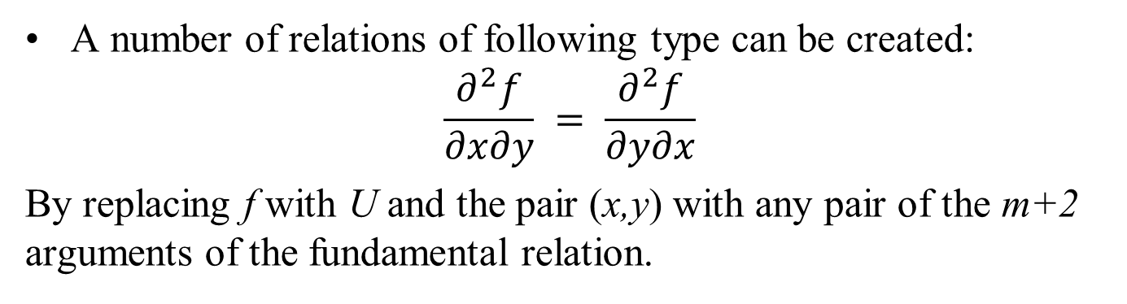
Maxwell’s Relations
When the equality holds,
one can move from one point (a) on the surface and arrive at the same neighbouring point (a+da) on the surface, either
by stepping first in x and second in y or by stepping first in y and second in x (option2).
The fundamental relation U=U(S,V,n₁,…,n_{m}) presents U as a function of m+2 variables.
A number of relations of following type can be created:
$$\frac{∂^{2}f}{∂x∂y} = \frac{∂^{2}f}{∂y∂x}$$
By replacing f with U and the pair (x,y) with any pair of the m+2 arguments of the fundamental relation.

Slide 15
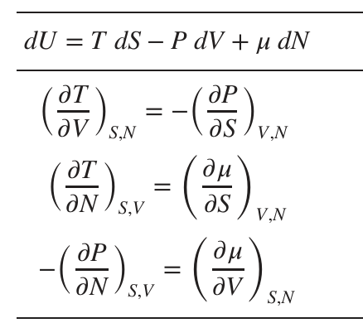
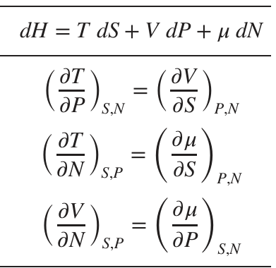
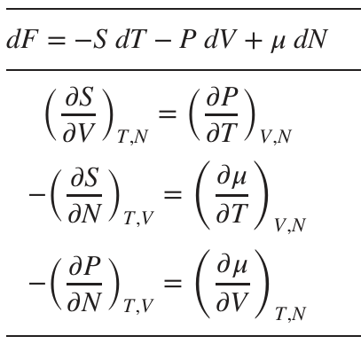
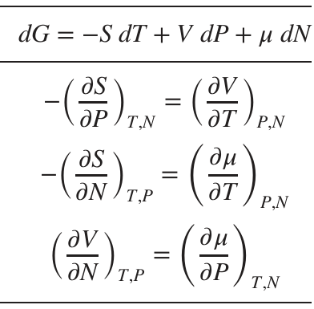
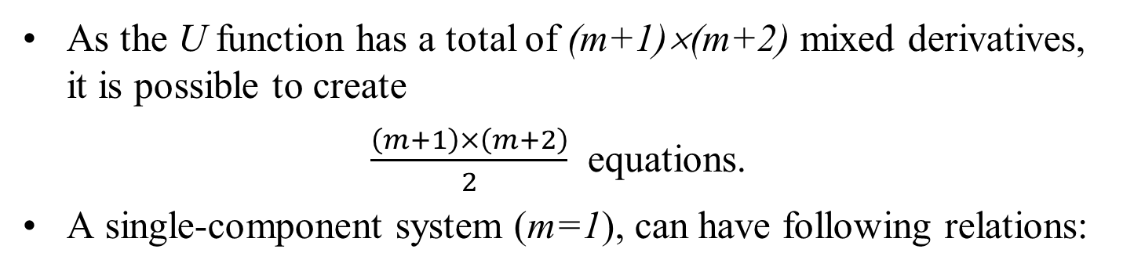
Maxwell’s Relations for a Single-Component System
As the U function has a total of (m+1)×(m+2) mixed derivatives, it is possible to create
$\frac{\left(m+1\right)×\left(m+2\right)}{2}$ equations.
A single-component system (m=1), can have following relations:
These relations are headed by the differential form of the fundamental relation, which shows that the intensities T,−p, and 𝜇 play a role of first derivatives.

Slide 16
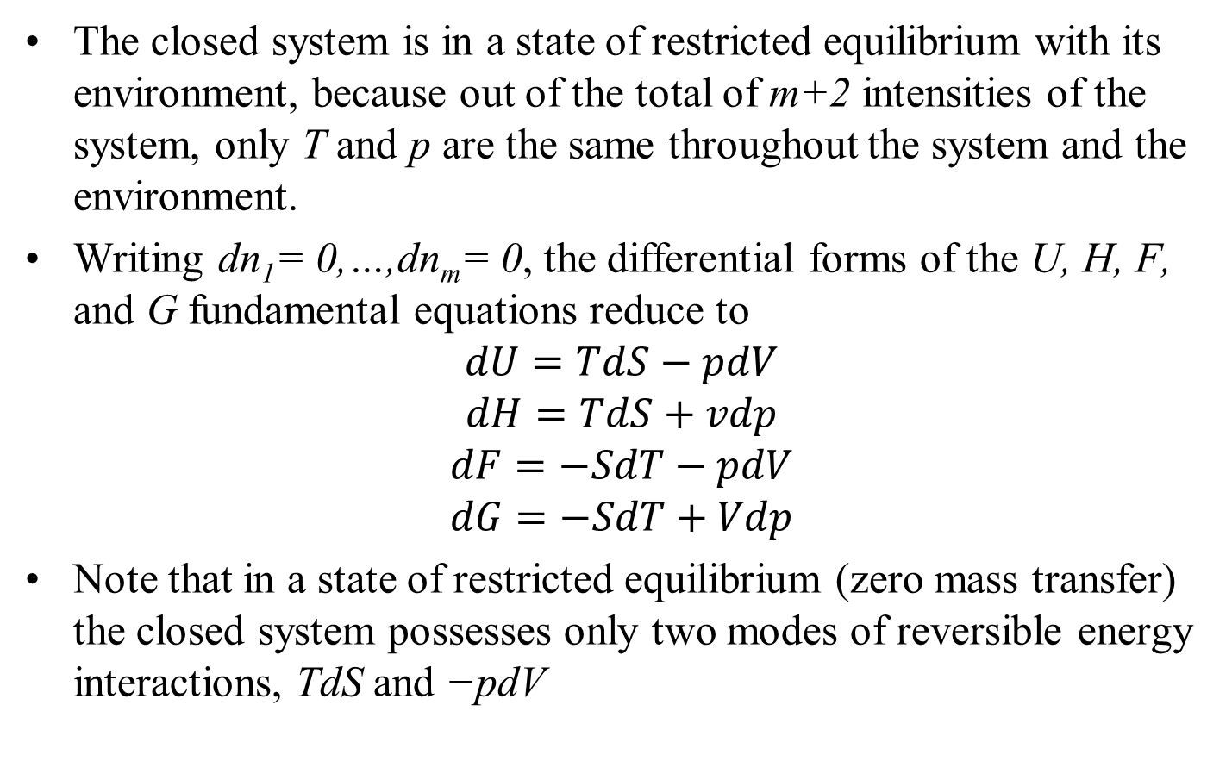
Maxwell’s Relations for a Single-Component Closed System
The closed system is in a state of restricted equilibrium with its environment, because out of the total of m+2 intensities of the system, only T and p are the same throughout the system and the environment.
Writing dn₁= 0,…,dn_{m}= 0, the differential forms of the U, H, F, and G fundamental equations reduce to
$$dU=TdS−pdV$$
$$dH=TdS+vdp$$
$$dF=−SdT−pdV$$
$$dG=−SdT+Vdp$$
Note that in a state of restricted equilibrium (zero mass transfer) the closed system possesses only two modes of reversible energy interactions, TdS and −pdV

Slide 17
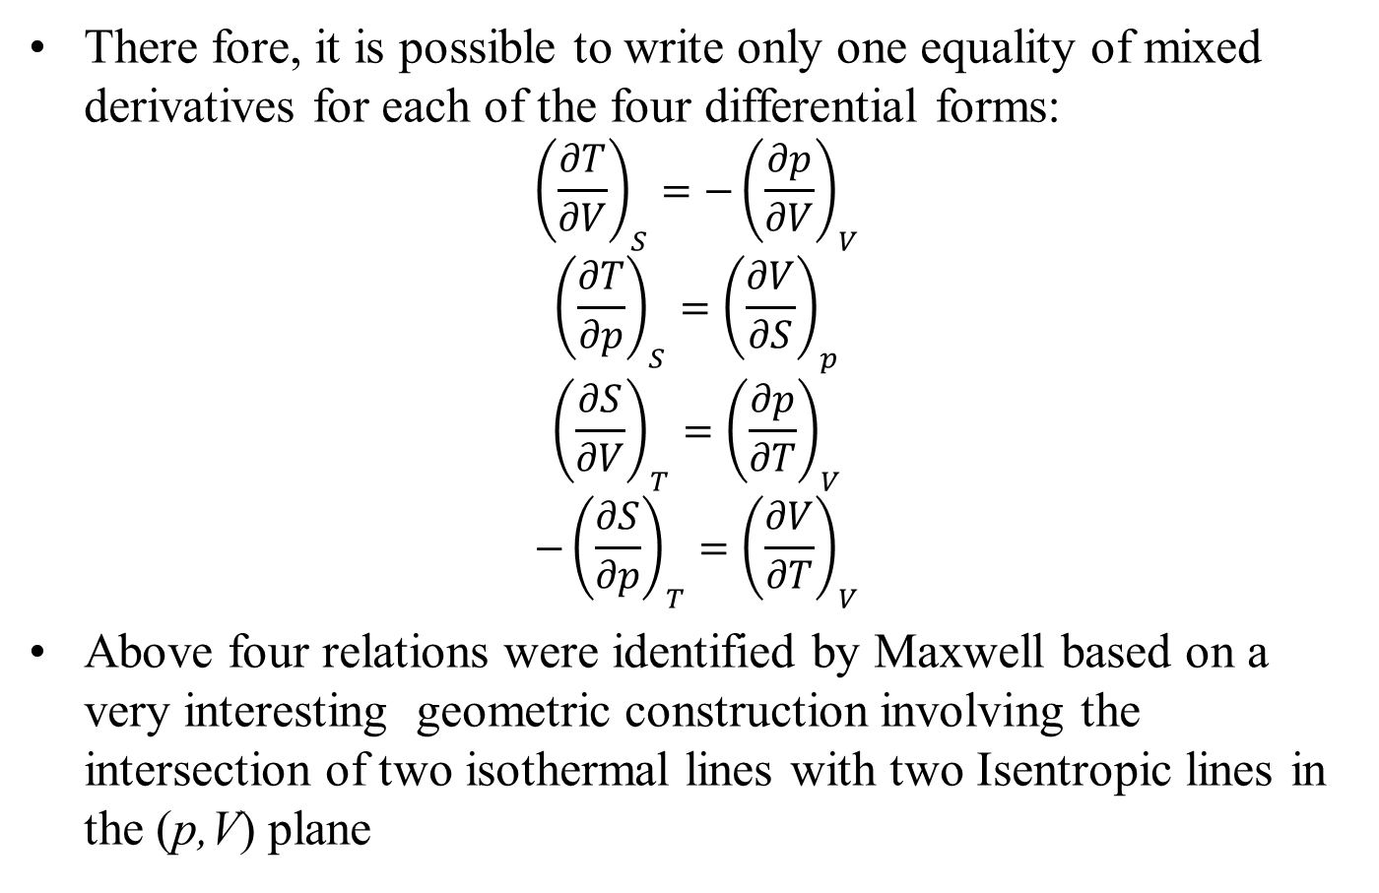
Mixed Derivatives for A Closed System
There fore, it is possible to write only one equality of mixed derivatives for each of the four differential forms:
$${\left(\frac{∂T}{∂V}\right)}_{S}={−\left(\frac{∂p}{∂V}\right)}_{V}$$
$${\left(\frac{∂T}{∂p}\right)}_{S}={\left(\frac{∂V}{∂S}\right)}_{p}$$
$${\left(\frac{∂S}{∂V}\right)}_{T}={\left(\frac{∂p}{∂T}\right)}_{V}$$
$$−{\left(\frac{∂S}{∂p}\right)}_{T}={\left(\frac{∂V}{∂T}\right)}_{V}$$
Above four relations were identified by Maxwell based on a very interesting geometric construction involving the intersection of two isothermal lines with two Isentropic lines in the (p,V) plane

Slide 18
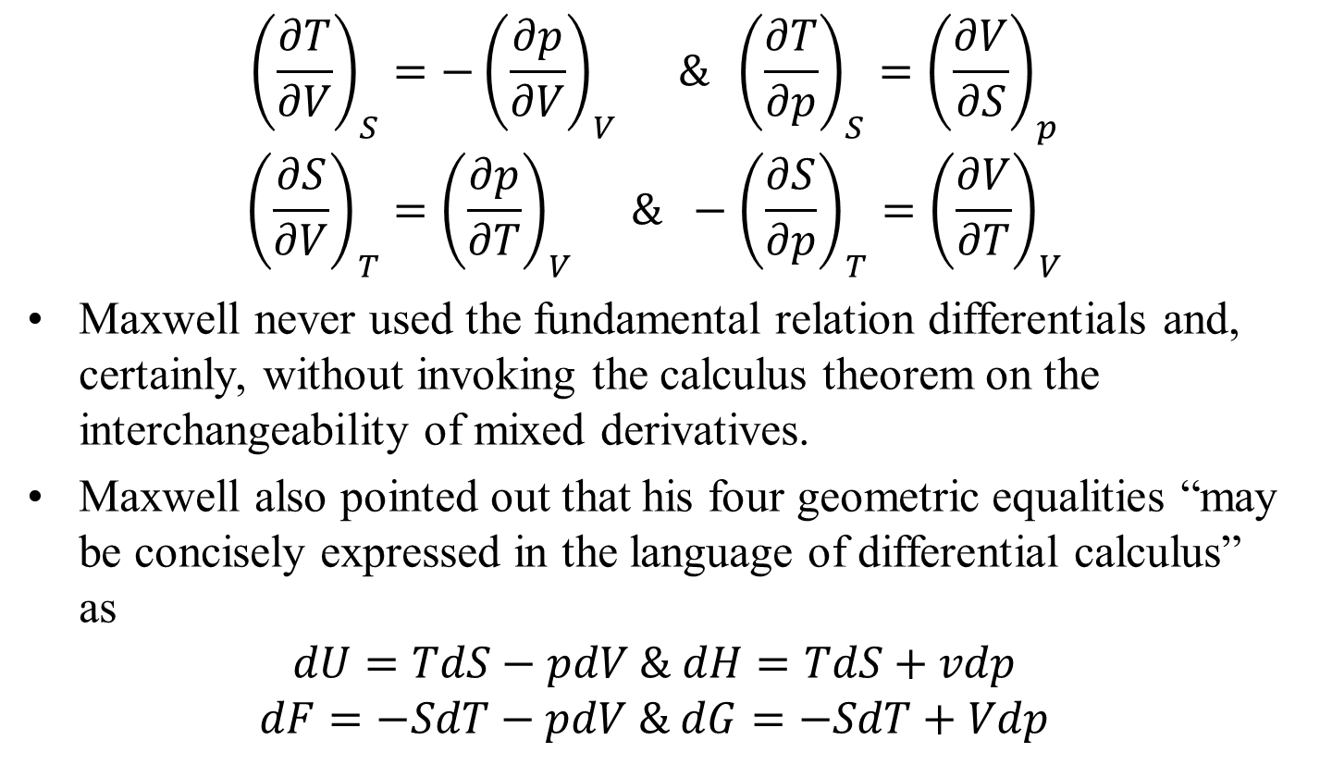
Mixed Derivatives for A Closed System
$${\left(\frac{∂T}{∂V}\right)}_{S}={−\left(\frac{∂p}{∂V}\right)}_{V} \& {\left(\frac{∂T}{∂p}\right)}_{S}={\left(\frac{∂V}{∂S}\right)}_{p}$$
$${\left(\frac{∂S}{∂V}\right)}_{T}={\left(\frac{∂p}{∂T}\right)}_{V} \& −{\left(\frac{∂S}{∂p}\right)}_{T}={\left(\frac{∂V}{∂T}\right)}_{V}$$
Maxwell never used the fundamental relation differentials and, certainly, without invoking the calculus theorem on the interchangeability of mixed derivatives.
Maxwell also pointed out that his four geometric equalities “may be concisely expressed in the language of differential calculus” as
$$dU=TdS−pdV \& dH=TdS+vdp$$
$$dF=−SdT−pdV \& dG=−SdT+Vdp$$

Slide 19
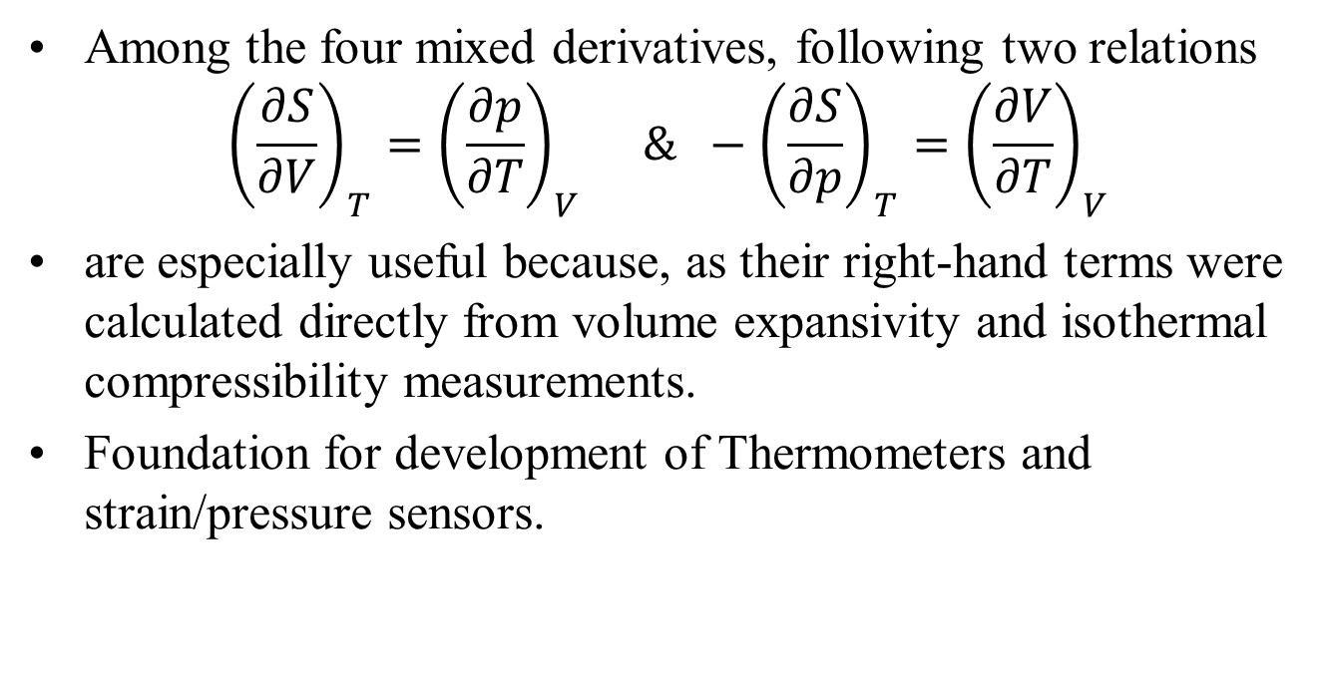
Mixed Derivatives for A Closed System
Among the four mixed derivatives, following two relations
$${\left(\frac{∂S}{∂V}\right)}_{T}={\left(\frac{∂p}{∂T}\right)}_{V} \& −{\left(\frac{∂S}{∂p}\right)}_{T}={\left(\frac{∂V}{∂T}\right)}_{V}$$
are especially useful because, as their right-hand terms were calculated directly from volume expansivity and isothermal compressibility measurements.
Foundation for development of Thermometers and strain/pressure sensors.

