Slide 1

Development of Special Representation Functions
P M V Subbarao
Professor
Mechanical Engineering Department
Appropriate Energy Representatives are Essential for Better Design !!!!

Slide 2


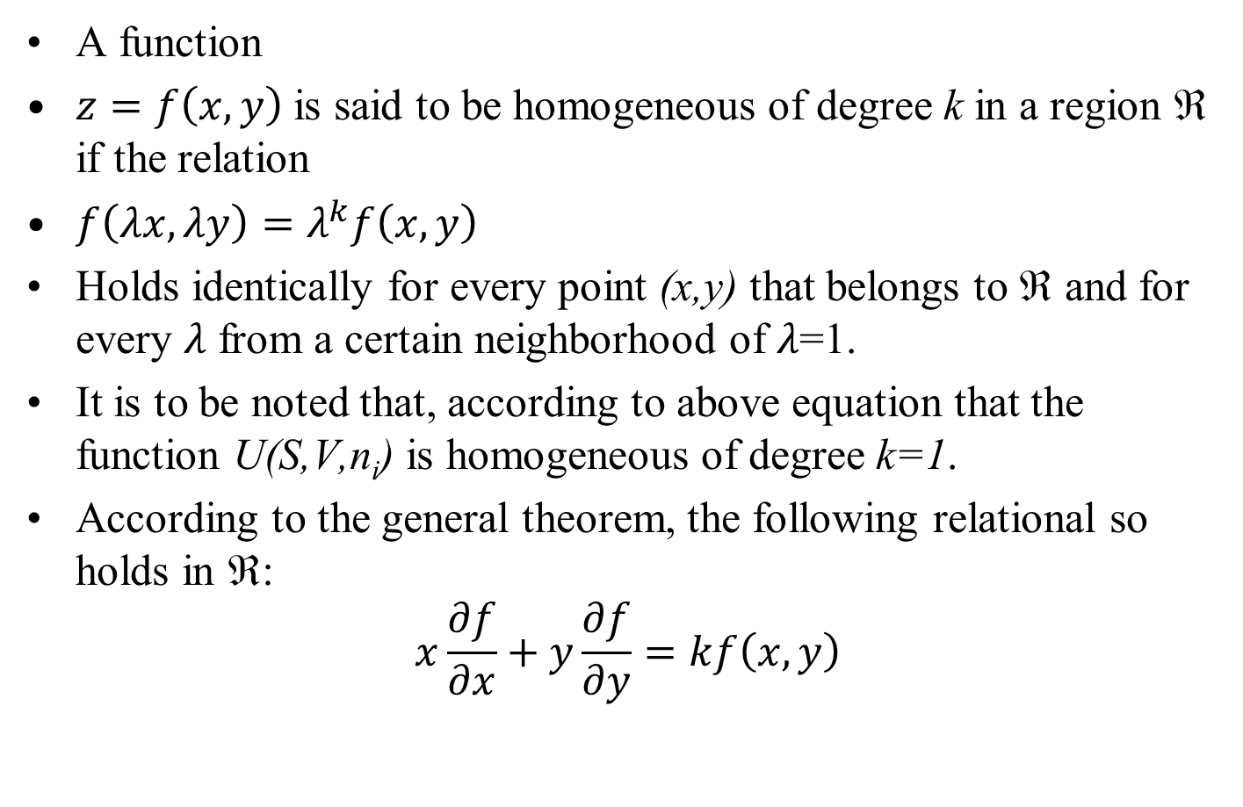
The Euler Equation
A function
$z=f\left(x,y\right)$ is said to be homogeneous of degree k in a region ℜ if the relation
$f\left(λx,λy\right)=λ^{k}f\left(x,y\right)$
Holds identically for every point (x,y) that belongs to ℜ and for every 𝜆 from a certain neighborhood of 𝜆=1.
It is to be noted that, according to above equation that the function U(S,V,n_{i}) is homogeneous of degree k=1.
According to the general theorem, the following relational so holds in ℜ:
$$x\frac{∂f}{∂x}+y\frac{∂f}{∂y}=kf\left(x,y\right)$$

Slide 3
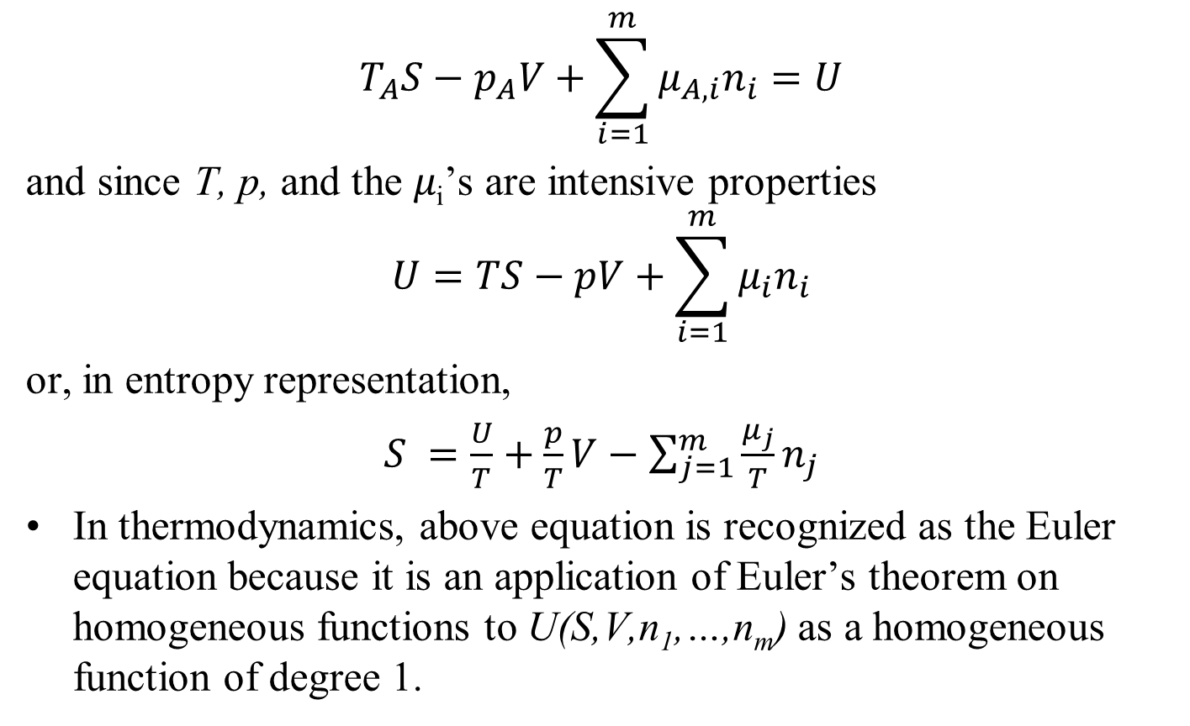
Application of the Euler Equation
$$T_{A}S−p_{A}V+\sum_{i=1}^{m}{μ_{A,i}n_{i}}=U$$
and since T, p, and the 𝜇_{i}’s are intensive properties
$$U=TS−pV+\sum_{i=1}^{m}{μ_{i}n_{i}}$$
or, in entropy representation,
$S =\frac{U}{T}+\frac{p}{T}V−$ $\sum_{j=1}^{m}{\frac{μ_{j}}{T}n_{j}}$
In thermodynamics, above equation is recognized as the Euler equation because it is an application of Euler’s theorem on homogeneous functions to U(S,V,n₁,…,n_{m}) as a homogeneous function of degree 1.

Slide 4
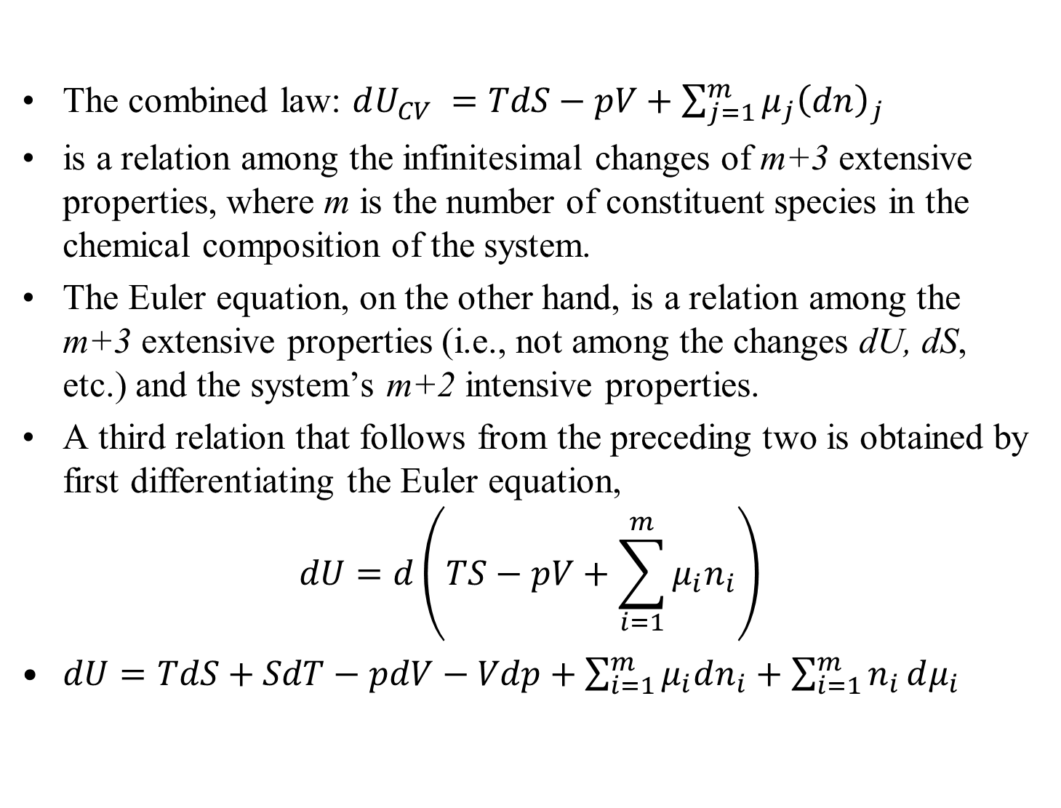
The Gibbs–Duhem Relation
The combined law: $dU_{CV} =TdS−pV+$ $\sum_{j=1}^{m}{μ_{j}{\left(dn\right)}_{j}}$
is a relation among the infinitesimal changes of m+3 extensive properties, where m is the number of constituent species in the chemical composition of the system.
The Euler equation, on the other hand, is a relation among the m+3 extensive properties (i.e., not among the changes dU, dS, etc.) and the system’s m+2 intensive properties.
A third relation that follows from the preceding two is obtained by first differentiating the Euler equation,
$$dU=d\left(TS−pV+\sum_{i=1}^{m}{μ_{i}n_{i}}\right)$$
$dU=TdS+SdT−pdV−Vdp+\sum_{i=1}^{m}{μ_{i}dn_{i}}+\sum_{i=1}^{m}{n_{i}}dμ_{i}$

Slide 5
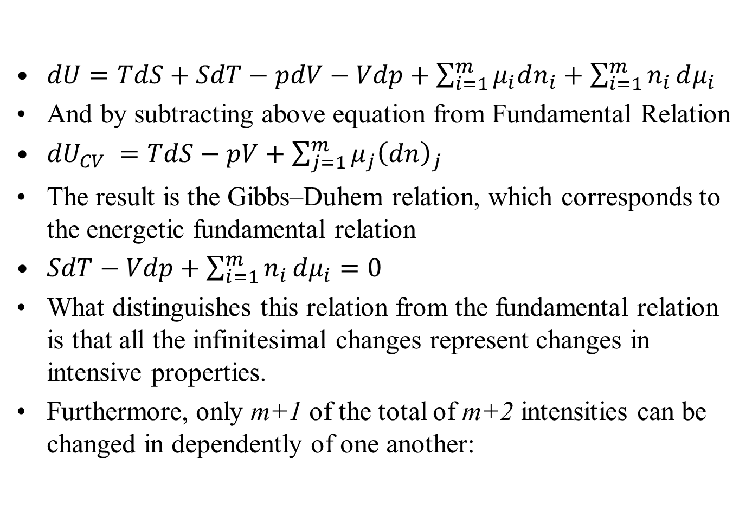
The Gibbs–Duhem Relation
$dU=TdS+SdT−pdV−Vdp+\sum_{i=1}^{m}{μ_{i}dn_{i}}+\sum_{i=1}^{m}{n_{i}}dμ_{i}$
And by subtracting above equation from Fundamental Relation
${dU}_{CV} =TdS−pV+$ $\sum_{j=1}^{m}{μ_{j}{\left(dn\right)}_{j}}$
The result is the Gibbs–Duhem relation, which corresponds to the energetic fundamental relation
$SdT−Vdp+\sum_{i=1}^{m}{n_{i}}dμ_{i}=0$
What distinguishes this relation from the fundamental relation is that all the infinitesimal changes represent changes in intensive properties.
Furthermore, only m+1 of the total of m+2 intensities can be changed in dependently of one another:

Slide 6
The Gibbs–Duhem Relation
If the changes in m+1intensive properties are specified, the change in the (m+2)^{th} intensive property results from the Gibbs–Duhem equation.
The intensive properties that can be varied independently are the degrees of freedom of the system; consequently, a simple system containing m species has m+1degrees of freedom.

Slide 7
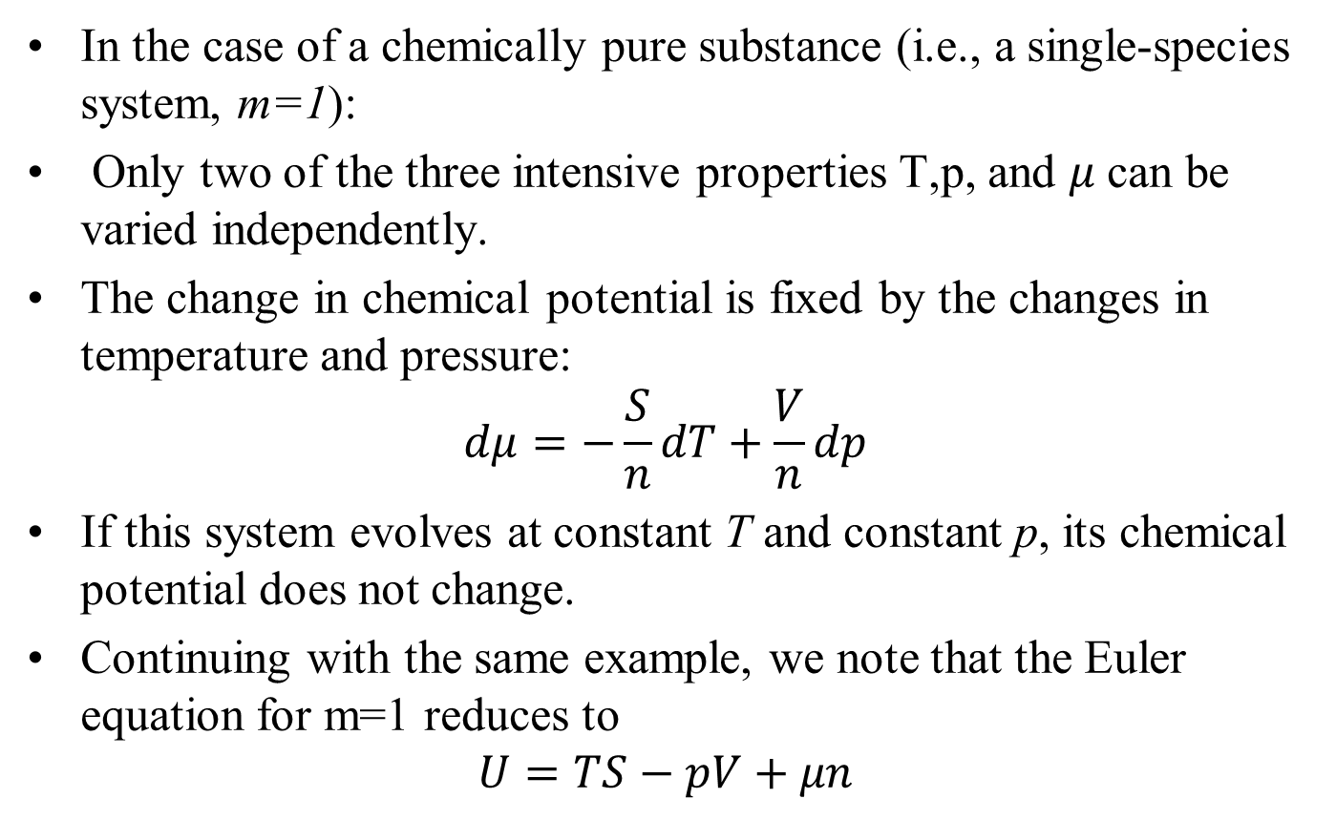
Simple System with A Single Species
In the case of a chemically pure substance (i.e., a single-species system, m=1):
Only two of the three intensive properties T,p, and 𝜇 can be varied independently.
The change in chemical potential is fixed by the changes in temperature and pressure:
$$dμ=−\frac{S}{n}dT+\frac{V}{n}dp$$
If this system evolves at constant T and constant p, its chemical potential does not change.
Continuing with the same example, we note that the Euler equation for m=1 reduces to
$$U=TS−pV+μn$$

Slide 8
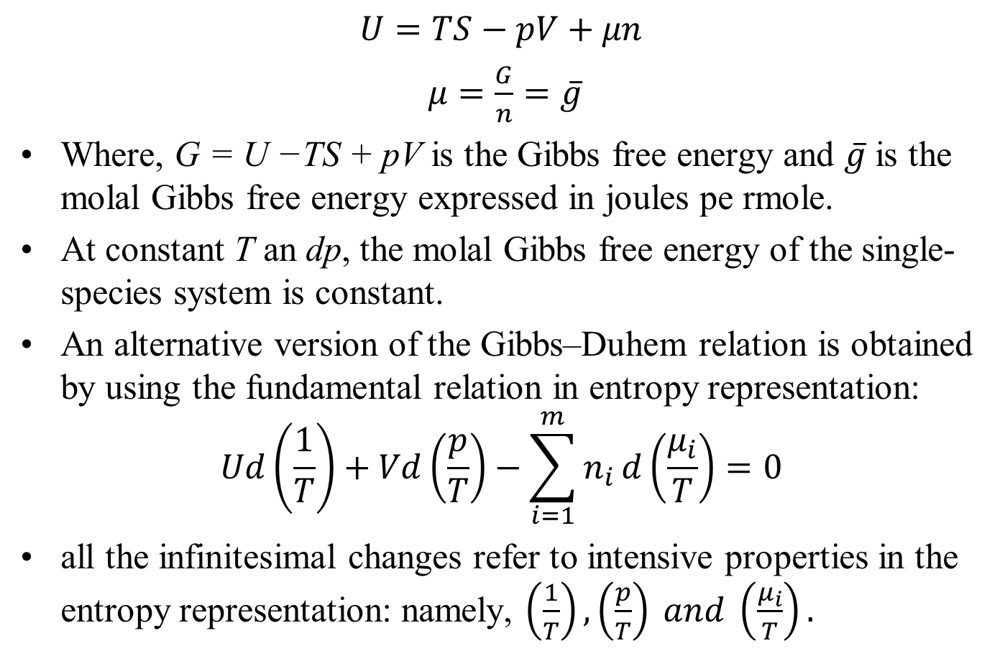
Simple System with A Single Species
$$U=TS−pV+μn$$
$μ=\frac{G}{n}=\overline{g}$
Where, G = U −TS + pV is the Gibbs free energy and $\overline{g}$ is the molal Gibbs free energy expressed in joules pe rmole.
At constant T an dp, the molal Gibbs free energy of the single-species system is constant.
An alternative version of the Gibbs–Duhem relation is obtained by using the fundamental relation in entropy representation:
$$Ud\left(\frac{1}{T}\right)+Vd\left(\frac{p}{T}\right)−\sum_{i=1}^{m}{n_{i}}d\left(\frac{μ_{i}}{T}\right)=0$$
all the infinitesimal changes refer to intensive properties in the entropy representation: namely, $\left(\frac{1}{T}\right), \left(\frac{p}{T}\right) and \left(\frac{μ_{i}}{T}\right).$

Slide 9
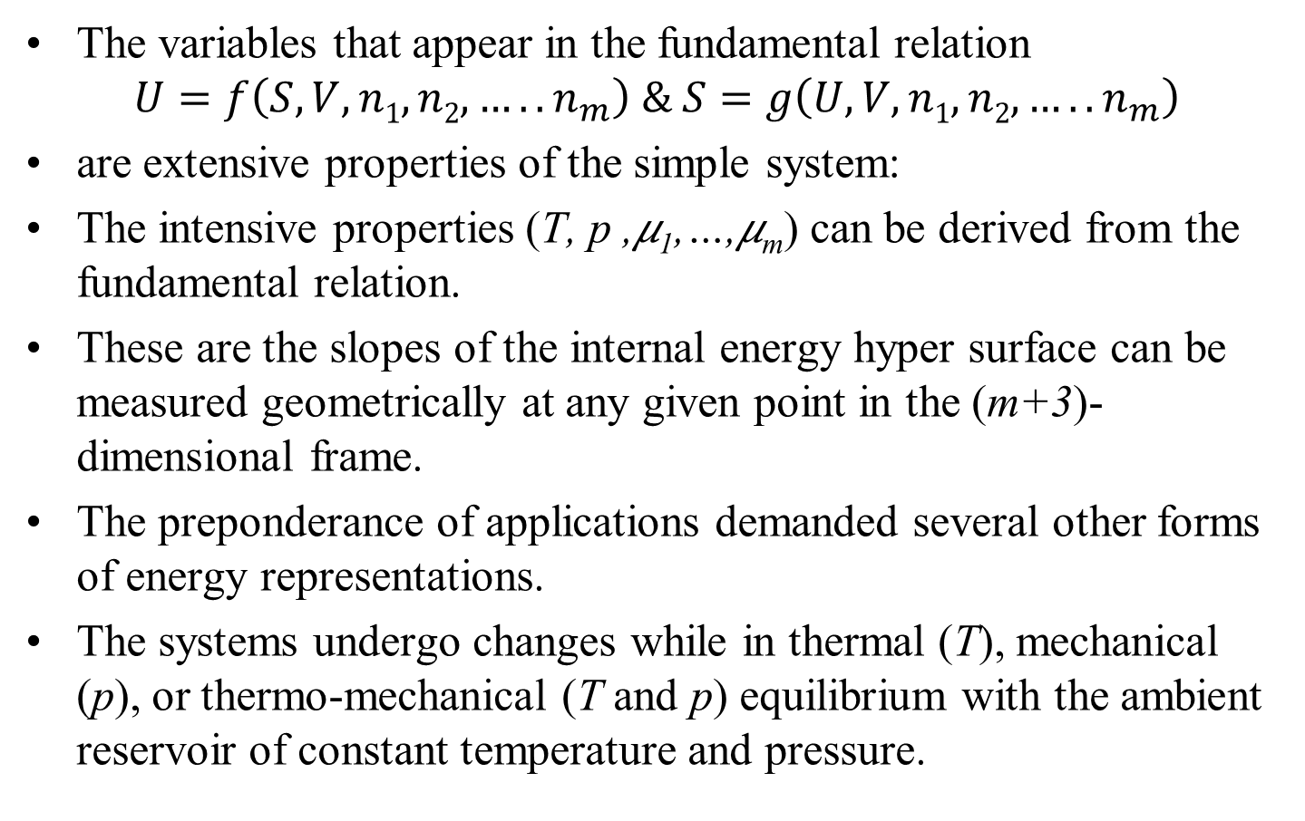
More Energy Representations
The variables that appear in the fundamental relation
$$U=f\left(S,V,n1, n2, …..n_{m}\right) \& S=g\left(U,V,n1, n2, …..n_{m}\right)$$
are extensive properties of the simple system:
The intensive properties (T, p ,𝜇₁,…,𝜇_{m}) can be derived from the fundamental relation.
These are the slopes of the internal energy hyper surface can be measured geometrically at any given point in the (m+3)-dimensional frame.
The preponderance of applications demanded several other forms of energy representations.
The systems undergo changes while in thermal (T), mechanical (p), or thermo-mechanical (T and p) equilibrium with the ambient reservoir of constant temperature and pressure.

Slide 10
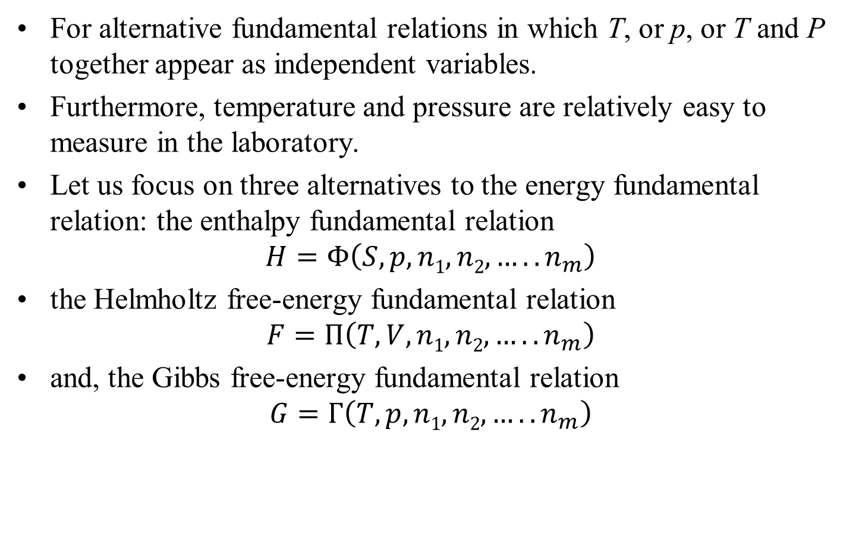
Popular Energy Representations
For alternative fundamental relations in which T, or p, or T and P together appear as independent variables.
Furthermore, temperature and pressure are relatively easy to measure in the laboratory.
Let us focus on three alternatives to the energy fundamental relation: the enthalpy fundamental relation
$$H=Φ\left(S,p,n1, n2, …..n_{m}\right)$$
the Helmholtz free-energy fundamental relation
$$F=Π\left(T,V,n1, n2, …..n_{m}\right)$$
and, the Gibbs free-energy fundamental relation
$$G=Γ\left(T,p,n1, n2, …..n_{m}\right)$$

Slide 11
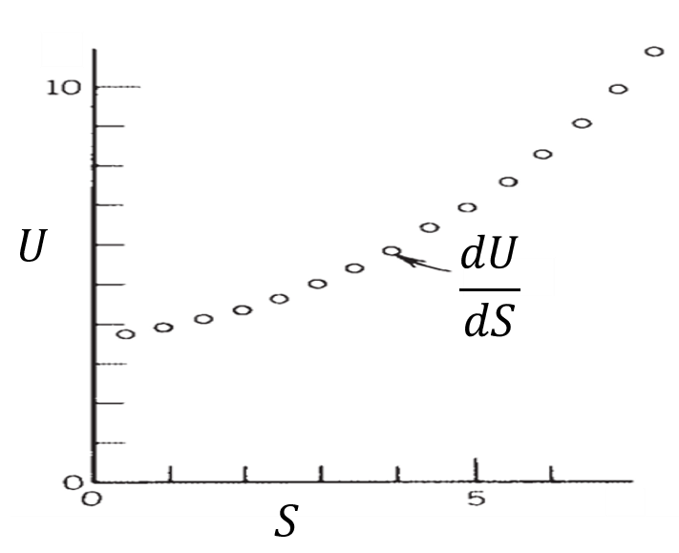
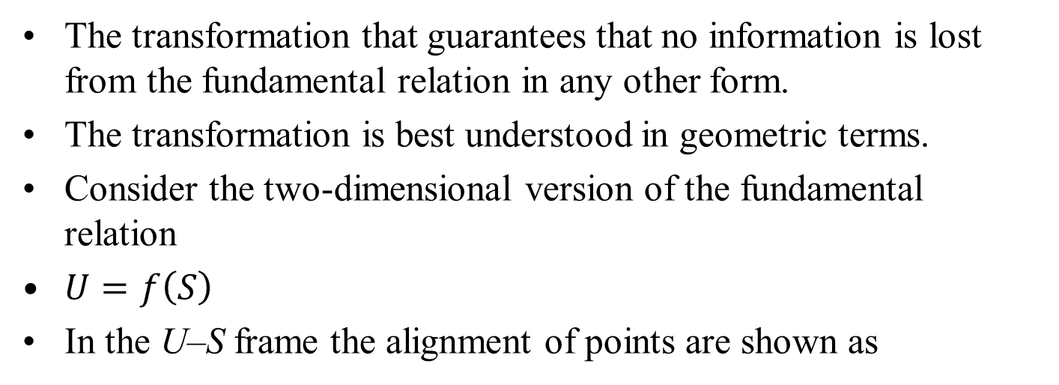
LEGENDRE TRANSFORMS
The transformation that guarantees that no information is lost from the fundamental relation in any other form.
The transformation is best understood in geometric terms.
Consider the two-dimensional version of the fundamental relation
$U=f\left(S\right)$
In the U–S frame the alignment of points are shown as
A wish to replace the extensive property (S) with an intensive property T or p needs the new slope.

