Slide 1

Property Representation using Fundamental Equation
P M V Subbarao
Professor
Mechanical Engineering Department
Start with First Degree Systems!!!!

Slide 2

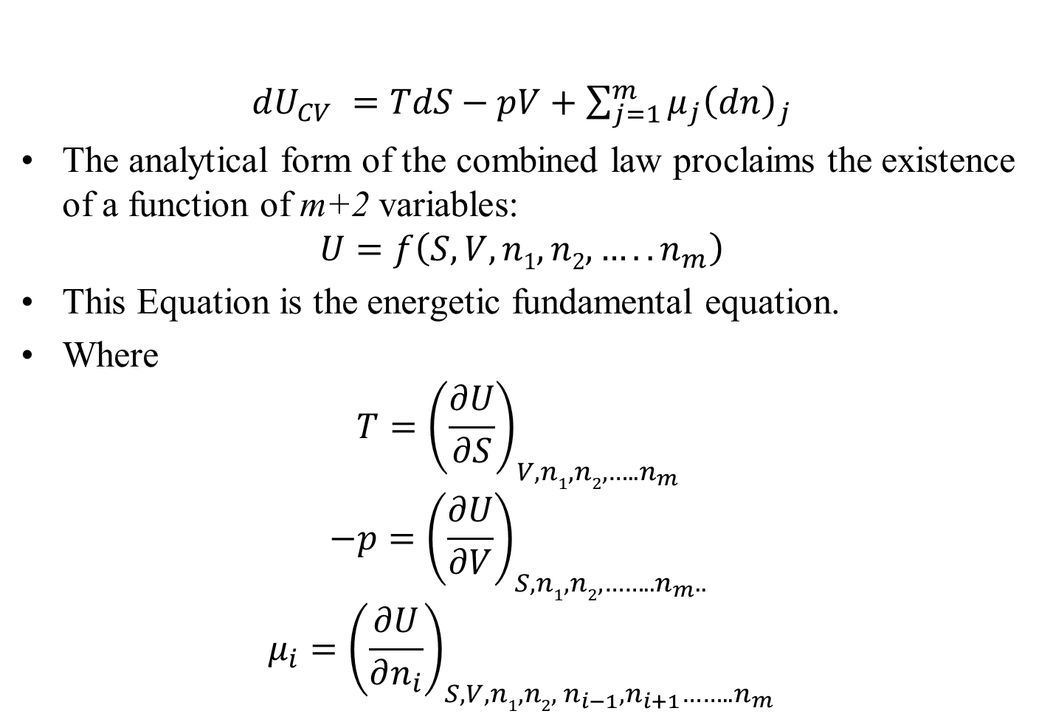
Energetic Fundamental Equation
$dU_{CV} =TdS−pV+$ $\sum_{j=1}^{m}{μ_{j}{\left(dn\right)}_{j}}$
The analytical form of the combined law proclaims the existence of a function of m+2 variables:
$$U=f\left(S,V,n1, n2, …..n_{m}\right)$$
This Equation is the energetic fundamental equation.
Where
$$T={\left(\frac{∂U}{∂S}\right)}_{V,n1, n2, …..n_{m} }$$
$$−p={\left(\frac{∂U}{∂V}\right)}_{S,n1, n2, ……..n_{m}.. }$$
$$μ_{i}={\left(\frac{∂U}{∂n_{i}}\right)}_{S,V,n1, n2, n_{i−1},n_{i+1}……..n_{m}}$$

Slide 3
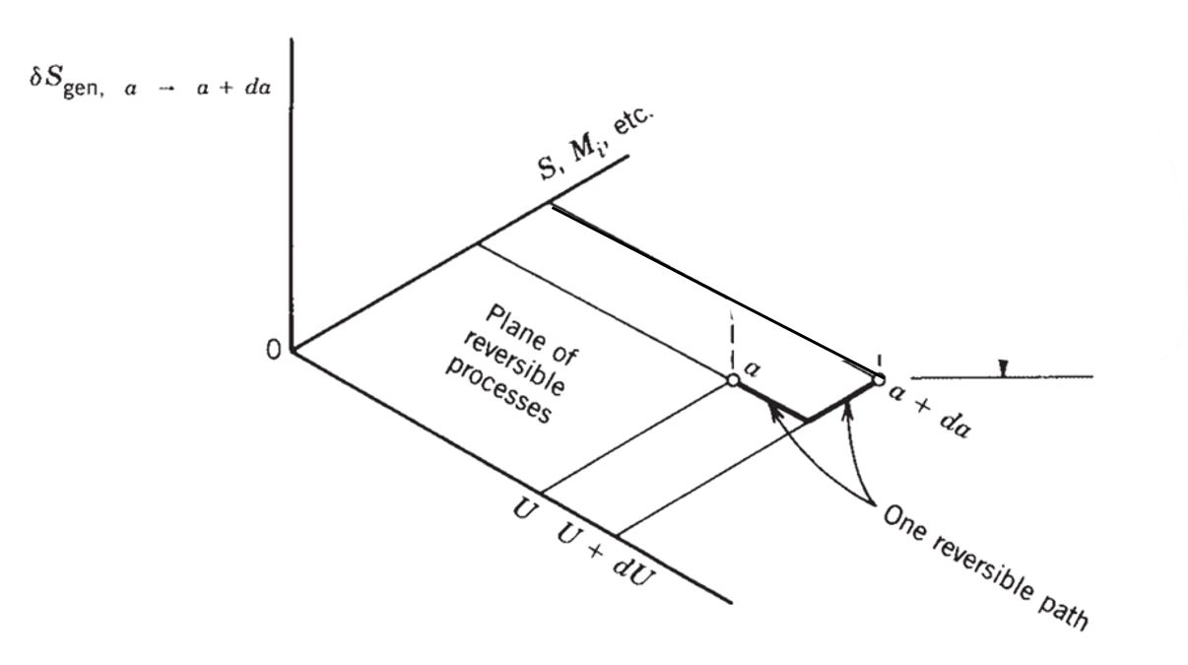
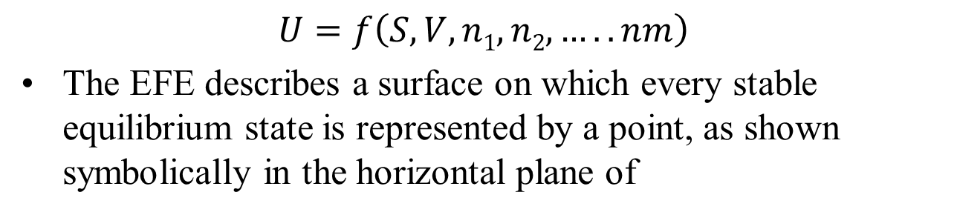
Energetic Fundamental Equation
$$U=f\left(S,V,n1, n2, …..nm\right)$$
The EFE describes a surface on which every stable equilibrium state is represented by a point, as shown symbolically in the horizontal plane of

Slide 4
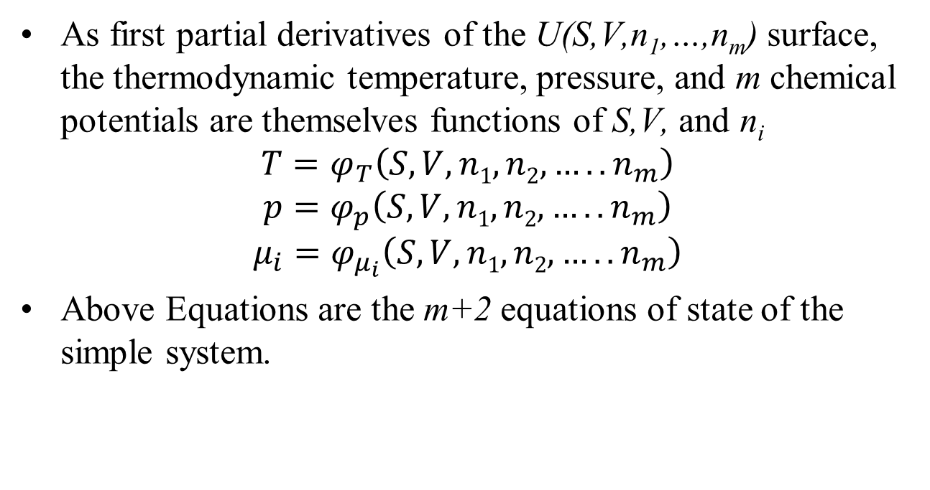
Modern Thermodynamics of A System
As first partial derivatives of the U(S,V,n₁,…,n_{m}) surface, the thermodynamic temperature, pressure, and m chemical potentials are themselves functions of S,V, and n_{i}
$$T=φ_{T}\left(S,V,n1, n2,…..n_{m}\right)$$
$$p=φ_{p}\left(S,V,n1, n2,…..n_{m}\right)$$
$$μ_{i}=φ_{μ_{i}}\left(S,V,n1, n2,…..n_{m}\right)$$
Above Equations are the m+2 equations of state of the simple system.

Slide 5
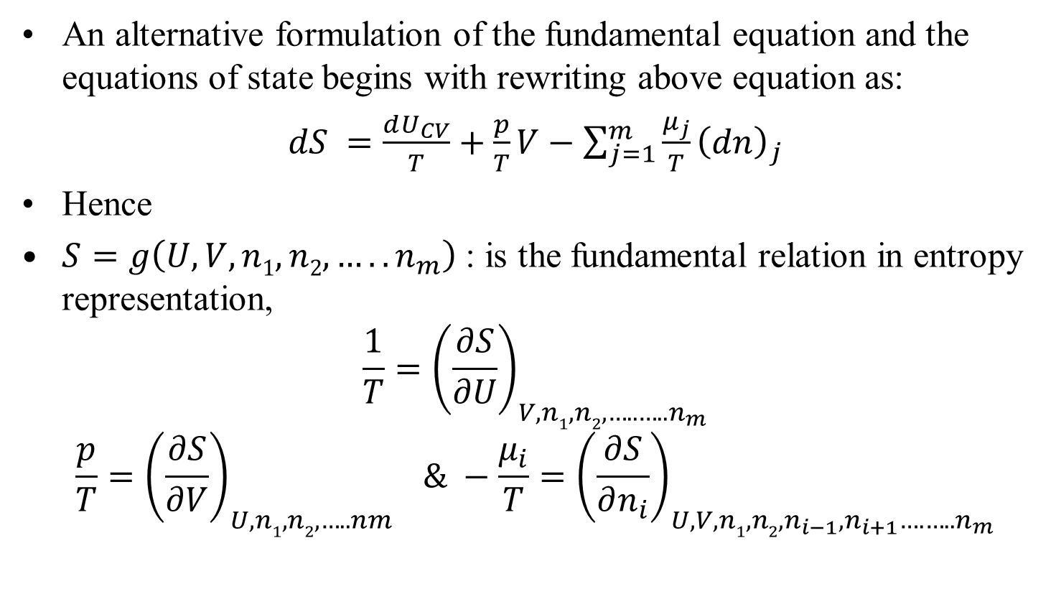
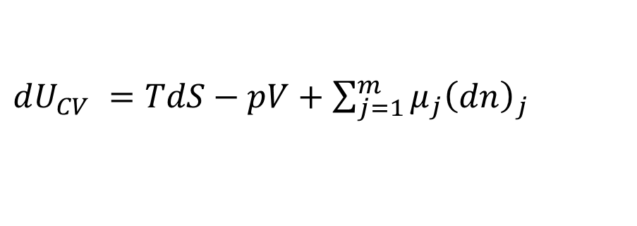
Entropy Representation
$dU_{CV} =TdS−pV+$ $\sum_{j=1}^{m}{μ_{j}{\left(dn\right)}_{j}}$
An alternative formulation of the fundamental equation and the equations of state begins with rewriting above equation as:
$dS =\frac{dU_{CV}}{T}+\frac{p}{T}V−$ $\sum_{j=1}^{m}{\frac{μ_{j}}{T}{\left(dn\right)}_{j}}$
Hence
$S=g\left(U,V,n1, n2,…..n_{m}\right)$ : is the fundamental relation in entropy representation,
$$\frac{1}{T}={\left(\frac{∂S}{∂U}\right)}_{V,n1, n2, …..…..n_{m}}$$
$$\frac{p}{T}={\left(\frac{∂S}{∂V}\right)}_{U,n1, n2, …..nm} \& −\frac{μ_{i}}{T}={\left(\frac{∂S}{∂n_{i}}\right)}_{U,V,n1, n2, n_{i−1},n_{i+1}….…..n_{m}}$$

Slide 6
Property Representation using Fundamental Equation
In either energy or entropy representation, the fundamental equation serves as origin for all the relations that exist between properties at equilibrium.
Only some of these properties and relations can be measured with relative ease.
Pressure, temperature, specific heat at constant pressure, and coefficient of thermal expansion…..
The fundamental equation makes the connection between direct measurements and properties that cannot be measured directly.
These must be derived (e.g.,internal energy, entropy, enthalpy, and exergy).

Slide 7
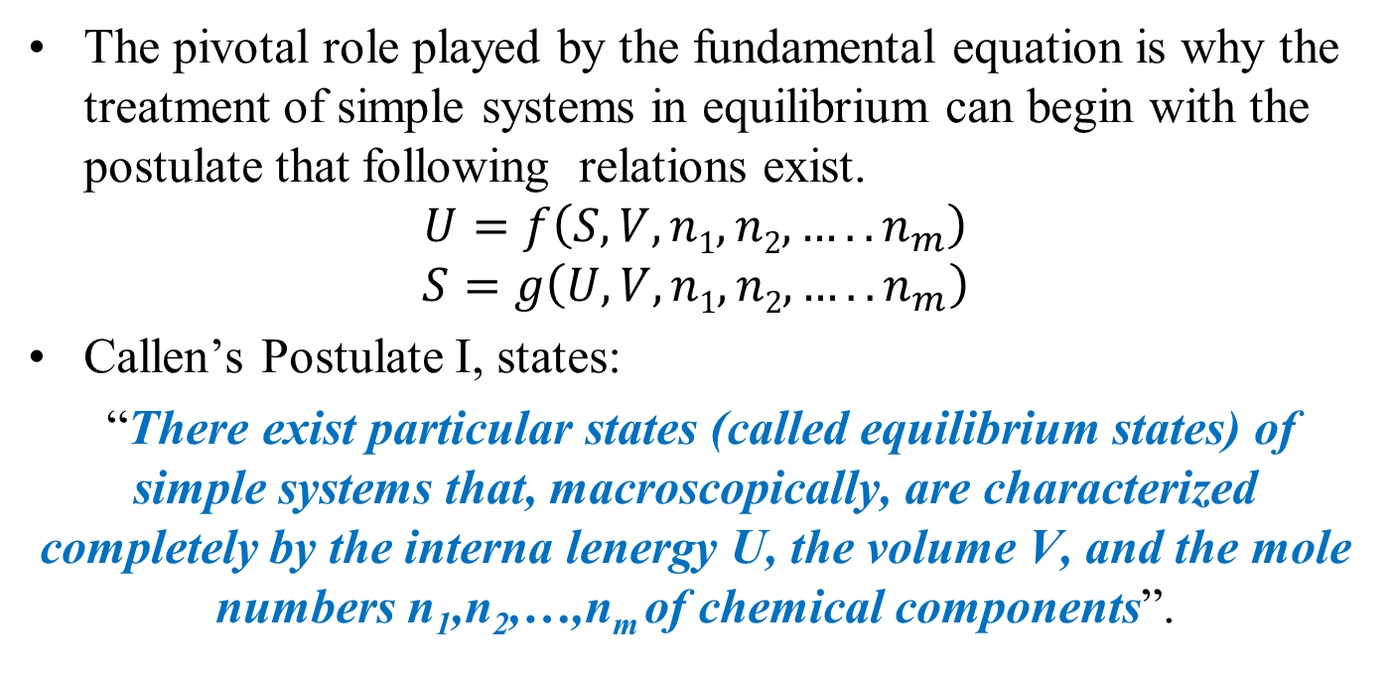
Fundamental Equation for Simple System
The pivotal role played by the fundamental equation is why the treatment of simple systems in equilibrium can begin with the postulate that following relations exist.
$$U=f\left(S,V,n1, n2,…..n_{m}\right)$$
$$S=g\left(U,V,n1, n2,…..n_{m}\right)$$
Callen’s Postulate I, states:
“There exist particular states (called equilibrium states) of simple systems that, macroscopically, are characterized completely by the interna lenergy U, the volume V, and the mole numbers n₁,n₂,…,n_{m} of chemical components”.

Slide 8


Extensive vs Intensive Properties
$$U=f\left(S,V,n1, n2,…..n_{m}\right)$$
In above fundamental relation, all the variables that appear in it are extensive properties.
Consider a simple system (A) is made up of 𝜆 identical “unit” sub systems in mutual equilibrium.
1
2
.
Unit
Sub system
λ

Slide 9
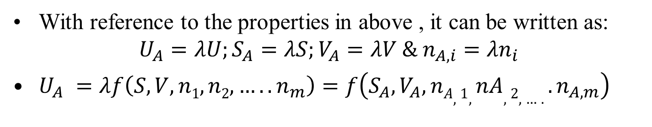
Extensive vs Intensive Properties
1
2
.
Unit
Sub system
The property X of the unit sub system is “extensive” if the corresponding property of system (A) obeys the relation
X_{A}=𝜆X.
λ
With reference to the properties in above , it can be written as:
$$U_{A}=λU;S_{A}=λS;V_{A}=λV \& n_{A,i}=λn_{i}$$
$U_{A} =λf\left(S,V,n1, n2, …..n_{m}\right)=f\left(S_{A},V_{A},nA,1, nA,2, …..n_{A,m}\right)$

Slide 10
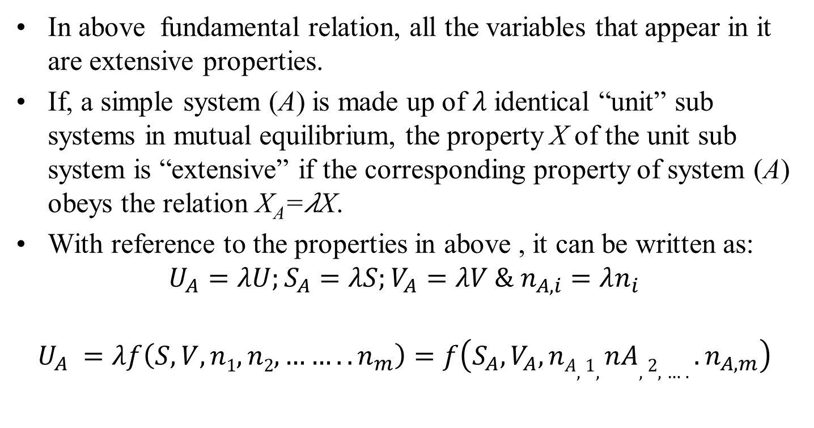
Representation of Extensive Properties
$$U=f\left(S,V,n1, n2,…..n_{m}\right)$$
In above fundamental relation, all the variables that appear in it are extensive properties.
If, a simple system (A) is made up of 𝜆 identical “unit” sub systems in mutual equilibrium, the property X of the unit sub system is “extensive” if the corresponding property of system (A) obeys the relation X_{A}=𝜆X.
With reference to the properties in above , it can be written as:
$$U_{A}=λU;S_{A}=λS;V_{A}=λV \& n_{A,i}=λn_{i}$$
$$U_{A} =λf\left(S,V,n1, n2, ……..n_{m}\right)=f\left(S_{A},V_{A},nA,1, nA,2, …..n_{A,m}\right)$$

Slide 11
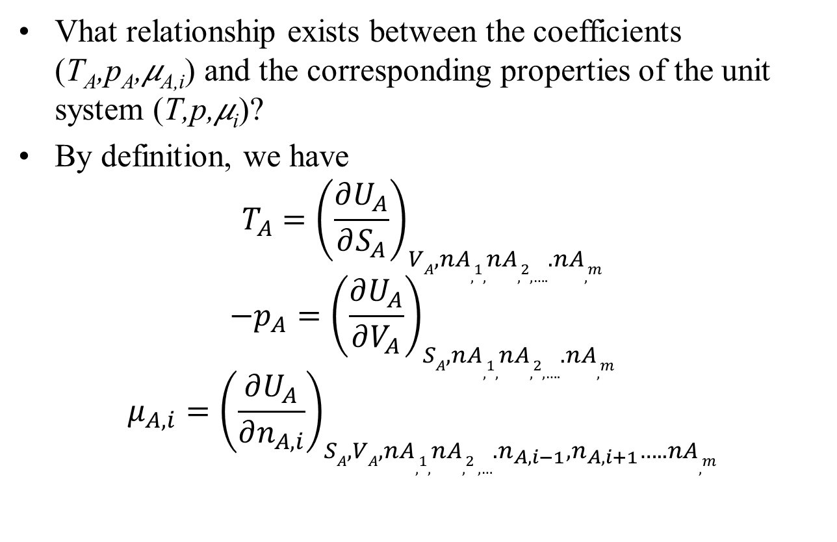
Representation of Intensive Properties
Vhat relationship exists between the coefficients (T_{A},p_{A},𝜇_{A,i}) and the corresponding properties of the unit system (T,p,𝜇_{i})?
By definition, we have
$$T_{A}={\left(\frac{∂U_{A}}{∂S_{A}}\right)}_{VA,nA,1, nA,2, …..nA,m}$$
$$−p_{A}={\left(\frac{∂U_{A}}{∂V_{A}}\right)}_{SA,nA,1, nA,2, …..nA,m}$$
$$μ_{A,i}={\left(\frac{∂U_{A}}{∂n_{A,i}}\right)}_{SA,VA,nA,1, nA,2 , …. n_{A,i−1},n_{A,i+1}…..nA,m}$$

Slide 12
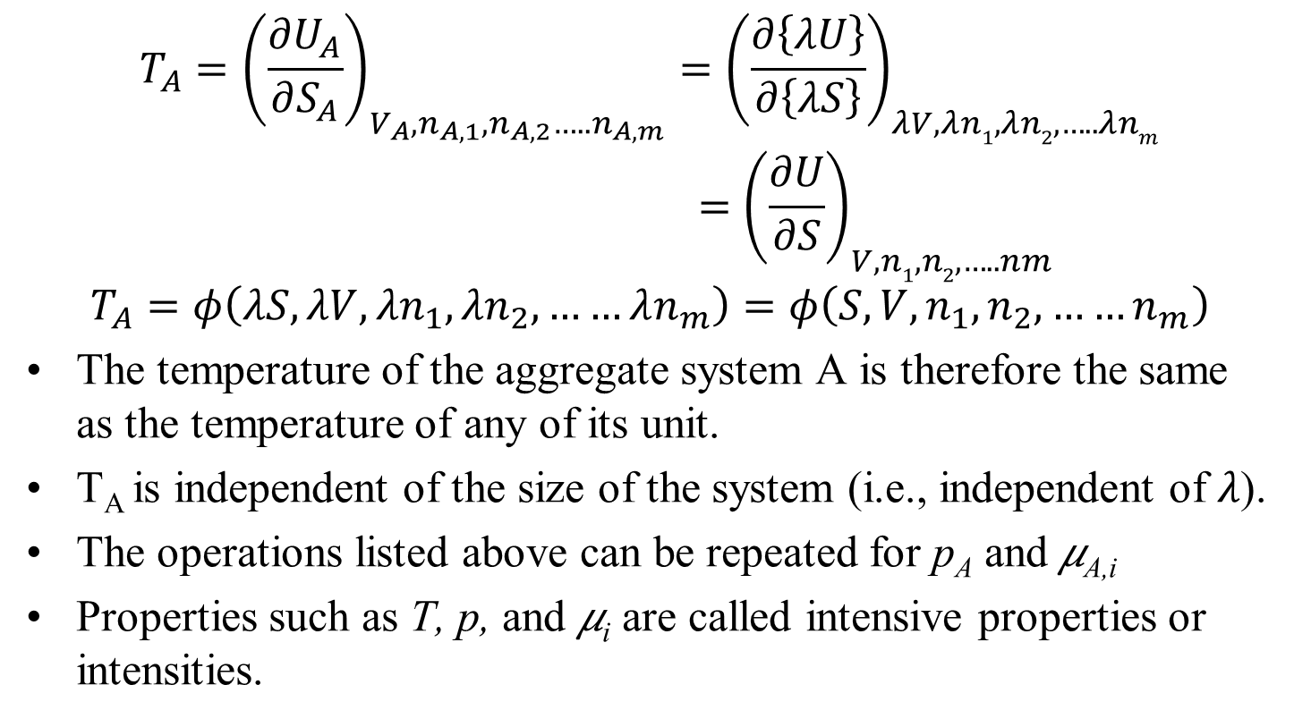
Representation of Intensive Properties
$$T_{A}={\left(\frac{∂U_{A}}{∂S_{A}}\right)}_{V_{A}, n_{A,1},n_{A,2}…..n_{A,m}}={\left(\frac{∂\left\{λU\right\}}{∂\left\{λS\right\}}\right)}_{λV,λn1, λn2, …..λnm}$$
$$={\left(\frac{∂U}{∂S}\right)}_{V,n1, n2, …..nm}$$
$$T_{A}=φ\left(λS,λV,λn_{1},{λn}_{2}, ……λn_{m}\right)=φ\left(S,V,n_{1},n_{2}, ……n_{m}\right)$$
The temperature of the aggregate system A is therefore the same as the temperature of any of its unit.
T_{A} is independent of the size of the system (i.e., independent of 𝜆).
The operations listed above can be repeated for p_{A} and 𝜇_{A,i}
Properties such as T, p, and 𝜇_{i} are called intensive properties or intensities.

Slide 13
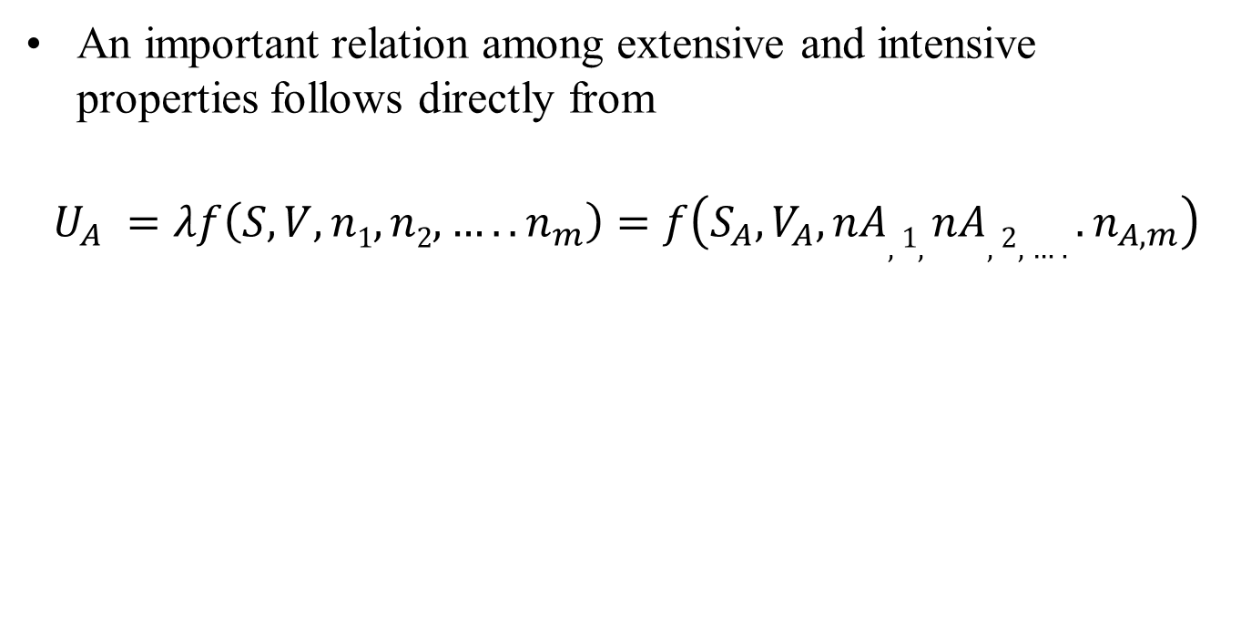
Representation of Intensive Properties
An important relation among extensive and intensive properties follows directly from
$$U_{A} =λf\left(S,V,n1, n2,…..n_{m}\right)=f\left(S_{A},V_{A},nA,1, nA,2, …..n_{A,m}\right)$$

