Slide 1

Basics of Modern Thermodynamic Analysis
P M V Subbarao
Professor
Mechanical Engineering Department
An Inverse of Conventional Thermodynamics !!!!

Slide 2

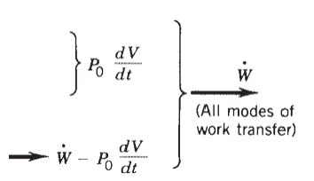
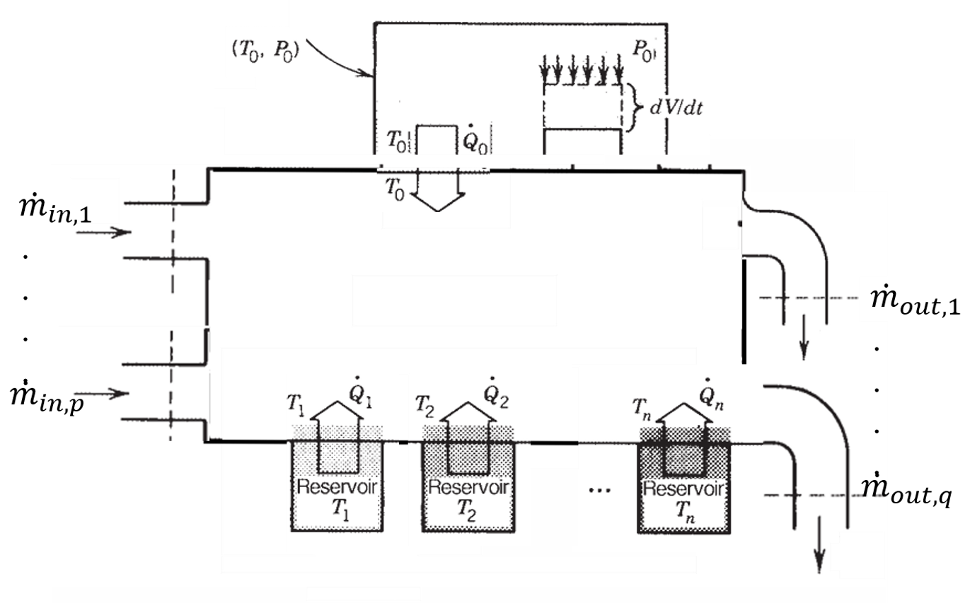
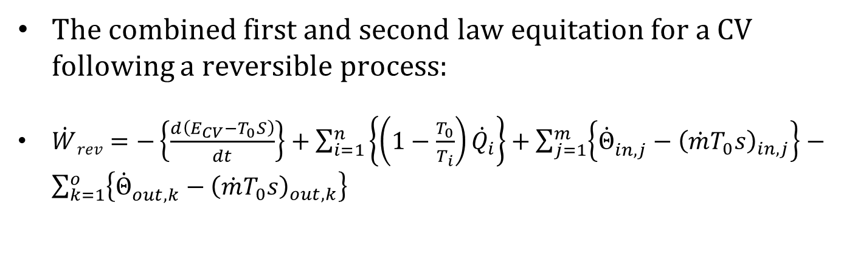
A CV Reversibly Interacting with with the ambience and n reservoirs
The combined first and second law equitation for a CV following a reversible process:
$\dot{W}rev=−\left\{\frac{d\left(E_{CV}−T_{0}S\right)}{dt}\right\}+\sum_{i=1}^{n}{\left\{{\left(1−\frac{T_{0}}{T_{i}}\right)\dot{Q}}_{i}\right\}}+\sum_{j=1}^{m}{\left\{{\dot{Θ}}_{in,j}^{}−{\left(\dot{m}T_{0}s\right)}_{in,j}\right\}}−\sum_{k=1}^{o}{\left\{{\dot{Θ}}_{out,k}^{}−{\left(\dot{m}T_{0}s\right)}_{out,k}\right\}}$

Slide 3
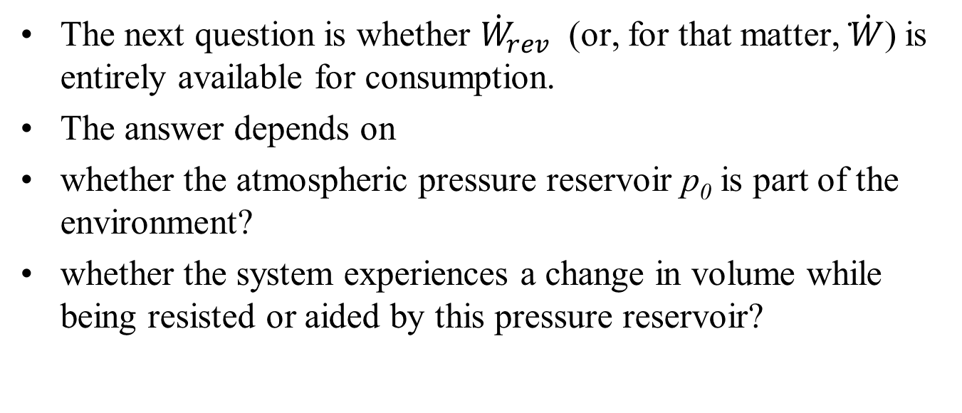
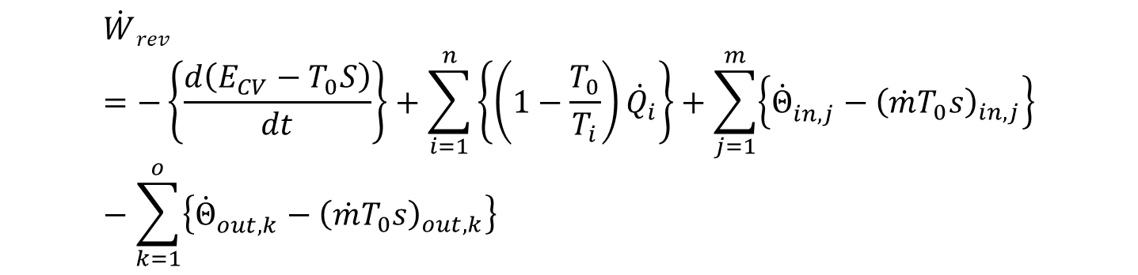
Availability of Reversible Work
$$\dot{W}rev=−\left\{\frac{d\left(E_{CV}−T_{0}S\right)}{dt}\right\}+\sum_{i=1}^{n}{\left\{{\left(1−\frac{T_{0}}{T_{i}}\right)\dot{Q}}_{i}\right\}}+\sum_{j=1}^{m}{\left\{{\dot{Θ}}_{in,j}^{}−{\left(\dot{m}T_{0}s\right)}_{in,j}\right\}}−\sum_{k=1}^{o}{\left\{{\dot{Θ}}_{out,k}^{}−{\left(\dot{m}T_{0}s\right)}_{out,k}\right\}}$$
The next question is whether ${\dot{W}}_{rev}$ (or, for that matter, ̇$\dot{W}$) is entirely available for consumption.
The answer depends on
whether the atmospheric pressure reservoir p₀ is part of the environment?
whether the system experiences a change in volume while being resisted or aided by this pressure reservoir?

Slide 4
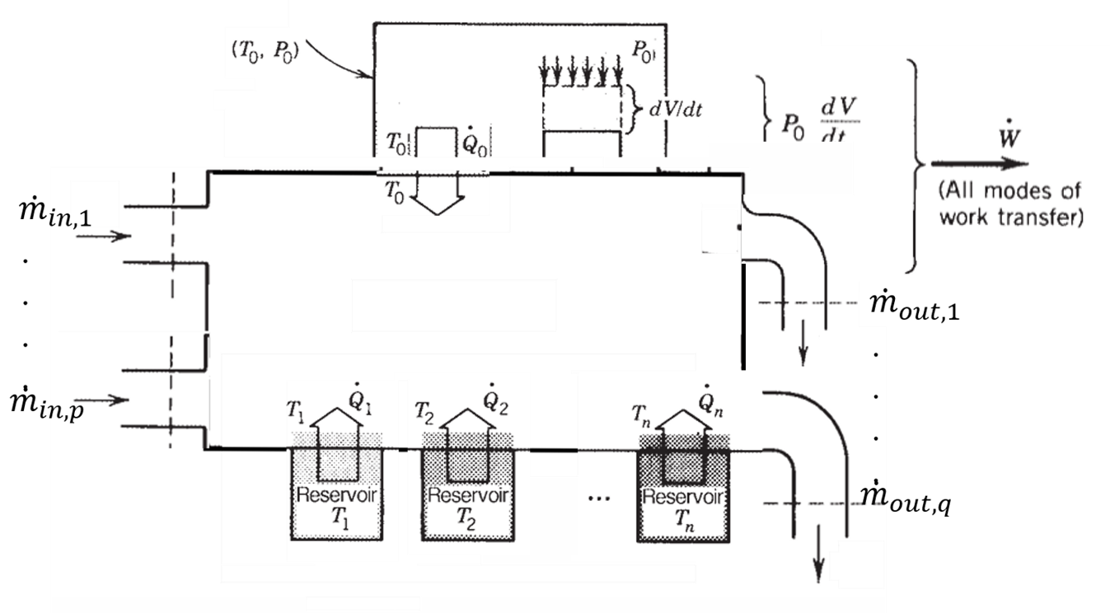

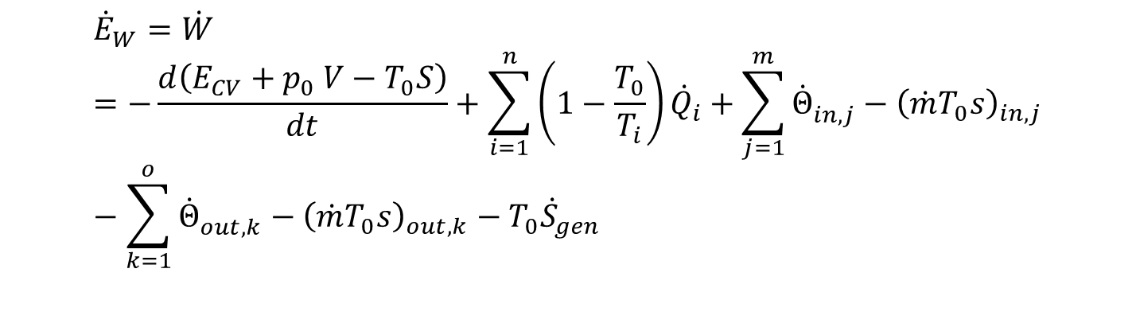
A CV Irreversibly Interacting with with the ambience and n reservoirs
Consider a CV with flexible surface/boundaries.
The net irreversible work is
$${\dot{E}}_{W}=\dot{W} =−\frac{d\left(E_{CV}{+ p}_{0}V−T_{0}S\right)}{dt}+\sum_{i=1}^{n}{{\left(1−\frac{T_{0}}{T_{i}}\right)\dot{Q}}_{i}}+\sum_{j=1}^{m}{{\dot{Θ}}_{in,j}^{}−{\left(\dot{m}T_{0}s\right)}_{in,j}}−\sum_{k=1}^{o}{{\dot{Θ}}_{out,k}^{}−{\left(\dot{m}T_{0}s\right)}_{out,k}−T_{0}{\dot{S}}_{gen}}$$

Slide 5
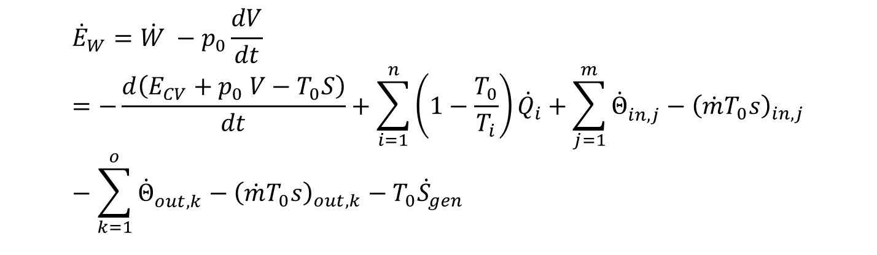
Irreversible Work Exchanging Atmosphere
Consider a CV with flexible surface/boundaries.
The net irreversible work is
$${\dot{E}}_{W}=\dot{W} −p_{0}\frac{dV}{dt}=−\frac{d\left(E_{CV}{+ p}_{0}V−T_{0}S\right)}{dt}+\sum_{i=1}^{n}{{\left(1−\frac{T_{0}}{T_{i}}\right)\dot{Q}}_{i}}+\sum_{j=1}^{m}{{\dot{Θ}}_{in,j}^{}−{\left(\dot{m}T_{0}s\right)}_{in,j}}−\sum_{k=1}^{o}{{\dot{Θ}}_{out,k}^{}−{\left(\dot{m}T_{0}s\right)}_{out,k}−T_{0}{\dot{S}}_{gen}}$$

Slide 6
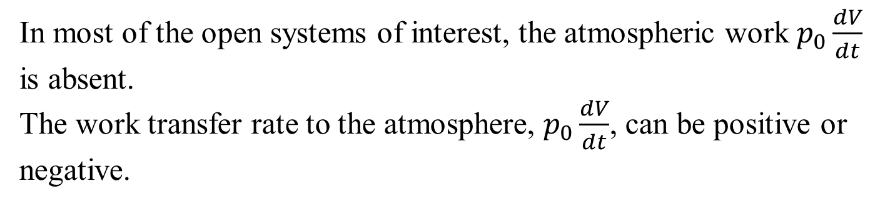
Work Exchanging Atmosphere
In most of the open systems of interest, the atmospheric work $p_{0}\frac{dV}{dt}$ is absent.
The work transfer rate to the atmosphere, $p_{0}\frac{dV}{dt}$, can be positive or negative.

Slide 7

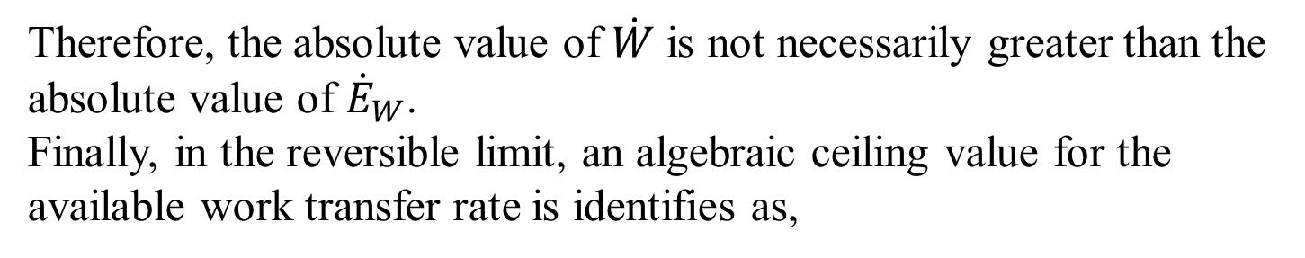
Work Exchanging Atmosphere
Therefore, the absolute value of $\dot{W}$ is not necessarily greater than the absolute value of ${\dot{E}}_{W}$.
Finally, in the reversible limit, an algebraic ceiling value for the available work transfer rate is identifies as,
$${\dot{E}}_{W−rev}=\dot{W} −p_{0}\frac{dV}{dt}$$

Slide 8
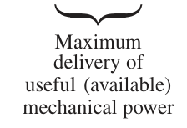
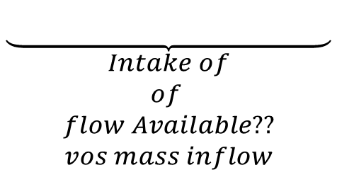
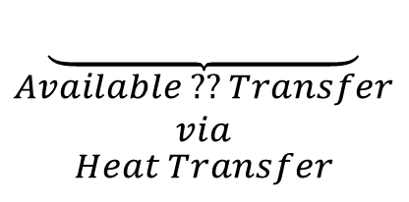
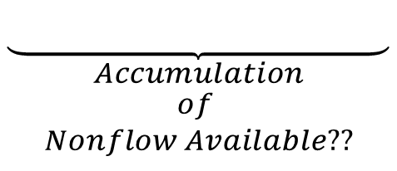
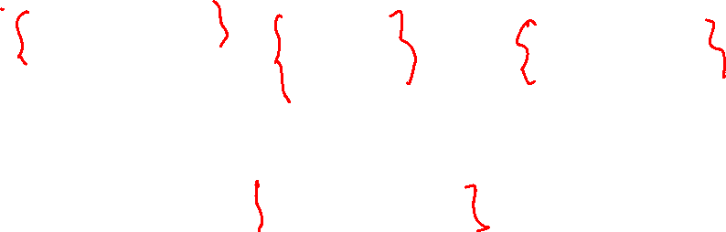
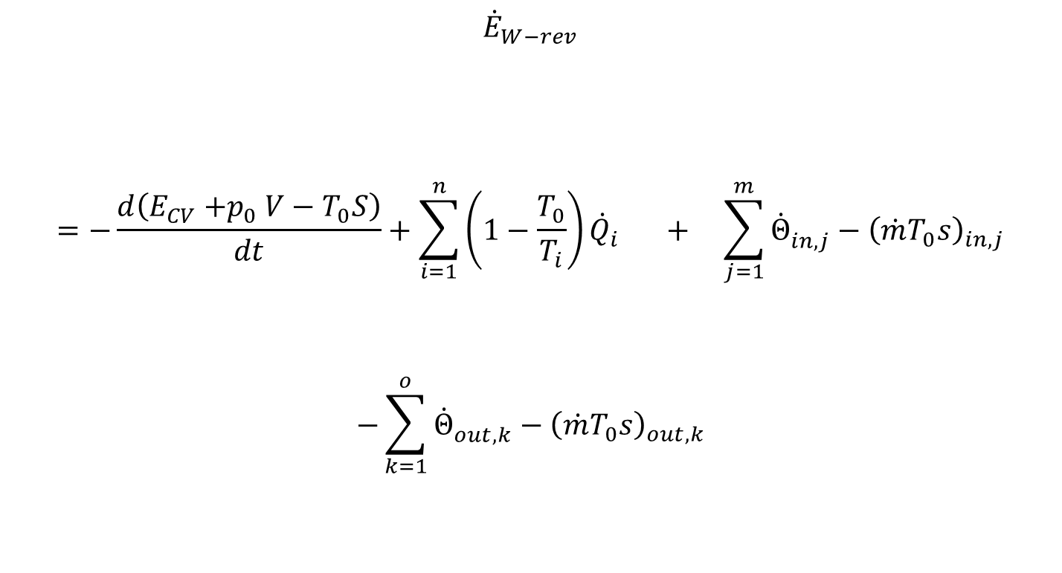
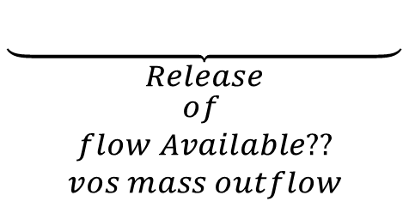
Modern Terminology of Thermodynamics
$${\dot{E}}_{W−rev}$$
$$=−\frac{d\left(E_{CV}{+p}_{0}V−T_{0}S\right)}{dt}+\sum_{i=1}^{n}{{\left(1−\frac{T_{0}}{T_{i}}\right)\dot{Q}}_{i}} + \sum_{j=1}^{m}{{\dot{Θ}}_{in,j}^{}−{\left(\dot{m}T_{0}s\right)}_{in,j}}$$
$$−\sum_{k=1}^{o}{{\dot{Θ}}_{out,k}^{}−{\left(\dot{m}T_{0}s\right)}_{out,k}}$$
$$\underset{\begin{aligned}Accumulation \\ of \\ Nonflow Available??\end{aligned}}{\underbrace{ }}$$
$$\underset{\begin{aligned}Available ?? Transfer \\ via \\ Heat Transfer\end{aligned}}{\underbrace{ }}$$
$$\underset{\begin{aligned}Intake of \\ of \\ flow Available?? \\ vos mass inflow\end{aligned}}{\underbrace{ }}$$
$$\underset{\begin{aligned}Release \\ of \\ flow Available?? \\ vos mass outflow\end{aligned}}{\underbrace{ }}$$

Slide 9
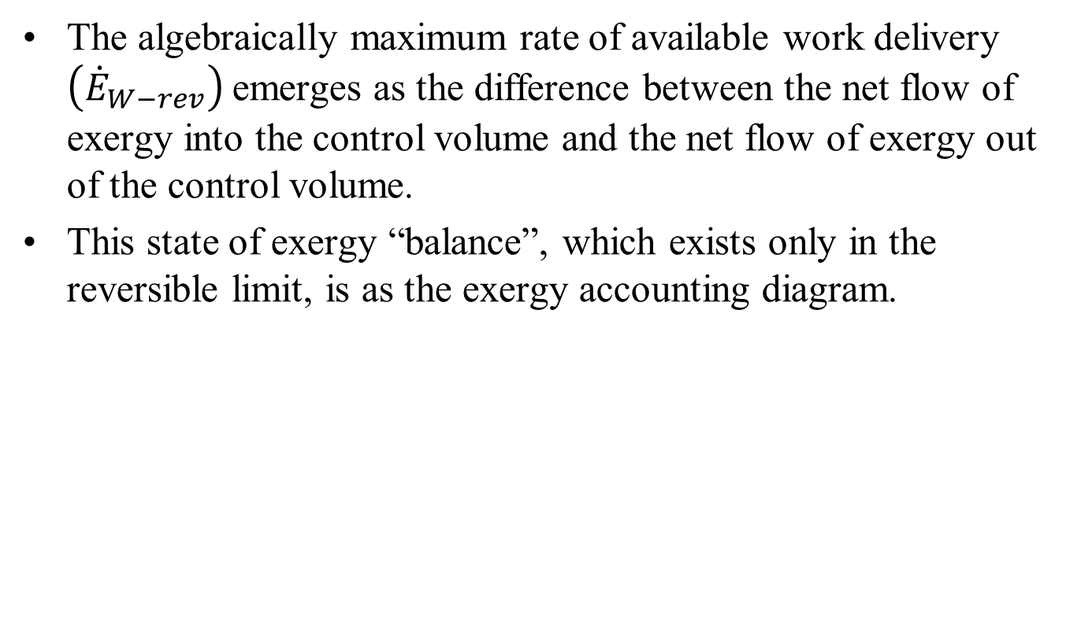
Modern Terminology of Thermodynamics
The algebraically maximum rate of available work delivery $\left({\dot{E}}_{W−rev}\right)$emerges as the difference between the net flow of exergy into the control volume and the net flow of exergy out of the control volume.
This state of exergy “balance”, which exists only in the reversible limit, is as the exergy accounting diagram.

Slide 10
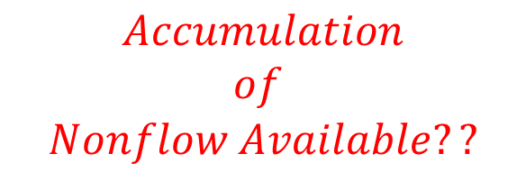
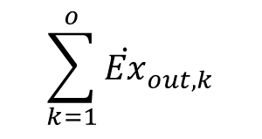
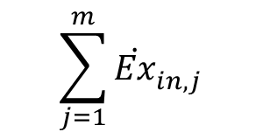


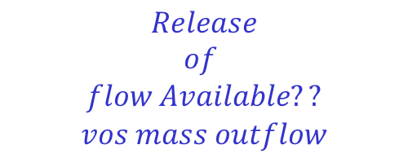
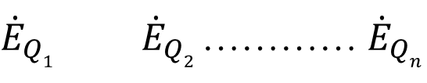
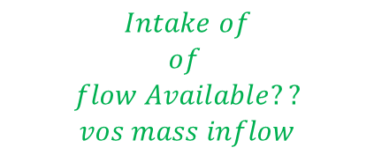
Exergy Balance in a Reversible Open System
$$\begin{aligned}Accumulation \\ of \\ Nonflow Available??\end{aligned}$$
$$\frac{dΞ}{dt}$$
$$\sum_{k=1}^{o}{{\dot{Ex}}_{out,k}^{}}$$
$$\sum_{j=1}^{m}{{\dot{Ex}}_{in,j}^{}}$$
$$\begin{aligned}Intake of \\ of \\ flow Available?? \\ vos mass inflow\end{aligned}$$
$$\begin{aligned}Release \\ of \\ flow Available?? \\ vos mass outflow\end{aligned}$$
${\dot{E}}_{Q1}{ \dot{E}}_{Q2}$………… ${\dot{E}}_{Qn}$
$$\begin{aligned}Available ?? Transfer \\ via \\ Heat Transfer\end{aligned}$$

Slide 11
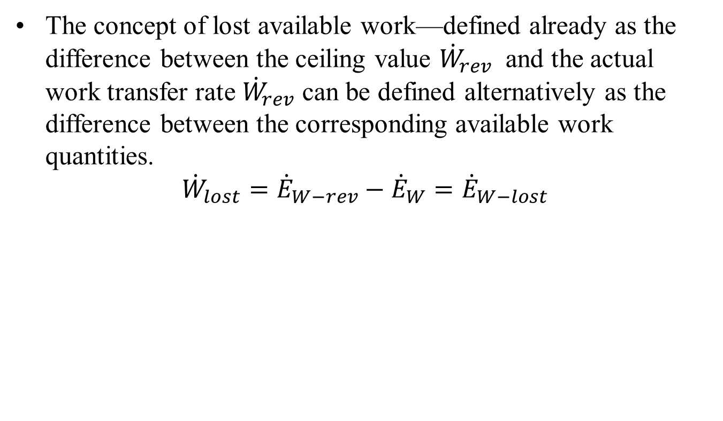
The Lost Work
The concept of lost available work—defined already as the difference between the ceiling value ${\dot{W}}_{rev}$ and the actual work transfer rate ${\dot{W}}_{rev}$ can be defined alternatively as the difference between the corresponding available work quantities.
$${\dot{W}}_{lost}={\dot{E}}_{W−rev}−{\dot{E}}_{W}={\dot{E}}_{W−lost}$$

Slide 12
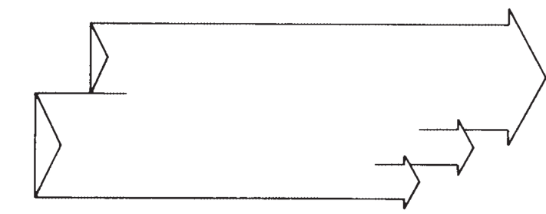
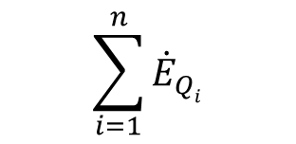
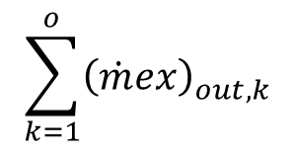
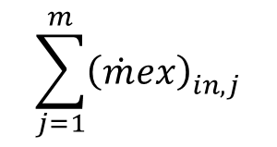
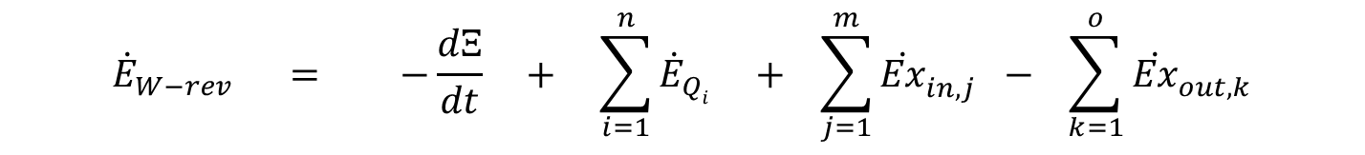


The Destruction due to Heat Transfer Irreversibility
$$\sum_{j=1}^{m}{{\left(\dot{m}ex\right)}_{in,j}^{}}$$
$${\dot{E}}_{W−rev}$$
$$\sum_{i=1}^{n}{{\dot{E}}_{Qi}}$$
$$\frac{dΞ}{dt}$$
$$\sum_{k=1}^{o}{{\left(\dot{m}ex\right)}_{out,k}^{}}$$
A Available ?? Balance equation for a reversible CV:
$${\dot{E}}_{W−rev} = −\frac{dΞ}{dt} + \sum_{i=1}^{n}{{\dot{E}}_{Qi}} + \sum_{j=1}^{m}{{\dot{Ex}}_{in,j}^{} }− \sum_{k=1}^{o}{{\dot{Ex}}_{out,k}^{}}$$

Slide 13
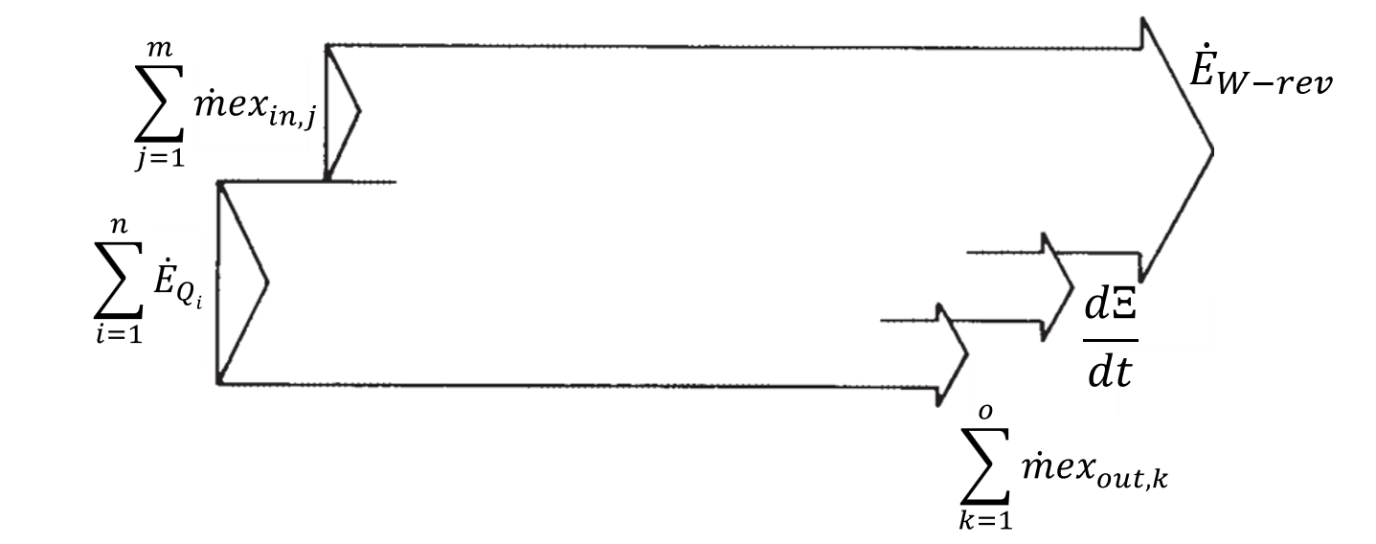
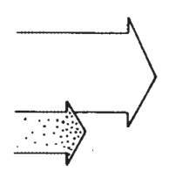



The Destruction due to Other Irreversibility
$${\dot{E}}_{W}$$
$${\dot{E}}_{W−lost}$$
$${\dot{E}}_{W}=−\frac{dΞ}{dt} +\sum_{i=1}^{n}{{\dot{E}}_{Qi}}+\sum_{j=1}^{m}{{\dot{Ex}}_{in,j}^{} }− \sum_{k=1}^{o}{{\dot{Ex}}_{out,k}^{}}−{\dot{E}}_{W−lost}$$

Slide 14
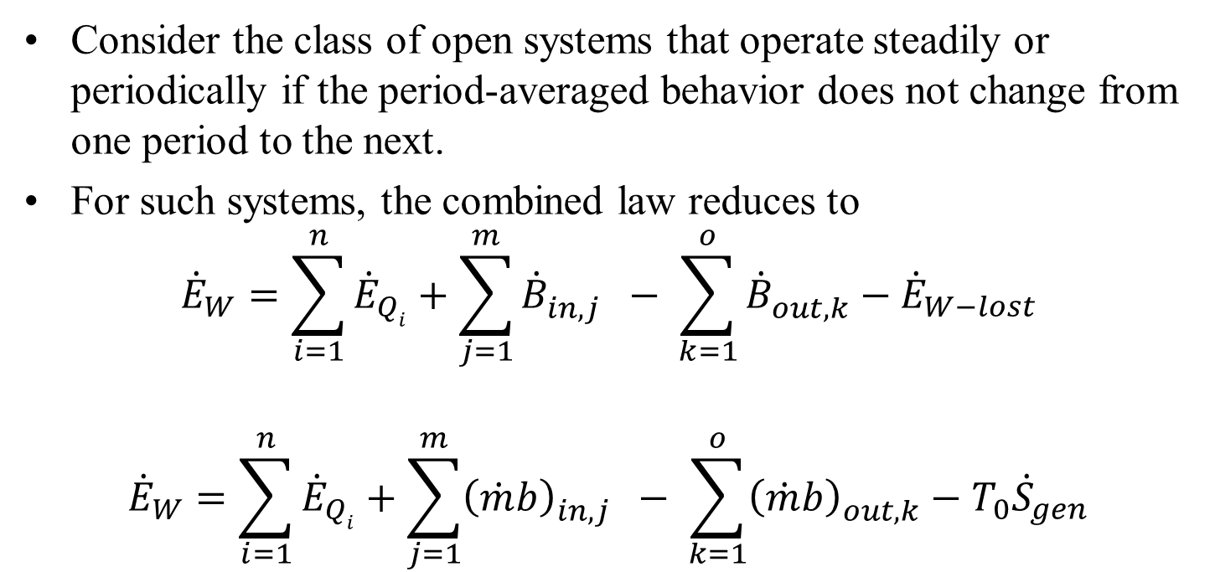

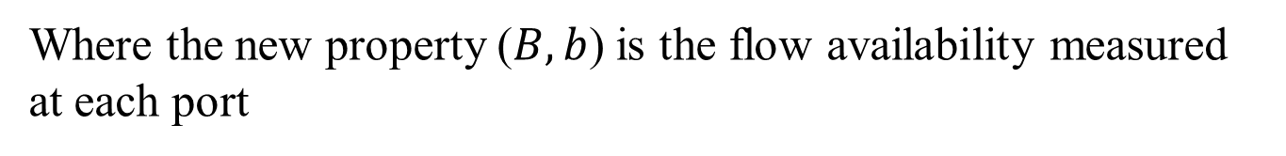
STEADY-FLOWPROCESSES - RTT
Consider the class of open systems that operate steadily or periodically if the period-averaged behavior does not change from one period to the next.
For such systems, the combined law reduces to
$${\dot{E}}_{W}=\sum_{i=1}^{n}{{\dot{E}}_{Qi}}+\sum_{j=1}^{m}{{\dot{B}}_{in,j}^{} }− \sum_{k=1}^{o}{{\dot{B}}_{out,k}^{}}−{\dot{E}}_{W−lost}$$
$${\dot{E}}_{W}=\sum_{i=1}^{n}{{\dot{E}}_{Qi}}+\sum_{j=1}^{m}{{\left(\dot{m}b\right)}_{in,j}^{} }− \sum_{k=1}^{o}{{\left(\dot{m}b\right)}_{out,k}^{}}−T_{0}{\dot{S}}_{gen}$$
Where the new property ($B,b$) is the flow availability measured at each port
$$B=Θ−T_{0}S \& b=θ−T_{0}s$$

Slide 15
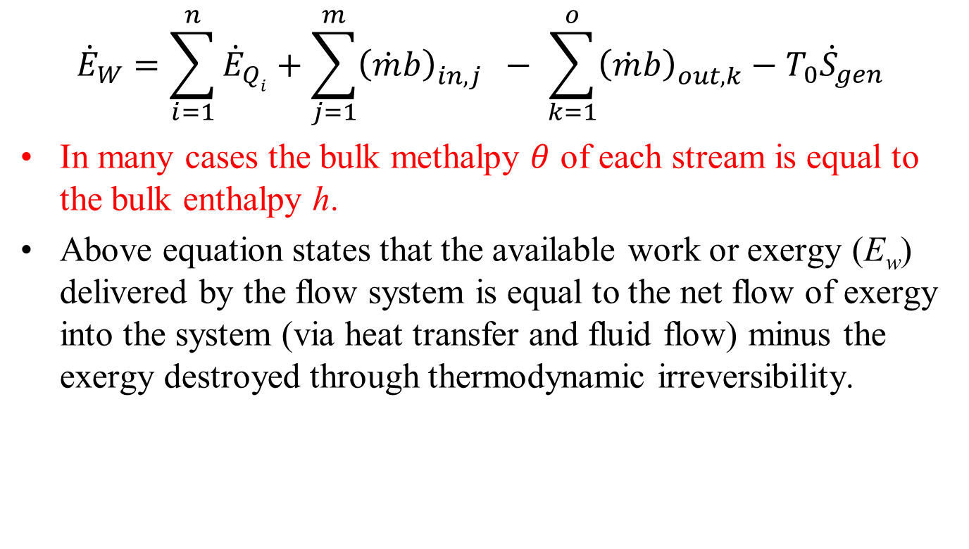
STEADY-FLOWPROCESSES
$${\dot{E}}_{W}=\sum_{i=1}^{n}{{\dot{E}}_{Qi}}+\sum_{j=1}^{m}{{\left(\dot{m}b\right)}_{in,j}^{} }− \sum_{k=1}^{o}{{\left(\dot{m}b\right)}_{out,k}^{}}−T_{0}{\dot{S}}_{gen}$$
In many cases the bulk methalpy $θ$ of each stream is equal to the bulk enthalpy h.
Above equation states that the available work or exergy (E_{w}) delivered by the flow system is equal to the net flow of exergy into the system (via heat transfer and fluid flow) minus the exergy destroyed through thermodynamic irreversibility.

Slide 16
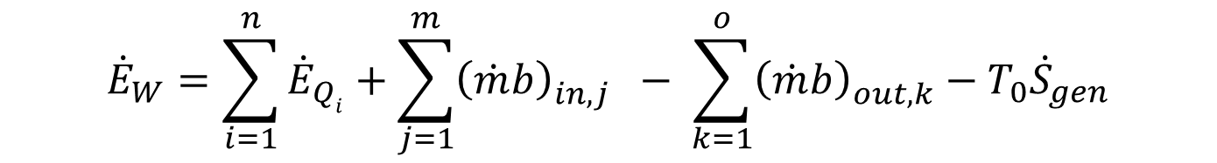
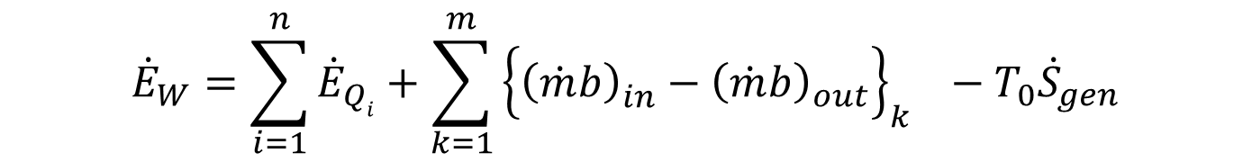
STEADY-FLOW PROCESSES with Non-mixing flows
$${\dot{E}}_{W}=\sum_{i=1}^{n}{{\dot{E}}_{Qi}}+\sum_{j=1}^{m}{{\left(\dot{m}b\right)}_{in,j}^{} }− \sum_{k=1}^{o}{{\left(\dot{m}b\right)}_{out,k}^{}}−T_{0}{\dot{S}}_{gen}$$
Consider the class of systems in which the streams do not mix as they flow through the system.
The simplest examples of this kind are the single-stream shaft work components encountered in power and refrigeration cycles: expanders, turbines, pumps, and compressors.
Two-stream or multi-stream heat exchangers in which the streams do not mix also belong to this special class of systems.
Above can be rewritten as
$${\dot{E}}_{W}=\sum_{i=1}^{n}{{\dot{E}}_{Qi}}+\sum_{k=1}^{m}{{\left\{{\left(\dot{m}b\right)}_{in}^{}−{\left(\dot{m}b\right)}_{out}^{}\right\}}_{k}^{} }−T_{0}{\dot{S}}_{gen}$$

Slide 17
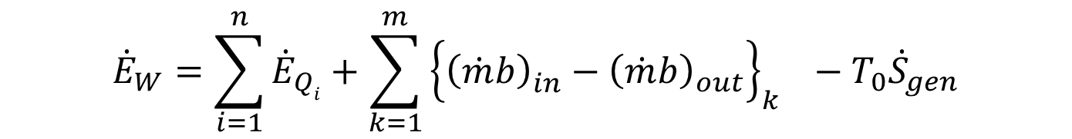

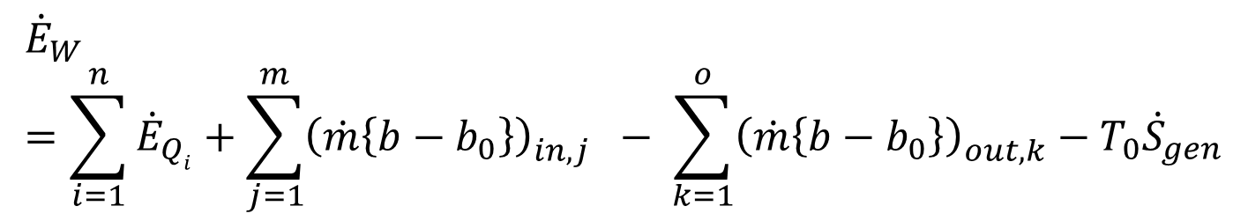
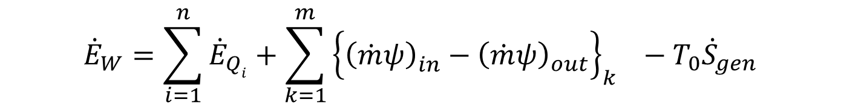
STEADY-FLOW PROCESSES with Non-mixing flows
$${\dot{E}}_{W}=\sum_{i=1}^{n}{{\dot{E}}_{Qi}}+\sum_{k=1}^{m}{{\left\{{\left(\dot{m}b\right)}_{in}^{}−{\left(\dot{m}b\right)}_{out}^{}\right\}}_{k}^{} }−T_{0}{\dot{S}}_{gen}$$
As the steams or not mixing, following algebraic modifications is valid.
$${\dot{E}}_{W}=\sum_{i=1}^{n}{{\dot{E}}_{Qi}}+\sum_{j=1}^{m}{{\left(\dot{m}\left\{b−b_{0}\right\}\right)}_{in,j}^{} }− \sum_{k=1}^{o}{{\left(\dot{m}\left\{b−b_{0}\right\}\right)}_{out,k}^{}}−T_{0}{\dot{S}}_{gen}$$
Where, $b_{0}$is defined as: $b_{0}=θ_{0}−T_{0}s_{0}$ also define
$$ψ=b−b_{0}=θ−θ_{0}−T_{0}\left(s−s_{0}\right)$$
$${\dot{E}}_{W}=\sum_{i=1}^{n}{{\dot{E}}_{Qi}}+\sum_{k=1}^{m}{{\left\{{\left(\dot{m}ψ\right)}_{in}^{}−{\left(\dot{m}ψ\right)}_{out}^{}\right\}}_{k}^{} }−T_{0}{\dot{S}}_{gen}$$

Slide 18


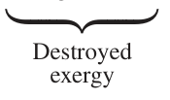
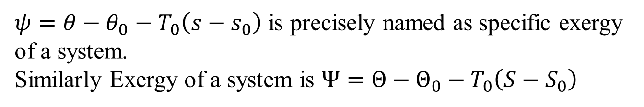
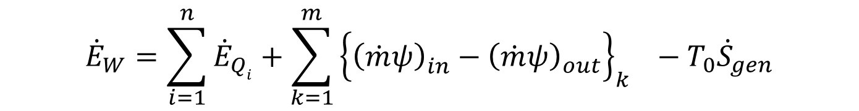

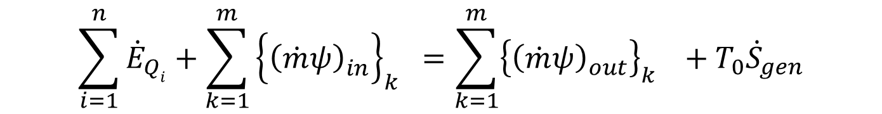
STEADY-FLOW PROCESSES in an Heat Exchanger
$${\dot{E}}_{W}=\sum_{i=1}^{n}{{\dot{E}}_{Qi}}+\sum_{k=1}^{m}{{\left\{{\left(\dot{m}ψ\right)}_{in}^{}−{\left(\dot{m}ψ\right)}_{out}^{}\right\}}_{k}^{} }−T_{0}{\dot{S}}_{gen}$$
$ψ=θ−θ_{0}−T_{0}\left(s−s_{0}\right)$ is precisely named as specific exergy of a system.
Similarly Exergy of a system is $Ψ=Θ−Θ_{0}−T_{0}\left(S−S_{0}\right)$
$$\sum_{i=1}^{n}{{\dot{E}}_{Qi}}+\sum_{k=1}^{m}{{\left\{{\left(\dot{m}ψ\right)}_{in}^{}\right\}}_{k}^{} }=\sum_{k=1}^{m}{{\left\{{\left(\dot{m}ψ\right)}_{out}^{}\right\}}_{k}^{} }+T_{0}{\dot{S}}_{gen}$$

Slide 19
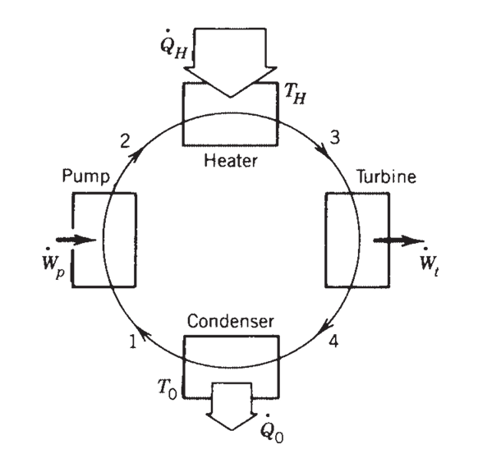
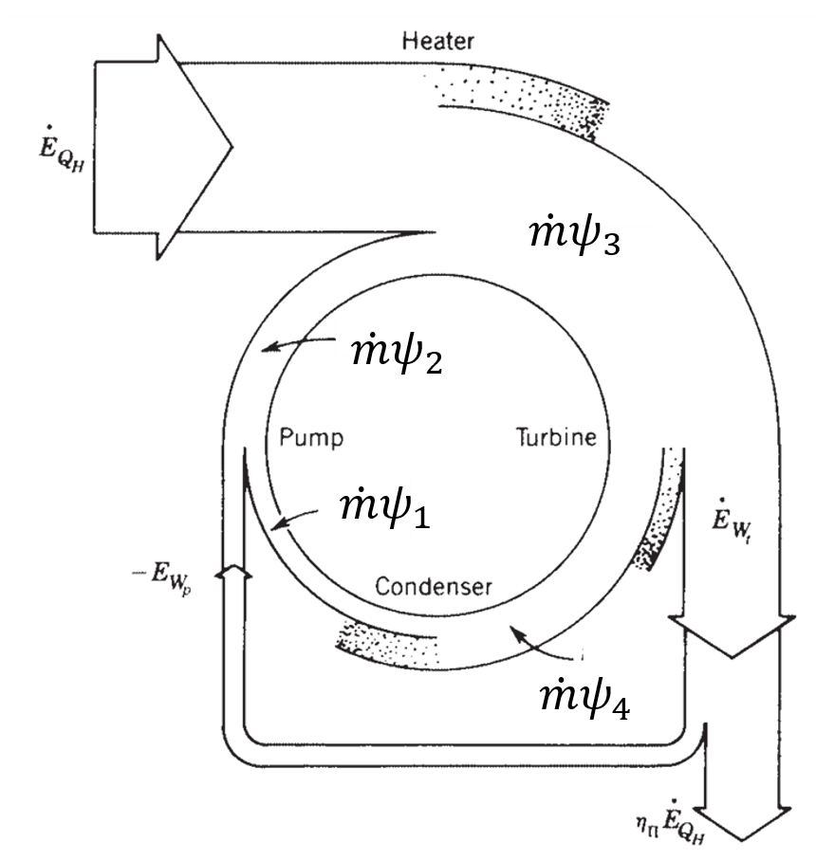
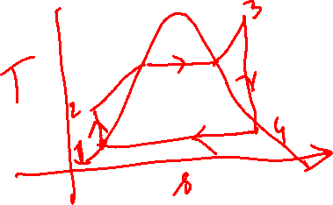
Exergy wheel diagram for a simple Rankine Cycle Plant

Slide 20
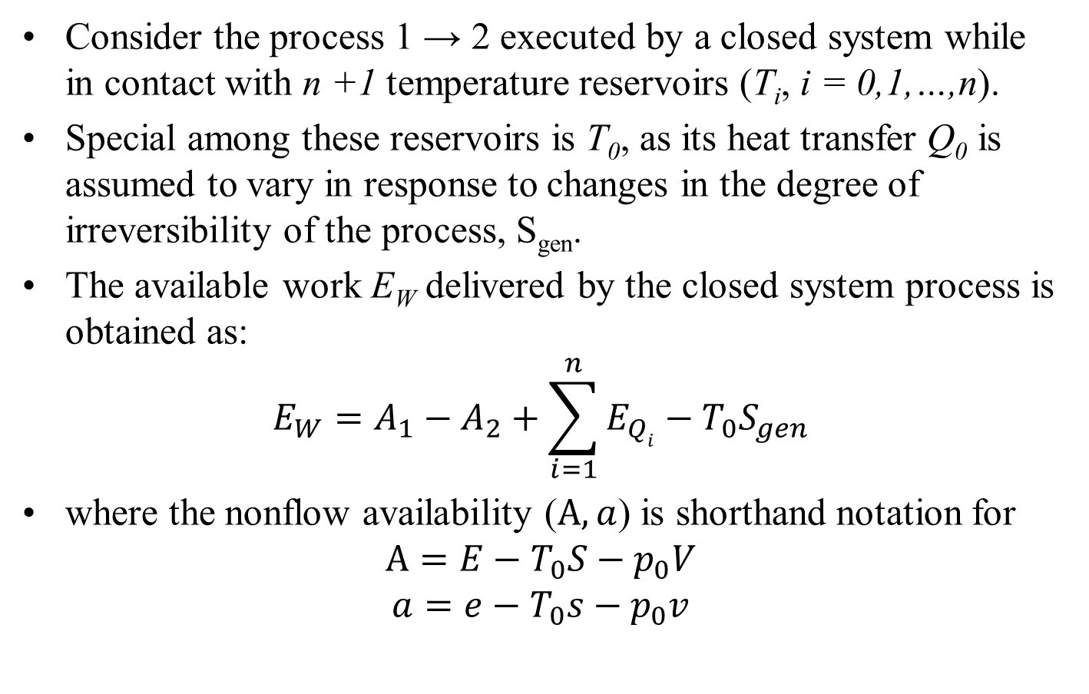
NONFLOW PROCESSES
Consider the process 1 → 2 executed by a closed system while in contact with n +1 temperature reservoirs (T_{i}, i = 0,1,…,n).
Special among these reservoirs is T₀, as its heat transfer Q₀ is assumed to vary in response to changes in the degree of irreversibility of the process, S_{gen}.
The available work E_{W} delivered by the closed system process is obtained as:
$$E_{W}=A_{1}−A_{2}+\sum_{i=1}^{n}{E_{Qi}}−T_{0}S_{gen}$$
where the nonflow availability ($A, a$) is shorthand notation for
$$A=E−T_{0}S−p_{0}V$$
$$a=e−T_{0}s−p_{0}v$$

Slide 21
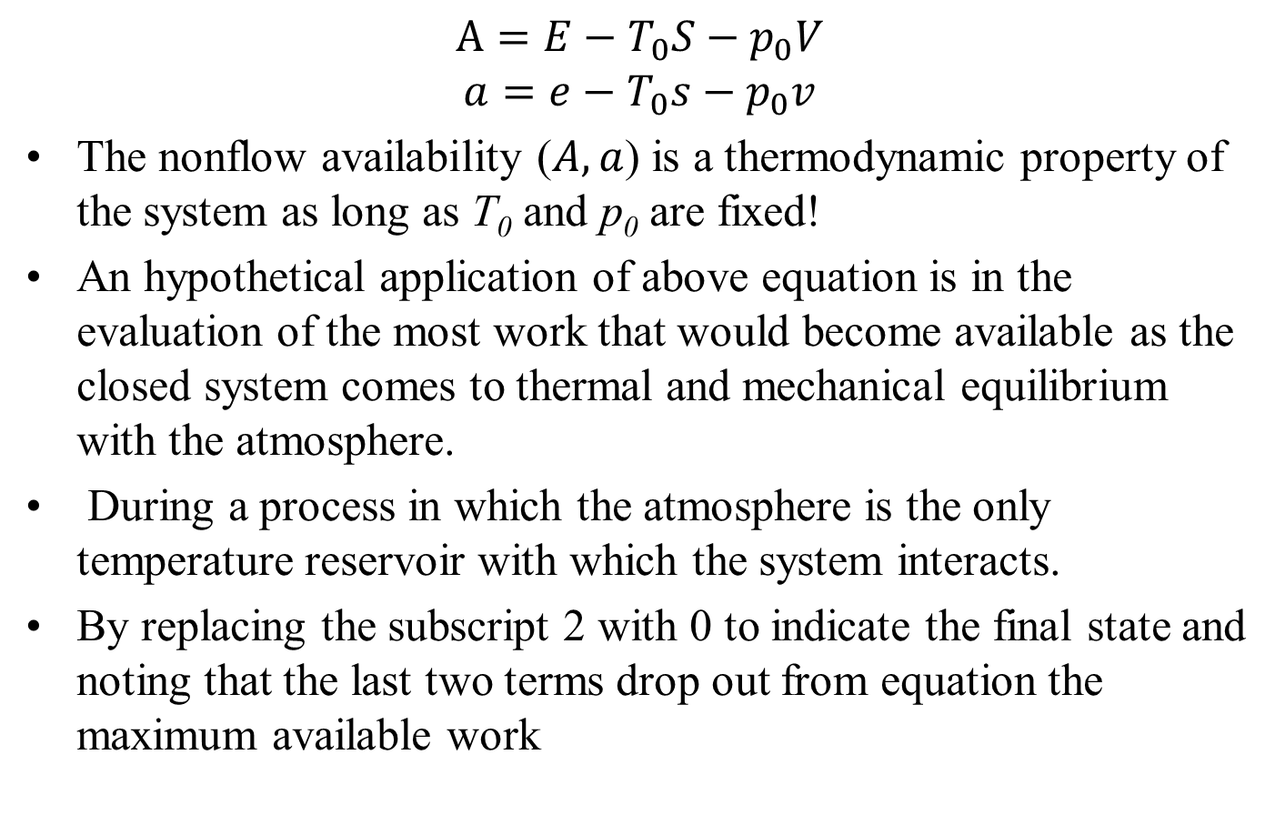

NONFLOW PROCESSES
$$A=E−T_{0}S−p_{0}V$$
$$a=e−T_{0}s−p_{0}v$$
The nonflow availability ($A,a$) is a thermodynamic property of the system as long as T₀ and p₀ are fixed!
An hypothetical application of above equation is in the evaluation of the most work that would become available as the closed system comes to thermal and mechanical equilibrium with the atmosphere.
During a process in which the atmosphere is the only temperature reservoir with which the system interacts.
By replacing the subscript 2 with 0 to indicate the final state and noting that the last two terms drop out from equation the maximum available work
$$E_{W,rev,T_{0}}=A−A_{0}$$

Slide 22
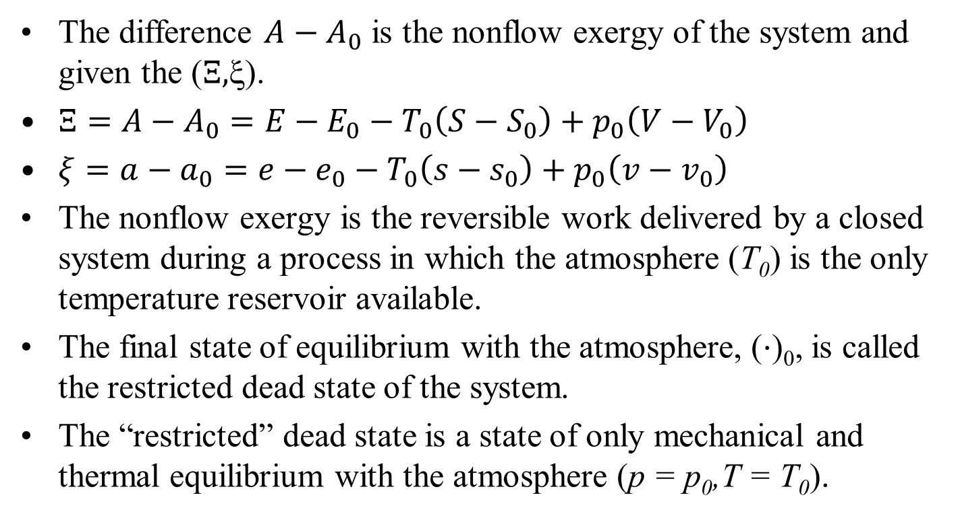

NONFLOW PROCESSES
$$E_{W,rev,T_{0}}=A−A_{0}$$
The difference $A−A_{0}$ is the nonflow exergy of the system and given the ($Ξ,$ξ).
$Ξ=A−A_{0}=E−E_{0}−T_{0}\left(S−S_{0}\right)+p_{0}\left(V−V_{0}\right)$
$ξ=a−a_{0}=e−e_{0}−T_{0}\left(s−s_{0}\right)+p_{0}\left(v−v_{0}\right)$
The nonflow exergy is the reversible work delivered by a closed system during a process in which the atmosphere (T₀) is the only temperature reservoir available.
The final state of equilibrium with the atmosphere, (⋅)₀, is called the restricted dead state of the system.
The “restricted” dead state is a state of only mechanical and thermal equilibrium with the atmosphere (p = p₀,T = T₀).

