Slide 1

Ecology Aware Thermodynamics
P M V Subbarao
Professor
Mechanical Engineering Department
Inclusion of Surroundings in Thermodynamic Analysis!!!!

Slide 2

Ecological Negligence by Thermodynamics
The first observation is that all industrial processes occur in the terrestrial atmosphere.
This atmosphere for all practical purposes is treated as an inexhaustible source (or sink) of energy, work, and matter.
The energy of the atmosphere can be increased or decreased by an exchange of heat.
The atmosphere can perform an unlimited amount of work or have an unlimited amount of work performed on it by expanding or contracting volumes against its pressure.
Finally, certain chemical species present in the atmosphere can be withdrawn, and all others can be exhaled into it.
In addition to being inexhaustible, is is assumed that energy, work, and matter can be obtained from or dumped into the atmosphere at no economic cost.

Slide 3
Ecological Negligence by Thermodynamics
The second observation is that industrial processes are possible because natural substances exist which are not in equilibrium with the atmosphere.
These are natural resources.
In contrast with the atmosphere, an economic value is attached to natural resources.
Recent awareness showed that they are not inexhaustible.
Work is generated by forcing such natural resources to change their thermodynamic state in any industrial installation.
This work (or “energy” in the contemporary media) is considered valuable in the economic sense.

Slide 4
Ecological Negligence by Thermodynamics
The third observation is that the industrial activities forever do is to reduce the thermodynamic state of a resource to one of equilibrium with the atmosphere.
When this happens, no further useful processes are possible!
This final state with respect to its surroundings is called as the passive state or the dead state.
There is a need to surmise that the corresponding amount of work transferred outside the system will be optimum, subject to the fulfilment of certain conditions which are to be consciously explored.

Slide 5
Ecological Negligence by Thermodynamics
The fourth observation is that
the work made available by one system at the expense of a natural resource can be utilized to transform the state of substances present passively in the atmosphere of another system, and so to confer on them an enhanced economic value.
In all cases, the concept of a “change in the thermodynamic state” includes the transformation of the nature of substances through chemical reactions.

Slide 6
Conscious Thermodynamics
H. Callen’s Conscious Thermodynamics, recognize that the manipulation of internal or external constraints causes a generally irreversible process to occur.
All subsystems within the system or the passive surroundings transfer some extensive quantity of matter, and tend to equalize a corresponding intensive property as a result of this process, .
This equalization is not achieved if the process is arrested at some intermediate state due to negligence.

Slide 7
Conscious Thermodynamics
The type of interaction that occurs between a system and its passive surroundings depends on the character of the system’s boundary, which remains the partition placed between the system and the atmosphere.
Following the usual practice, let us consider
adiabatic versus diathermal walls,
rigid vs deformable walls, and
impermeable vs semi-permeable or completely pervious walls.

Slide 8
Atmosphere Aware Thermodynamics
By developing an awareness about atmosphere, it is anticipated that the amount of obtainable work (positive) or required work (negative) in given circumstances will depend on
(a) The thermodynamic characteristics of the atmosphere.
(b) The type of system considered.
(c) The types of interaction permitted between the system and the atmosphere.
(d) The initial and final state of the system.
(e) The rate of dissipation produced within the system.

Slide 9
Available Work
The optimum work possible in the light of this awareness is recognized as Available Work.
This cannot be described by a single formula.
The detailed nature of each formula must be adapted to circumstances.
It is feasible to subsume all possible cases under a small number of categories.
This is sanctified by longterm use in thermodynamics.
This will be based on idealized models of atmosphere, system, and allowed type of interaction.
These models will help in developing convenient conventions.

Slide 10
Model of the Atmosphere: The Passive Environment
The proposed passive environment model of the atmosphere is conceived as a union of three very large reservoirs:
An energy reservoir,
A volume reservoir, and
A mass reservoir containing n chemical species.
The intensive state of the passive surroundings is described by
temperature T₀ for the energy reservoir
pressure p₀ for the volume reservoir
m_{i0} for the mass reservoir.

Slide 11
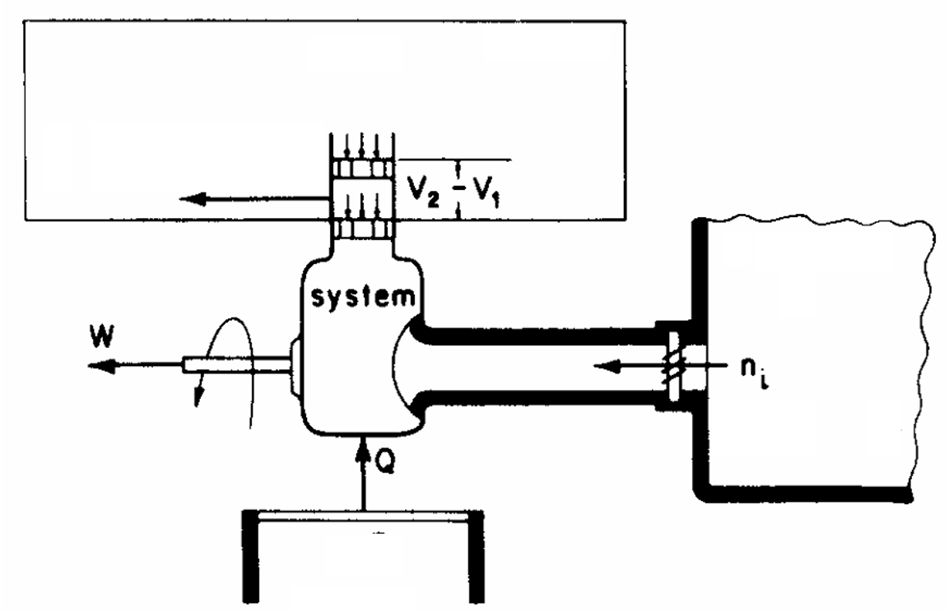
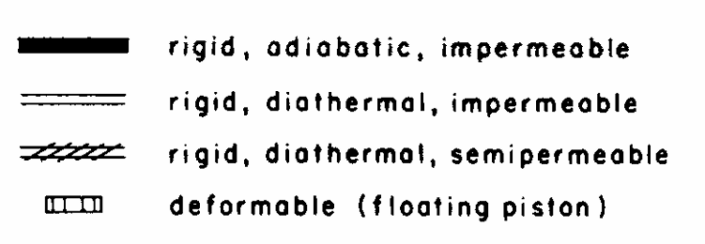



Model of Atmosphere as Passive Environment
Volume Reservoir
$$p_{0}$$
$$m_{i0}$$
Masses Reservoir
$$T_{0}$$
Energy Reservoir

Slide 12

Model of Atmosphere as Passive Environment
Volume Reservoir
The volume reservoir exchanges work W₀
$$p_{0}$$
$$n_{i0}$$
Masses Reservoir
$$T_{0}$$
mass reservoir exchanges matter n_{i0} along a number of channels,
Energy Reservoir
The energy reservoir exchanges heat Q

Slide 13
Model of Atmosphere as Passive Environment
The systems to undergo the following sequence of interactions
Volume Reservoir
$$p_{0}$$
$$m_{i0}$$
Masses Reservoir
$$T_{0}$$
(il) Transfer of heat
(i2) Transfer of heat and work
(i3) Transfer of heat, work, and mass.
Energy Reservoir

Slide 14
Model of the Atmosphere: The Passive Environment
It is pictured that the conjugate extensive variables U₀, V₀, and n_{i0} are infinitely large.
The atmospheric reservoirs either remain in internal equilibrium during interaction with man-made devices.
or, maintain relaxation times for a return to equilibrium which are much shorter for the passive environment than for the system under consideration.
Consequently, the reservoirs forming the passive environment are capable of performing only Reversible Processes.

Slide 15
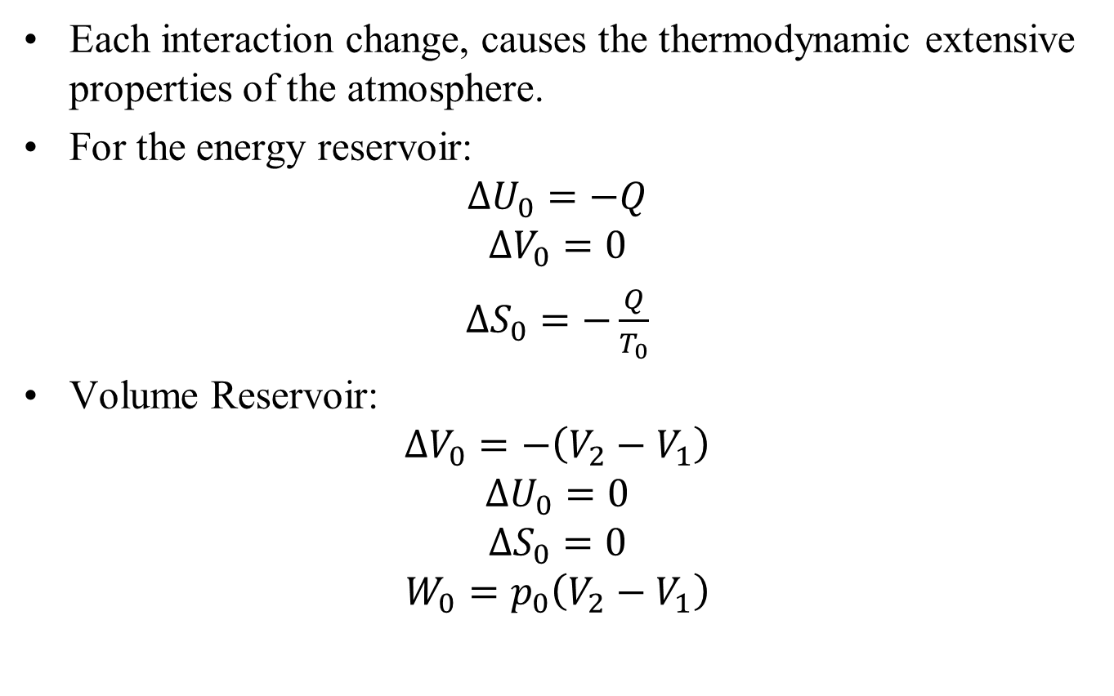
Results of Interactions
Each interaction change, causes the thermodynamic extensive properties of the atmosphere.
For the energy reservoir:
$$∆U_{0}=−Q$$
$$∆V_{0}=0$$
$∆S_{0}=−\frac{Q}{T_{0}}$
Volume Reservoir:
$$∆V_{0}=−\left(V_{2}−V_{1}\right)$$
$$∆U_{0}=0$$
$$∆S_{0}=0$$
$$W_{0}=p_{0}\left(V_{2}−V_{1}\right)$$

Slide 16
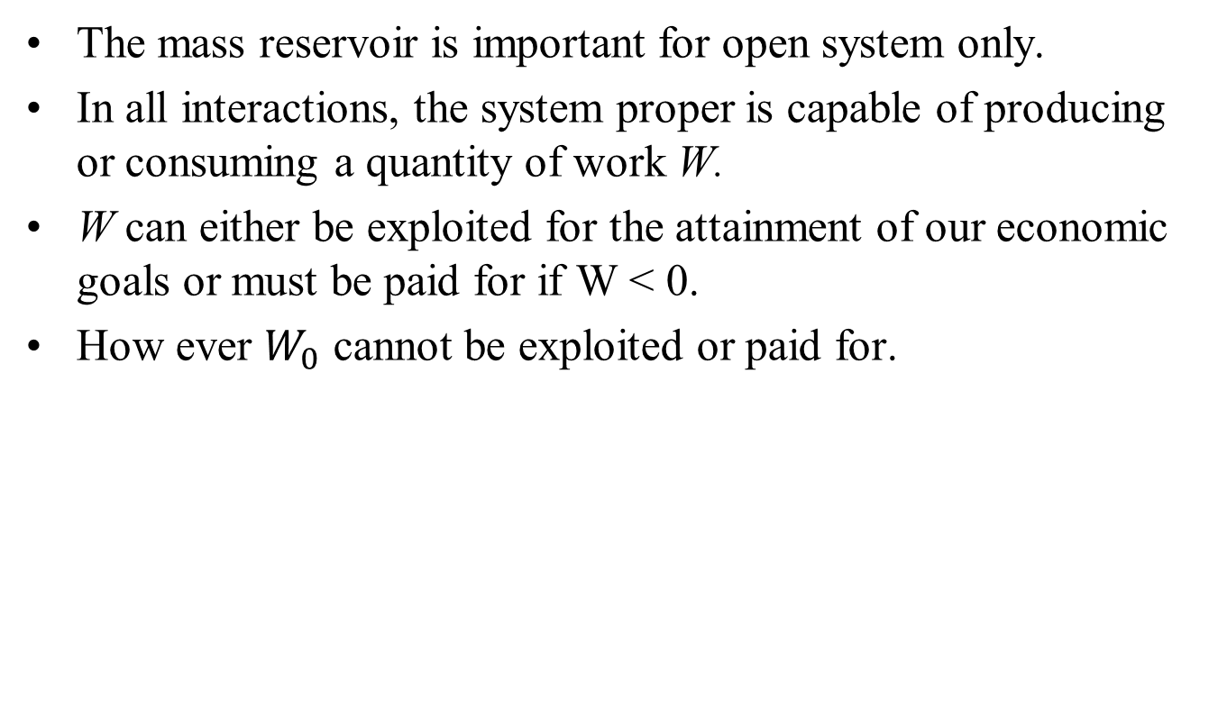
Results of Interactions
The mass reservoir is important for open system only.
In all interactions, the system proper is capable of producing or consuming a quantity of work W.
W can either be exploited for the attainment of our economic goals or must be paid for if W < 0.
How ever $W_{0}$ cannot be exploited or paid for.

Slide 17
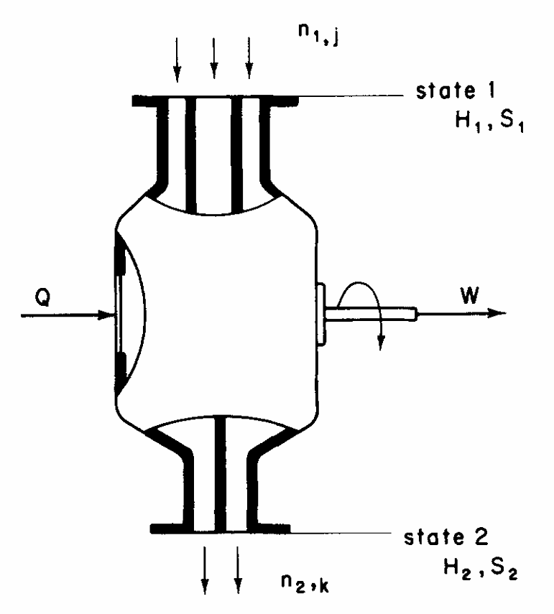
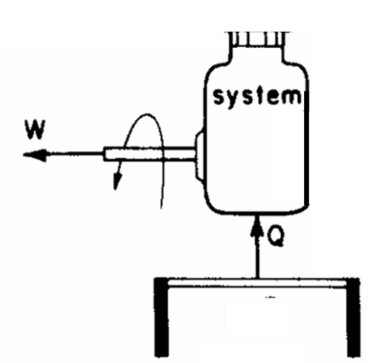
MAN-MADE SYSTEMS
From a practical point of view, all thermodynamic systems are considered as prime movers P characterized by W > 0.
The receivers R characterized by W < 0.
The latter consume work to effect a change in state.
Two classes of systems: closed systems (CL) and flow systems (FL)

Slide 18
MAN-MADE SYSTEMS
Closed System
Flow System
The shaft represents that the system either produces usable work W or consumes it at some other system’s expense.

Slide 19
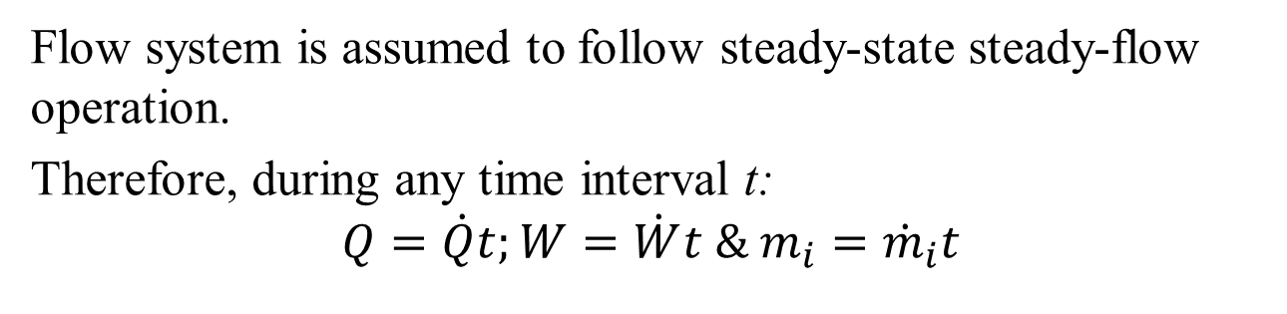
MAN-MADE SYSTEMS
Closed System
Flow System
Flow system is assumed to follow steady-state steady-flow operation.
Therefore, during any time interval t:
$$Q=\dot{Q}t;W=\dot{W}t \& m_{i}={\dot{m}}_{i}t$$

Slide 20
Resources
Let us assume that the resource for P operations is given to us at state 1.
The resource need not consist of a single substance; it may appear in the form of a mixture of unrelated streams, as in combustion.
In the reverse, or R operation, the same is true, because a complex installation may be employed to produce several mixed or separated streams.

Slide 21
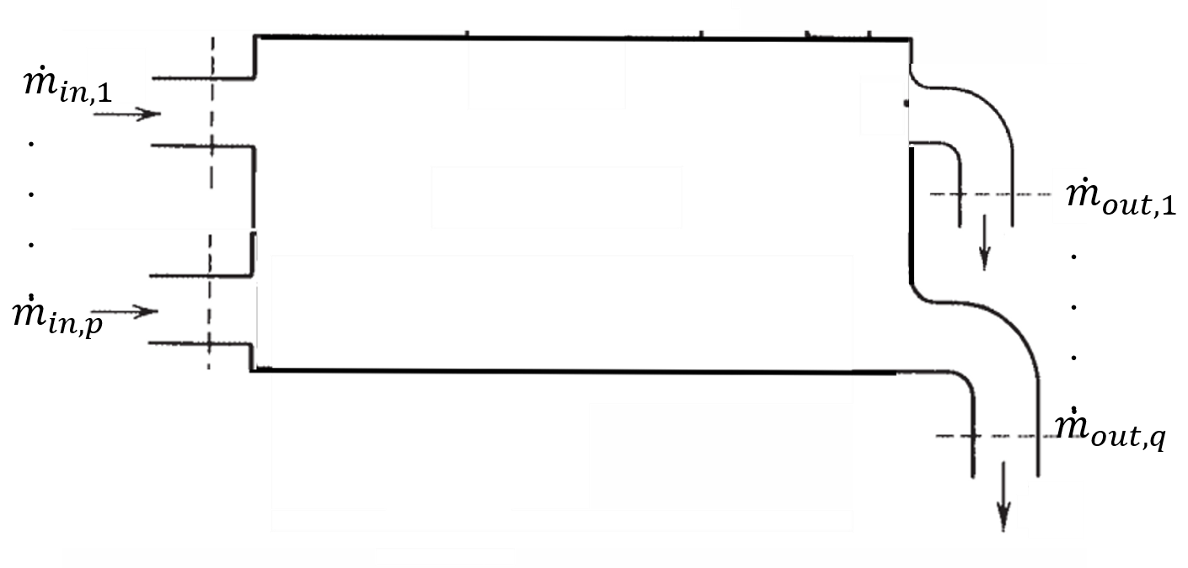
A CV Interacting with multiple inlet and outlets
Consider a general purpose open system:

Slide 22
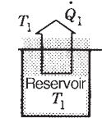
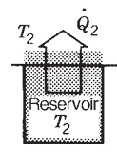
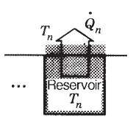
A CV Interacting with with n reservoirs
At a certain point intime, this system is in thermal contact with any number of temperature reservoirs of temperatures T_{i}(i=0,1,2,…,n).

Slide 23
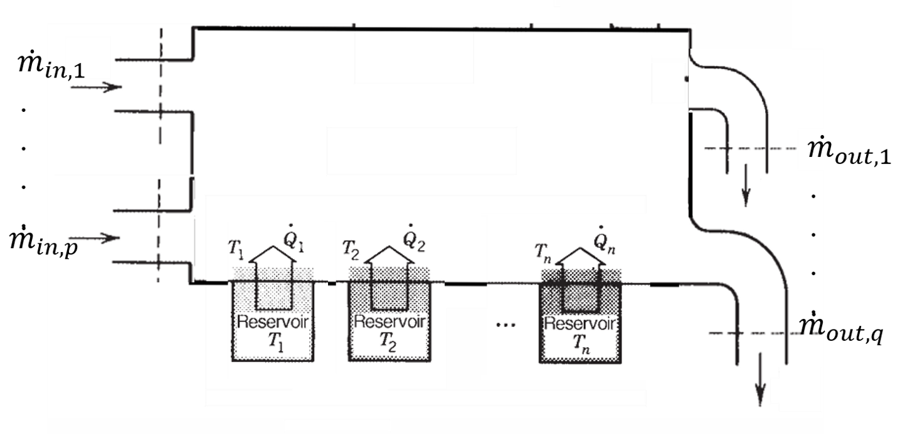
A CV Interacting with with the ambience and n reservoirs
Ambience plays a special role in the functioning of every engineering installation.
This ambience is represented as a temperature and pressure reservoir (T₀,p₀).

Slide 24
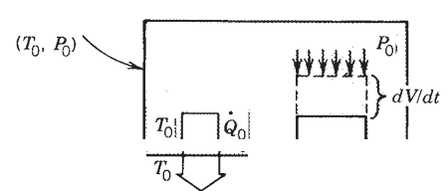
A CV Interacting with with the ambience and n reservoirs

Slide 25
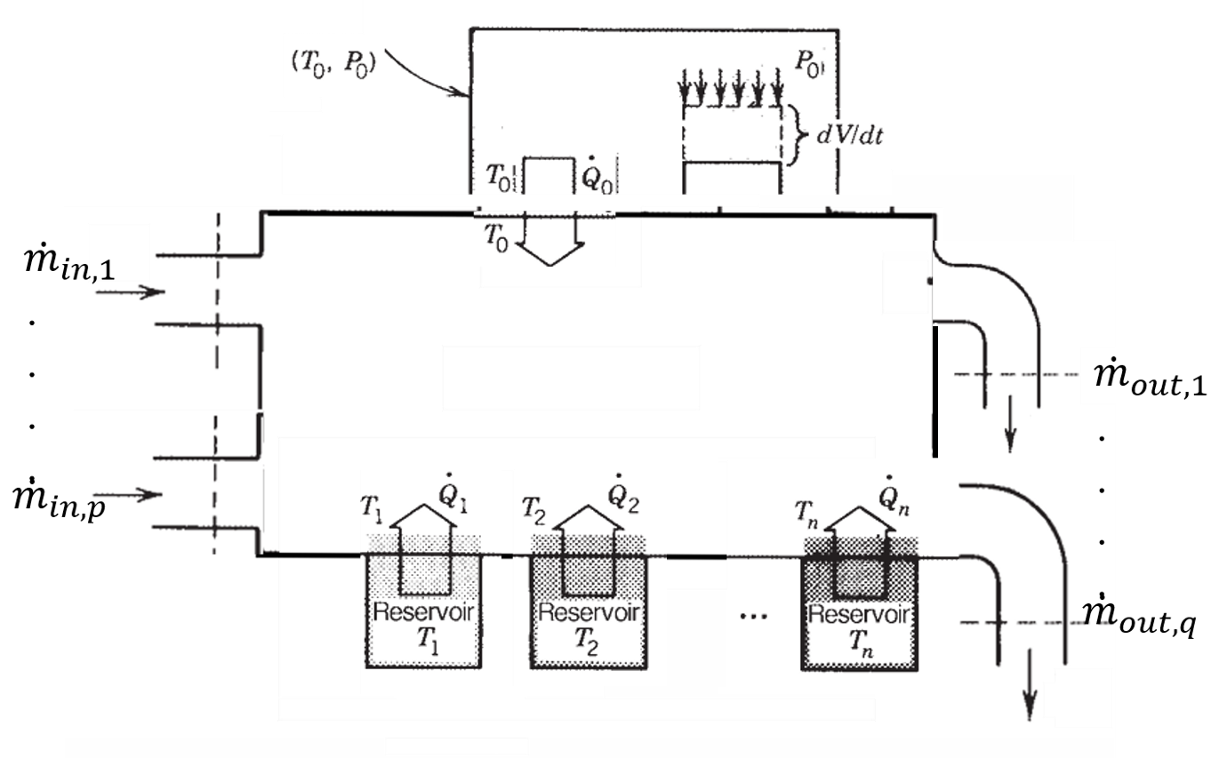
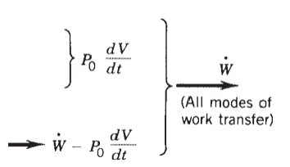
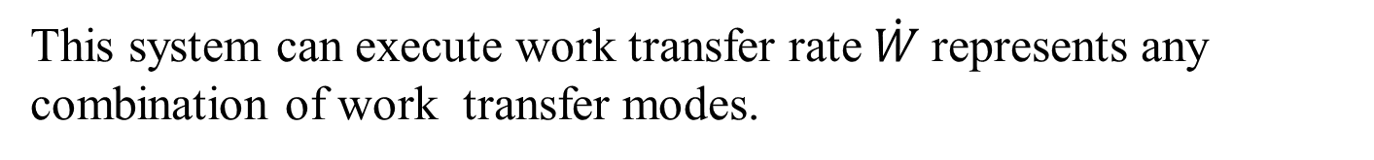
A CV Interacting with with the ambience and n reservoirs
This system can execute work transfer rate $\dot{W}$represents any combination of work transfer modes.

Slide 26
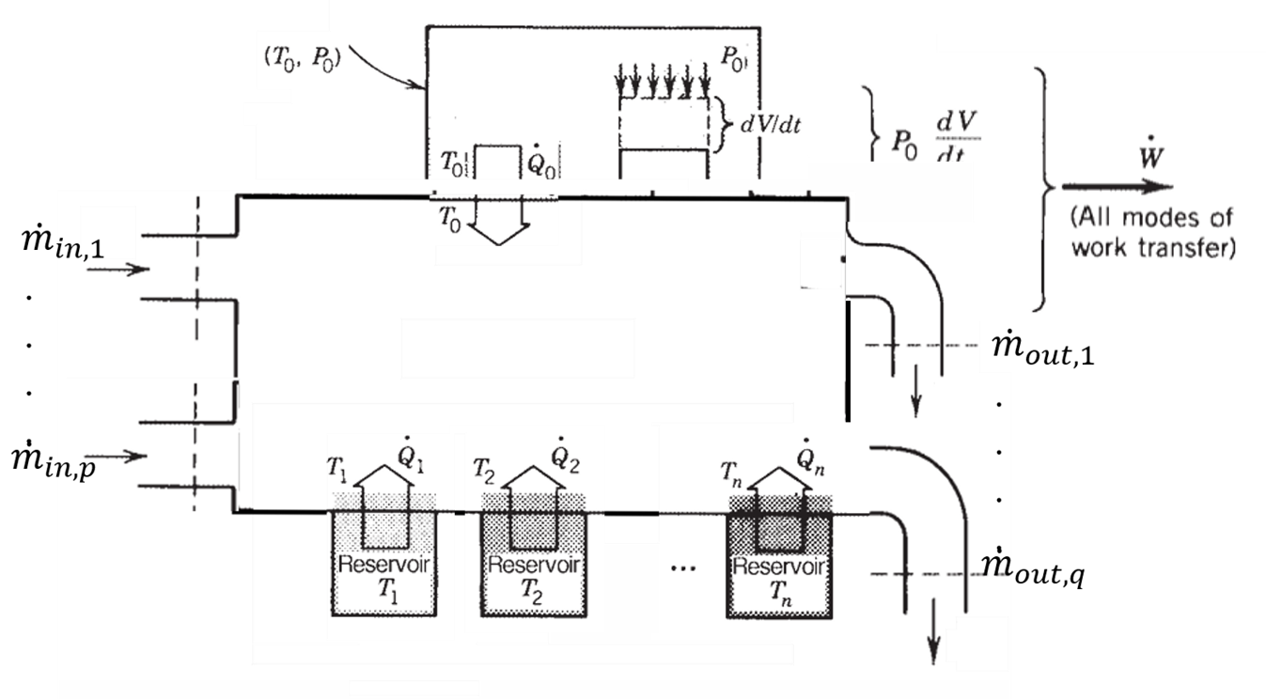
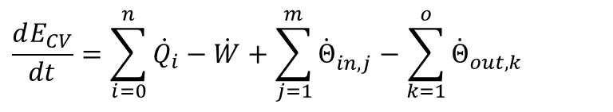
A CV Interacting with with the ambience and n reservoirs
$$\frac{dE_{CV}}{dt}=\sum_{i=0}^{n}{{\dot{Q}}_{i}}−\dot{W}+\sum_{j=1}^{m}{{\dot{Θ}}_{in,j}^{}}−\sum_{k=1}^{o}{{\dot{Θ}}_{out,k}^{}}$$
First Law

Slide 27
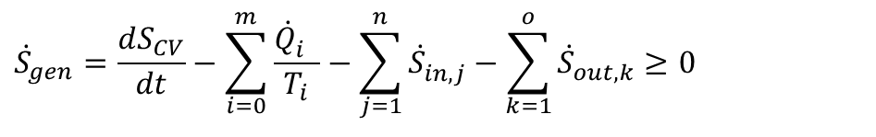
A CV Interacting with with the ambience and n reservoirs
Second Law
$${\dot{S}}_{gen}=\frac{dS_{CV}}{dt}−\sum_{i=0}^{m}{\frac{{\dot{Q}}_{i}^{}}{T_{i}}}−\sum_{j=1}^{n}{{\dot{S}}_{in,j}^{}}−\sum_{k=1}^{o}{{\dot{S}}_{out,k}^{}}≥0$$

Slide 28
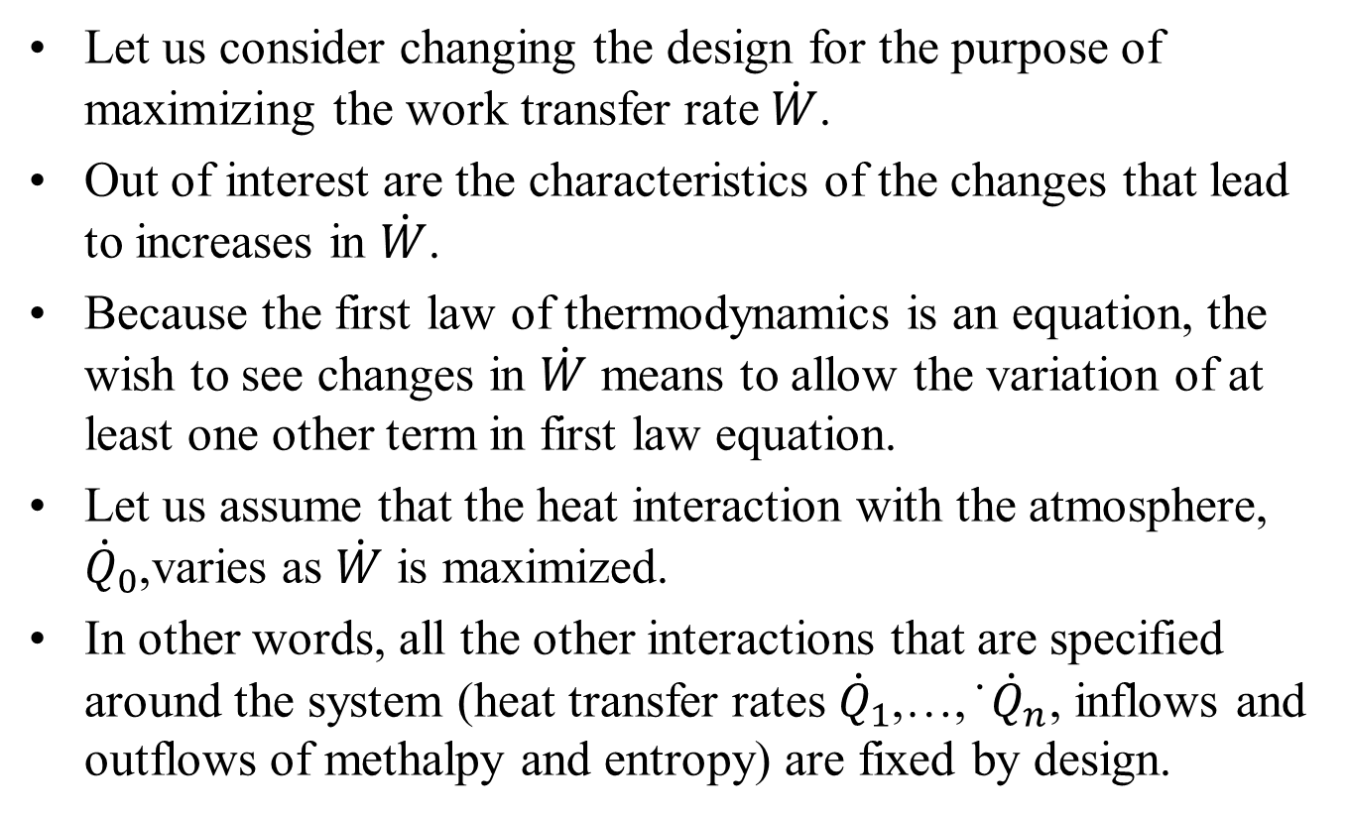
Clues for Achieving Maximum Work
Let us consider changing the design for the purpose of maximizing the work transfer rate $\dot{W}$.
Out of interest are the characteristics of the changes that lead to increases in $\dot{W}$.
Because the first law of thermodynamics is an equation, the wish to see changes in $\dot{W}$ means to allow the variation of at least one other term in first law equation.
Let us assume that the heat interaction with the atmosphere, ${\dot{Q}}_{0}$,varies as $\dot{W}$ is maximized.
In other words, all the other interactions that are specified around the system (heat transfer rates ${\dot{Q}}_{1}$,…, ̇ ${\dot{Q}}_{n}$, inflows and outflows of methalpy and entropy) are fixed by design.

Slide 29
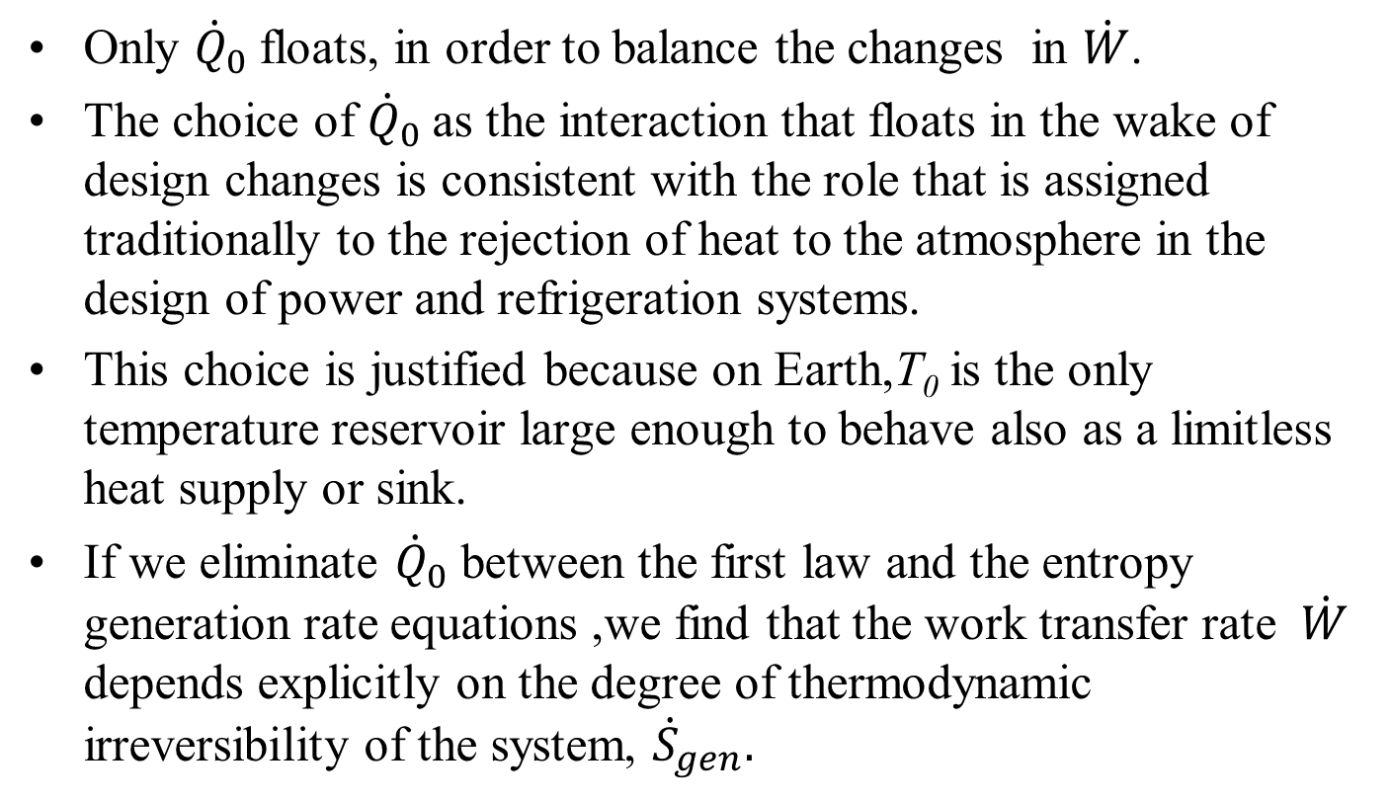
Clues for Achieving Maximum Work
Only ${\dot{Q}}_{0}$floats, in order to balance the changes in $\dot{W}$.
The choice of ${\dot{Q}}_{0}$as the interaction that floats in the wake of design changes is consistent with the role that is assigned traditionally to the rejection of heat to the atmosphere in the design of power and refrigeration systems.
This choice is justified because on Earth,T₀ is the only temperature reservoir large enough to behave also as a limitless heat supply or sink.
If we eliminate ${\dot{Q}}_{0}$ between the first law and the entropy generation rate equations ,we find that the work transfer rate $\dot{W}$ depends explicitly on the degree of thermodynamic irreversibility of the system, ${\dot{S}}_{gen}.$

