Slide 1

Entropy Generation in Industrial Processes
P M V Subbarao
Professor
Mechanical Engineering Department
An Environmental View of Thermodynamic Analysis!!!!

Slide 2

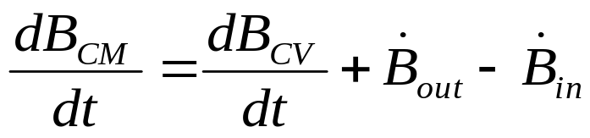
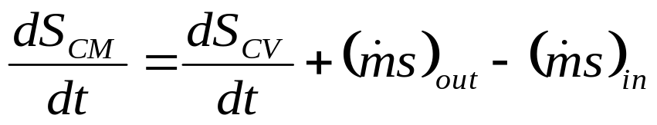
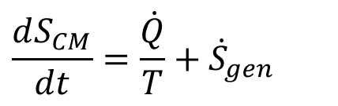
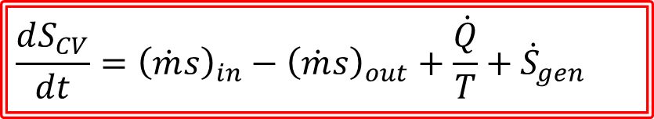
The Second Law Of Thermodynamics
For A Control Volume
The rate of change of property B of the system .
Let B = Entropy of the system, S = ms.
$$\frac{dS_{CM}}{dt}=\frac{\dot{Q}}{T}+{\dot{S}}_{gen}$$
$$\frac{dS_{CV}}{dt}={\left(\dot{m}s\right)}_{in}−{\left(\dot{m}s\right)}_{out}+\frac{\dot{Q}}{T}+{\dot{S}}_{gen}$$
Rate of change in entropy of a CV = Entropy in flow rate –Entropy out flow rate + the flux of entropy into the control mass from heat transfer + Rate of Entropy generation

Slide 3
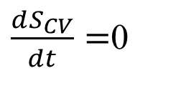

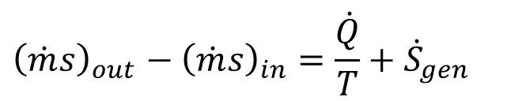
SSSF PROCESS by A CV
For the steady-state process, there is no change with time of the property (entropy) per unit mass at any point within the control volume.
That is,
$\frac{dS_{CV}}{dt}=$0
so that, for the steady-state process,
$${\left(\dot{m}s\right)}_{out}−{\left(\dot{m}s\right)}_{in}=\frac{\dot{Q}}{T}+{\dot{S}}_{gen}$$
For an adiabatic steady-state process,
$${\left(\dot{m}s\right)}_{out}−{\left(\dot{m}s\right)}_{in}={\dot{S}}_{gen}$$

Slide 4

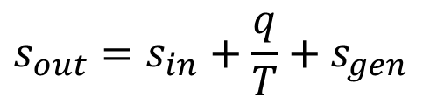
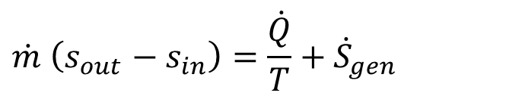
THE SSSF PROCESS
$$\dot{m} \left(s_{out}−s_{in}\right)=\frac{\dot{Q}}{T}+{\dot{S}}_{gen}$$
As $\dot{m}$ divide above equation with the mass flow rate to get
$$s_{out}=s_{in}+\frac{q}{T}+s_{gen}$$
Since s_{gen} is always greater than or equal to zero, for an adiabatic process it follows that
$$s_{out}=s_{in}+s_{gen}≥s_{in}$$
where the equality holds for a reversible adiabatic process.

Slide 5
Industrial Use of Entropy Generation
Entropy is negative concept emerged from negative laws.
Inferior quality devices lead to high entropy generation and vice versa.
Quality of a device is characterized by amount of entropy generation, which cannot be directly translated into energy transactions.
Every industrial process can be modelled as a thermodynamic process and rate of entropy generation can be calculated to characterize the quality of a process.
Cost of any operation is proportional to energy transactions involved in the operation. !?!?!

Slide 6
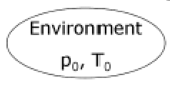
A Generalized Model Of A Manufacturing System
Creation of Energy Sources for Manufacturing System
Manufacturing System
Material Processing System
Creation of Energy Sources for Material Processing System

Slide 7
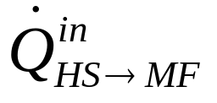
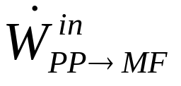
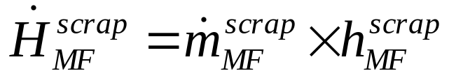
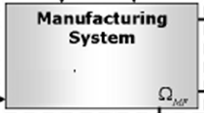
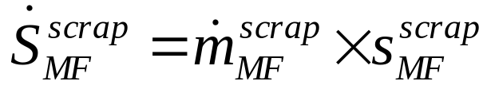
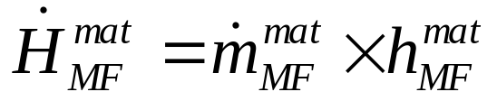
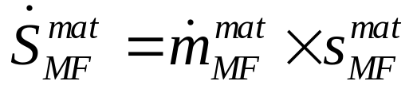
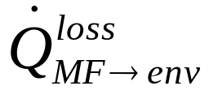
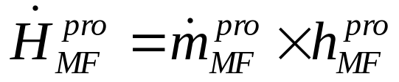
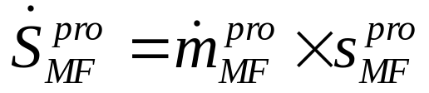
Manufacturing System as a Rate Process

Slide 8
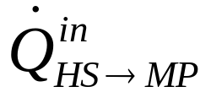
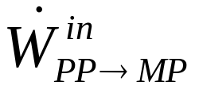

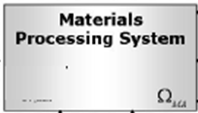

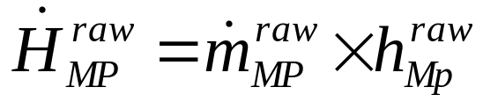
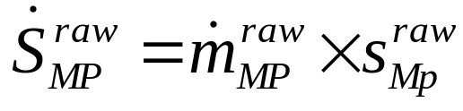
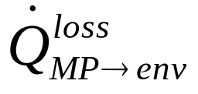

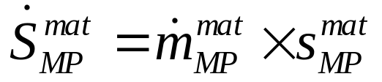
Auxiliaries (to Manufacturing System) as a Thermodynamic CV

Slide 9
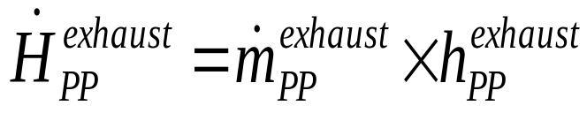
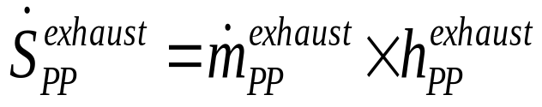
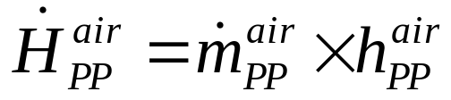
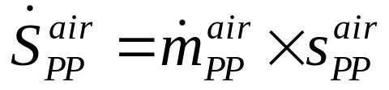
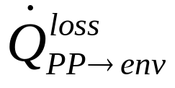
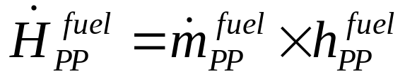
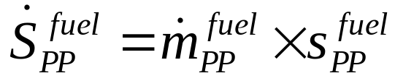
Power Plant for A Manufacturing System & Material Processing System
Power Plant for
Manufacturing System &
Material Processing System

Slide 10
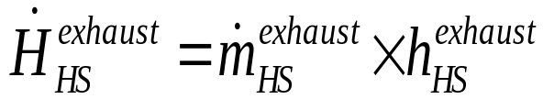
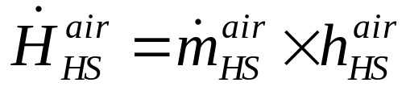
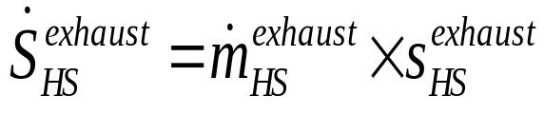
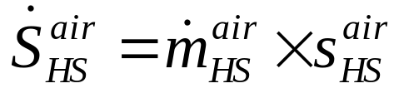
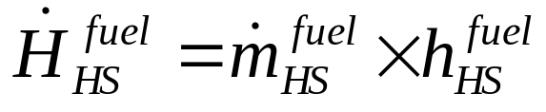

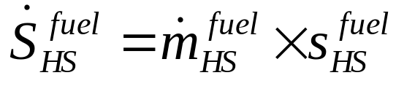
Heat Source for A Manufacturing System & Material Processing System
Heat Generation Unit for
Manufacturing System &
Material Processing System

Slide 11
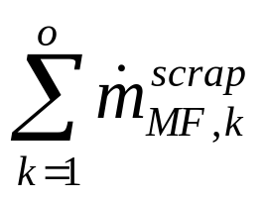
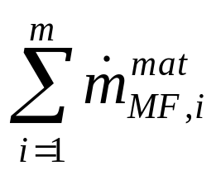
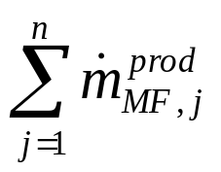
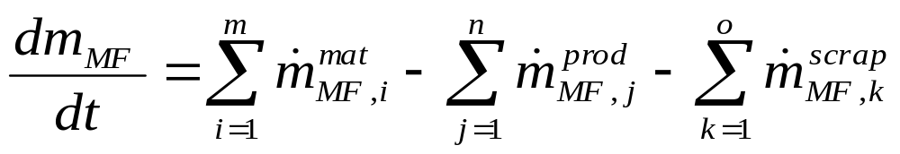
Generalized Manufacturing System
Mass Balance:
Conservation of mass:

Slide 12
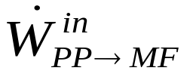
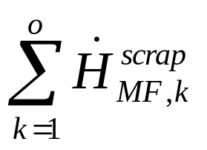
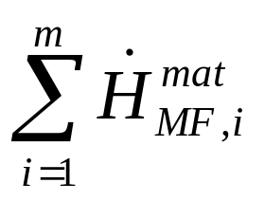
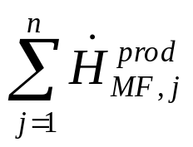
Generalized Manufacturing System
First law equation:
First Law

Slide 13
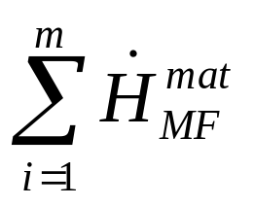
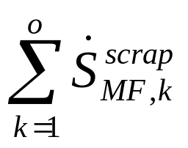
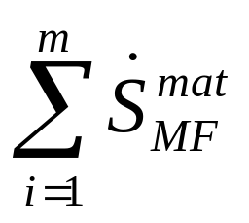



Generalized Manufacturing System
Second law equation:

Slide 14

Model Equations for Generalized Manufacturing System
Conservation of mass:
First Law
Entropy Balance:

Slide 15





Accumulated Impact of Transient Process
For the transient process, the second law for a control volume, it can be written in the following form:
$$\frac{dS_{CV}}{dt}={\left(\dot{m}s\right)}_{in}−{\left(\dot{m}s\right)}_{out}+\frac{\dot{Q}}{T}+{\dot{S}}_{gen}$$
If this is integrated over the time interval t, we have
$$\int_{0}^{∆t}{\frac{dS_{CV}}{dt}}dt=∆S_{CV}$$
$$\int_{0}^{∆t}{{\left(\dot{m}s\right)}_{in}}dt={∆\left(ms\right)}_{in}$$
$$\int_{0}^{∆t}{{\left(\dot{m}s\right)}_{out}}dt={∆\left(ms\right)}_{out}$$
$$\int_{0}^{∆t}{{\dot{S}}_{gen}}dt=S_{gen−t}$$

Slide 16

Accumulated Impact Transient Process
Therefore, for this period of time Δt, the second law for the transient process is written as
$$∆S_{CV}={∆\left(ms\right)}_{in}−{∆\left(ms\right)}_{out}+\int_{0}^{∆t}{\left(\frac{\dot{Q}}{T}\right)}dt+S_{gen−t}$$

Slide 17
Ecological Negligence by Thermodynamics
The first observation is that all industrial processes occur in the terrestrial atmosphere.
This atmosphere for all practical purposes is an inexhaustible source (or sink) of energy, work, and matter.
The energy of the atmosphere can be increased or decreased by an exchange of heat.
The atmosphere can perform an unlimited amount of work or have an unlimited amount of work performed on it by expanding or contracting volumes against its pressure.
Finally, certain chemical species present in the atmosphere can be withdrawn, and all others can be exhaled into it.
In addition to being inexhaustible, is is assumed that energy, work, and matter can be obtained from or dumped into the atmosphere at no economic cost.

