Slide 1

Irreversible Process & Entropy Generation
P M V Subbarao
Professor
Mechanical Engineering Department
A Measure of Incapability & Irreversibility !!!!

Slide 2

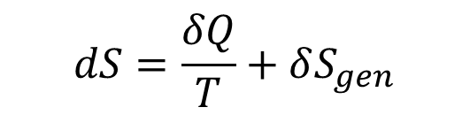
ENTROPY GENERATION
The entropy change for an irreversible process is larger than the change in a reversible process for the same δQ and T.
This can be written out in a common form as an equality
$$dS=\frac{δQ}{T}+δS_{gen}$$
δS_{gen}, is the entropy generation in the process due to irreversibilities occurring inside a control mass.
This internal generation can be caused by the processes such as friction, unrestrained expansions, and the internal transfer of energy (redistribution) over a finite temperature difference.

Slide 3
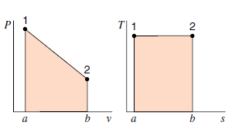
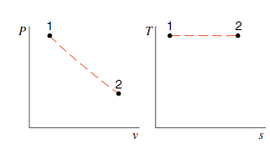
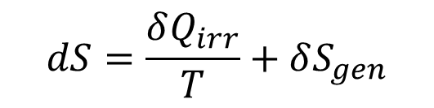

Heat Transfer in an Irreversible Process
$$dS=\frac{δQ_{irr}}{T}+δS_{gen}$$
For an irreversible process with a nonzero entropy generation, the heat transfer from above equation becomes
$$δQ_{irr}=TdS−TδS_{gen}$$
Heat transfer in an irreversible process is smaller than that for the reversible case for the same change of state, dS.
For the irreversible process, the work is no longer equal to pdV or -Vdp but is smaller.
Reversible Process
Irreversible Process

Slide 4







Work Transfer During an Irreversible Process by A Control Mass
First law for an infinitesimal process executed by a control mass is expressed as:
Irreversible CoS:
Reversible CoS:
$$δQ_{irr}=dU+δW_{irr}$$
$$δQ_{rev}= dU+pdV$$
As per second law:
$$δQ_{irr}=TdS−TδS_{gen}$$
$$TdS=dU+pdV$$
$$dU=δQ_{irr}−δW_{irr}$$
$$dU=TdS−pdV$$
dU must be same for same end states:
$$δQ_{irr}−δW_{irr}=TdS−pdV$$
$$δQ_{irr}−δW_{irr}=δQ_{irr}+TδS_{gen}−pdV$$
$$δW_{irr}=pdV−TδS_{gen}$$

Slide 5

Work Transfer During an Irreversible Process by A Control Mass
$$δW_{irr}=pdV−TδS_{gen}$$
The work during an irreversible process is reduced by an amount proportional to the entropy generation.
For this reason, the term TδS_{gen} is often called “lost work,” although it is not a real work or energy quantity lost but rather a lost opportunity to extract work.

Slide 6
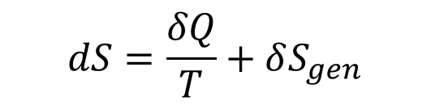
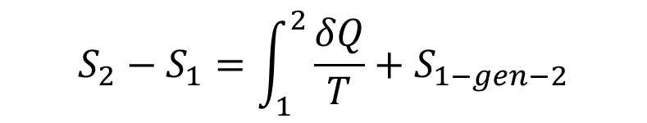
Total Entropy Change during an Irreversible Process
$$dS=\frac{δQ}{T}+δS_{gen}$$
Above equation can be integrated between initial and final states to
$$S_{2}−S_{1}=\int_{1}^{2}{\frac{δQ}{T}}+S_{1−gen−2}$$

Slide 7
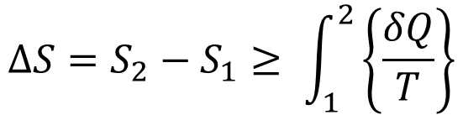
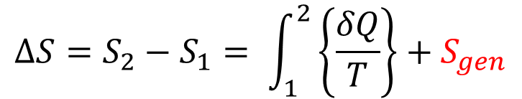
Increase of Entropy Principle
$$∆S=S_{2}−S_{1}≥ \int_{1}^{2}{\left\{\frac{δQ}{T}\right\}}$$
Define entropy generation S_{gen} as,
$$∆S=S_{2}−S_{1}= \int_{1}^{2}{\left\{\frac{δQ}{T}\right\}}+S_{gen}$$
Increase of Entropy Principle
Entropy change
Entropy Transfer
(due to heat transfer)
Entropy Generation
The principle states that for an isolated Or a closed adiabatic Or System + Surroundings;
A process can only take place such that S_{gen}≥ 0 where S_{gen} = 0 for a reversible process only and S_{gen} can never be less than zero.

Slide 8
Implications of Increase of Entropy Principle
Entropy, unlike energy, is non-conservative since it is always increasing.
The entropy of the universe is continuously increasing, in other words, it is becoming disorganized and is approaching chaotic.
The entropy generation is due to the presence of irreversibilities.
Therefore, the higher irreversibilities lead to the higher the entropy generation and the lower the efficiency of a device.
The above is Engineering statement of the second law

Slide 9
Major Irreversibilities Affecting Nation’s Average Fuel Efficiency
Driving Behavior: Smooth acceleration, anticipatory braking, and steady speeds can lead to up to 25% fuel savings. Known as “eco-driving,” this is one of the most effective and cost-free methods to improve fuel economy.
Road Quality: Often overlooked, road conditions—particularly surface smoothness—have a significant effect on fuel economy, offering 8 – 18% in savings.
Engine and Transmission Technologies: Features like turbocharging, CVTs, and start-stop systems improve internal efficiency, offering 5–10% in savings.
Aerodynamics: Streamlined vehicle shapes, covered underbodies, and smooth mirror designs help at highway speeds, saving 3–7%.

Slide 10
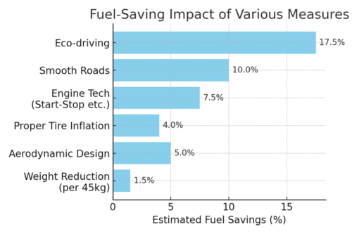
Major Irreversibilities Affecting Nation’s Average Fuel Efficiency
Aerodynamics: Streamlined vehicle shapes, covered underbodies, and smooth mirror designs help at highway speeds, saving 3–7%.
Tire Pressure: Underinflated tires increase rolling resistance. Keeping them at optimal pressure can save 3–5% in fuel.
Vehicle Load: Every additional 45 kg (~100 lb) of weight can increase fuel consumption by around 1–2%. Carrying only essential cargo and removing roof racks helps reduce drag and weight.

Slide 11
Second Law & Entropy Balance
Increase of Entropy Principle is another way of stating the Second Law of Thermodynamics:
Second Law : Entropy can be created but NOT destroyed
In contrast, the first law states: Energy is always conserved.
Note that this does not mean that the entropy of a system cannot be reduced, it can.
However, total entropy of a system + surroundings cannot be reduced.

Slide 12
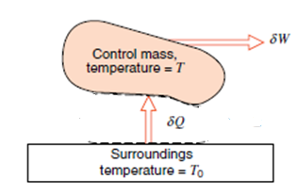
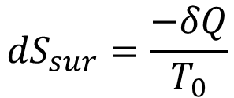
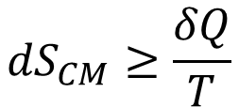
Entropy of Universe
Thermodynamic universe is the union of systems and surroundings
A quantity of heat δQ is spontaneously transferred from the surroundings at temperature T₀ to the control mass at temperature T.
Let the work done during this process be δW.
For this process by control mass and write
$${dS}_{CM}≥\frac{δQ}{T}$$
For the surroundings at T₀, δQ is negative, and we assume a reversible heat extraction so
$${dS}_{sur}=\frac{−δQ}{T_{0}}$$

Slide 13
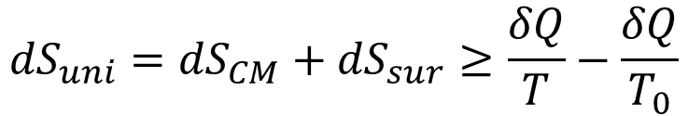

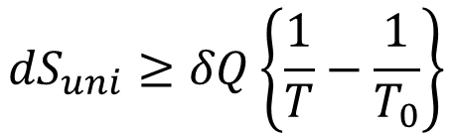
Entropy of Universe
The total net change of entropy is therefore
$${dS}_{uni}={dS}_{CM}+{dS}_{sur}≥\frac{δQ}{T}−\frac{δQ}{T_{0}}$$
$${dS}_{uni}≥δQ\left\{\frac{1}{T}−\frac{1}{T_{0}}\right\}$$
Since T₀ > T, the quantity [(1/T) - (1/T₀)] is positive, and we conclude that
$${dS}_{uni}={dS}_{CM}+{dS}_{sur}≥0$$

Slide 14
The Third Law of Thermodynamics
The entropy change of a system during a reversible isothermal process tends towards zero when the thermodynamic temperature of the system tends towards zero.
In the neighbourhood of absolute zero, all reactions in a liquid or solid in internal equilibrium take place with no change in entropy.
[Nernst 'principle'].

Slide 15
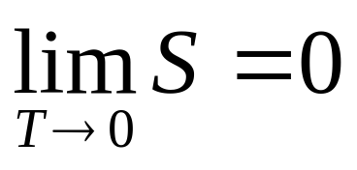
Planck’s statement of the 3rd law
In 1911, Planck one step further and made the hypothesis that not only does the entropy difference vanish as T → 0, but that:
Planck’s statement of the Third Law: The entropy of every solid or liquid substance in internal equilibrium at absolute zero is itself zero.
Planck is just saying:

Slide 16
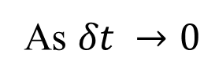
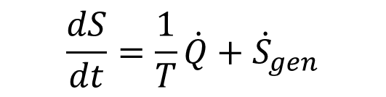
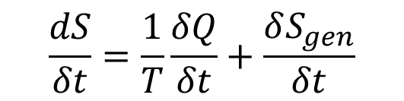

Entropy Rate Equation
The second law of thermodynamics was used to write the balance of entropy for a infinitesimal variation for a finite change.
Here the equation is needed in a rate form so that a given process can be tracked in time.
Take the incremental change and divide by δt.
We get
$$\frac{dS}{δt}=\frac{1}{T}\frac{δQ}{δt}+\frac{δS_{gen}}{δt}$$
$$\frac{dS}{dt}=\frac{1}{T}\dot{Q}+{\dot{S}}_{gen}$$
As $δt →0$
The rate of entropy change is due to the flux of entropy into the control mass from heat transfer and an increase due to irreversible processes inside the control mass.

