Slide 1

Caratheodory’s & Kelvin Analyses of Irreversible Cycles
P M V Subbarao
Professor
Mechanical Engineering Department
I I T Delhi
Thermal limits & geometric logic for Real Life Systems!!!

Slide 2

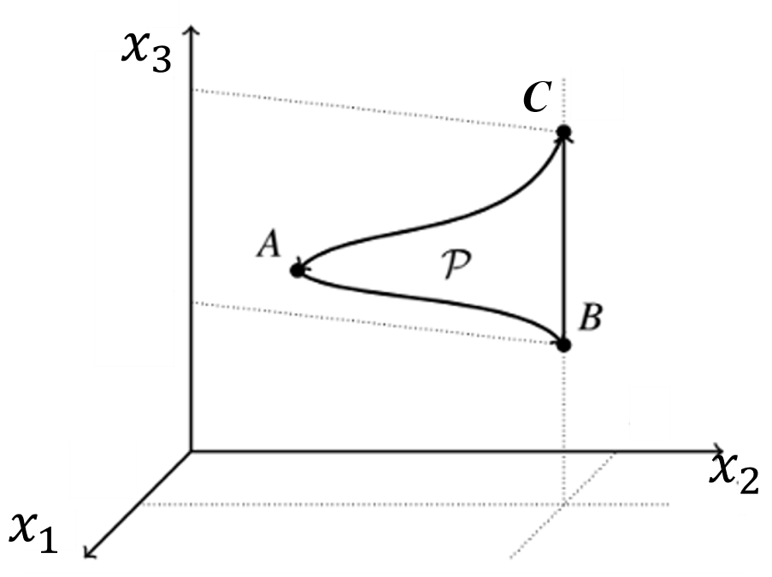
KP vs AC : Reversible Cycle
If (AC) is false, falsifies (KP).
For reversible processes (KP) ⇒(AC).
However, irreversible processes also to be studied in Advanced thermodynamics.
These processes are, as the name suggests, processes that can only be realized in a single “time direction”.

Slide 3
KP vs AC : Irreversible Cycle
If (AC) is false, falsifies (KP) for an irreversible cycle too????
The intermediate situations of the system in an irreversible process are not equilibrium situations.

Slide 4
Engineering Irreversibilities
Fluid friction
Solid friction
Heat Transfer with a finite temperature difference
Electrical resistance
Thermo-chemical Reactions (Combustion)
Unrestrained motion

Slide 5
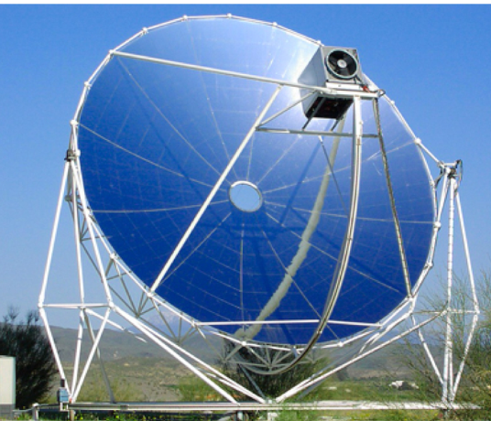
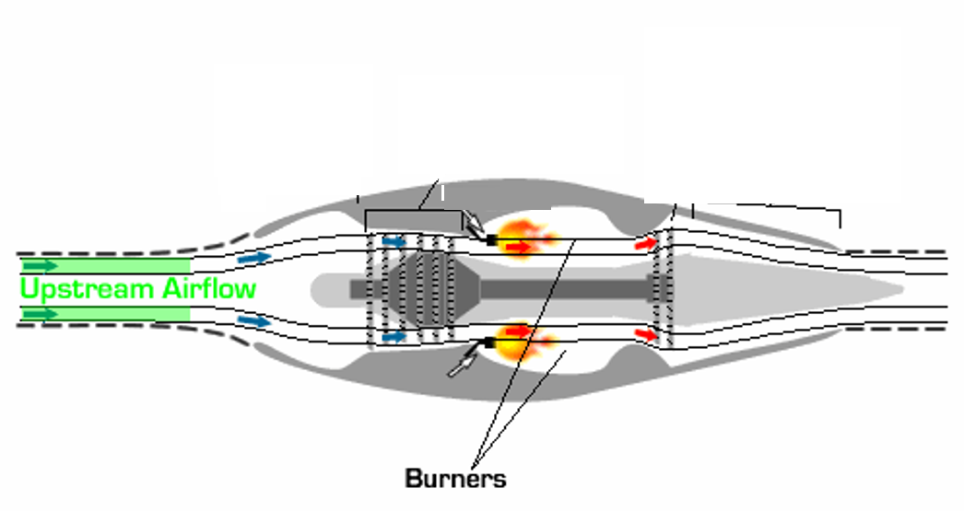








Combustion is An Irreversible Process
$${\dot{m}}_{air}$$
$${\dot{Q}}_{in}$$
Reversed burner
$${\dot{m}}_{fuel}$$
$${\dot{Q}}_{comb}$$
$${\dot{m}}_{hot }$$
$$T_{∞}, p_{∞} \&{\dot{m}}_{air}$$
$$T_{jet}, p_{∞} \& {\dot{m}}_{jet}$$

Slide 6
Irreversible Processes
It is well known that real world process are irreversible processes.
These processes that can only be realized in a single “(time) direction”.
Conceptually, thermodynamics is a theory that studies only equilibrium situations.
However, a qualitative analysis of irreversible processes is always possible as thermodynamic initial and final situations of irreversible processes are always equilibrium situations.
Finally, the true meaning of entropy and second law of thermodynamics emerges from irreversible processes.

Slide 7
Study of an Irreversible Process
In thermodynamic space, irreversible processes cannot be represented as the usual continuous curves.
However, the initial and final states of an irreversible process are well defined.
It is a practice in thermodynamics to represent an irreversible process as a dashed line in thermodynamic space.
This dashed line connects its initial and final states.
It is natural that the relation (KP) ⇒ (AC) for irreversible processes must be evaluated as well.

Slide 8
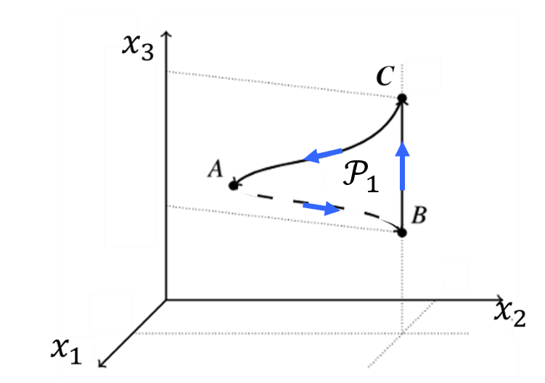
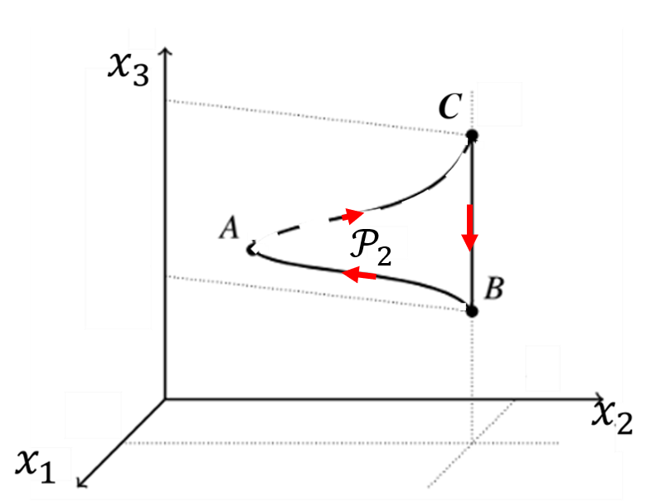
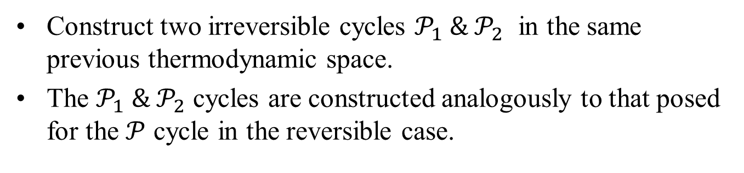
Analysis of an Irreversible Process
Construct two irreversible cycles $𝒫_{1} \& 𝒫_{2}$ in the same previous thermodynamic space.
The $𝒫_{1} \& 𝒫_{2}$ cycles are constructed analogously to that posed for the $𝒫$ cycle in the reversible case.

Slide 9
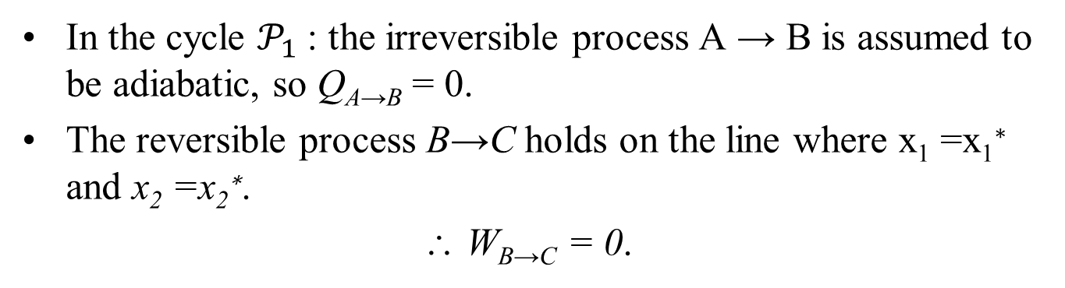
Analysis of an Irreversible Process
In the cycle $𝒫_{1}$: the irreversible process A → B is assumed to be adiabatic, so Q_{A→B} = 0.
The reversible process B→C holds on the line where x₁ =x₁∗ and x₂ =x₂∗.
∴ W_{B→C} = 0.

Slide 10
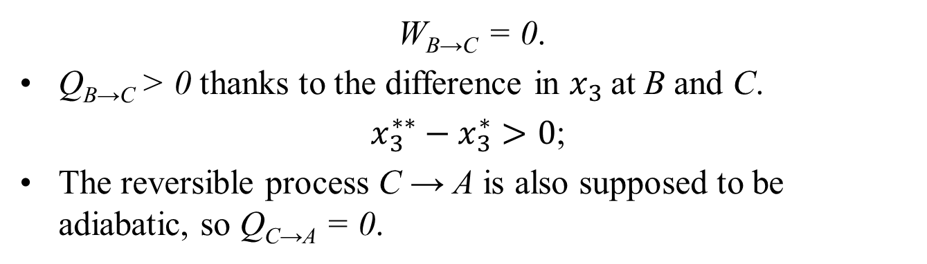

Analysis of an Irreversible Process
W_{B→C} = 0.
Q_{B→C} > 0 thanks to the difference in $x_{3}$at B and C.
$x_{3}^{∗∗}−x_{3}^{∗}>0$;
The reversible process C → A is also supposed to be adiabatic, so Q_{C→A} = 0.

Slide 11

Analysis of an Irreversible Process
This closes the cycle $𝒫_{1}$.
Note that due to the irreversibility of $𝒫_{1}$can only be traversed in the direction A→B→C→A.

Slide 12
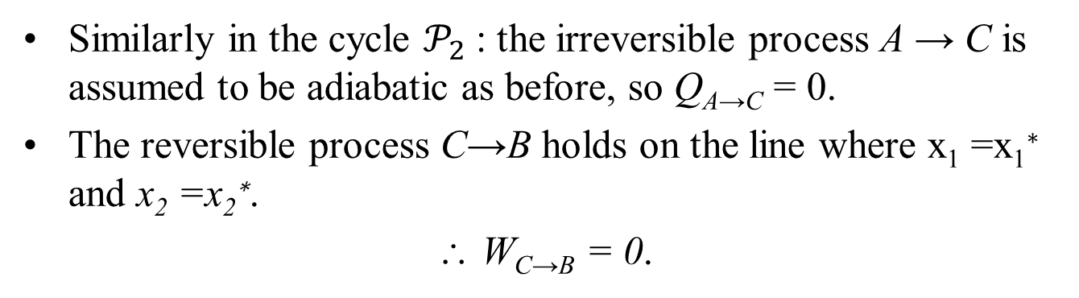
Analysis of an Irreversible Process
Similarly in the cycle $𝒫_{2}$: the irreversible process A → C is assumed to be adiabatic as before, so Q_{A→C} = 0.
The reversible process C→B holds on the line where x₁ =x₁∗ and x₂ =x₂∗.
∴ W_{C→B} = 0.

Slide 13
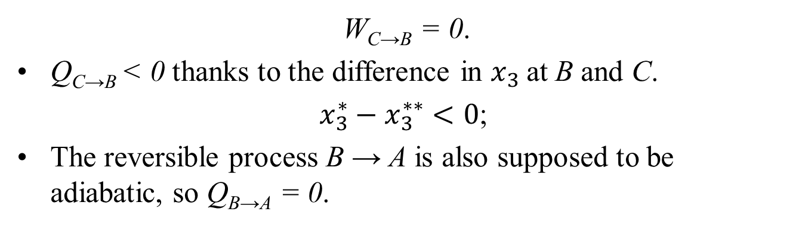
Analysis of an Irreversible Process
W_{C→B} = 0.
Q_{C→B} < 0 thanks to the difference in $x_{3}$at B and C.
$x_{3}^{∗}−x_{3}^{∗∗}<0$;
The reversible process B → A is also supposed to be adiabatic, so Q_{B→A} = 0.

Slide 14
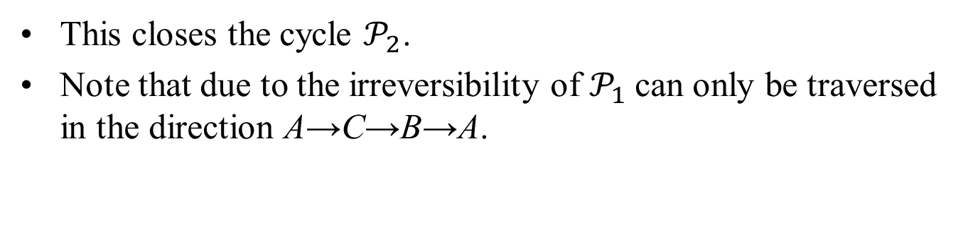
Analysis of an Irreversible Process
This closes the cycle $𝒫_{2}$.
Note that due to the irreversibility of $𝒫_{1}$can only be traversed in the direction A→C→B→A.

Slide 15
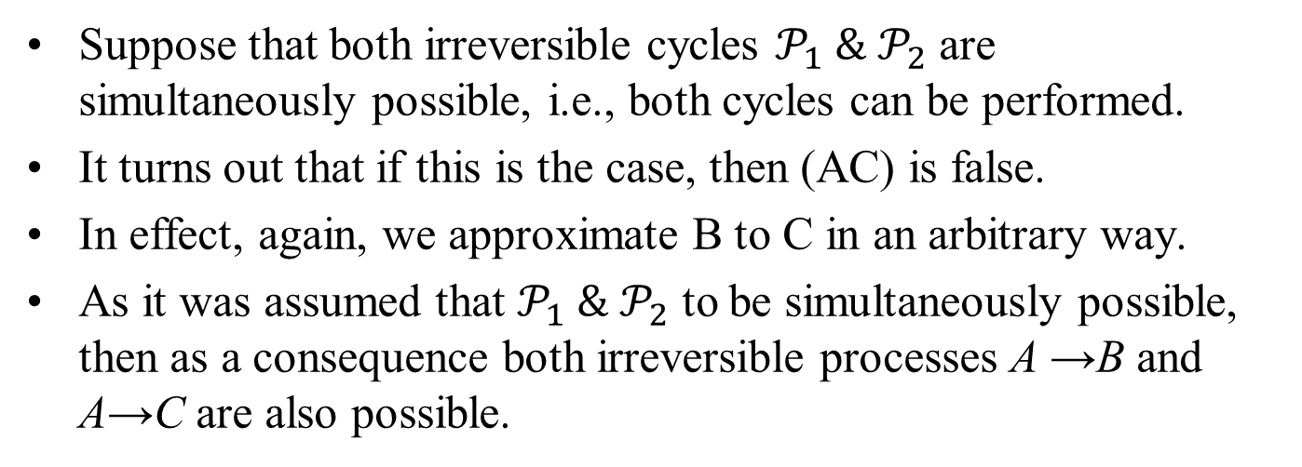
Analysis of an Irreversible Process
Suppose that both irreversible cycles $𝒫_{1} \& 𝒫_{2}$ are simultaneously possible, i.e., both cycles can be performed.
It turns out that if this is the case, then (AC) is false.
In effect, again, we approximate B to C in an arbitrary way.
As it was assumed that $𝒫_{1} \& 𝒫_{2}$ to be simultaneously possible, then as a consequence both irreversible processes A →B and A→C are also possible.

Slide 16
Analysis of an Irreversible Process
Then, if C is approximated arbitrarily from B, and from A one can reach both B and C by irreversible adiabatic processe.
Therefore, from A all states on the same line x₁∗--x₂∗ as B and C can be reached by irreversible adiabatic processes.
Also approximate that the line x₁∗--x₂∗ arbitrarily close to A.

Slide 17
Analysis of an Irreversible Process
It is obtained that:
arbitrarily close to A there are states that can be reached from A by irreversible adiabatic processes, thus falsifying (AC) for irreversible processes.

Slide 18
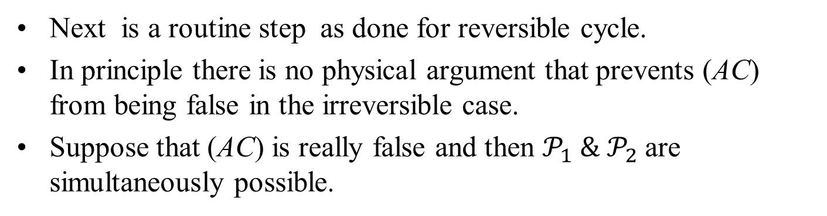
Analysis of an Irreversible Process
Next is a routine step as done for reversible cycle.
In principle there is no physical argument that prevents (AC) from being false in the irreversible case.
Suppose that (AC) is really false and then $𝒫_{1} \& 𝒫_{2}$are simultaneously possible.

Slide 19
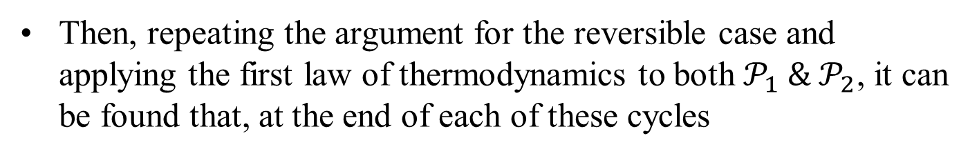

Analysis of an Irreversible Process
Then, repeating the argument for the reversible case and applying the first law of thermodynamics to both $𝒫_{1} \& 𝒫_{2}$, it can be found that, at the end of each of these cycles
$$W_{𝒫}=Q_{B→C}$$

Slide 20
Analysis of an Irreversible Process
For irreversible processes (KP) ⇒ (AC).

Slide 21
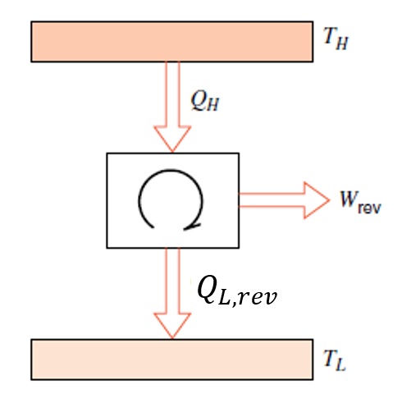
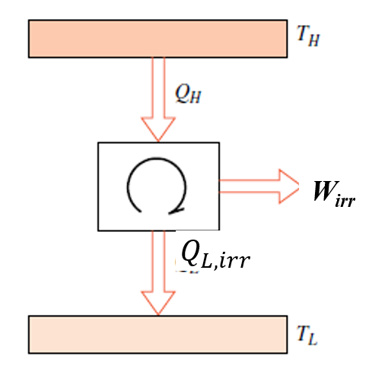
Reversible Vs Irreversible Engines
Consider an irreversible cyclic heat engine operating between the same T_{H} and T_{L} as the reversible engine

Slide 22
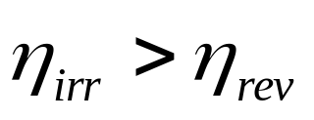
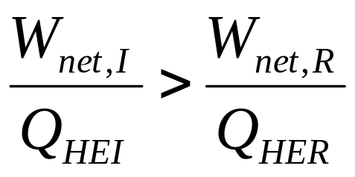
Irreversible and Reversible engines
Assume that an irreversible
Engine is more efficient than
the reversible engine.
HTR
Q_{HEI}
Q_{HE}
Q_{HER}
W_{netI}
W_{netI}
W_{netR}
E_{I}
E
E_{R}
Q_{LEI}
Q_{LE}
Q_{LER}
LTR

Slide 23
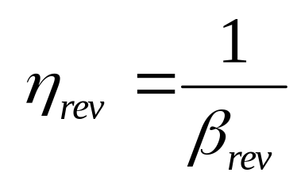
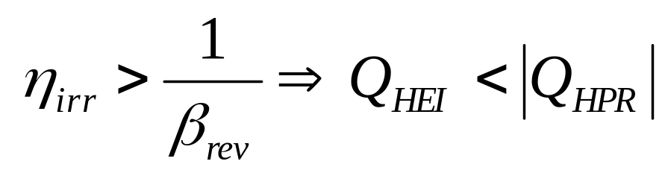
More Efficient Irreversible engine
W_{net,I} W_{net,R}
>
Q_{HEI} Q_{HER}
For same W_{net}, Q_{HEI} < Q_{HER}
Implies that, |Q_{LEI} | < |Q_{LER}|
But a reversible engine can be completely reversed and it will work as a heat pump.
For same |W_{net} |,
Let us construct a compound machine using an irreversible engine
and reversed reversible engine (reversible Heat Pump).

Slide 24
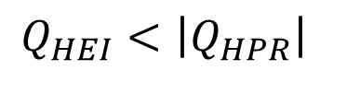
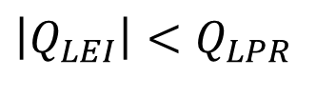
Compound Machine using Reversible & Irreversible Engines
HTR (Sink)
Q_{HEI}
Q_{HPR}
W_{netR}
E_{I}
W_{netR}
∃_{R}
For same |W_{net} |,
Q_{LEI}
$$Q_{HEI}<\left|Q_{HPR}\right|$$
Q_{LPR}
$$\left|Q_{LEI}\right|<Q_{LPR}$$
LTR (Source)

Slide 25
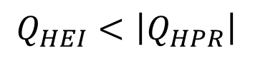
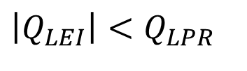
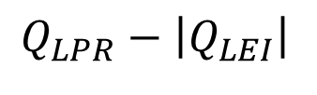

Compound Machine using Reversible & Irreversible Engines
HTR (Sink)
$$Q_{HPR}+Q_{HEI}$$
Q_{HEI}
For same |W_{net} |,
Q_{HPR}
$$Q_{HEI}<\left|Q_{HPR}\right|$$
W_{netR}
$$\left|Q_{LEI}\right|<Q_{LPR}$$
E_{I}
∃_{R}
Q_{LEI}
Q_{LPR}
$$Q_{LPR}−\left|Q_{LEI}\right|$$
LTR (Source)

Slide 26
HTR (Sink)
|Q_{HPR} | - Q_{HEI}
Q_{HEI} < |Q_{HPR} |
Q_{HEI}
Q_{HPR}
W_{netR}
E_{I}
∃_{R}
Q_{LPR}
Q_{LE}
|Q_{LEI}| < Q_{LPR}
Q_{LPR} - |Q_{LEI} |
LTR (Source)

Slide 27
Irreversible Machines
The efficiency of an irreversible heat engine will always less than the efficiency of a reversible engine working between the same reservoirs.
The COP of an irreversible heat pump will always less than the COP of a reversible heat pump working between the same reservoirs.

Slide 28
Further Discussions
η_{irr} < η_{rev}
1/η_{irr} >1/η_{rev} but, 1/η_{rev} = β_{rev}
1/η_{irr} > β_{rev} (Mathematically possible but thermodynamically impossible).
Similarly, β_{irr} < β_{rev} ⇒ 1/β_{irr} > 1/β_{rev}
1/β_{irr} >η_{rev} (Mathematically possible but thermodynamically impossible).

Slide 29
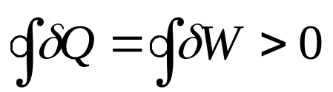
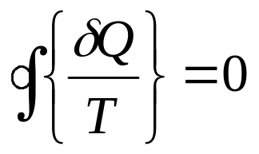
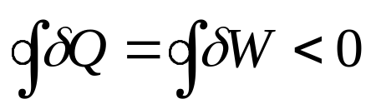
Nature of Reversible Machines
For all reversible heat engines:
For all reversible heat pumps and refrigerators:
Therefore all reversible machines in this universe :

Slide 30
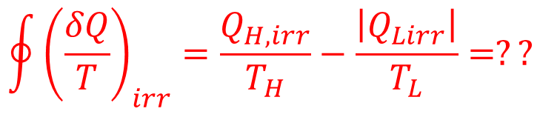
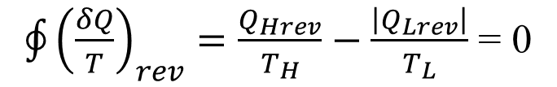
Comparison of Reversible & Irreversible Engines
For a reversible engine with two adiabatic and two isothermal reversible processes:
$\oint{{\left(\frac{δQ}{T}\right)}_{rev}=\frac{Q_{Hrev}}{T_{H}}−\frac{\left|Q_{Lrev}\right|}{T_{L}}}$ = 0
Estimate this cyclic integral for a similar irreversible engine :
$$\oint{{\left(\frac{δQ}{T}\right)}_{irr}=\frac{Q_{H, irr}}{T_{H}}−\frac{\left|Q_{Lirr}\right|}{T_{L}}}=??$$

Slide 31
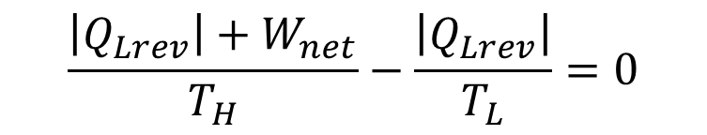
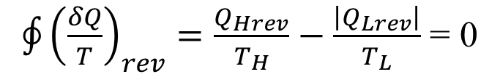
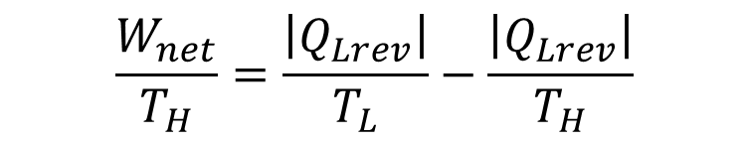
Cyclic Analysis of Reversible Engines
For a reversible engine with two adiabatic and two isothermal reversible processes:
$\oint{{\left(\frac{δQ}{T}\right)}_{rev}=\frac{Q_{Hrev}}{T_{H}}−\frac{\left|Q_{Lrev}\right|}{T_{L}}}$ = 0
$$\frac{\left|Q_{Lrev}\right|+W_{net}}{T_{H}}−\frac{\left|Q_{Lrev}\right|}{T_{L}}=0$$
$$\frac{W_{net}}{T_{H}}=\frac{\left|Q_{Lrev}\right|}{T_{L}}−\frac{\left|Q_{Lrev}\right|}{T_{H}}$$
Reversible and irreversible are designed for same value of W_{net}

Slide 32
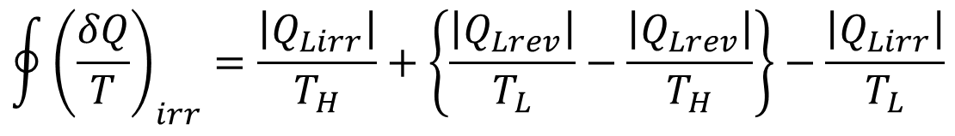
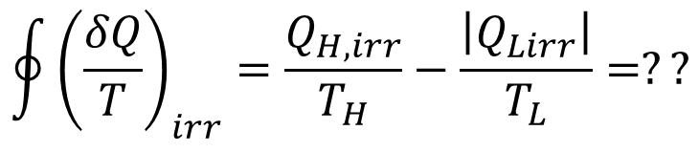
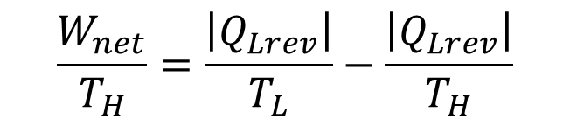
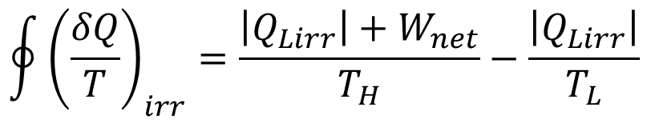
Cyclic Analysis Irreversible Engines
$$\oint{{\left(\frac{δQ}{T}\right)}_{irr}=\frac{Q_{H, irr}}{T_{H}}−\frac{\left|Q_{Lirr}\right|}{T_{L}}}=??$$
$$\oint{{\left(\frac{δQ}{T}\right)}_{irr}=\frac{\left|Q_{Lirr}\right|+W_{net}}{T_{H}}−\frac{\left|Q_{Lirr}\right|}{T_{L}}}$$
$$\frac{W_{net}}{T_{H}}=\frac{\left|Q_{Lrev}\right|}{T_{L}}−\frac{\left|Q_{Lrev}\right|}{T_{H}}$$
For same W_{net}
$$\oint{{\left(\frac{δQ}{T}\right)}_{irr}=\frac{\left|Q_{Lirr}\right|}{T_{H}}+\left\{\frac{\left|Q_{Lrev}\right|}{T_{L}}−\frac{\left|Q_{Lrev}\right|}{T_{H}}\right\}−\frac{\left|Q_{Lirr}\right|}{T_{L}}}$$

Slide 33

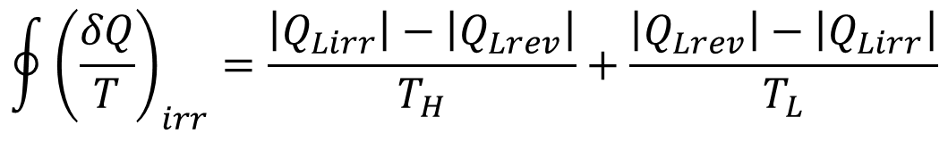
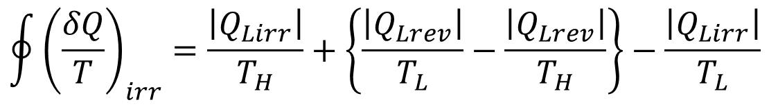
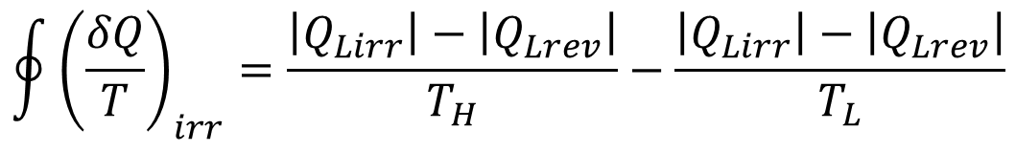
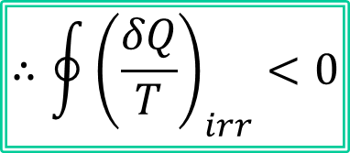
Comparison Cyclic Analyses
$$\oint{{\left(\frac{δQ}{T}\right)}_{irr}=\frac{\left|Q_{Lirr}\right|}{T_{H}}+\left\{\frac{\left|Q_{Lrev}\right|}{T_{L}}−\frac{\left|Q_{Lrev}\right|}{T_{H}}\right\}−\frac{\left|Q_{Lirr}\right|}{T_{L}}}$$
$$\oint{{\left(\frac{δQ}{T}\right)}_{irr}=\frac{\left|Q_{Lirr}\right|−\left|Q_{Lrev}\right|}{T_{H}}+\frac{\left|Q_{Lrev}\right|−\left|Q_{Lirr}\right|}{T_{L}}}$$
$$\oint{{\left(\frac{δQ}{T}\right)}_{irr}=\frac{\left|Q_{Lirr}\right|−\left|Q_{Lrev}\right|}{T_{H}}−\frac{\left|Q_{Lirr}\right|−\left|Q_{Lrev}\right|}{T_{L}}}$$
It is already known that
$$\left|Q_{L,irr}\right|>\left|Q_{Lrev}\right|$$
$$∴\oint{{\left(\frac{δQ}{T}\right)}_{irr}<0}$$

Slide 34
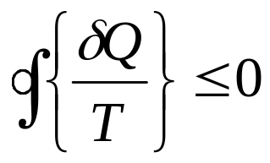
Clausius Inequality
The fist step in consideration of the property we call entropy is to accept the inequality of Clausius,
Therefore, all machines in this universe :
The inequality of Clausius is a corollary or a consequence of the second law of thermodynamics.
It is valid for all possible cycles, including both reversible and irreversible heat engines and refrigerators.

Slide 35
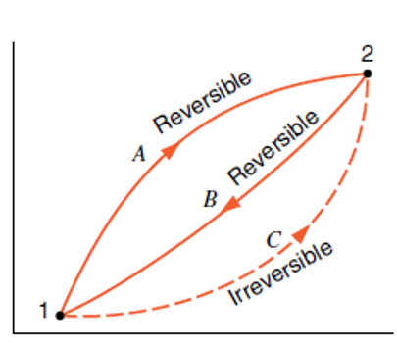
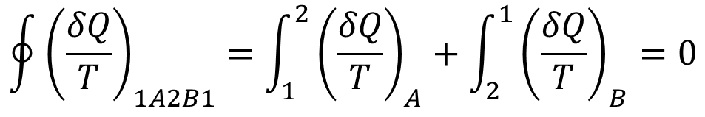
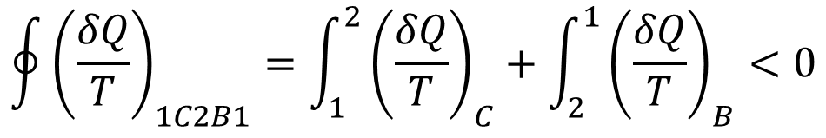
Entropy Change Of A Control Mass During An Irreversible Process
The cycle made up of the reversible processes A and B is a reversible cycle.
Therefore, we can write
$$\oint{{\left(\frac{δQ}{T}\right)}_{1A2B1}=\int_{1}^{2}{{\left(\frac{δQ}{T}\right)}_{A}}+\int_{2}^{1}{{\left(\frac{δQ}{T}\right)}_{B}}=0}$$
The cycle made of the irreversible process C and the reversible process B is an irreversible cycle.
Therefore, for this cycle the inequality of Clausius may be applied, giving the result
$$\oint{{\left(\frac{δQ}{T}\right)}_{1C2B1}=\int_{1}^{2}{{\left(\frac{δQ}{T}\right)}_{C}}+\int_{2}^{1}{{\left(\frac{δQ}{T}\right)}_{B}}<0}$$

Slide 36
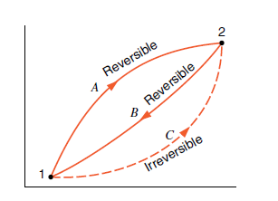

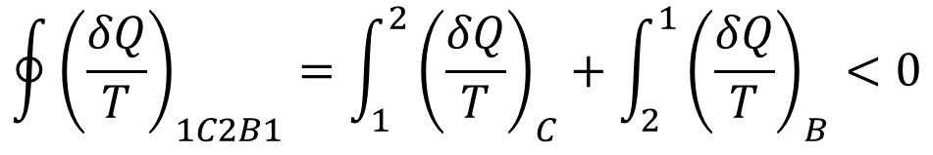
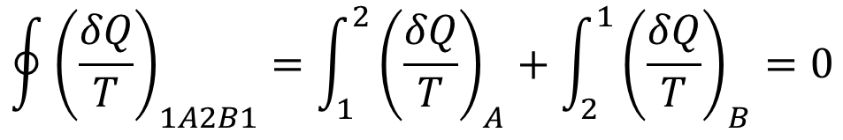
Entropy Change Of A Control Mass During An Irreversible Process
For reversible cycle 1A2B1:
$$\oint{{\left(\frac{δQ}{T}\right)}_{1A2B1}=\int_{1}^{2}{{\left(\frac{δQ}{T}\right)}_{A}}+\int_{2}^{1}{{\left(\frac{δQ}{T}\right)}_{B}}=0}$$
For reversible cycle 1C2B1:
$$\oint{{\left(\frac{δQ}{T}\right)}_{1C2B1}=\int_{1}^{2}{{\left(\frac{δQ}{T}\right)}_{C}}+\int_{2}^{1}{{\left(\frac{δQ}{T}\right)}_{B}}<0}$$
Subtracting the second equation from the first and rearranging, we have

Slide 37

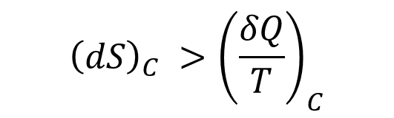
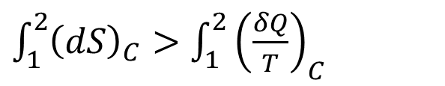


Entropy Change Of A Control Mass During An Irreversible Process
Using the definition of entropy
$$\int_{1}^{2}{{\left(\frac{δQ}{T}\right)}_{A}}=\int_{1}^{2}{{\left(dS\right)}_{A}}$$
$$\int_{1}^{2}{{\left(dS\right)}_{C}}=\int_{1}^{2}{{\left(dS\right)}_{A}}$$
$\int_{1}^{2}{{\left(dS\right)}_{C}}>$ $\int_{1}^{2}{{\left(\frac{δQ}{T}\right)}_{C}}$
$${\left(dS\right)}_{C} >{\left(\frac{δQ}{T}\right)}_{C}$$
As path C was irreversible, the general result is:
$$dS ≥\frac{δQ}{T}$$
For any process

Slide 38

Entropy Change Of A Control Mass During An Irreversible Process
$$dS ≥\frac{δQ}{T}$$
Above equation holds when δQ > 0, when δQ =0, and when δQ < 0.
If δQ is negative, the entropy of the system will tend to decrease as a result of the heat transfer.
However, the entropy of surroundings will tend to increase.
As a total the influence of irreversibility is still to increase the entropy of the system and surroundings.

