Slide 1

Reconciliation Between Axioms of Caratheodory’s & Kelvin Principle
P M V Subbarao
Professor
Mechanical Engineering Department
I I T Delhi
Thermal limits meet geometric logic!!!

Slide 2

Need to show that (KP) ⇒ (AC).
To do this we need only show that if (AC) is false, then (KP) is also.
first prove that (KP) ⇒ (AC) for reversible processes.

Slide 3
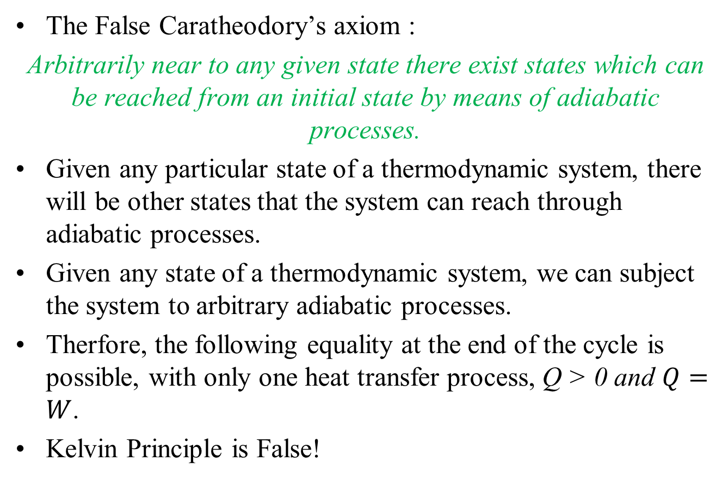
If Caratheodory’s axiom is False, Kelvin’s Principle also False
The False Caratheodory’s axiom :
Arbitrarily near to any given state there exist states which can be reached from an initial state by means of adiabatic processes.
Given any particular state of a thermodynamic system, there will be other states that the system can reach through adiabatic processes.
Given any state of a thermodynamic system, we can subject the system to arbitrary adiabatic processes.
Therfore, the following equality at the end of the cycle is possible, with only one heat transfer process, Q > 0 and $Q=W$.
Kelvin Principle is False!

Slide 4
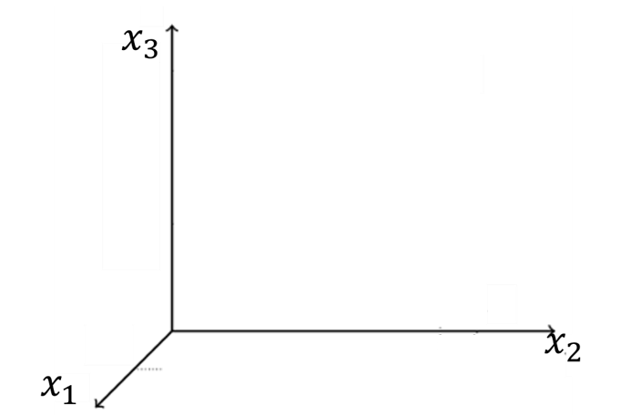
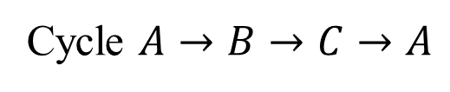





If Caratheodory’s axiom is False, Kelvin’s Principle also False
Synthesize an arbitrary cycle which falsifies axiom of Caratheodory.
Prove that this cycle will have 100% Efficiency.
Cycle $A→B→C→A$
C
$$\left(x_{1}^{∗},x_{2}^{∗},x_{3}^{∗∗}\right)$$
$$Q_{in}=0$$
A
$$Q_{in}>0$$
$$Q_{in}=0$$
$$\left(x_{1}^{∗},x_{2}^{∗},x_{3}^{∗}\right)$$
B

Slide 5
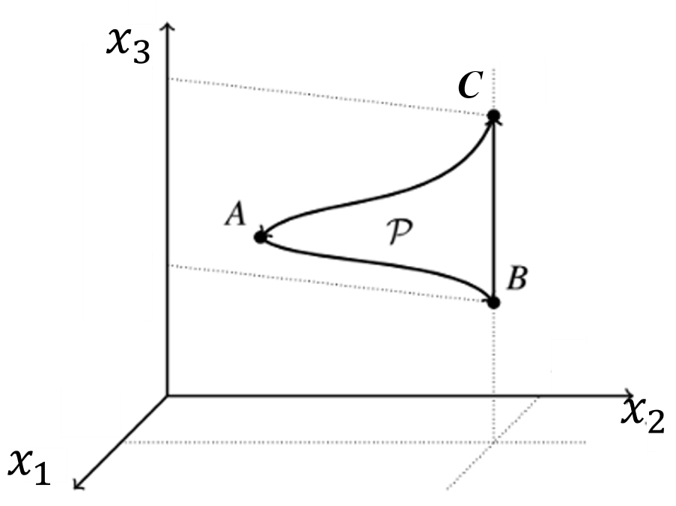

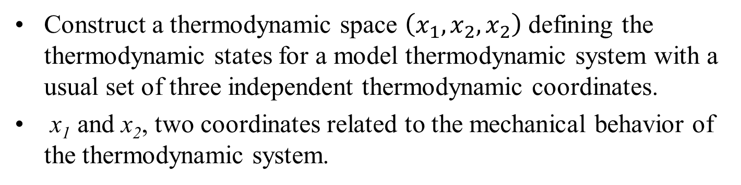
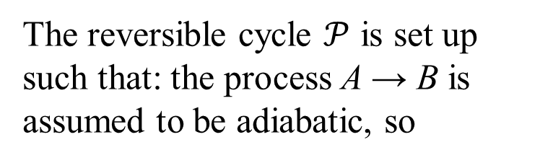
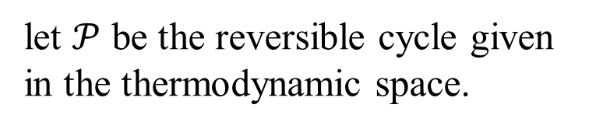
Reversible cycle constructed by intermediate processes in thermodynamic space.
Construct a thermodynamic space $\left(x_{1}, x_{2},x_{2}\right)$ defining the thermodynamic states for a model thermodynamic system with a usual set of three independent thermodynamic coordinates.
x₁ and x₂, two coordinates related to the mechanical behavior of the thermodynamic system.
let $𝒫$ be the reversible cycle given in the thermodynamic space.
The reversible cycle $𝒫$ is set up such that: the process A → B is assumed to be adiabatic, so
$$Q_{A→B}=0$$

Slide 6
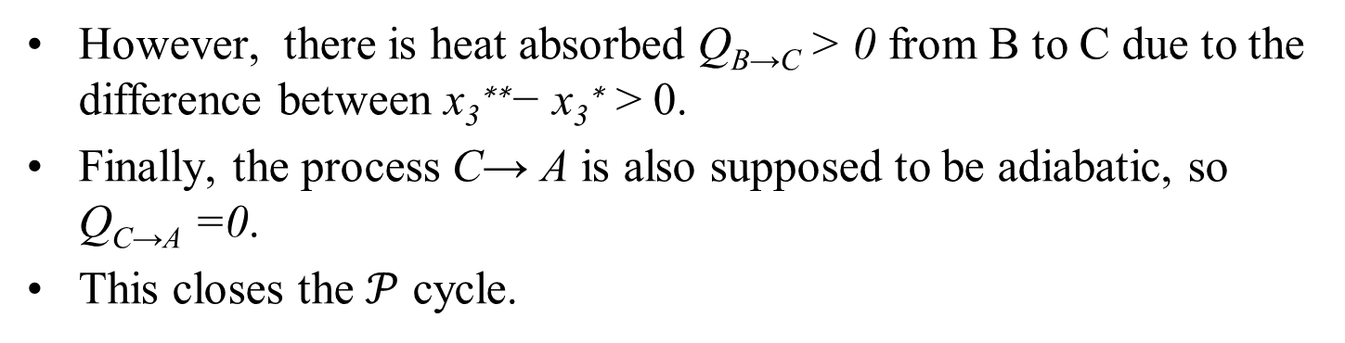
Reversible cycle constructed by intermediate processes in thermodynamic space.
x₃**
The process B → C does not escape the line that preserves the values of x₁ = x₁∗ and x₂ = x₂∗.
There is no work involved from B to C.
x₃*
However, there is heat absorbed Q_{B→C} > 0 from B to C due to the difference between x₃∗∗− x₃∗ > 0.
Finally, the process C→ A is also supposed to be adiabatic, so Q_{C→A} =0.
This closes the $𝒫$ cycle.

Slide 7
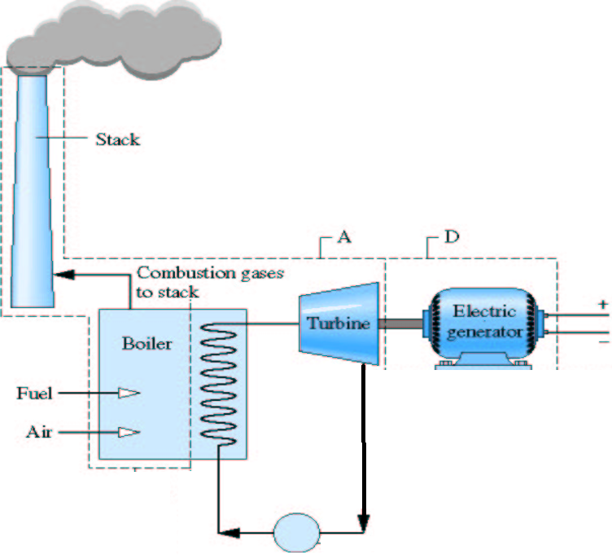

Cycle Executed by Connected Control Volumes in Space
h
C
B
A
p
v

Slide 8
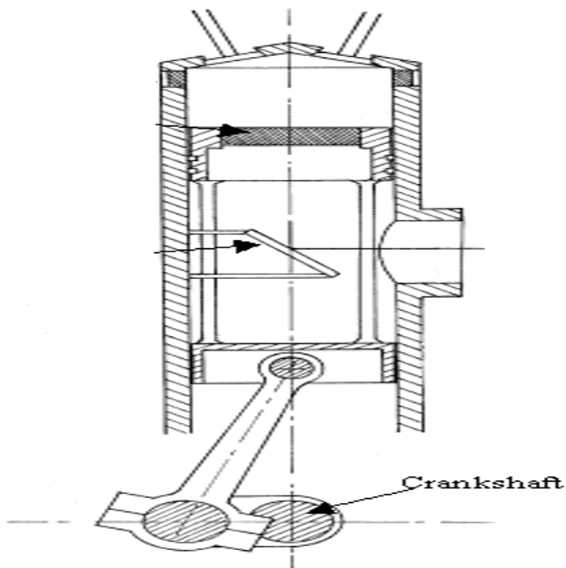
Cycle Executed by Control Mass in Time
u
C
B
p
A
v

Slide 9
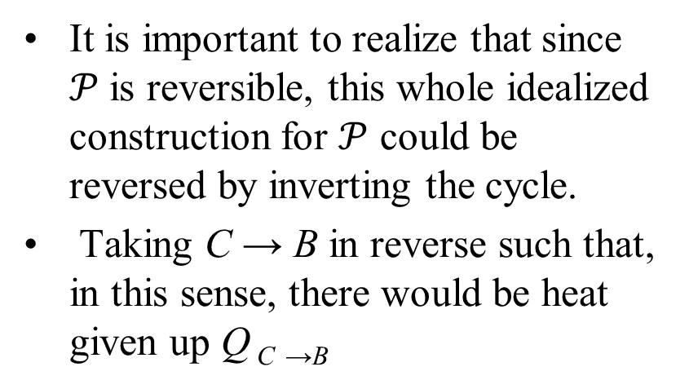
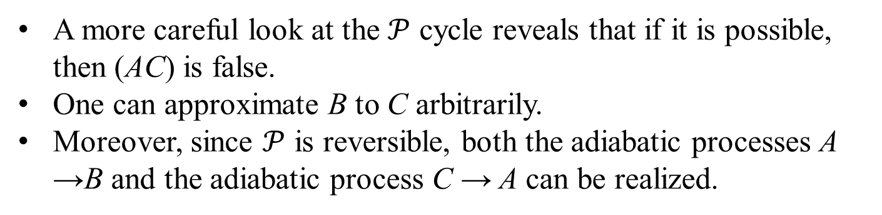
Reversible cycle constructed by intermediate processes in thermodynamic space.
It is important to realize that since $𝒫$is reversible, this whole idealized construction for $𝒫$ could be reversed by inverting the cycle.
Taking C → B in reverse such that, in this sense, there would be heat given up Q _{C} _{→B}
x₃**
x₃*
A more careful look at the $𝒫$ cycle reveals that if it is possible, then (AC) is false.
One can approximate B to C arbitrarily.
Moreover, since $𝒫$ is reversible, both the adiabatic processes A →B and the adiabatic process C → A can be realized.

Slide 10

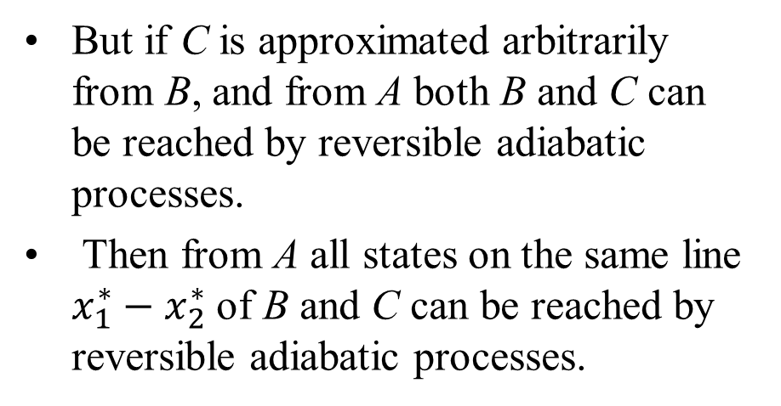
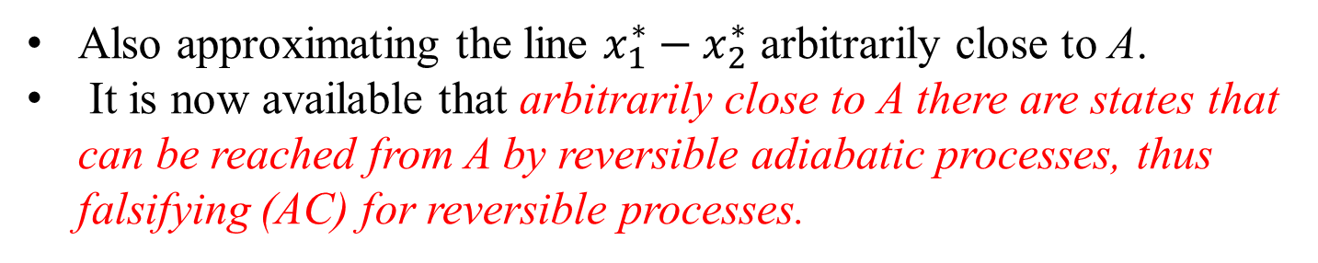
Reversible cycle constructed by intermediate processes in thermodynamic space.
But if C is approximated arbitrarily from B, and from A both B and C can be reached by reversible adiabatic processes.
Then from A all states on the same line $x_{1}^{∗}−x_{2}^{∗}$ of B and C can be reached by reversible adiabatic processes.
x₃**
x₃*
Also approximating the line $x_{1}^{∗}−x_{2}^{∗}$ arbitrarily close to A.
It is now available that arbitrarily close to A there are states that can be reached from A by reversible adiabatic processes, thus falsifying (AC) for reversible processes.

Slide 11
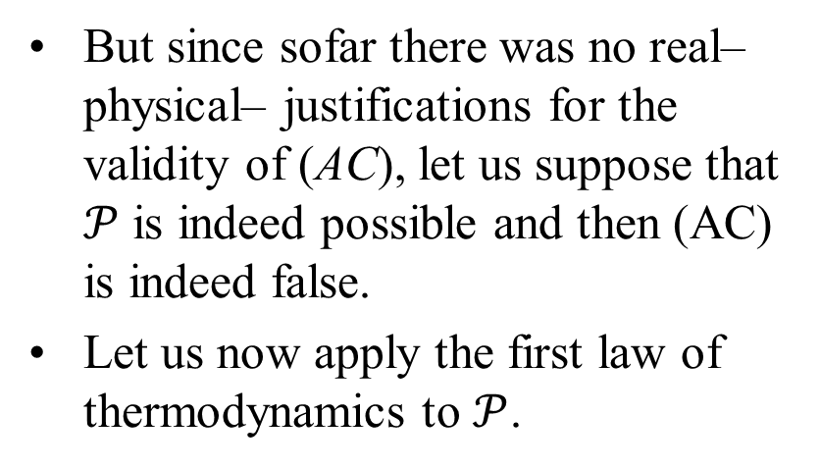
Reversible cycle constructed by intermediate processes in thermodynamic space.
But since sofar there was no real– physical– justifications for the validity of (AC), let us suppose that $𝒫$ is indeed possible and then (AC) is indeed false.
Let us now apply the first law of thermodynamics to $𝒫$.
x₃**
x₃*
This gives, thanks to the additivity of energy:
$$∆E_{𝒫}=∆E_{A→B}+∆E_{B→C}+∆E_{C→A}$$
Since $𝒫$ is a thermodynamic cycle, $∆E_{𝒫}=0$.

Slide 12

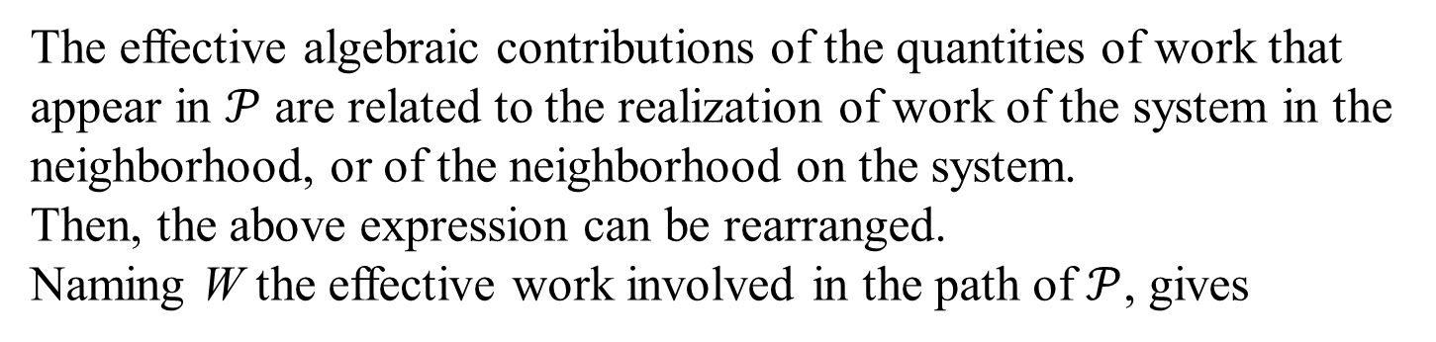

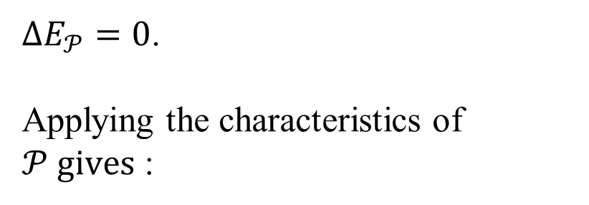
Reversible cycle constructed by intermediate processes in thermodynamic space.
$∆E_{𝒫}=0$.
Applying the characteristics of $𝒫 gives$ :
x₃**
x₃*
$$−W_{A→B}+Q_{B→C}+W_{C→A}=0$$
The effective algebraic contributions of the quantities of work that appear in $𝒫$ are related to the realization of work of the system in the neighborhood, or of the neighborhood on the system.
Then, the above expression can be rearranged.
Naming W the effective work involved in the path of $𝒫$, gives
$$W_{𝒫}=Q_{B→C}$$

Slide 13
KP vs AC : Reversible Cycle
If (AC) is false, falsifies (KP).
For reversible processes (KP) ⇒(AC).
However, irreversible processes also to be studied in Advanced thermodynamics.
These processes are, as the name suggests, processes that can only be realized in a single “time direction”.

Slide 14
KP vs AC : Irreversible Cycle
If (AC) is false, falsifies (KP) for an irreversible cycle too????
The intermediate situations of the system in an irreversible process are not equilibrium situations.

Slide 15
Irreversible Cycle
It is well known that real world process are irreversible processes.
The intermediate situations of the system in an irreversible process are not equilibrium situations.
These processes that can only be realized in a single “(time) direction”.
Conceputally, thermodynamics is a theory that studies only equilibrium situations.
However, a qualitative analysis of irreversible processes is always possible as thermodynamic initial and final situations of irreversible processes are always equilibrium situations.
Finally, the true meaning of entropy and second law of thermodynamics emerges from irreversible processes.

