Slide 1

Reconciliation Between Statements of Second Law
P M V Subbarao
Professor
Mechanical Engineering Department
I I T Delhi
From the heat engines of Kelvin and Clausius to the integrating factors of Carathéodory!!!

Slide 2

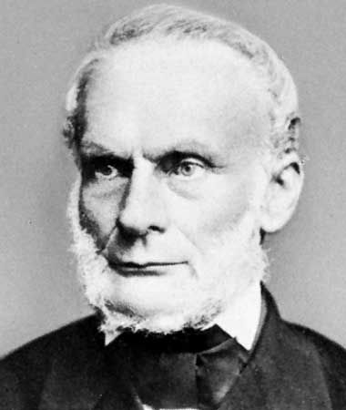
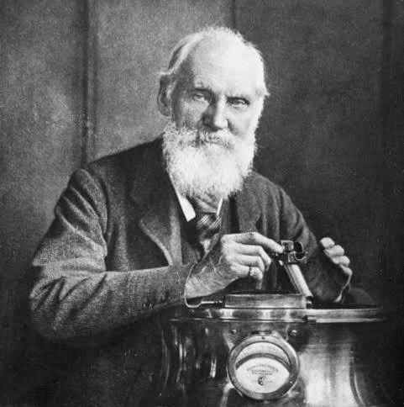
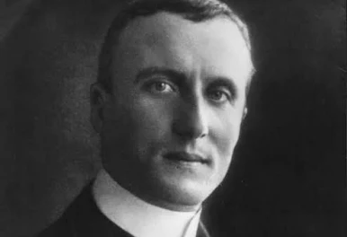

Nature of Universe

Slide 3
Performance of Reversible Machines
HTR (Source)
HTR (Source)
HTR (Source)
Q_{HEC}
Q_{HES}
Q_{HER}
W_{out,C}
W_{out,S}
W_{out,R}
Carnot Engine
Regenerative Engine
Stirling Engine
Q_{LEC}
Q_{LECS}
Q_{LER}
LTR (Sink)
LTR (Sink)
LTR (Sink)

Slide 4
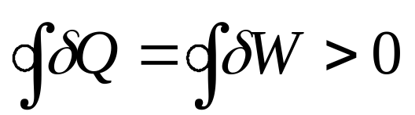
Kelvin Planks postulate
“It is impossible to construct a heat engine which produces no effect other than the extraction of heat from a single source and the production of an equivalent amount of work”
On the other side
It is possible to construct a heat engine which produces no effect other than the extraction of work from a single source and the production of an equivalent amount of heat

Slide 5
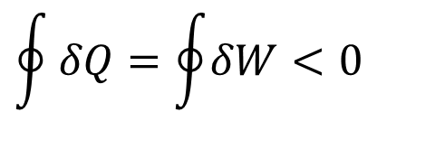
Thermodynamic Model for a General Heat Pump
HTR (Sink)
Q_{out}
$$\oint{δQ=\oint{δW<0}}$$
W_{in}
HP
First law:
W_{in} = Q_{in} - Q_{out}
Q_{in}
LTR (Source)

Slide 6
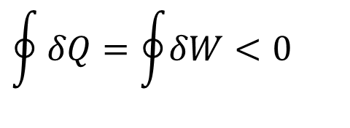
Clausius postulate
$$\oint{δQ=\oint{δW<0}}$$
“Heat cannot pass spontaneously (unaided) from a region of lower temperature to a region of higher temperature”
However,
Heat can pass spontaneously (unaided) from a region of higher temperature to a region of lower temperature

Slide 7
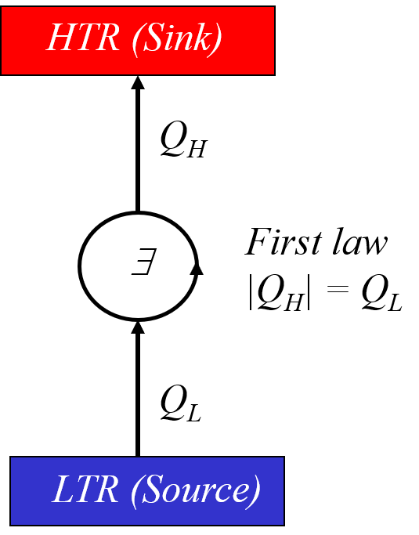
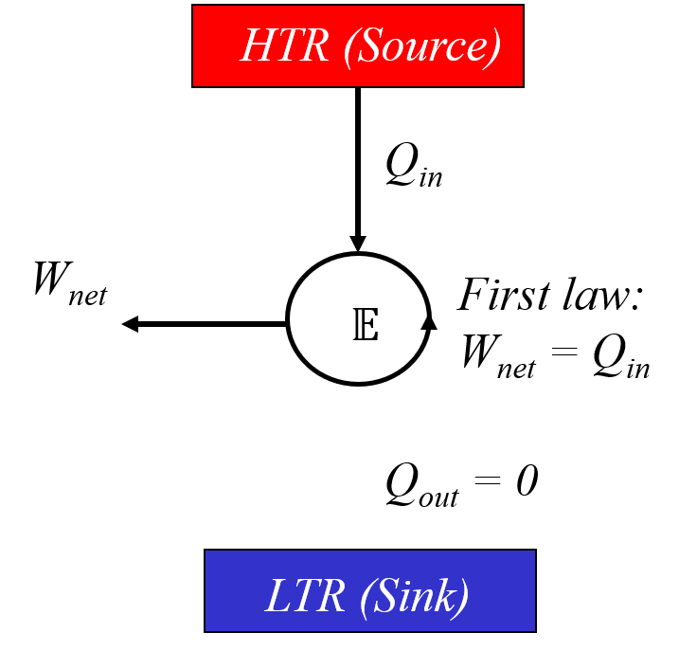
The Impossible Machines

Slide 8
Discussion of Second Law
It is impossible to construct a heat engine with 100% efficiency.
It is impossible to construct a heat pump or refrigerator with infinite COP.
Both are negative statements.
They cannot be proved.
They will remain correct till they are disproved.
Violation of Kelvin Planks statement leads to violation of Clasius statement and vice versa.

Slide 9
Violation of any one Statement led to violation of the other automatically!
Reconciliation between Two Statements of Second Law

Slide 10
Perpetual Heat Pump Model
HTR (Source)
Q_{H}
Let us assume this is possible
First law
|Q_{H} | = Q_{L}
∃
Q_{L}
LTR (Sink)

Slide 11

Perpetual Heat Pump & A Realistic Heat Engine
HTR
HTR
Q_{HE}
Q_{HP}
Wnet
E
∃
Q_{LE}
Q_{LP}
LTR
LTR

Slide 12
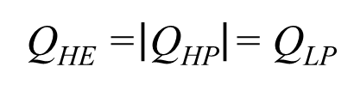

Compound Heat Engine
HTR
Q_{HE} =$\left|\text{Q}\text{HP}\right|$= Q_{LP}
Q_{HE}
Q_{HP}
Wnet
E
∃
Q_{LE} = Q_{LP}-Wnet
Q_{LP}
Q_{LE}
LTR (Sink)
LTR (Sink)

Slide 13
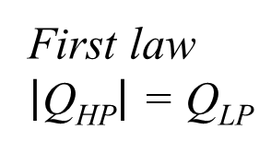
Perpetual Motion Machine II : Compound Engine
HTR (Sink)
Q_{HE} = Q_{LP}
Q_{HE}
Q_{HP}
First law
$\left|\text{Q}\text{HP}\right|$ = Q_{LP}
Wnet
E
∃
Q_{LP}
Q_{LE} = Q_{LP}-W_{net}
Q_{LP} - Q_{LE}=W_{net}
LTR (Source)

Slide 14
Perpetual Motion Machine II : Compound Engine
Q_{HE} = Q_{HP}
Q_{HE}
Q_{HP}
Wnet
E
∃
Q_{LP}
Q_{LE} = Q_{LP}-Wnet
Q_{LC}=Q_{LP} - Q_{LE}=Wnet
LTR (Source)

Slide 15
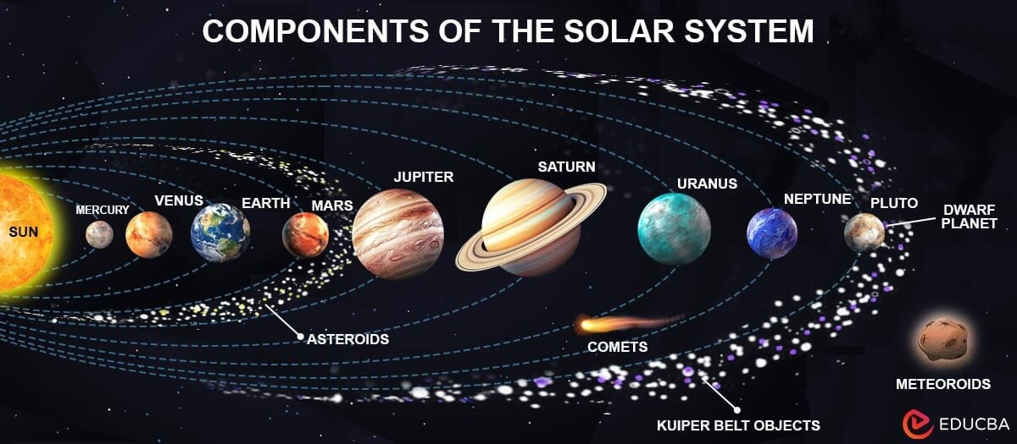
A Compound Reversible Machine
HTR (Sink)
Q_{HE} = Q_{HP}
Both Reversible Pump and
Engine having same performance
Q_{HE}
Q_{HP}
η_{rev} = 1/β_{rev}
Wnet
E
∃
Perpetual Motion Machine III
Q_{LP}
Q_{LE}
Q_{LE} = Q_{LP}
LTR (Source)

Slide 16
The Second Law of Thermodynamics and Religion: Conceptual Parallels and Entrenchment in Doctrine
Douglas C. Youvan
The Second Law of Thermodynamics, much like religious doctrines, provides a fundamental framework for understanding the universe.
The parallels between these seemingly disparate domains underscore the universal human quest for meaning and order in the cosmos.

Slide 17
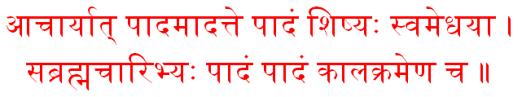
The Law of Learning
one fourth from the teacher, one fourth from own intelligence,
one fourth from classmates, and one fourth only with time.
Mahabharath

Slide 18
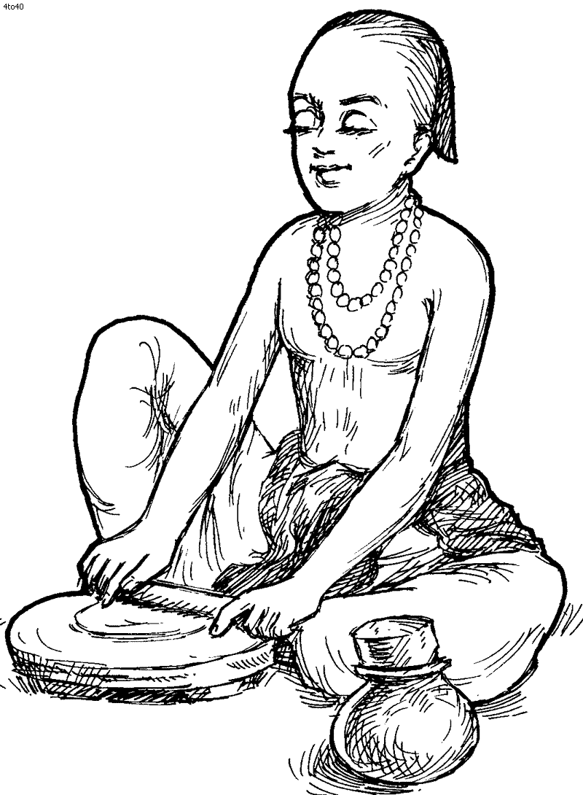
The Law of Bhakti
Ram Swaroop Tumhar, Bachan Agochar Budhi Per
Abigat Akath Apaar, Neti Neti Nit Nigam Kahe.
Sant Tulsi Das

Slide 19
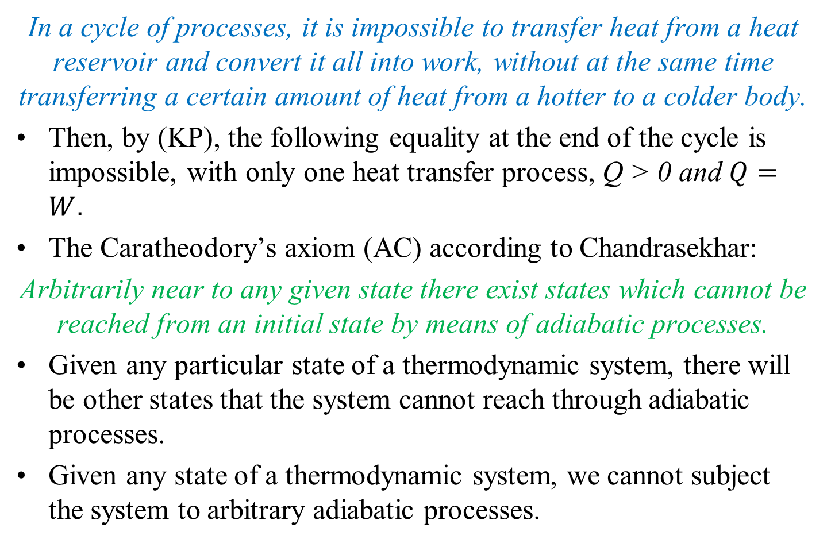
Kelvin’s principle (KP), according to Chandrasekhar
In a cycle of processes, it is impossible to transfer heat from a heat reservoir and convert it all into work, without at the same time transferring a certain amount of heat from a hotter to a colder body.
Then, by (KP), the following equality at the end of the cycle is impossible, with only one heat transfer process, Q > 0 and $Q=W.$
The Caratheodory’s axiom (AC) according to Chandrasekhar:
Arbitrarily near to any given state there exist states which cannot be reached from an initial state by means of adiabatic processes.
Given any particular state of a thermodynamic system, there will be other states that the system cannot reach through adiabatic processes.
Given any state of a thermodynamic system, we cannot subject the system to arbitrary adiabatic processes.

Slide 20
Need to show that (KP) ⇒ (AC).
To do this we need only show that if (AC) is false, then (KP) is also.
first prove that (KP) ⇒ (AC) for reversible processes.

