Slide 1

Thermodynamic Cycles & Second Law Statements
P M V Subbarao
Professor
Mechanical Engineering Department
I I T Delhi
A Cyclic Approach to Explore Truths of Nature!!!

Slide 2

Thermodynamic Cycle : Mother of Entropy
Entropy was discovered by a somewhat circuitous path through the efficiency of heat engines.
A finding that in hindsight could appear serendipitous.
Were we just lucky to have discovered something so fundamental in this way?
Can it be seen directly that entropy as a state variable is contained in the structure of thermodynamics, without the baggage of heat engines?
Let us revise the Circuitous path….

Slide 3
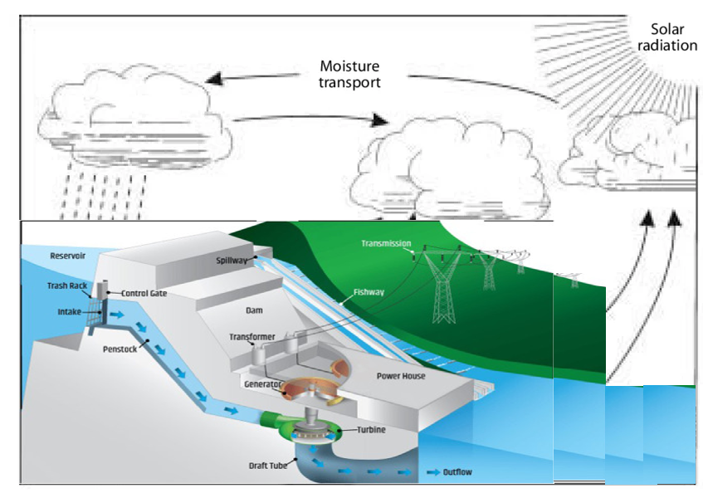
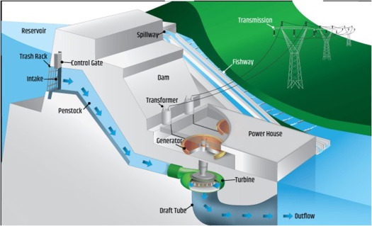
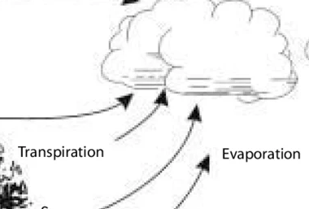
The Natural Adiabatic Open System as A Cycle
Q_{in}
Q_{out}
W_{in}

Slide 4
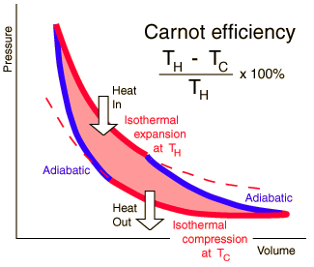
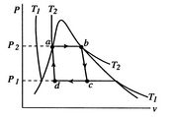

Carnot Cycle
1
2
4
3

Slide 5
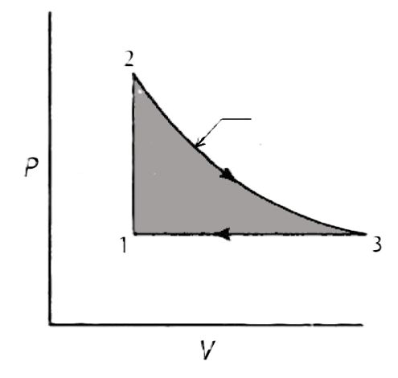
Lenoir Cycle vs Carnot Cycle
1
2
4
3

Slide 6
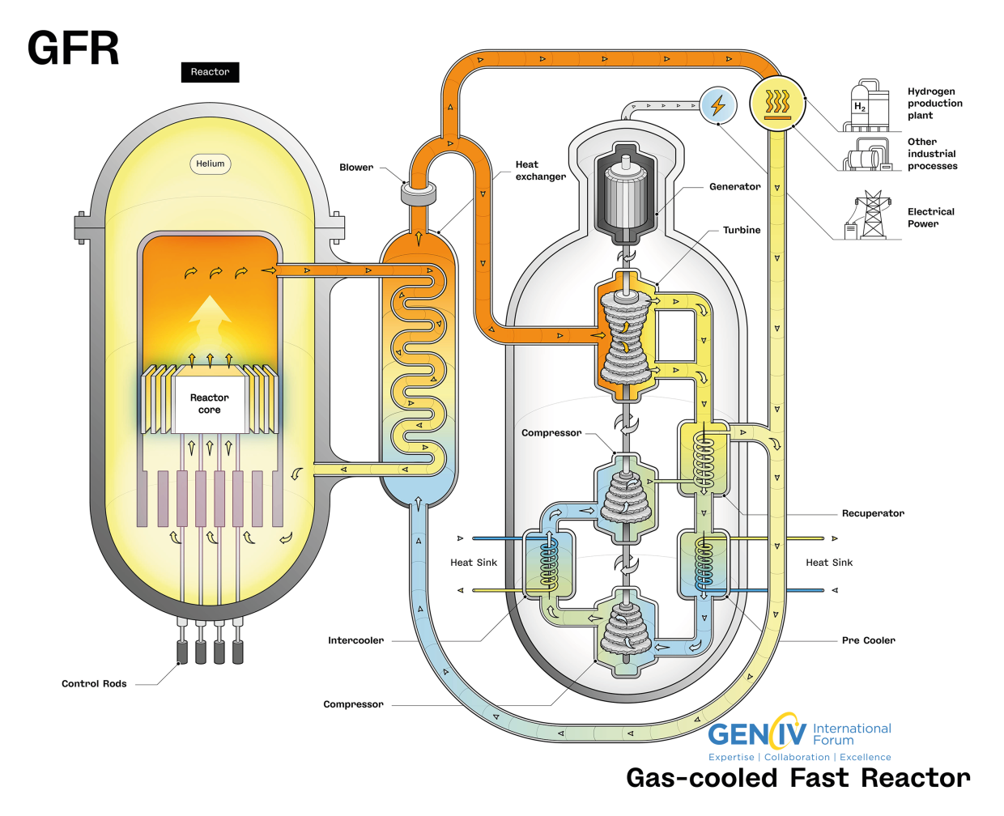
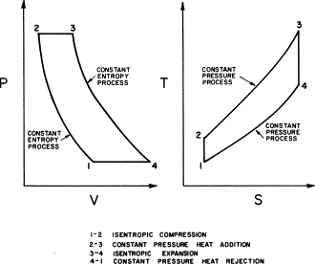
Brayton Cycle in 21st Century

Slide 7
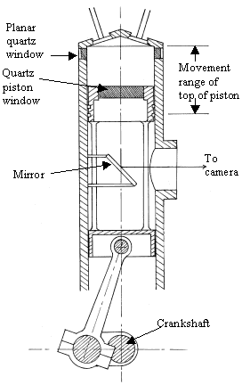
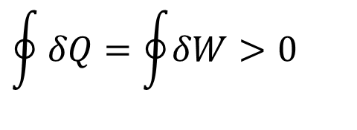
Reciprocating IC Engine : A Heat Engine
Q_{in}
Q_{out}
$$\oint{δQ=\oint{δW>0}}$$
W_{out}

Slide 8
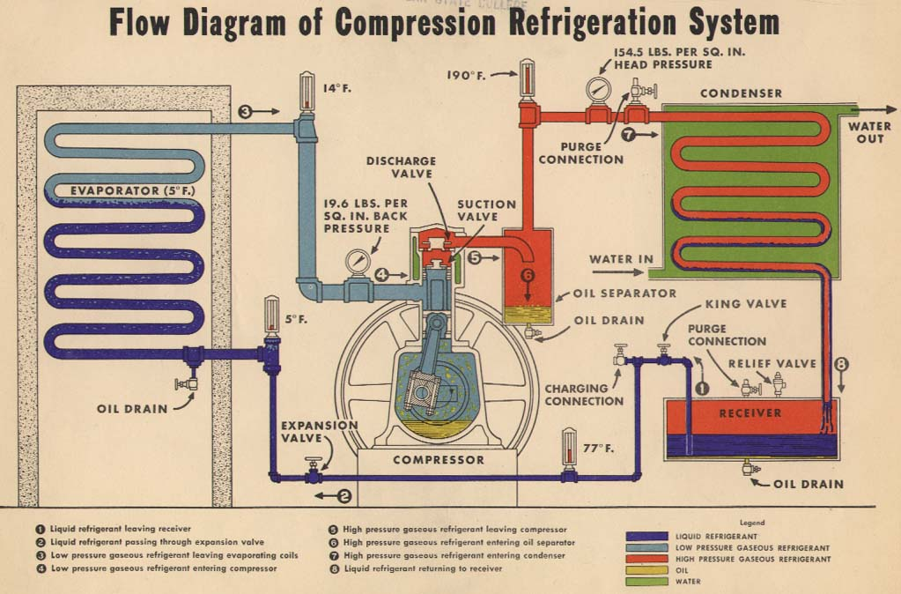
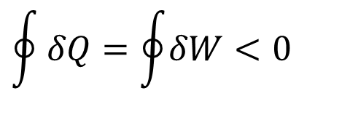
Refrigeration System : A Heat Pump
$$\oint{δQ=\oint{δW<0}}$$

Slide 9
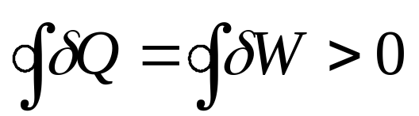
Thermodynamic Model for a General Heat Engine
High Temperature Reservoir (Source)
Q_{in}
W_{net}
HE
First law:
W_{net} = Q_{in} - Q_{out}
Q_{out}
Low Temperature Reservoir (Sink)

Slide 10
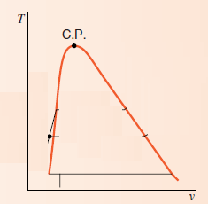

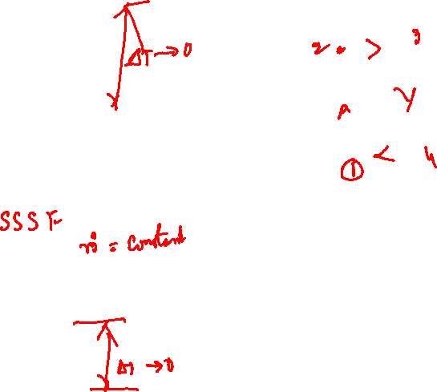
Carnot Engine using Control Volumes
HTR
Boiler
3
2
Compressor
Turbine
1
Condenser
4
LTR

Slide 11
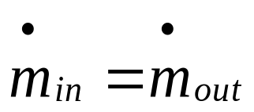
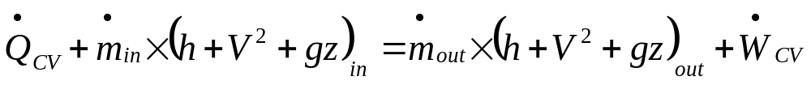
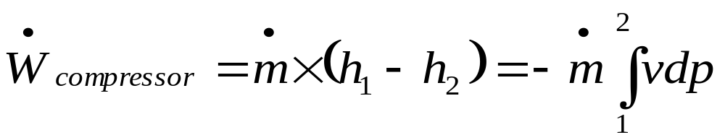

Compressor : Reversible Adiabatic Compression Process
1
2
SSSF: Conservation of mass
First Law :
No heat transfer, change in kinetic and potential energies are negligible

Slide 12
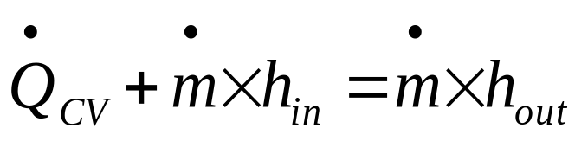
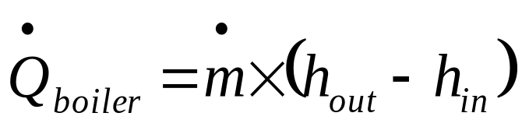
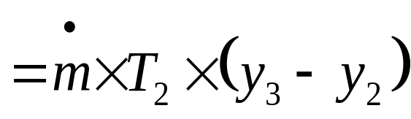
2 – 3 : Boiler: Isothermal Heating : T₃ = T₂
Q_{CV}
2
3
No work transfer, change in kinetic and potential energies are negligible
Αssuming a single fluid entering and leaving…

Slide 13
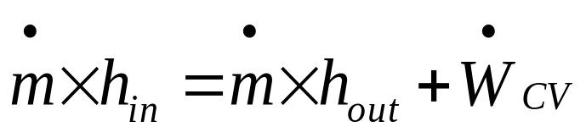
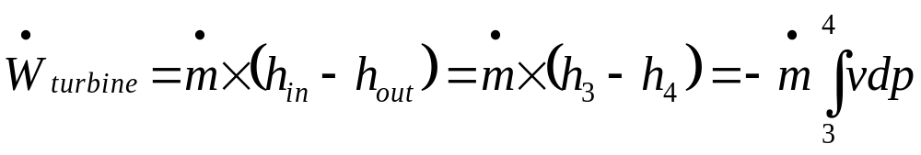
Turbine : Isentropic Process : s₄ = s₃
3
T
4
No heat transfer. Change in kinetic and potential energies are negligible

Slide 14
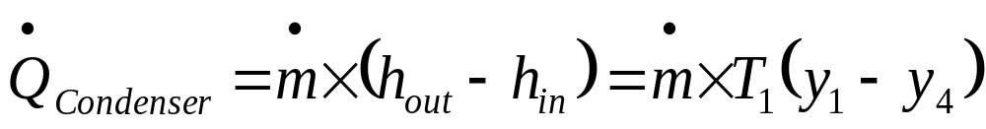
4 – 1 : Condenser : Isothermal Cooling : T₄= T₁
Q_{CV}
1
4
No work transfer, change in kinetic and potential energies are negligible
Αssuming a single fluid entering and leaving…

Slide 15
Analysis of Cycle
A Cycles is a Control Mass : Constant Mass Flow Rate
First law:
Σq_{i} = Σw_{i}
q_{b}+q_{c} = w_{t}+w_{c}
w_{net} = q_{net} = h₃-h₂ + (h₁-h₄) = T₂ (y₃-y₂) + T₁ (y₁-y₄)
T₂ (y₃-y₂) = T₂ Δy_{boiler} & T₁ (y₁-y₄) = T₁ Δy_{condenser}
w_{net} = q_{net} = h₃-h₂ + (h₁-h₄) = T₂ Δy_{boiler} + T₁ Δy_{condenser}
q_{boiler} = T₂ (y₃-y₂) = T₂ Δy_{boiler}

Slide 16
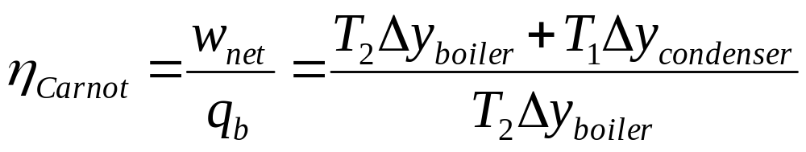
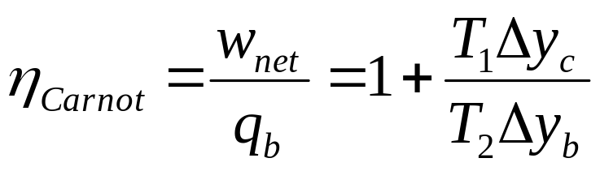
Figure of Merit for A Cycle
Efficiency of the cycle = net work/heat input
Δy is a change in a variable of a working fluid.
Different working fluid will have different values of Δy at same Temperatures.

Slide 17
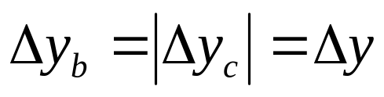
Geometrization of Thermodynamics
For a reversible cycle the curve 1– 2 must be parallel to curve 3– 4 !?!?!
For a reversible cycle the magnitude of Δy should be same at hot and cold reservoir conditions.

Slide 18
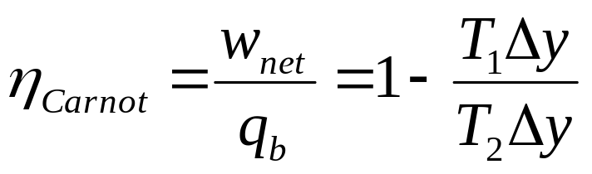
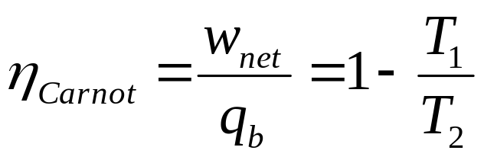
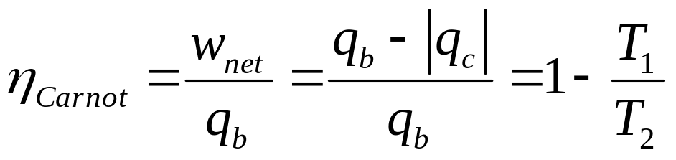
Figure of Merit for A Cycle
Efficiency of a Reversible Engine is independent of work fluid !!!!
Higher the temperature of heat addition, higher will be the efficiency.
Lower the temperature of heat rejection, higher will be the efficiency.

Slide 19
Performance of Reversible Machines
HTR (Source)
HTR (Source)
HTR (Source)
Q_{HEC}
Q_{HES}
Q_{HER}
W_{out,C}
W_{out,S}
W_{out,R}
Carnot Engine
Regenerative Engine
Stirling Engine
Q_{LEC}
Q_{LECS}
Q_{LER}
LTR (Sink)
LTR (Sink)
LTR (Sink)

Slide 20
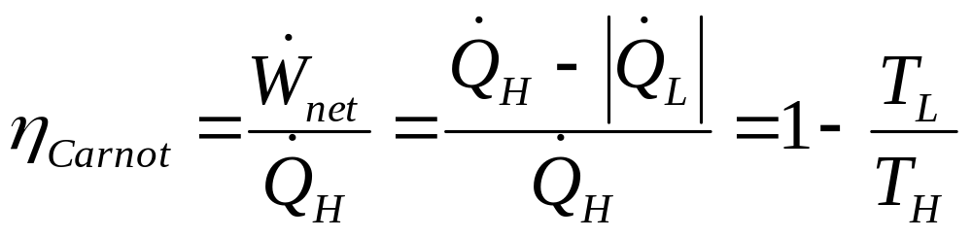
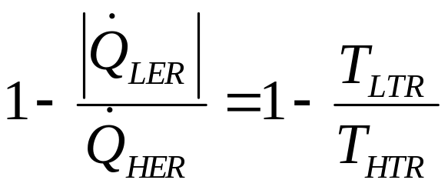
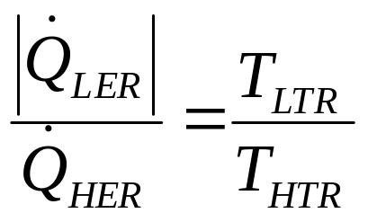
Further Algebra of A Reversible Engine Model
Use a generalized indices…

Slide 21
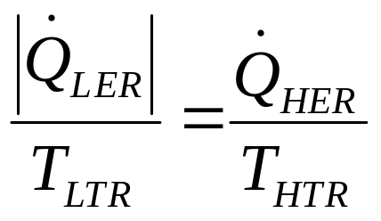
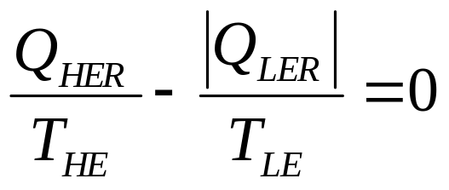
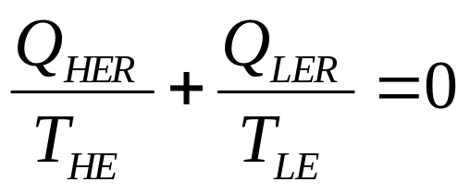
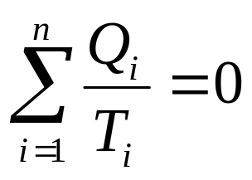
During a time duration τ
For any reversible cycle with n number heat transfer processes
Where, i shows i^{th} process and n is number of process in a cycle.
But Q is a path function and depends on process.

Slide 22
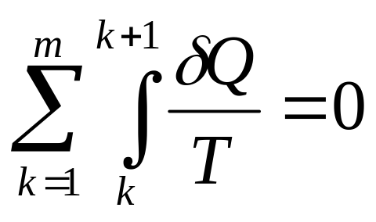
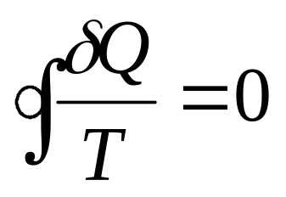
Therefore,
k is an initial state and k+1 is a final state.
m is the number state Points in a cycle.
Therefore for all reversible cycles.

Slide 23
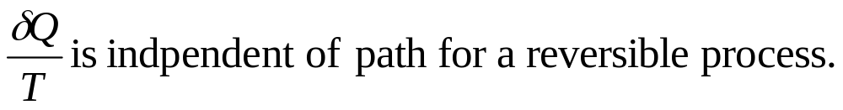
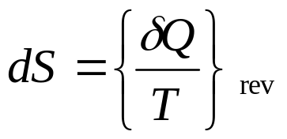
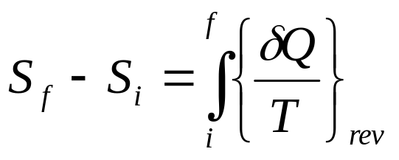
The cyclic Integral
Cyclic integral of this new quantity is zero!
Any quantity whose cyclic integral is zero is a property !
Therefore:
For a reversible process infinitesimal change in property is:
Boltzman named S as Entropy of a substance.
During a reversible process

Slide 24
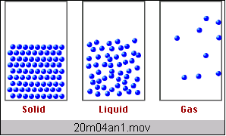
Entropy, S : A Measure of State of Matter
Sº (J/K•mol)
H₂O_{(liq)} 69.95
H₂O_{(gas)} 188.8
For a given substance
S _{(gaseous state)} > S _{(liquid state)} > S _{(solid state)}

Slide 25
Performance of Reversible Machines
HTR (Source)
HTR (Source)
HTR (Source)
Q_{HEC}
Q_{HES}
Q_{HER}
W_{out,C}
W_{out,S}
W_{out,R}
Carnot Engine
Regenerative Engine
Stirling Engine
Q_{LEC}
Q_{LECS}
Q_{LER}
LTR (Sink)
LTR (Sink)
LTR (Sink)

Slide 26
Kelvin Planks postulate
“It is impossible to construct a heat engine which produces no effect other than the extraction of heat from a single source and the production of an equivalent amount of work”
On the other side
It is possible to construct a heat engine which produces no effect other than the extraction of work from a single source and the production of an equivalent amount of heat

