Slide 1

Formulation of Caratheodory’s Axioms for A Control Volume
P M V Subbarao
Professor & Head
Mechanical Engineering Department
I I T Delhi
Real Systems are truly Control Volumes!!!

Slide 2

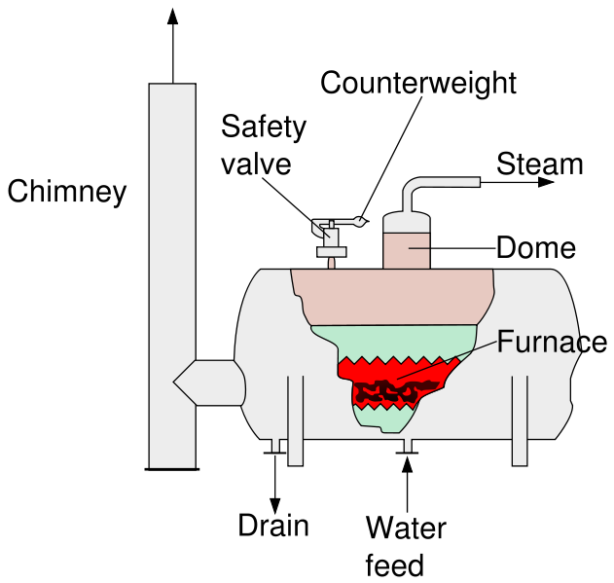
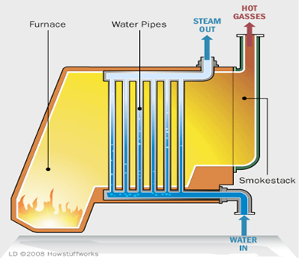

Experimental Evidence:
Increasing unit Temperature of A Pure Substance (water)
Fire Tube Boiler (CM)
Water Tube Boiler (CV)
$${Why Q}_{CV}>Q_{CM} ????$$

Slide 3
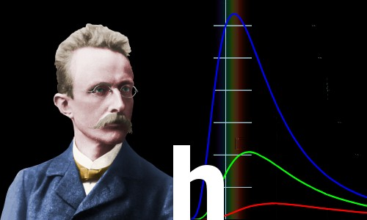
Max Karl Ernst Ludwig Planck:
A Free Thinker
Max Planck changed physics and our cognizance of the world forever
Hermann Müller taught his receptive young student how to visualize the laws of physics in his mind – a vital weapon in the armory of the great physicists

Slide 4
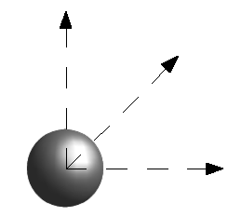

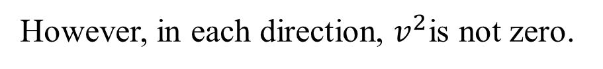
Internal (Microscopic) Energy : Monatomic Ideal Gas
Fundamental classification of energy is only potential or kinetic energy.
Internal energy must be a microscopic form of these fundamental forms.
For an ideal monatomic gas, the translational kinetic energy of the linear motion of the "hard sphere" type atoms contributes to Internal Energy, U.
Instantaneous magnitude of velocity
Average
Velocity=0
fluctuation
around
average
velocity
$$v_{atom}\left(t\right)$$
time
However, in each direction, $v^{2}$is not zero.
This is a peculiar velocity!

Slide 5
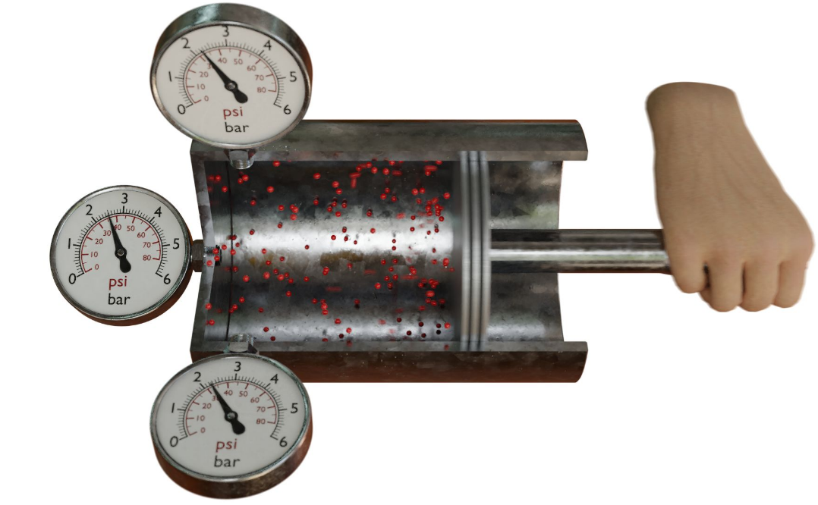
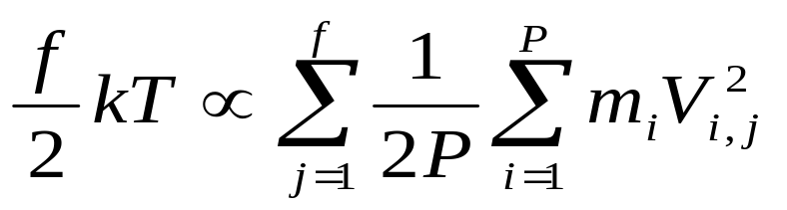
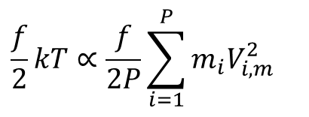
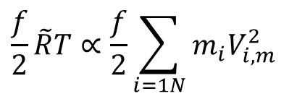
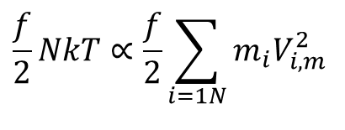
Temperature and Microscopic Kinetic Energy: Boltzmann Equation by Maxwell
For a substance inside (non-flowing) a system:
If atoms/molecules of a substance possess f number of DoF,
Law of equipartition of energy:
$$\frac{f}{2}kT∝\frac{f}{2P}\sum_{i=1}^{P}{m_{i}V_{i,m}^{2}}$$
For one kmol of gas with law of equipartition of energy:
$$\frac{f}{2}NkT∝\frac{f}{2}\sum_{i=1N}{m_{i}V_{i,m}^{2}}$$
$$\frac{f}{2}\tilde{R}T∝\frac{f}{2}\sum_{i=1N}{m_{i}V_{i,m}^{2}}$$

Slide 6
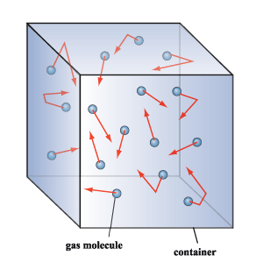

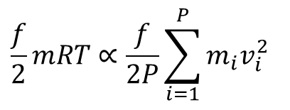
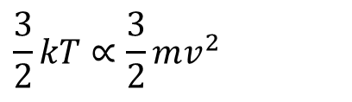
Temperature and Microscopic Kinetic Energy: Boltzmann Equation by Maxwell
For a gas inside (non-flowing) a system of mass m:
If there are P number of atoms/molecules and each atom/molecule of a substance possess f number of DoF:
Law of equipartition of energy:
For single atom of an inert gas in a CM:
$$\frac{f}{2}mRT∝\frac{f}{2P}\sum_{i=1}^{P}{m_{i}v_{i}^{2}}$$
$$\frac{3}{2}kT∝\frac{3}{2}mv^{2}$$
Is it valid for a flow System?

Slide 7

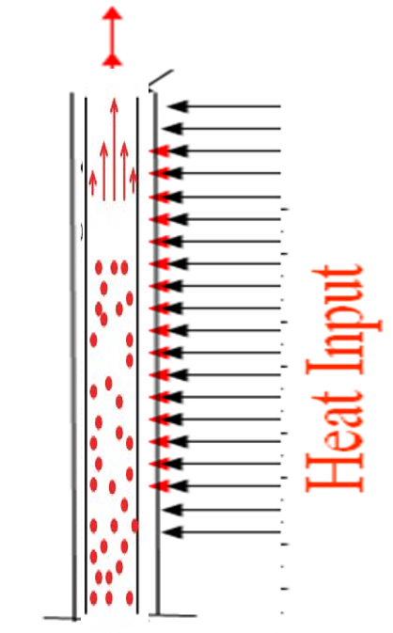

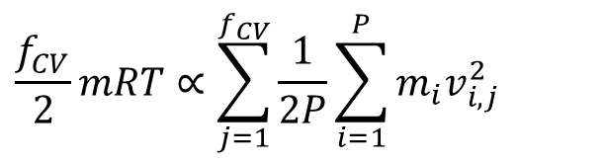

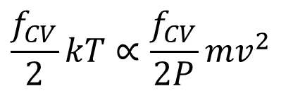
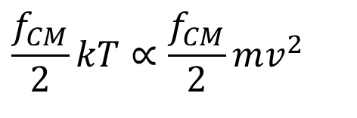

Simplified Control Volume to Quantify Change in Enthalpy
For single molecule of any gas in a CM:
$$\frac{f_{CM}}{2}kT∝\frac{f_{CM}}{2}mv^{2}$$
For single molecule of any gas in a CV:
$$\frac{f_{CV}}{2}kT∝\frac{f_{CV}}{2P}mv^{2}$$
Co-equal of Caratheodory’s (Rankine’s) U is H (Ethalpy).
$$f_{CV}>f_{CM}$$
Degrees of freedom of a molecule in CV is always higher than that of CM!
$$\frac{f_{CV}}{2}mRT∝\sum_{j=1}^{f_{CV}}{\frac{1}{2P}\sum_{i=1}^{P}{m_{i}v_{i,j}^{2}}}$$
Degrees of freedom of a molecule in CV is always higher than that of CM!
$$f_{CV}−f_{CM}=2$$

Slide 8
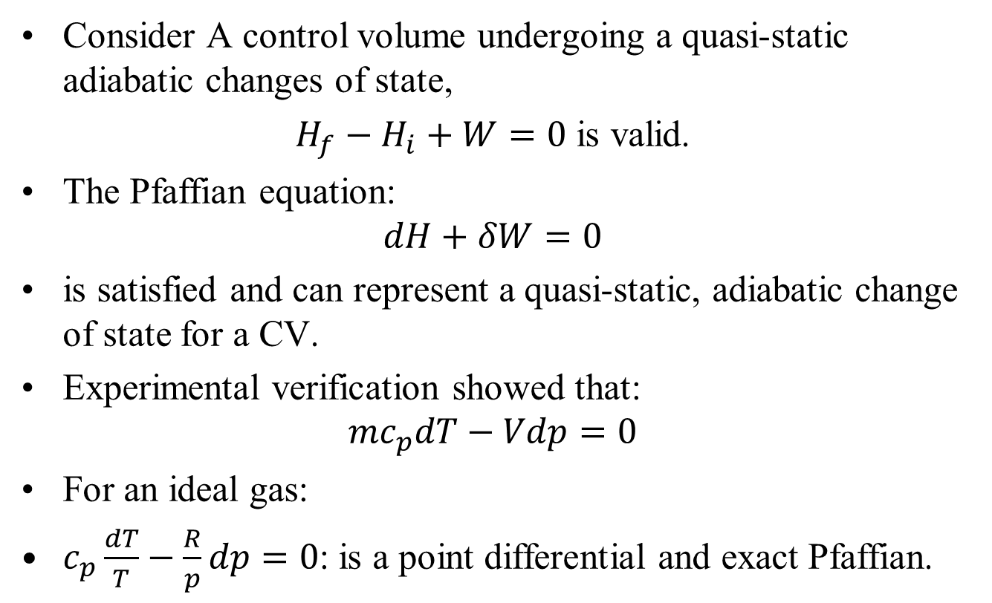
First Law Model for A Control Volume
Consider A control volume undergoing a quasi-static adiabatic changes of state,
$H_{f}−H_{i}+W=0$ is valid.
The Pfaffian equation:
$$dH+δW=0$$
is satisfied and can represent a quasi-static, adiabatic change of state for a CV.
Experimental verification showed that:
$${mc}_{p}dT−Vdp=0$$
For an ideal gas:
$c_{p}\frac{dT}{T}−\frac{R}{p}dp=0$: is a point differential and exact Pfaffian.

Slide 9



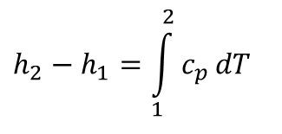
Simplified Control Volume to Quantify Change in Enthalpy
Consider a Steady flow of homogeneous phase of a substance flowing through a frictionless pipe.
No change in other forms of energy, except total microscopic energy.
For and infinitesimal process:
$$δq=dh−vdp$$
$$δq=dh$$
Establish a constant pressure heat transfer process using fire.
Note down the temperature change due to heating.
$$δq=dh=f\left(T\right)$$
$$h_{2}−h_{1}=\int_{1}^{2}{c_{p}}dT$$
C_{p} Constant Pressure Specific Heat

Slide 10

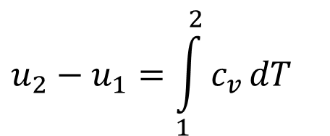
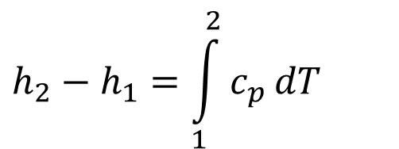

Quantification of Changes in Internal Energy & Enthalpy
Change in specific internal energy of any substance in a CM during any process 1--2:
$$u_{2}−u_{1}=\int_{1}^{2}{c_{v}}dT$$
c_{v} Constant Volume Specific Heat
Change in Enthalpy of any substance in A CV during any process 1--2 :
$$h_{2}−h_{1}=\int_{1}^{2}{c_{p}}dT$$
c_{p} Constant Pressure Specific Heat
$$f_{CV}−f_{CM}=2$$
$$c_{p}−c_{v}=R$$
Change in Enthalpy is realized only for flowing systems.

Slide 11




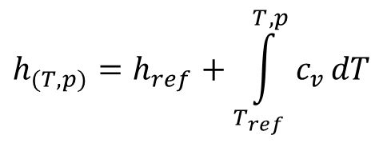
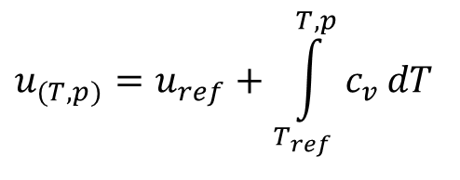
Models for Internal Energy & Enthalpy
$$u_{(T,p)}=u_{ref}+\int_{T_{ref}}^{T,p}{c_{v}}dT$$
$$u_{(T,p)}=u_{ref}+Δu$$
$$h_{(T,p)}=h_{ref}+\int_{T_{ref}}^{T,p}{c_{v}}dT$$
$$h_{(T,p)}=h_{ref}+Δh$$
For solid & many liquids:
$$pv≈0$$
$$∴h≈u$$

Slide 12
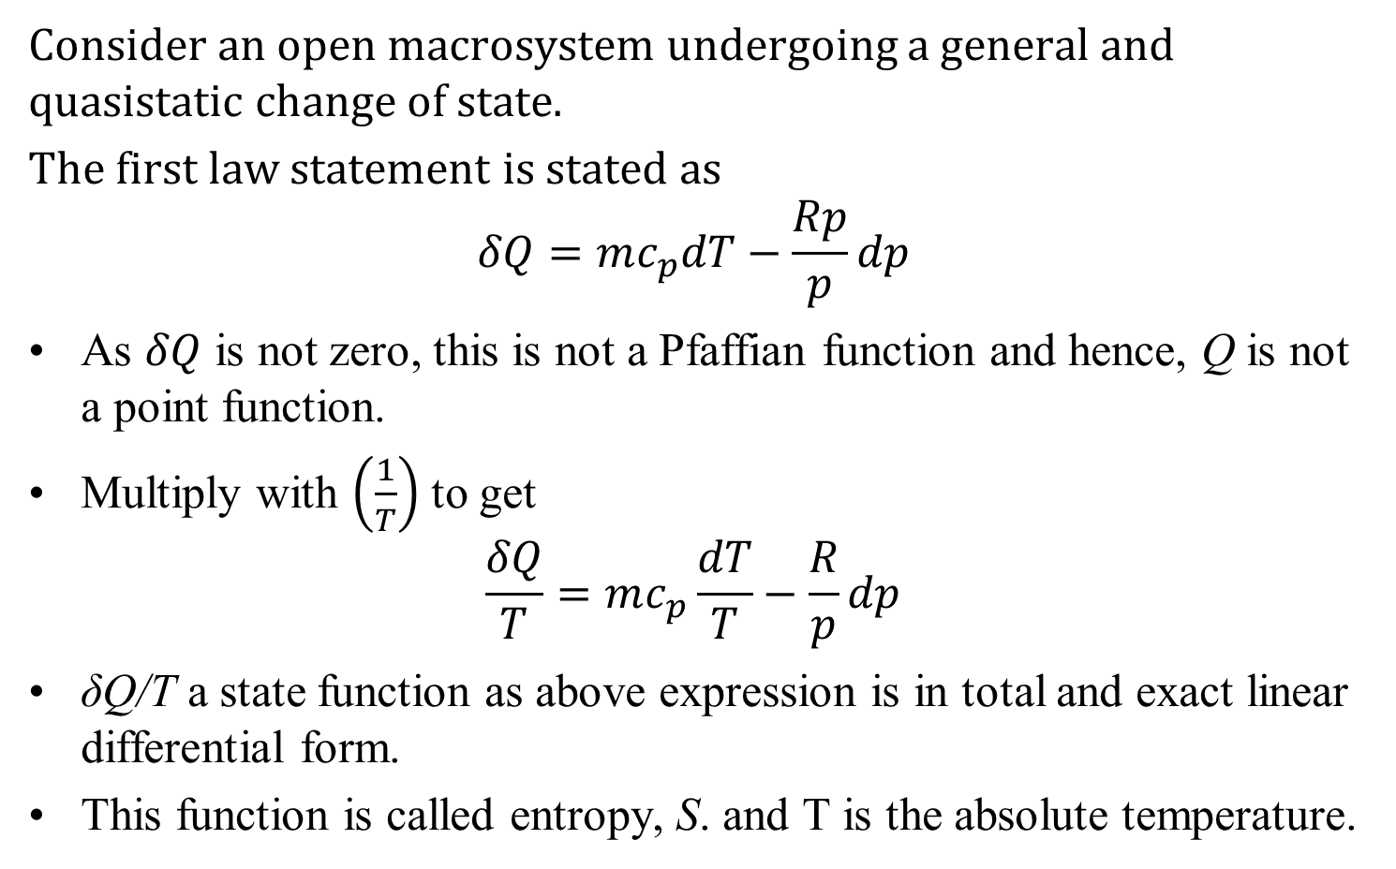
General transformation of an ideal gas in a Control Volume
Consider an open macrosystem undergoing a general and quasistatic change of state.
The first law statement is stated as
$$δQ=mc_{p}dT−\frac{Rp}{p}dp$$
As $δQ$ is not zero, this is not a Pfaffian function and hence, Q is not a point function.
Multiply with $\left(\frac{1}{T}\right)$ to get
$$\frac{δQ}{T}=mc_{p}\frac{dT}{T}−\frac{R}{p}dp$$
δQ/T a state function as above expression is in total and exact linear differential form.
This function is called entropy, S. and T is the absolute temperature.

Slide 13
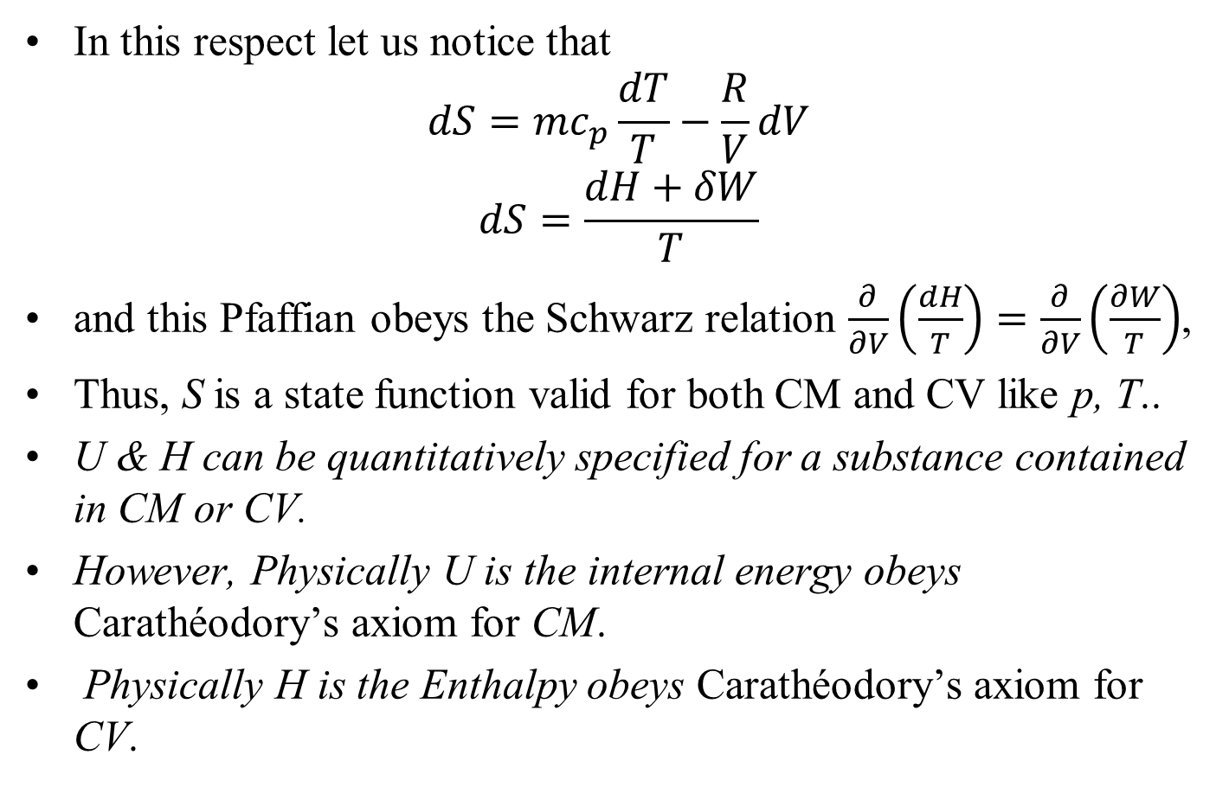

Carathéodory’s Definition of Entropy for A CV
In this respect let us notice that
$$dS=mc_{p}\frac{dT}{T}−\frac{R}{V}dV$$
$$dS=\frac{dH+δW}{T}$$
and this Pfaffian obeys the Schwarz relation $\frac{∂}{∂V}\left(\frac{dH}{T}\right)=\frac{∂}{∂V}\left(\frac{∂W}{T}\right)$,
Thus, S is a state function valid for both CM and CV like p, T..
U & H can be quantitatively specified for a substance contained in CM or CV.
However, Physically U is the internal energy obeys Carathéodory’s axiom for CM.
Physically H is the Enthalpy obeys Carathéodory’s axiom for CV.

Slide 14
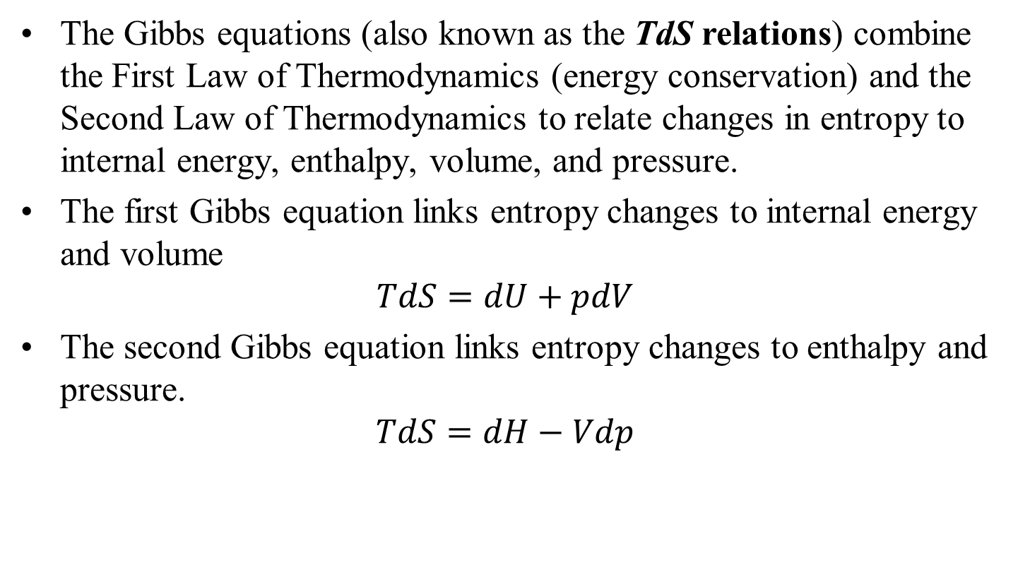
Carathéodory’s Definition of Entropy for A General System
The Gibbs equations (also known as the TdS relations) combine the First Law of Thermodynamics (energy conservation) and the Second Law of Thermodynamics to relate changes in entropy to internal energy, enthalpy, volume, and pressure.
The first Gibbs equation links entropy changes to internal energy and volume
$$TdS=dU+pdV$$
The second Gibbs equation links entropy changes to enthalpy and pressure.
$$TdS=dH−Vdp$$

Slide 15
Cyclic Device: A single system or a group of thermodynamic CVs, which are responsible for execution of thermodynamic cycle by a pure substance.

Slide 16
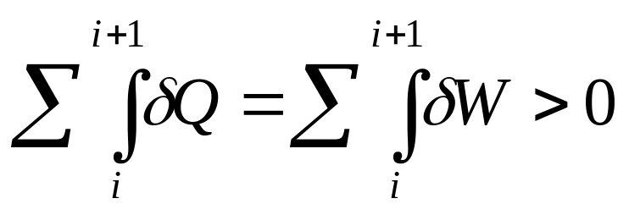
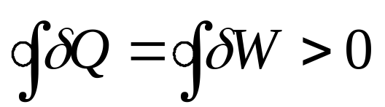
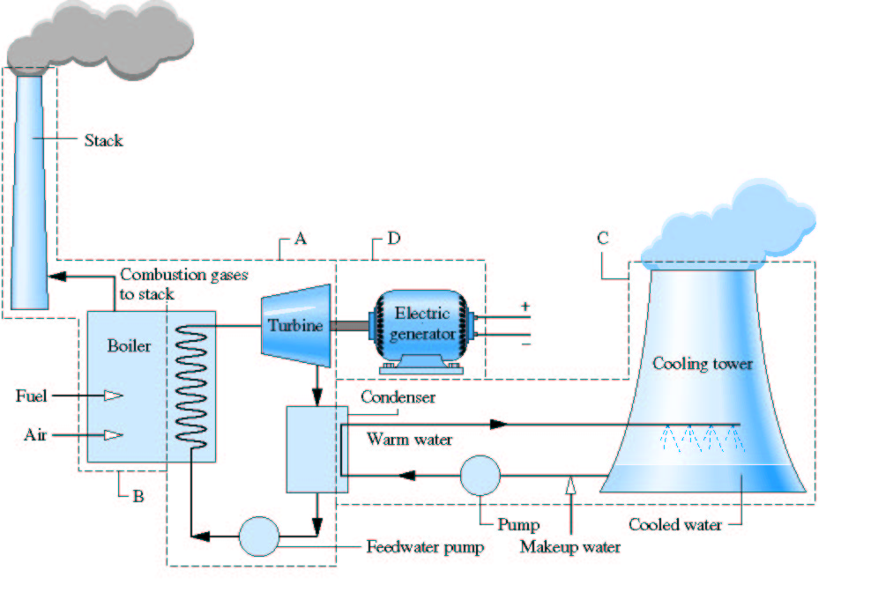
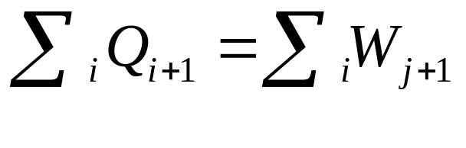
Steam Power Plant: A Heat Engine
W_{out}
Q_{out}
Q_{in}
W_{in}

Slide 17
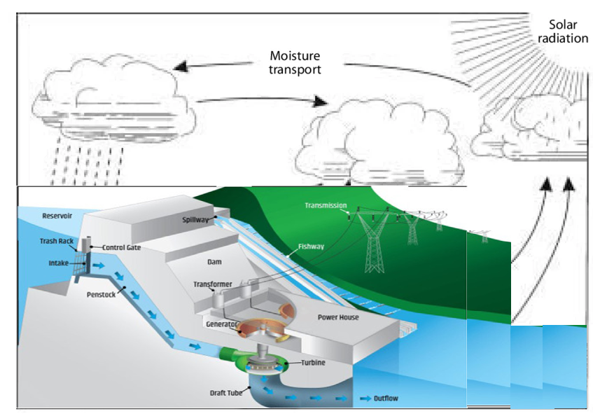
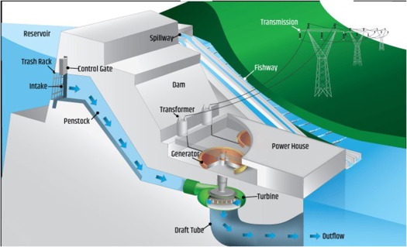
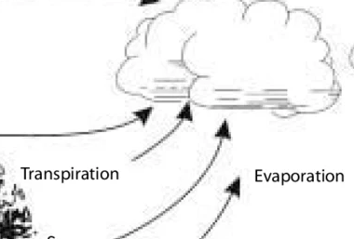
The Natural Adiabatic Open System as A Cycle
Q_{in}
Q_{out}
W_{in}

Slide 18

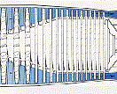


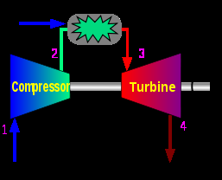
Turbojet Engine: A Heat Engine
Q_{in}
Q_{out}
W_{out}

Slide 19
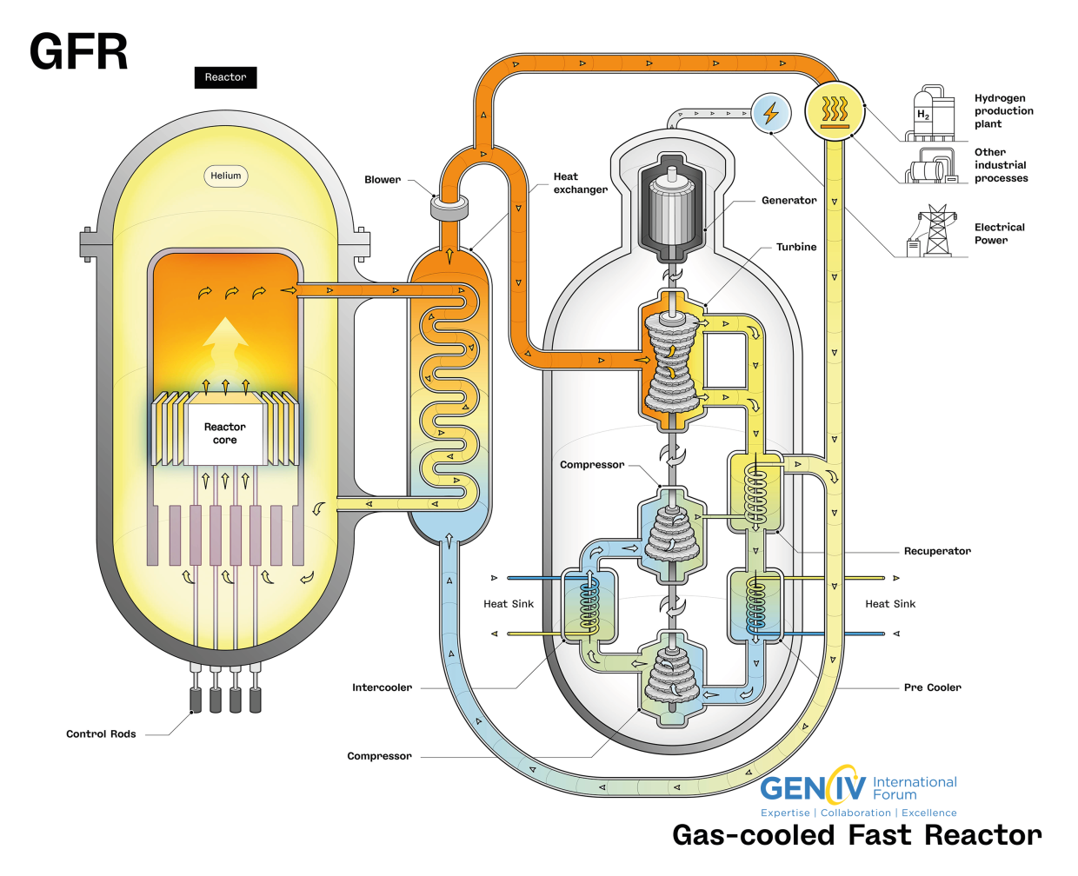
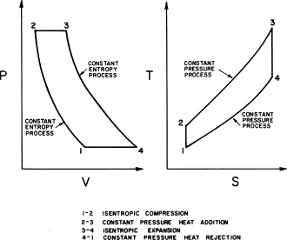
Brayton Cycle in 21st Century

Slide 20
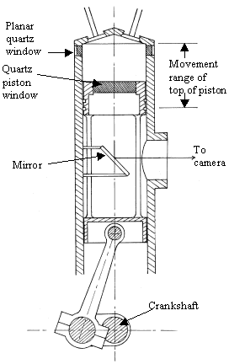
Reciprocating IC Engine : A Heat Engine
Q_{in}
Q_{out}
W_{out}

Slide 21
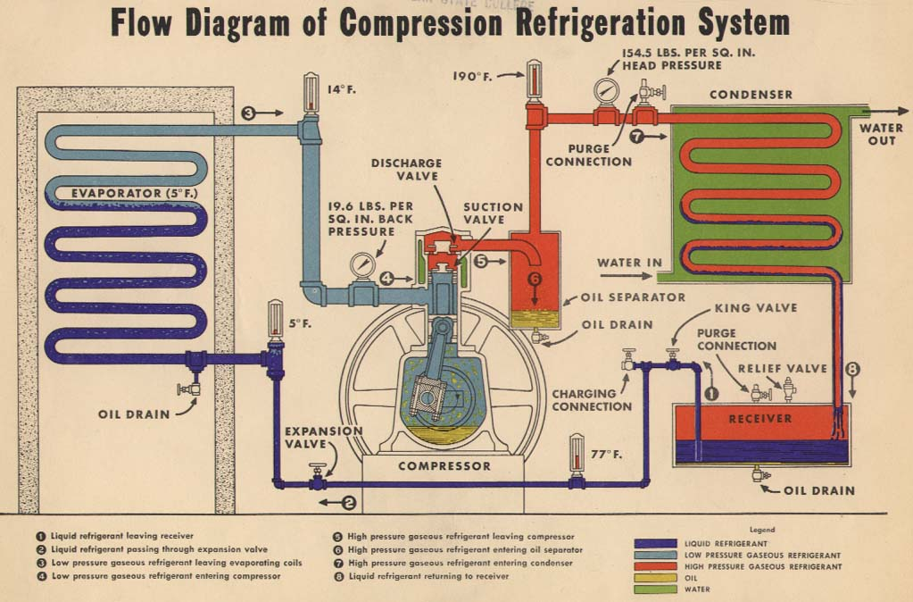
Refrigeration System : A Heat Pump

Slide 22
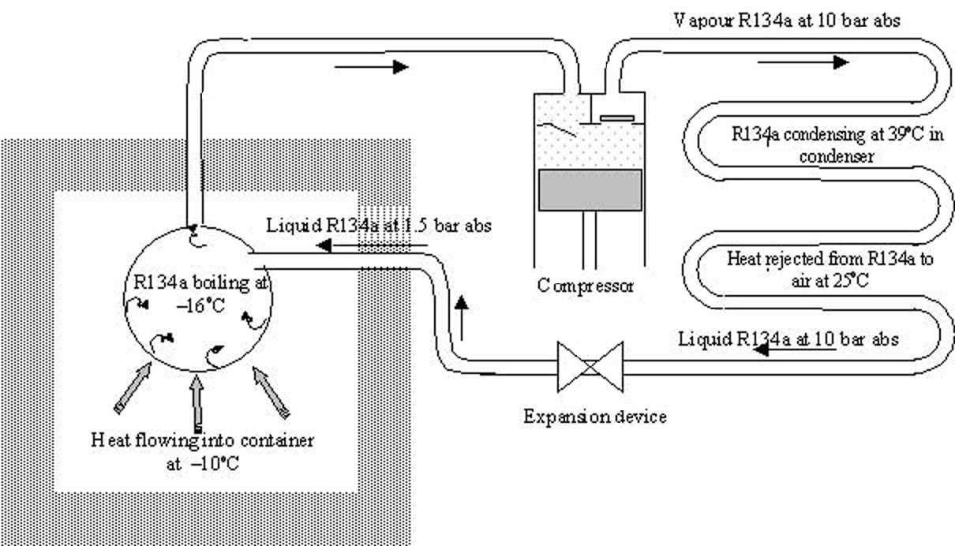
Vapour Compression Refrigeration System : A Heat Pump
W_{in}
Q_{out}
Q_{in}

Slide 23
Thermodynamic Model for a General Heat Engine
High Temperature Reservoir (Source)
Q_{in}
First law:
W_{net} = Q_{in} - Q_{out}
W_{net}
HE
Q_{out}
Low Temperature Reservoir (Sink)

Slide 24
Thermodynamic Model for a General Heat Pump
HTR (Sink)
Q_{out}
First law:
W_{in} = Q_{in} - Q_{out}
W_{in}
HP
Q_{in}
LTR (Source)

Slide 25
Kelvin Planks postulate
“It is impossible to construct a heat engine which produces no effect other than the extraction of heat from a single source and the production of an equivalent amount of work”
On the other side
It is possible to construct a heat engine which produces no effect other than the extraction of work from a single source and the production of an equivalent amount of heat

Slide 26
Clausius postulate
“Heat cannot pass spontaneously (unaided) from a region of lower temperature to a region of higher temperature”
However,
Heat can pass spontaneously (unaided) from a region of higher temperature to a region of lower temperature

Slide 27
Discussion of Second Law
It is impossible to construct a heat engine with 100% efficiency.
It is impossible to construct a heat pump or refrigerator with infinite COP.
Both are negative statements.
They cannot be proved.
They will remain correct till they are disproved.
Violation of Kelvin Planks statement leads to violation of Clasius statement and vice versa.

