Slide 1

Basic Analysis to Extend Caratheodory’s Axioms for A Control Volume
P M V Subbarao
Professor & Head
Mechanical Engineering Department
I I T Delhi
Real Systems are truly Control Volumes!!!

Slide 2

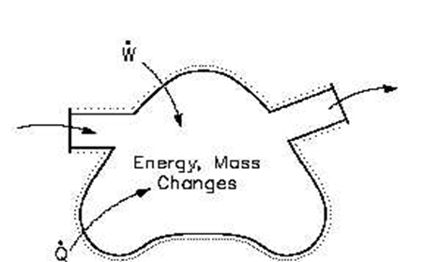
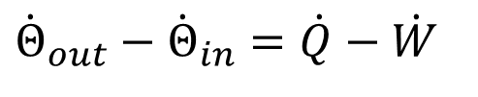
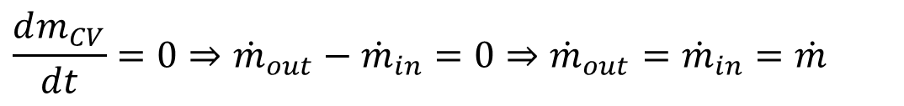
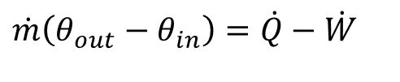
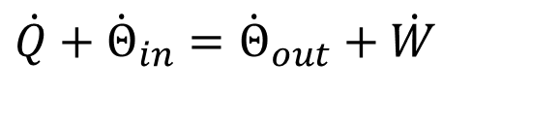
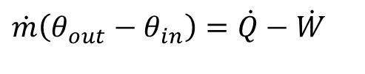
First Law for A CV: Steady State Steady Flow
Properties of CV are Invariant: not varying with time.
Conservation of mass:
$$\frac{dm_{CV}}{dt}=0⇒{\dot{m}}_{out}−{\dot{m}}_{in}=0⇒{\dot{m}}_{out}={\dot{m}}_{in}=\dot{m}$$
No accumulation or depletion of mass of a CV.
First Law:
$$\dot{Q}+{\dot{Θ}}_{in}={\dot{Θ}}_{out}+\dot{W}$$
No addition or removal of energy for a CV.
$${\dot{Θ}}_{out}−{\dot{Θ}}_{in}=\dot{Q}−\dot{W}$$
$$\dot{m}\left(θ_{out}−θ_{in}\right)=\dot{Q}−\dot{W}$$
$$\dot{m}\left(θ_{out}−θ_{in}\right)=\dot{Q}−\dot{W}$$

Slide 3
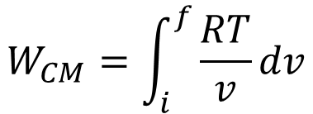

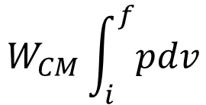



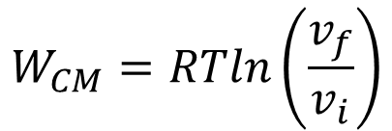
Wind and Hydro Systems are Adiabatic and Isothermal
Consider a control mass and a control volume containing an ideal gas working between same states and following an isothermal process.
Identify a common process equation valid for both CM and CV.
$$pv=RT$$
If there are no chemical reactions or ideal gas remain pure during the entire process.
$$d\left(pv\right)=0$$
$$pdv+vdp=0$$
$$pdv=−vdp$$
Work done by control mass is:
$$W_{CM}\int_{i}^{f}{pdv}$$
$$W_{CM}=\int_{i}^{f}{\frac{RT}{v}dv}$$
$$W_{CM}=RTln\left(\frac{v_{f}}{v_{i}}\right)$$

Slide 4
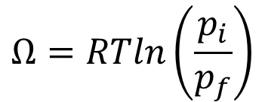

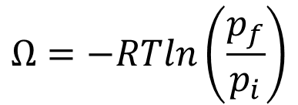
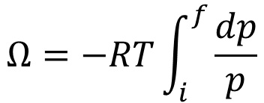

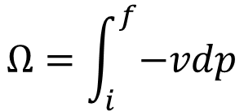
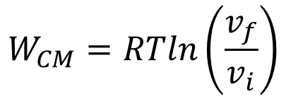
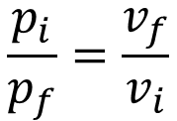
Wind and Hydro Systems follow Adiabatic and Isothermal CoS
$$pdv=−vdp$$
$$W_{CM}=RTln\left(\frac{v_{f}}{v_{i}}\right)$$
Work done by control mass is:
$$Ω=\int_{i}^{f}{−vdp}$$
$$Ω=−RT\int_{i}^{f}{\frac{dp}{p}}$$
Consider
$$Ω=−RTln\left(\frac{p_{f}}{p_{i}}\right)$$
$$Ω=RTln\left(\frac{p_{i}}{p_{f}}\right)$$
For an isothermal CoS executed by an ideal gas;
$$\frac{p_{i}}{p_{f}}=\frac{v_{f}}{v_{i}}$$
$$W_{CM}=Ω$$
∴ -vdp is co-equivalent of Displacement work.
Identify a thermodynamic system for which $δw=−vdp$.

Slide 5
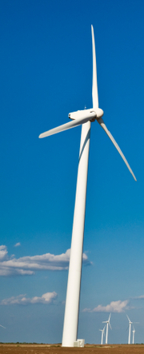
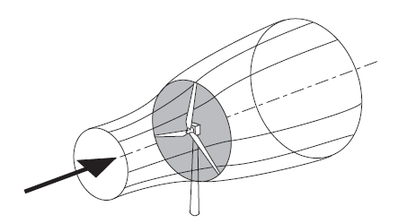
Onset of Quai-static Process in A CV
Bernoulli’s Theorem: The pressure of the upstream wind approaching the rotor will increase due to deceleration caused by the presence of wind turbine rotor.

Slide 6
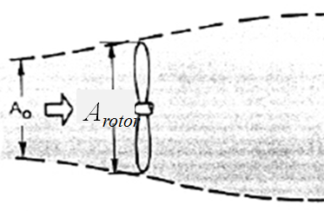
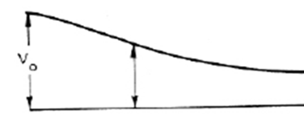
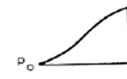
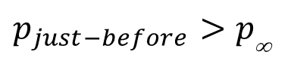
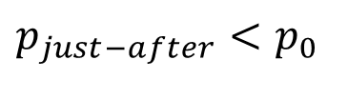
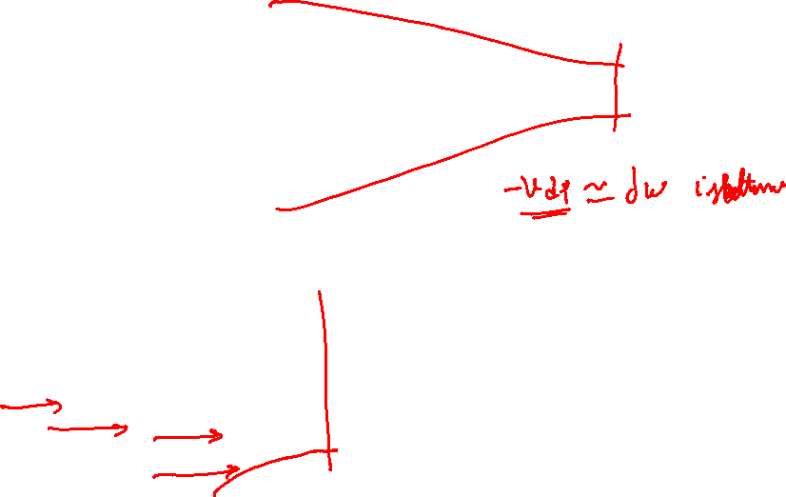
Thermodynamic View of A Donating Stream Tube’s Action
V∞
V∞
$$p_{just−before}>p_{\text{∞}}$$
p∞
$$p_{just−after}<p_{0}$$

Slide 7


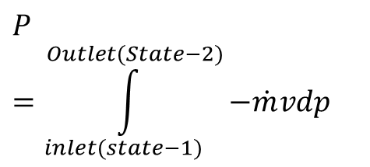
Work Transfer by a Flowing Fluid
A successful thermodynamic device generates a pressure Field.
There exists a continuous mass flow rate of fluid and hence continuous work transfer between flowing fluid and the device.
Infinitesimal positive work done by unit mass of wind (flowing fluid) in a CV
$$δw=−vdp$$
Infinitesimal Power
$$δP=−\dot{m}vdp$$
Power generation in a Flow Device
$$P=\int_{inlet(state−1)}^{Outlet(State−2)}{−\dot{m}vdp}$$

Slide 8
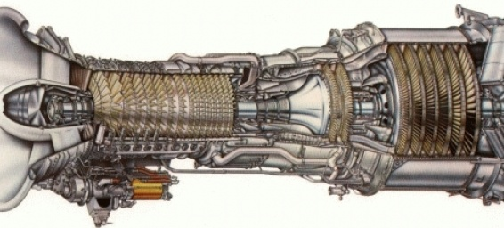
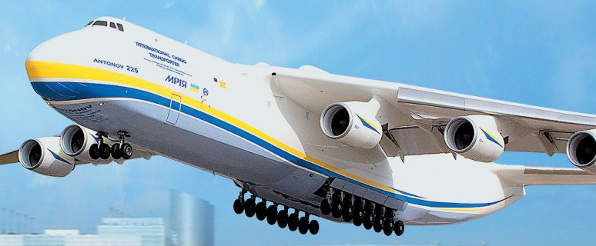
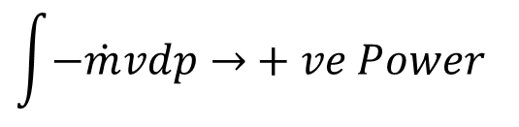
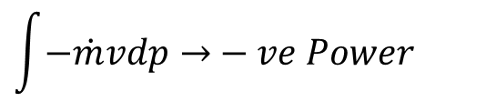
Special Coequal to Work Transfer: Jet Engines
The Devices for Development of Large Flying Machines…
Transactions Across A Control Volume
$$\int{−\dot{m}vdp→}−ve Power$$
$$\int{−\dot{m}vdp→}+ve Power$$
Pressure Field, p
p_{atm}
A Travel by Fluid

Slide 9

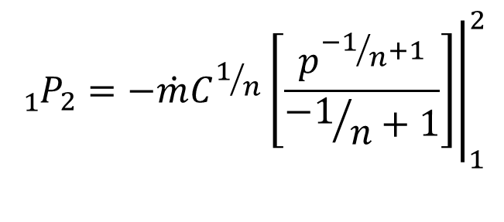

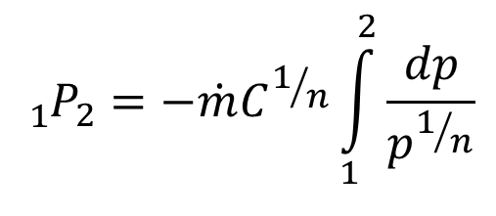

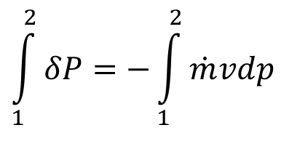
Polytropic Work Transfer in A Flow Device
Infinitesimal positive work done by unit mass of wind (flowing fluid) in a CV
$$δw=−vdp$$
CVs work with continuous flow rate of working substance:
$$\int_{1}^{2}{δP}=−\int_{1}^{2}{\dot{m}vdp}$$
$$δP=−\dot{m}vdp$$
Let the process followed is Polytropic:
$$pv^{n}=C$$
$${{}_{1}^{}P}_{2}=−\dot{m}C^{1/n}{\left.\left[\frac{p^{{−1}/n+1}}{{−1}/n+1}\right]\right|}_{1}^{2}$$
$${{}_{1}^{}P}_{2}=−\dot{m}C^{1/n}\int_{1}^{2}{\frac{dp}{p^{1/n}}}$$

Slide 10
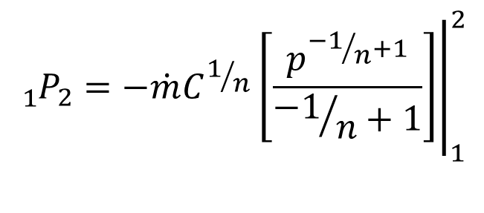
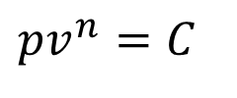
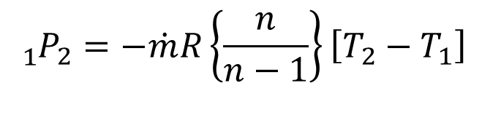
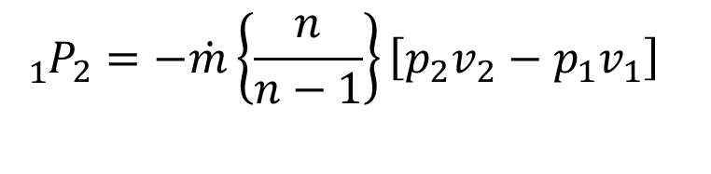
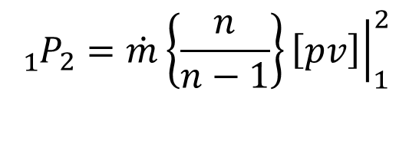
Polytropic work Transfer in A Flow Device
$${{}_{1}^{}P}_{2}=−\dot{m}C^{1/n}{\left.\left[\frac{p^{{−1}/n+1}}{{−1}/n+1}\right]\right|}_{1}^{2}$$
$$pv^{n}=C$$
$${{}_{1}^{}P}_{2}=\dot{m}\left\{\frac{n}{n−1}\right\}{\left.\left[pv\right]\right|}_{1}^{2}$$
$${{}_{1}^{}P}_{2}=−\dot{m}\left\{\frac{n}{n−1}\right\}\left[p_{2}v_{2}−p_{1}v_{1}\right]$$
If the substance (flowing fluid) is an Ideal gas….
$${{}_{1}^{}P}_{2}=−\dot{m}R\left\{\frac{n}{n−1}\right\}\left[T_{2}−T_{1}\right]$$

Slide 11
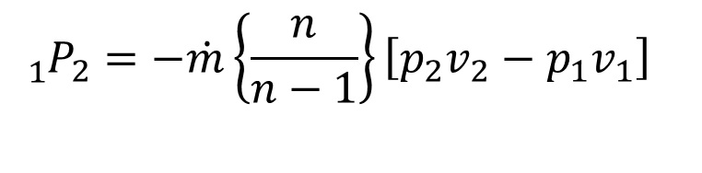
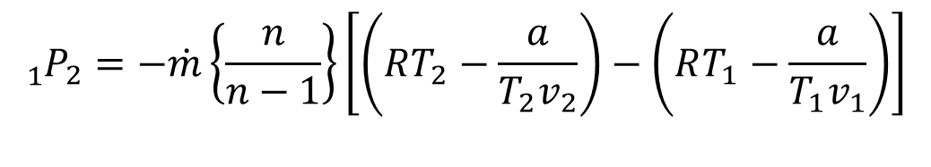
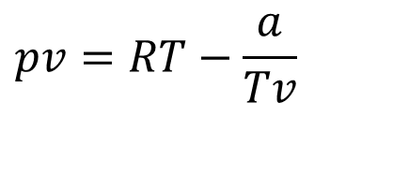
Polytropic work Transfer by A Flowing Steam in A Steam Turbine
$${{}_{1}^{}P}_{2}=−\dot{m}\left\{\frac{n}{n−1}\right\}\left[p_{2}v_{2}−p_{1}v_{1}\right]$$
If the substance (flowing fluid) is a Real gas described by ….
$$pv=RT−\frac{a}{Tv}$$
Rankine’s Equation of state, 1849.
$${{}_{1}^{}P}_{2}=−\dot{m}\left\{\frac{n}{n−1}\right\}\left[\left(RT_{2}−\frac{a}{T_{2}v_{2}}\right)−\left(RT_{1}−\frac{a}{T_{1}v_{1}}\right)\right]$$
Scientific development of new CVs, Steam Turbines, gas turbines …..

Slide 12
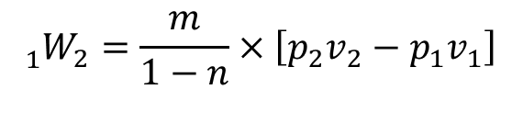
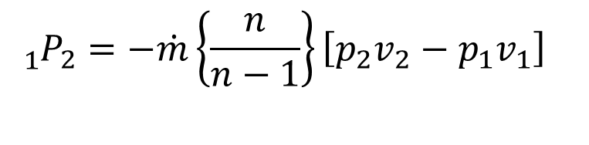


Thermodynamic Superiority of A CV
Consider a control mass and a control volume working between same states and following same polytropic process.
$${δW}_{CM}=pdv$$
$${δW}_{CV}=−vpdp$$
In general, n≥ 1
$${{}_{1}^{}W}_{2}=\frac{m}{1−n}×\left[p_{2}v_{2}−p_{1}v_{1}\right]$$
$${{}_{1}^{}P}_{2}=−\dot{m}\left\{\frac{n}{n−1}\right\}\left[p_{2}v_{2}−p_{1}v_{1}\right]$$

Slide 13
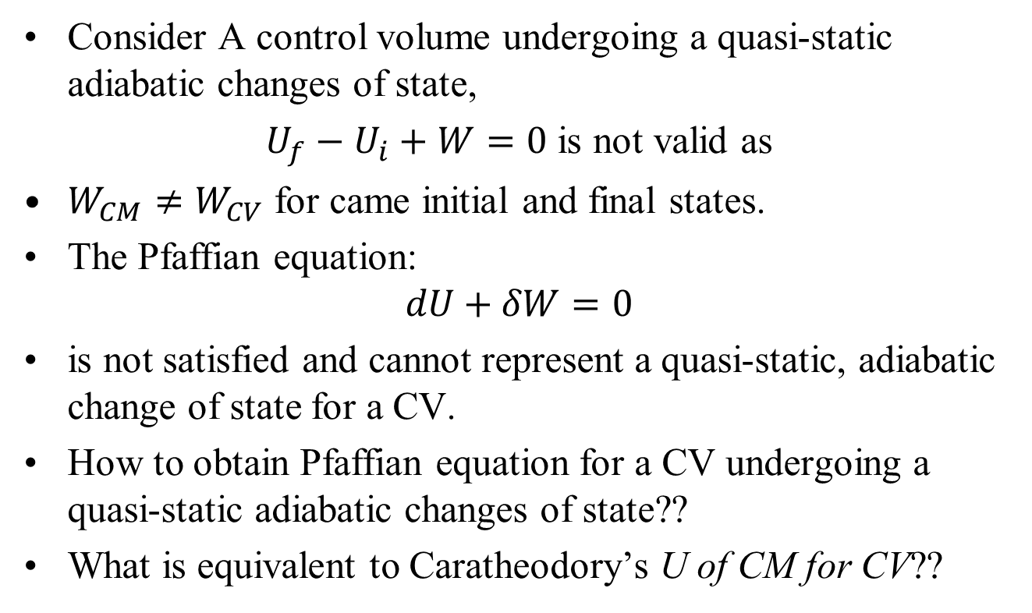
First Law Model for A Control Volume
Consider A control volume undergoing a quasi-static adiabatic changes of state,
$U_{f}−U_{i}+W=0$ is not valid as
$W_{CM}≠W_{CV}$ for came initial and final states.
The Pfaffian equation:
$$dU+δW=0$$
is not satisfied and cannot represent a quasi-static, adiabatic change of state for a CV.
How to obtain Pfaffian equation for a CV undergoing a quasi-static adiabatic changes of state??
What is equivalent to Caratheodory’s U of CM for CV??

Slide 14
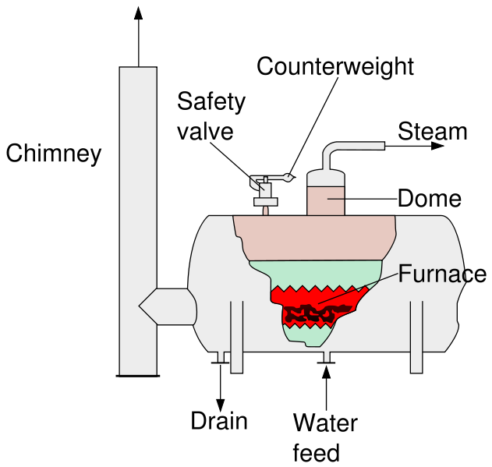
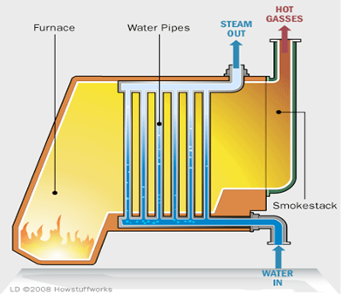

Experimental Evidence:
Increasing unit Temperature of A Pure Substance (water)
Fire Tube Boiler (CM)
Water Tube Boiler (CV)
Heat is supplied to a Pool of 1kg water to increase unit temperature
Heat is supplied to a stream of 1kg water to increase unit temperature
$$Q_{CV}>Q_{CM}$$

Slide 15
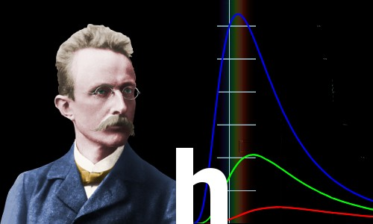
Max Karl Ernst Ludwig Planck:
A Free Thinker
Followed logic past accepted norms: Introduced energy quanta in 1900 as an "act of despair" to solve black-body radiation, dismantling classical physics.
Challenged dogmatic resistance: Famously noted that new scientific truths triumph not by convincing opponents, but because opponents eventually die off.
There is no matter as such.
All matter originates and exists only by virtue of a force which brings the particle of an atom to vibration and holds this most minute solar system of the atom together.
We must assume behind this force the existence of a conscious and intelligent Mind. This Mind is the matrix of all matter.
Max Planck changed physics and our cognizance of the world forever
Hermann Müller taught his receptive young student how to visualize the laws of physics in his mind – a vital weapon in the armory of the great physicists

