Slide 1

Application of Caratheodory’s Axioms for Second Law
P M V Subbarao
Professor & Head
Mechanical Engineering Department
I I T Delhi
A Rich Mathematical Theory!!!

Slide 2

Caratheodory Axiom for the Second Law
This axiom was not based on experiments.
In any arbitrary neighborhood of an arbitrarily given initial point there is a state that cannot be arbitrarily approximated by adiabatic changes of state.
Entropy and its classical mathematical content emerged from this axiom.
Carath´eodory’s axiom according to Chandrasekhar:
Arbitrarily near to any given state there exist states which cannot be reached from an initial state by means of adiabatic processes.
To reach these adiabatic not reachable states, a general process/change of state is essential.

Slide 3
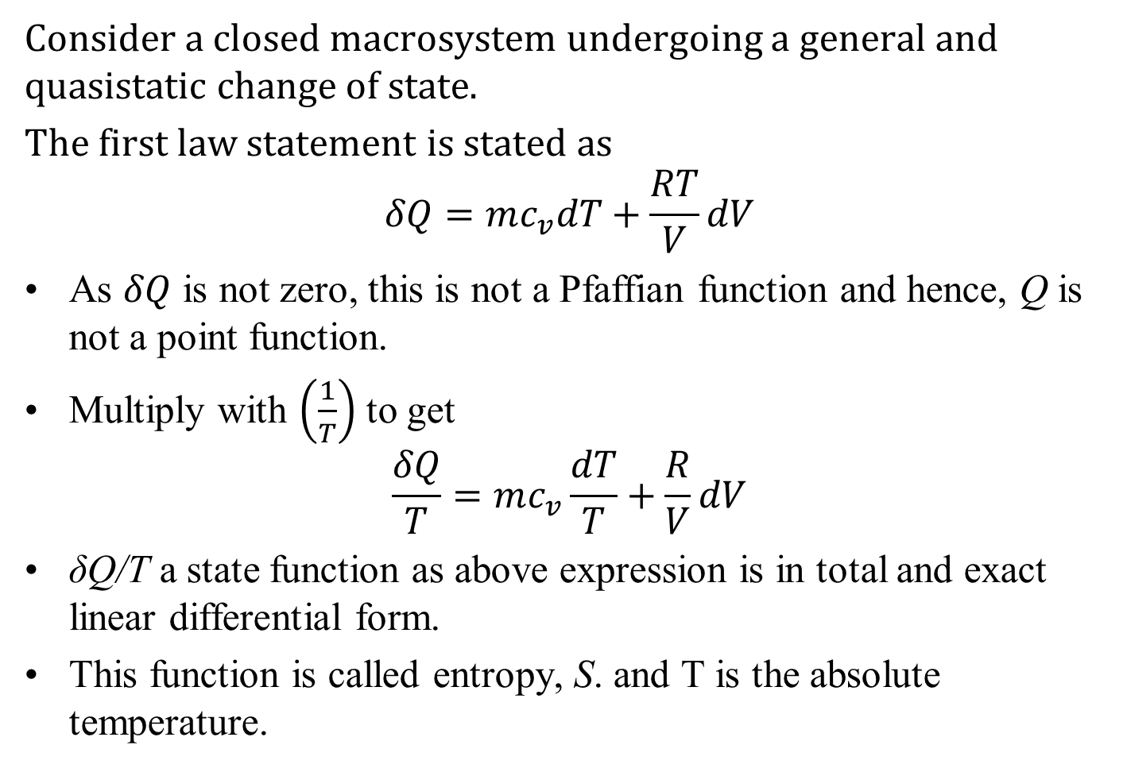
General transformation of an ideal gas
Consider a closed macrosystem undergoing a general and quasistatic change of state.
The first law statement is stated as
$$δQ=mc_{v}dT+\frac{RT}{V}dV$$
As $δQ$ is not zero, this is not a Pfaffian function and hence, Q is not a point function.
Multiply with $\left(\frac{1}{T}\right)$ to get
$$\frac{δQ}{T}=mc_{v}\frac{dT}{T}+\frac{R}{V}dV$$
δQ/T a state function as above expression is in total and exact linear differential form.
This function is called entropy, S. and T is the absolute temperature.

Slide 4
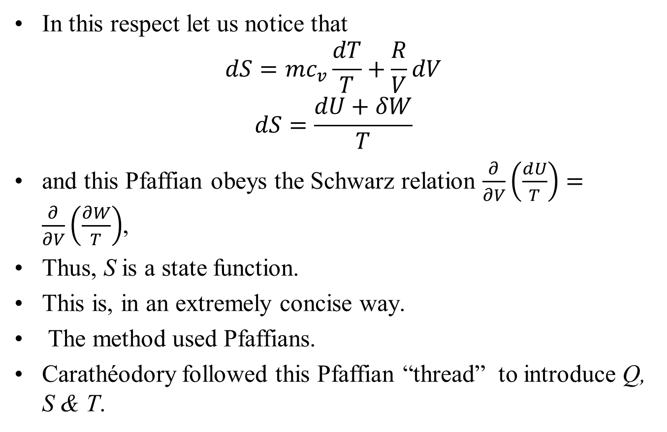
Carathéodory’s Definition of Entropy
In this respect let us notice that
$$dS=mc_{v}\frac{dT}{T}+\frac{R}{V}dV$$
$$dS=\frac{dU+δW}{T}$$
and this Pfaffian obeys the Schwarz relation $\frac{∂}{∂V}\left(\frac{dU}{T}\right)=\frac{∂}{∂V}\left(\frac{∂W}{T}\right)$,
Thus, S is a state function.
This is, in an extremely concise way.
The method used Pfaffians.
Carathéodory followed this Pfaffian “thread” to introduce Q, S & T.

Slide 5
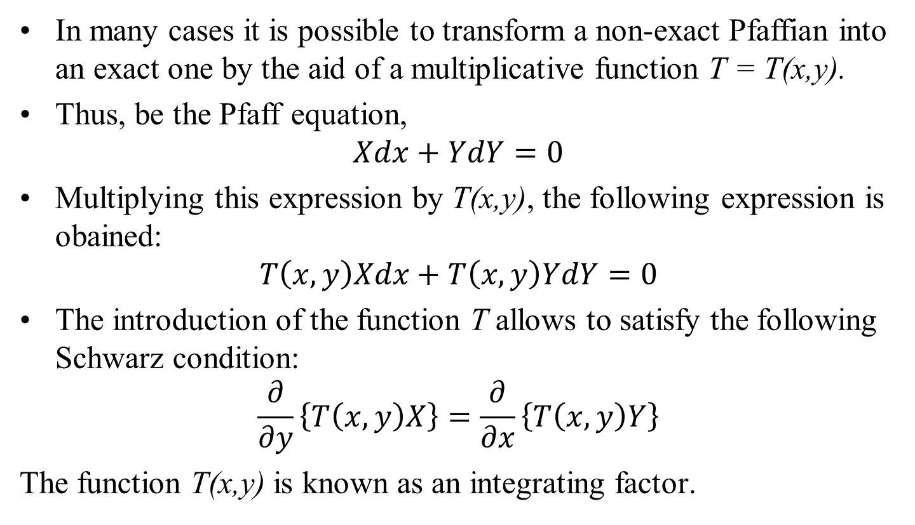
The Integrating Factor
In many cases it is possible to transform a non-exact Pfaffian into an exact one by the aid of a multiplicative function T = T(x,y).
Thus, be the Pfaff equation,
$$Xdx+YdY=0$$
Multiplying this expression by T(x,y), the following expression is obained:
$$T\left(x,y\right)Xdx+T\left(x,y\right)YdY=0$$
The introduction of the function T allows to satisfy the following Schwarz condition:
$$\frac{∂}{∂y}\left\{T\left(x,y\right)X\right\}=\frac{∂}{∂x}\left\{T\left(x,y\right)Y\right\}$$
The function T(x,y) is known as an integrating factor.

Slide 6
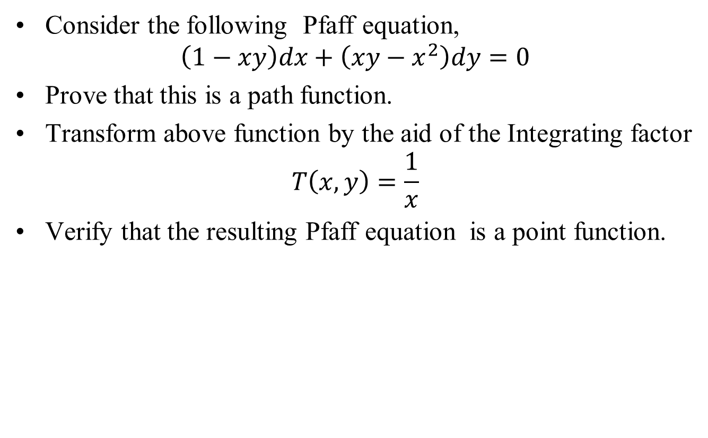
Example case: The Integrating Factor
Consider the following Pfaff equation,
$$\left(1−xy\right)dx+\left(xy−x^{2}\right)dy=0$$
Prove that this is a path function.
Transform above function by the aid of the Integrating factor
$$T\left(x,y\right)=\frac{1}{x}$$
Verify that the resulting Pfaff equation is a point function.

Slide 7
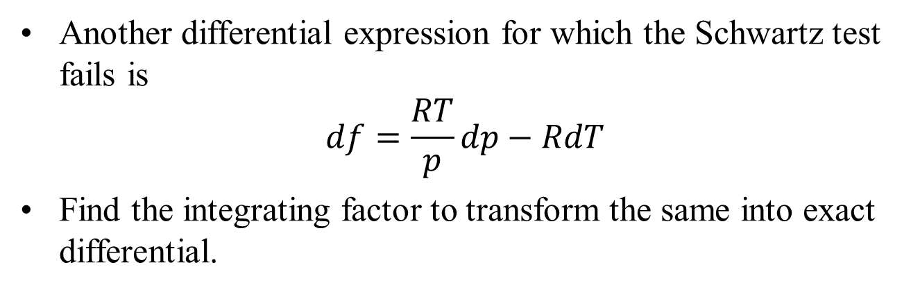
Example case: The Integrating Factor
Another differential expression for which the Schwartz test fails is
$$df=\frac{RT}{p}dp−RdT$$
Find the integrating factor to transform the same into exact differential.
“Laplace was asked one day who was the greatest mathematician in Germany, and he replied Pfaff in Germany and Gauss in Europe.”

Slide 8
Extension of Caratheodory’s Axiom for Control Volumes…

Slide 9
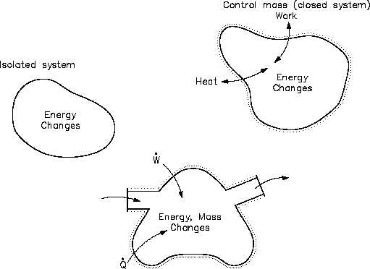
Real Engineering Thermodynamic Systems
Control Volume

Slide 10
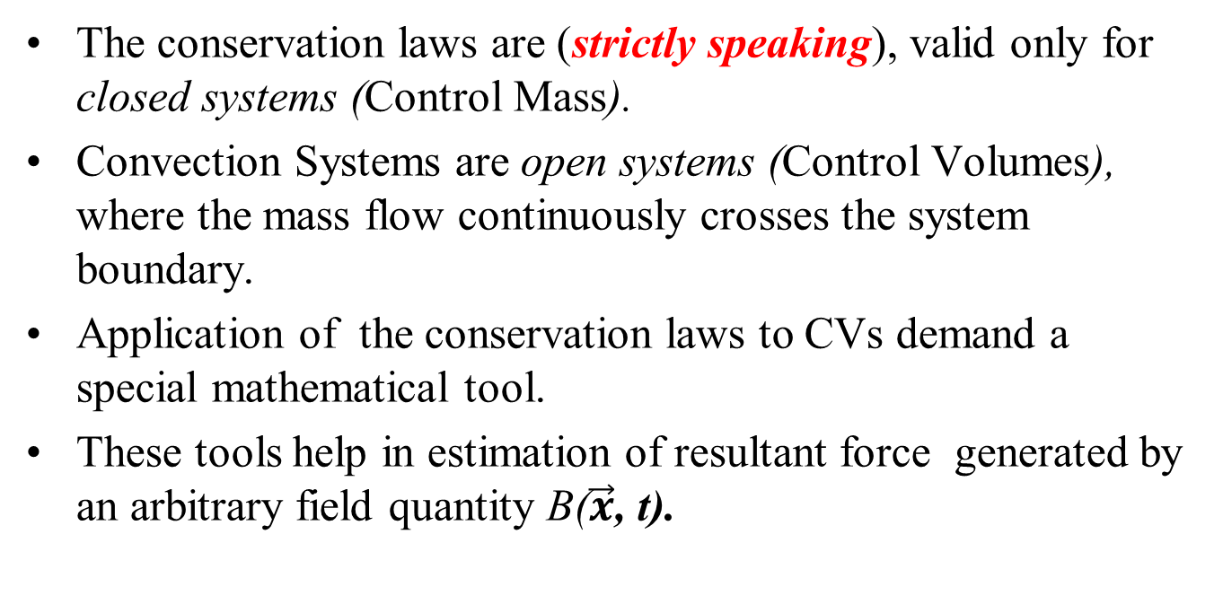
Tools for Comprehensive Description
The conservation laws are (strictly speaking), valid only for closed systems (Control Mass).
Convection Systems are open systems (Control Volumes), where the mass flow continuously crosses the system boundary.
Application of the conservation laws to CVs demand a special mathematical tool.
These tools help in estimation of resultant force generated by an arbitrary field quantity B($\vec{x}$, t).

Slide 11
J. L. M. Poiseuille
Jean Léonard Marie Poiseuille.
A French Physicist & Physiologist
Poiseuille possess extraordinary sense of experimental precision.
He carried out his doctoral research on, ”The force of the aortic heart” in 1828.
Poiseuille invented the U-tube mercury manometer (called the hemodynamometer) and used it to measure pressures in the arteries of horses and dogs.
To this day blood pressures are reported in mm Hg due to Poiseuille's invention.
n 1838, he experimentally derived, and in 1840 and 1846 formulated and published, Poiseuille's law.

Slide 12

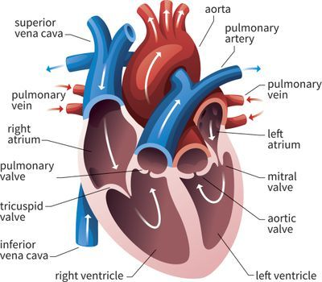
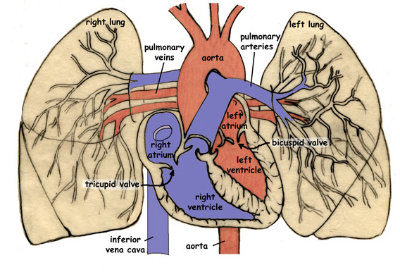
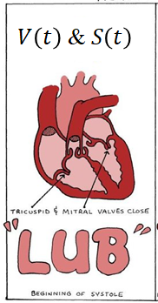
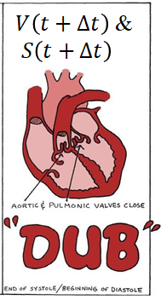
Biologically Inspired Reynolds Control Volume
~1903

Slide 13
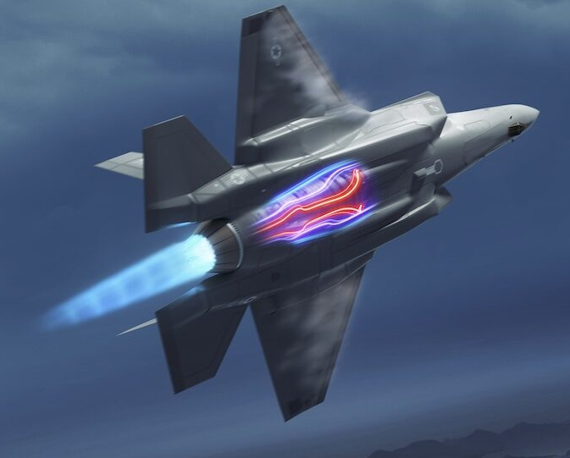
Reynolds Description of A Control Volume
At time t₀
At time t₀+δt

Slide 14
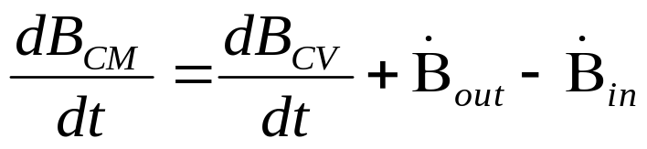
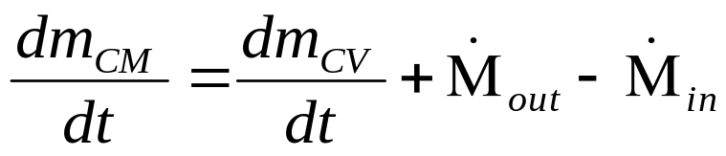
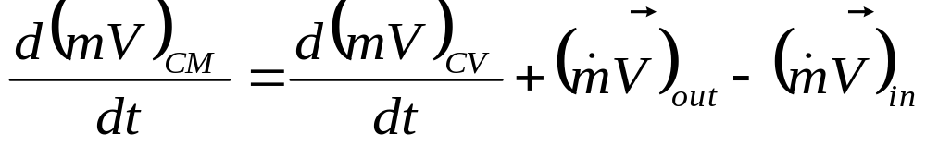
Reynolds Transport Theorem
The rate of change of any property B (=mb =ρVb) of a CM and that of CV are related as: the system.
Conservation of Mass for A CV: Let b=1
Conservation of Momentum for A CV: Let b=V

Slide 15
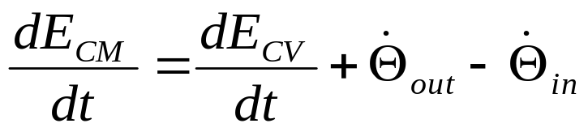
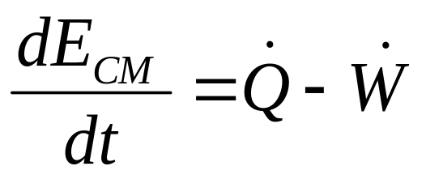
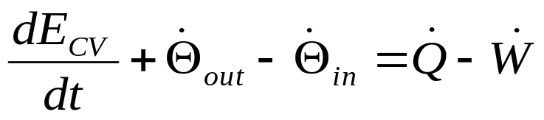
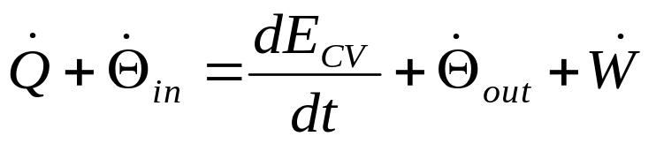
Development of First Law for A CV using RTT
Conservation of energy: b=e

Slide 16
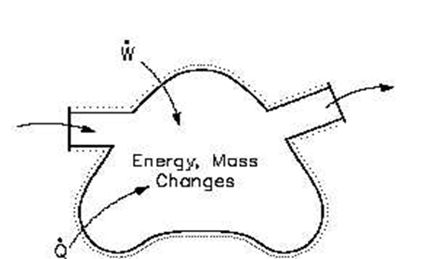
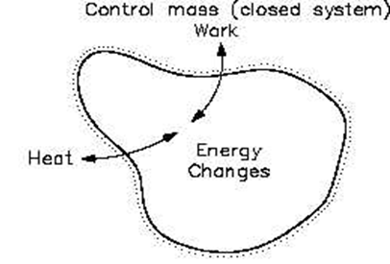
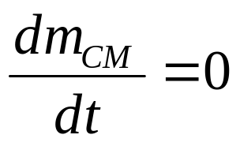
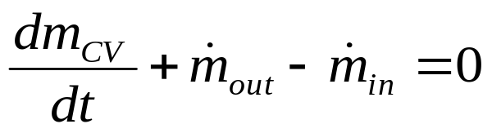
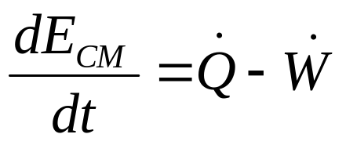
The Family of Thermodynamic Systems
Conservation of Mass :
First law of thermodynamics :

Slide 17
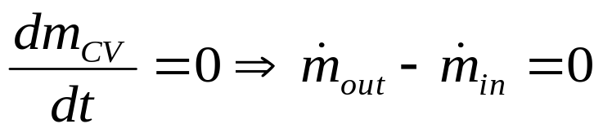
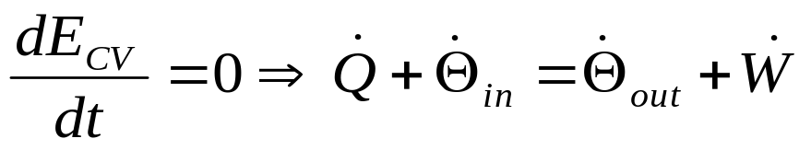
First Law for A CV: Steady State Steady Flow
Properties of CV are Invariant: not varying with time.
Conservation of mass:
NO accumulation or depletion of mass of a CV.
First Law:
NO addition or removal of energy for a CV.

Slide 18
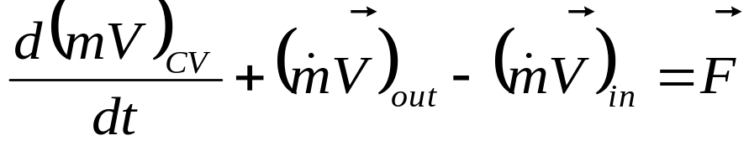
Laws of Nature for A Control Volume
Conservation of mass:
Conservation of momentum:
Conservation of energy:
E=me: is the total energy of the substance present inside the boundary of SV.
Θ : mθ = Total energy flow rate of A Flowing substance

Slide 19
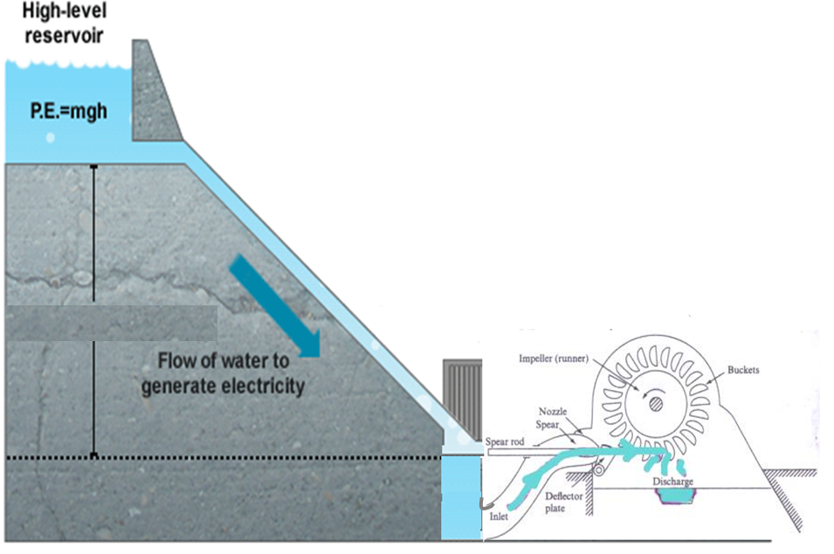
The Natural Adiabatic Open System: Generates Work

Slide 20
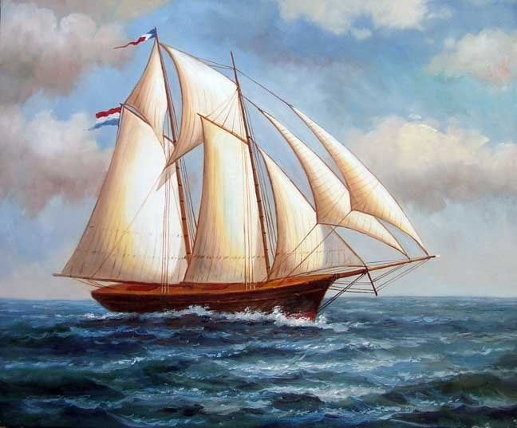
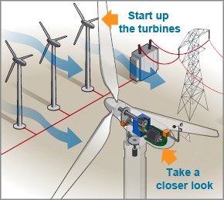
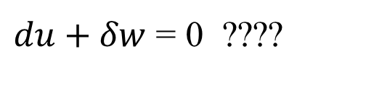
Extension of Adiabatic Work Transfer to A Control Volume????
First law for an infinitesimal element of A SSSF CV with unit mass flow rate:
$du+δw$ = 0 ????

Slide 21
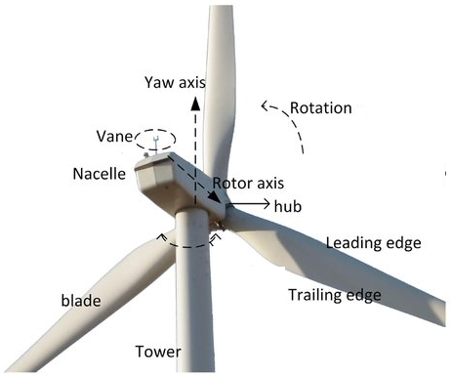
Imagination of Thermodynamic Process
The one set of process which may be responsible to establish Work Transfer from Wind to the Rotor may be thought as ….
≈
TE1: Rotor of a wind turbine is analogous to Sail
TE2: Similar to a sail, turbine rotor also decelerates the approaching wind.

Slide 22
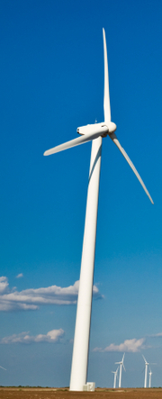
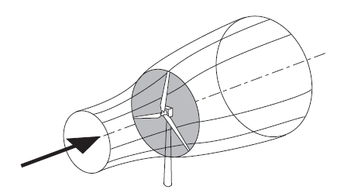
Thought Experiment 3: Identification of Donor Stream and Escape Stream
Bernoulli’s Theorem: The pressure of the upstream wind approaching the rotor will increase due to deceleration caused by the presence of wind turbine rotor.

Slide 23
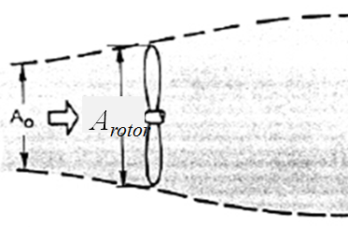
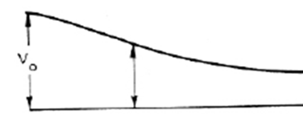
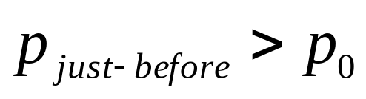
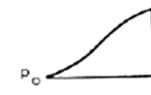
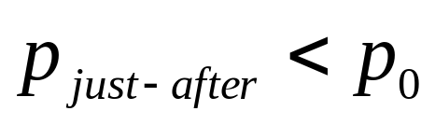
Thermodynamic View of A Donating Stream Tube’s Action
V₀
V₀
p₀

Slide 24
Wind and Hydro Systems are Adiabatic and Isothermal
Consider a control mass and a control volume working between same states and following an isothermal process.

Slide 25
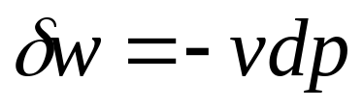
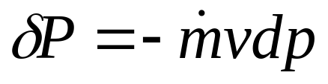
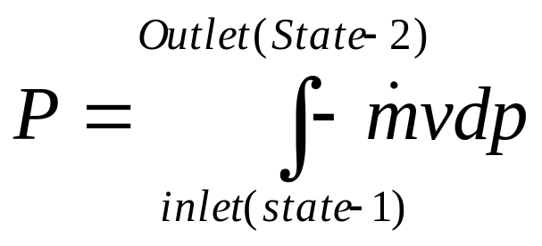
Work Transfer by a Flowing Fluid
A successful thermodynamic device generates a pressure Field.
There exists a continuous mass flow rate of fluid and hence continuous work transfer between flowing fluid and the device.
Infinitesimal positive work done by unit mass of wind (flowing fluid) in a CV
Infinitesimal Power
Power generation in a Flow Device

Slide 26
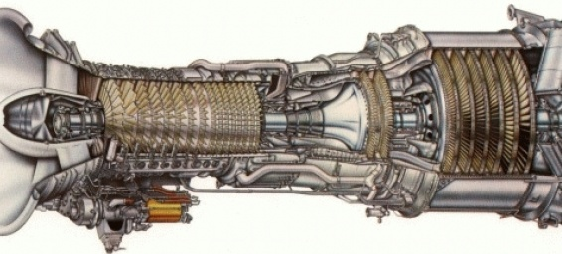
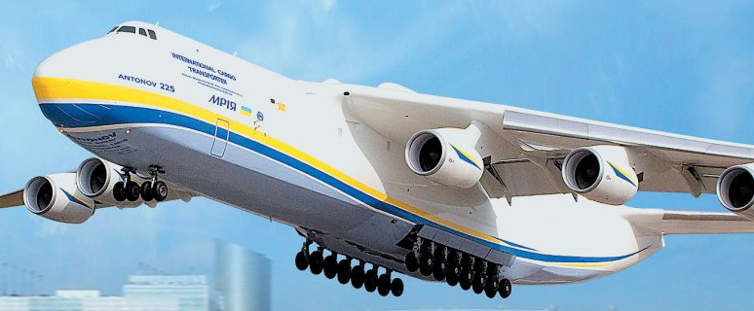
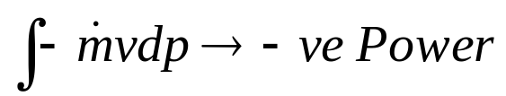
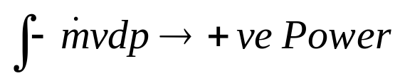
Special Coequal to Work Transfer: Jet Engines
The Devices for Development of Large Flying Machines…
Transactions Across A Control Volume
Pressure Field, p
p_{atm}
A Travel by Fluid

Slide 27
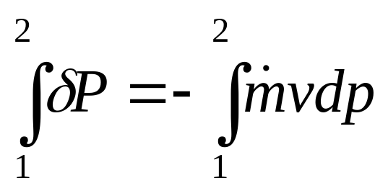
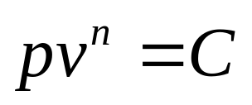
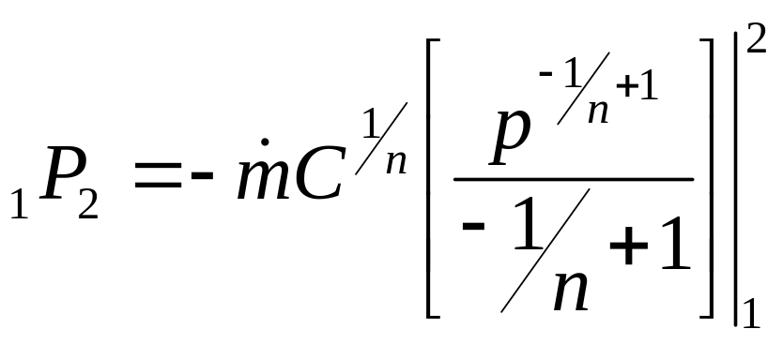
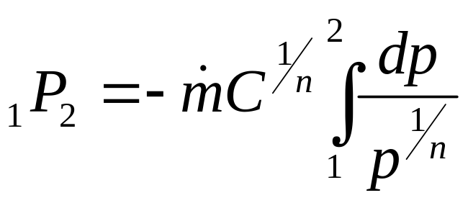
Polytropic work Transfer in A Flow Device
Infinitesimal positive work done by unit mass of wind (flowing fluid) in a CV
CVs work with continuous flow rate of working substance:
Let the process followed is Polytropic:

Slide 28



Polytropic work Transfer in A Flow Device
If the substance (flowing fluid) is an Ideal gas….

Slide 29


Polytropic work Transfer by A Flowing Steam in A Steam Turbine
If the substance (flowing fluid) is a Real gas described by ….
Rankine’s Equation of state, 1849.
Scientific development of new CVs, Steam Turbines

Slide 30

Thermodynamic Superiority of A CV
Consider a control mass and a control volume working between same states and following same polytropic process.

Slide 31

First Law Model for A Control Volume
Consider A control volume undergoing a quasi-static adiabatic changes of state,
$U_{f}−U_{i}+W=0$ is not valid as
$W_{CM}≠W_{CV}$ for came initial and final states.
The Pfaffian equation:
$$dU+δW=0$$
is not satisfied and cannot represent a quasi-static, adiabatic change of state for a CV.
How to obtain Pfaffian equation for a CV undergoing a quasi-static adiabatic changes of state??
What is equivalent to Caratheodory’s U of CM for CV??

Slide 32



Experimental Evidence:
Increasing unit Temperature of A Pure Substance (water)
Fire Tube Boiler (CM)
Water Tube Boiler (CV)
Heat is supplied to a Pool of 1kg water to increase unit temperature
Heat is supplied to a stream of 1kg water to increase unit temperature
$$Q_{CV}>Q_{CM}$$

Slide 33

Microscopic View
Max Planck changed physics and our understanding of the world forever
Hermann Müller taught his receptive young student how to visualize the laws of physics in his mind – a vital weapon in the armory of the great physicists

Slide 34




Temperature and Microscopic Kinetic Energy: Boltzmann Equation by Maxwell
For a substance inside (non-flowing) a system:
If atoms/molecules of a substance possess f number of DoF:
Law of equipartition of energy:
For a flow System?

Slide 35






Simplified Control Volume to Quantify Change in Enthalpy
Law of equipartition of energy:

Slide 36

First Law Model for A Control Volume
Consider A control volume undergoing a quasi-static adiabatic changes of state,
$H_{f}−H_{i}+W=0$ is not valid as
The Pfaffian equation:
$$dH+δW=0$$
is satisfied and can represent a quasi-static, adiabatic change of state for a CV.
Experimental verification showed that:
${mc}_{p}dT−Vdp=0$
For an ideal gas:
$c_{p}\frac{dT}{T}−\frac{R}{p}dp=0$: is a point differential and exact Pfaffian.

Slide 37





Simplified Control Volume to Quantify Change in Enthalpy
Consider a Steady flow of homogeneous phase of a substance flowing through a frictionless pipe.
No change in other forms of energy, except total microscopic energy.
For and infinitesimal process:
Establish a constant pressure heat transfer process using fire.
Note down the temperature change due to heating.
C_{p} Constant Pressure Specific Heat

Slide 38

Quantification of Changes in Internal Energy & Enthalpy
Change in specific internal energy of any substance during any process 1--2:
c_{v} Constant Volume Specific Heat
Change in Enthalpy of any substance during any process 1--2 :
c_{p} Constant Pressure Specific Heat
Change in Enthalpy is applicable only for flowing systems.

Slide 39






Models for Internal Energy & Enthalpy
For solid & many liquids:

Slide 40

General transformation of an ideal gas in a Control Volume
Consider an open macrosystem undergoing a general and quasistatic change of state.
The first law statement is stated as
$$δQ=mc_{p}dT−\frac{Rp}{p}dp$$
As $δQ$ is not zero, this is not a Pfaffian function and hence, Q is not a point function.
Multiply with $\left(\frac{1}{T}\right)$ to get
$$\frac{δQ}{T}=mc_{p}\frac{dT}{T}−\frac{R}{p}dp$$
δQ/T a state function as above expression is in total and exact linear differential form.
This function is called entropy, S. and T is the absolute temperature.

Slide 41

Carathéodory’s Definition of Entropy for A CV
In this respect let us notice that
$$dS=mc_{p}\frac{dT}{T}−\frac{R}{V}dV$$
$$dS=\frac{dH+δW}{T}$$
and this Pfaffian obeys the Schwarz relation $\frac{∂}{∂V}\left(\frac{dH}{T}\right)=\frac{∂}{∂V}\left(\frac{∂W}{T}\right)$,
Thus, S is a state function.
This is, in an extremely concise way,
The method used Pfaffians.
Carathéodory followed this Pfaffian “thread” to introduce Q, S & T.

