Slide 1

Pfaffian Differential Equations with Multiple Variables
P M V Subbarao
Professor & Head
Mechanical Engineering Department
I I T Delhi
Models for EoS and Reversible Adiabatic Processes.

Slide 2

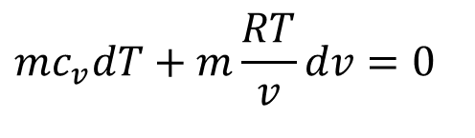
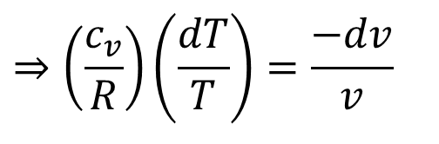
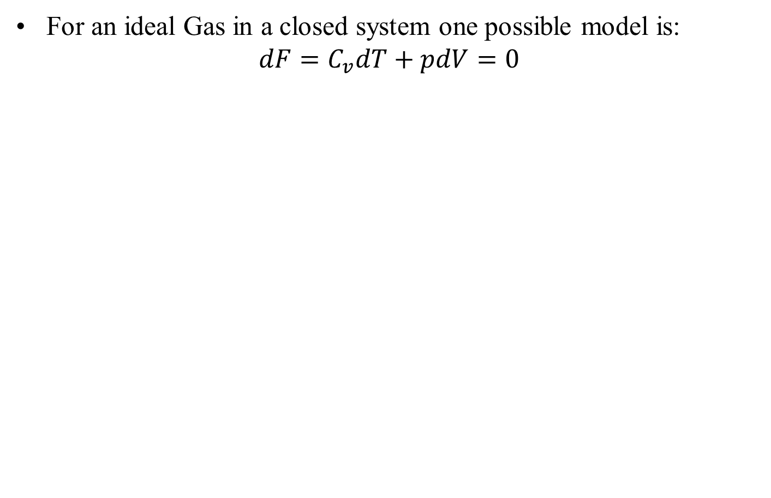
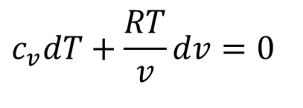
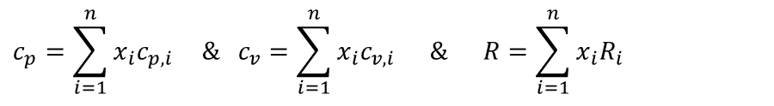
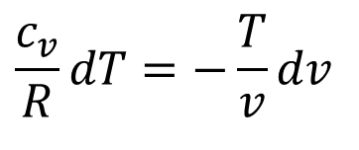
Adiabatic Transformation of an ideal gas
For an ideal Gas in a closed system one possible model is:
$$dF=C_{v}dT+pdV=0$$
Assume ideal gas nature with variable properties:
$$mc_{v}dT+m\frac{RT}{v}dv=0$$
$$c_{v}dT+\frac{RT}{v}dv=0$$
$$\frac{c_{v}}{R}dT=−\frac{T}{v}dv$$
$$⇒\left(\frac{c_{v}}{R}\right)\left(\frac{dT}{T}\right)=\frac{−dv}{v}$$
Mass averaged properties for an ideal gas mixture:
$$c_{p}=\sum_{i=1}^{n}{x_{i}c_{p,i}}\text{ \& }c_{v}=\sum_{i=1}^{n}{x_{i}c_{v,i}}\text{ \& }R=\sum_{i=1}^{n}{x_{i}R_{i}}$$

Slide 3
Variation of Specific Heat of Ideal Gases
$$c_{p}=C_{0}+C_{1}\frac{T}{1000}+C_{2}{\left(\frac{T}{1000}\right)}^{2}+C_{3}{\left(\frac{T}{1000}\right)}^{3}kJ/kgK$$
Gas | C₀ | C₁ | C₂ | C₃
Air | 1.05 | -0.365 | 0.85 | -0.39
Methane | 1.2 | 3.25 | 0.75 | -0.71
CO₂ | 0.45 | 1.67 | -1.27 | 0.39
Steam | 1.79 | 0.107 | 0.586 | -0.20
O₂ | 0.88 | -0.0001 | 0.54 | -0.33
N₂ | 1.11 | -0.48 | 0.96 | -0.42

Slide 4
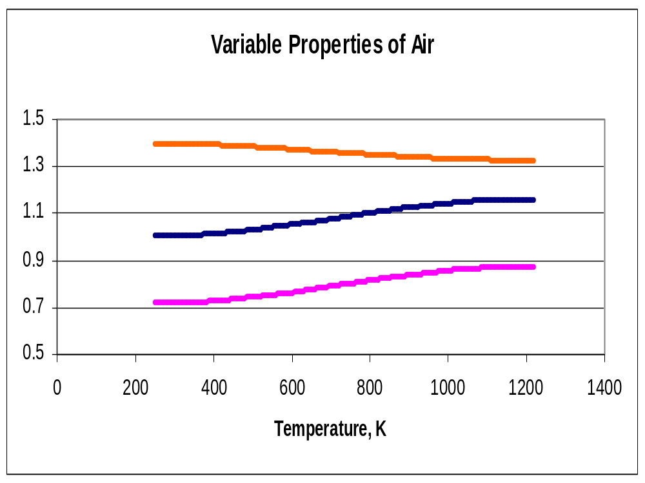
γ
c_{p}
c_{v}

Slide 5
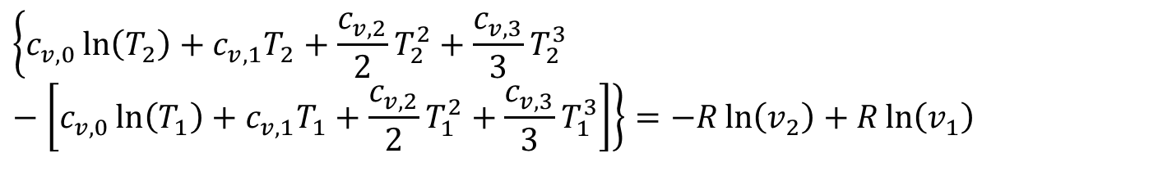
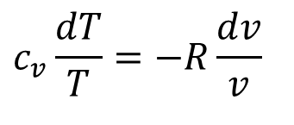
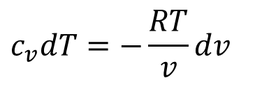
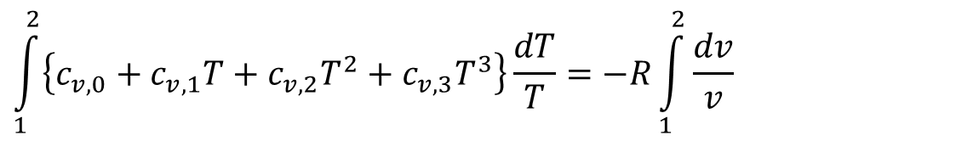
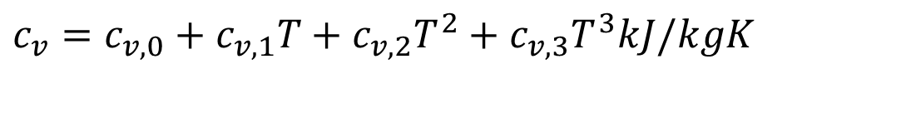
True Phenomenological Model for Reversible Adiabatic Transformation
$$c_{v}dT=−\frac{RT}{v}dv$$
$$c_{v}\frac{dT}{T}=−R\frac{dv}{v}$$
Let the mixture is modeled as:
$$c_{v}=c_{v,0}+c_{v,1}T+c_{v,2}T^{2}+c_{v,3}T^{3}kJ/kgK$$
$$\int_{1}^{2}{\left\{c_{v,0}+c_{v,1}T+c_{v,2}T^{2}+c_{v,3}T^{3}\right\}\frac{dT}{T}}=−R\int_{1}^{2}{\frac{dv}{v}}$$
$$\left\{c_{v,0}\ln\left(\frac{T_{2}}{T_{1}}\right)+c_{v,1}\left(T_{2}−T_{1}\right)+\frac{c_{v,2}}{2}\left(T_{2}^{2}−T_{1}^{2}\right)+\frac{c_{v,3}}{3}\left(T_{2}^{3}−T_{1}^{3}\right)\right\}=−R\ln\left(\frac{v_{2}}{v_{1}}\right)$$
$$\left\{c_{v,0}\ln\left(T_{2}\right)+c_{v,1}T_{2}+\frac{c_{v,2}}{2}T_{2}^{2}+\frac{c_{v,3}}{3}T_{2}^{3}−\left[c_{v,0}\ln\left(T_{1}\right)+c_{v,1}T_{1}+\frac{c_{v,2}}{2}T_{1}^{2}+\frac{c_{v,3}}{3}T_{1}^{3}\right]\right\}=−R\ln\left(v_{2}\right)+R\ln\left(v_{1}\right)$$

Slide 6
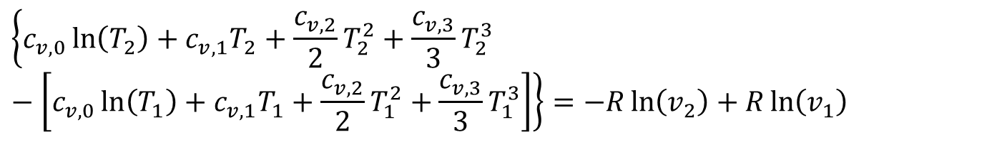
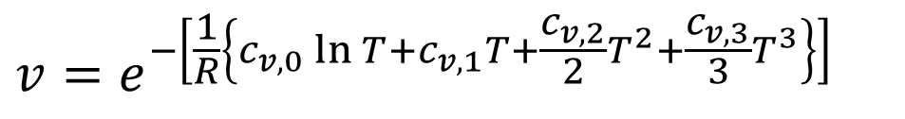
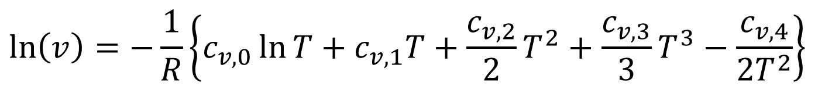
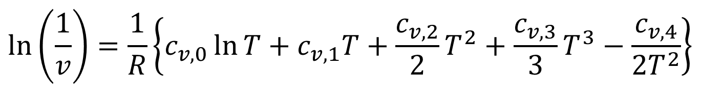
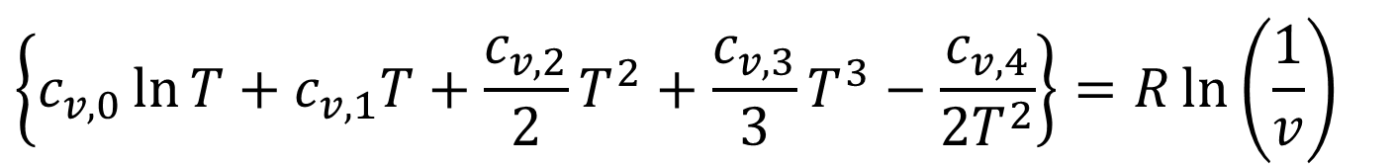
True Phenomenological Model for Reversible Adiabatic Transformation
$$\left\{c_{v,0}\ln\left(T_{2}\right)+c_{v,1}T_{2}+\frac{c_{v,2}}{2}T_{2}^{2}+\frac{c_{v,3}}{3}T_{2}^{3}−\left[c_{v,0}\ln\left(T_{1}\right)+c_{v,1}T_{1}+\frac{c_{v,2}}{2}T_{1}^{2}+\frac{c_{v,3}}{3}T_{1}^{3}\right]\right\}=−R\ln\left(v_{2}\right)+R\ln\left(v_{1}\right)$$
$$\left\{c_{v,0}\ln{T}+c_{v,1}T+\frac{c_{v,2}}{2}T^{2}+\frac{c_{v,3}}{3}T^{3}−\frac{c_{v,4}}{2T^{2}}\right\}=R\ln\left(\frac{1}{v}\right)$$
$$\ln\left(\frac{1}{v}\right)=\frac{1}{R}\left\{c_{v,0}\ln{T}+c_{v,1}T+\frac{c_{v,2}}{2}T^{2}+\frac{c_{v,3}}{3}T^{3}−\frac{c_{v,4}}{2T^{2}}\right\}$$
$$\ln\left(v\right)=−\frac{1}{R}\left\{c_{v,0}\ln{T}+c_{v,1}T+\frac{c_{v,2}}{2}T^{2}+\frac{c_{v,3}}{3}T^{3}−\frac{c_{v,4}}{2T^{2}}\right\}$$
$$v=e^{−\left[\frac{1}{R}\left\{c_{v,0}\ln{T}+c_{v,1}T+\frac{c_{v,2}}{2}T^{2}+\frac{c_{v,3}}{3}T^{3}\right\}\right]}$$

Slide 7
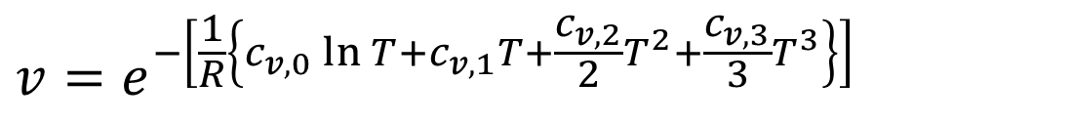
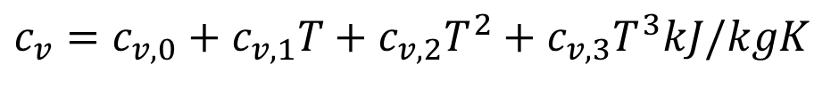


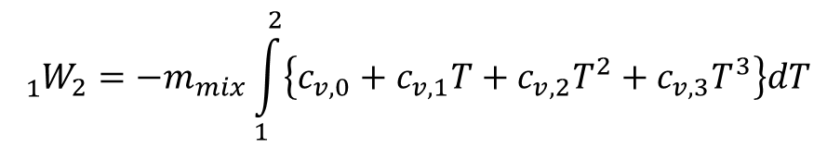
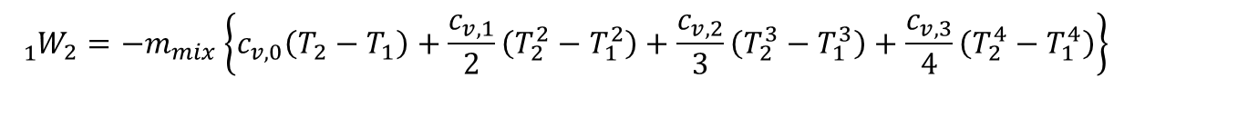
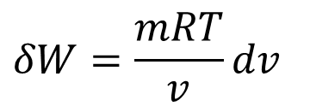
Realistic Estimate of Work
$$v=e^{−\left[\frac{1}{R}\left\{c_{v,0}\ln{T}+c_{v,1}T+\frac{c_{v,2}}{2}T^{2}+\frac{c_{v,3}}{3}T^{3}\right\}\right]}$$
$$δW=\frac{mRT}{v}dv$$
$$δW=mpdv$$
$$δW=mpdv=−m_{mix}c_{v}dT$$
Let the mixture is modeled as:
$$c_{v}=c_{v,0}+c_{v,1}T+c_{v,2}T^{2}+c_{v,3}T^{3}kJ/kgK$$
$${{}_{1}^{}W}_{2}=−m_{mix}\int_{1}^{2}{\left\{c_{v,0}+c_{v,1}T+c_{v,2}T^{2}+c_{v,3}T^{3}\right\}dT}$$
$${{}_{1}^{}W}_{2}=−m_{mix}\left\{c_{v,0}\left(T_{2}−T_{1}\right)+\frac{c_{v,1}}{2}\left(T_{2}^{2}−T_{1}^{2}\right)+\frac{c_{v,2}}{3}\left(T_{2}^{3}−T_{1}^{3}\right)+\frac{c_{v,3}}{4}\left(T_{2}^{4}−T_{1}^{4}\right)\right\}$$

Slide 8
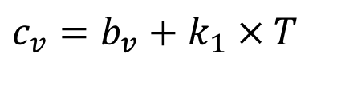
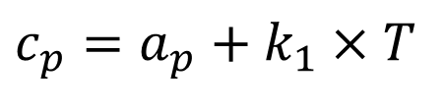
Generalized First Order Models for Variable Specific Heats
$$c_{p}=a_{p}+k_{1}×T$$
$$c_{v}=b_{v}+k_{1}×T$$
For design analysis of Engine Models:
a_{p} = 28.182 – 32.182 kJ/kmol.K
b_{v} = 19.868 – 23.868 kJ/kmol.K
k₁ = 0.003844–0.009844 kJ/kmol.K²

Slide 9
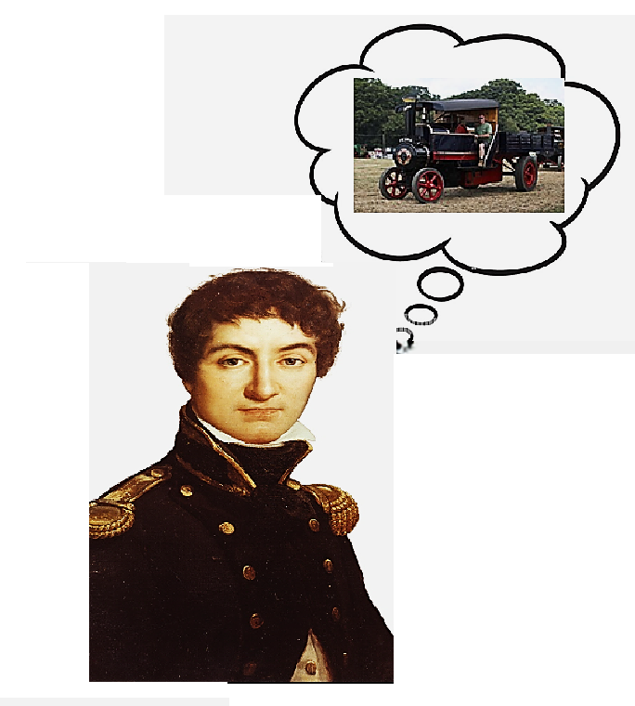
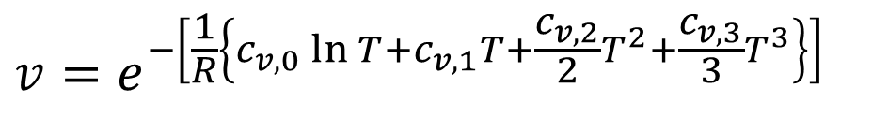
Carnot’s Concept of Air-Standard Model
$$v=e^{−\left[\frac{1}{R}\left\{c_{v,0}\ln{T}+c_{v,1}T+\frac{c_{v,2}}{2}T^{2}+\frac{c_{v,3}}{3}T^{3}\right\}\right]}$$
$$v=e^{−\left[\frac{c_{v,0}}{R}\ln{T}\right]}×e^{−\left[\frac{c_{v,1}}{R}T\right]}×e^{−\left[\frac{c_{v,2}}{R}T^{2}\right]}×e^{−\left[\frac{c_{v,3}}{R}T^{3}\right]}$$

Slide 10
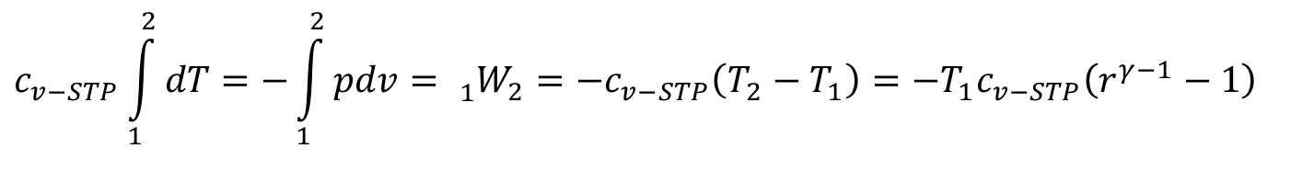
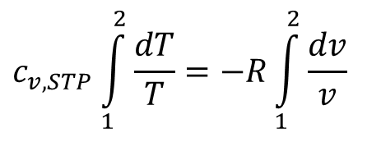
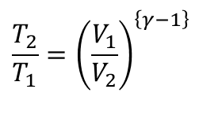
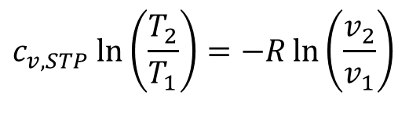
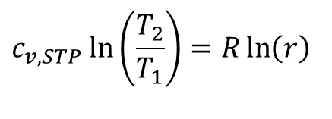
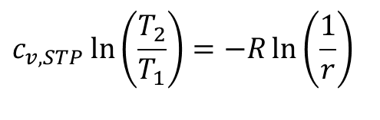
Carnot’s Concept of Air-Standard Model
$$v=e^{−\left[\frac{c_{v,0}}{R}\ln{T}\right]}×e^{−\left[\frac{c_{v,1}}{R}T\right]}×e^{−\left[\frac{c_{v,2}}{R}T^{2}\right]}×e^{−\left[\frac{c_{v,3}}{R}T^{3}\right]}$$
Let the mixture is modeled as air with constant properties measured at STP:
$$c_{v,STP}\int_{1}^{2}{\frac{dT}{T}}=−R\int_{1}^{2}{\frac{dv}{v}}$$
$$c_{v,STP}\ln\left(\frac{T_{2}}{T_{1}}\right)=−R\ln\left(\frac{v_{2}}{v_{1}}\right)$$
$$c_{v,STP}\ln\left(\frac{T_{2}}{T_{1}}\right)=−R\ln\left(\frac{1}{r}\right)$$
$$c_{v,STP}\ln\left(\frac{T_{2}}{T_{1}}\right)=R\ln\left(r\right)$$
$$\frac{T_{2}}{T_{1}}={\left(\frac{V_{1}}{V_{2}}\right)}^{\left\{γ−1\right\}}$$
$$c_{v−STP}\int_{1}^{2}{dT}=−\int_{1}^{2}{pdv}={{}_{1}^{}W}_{2}=−c_{v−STP}\left(T_{2}−T_{1}\right)=−T_{1}c_{v−STP}\left(r^{γ−1}−1\right)$$

Slide 11
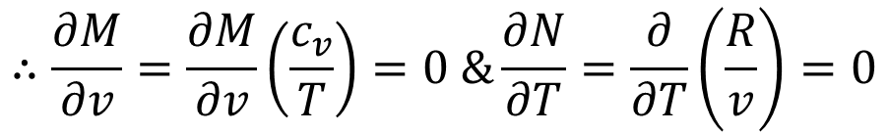
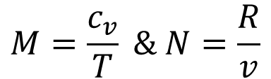
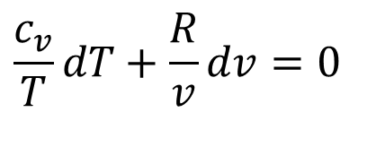
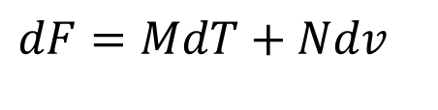
Adiabatic Transformation of an ideal gas
For an ideal Gas in a closed system one possible model is:
$$dF=C_{v}dT+pdV=0$$
Assume ideal gas nature with variable properties:
$$mc_{v}dT+m\frac{RT}{v}dv=0$$
$$c_{v}dT+\frac{RT}{v}dv=0$$
$$\frac{c_{v}}{T}dT+\frac{R}{v}dv=0$$
$$dF=MdT+Ndv$$
$$M=\frac{c_{v}}{T} \& N=\frac{R}{v}$$
$$∴\frac{∂M}{∂v}=\frac{∂M}{∂v}\left(\frac{c_{v}}{T}\right)=0 \&\frac{∂N}{∂T}=\frac{∂}{∂T}\left(\frac{R}{v}\right)=0$$

Slide 12
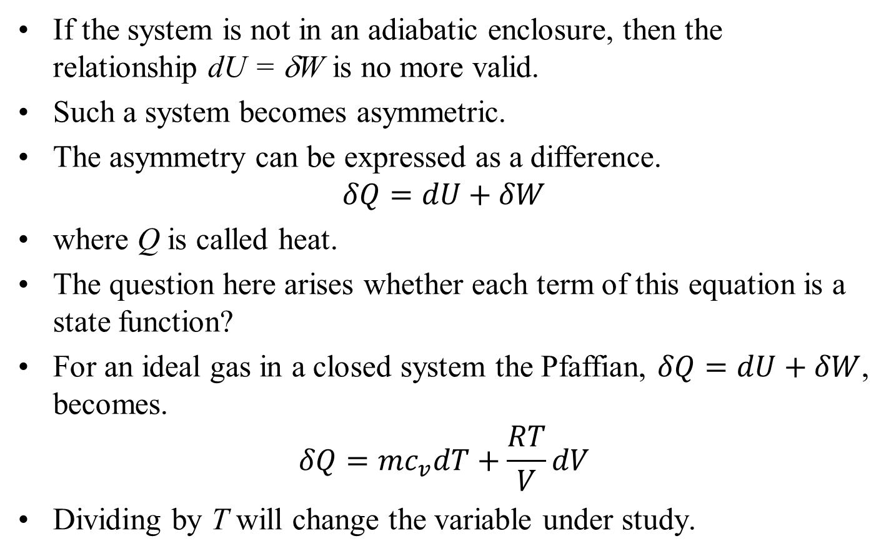
General transformation of an ideal gas
If the system is not in an adiabatic enclosure, then the relationship dU = δW is no more valid.
Such a system becomes asymmetric.
The asymmetry can be expressed as a difference.
$$δQ=dU+δW$$
where Q is called heat.
The question here arises whether each term of this equation is a state function?
For an ideal gas in a closed system the Pfaffian, $δQ=dU+δW$, becomes.
$$δQ=mc_{v}dT+\frac{RT}{V}dV$$
Dividing by T will change the variable under study.

Slide 13
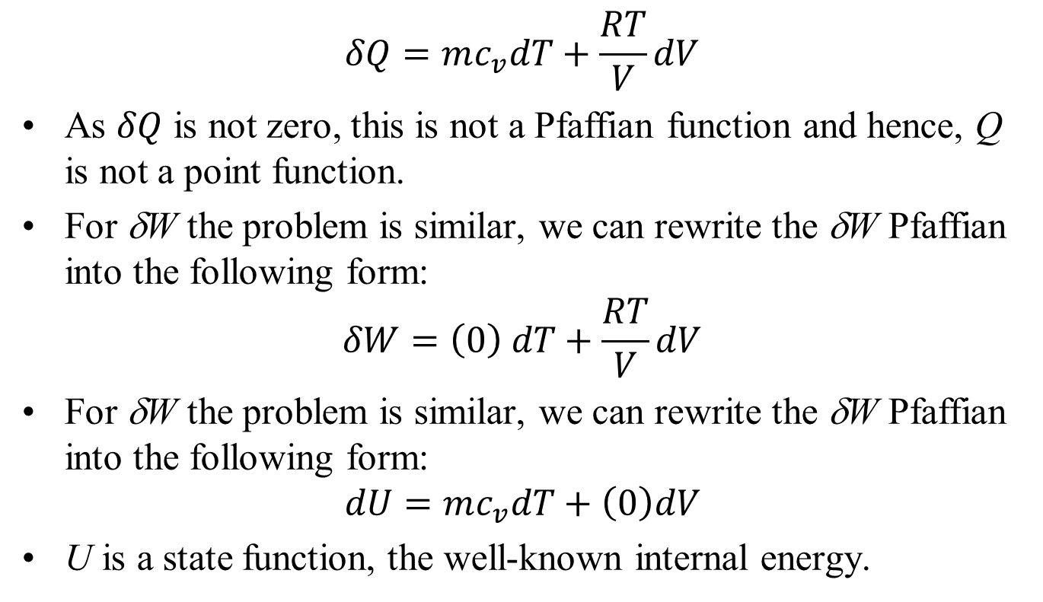
General transformation of an ideal gas
$$δQ=mc_{v}dT+\frac{RT}{V}dV$$
As $δQ$ is not zero, this is not a Pfaffian function and hence, Q is not a point function.
For δW the problem is similar, we can rewrite the δW Pfaffian into the following form:
$$δW=\left(0\right) dT+\frac{RT}{V}dV$$
For δW the problem is similar, we can rewrite the δW Pfaffian into the following form:
$$dU=mc_{v}dT+\left(0\right)dV$$
U is a state function, the well-known internal energy.

Slide 14
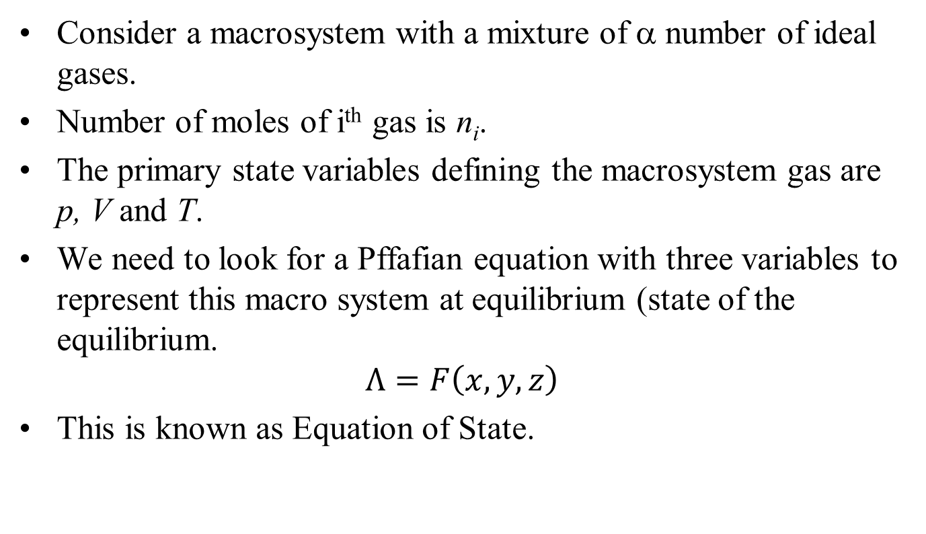
Macrosystem with Mixture of Ideal Gases
Consider a macrosystem with a mixture of α number of ideal gases.
Number of moles of i^{th} gas is n_{i}.
The primary state variables defining the macrosystem gas are p, V and T.
We need to look for a Pffafian equation with three variables to represent this macro system at equilibrium (state of the equilibrium.
$$Λ=F\left(x,y,z\right)$$
This is known as Equation of State.

Slide 15
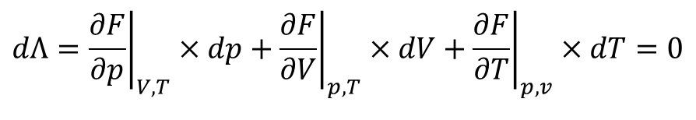
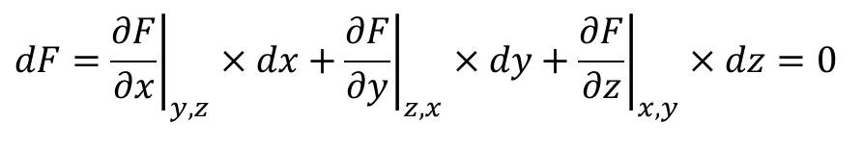
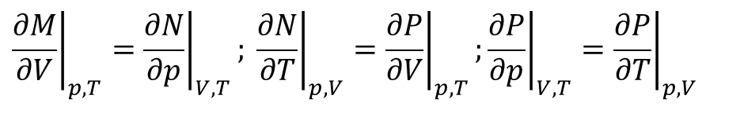
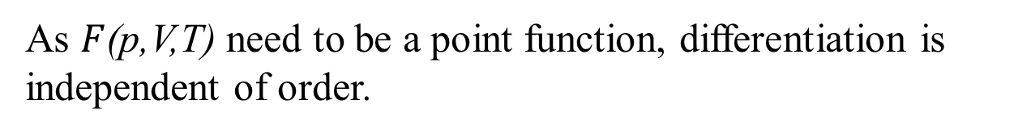
Total Differential of three Variable Function
A total change in an unknown function is expressed as:
$$dF={\left.\frac{∂F}{∂x}\right|}_{y,z}×dx+{\left.\frac{∂F}{∂y}\right|}_{z,x}×dy+{\left.\frac{∂F}{∂z}\right|}_{x,y}×dz=0$$
$$dΛ={\left.\frac{∂F}{∂p}\right|}_{V,T}×dp+{\left.\frac{∂F}{∂V}\right|}_{p,T}×dV+{\left.\frac{∂F}{∂T}\right|}_{p,v}×dT=0$$
Define functions M,N & P such that:
$$dF=M(p,V,T)×dp+N(p,V,T)×dV+P(p,V,T)×dT$$
This is called as Pfaffian differential equation.
As $F$(p,V,T) need to be a point function, differentiation is independent of order.
$${\left.\frac{∂M}{∂V}\right|}_{p,T}={\left.\frac{∂N}{∂p}\right|}_{V,T}; {\left.\frac{∂N}{∂T}\right|}_{p,V}={\left.\frac{∂P}{∂V}\right|}_{p,T};{\left.\frac{∂P}{∂p}\right|}_{V,T}={\left.\frac{∂P}{∂T}\right|}_{p,V}$$

Slide 16
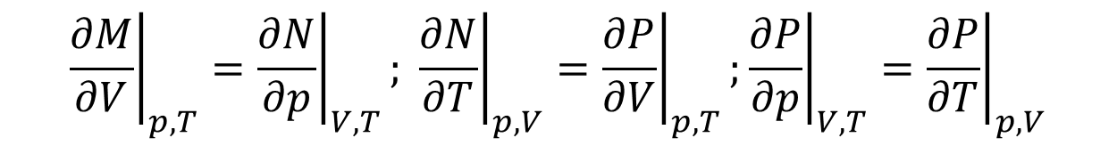
Mathematics for Change in State
$${\left.\frac{∂M}{∂V}\right|}_{p,T}={\left.\frac{∂N}{∂p}\right|}_{V,T}; {\left.\frac{∂N}{∂T}\right|}_{p,V}={\left.\frac{∂P}{∂V}\right|}_{p,T};{\left.\frac{∂P}{∂p}\right|}_{V,T}={\left.\frac{∂P}{∂T}\right|}_{p,V}$$
This is a necessary and sufficient condition for Λ(.) to be a Point function or state function.
Thermodynamic properties are so related that F(.) is constant.
Every substance is represented as F(.) in Mathematical (Caratheodory) Thermodynamics.
This shows a surface connectivity of Property of a substance.

Slide 17
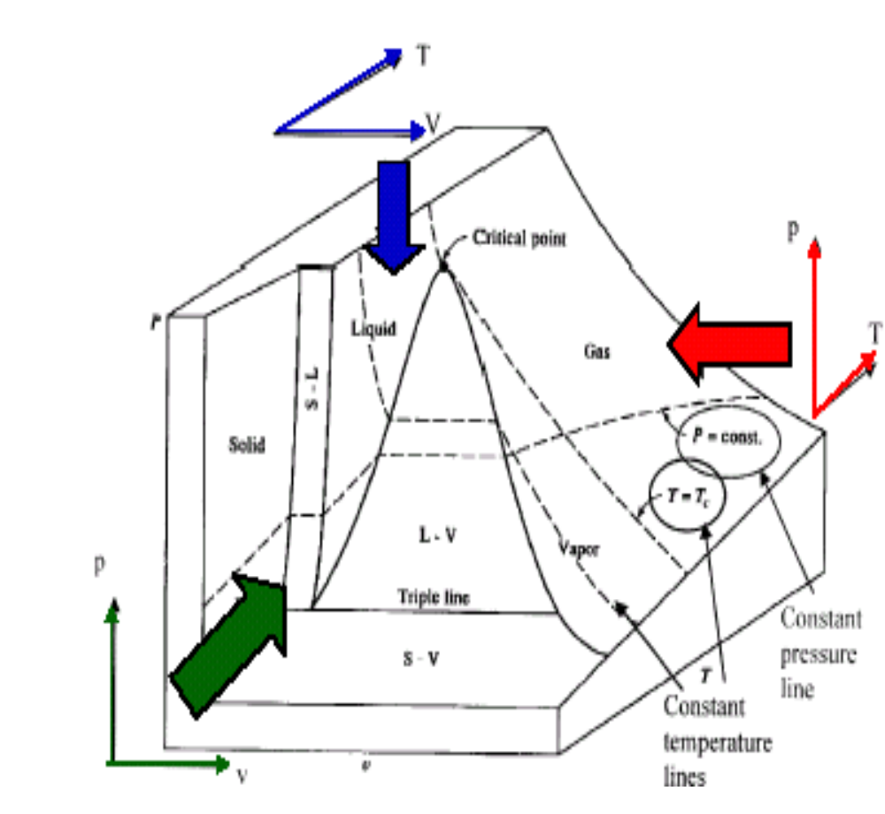
p-v-T Diagram of H₂O

Slide 18
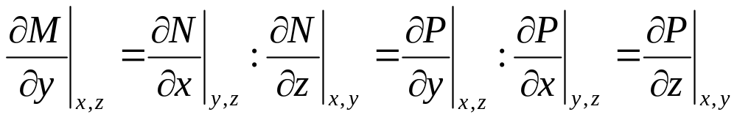
Inaccessibility of Thermodynamic State
From a point on any (property) surface (of a substance) only on the same surface are accessible along that solution surface.
Any given substance, starting from an initial state on its property relation surface it can access only those states which lie on this surface.
Consider any analytic function G(x,y,z) and derived dG as
$$dG=M\left(x,y,z\right)×dx+N\left(x,y,z\right)×dy+P\left(x,y,z\right)×dz=0$$
This total differential may not satisfy

Slide 19
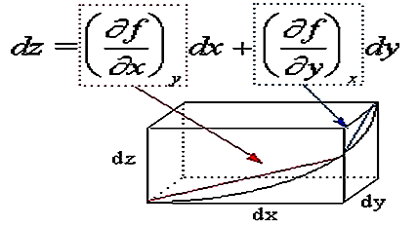
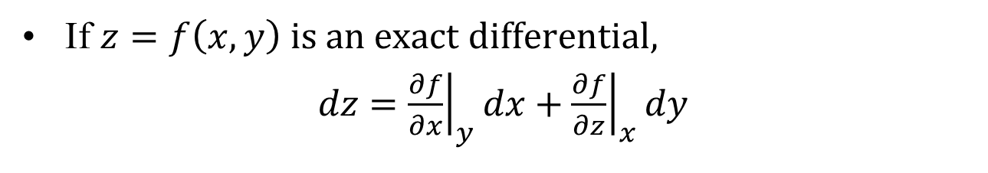
Geometrical Interpretation Exact Differentials
If $z=f\left(x,y\right) is an exact differential,$
$dz={\left.\frac{∂f}{∂x}\right|}_{y}dx+{\left.\frac{∂f}{∂z}\right|}_{x}dy$

Slide 20
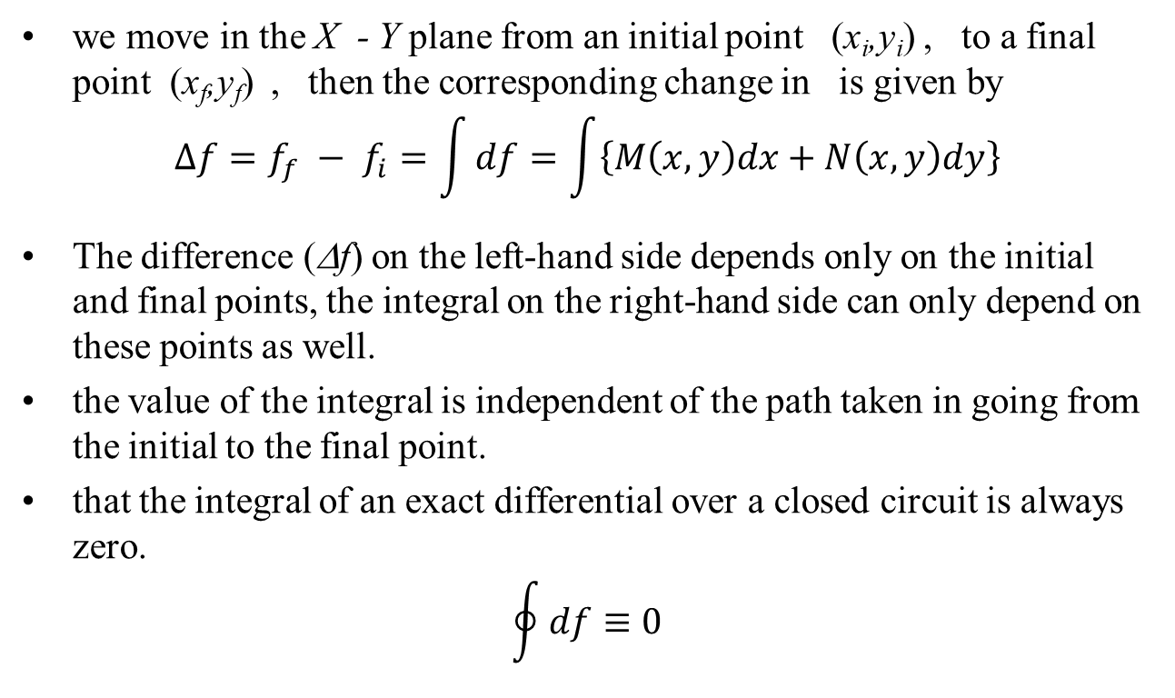
Integration of Exact Differential
we move in the X - Y plane from an initial point (x_{i},y_{i}) , to a final point (x_{f},y_{f}) , then the corresponding change in is given by
$$Δf=f_{f} − f_{i}=\int{df}=\int{\left\{M\left(x,y\right)dx+N\left(x,y\right)dy\right\}}$$
The difference (Δf) on the left-hand side depends only on the initial and final points, the integral on the right-hand side can only depend on these points as well.
the value of the integral is independent of the path taken in going from the initial to the final point.
that the integral of an exact differential over a closed circuit is always zero.
$$\oint{df≡0}$$

Slide 21
Model for Thermodynamic Property
A Macrosystem at any equilibrium state should be described using an Exact function.
The change in this function can be calculated without doing any action.
Instruments can be easily developed to measure these functions.
Function tables can be prepared and marketed.
Any industrial process can use these tables.
Primary functions are in general directly measured.
Derived functions are calculated using the measured primary functions.
Special instruments can be developed to measure derived properties !
This function is called as PROPERTY in Thermodynamics.

Slide 22
Corollaries on Properties.
Corollary 1: A change of state is fully described by means of the initial and final values of all the primitive properties of the system.
  A change occurs when at least one of its primitive properties changes value.
Corollary 2: A process is required for the determination of a derived property.
Corollary 3: The change in value of a property is fixed by the end states of a system undergoing a change of state and is independent of the path.
Corollary 4: Any quantity which is fixed by the end states of a process is a property.
Corollary 5: When a system goes through a cycle, the change in value of any property is zero.
Corollary 6: Any quantity whose change in a cycle is zero is a property of a system.

Slide 23
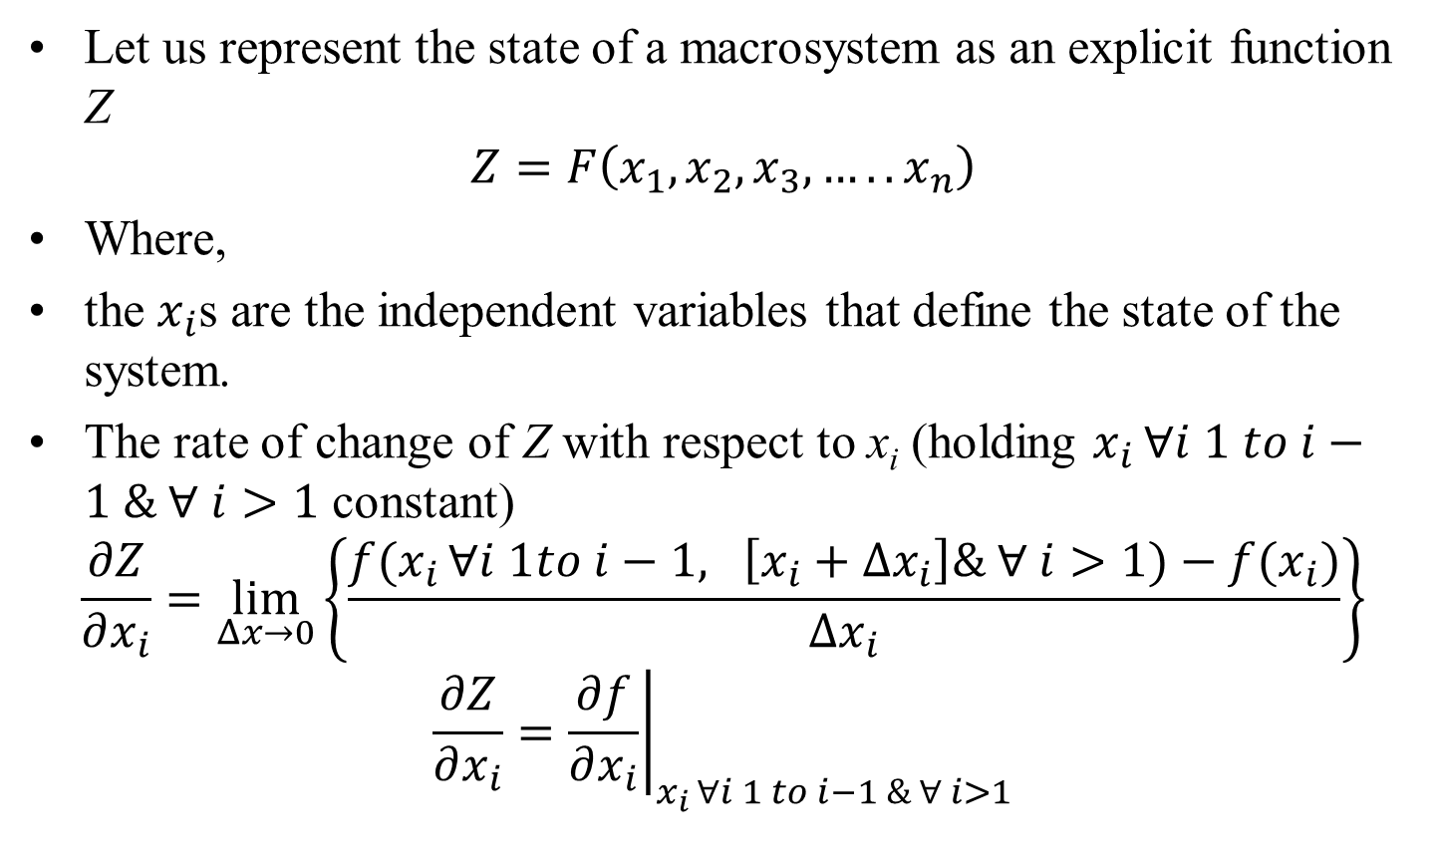
Functions of Several Variables
Let us represent the state of a macrosystem as an explicit function Z
$$Z=F\left(x_{1}, x_{2}, x_{3}, …..x_{n}\right)$$
Where,
the $x_{i}$s are the independent variables that define the state of the system.
The rate of change of Z with respect to x_{i} (holding $x_{i }∀i 1 to i−1 \& ∀ i>1$ constant)
$$\frac{∂Z}{∂x_{i}}=\lim_{Δx→0}\left\{\frac{f(x_{i }∀i 1to i−1, \left[x_{i}+Δx_{i}\right]\& ∀ i>1)−f(x_{i})}{Δx_{i}}\right\}$$
$$\frac{∂Z}{∂x_{i}}={\left.\frac{∂f}{∂x_{i}}\right|}_{x_{i }∀i 1 to i−1 \& ∀ i>1}$$

Slide 24

Functions of Several Variables
$$\frac{∂Z}{∂x_{i}}={\left.\frac{∂f}{∂x_{i}}\right|}_{x_{i }∀i 1 to i−1 \& ∀ i>1}$$
As the physical variables in thermodynamics are continuous functions, all the higher order derivative are also continuous.
In general, following assumption is valid:
$$\frac{∂}{∂x_{j}}\frac{∂f}{∂x_{i}}=\frac{∂}{∂x_{i}}\frac{∂f}{∂x_{j}} …. etc.$$
If the variables $x_{1}, x_{2}, x_{3}, …..x_{n}$are not independent but are each functions of a finite number of independent variables $y_{1}, y_{2}, y_{3}, …..y_{n}$, i.e.,
$$x_{1}=f_{1}\left(y_{1}, y_{2}, y_{3}, …..y_{n}\right);x_{2}=f_{2}\left(y_{1}, y_{2}, y_{3}, …..y_{n}\right);…$$

Slide 25

Functions of Several Variables
$$x_{1}=f_{1}\left(y_{1}, y_{2}, y_{3}, …..y_{n}\right); x_{2}=f_{2}\left(y_{1}, y_{2}, y_{3}, …..y_{n}\right);$$
$$…… .{ x}_{n}=f_{2}\left(y_{1}, y_{2}, y_{3}, …..y_{n}\right)$$
Then it may readily be shown that the total differential of Z can be written as
$$dZ={\left.\frac{∂f}{∂y_{1}}\right|}_{y_{2 }…….y_{n }}dy_{1}+{\left.\frac{∂f}{∂y_{1}}\right|}_{y_{1, }y_{3}…….y_{n }}dy_{2}+ …….$$
Or as
$$dZ={\left.\frac{∂f}{∂x_{1}}\right|}_{x_{2 }…….x_{n }}dx_{1}+{\left.\frac{∂f}{∂x_{1}}\right|}_{x_{1, }x_{3}…….x_{n }}dx_{2}+ …….$$
Thus, the total differential may be expressed in terms of partial derivatives taken with respect to the independent variables or
In terms of partial derivatives taken with respect to the dependent variables

Slide 26

Functions of Several Variables
Higher- order differentials are defined in the usual way as
$$d^{2}f=d\left(df\right), ……..d^{n}f=d^{n−1}\left(df\right)$$
For the special case of a two variable function…

Slide 27



Functions of Two Variables
Let a thermodynamic state of a system is defined using variables x, y and z as;
$$Z=F\left(x,y\right)$$
The rate of change of F with respect to x (holding y constant) is called the partial derivative of f with respect to x and is denoted by
$$\frac{∂F}{∂x}=\lim_{Δx→0}\left\{\frac{f(x+Δx,y)−f(x,y)}{Δx}\right\}$$
Similarly, the rate of change of f with respect to y is called the partial derivative of f with respect to y and is denoted by .
$$\frac{∂F}{∂y}=\lim_{Δy→0}\left\{\frac{f(x,y+Δy)−f(x,y)}{Δy}\right\}$$

Slide 28




Total Differential of three Variable Function
A total change in Function is expressed as:
$$dZ={\left.\frac{∂F}{∂x}\right|}_{y}×dx+{\left.\frac{∂F}{∂y}\right|}_{x}×dy$$
It can be readily shown that
$$d^{n}F=\frac{∂^{n}f}{∂x^{n}}{\left(dx\right)}^{n}+\left(\begin{matrix}n \\ 1\end{matrix}\right)\frac{∂^{n}f}{∂x^{n−1}dy}{\left(dx\right)}^{n−1}dy+ ….. +\left(\begin{matrix}n \\ k\end{matrix}\right)\frac{∂^{n}f}{∂x^{n−k}dy^{k}}{\left(dx\right)}^{n−k}{\left(dy\right)}^{k}+ …..+n\frac{∂^{n}f}{dx∂y^{n−1}}dx{\left(dy\right)}^{n−1}+\frac{∂^{n}f}{∂y^{n}}{\left(dy\right)}^{n}$$
where,
$$\left(\begin{matrix}n \\ k\end{matrix}\right)=\frac{n!}{k!\left(n−k\right)!}$$
$$\left(\begin{matrix}n \\ k−1\end{matrix}\right)=\frac{n!}{k!\left(n−k\right)!}$$
is the binomial coefficient.

Slide 29

Total Differentials in Thermodynamics
In many problems arising in thermodynamics, the dependance of a given variable is not known explicitly in terms of the independent variables.
The relations between the variables is given implicitly,
If $α\left(x,y\right)=0$
It is readily shown that
$$\frac{dy}{dx}=−\frac{\left.\left({∂α}/{∂x}\right)\right|y}{\left.\left({∂α}/{∂y}\right)\right|x}$$
Similarly, if $β\left(x,y,z\right)=0.$
Then $\left.\frac{∂x}{∂z}\right|y=−\frac{\left.\left({∂β}/{∂z}\right)\right|x,y}{\left.\left({∂β}/{∂x}\right)\right|y,z}$ & $\left.\frac{∂x}{∂y}\right|z=−\frac{\left.\left({∂β}/{∂y}\right)\right|x,z}{\left.\left({∂β}/{∂x}\right)\right|y,z}$

Slide 30

Total Differentials in Thermodynamics
Finally, if
$$γ\left(x,y,z\right)=0$$
$$ε\left(x,y,z\right)=0$$
Then $dx:dy:dz=\left|\begin{matrix}γ_{y} & γ_{z} \\ ε_{y} & ε_{z}\end{matrix}\right|:\left|\begin{matrix}γ_{z} & γ_{x} \\ ε_{z} & ε_{x}\end{matrix}\right|:\left|\begin{matrix}γ_{x} & γ_{y} \\ ε_{x} & ε_{y}\end{matrix}\right|$
Where,$γ_{y}={\left.\frac{∂γ}{∂y}\right|}_{z,x},ε_{y}= {\left.\frac{∂ε}{∂y}\right|}_{z,x}$_{, etc……}

Slide 31
Exact Differentials in Thermodynamics
Many of the thermodynamic variables are complete or exact differentials.
Their integrals are independent of the path of integration and depend only on the end equilibrium states.
This result for completed differentials may be derived by considering functions of two independent variables.
In the solution of thermodynamic problems , it may be important to use the differential calculus discussed above.

