Slide 1

Pfaffian Differential Equations
P M V Subbarao
Professor & Head
Mechanical Engineering Department
I I T Delhi
Pfaffian differential equations are the mathematical tools for axiomatic thermodynamics of Carathéodory.

Slide 2

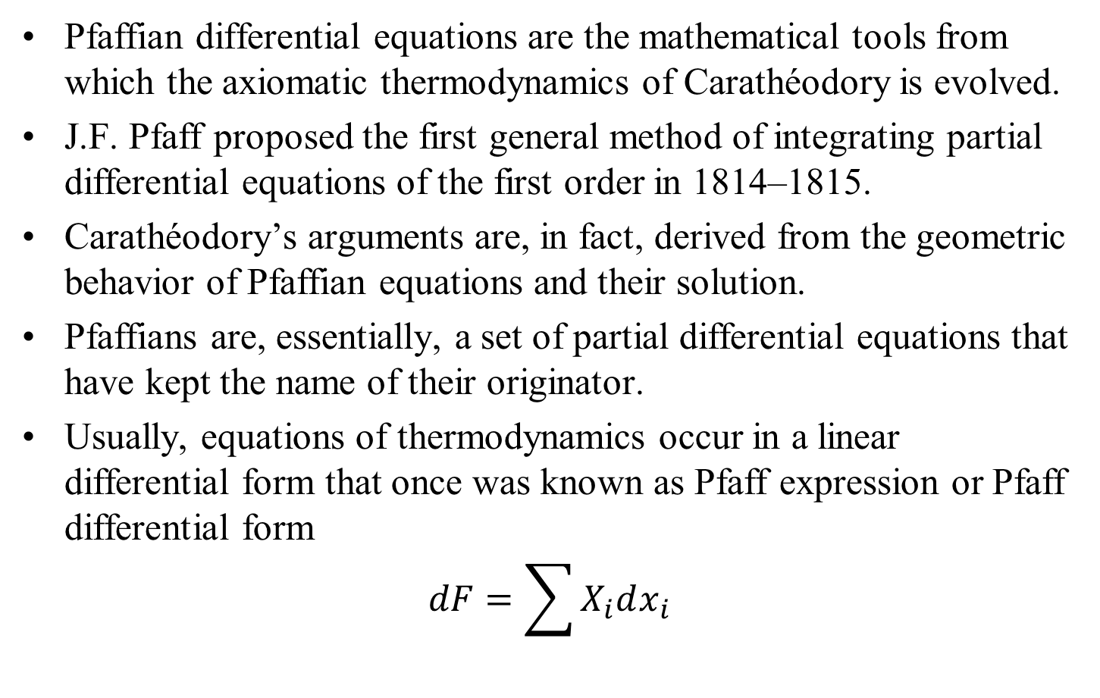
Pfaffian Differential Equations
Pfaffian differential equations are the mathematical tools from which the axiomatic thermodynamics of Carathéodory is evolved.
J.F. Pfaff proposed the first general method of integrating partial differential equations of the first order in 1814–1815.
Carathéodory’s arguments are, in fact, derived from the geometric behavior of Pfaffian equations and their solution.
Pfaffians are, essentially, a set of partial differential equations that have kept the name of their originator.
Usually, equations of thermodynamics occur in a linear differential form that once was known as Pfaff expression or Pfaff differential form
$$dF=\sum{X_{i}dx_{i}}$$

Slide 3
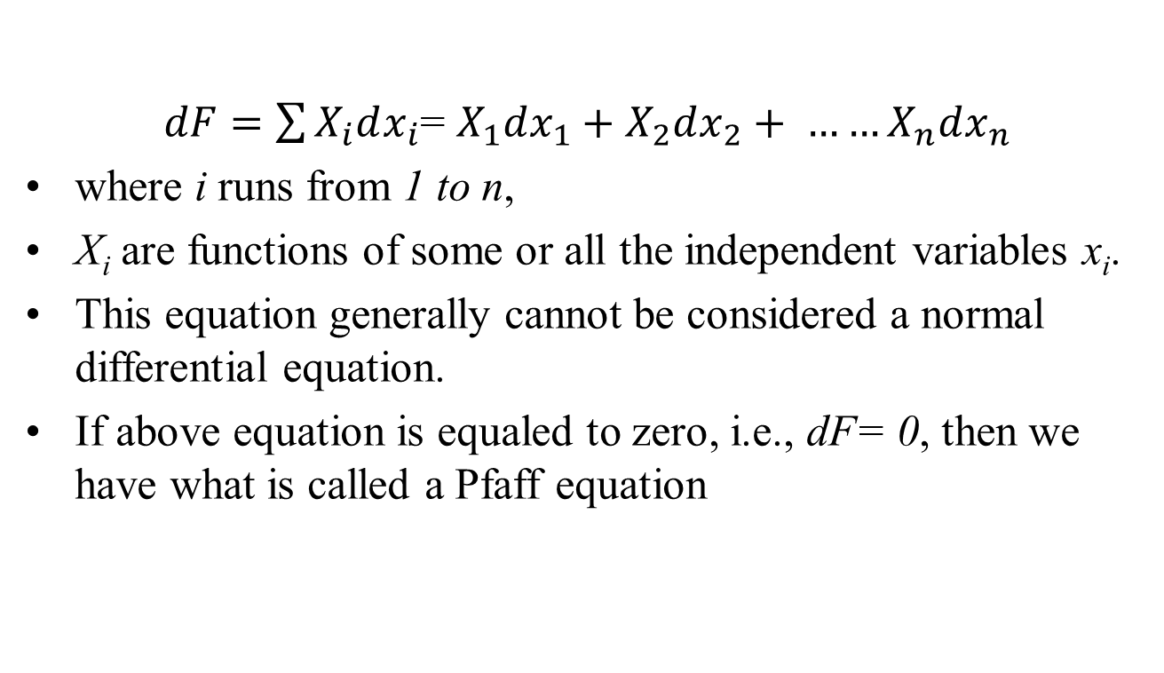
Pfaffian Differential Equations
$dF=\sum{X_{i}dx_{i}}$= $X_{1}dx_{1}+X_{2}dx_{2}+ ……X_{n}dx_{n}$
where i runs from 1 to n,
X_{i} are functions of some or all the independent variables x_{i}.
This equation generally cannot be considered a normal differential equation.
If above equation is equaled to zero, i.e., dF= 0, then we have what is called a Pfaff equation

Slide 4
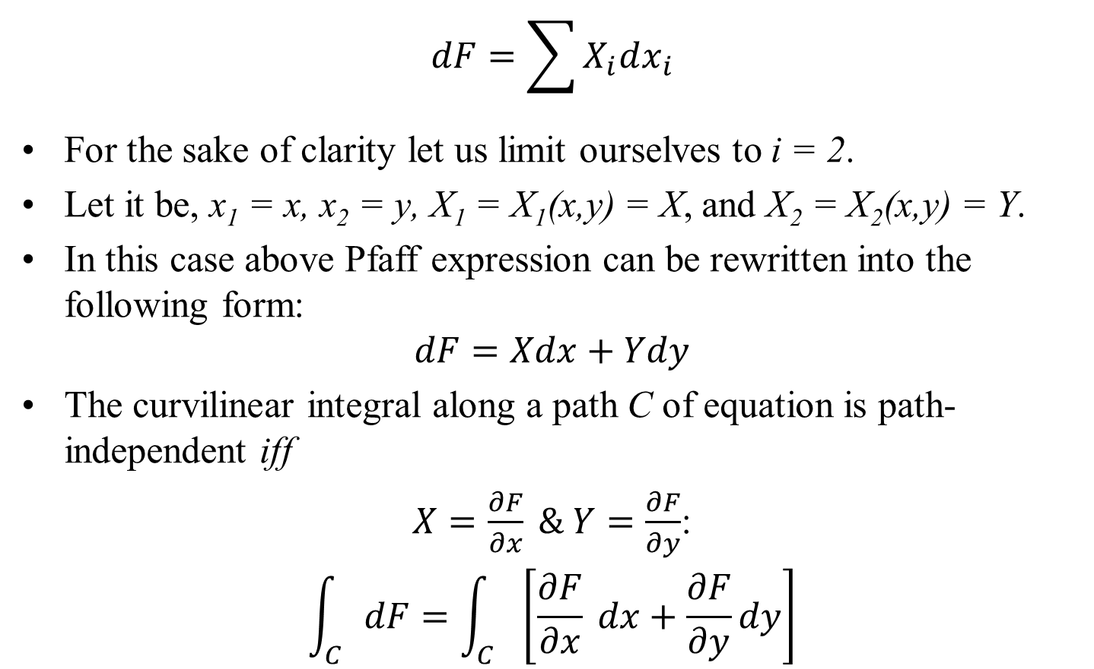
Functions of Two Variables
$$dF=\sum{X_{i}dx_{i}}$$
For the sake of clarity let us limit ourselves to i = 2.
Let it be, x₁ = x, x₂ = y, X₁ = X₁(x,y) = X, and X₂ = X₂(x,y) = Y.
In this case above Pfaff expression can be rewritten into the following form:
$$dF=Xdx+Ydy$$
The curvilinear integral along a path C of equation is path-independent iff
$X=\frac{∂F}{∂x} \& Y=\frac{∂F}{∂y}$:
$$\int_{C}{dF}=\int_{C}{\left[\frac{∂F}{∂x} dx+\frac{∂F}{∂y}dy\right]}$$

Slide 5
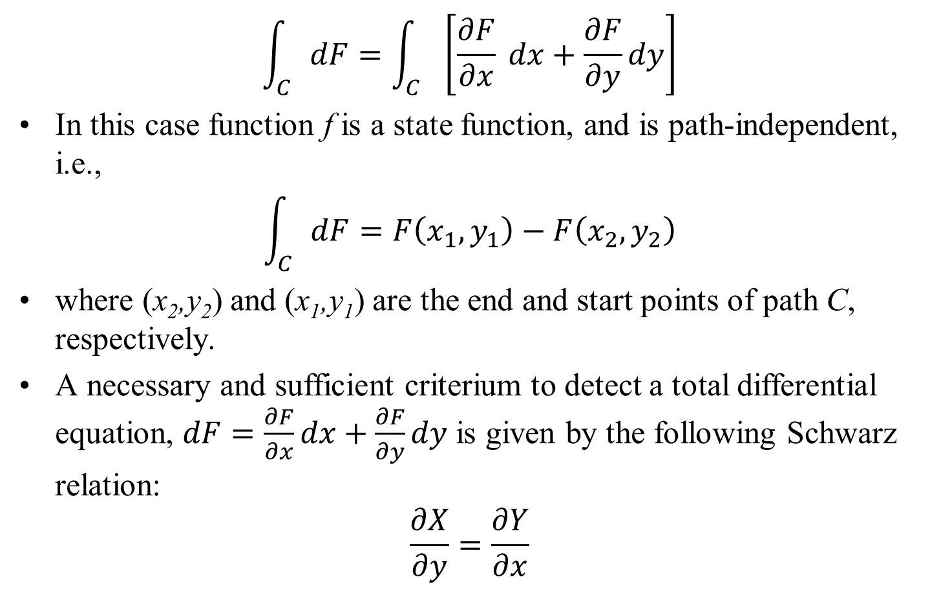

Functions of Two Variables
$$\int_{C}{dF}=\int_{C}{\left[\frac{∂F}{∂x} dx+\frac{∂F}{∂y}dy\right]}$$
In this case function f is a state function, and is path-independent, i.e.,
$$\int_{C}{dF}=F\left(x_{1},y_{1}\right)−F\left(x_{2},y_{2}\right)$$
where (x₂,y₂) and (x₁,y₁) are the end and start points of path C, respectively.
A necessary and sufficient criterium to detect a total differential equation, $dF=\frac{∂F}{∂x}dx+\frac{∂F}{∂y}dy$ is given by the following Schwarz relation:
$$\frac{∂X}{∂y}=\frac{∂Y}{∂x}$$

Slide 6
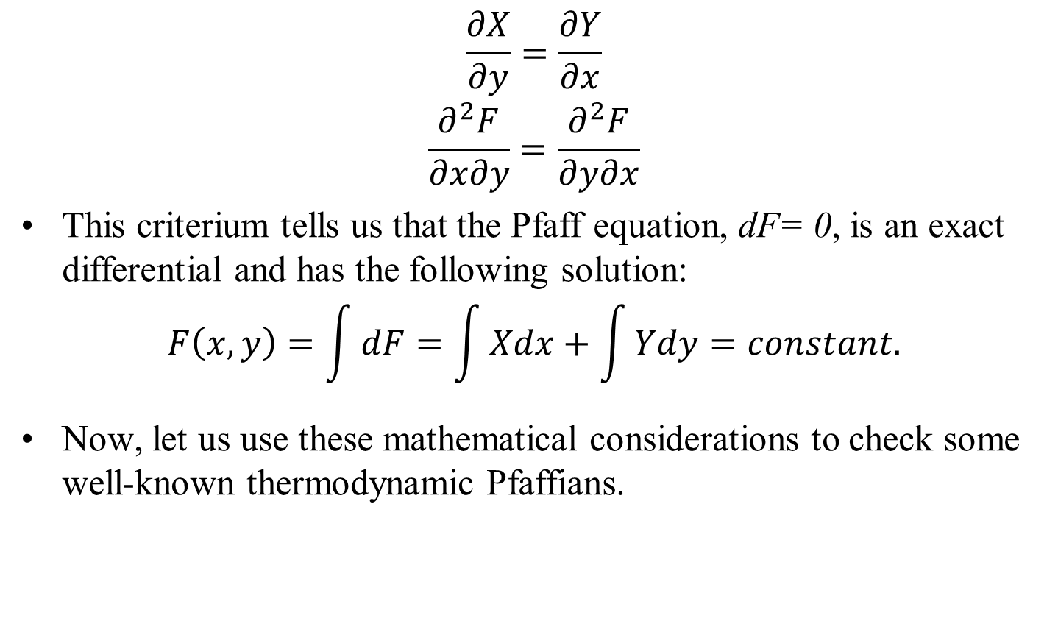
Functions of Two Variables
$$\frac{∂X}{∂y}=\frac{∂Y}{∂x}$$
$$\frac{∂^{2}F}{∂x∂y}=\frac{∂^{2}F}{∂y∂x}$$
This criterium tells us that the Pfaff equation, dF= 0, is an exact differential and has the following solution:
$$F\left(x,y\right)=\int{dF}=\int{Xdx}+\int{Ydy}=constant.$$
Now, let us use these mathematical considerations to check some well-known thermodynamic Pfaffians.

Slide 7
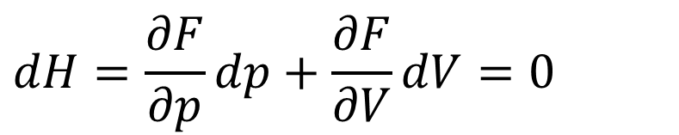
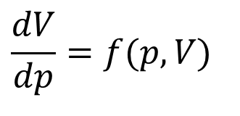
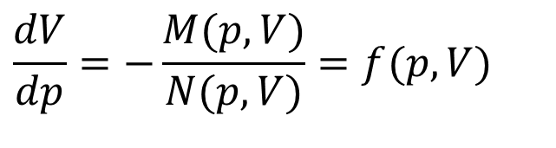
Boyle’s Experimental Work
Boyle considered a macrosystem consisting a mixture of unknown number of generally know gases at constant temperature and simplified his system to have a state equation as
$$dH=\frac{∂F}{∂p}dp+\frac{∂F}{∂V}dV=0$$
Define function M and N as:
$$dH=M(p,V)×dp+N(p,V)×dV=0$$
Then
$$\frac{dV}{dp}=−\frac{M(p,V)}{N(p,V)}=f(p,V)$$
$$\frac{dV}{dp}=f(p,V)$$
Is an ordinary differential equation with
F(x,y) = constant

Slide 8
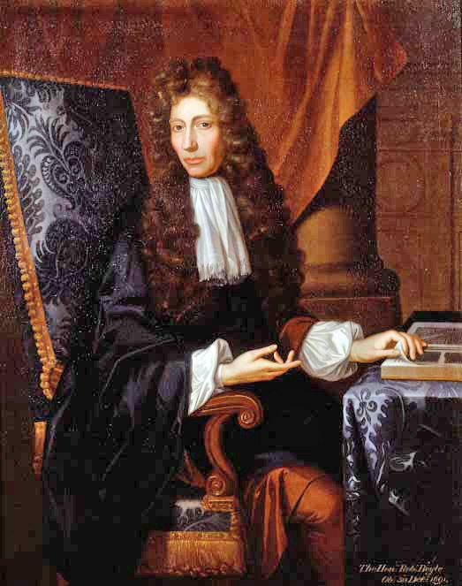
Robert Boyle
17th-century natural philosopher, chemist, physicist, and inventor, also noted for his writings in theology.
Unlike most scientists of the day, Boyle did not seek to discover new things by arguing matters logically.
Instead, Boyle was interested in making observations and drawing conclusions based on these.
It was Boyle who started the practice of conducting controlled experiments.
He used to publish his experiments while noting down his practices and the various apparatus that he used.

Slide 9
History of Biogas
Scientific interest in the gases produced by the natural decomposition of organic matter, was first reported by Robert Boyle and Stephen Hale.
They noted that inflammable gas was released by disturbing the sediment of streams and lakes.
In 1808, Sir Humphry Davy determined that methane was present in the gases produced by cattle manure.
The first anaerobic digester was built by a leper colony in Bombay, India in 1859.
In 1895 the technology was developed in Exeter, England, where a septic tank was used to generate gas for street lighting.

Slide 10
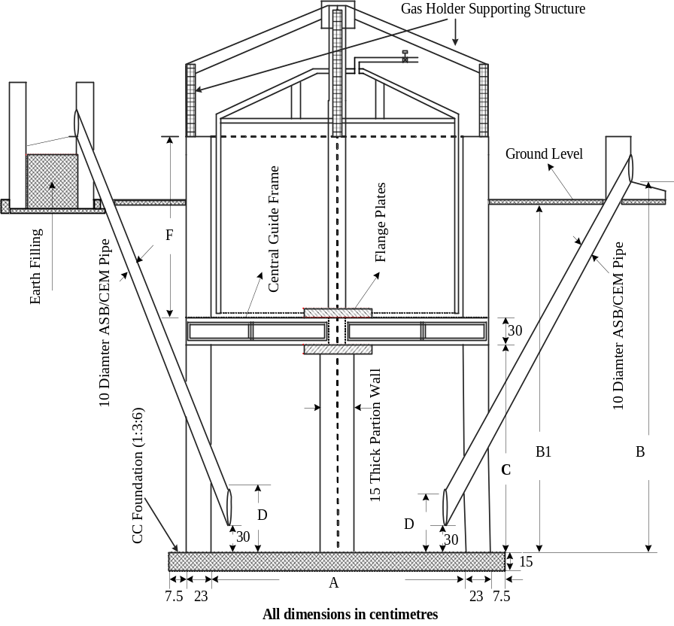
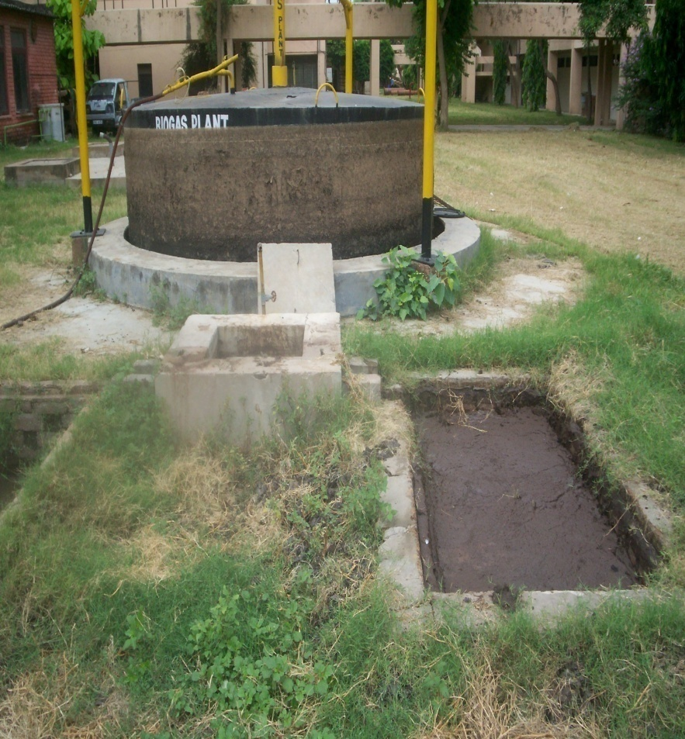
Biogas plant (20 m³/day) Available at IIT Delhi

Slide 11

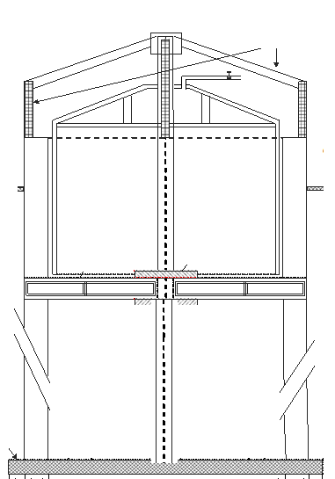
Biological Digester

Slide 12
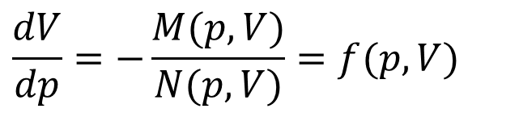
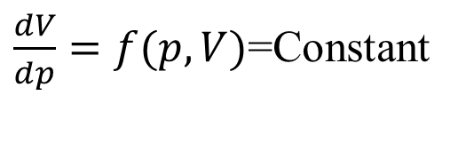
Boyle’s Experimental Work
$$\frac{dV}{dp}=−\frac{M(p,V)}{N(p,V)}=f(p,V)$$
$\frac{dV}{dp}=f(p,V)$=Constant
Is an ordinary differential equation with
pV= constant

Slide 13
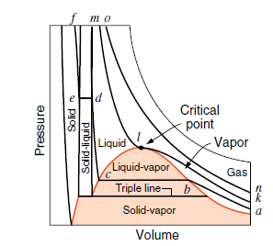
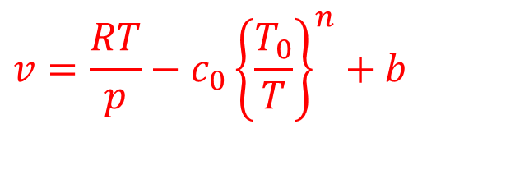
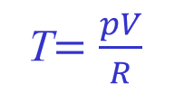
Pressure Volume Diagram
T$=\frac{pV}{R}$
$$v=\frac{RT}{p}−c_{0}{\left\{\frac{T_{0}}{T}\right\}}^{n}+b$$

Slide 14
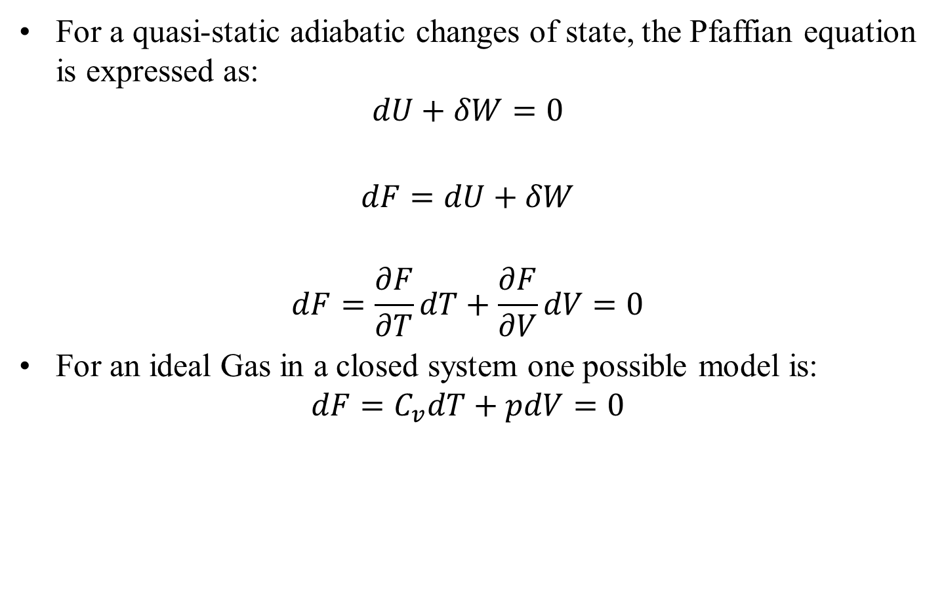
Adiabatic Transformation of an ideal gas
For a quasi-static adiabatic changes of state, the Pfaffian equation is expressed as:
$$dU+δW=0$$
$$dF=dU+δW$$
$$dF=\frac{∂F}{∂T}dT+\frac{∂F}{∂V}dV=0$$
For an ideal Gas in a closed system one possible model is:
$$dF=C_{v}dT+pdV=0$$

Slide 15
Adiabatic Transformation of an ideal gas
Recall Analysis done on Board…..

