Slide 1

Axiomatic Analysis of First Law
P M V Subbarao
Professor & Head
Mechanical Engineering Department
I I T Delhi
Analytics for Geometrization of thermodynamics…

Slide 2

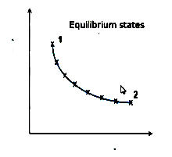
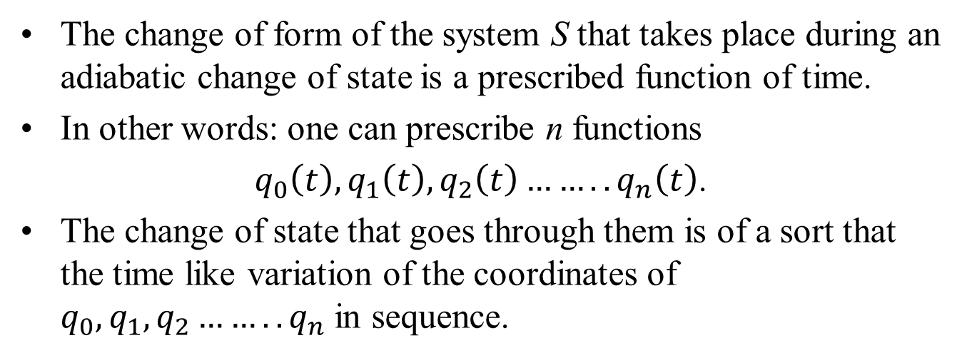

Sequence of Point Sets
The change of form of the system S that takes place during an adiabatic change of state is a prescribed function of time.
In other words: one can prescribe n functions
$q_{0}\left(t\right),q_{1}\left(t\right),q_{2}\left(t\right)……..q_{n}\left(t\right)$.
The change of state that goes through them is of a sort that the time like variation of the coordinates of $q_{0},q_{1},q_{2}……..q_{n}$ in sequence.
$$q_{i}$$
t
Geometrization of thermodynamics…

Slide 3
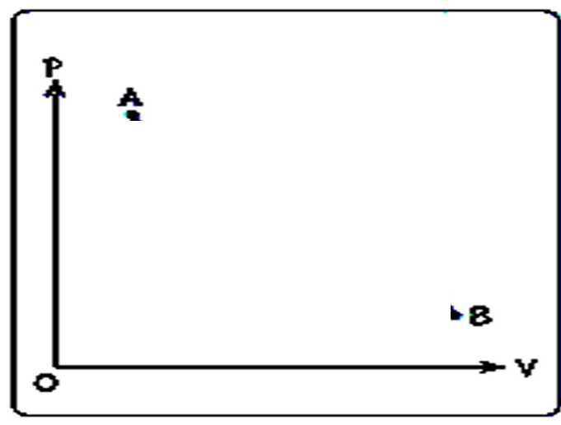
An Important Axiom for Work
Consider number of adiabatic change of States between A and B
Initial State
Maximum Work Path
Final State

Slide 4
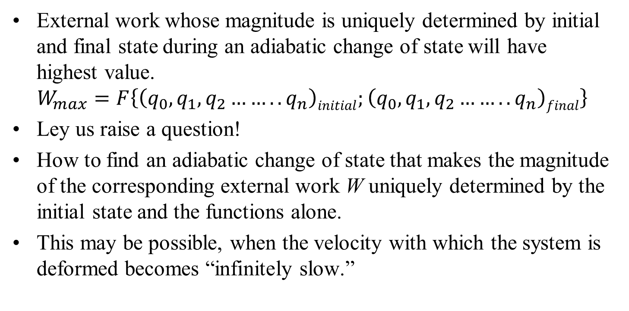
Unique Determination of Work
External work whose magnitude is uniquely determined by initial and final state during an adiabatic change of state will have highest value.
$$W_{max}=F\left\{\left(q_{0},q_{1},q_{2}……..q_{n}\right)initial;\left(q_{0},q_{1},q_{2}……..q_{n}\right)final\right\}$$
Ley us raise a question!
How to find an adiabatic change of state that makes the magnitude of the corresponding external work W uniquely determined by the initial state and the functions alone.
This may be possible, when the velocity with which the system is deformed becomes “infinitely slow.”

Slide 5
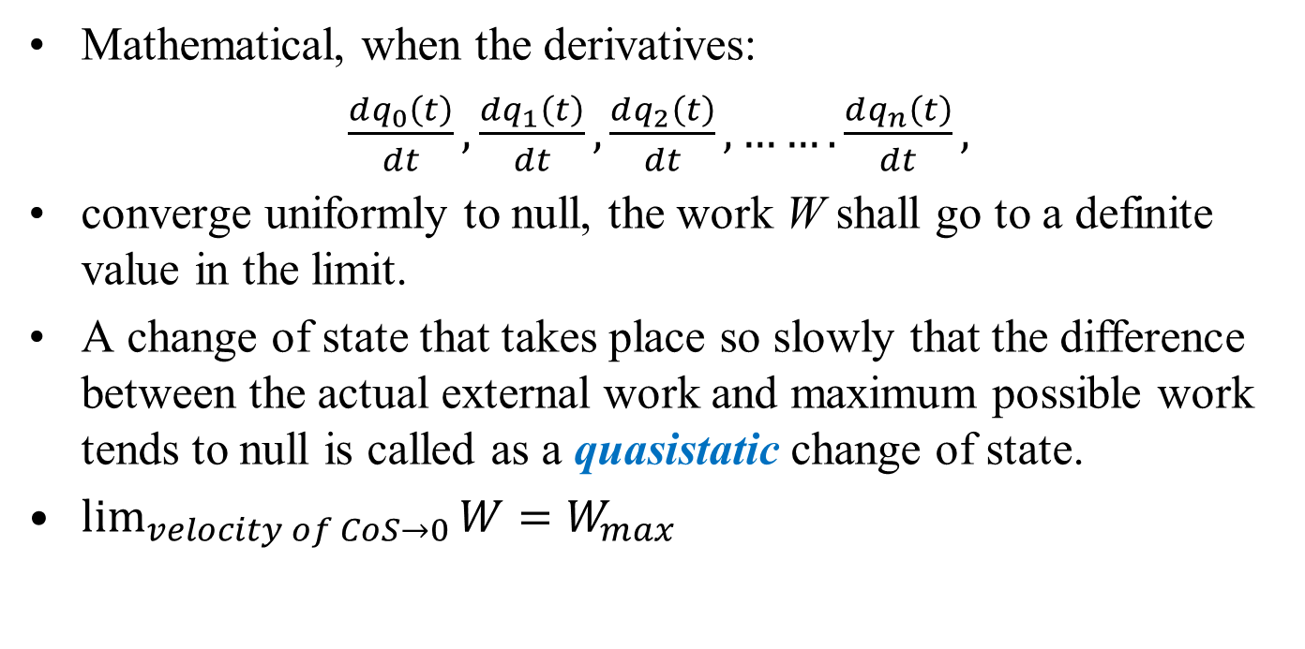
Unique Determination of Work
Mathematical, when the derivatives:
$\frac{dq_{0}\left(t\right)}{dt},\frac{dq_{1}\left(t\right)}{dt},\frac{dq_{2}\left(t\right)}{dt},…….\frac{dq_{n}\left(t\right)}{dt},$
converge uniformly to null, the work W shall go to a definite value in the limit.
A change of state that takes place so slowly that the difference between the actual external work and maximum possible work tends to null is called as a quasistatic change of state.
$\lim_{velocity of CoS→0}{W}=W_{max}$

Slide 6
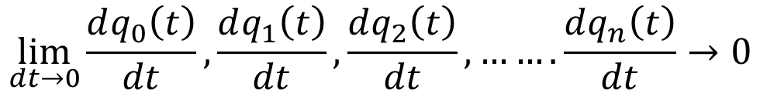
Maximum Work Path
$$\lim_{dt→0}{\frac{dq_{0}\left(t\right)}{dt},\frac{dq_{1}\left(t\right)}{dt},\frac{dq_{2}\left(t\right)}{dt},…….\frac{dq_{n}\left(t\right)}{dt}→0}$$
Initial State
Final State

Slide 7
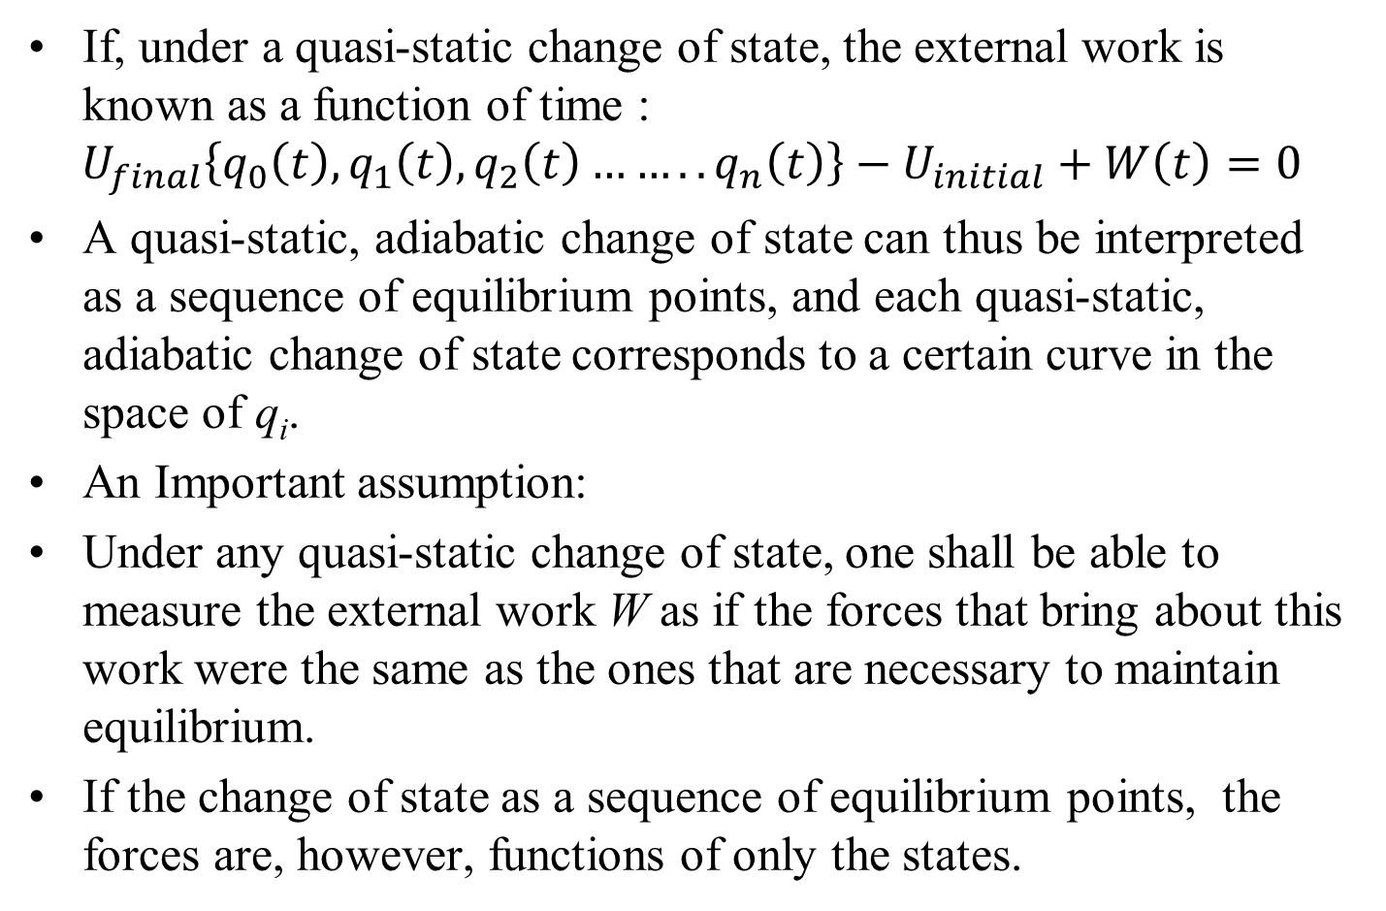
Quasistatic Change of State
If, under a quasi-static change of state, the external work is known as a function of time :
$$U_{final}\left\{q_{0}\left(t\right),q_{1}\left(t\right),q_{2}\left(t\right)……..q_{n}\left(t\right)\right\}−U_{initial}+W\left(t\right)=0$$
A quasi-static, adiabatic change of state can thus be interpreted as a sequence of equilibrium points, and each quasi-static, adiabatic change of state corresponds to a certain curve in the space of q_{i}.
An Important assumption:
Under any quasi-static change of state, one shall be able to measure the external work W as if the forces that bring about this work were the same as the ones that are necessary to maintain equilibrium.
If the change of state as a sequence of equilibrium points, the forces are, however, functions of only the states.

Slide 8
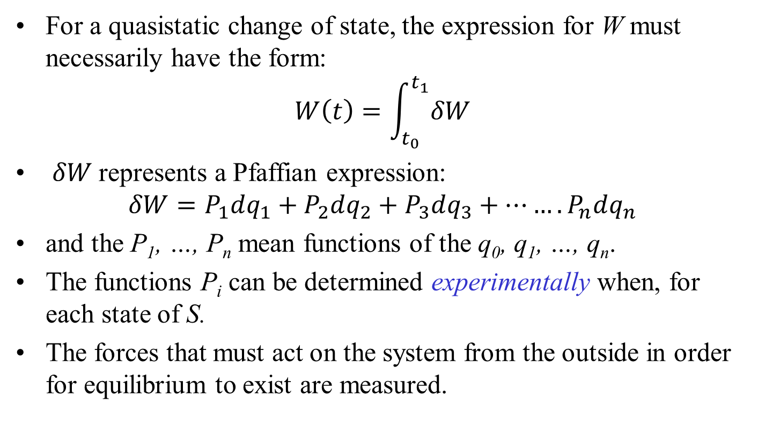
Model for Evaluation of W
For a quasistatic change of state, the expression for W must necessarily have the form:
$$W\left(t\right)=\int_{t_{0}}^{t_{1}}{δW}$$
$δW$represents a Pfaffian expression:
$$δW=P_{1}dq_{1}+P_{2}dq_{2}+P_{3}dq_{3}+…….P_{n}dq_{n}$$
and the P₁, …, P_{n} mean functions of the q₀, q₁, …, q_{n}.
The functions P_{i} can be determined experimentally when, for each state of S.
The forces that must act on the system from the outside in order for equilibrium to exist are measured.

Slide 9

Maximum Work Path
Initial State
$$W\left(t\right)=\int_{t_{0}}^{t_{1}}{δW}$$
Final State

Slide 10
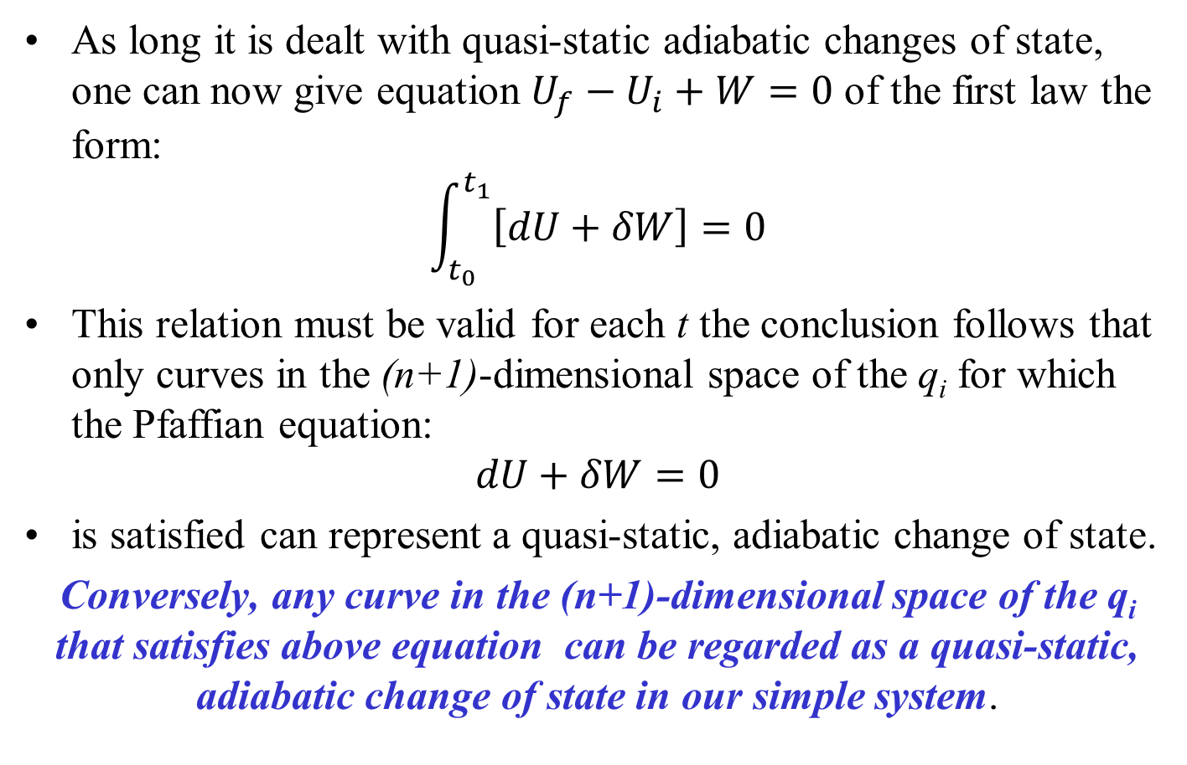
Model for First Law
As long it is dealt with quasi-static adiabatic changes of state, one can now give equation $U_{f}−U_{i}+W=0$ of the first law the form:
$$\int_{t_{0}}^{t_{1}}{\left[dU+δW\right]}=0$$
This relation must be valid for each t the conclusion follows that only curves in the (n+1)-dimensional space of the q_{i} for which the Pfaffian equation:
$$dU+δW=0$$
is satisfied can represent a quasi-static, adiabatic change of state.
Conversely, any curve in the (n+1)-dimensional space of the q_{i} that satisfies above equation can be regarded as a quasi-static, adiabatic change of state in our simple system.

Slide 11
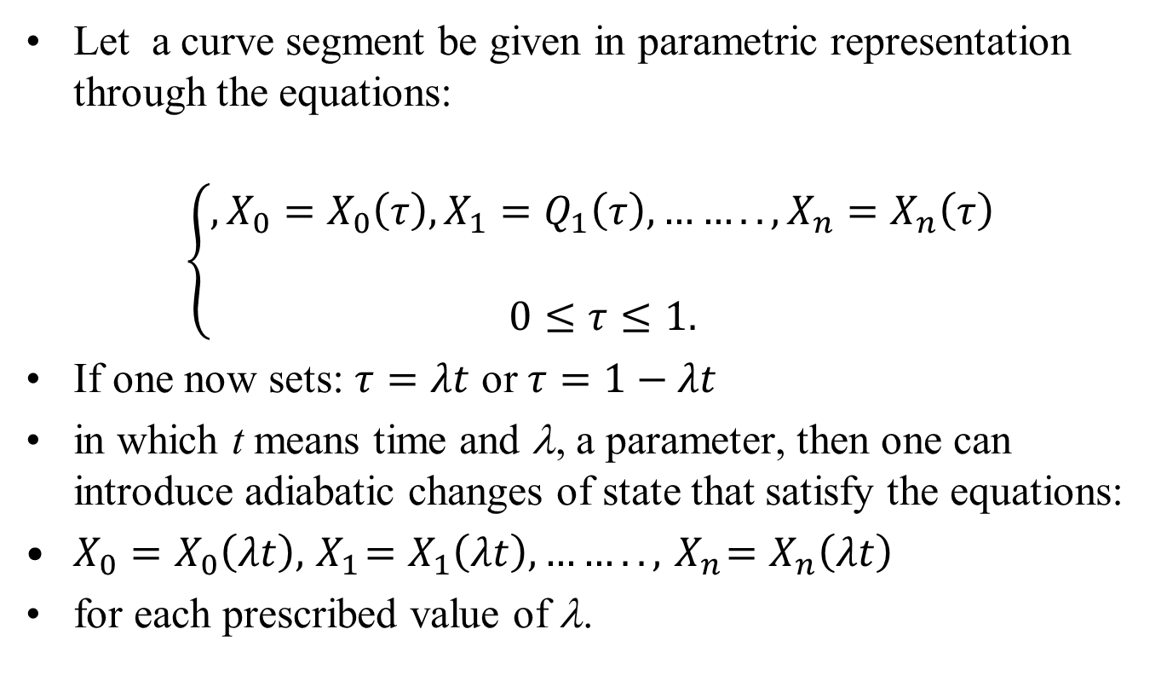
Geometrization of
Quasistatic Adiabatic Change of State
Let a curve segment be given in parametric representation through the equations:
$$\left\{\begin{matrix},X_{0}=X_{0}\left(τ\right),X_{1}=Q_{1}\left(τ\right),…….. ,X_{n}=X_{n}\left(τ\right) \\ \\ 0≤τ≤1.\end{matrix}\right.$$
If one now sets: $τ=λt$ or $τ=1−λt$
in which t means time and λ, a parameter, then one can introduce adiabatic changes of state that satisfy the equations:
$X_{0}=X_{0}\left(λt\right),{ X}_{1}=X_{1}\left(λt\right),…….. ,{ X}_{n}=X_{n}\left(λt\right)$
for each prescribed value of λ.

Slide 12
Maximum Work Path
Initial State
Final State

Slide 13
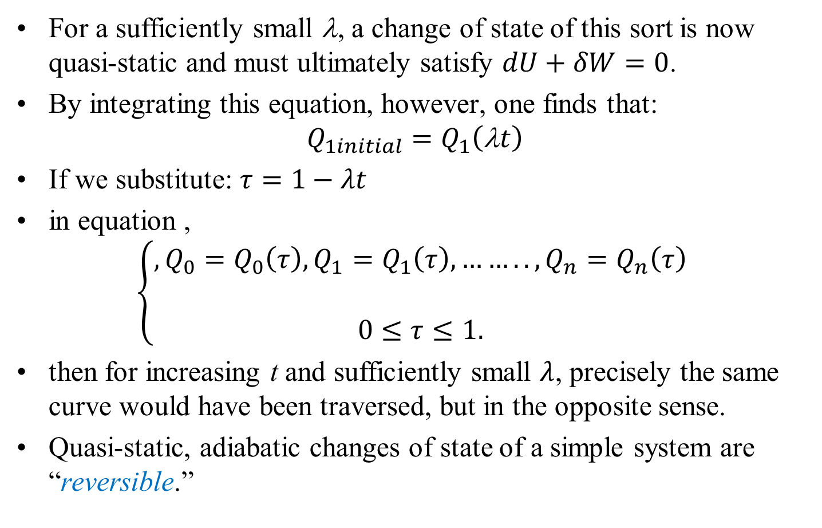
Quasistatic Adiabatic Change of State
For a sufficiently small λ, a change of state of this sort is now quasi-static and must ultimately satisfy $dU+δW=0$.
By integrating this equation, however, one finds that:
$$Q_{1initial}=Q_{1}\left(\text{λ}t\right)$$
If we substitute: $τ=1−λt$
in equation ,
$$\left\{\begin{matrix},Q_{0}=Q_{0}\left(τ\right),Q_{1}=Q_{1}\left(τ\right),…….. ,Q_{n}=Q_{n}\left(τ\right) \\ \\ 0≤τ≤1.\end{matrix}\right.$$
then for increasing t and sufficiently small $λ$, precisely the same curve would have been traversed, but in the opposite sense.
Quasi-static, adiabatic changes of state of a simple system are “reversible.”

Slide 14
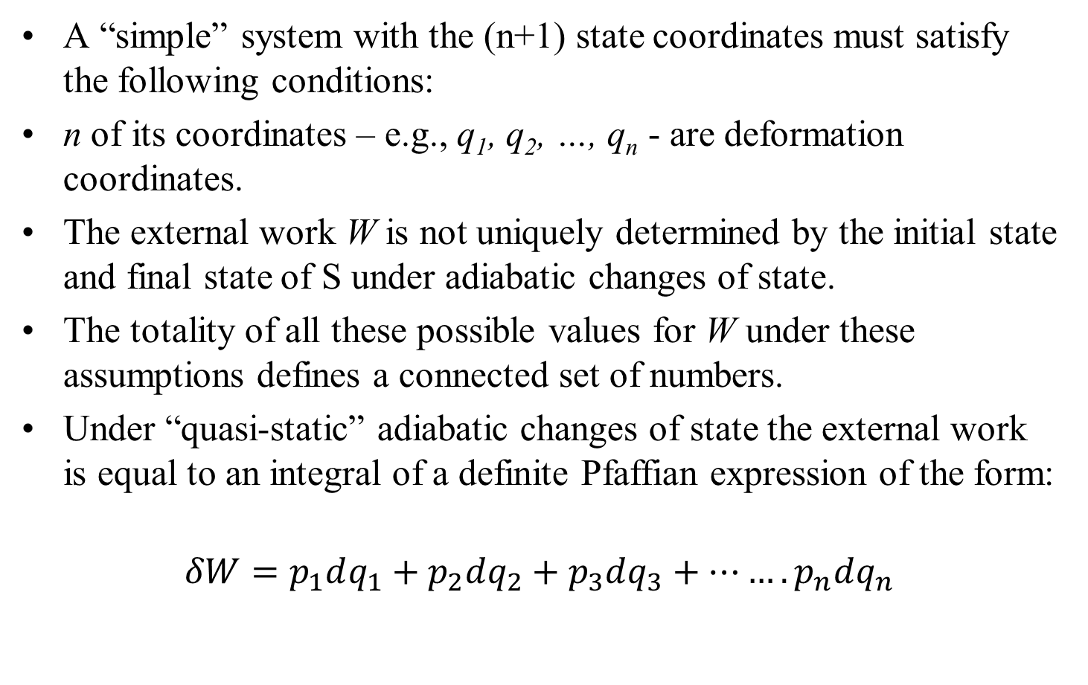
Summary of Simple System
A “simple” system with the (n+1) state coordinates must satisfy the following conditions:
n of its coordinates – e.g., q₁, q₂, …, q_{n} - are deformation coordinates.
The external work W is not uniquely determined by the initial state and final state of S under adiabatic changes of state.
The totality of all these possible values for W under these assumptions defines a connected set of numbers.
Under “quasi-static” adiabatic changes of state the external work is equal to an integral of a definite Pfaffian expression of the form:
$$δW=p_{1}dq_{1}+p_{2}dq_{2}+p_{3}dq_{3}+…….p_{n}dq_{n}$$

