Slide 1

Ancestors of Thermodynamics
P M V Subbarao
Professor
Mechanical Engineering Department
I I T Delhi
Beak through Inventions for Formulation of Thermodynamics …..

Slide 2

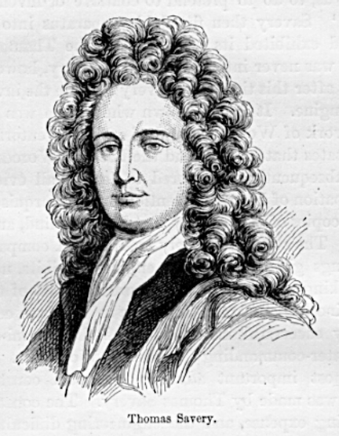
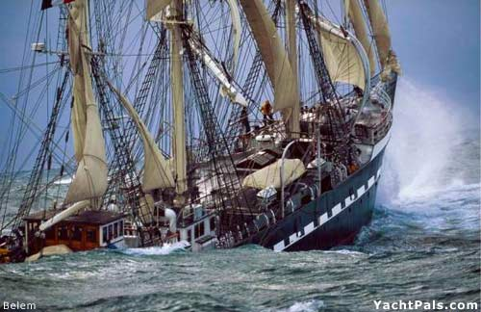

The Motive Power From Heat (Fuel)
Thomas Savery

Slide 3
Development of Cycle for Thomos savery Mine Pump

Slide 4
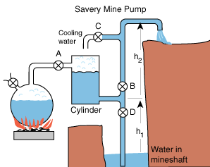
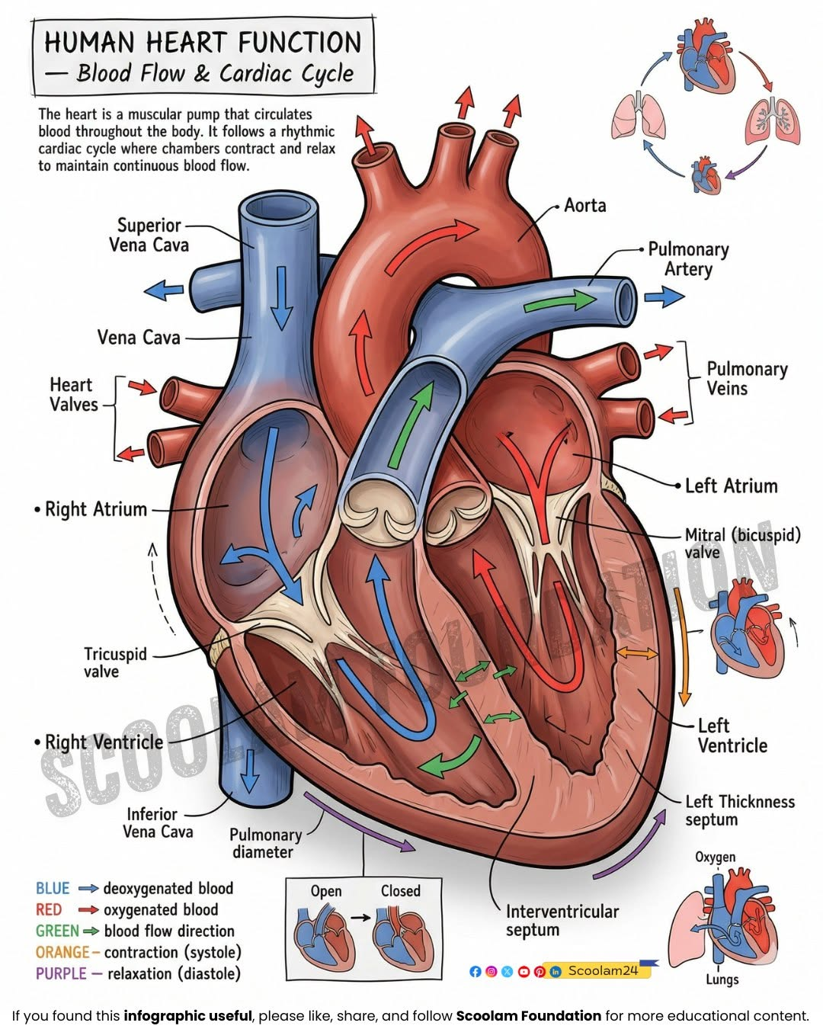
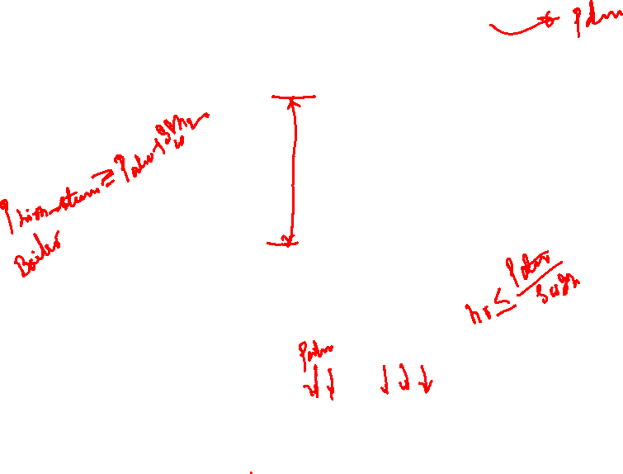

Slide 5
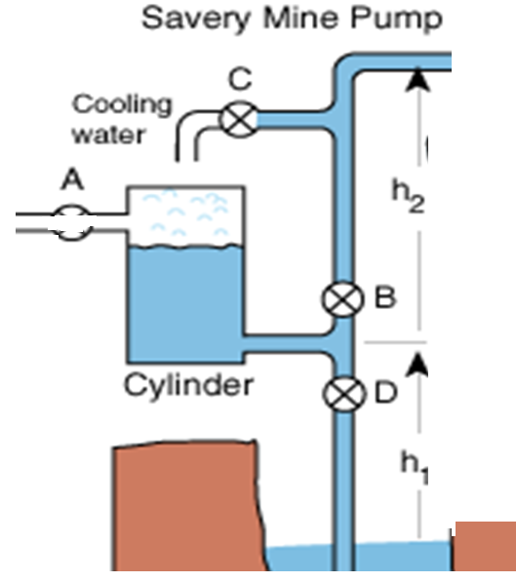

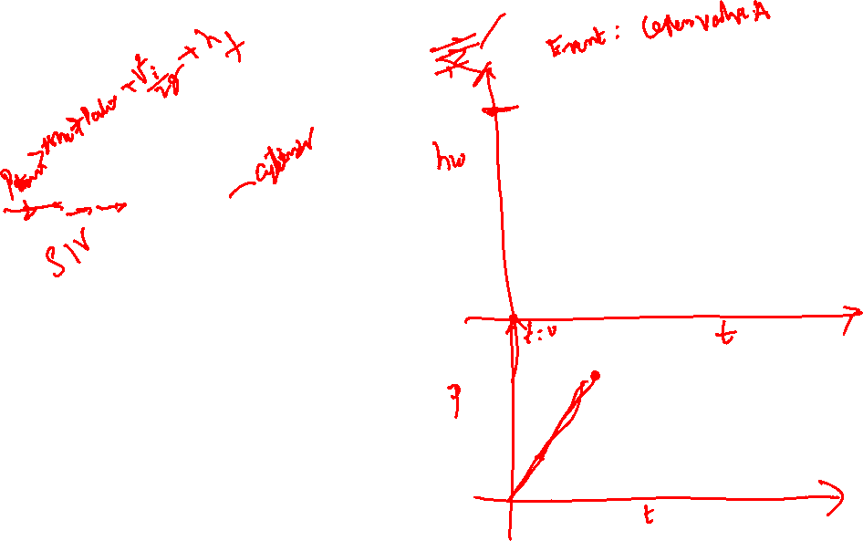
Thermodynamic Analysis of Savery Engine
Event 1

Slide 6
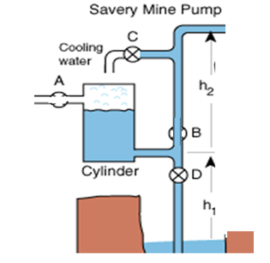
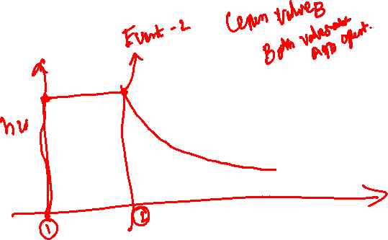
Thermodynamic Analysis of Savery Engine Event 2

Slide 7
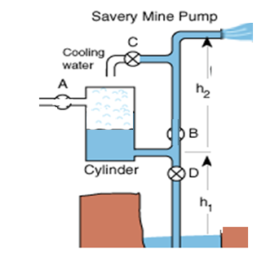
Thermodynamic Analysis of Savery Engine
Process 1 -2

Slide 8
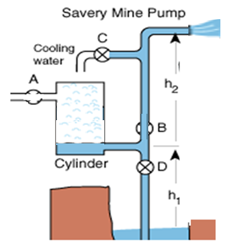
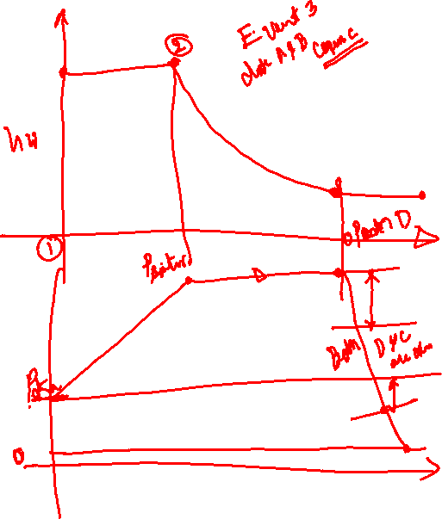
Thermodynamic Analysis of Savery Engine
Post Event 2 Process & Need for Event 3

Slide 9
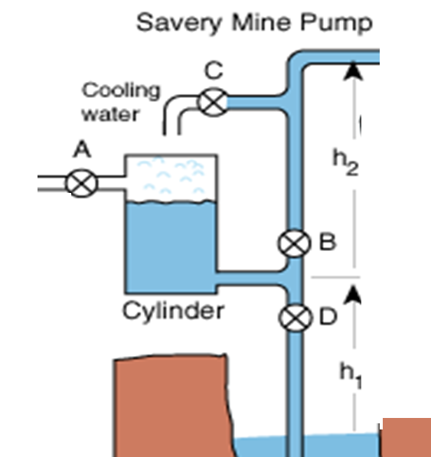

Thermodynamic Analysis of Savery Engine
Need for Event 4

Slide 10
Thermodynamic Analysis of Savery Engine
Process 3--4

Slide 11

Thermodynamic Analysis of Savery Engine
Event 5

Slide 12

Thermodynamic Analysis of Savery Engine
Process 5 -- 1

Slide 13
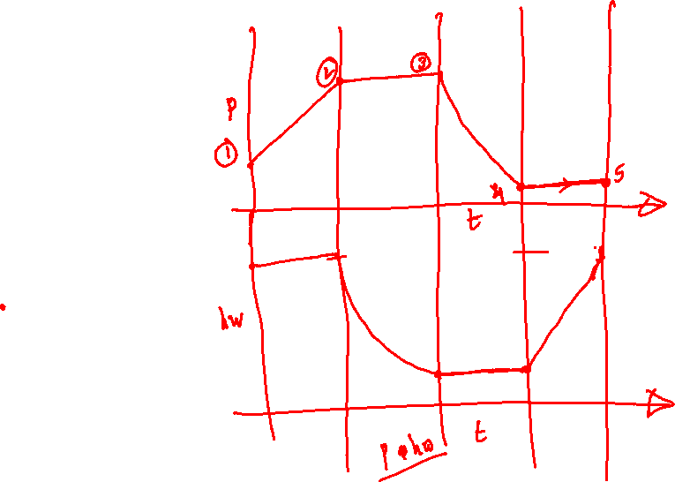
Processes & Variables Oserved by Savery in His Engine

Slide 14
Thermodynamic Boundary Conditions

Slide 15


Cyclic Process in Savery Engine
Starting Point:
Time | Events | Process

Slide 16
Recognitions for savery’s Engine
Thomas savery demonstrated it to the Royal Society on 14 June 1699.
Savery described the machine in his book The Miner's Friend; or, An Engine to Raise Water by Fire in 1702 .
In this book, he claimed that it could pump water out of mines.
A newspaper in March 1702 announced that Savery's engines were ready for use and might be seen on Wednesday and Saturday afternoons at his workhouse in Salisbury Court, London, over against the Old Playhouse.

Slide 17
Performance & Applications of Savery Engine
One of the savery engines was set up at York Buildings in London.
Another was built to control the water supply at Hampton Court.
The third at Campden House in Kensington operated for 18 years.
A few Savery engines were tried in mines failed to a satisfactory job.

Slide 18
A True Thermodynamic Cycle
Coal (Resource)
Ability to Perform
The power (Need)
Wastage / Ecological Nuisance

Slide 19
Drawbacks of Savery Engine: Critcism
Savery Engine was identified with four serious problems.
Firstly, the water first stage of the cycle required high-pressure steam to force the water up.
Secondly, every time water was admitted to the working vessel much of the heat was wasted in warming up the water that was being pumped.
Much of the steam was condensed due to direct contact between water-steam and heating up of cylinder walls.
Thirdly, to clear water from a deep mine would have needed a series of moderate-pressure engines all the way from the bottom level to the surface.
Fourthly, water was pushed up into the engine only by atmospheric pressure.

Slide 20
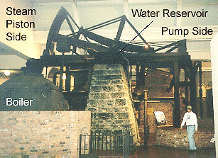
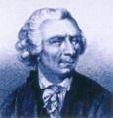
Thomas Necomen
The original Thomas Newcomen engine was invented in 1712.

Slide 21
Newcomen Engine : First Step in Innovation thru Conservation
Newcomen created his vacuum inside a cylinder and used it to pull down a piston.
It was the first practical engine to use a piston in a cylinder.
He then used a lever to transfer the force to the pump shaft that went down the mine.
Casting the cylinders and getting the pistons to fit was pushing the limit of existing technology.
Newcomen deliberately made the piston marginally smaller than the cylinder and sealed the gap with a ring of wet leather or rope.
To avoid infringing Savery's patent Newcomen was forced to go into partnership with him.

Slide 22
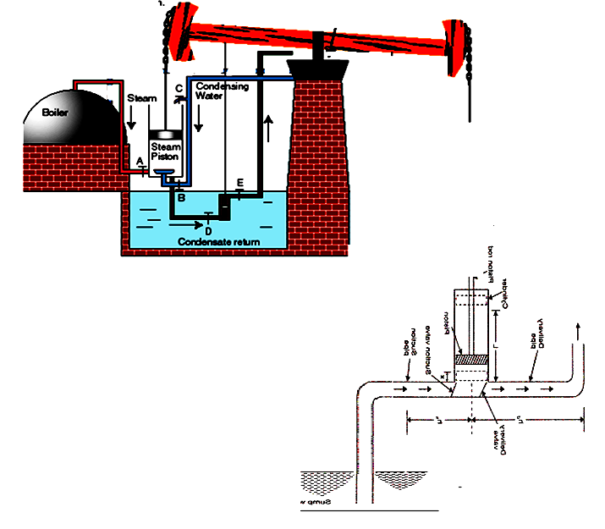
Anatomy of Newcomen Engine

Slide 23
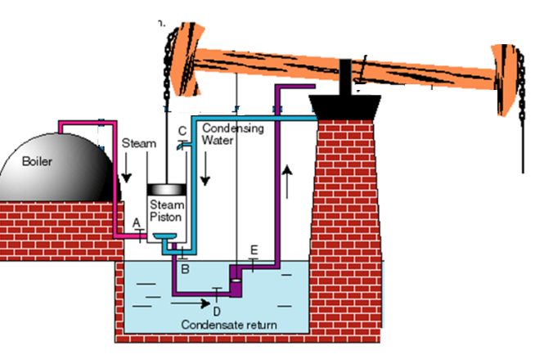

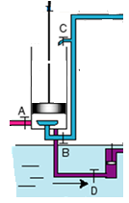
Process & Cycle Executed by Newcomen Engine
Cycle starting Point

Slide 24
Performance & Application of NewComen Engine
The first Newcomen’s working engine was installed at a coalmine at Dudley Castle in Staffordshire in 1712.
It had a cylinder of 21 inches in diameter and nearly eight feet long, and it worked at twelve strokes a minute.
It raised ten gallons of water from a depth of 156 feet – approximately.
The engines were rugged and reliable and worked day and night, but were extremely inefficient.
Newcomen engines were very expensive but were nevertheless very successful.
By the time Newcomen died on 5 August 1729 there were at least one hundred of his engines in Britain and across Europe.

Slide 25
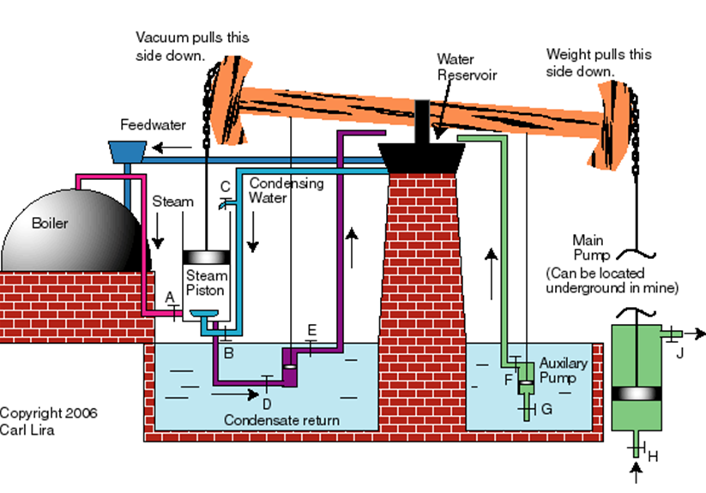
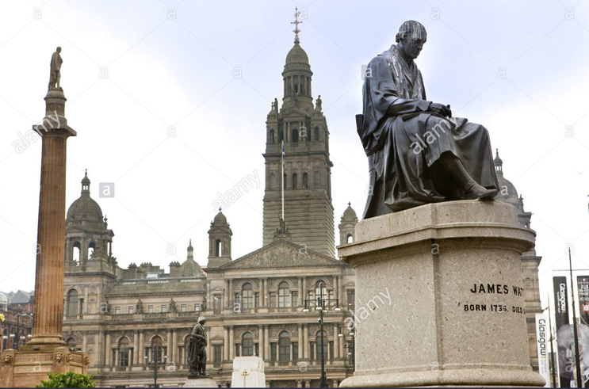
Post Newcomen Engine Era
1736 Watt born
1755 Watt trained in London
1763 Watt discovers problem with Newcomen engine

Slide 26
Major Parts (Control Volumes) in the Newcomen Engine
The boiler
The Cylinder
The cooling system
The pumps
  Condensate recycling pump
  Boiler feed pump
Newcomen engine was working at a steady speed of twelve strokes a minute.
It raised ten gallons of water from a depth of 156 feet – approximately.

Slide 27
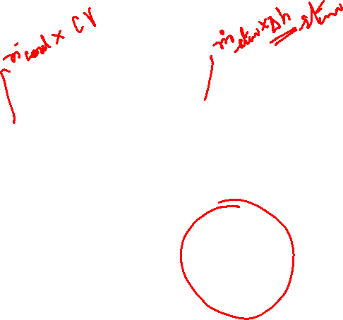
Sankey Diagram for Newcomen Engine
Rate of Energy used by discharge water
Rate of Steam Energy
Rate of Mechanical Energy input to Pump
Rate of Mechanical Energy input to Lever
Rate of input Coal Energy
Rate of energy losses due to
friction in pump
Rate of energy losses due to
friction in transmission system
Rate of energy losses due to
friction and heat transfer
In Cylidner
Rate of energy losses due to
Combustion and heat transfer
in boiler

Slide 28
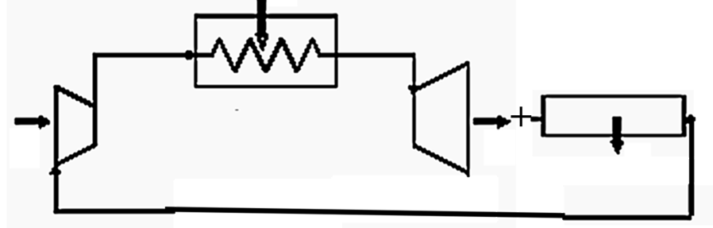
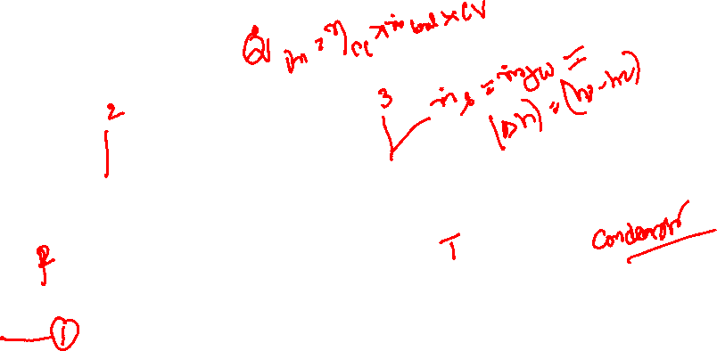
Watt’s Thought Layout for Newcomen Engine

Slide 29
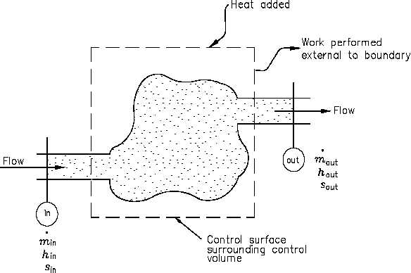
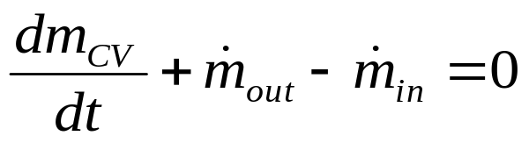
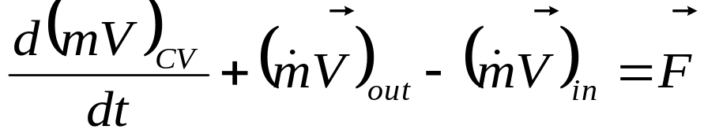
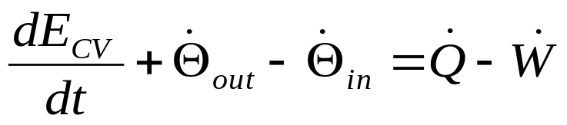
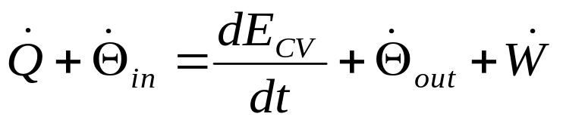
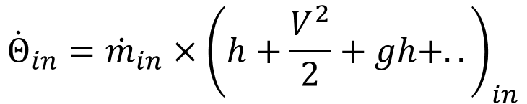
Watts’ Thought Analysis:
First Law for A Control Volume
Conservation of mass:
Conservation of momentum:
First Law of Thermodynamics:
$${\dot{Θ}}_{in}={\dot{m}}_{in}×{\left(h+\frac{V^{2}}{2}+gh+..\right)}_{in}$$

Slide 30
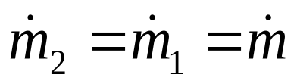
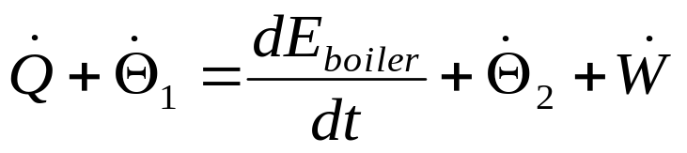
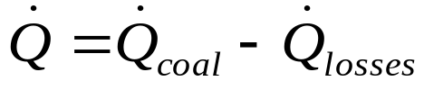
1 – 2 : Boiler for Steam generation
1
2
SSSF: Conservation of mass
First Law of Thermodynamics for SSSF:

Slide 31
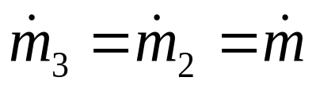
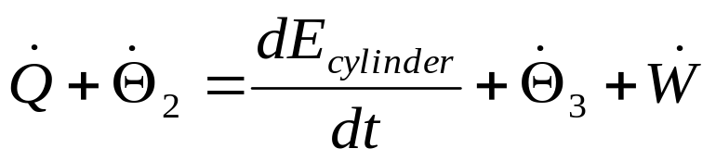
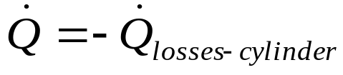
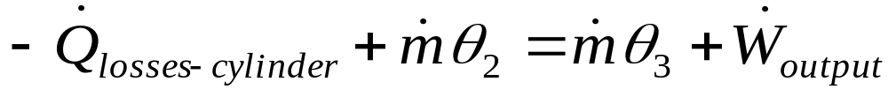
2 – 3 : Steam Expansion work in Cylinder
2
T
3
SSSF: Conservation of mass
First Law of Thermodynamics for SSSF:

Slide 32
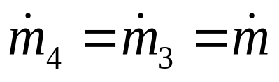
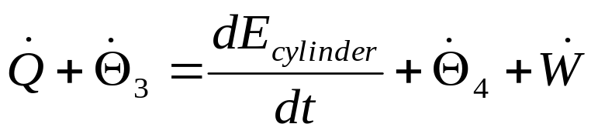
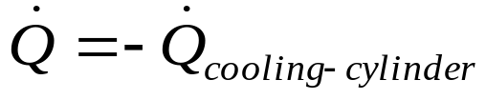
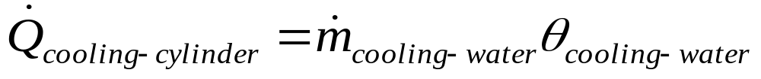
3 – 4 : Steam Condensation in Cylinder
3
T
4
SSSF: Conservation of mass
First Law of Thermodynamics for SSSF:

Slide 33
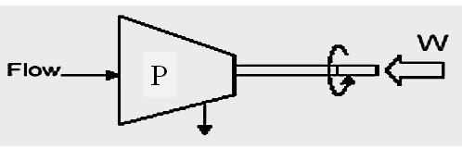
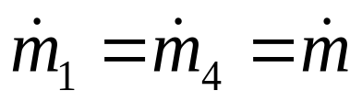
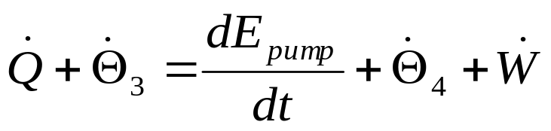
Internal Pumps : Consuming work from Lever
4
1
SSSF: Conservation of mass
First Law of Thermodynamics for SSSF:

Slide 34
An Audit of Energy Transactions

Slide 35
An Audit of Energy Transactions in A Necomen Engine : Thoughts of Watts
For Boiler
For Cylinder-expansion
For Cylinder - Condensing
ForPumps

Slide 36
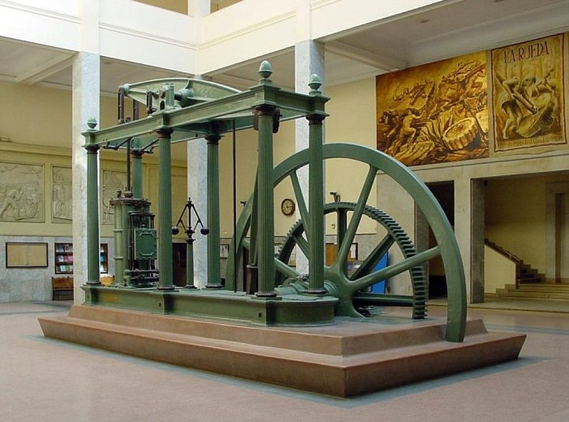
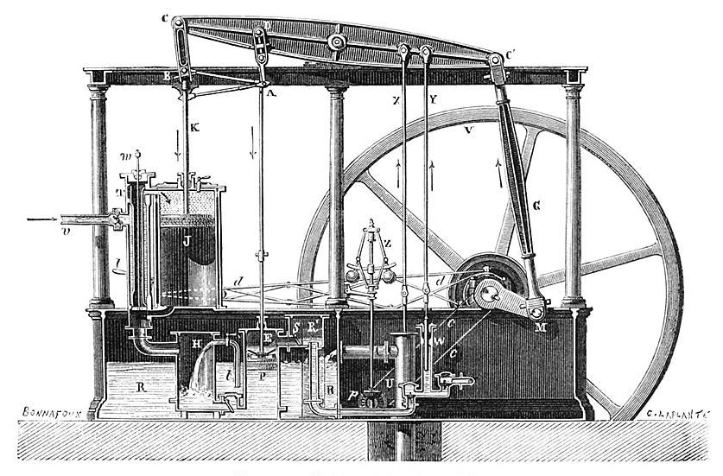
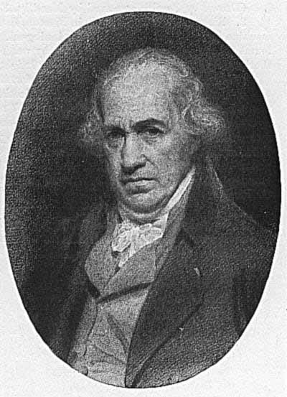
James Watt’s Engine : Most Important Innovation for Conservation
James Watt radically improved Newcomen's engine (1769) by condensing the steam outside the cylinder .

Slide 37
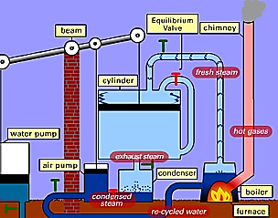
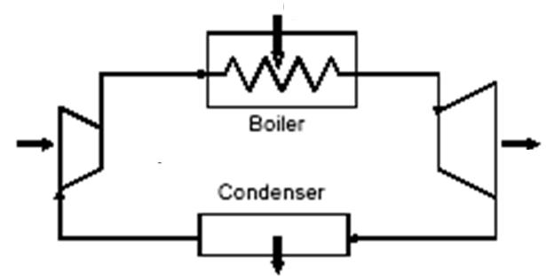
Cycle Executed by James Watt’s Engine
Work generation
Cylinder
Pump

Slide 38
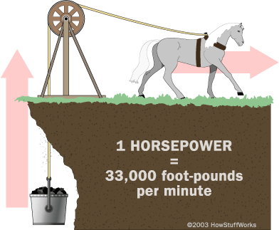

James Watts Creation of An Artificial Horse

Slide 39

Generation of Shaft Power using Watts Engine

Slide 40







Generation of Shaft Work
Energy transmission with a rotating shaft is very common in engineering practice.
A force F acting through a moment arm r_{s,p} generates a torque T of

Slide 41


James Watt Engine
Watt's Double-Acting Engine, 1784.
The Watt Hammer, 1784.
Trevithick's Locomotive, 1804
The " Atlantlc," 1832.
Steam Engine Reached its pinnacle in size when it was called to drive 5 MW electric generator.
Steam Engine As an Alternate to Horse or Cattle…..

Slide 42
Progress on Development of James Watt Engine
The British had progressed through the genius of a few engineers who lacked formal scientific education.
British engineers had also accumulated and published reliable data about the efficiency of many types of engines under actual running conditions.
They vigorously argued the merits of low- and high-pressure engines and of single-cylinder and multi-cylinder engines.

Slide 43
Infusion of Analytical Ideas into Power Plant Development
Sir James Watt is an ingenious engineering scientist, who carried out most useful hardware research and development.
He was not aware of many of the thermodynamic quantities.
Later engineers used Charles and Boyle laws in sizing of cylinder.
Prof. James Black carriedout research to determine specific heats of steam and water.
There was a gradual infusion of analytical and theoretical research into basic hardware development.
Analytical methods helped in removal of uncertainty in engine operation.
Many theoreticians got motivated to work on theory of James Watt Engine.

Slide 44

Sadi Nicolas Léonard Carnot
1814: After graduating, Carnot went to the École du Génie at Metz to take the two year course in military engineering.
1819: Carnot began to attend courses at various institutions in Paris.
The problem occupying Carnot was, how to design good steam engines?

Slide 45
Questions Raised by
Nicholas Leonard Sadi Carnot
How was the work developed by the engine related to the heat supplied (amount of coal burned)?
Was there an upper limit to this work and what condition could lead to its release?
Was water the best material to use, or might not some other liquid such as alcohol provide a more effective medium?
Might not a gas such as air be more advantageous than a condensable vapour?

Slide 46
The Quintessential Novelty
1824 : Réflexions sur la puissance motrice du feu et sur les machines propres à développer cette puissance which includes his description of the;
“ Mathematical Model for Carnot cycle".
Carnot's work is distinguished for his careful, clear analysis of the units and concepts employed.
Carnot’s use of both an adiabatic working stage and an isothermal stage in which heat is consumed, attracted the attention of all the experts.

Slide 47
Carnot’s Analysis of Watts Engine

Slide 48

A Mathematical Model for (James Watt’s) Steam Engine
expansion
Heat Removal
Heat Addition

Slide 49
Carnot’s Identification of Thermodynamic Cycle for Watts Engine
Burn Coal (to add Heat slowly)
Ability to perform
The Work
(Move piston slowly)
Wastage or Ecological Nuisance

Slide 50
Impact of Heat & Work Transfers on Steam
How to quantify the changes in steam due to work and heat transfer?
Human experts depended on their senses to define these changes.
Out of Five senses, Three senses could not quantify/recognize these changes.
Only two senses could quantify these changes:
Vision : Volume (m³)
Touch : Pressure (kPa) and Temperature (°C or K)
None of the above are equivalent to heat or work.
There must be a relation between these properties and heat & work.

Slide 51

Carnot Model for Steam Engine
T

Slide 52

Carnot Model for Gas Engine
Maximum Power : 17BHP@8500 RPM
Maximum Torque :15Nm@7500 rpm

Slide 53

The T-s Diagram for Carnot Cycle
T
Measure of wastage, x

Slide 54


Carnot’s Model for Power Generation System

Slide 55

Carnot’s Model for Power Cycle
s
1 – 2 : Compressor : Isentropic Compression : s₂ = s₁
2 – 3 : Boiler: Isothermal Heating : T₃ = T₂
3 – 4 : Turbines : Isentropic Expansion : s₄ = s₃
4 – 1 : Condenser: Isothermal Cooling : T₁ = T₄

Slide 56

First Law for A Control Volume
Conservation of mass:
Conservation of momentum:
Conservation of energy:

Slide 57

Carnot’s Model for Power Generation System
Expansion work

Slide 58
Carnot’s Identification of Thermodynamic Cycle for Watts Engine
Burn Coal (to add Heat slowly)
Ability to perform
The Work
(Move piston slowly)
Wastage or Ecological Nuisance

Slide 59
Carnot’s Model for Power Cycle
s
1 – 2 : Compressor : Isentropic Compression : s₂ = s₁
2 – 3 : Boiler: Isothermal Heating : T₃ = T₂
3 – 4 : Turbines : Isentropic Expansion : s₄ = s₃
4 – 1 : Condenser: Isothermal Cooling : T₁ = T₄

Slide 60



Air Standard Carnot Cycle
2
3
1
4
Practice on your own……

Slide 61
First Law for A Control Volume
Conservation of mass:
Conservation of momentum:
Conservation of energy:

Slide 62



Compressor : Isentropic Process
SSSF: Conservation of mass
First Law :
No heat transfer during compression.

Slide 63



2 – 3 : (Fire Tube) Boiler for Isothermal Steam Generation
Q_{CV}
2
3
No work transfer in boiler

Slide 64



Identification of Carnot’s High Temperature
for Isothermal Steam Generation, T₃ = T₂ = T_{high}
For reversible constant Pressure & Temperature Process

Slide 65


Expansion : Adiabatic Process : No wastage
3
T
4
Avoid heat transfer during expansion. Ideally zero….

Slide 66



4 – 1 : Condenser : Isothermal Cooling : T₁ = T₄
Q_{CV}
1
4
No work transfer in condenser

Slide 67





Analysis of Cycle
First law for a cycle:
For reversible adiabatic expansion and pumping:
Rate of Heat addition

Slide 68




Cost to Benefit Ratio Analysis of James Watt Engine using Carnot’s Model for Cycle
Work done per unit volume of the engine: Mean Effective Pressure

Slide 69

Engineering of Carnot Cycle
Isotherms

Slide 70


Use of Carnot Model for Optimization of Power Plant
Μinimize the capital & running costs.
Compact and efficient.

Slide 71

Model for Working of Muscle

Slide 72

Force Displacement (Stress-strain) Diagram of Muscle

Slide 73

Thermodynamic Cycle of A Muscle

Slide 74


Slide 75


Slide 76


Slide 77

Performance of Muscle Generating Cyclic Force

Slide 78

Cyclic Performance of Leg Muscle

Slide 79


Operation of Heart

Slide 80

Cyclic Operation of Heart

Slide 81

Cyclic Operation of deceased Heart

