Slide 1

Thermodynamic Practices for Extrasomatic Needs
P M V Subbarao
Professor & Head
Mechanical Engineering Department
I I T Delhi
A Slow Diversification from Metabolic needs to Extra Technological Needs…

Slide 2

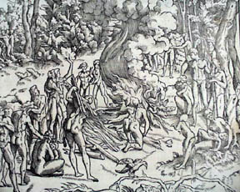
Thermodynamics thru Teaching & Training

Slide 3

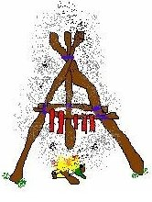
Innovation for Conservation

Slide 4

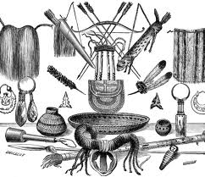
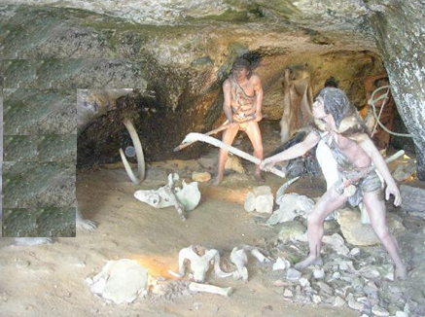
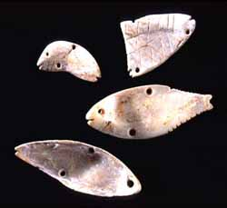
Innovation and Conservation

Slide 5

The Major Break Through Research due to Extra-somatic Behaviour….
Development of Equipment for Enhancing the Utility of Fire/fuel.
Extrasomatism for Somatic Needs
Why Fossils are created by Nature ????
Development of Theory & Systems for Motive Power.
Extra-somatism for Extra-Somatic Needs

Slide 6
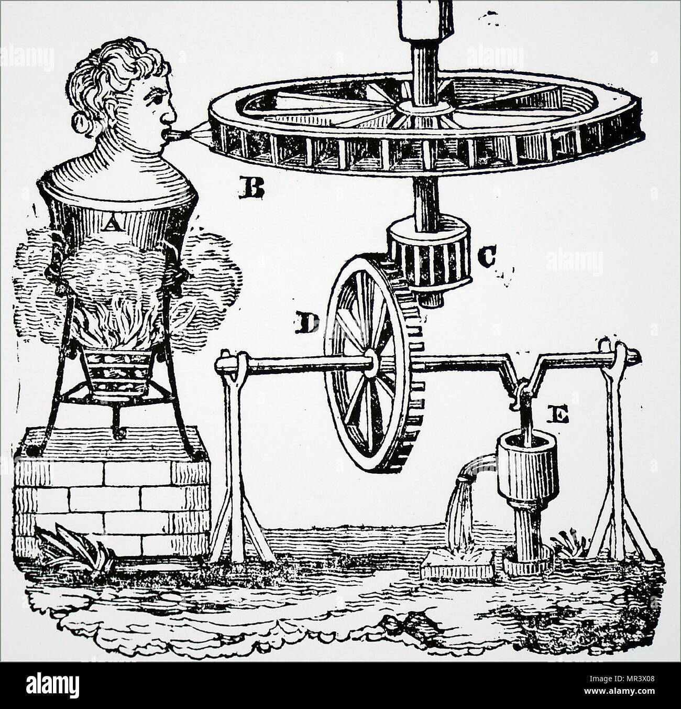
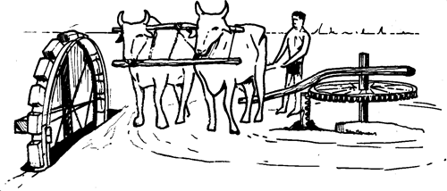
Branca's Steam Turbine
In 1629, Giovanni Branca, of the Italian town of Loretto, described, in a work' published at Rome, a number of ingenious contrivances.

Slide 7
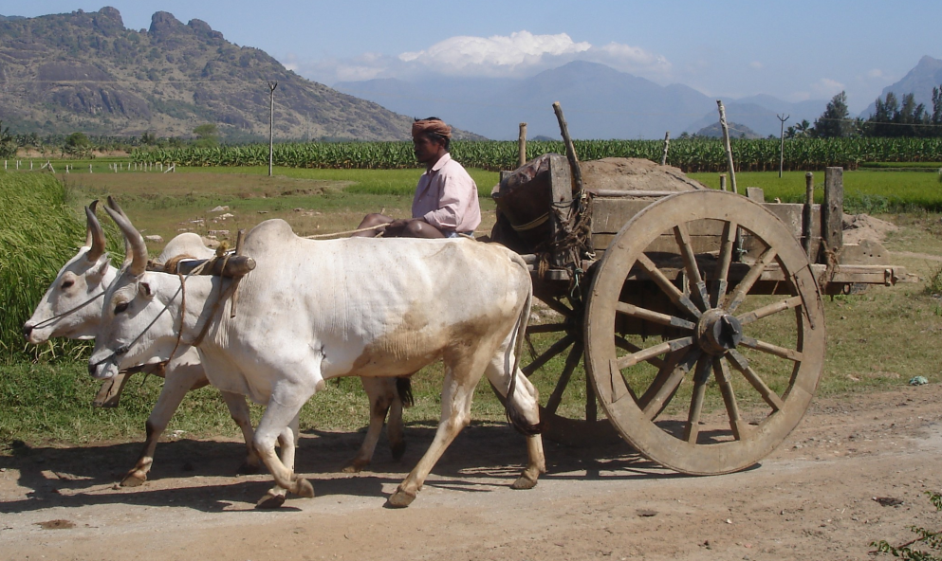
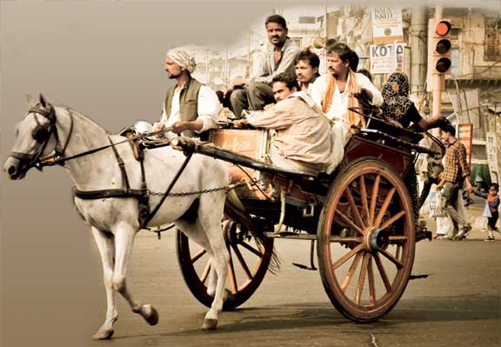
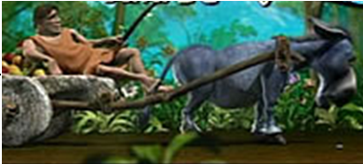
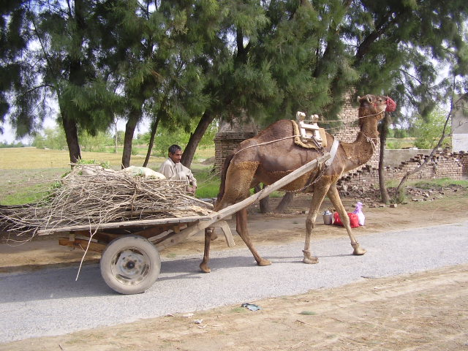
Extrasomatism as Motive Power

Slide 8
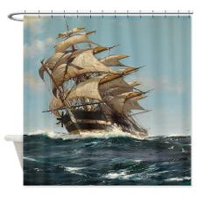
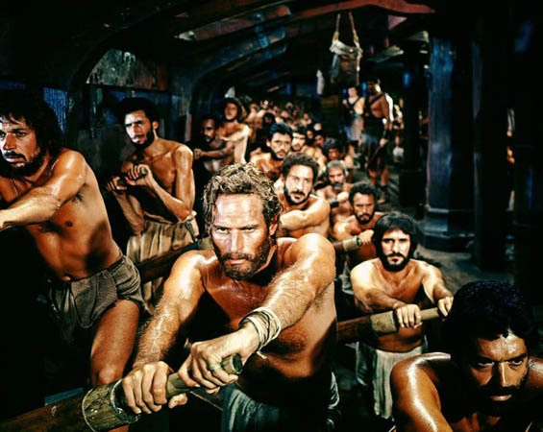
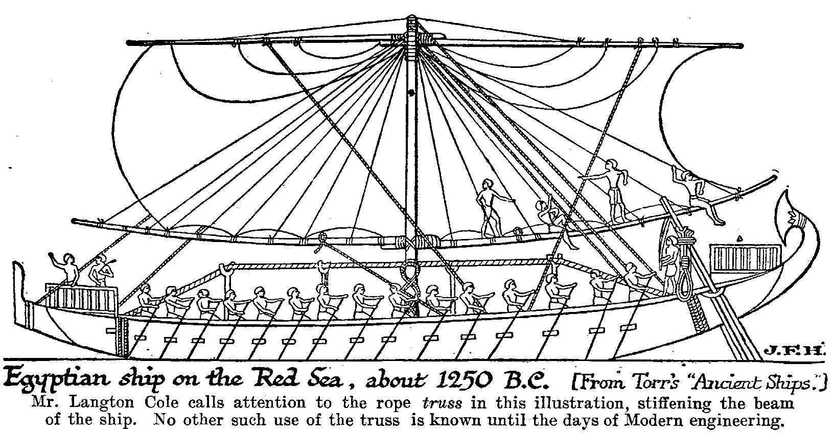
Extra-somatic Solutions w/o Holistic Approach
Creation of Motive Power on Water : Dangerous & Inhuman Technologies by copying

Slide 9
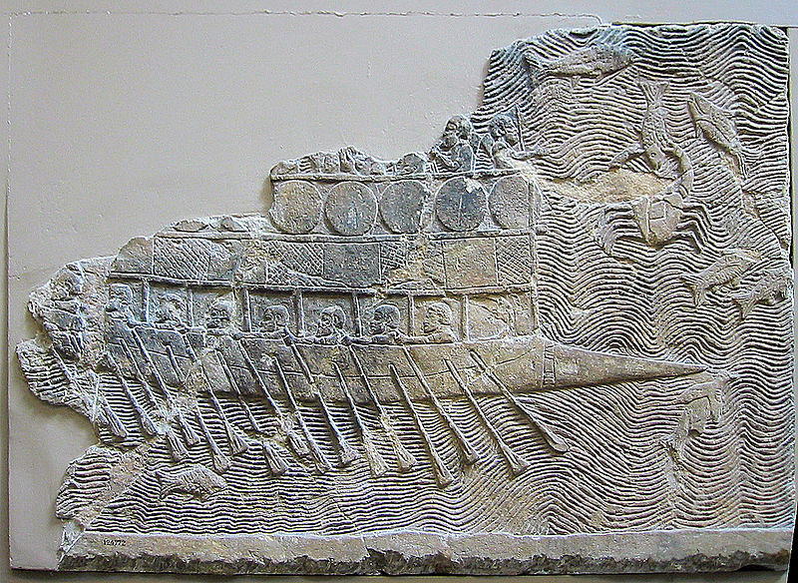
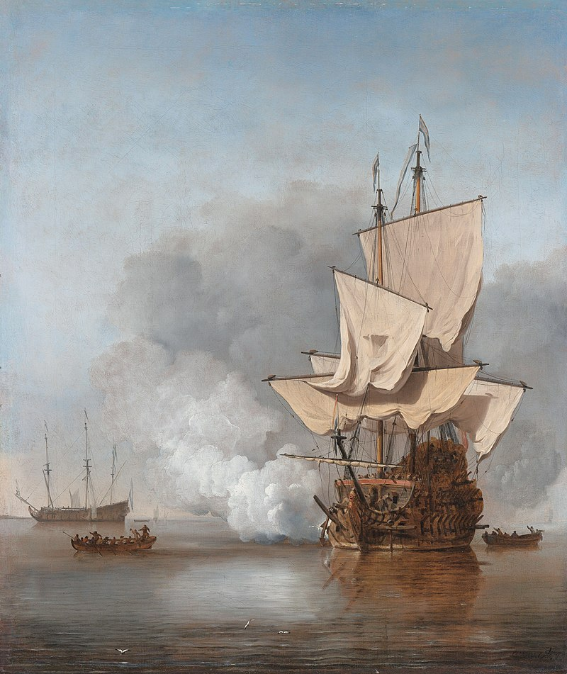
Early War Ships
Assyrian warship, a bireme with pointed bow circa 700 BC
Dutch 17th-century ship

Slide 10
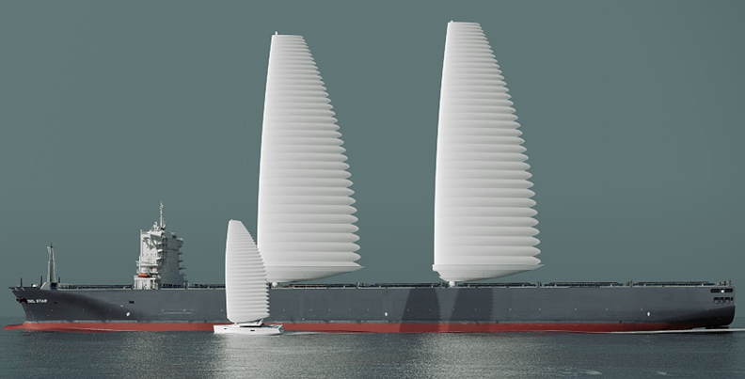
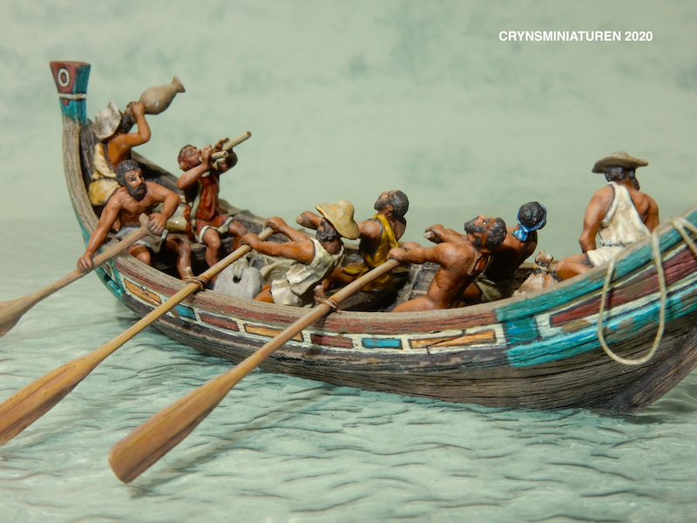
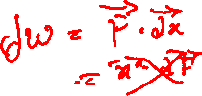
Force for Human Service :
Biological Adaptation of Mathematics

Slide 11
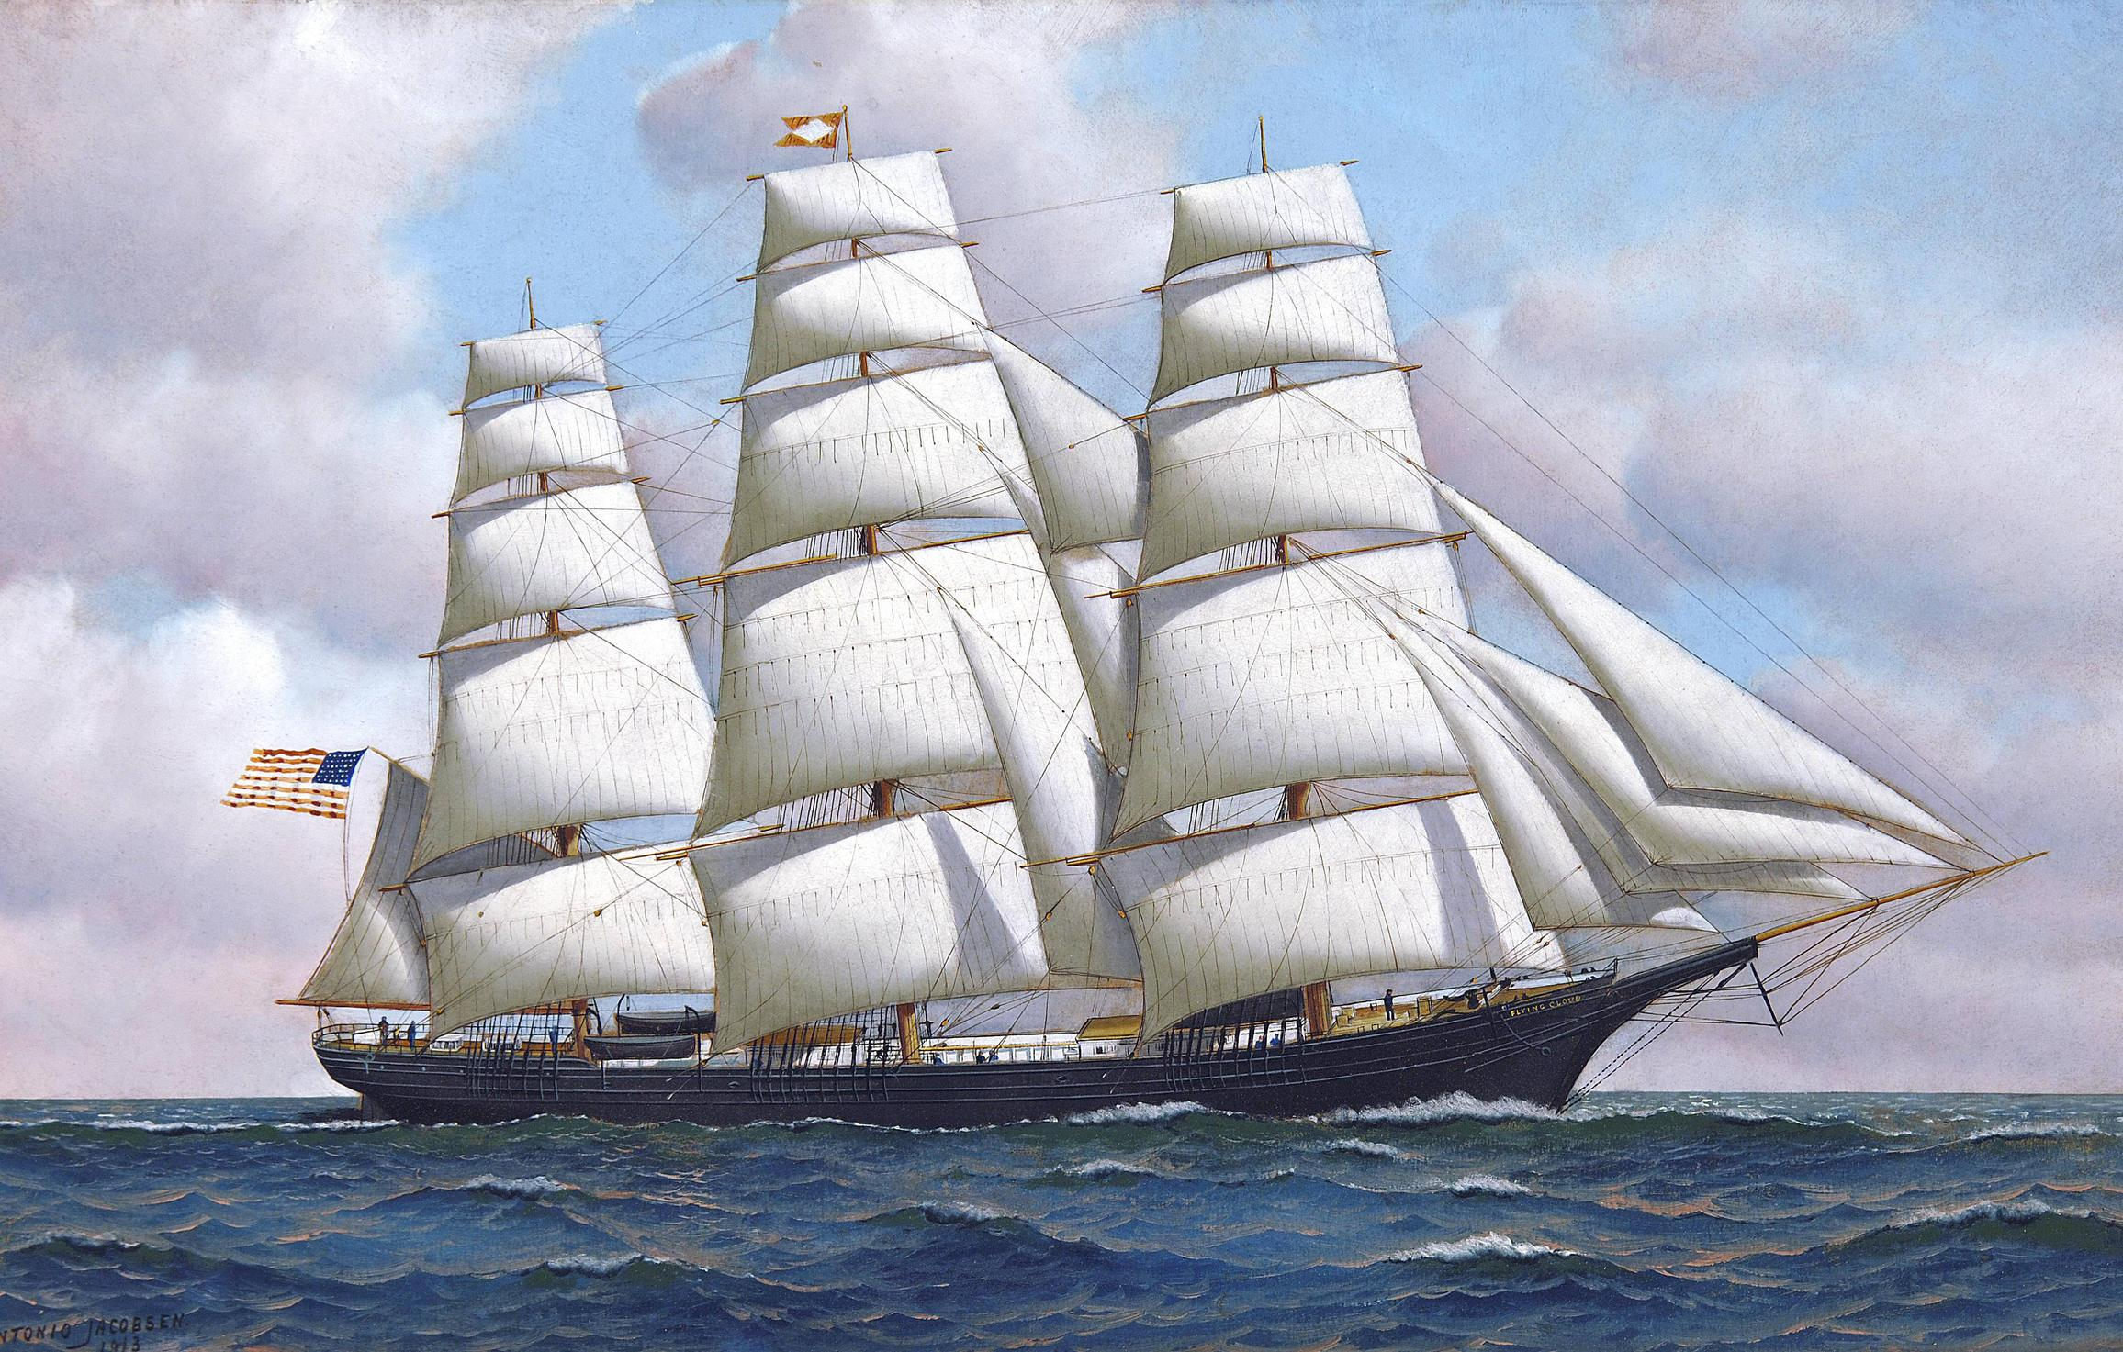
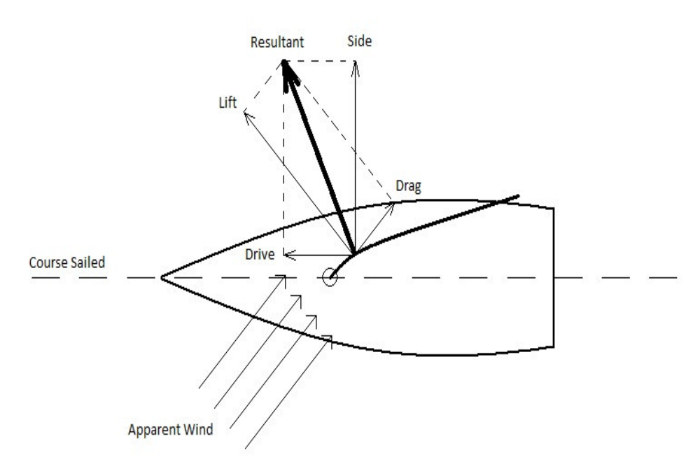


Utilization of Wind Force for Immediate Service
Instantaneous work done by wind on sail:
$$δW=\vec{F}.d\vec{x}$$
Scalar product leads to Immediate Consumption!
For a constant force
$$W=\vec{F}.\vec{x}$$

Slide 12
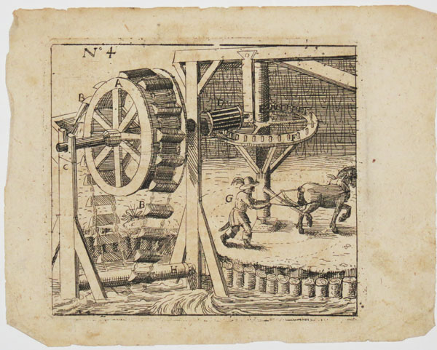
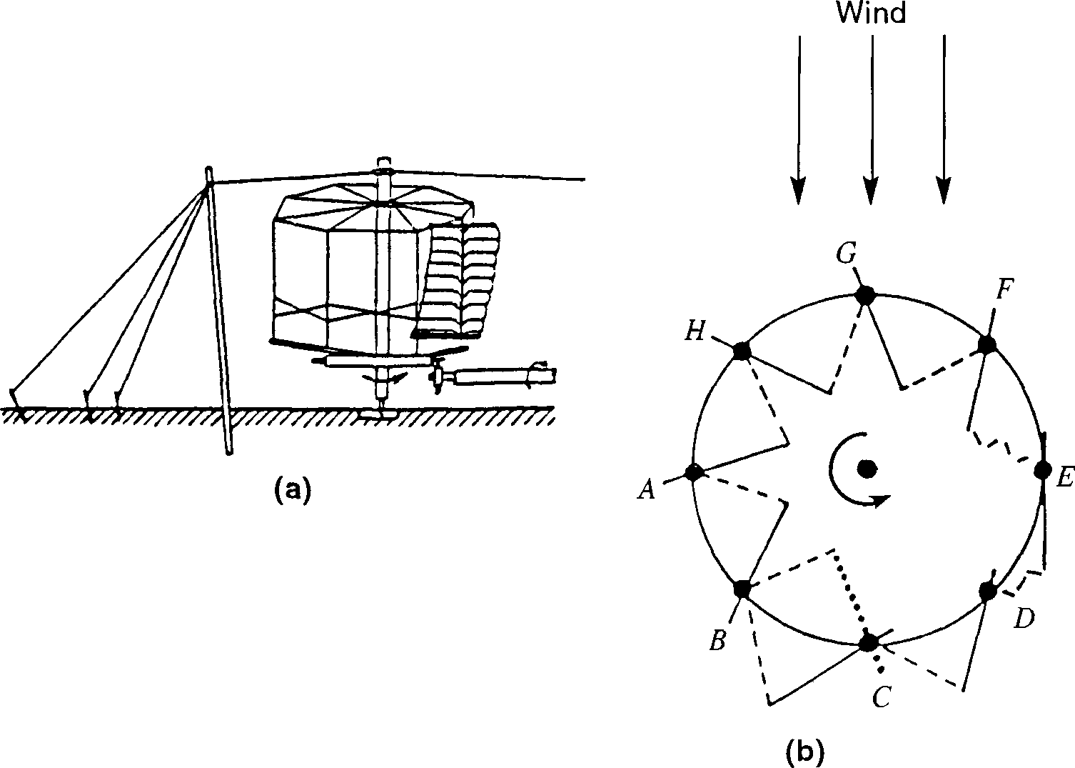


Utilization of Wind Force for Creation of Artificial Horse
Instantaneous Torque generated by wind :
$$\vec{τ}=\vec{F}× \vec{r}$$
Instantaneous shaft work done by wind :
Vector product preceding the Scalar product enhances the benefits!
$$δW=\vec{τ}.d\vec{θ}$$

Slide 13
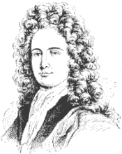
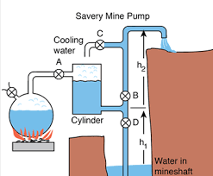
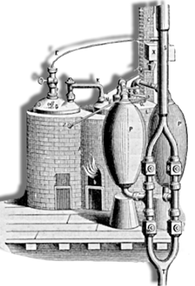
The Savery Engine
Thomas Savery, July 2, 1698, patented the design of the first engine which had the most important advance in actual construction. A working model was submitted to the Royal Society of London.

Slide 14
Thomas Savery
As an English army officer, Thomas Savery was once ejected from the Lord of the Admiralty's office as a lunatic because he proposed a ship that could be propelled by side-mounted wheels rather than by wind or oars.
He exhibited great fondness for mechanics, and for mathematicians' natural philosophy and gave much time to experimenting, to the contriving of various kinds of apparatus, and to invention.
http://inventors.about.com/library/inventors/blsavery1.htm

Slide 15
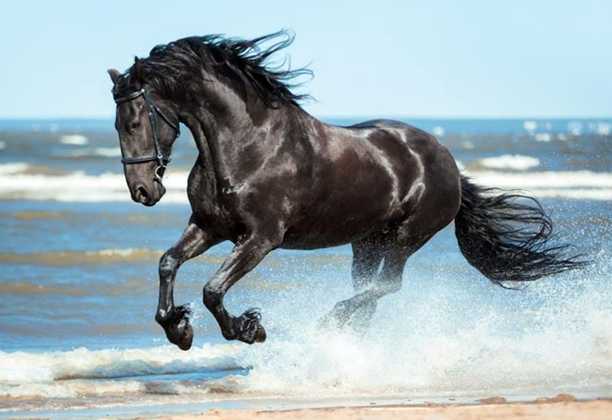
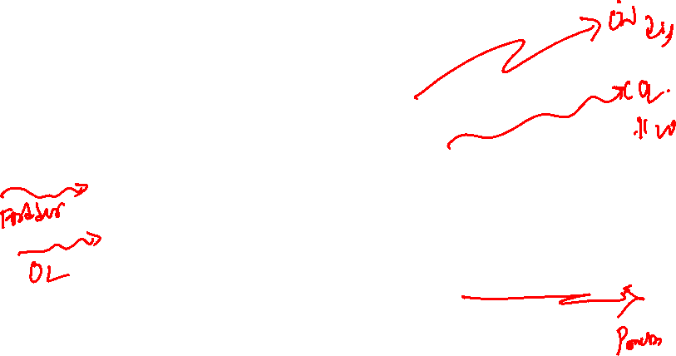
Natural Philosophy: Thermodynamics of Natural Generators

Slide 16
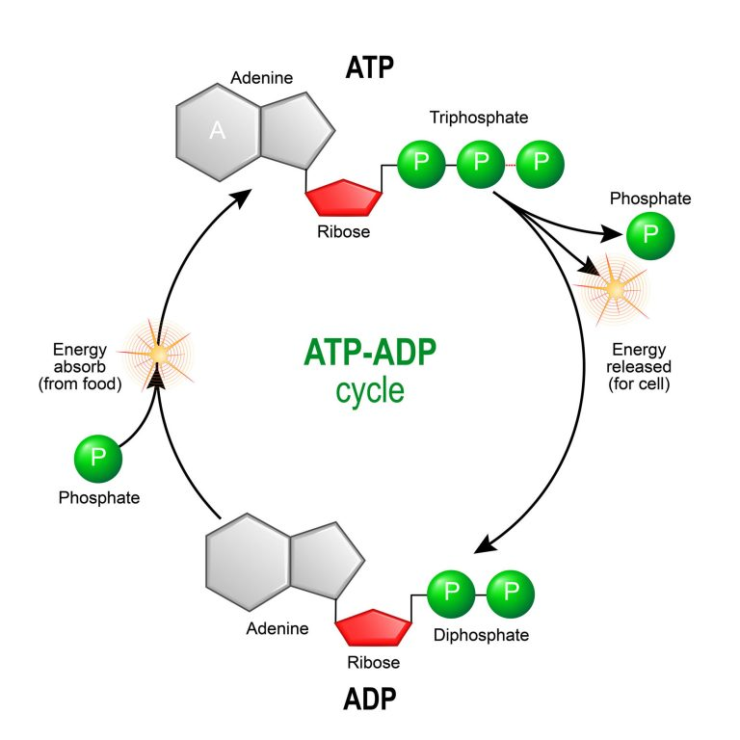
Cycles of Energy to Work

Slide 17

A cyclic action persists for long time (for ever)…..
The Engineering Philosophy of Savery
Cyclic devices are immortal….

Slide 18
The Savery Engine
Thomas Savery, July 2, 1698, patented the design of the first engine which had the most important advance in actual construction. A working model was submitted to the Royal Society of London.

Slide 19
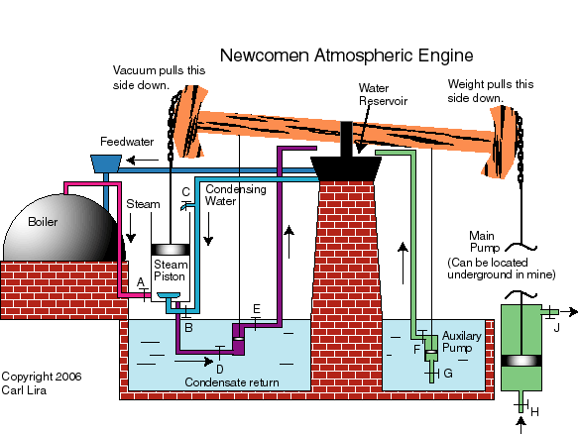
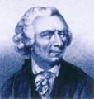
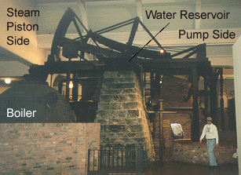
Newcomen Engine
The original Thomas Newcomen engine was invented in 1712.

Slide 20
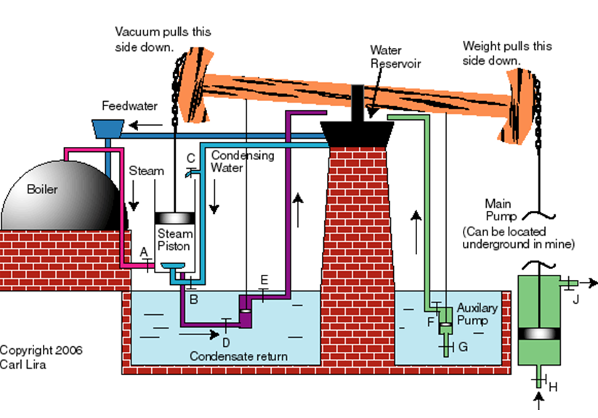
Major Parts (Control Volumes) in the Newcomen Engine
The boiler
The Cylinder
The cooling system
The pumps
  Condensate recycling pump
  Boiler feed pump
Newcomen engine was working at a steady speed of twelve strokes a minute.
It raised ten gallons of water from a depth of 156 feet – approximately.

Slide 21
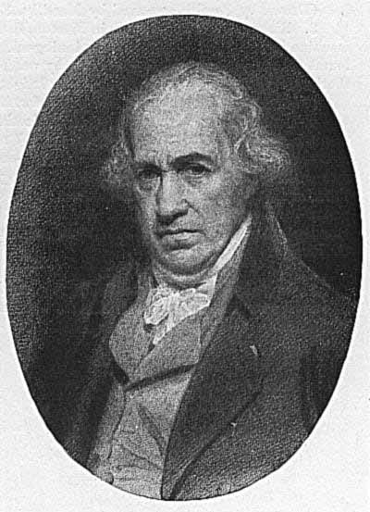
Inventors of Artificial Horse/animal
Savery Mine Pump
July 2, 1698
NewComen Engine
1712
Watts Engine
1769

Slide 22

Sankey Diagram for Newcomen Engine
Rate of Energy used by discharge water
Rate of Steam Energy
Rate of Mechanical Energy input to Pump
Rate of Mechanical Energy input to Lever
Rate of input Coal Energy
Rate of energy losses due to
friction in pump
Rate of energy losses due to
friction in transmission system
Rate of energy losses due to
friction and heat transfer
In Cylidner
Rate of energy losses due to
Combustion and heat transfer
in boiler

Slide 23
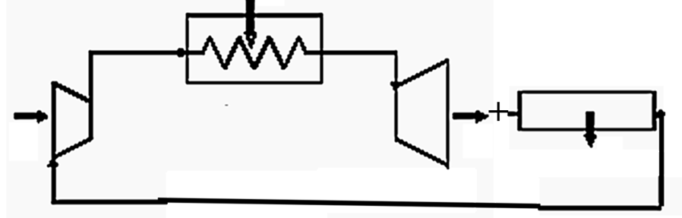
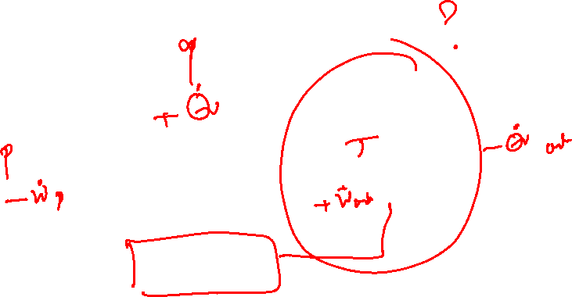
Watt’s Thought Layout for Newcomen Engine

Slide 24
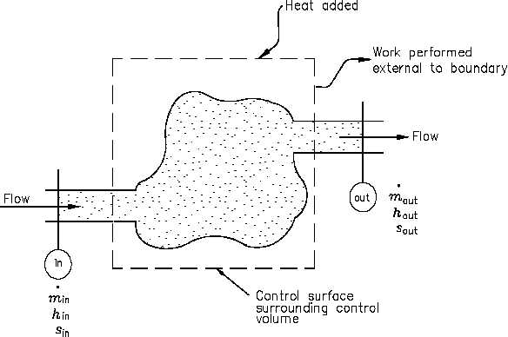
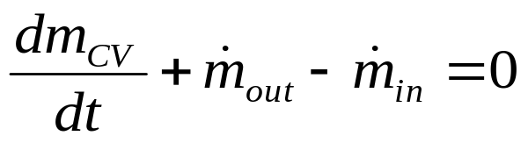
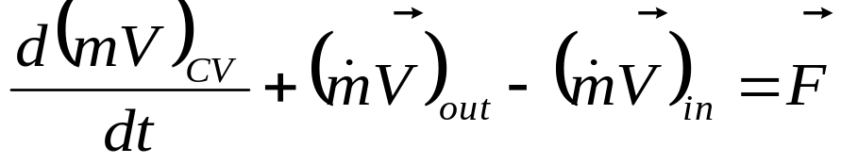
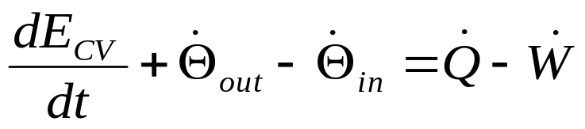
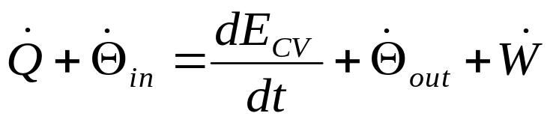

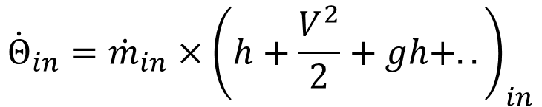
Watts’ Thought Analysis:
First Law for A Control Volume
Conservation of mass:
Conservation of momentum:
First Law of Thermodynamics:
$${\dot{Θ}}_{in}={\dot{m}}_{in}×{\left(h+\frac{V^{2}}{2}+gh+..\right)}_{in}$$

Slide 25
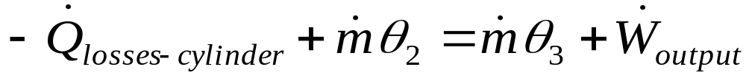
An Audit of Energy Transactions in A Necomen Engine : Thoughts of Watts
For Boiler
For Cylinder-expansion
For Cylinder - Condensing
ForPumps

Slide 26
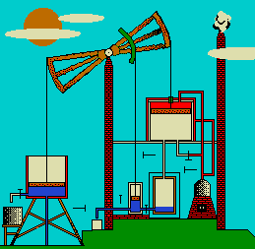
James Watt’s Engine
James Watt radically improved Newcomen's engine (1769) by condensing the steam outside the cylinder .

Slide 27
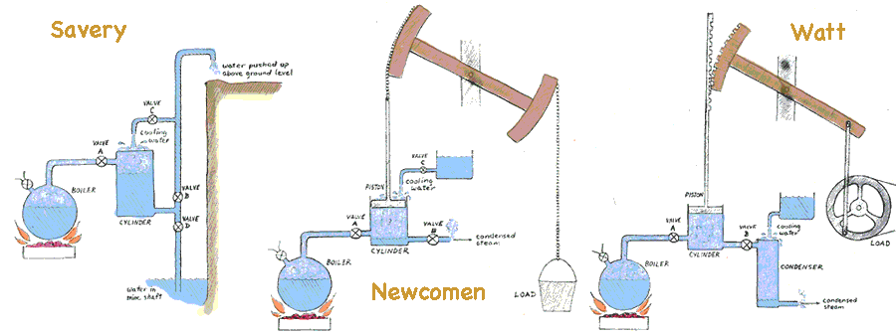
The Family of Steam Engines : Artificial Horse/animal
Direct Hardware Creations to the Essential Need …..

Slide 28
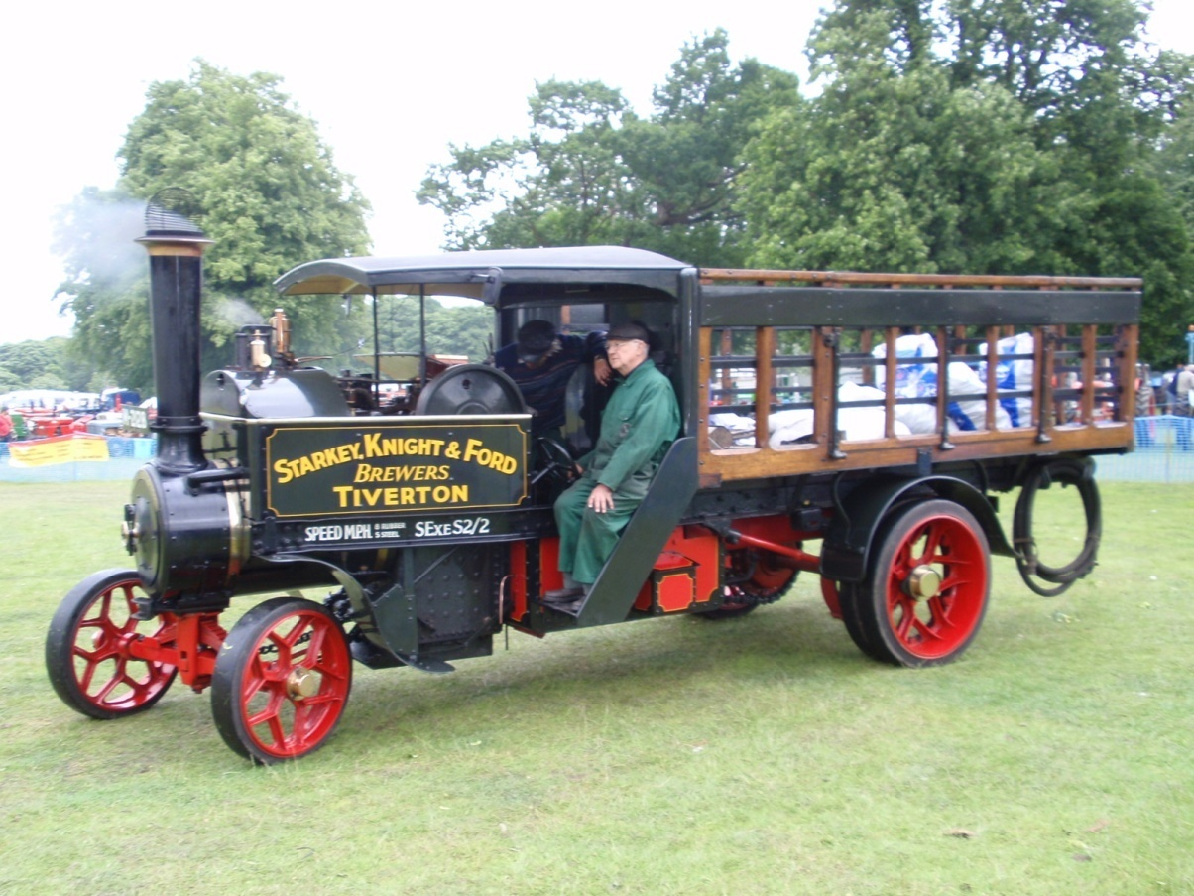
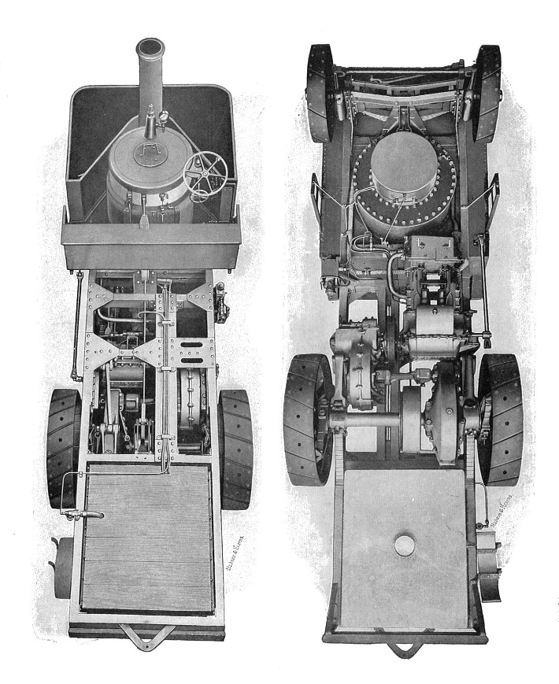
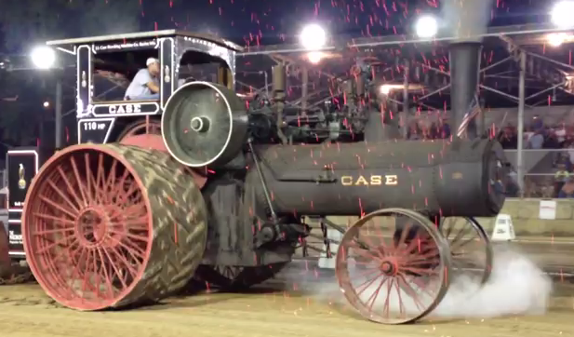
Steam Wagon/Tractor : Last decade of 19th Century

Slide 29
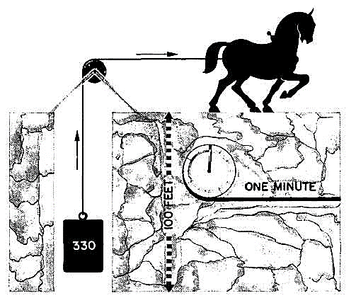
Capacity of Invention : Sir James Watt

Slide 30
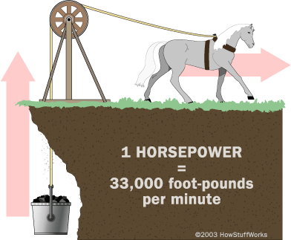

James Watts Creation of An Artificial Horse

Slide 31


James Watt Engine
Watt's Double-Acting Engine, 1784.
The Watt Hammer, 1784.
Trevithick's Locomotive, 1804
The " Atlantlc," 1832.
Steam Engine Reached its pinnacle in size when it was called to drive 5 MW electric generator.
Steam Engine As an Alternate to Horse or Cattle…..

Slide 32





Inventors of Cyclic Gas Engines
CARNOT Gas Engine THEORY
1824
Brayton Cycle
1872
Diesel Cycle
1893
Otto Cycle
1876

