Slide 1

Thermodynamics of Material to Life
https://web.iitd.ac.in/~pmvs/course_mel7401.php
P M V Subbarao
Professor & Head
Mechanical Engineering Department
I I T Delhi
Thus Spake Einstein
"It is a magnificent feeling to recognize the unity of a complex of phenomena which appear to be things quite apart from the direct visible truth.”

Slide 2

Origin of Life: Primary Thermodynamic Action
There are two basic ways to harness environmentally available energy: photosynthesis and chemical reactions.
The former involves converting light energy into ion gradients for chemiosmotic ATP synthesis (phototrophy).
The latter involves chemical reactions to generate ion gradients or to perform substrate-level phosphorylation (SLP) (chemotrophy).

Slide 3
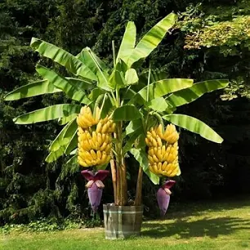
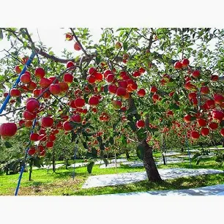

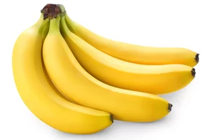

Thermodynamic of Life from Material
Life on Earth
CO₂
Solar Energy
Energy captured slowly by photosynthesis is stored up, and as denser reservoirs of energy have come into being over the course of Earth's history
Carbon Energy Reservoirs
Autotrophs
H₂O

Slide 4
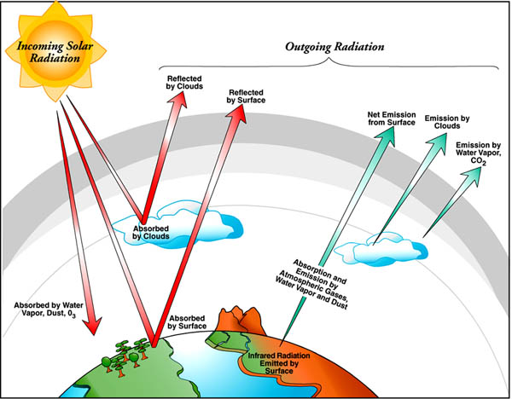
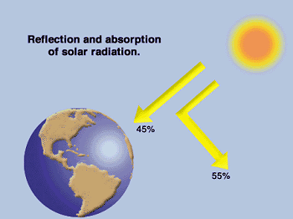
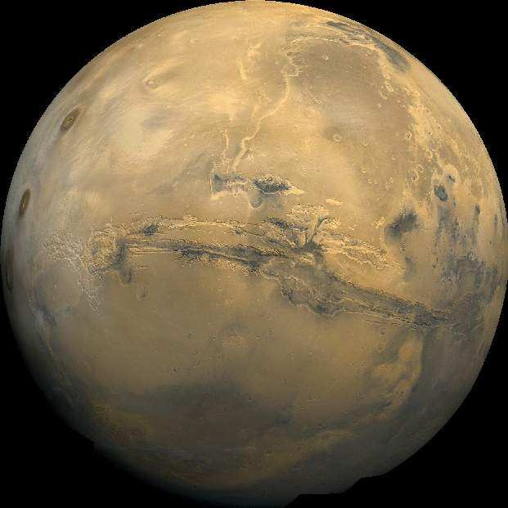
The flow of energy from a source to a sink through an intermediate system orders that system.
The Earth : A System with substems to Create Diversity in Energy Sources
Morowitz [1992]

Slide 5
Origin of Heterotrophy
Heterotrophic origin theories have it that the first cells lived from the fermentations of reduced organic compounds present in some kind of rich organic soup.
Though they are created thru rich organic soup, their survival and grows required biological carbon reservoirs.
Autotrophs were not only the ancestors of the first heterotrophs.
They were also the first viable substrate for heterotrophic growth.
Organisms that obtain more than 50% of their carbon from CO₂ alone are autotrophs.
Organisms that obtain less than 50% of their cellular carbon from CO₂ are termed heterotrophs.

Slide 6
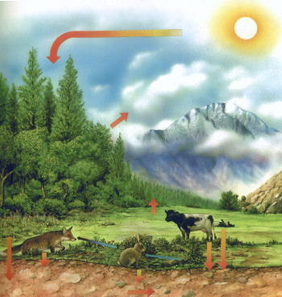
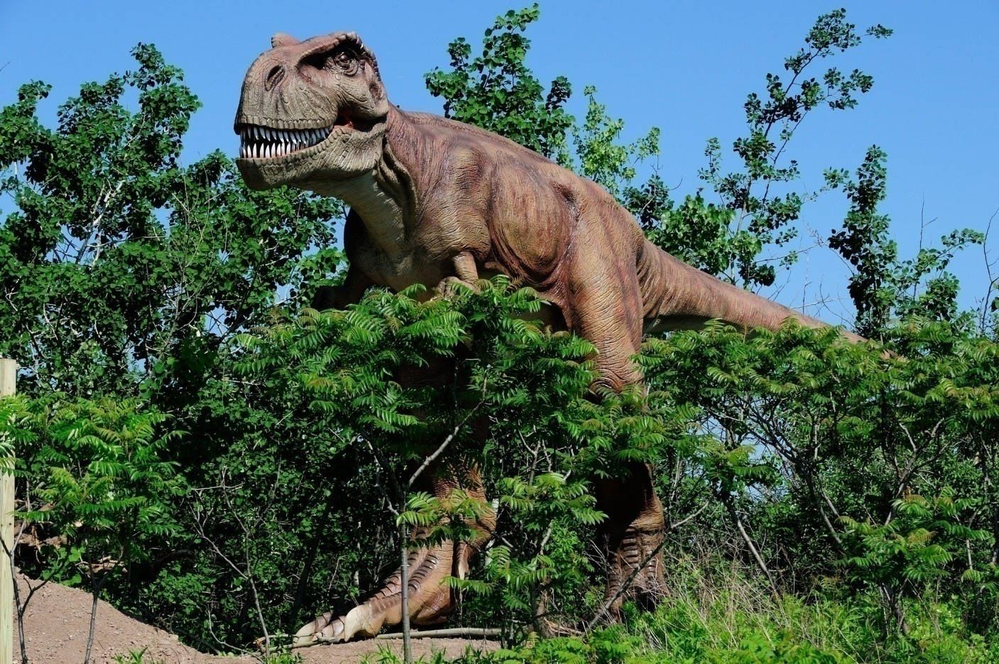
Creators and Exploiters of Energy Reservoirs
Heterotrophs take Energy for thermodynamic actions from autotrophs.

Slide 7
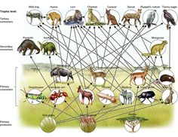
Thermodynamic Classification of Living Species
Life on Earth
Carbon Energy Reservoirs
Autotrophs
Heterotrophs
Somatic Heterotrophs
Consumption of Energy within the body is known as Somatism

Slide 8
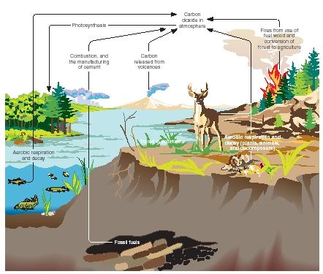
Organic Energy Cycles on Earth w/o Humans

Slide 9


Thermodynamic Classification of Living Species
Life on Earth
Carbon Energy Reservoirs
Autotrophs
Heterotrophs
Somatic Heterotrophs
Extra-Somatic Heterotrophs

Slide 10
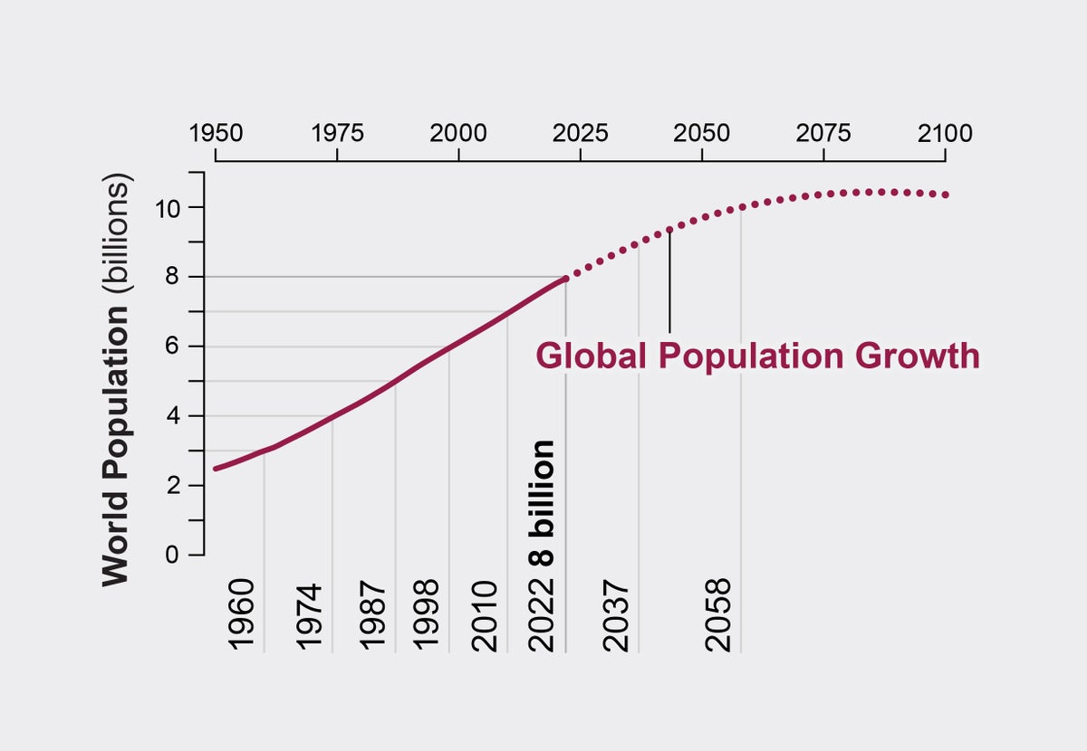
Humans : Extra-somatic Heterotrophs
The humans are extrasomatic heterotrophs.
The ability to use energy extrasomatically enables human beings to use far more energy than any other heterotroph that has ever evolved.
The human population modified more and more of its environment by using extrasomatic energy (Classical & Advanced Thermodynamics) to suit human needs.
The world's present population of over 8.3 billion is sustained and continues to grow through the use of extrasomatic energy.
The human race expanded its Energy resource base so that for long periods it has exceeded contemporary requirements.

Slide 11
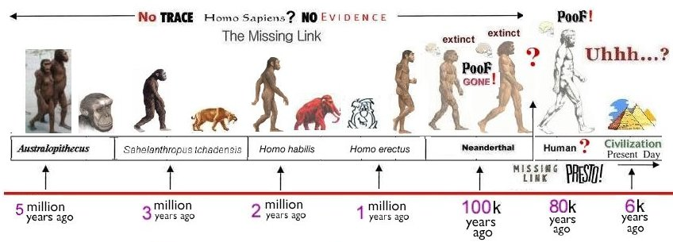
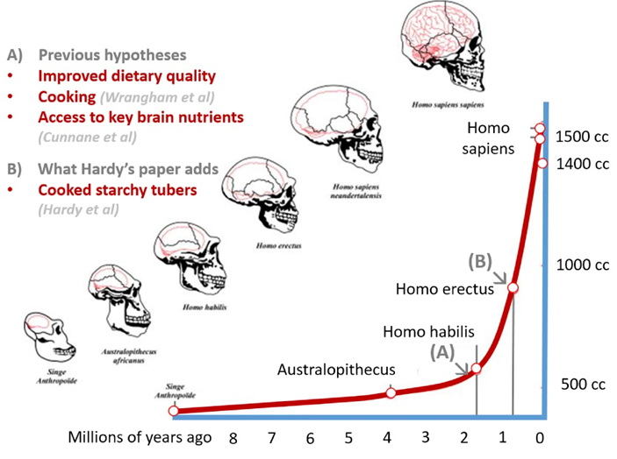
Extra Somatic Energy Usage Played/Plays A Vital Role in Human Evolution

Slide 12
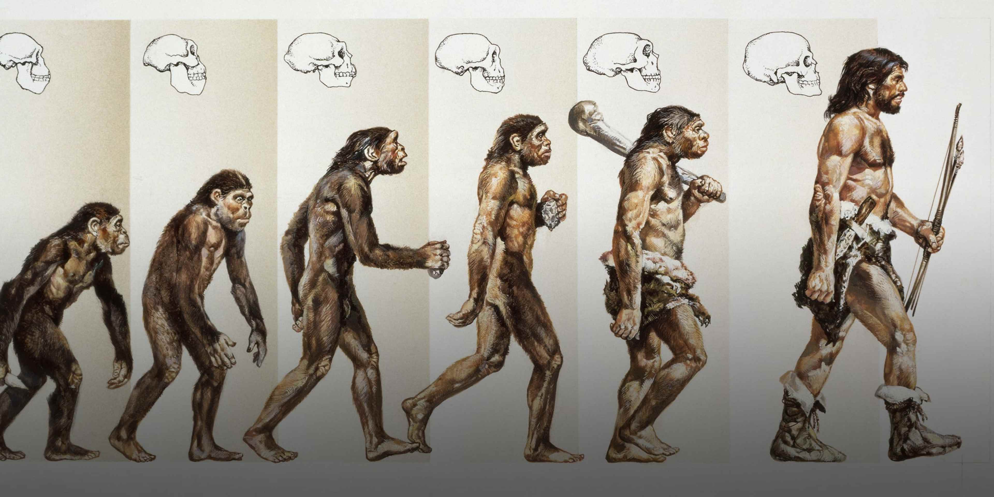
Evolution of Human Species

Slide 13
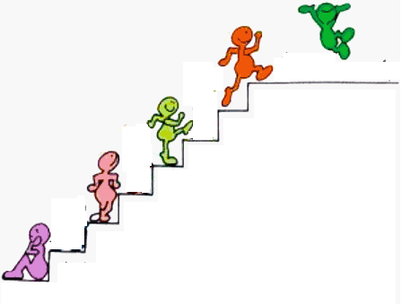
Human Evolution thru Use of Extra-somatic Mechanics
Quantum Era
Machine Free Era ???
Machines Era
Water Mills
Wind Mills
Heat Engines
Steam /gas turbines
Compound Tool Era
Single body Tool Era
Cattle as Energy Systems
Pre-historic Technology
Humans as Energy Systems
Pre-historic Energy Systems

Slide 14
Human Practices using Materials Lead to the Origin of Classical Thermodynamics

