Slide 1

Thermodynamics of Life & Human Evolution
P M V Subbarao
Professor
Mechanical Engineering Department
I I T Delhi
Realization of Biological Needs thru Innovation & Practice..

Slide 2

Definition of Thermodynamics
Therme – Greek for heat
Dynamics – Greek for power (motion)
An empirical practice to create several facilities.
A branch of science which takes a Macroscopic view of systems.
Assume Continuum.
Deals with transfer / conversion of energy from one form to another.
Scientific Study/innovation initiated using 4 simple laws and simple mathematics.

Slide 3
Thermodynamics in Einstein's Thought
Albert Einstein's "Autobiographical Notes" (1, p. 32) contain a striking passage that expresses his views on thermodynamics.
“A theory is the more impressive, the greater the simplicity of its premises is, the more different kinds of things it re lates, and the more extended is its area of applicability.”
“Therefore, the deep impression that classical thermodynamics made upon me.”
“It is the only physical theory of universal content concerning which I am convinced that, within the framework of applicability of its basic concepts, it will never be overthrown."

Slide 4
Thermodynamics in Einstein's Thought
it will never be overthrown
This last remark, he added. was "for the special attention of those who are skeptics on principle."
All of Einstein's boldly original attacks on what he saw as the critical problems of early-20th-century physics are intimately related to his understanding of thermodynamics.
Thermodynamics is, a "theory of principle," which starts from "empirically observed general properties of phenomena.“
"It is a magnificent feeling to recognize the unity of a complex of phenomena which appear to be things quite apart from the direct visible truth.”

Slide 5
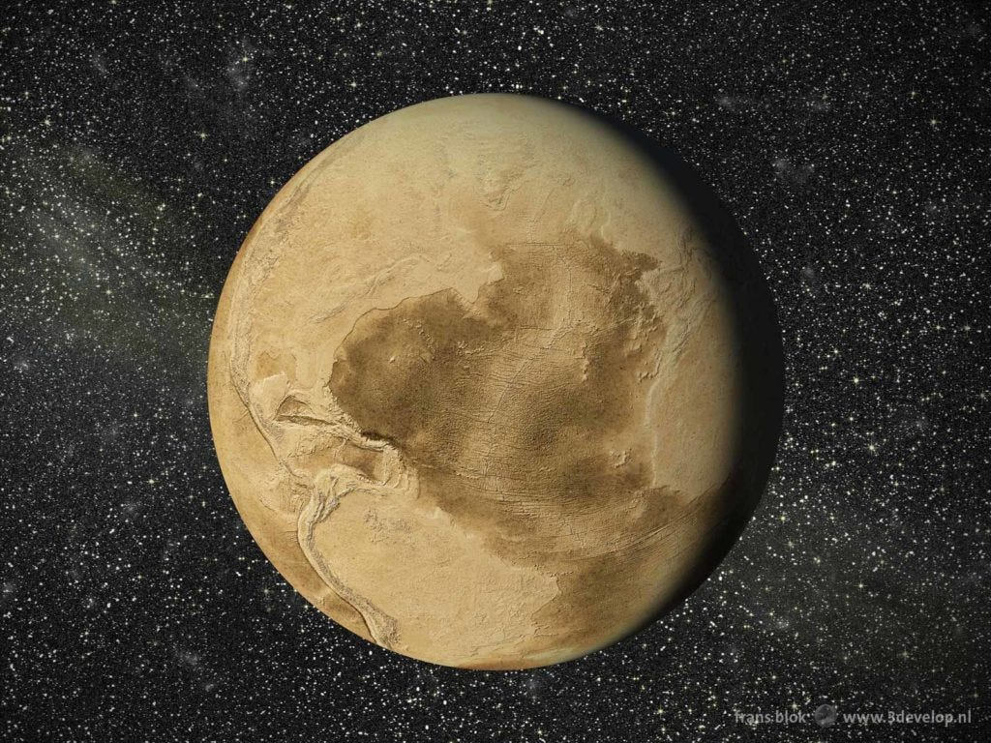
Life was born from materials, and life has evolved gradually to complex and functional organizations.
Energy is responsible for Creation of Life on Earth…..
Energy is a Vital Biological Need of Humans…

Slide 6
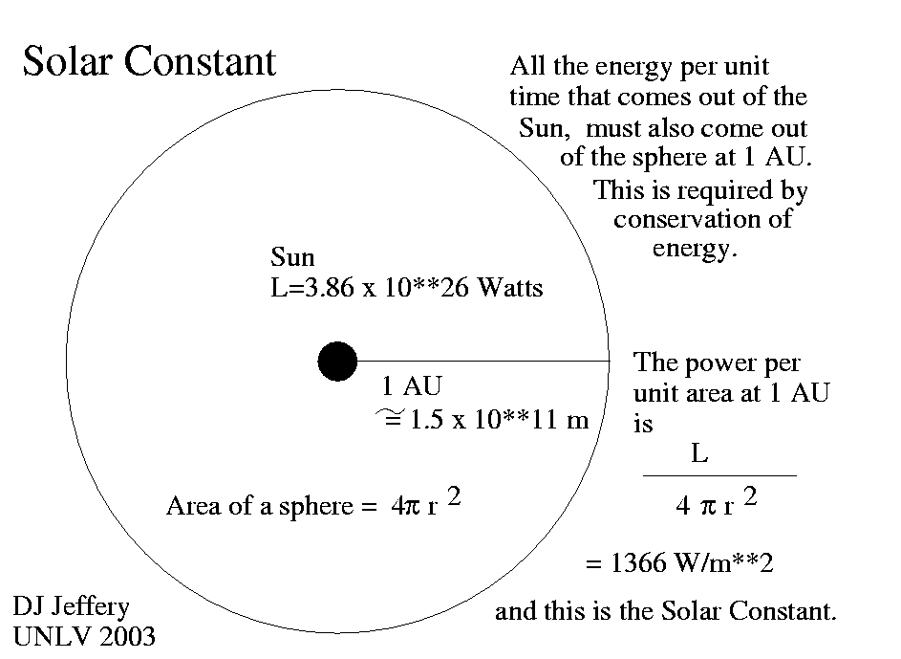
Emergy Available for Earth

Slide 7
Estimation of Emergy
The Earth’s Emergy baseline has been stable over the past 0.555 × 10⁹ years.
Emergy Received by Earth: 1.00 × 10²⁵ seJ/year ± 11%
8.0 × 10²⁴ seJ y⁻¹ …………………….. Odum, 1996
9.44 × 10²⁴ seJ y⁻¹ …………….. Odum, 1996
10.57 × 10²⁴ seJ y⁻¹ …………………. Campbell, 1998
15.83 × 10²⁴ seJ y⁻¹ …………….. Odum, et.al , 2000
1.2 × 10²⁵ seJ y⁻¹ …………..Campbell, 2016

Slide 8
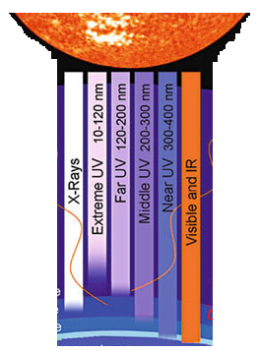

Solar Heating of Soil on other Planets: Wastage of Emergy

Slide 9
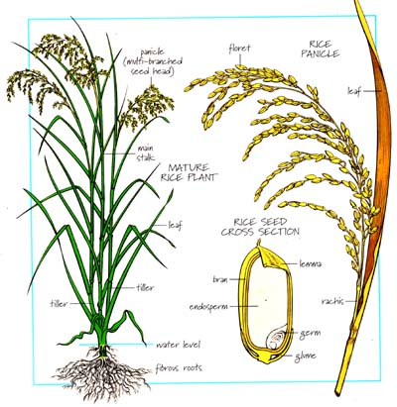

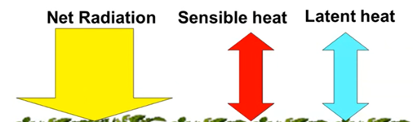
Conversion of Emergy to Biomass Energy by Biosphere

Slide 10

Irresponsible Wastage of Emergy and Carbon Burden on Environment

Slide 11
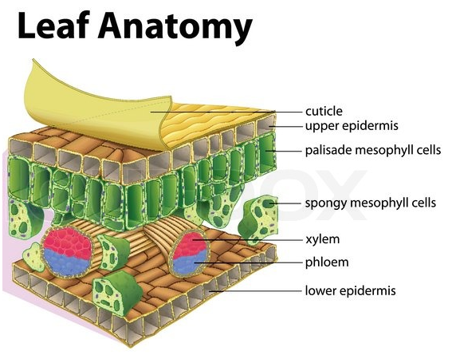
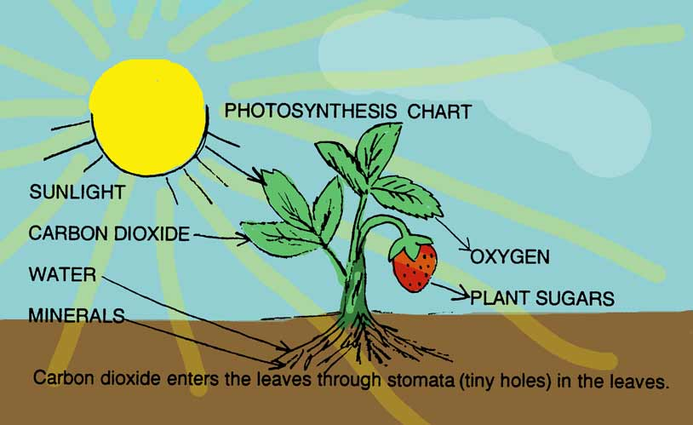
Thermodynamics of Life
Life on Earth is driven by energy.
Autotrophs take it from solar radiation and create Energy Reservoirs on Earth.

Slide 12


Thermodynamic Classification of Living Species
Life on Earth
CO₂
Solar Energy
Energy captured slowly by photosynthesis is stored up, and as denser reservoirs of energy have come into being over the course of Earth's history
Carbon Energy Reservoirs
Autotrophs
H₂O

