Slide 1

MEL7401 : Introduction to Advanced Thermodynamics
P M V Subbarao
Professor & Head
Mechanical Engineering Department
Classical Thermodynamics: Models for Natural Substance leading to Energy Appliances
Advanced Thermodynamics: Creation of Substances as per Models to Build Sustainable & Digital 21st Century!!!

Slide 2

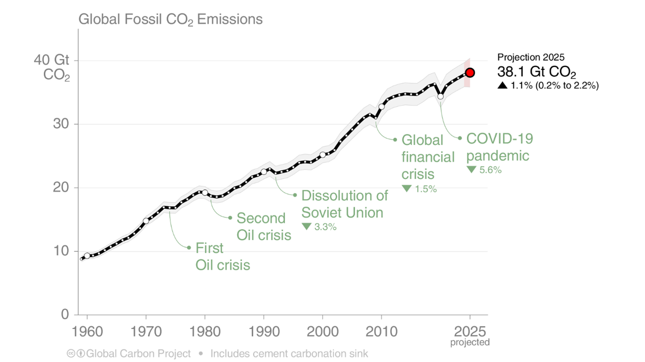
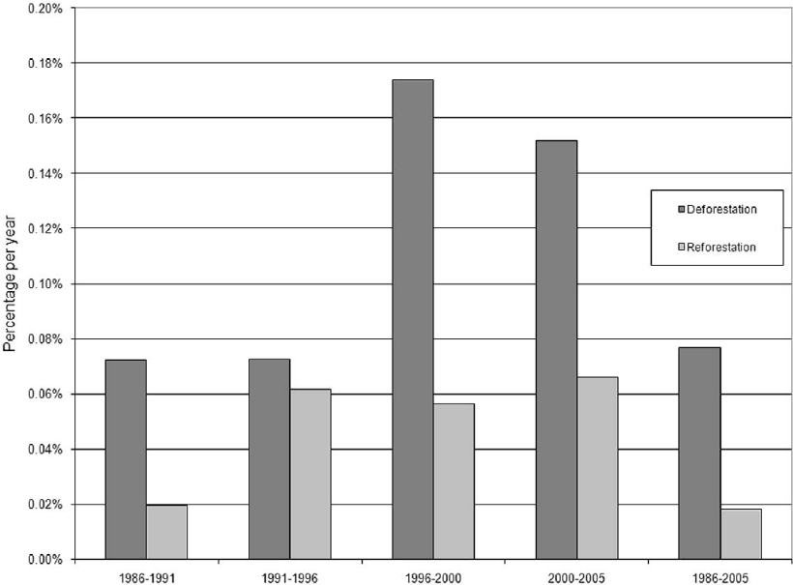
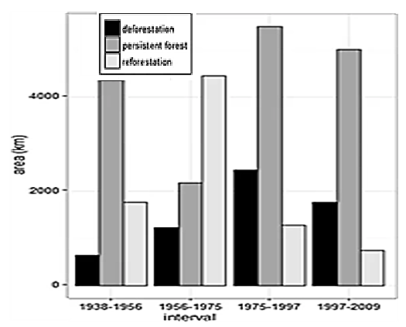
Sustainable Way of Invention
Every experimentalist/inventor must have the planned arrangement in his head before translating it into fact.
— Ernst Mach
A three-layered Innovation:
Think
Model & Analyse….
Build

Slide 3
Why 20th Century Innovations were Eco-harsh???

Slide 4
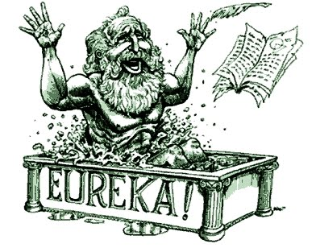
"It is possible to fly without motors, but not without knowledge and skill."
By
Wright Brothers
Aha! moment

Slide 5
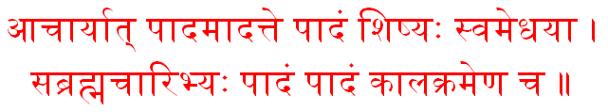
The Law of High-Level Learning
one fourth from the teacher, one fourth from own intelligence,
one fourth from classmates, and one fourth only with time.
Mahabharath

Slide 6
Acquisition of Skills thru The Law of Learning
Mathematical ability
Scientific acumen
Analytical skills

Slide 7
Acquisition of Skills thru The Law of Learning
Logical thinking
Creative problem-solving

Slide 8
Acquisition of Skills thru The Law of Learning
Technical skills
Project management & teamwork
Communication skills

Slide 9
Acquisition of Skills thru The Law of Learning
Attention to detail
Adaptability and continuous learning

Slide 10
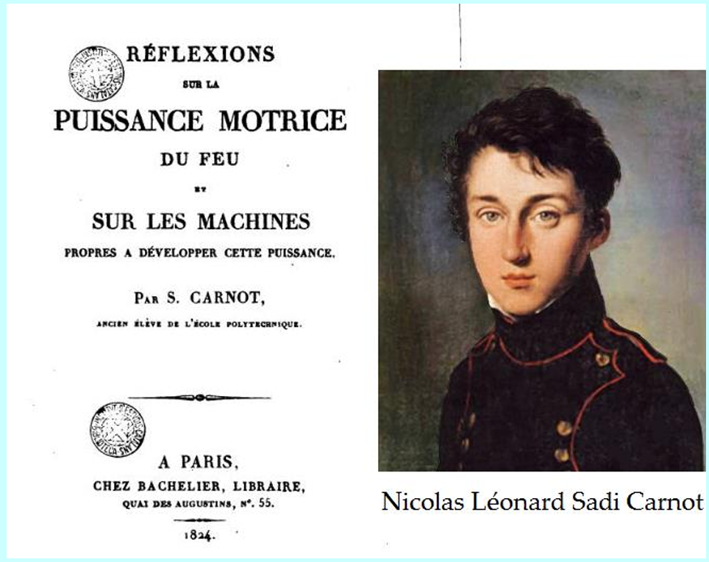
Two Centuries old Thermodynamics
In 2024 Thermodynamics turns 200 years old!

Slide 11
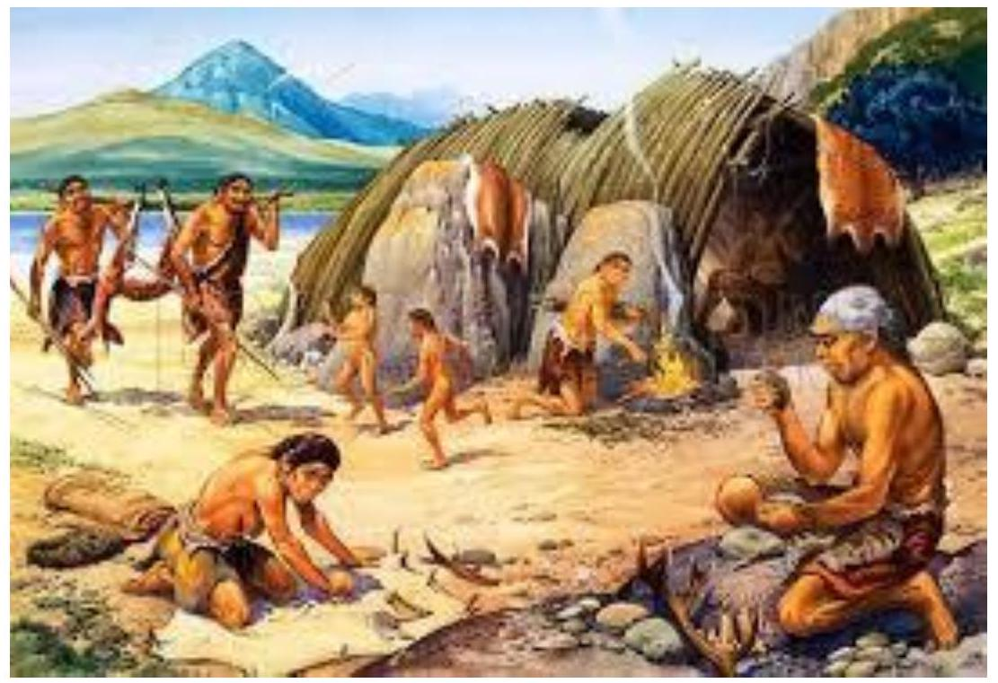
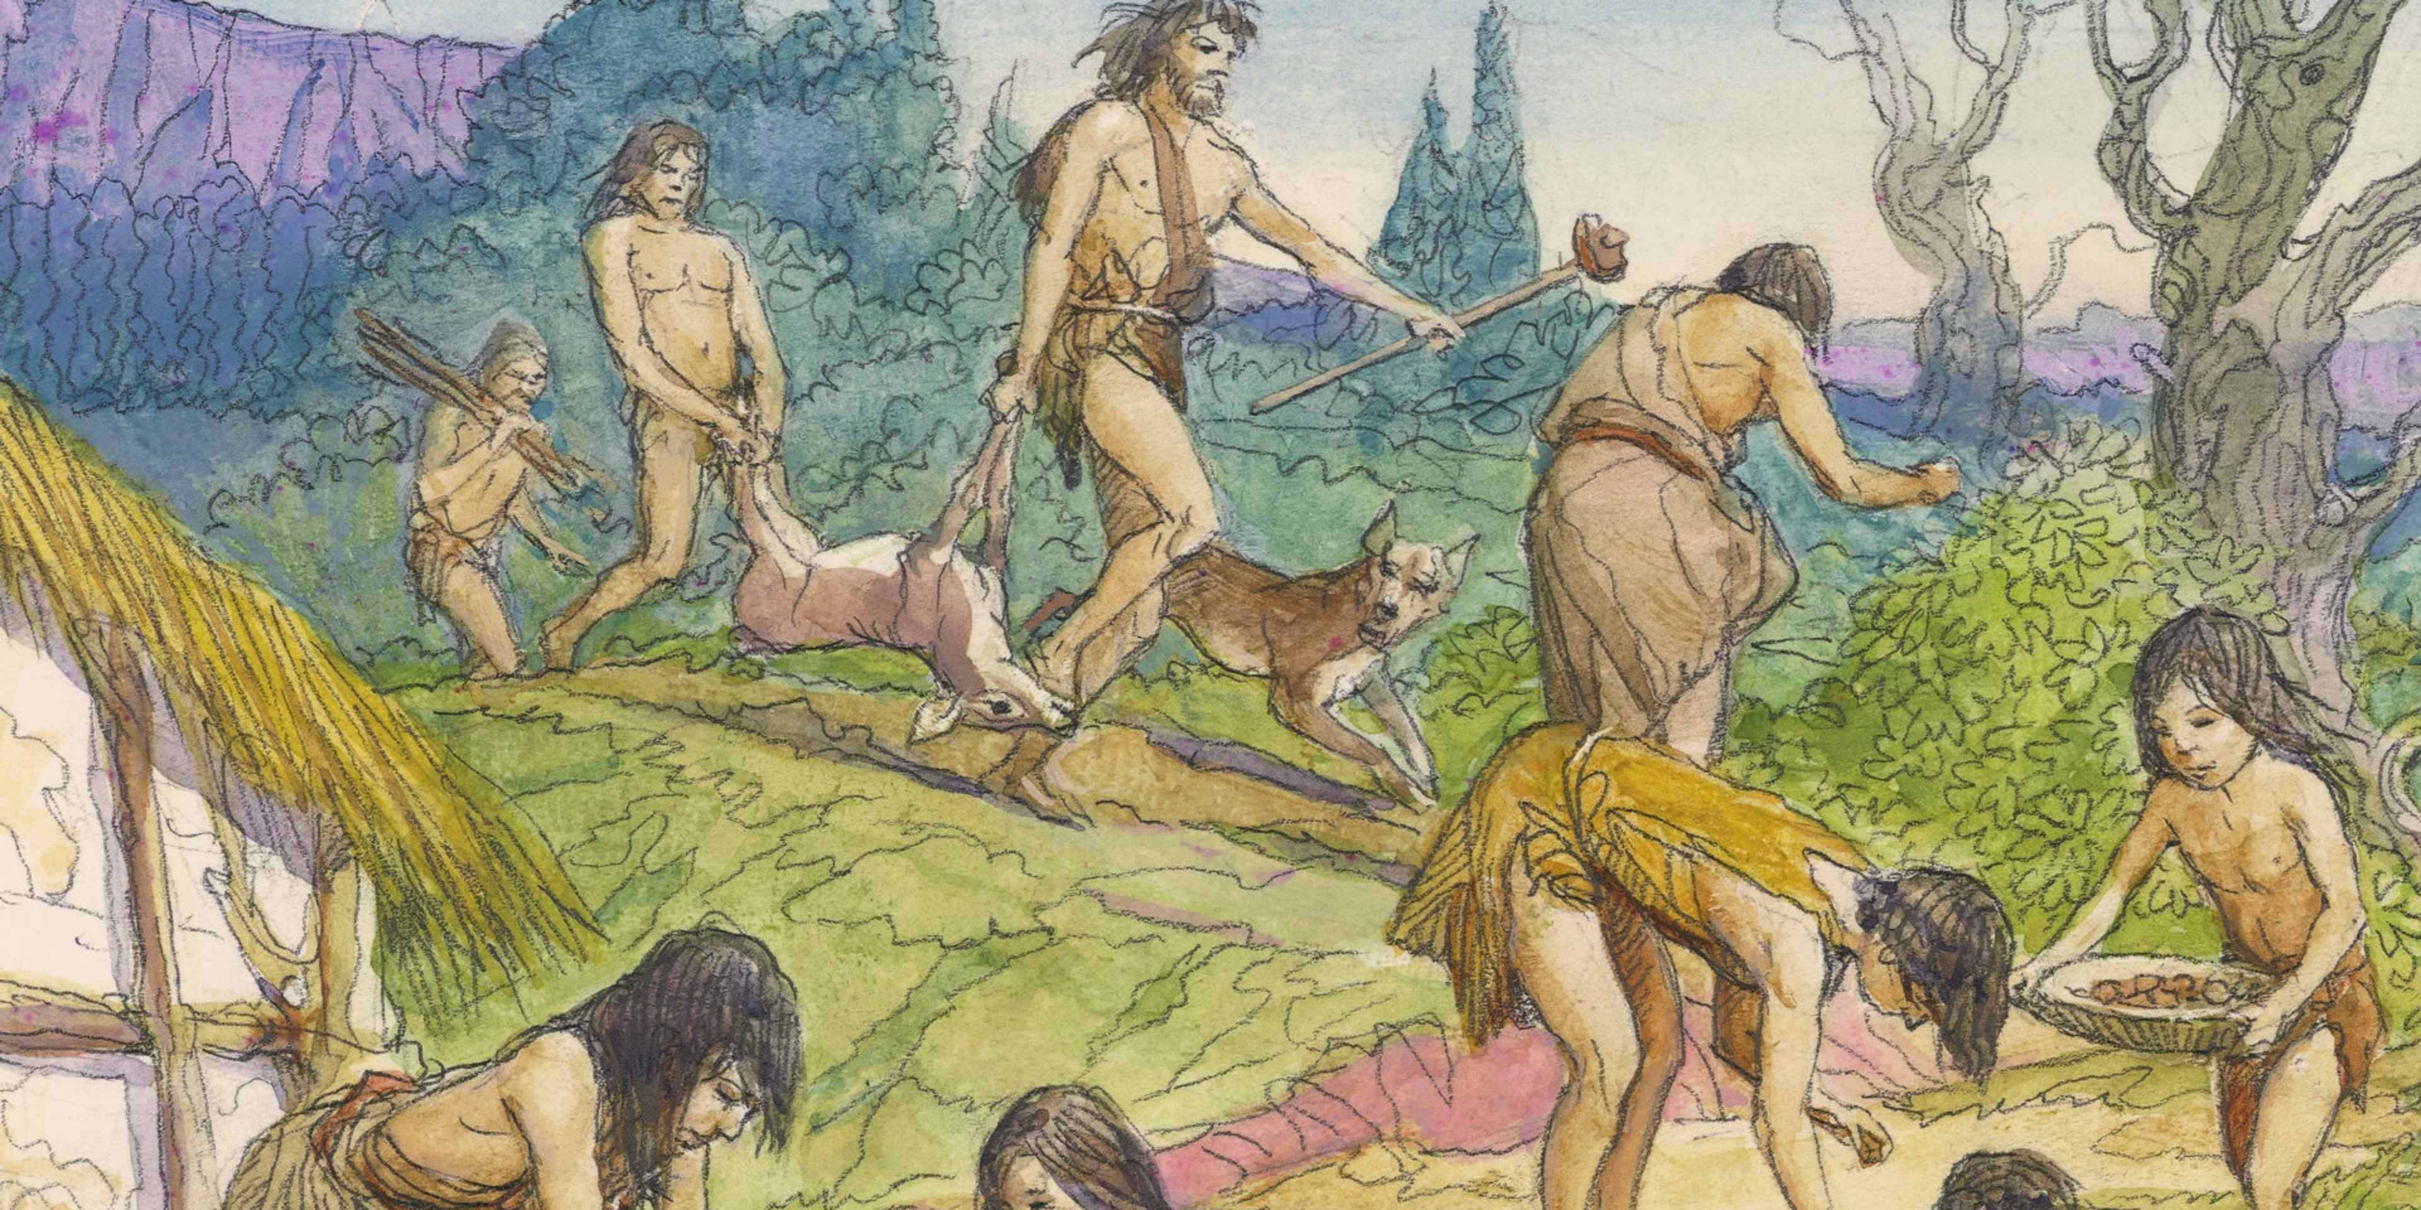
Humans as Hunters and Gatherers : No use of Extrasomatic Mechanics

Slide 12
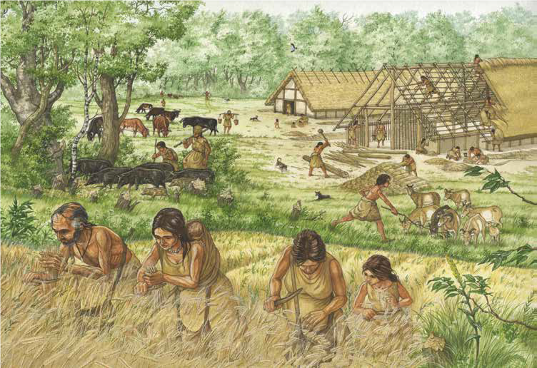
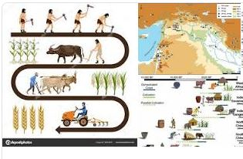
Humans as Farmers : Use of Extra-somatic Mechanics

Slide 13

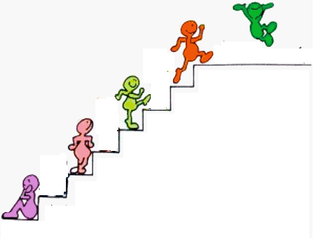
Human Evolution thru Use of Extra-somatic Mechanics
Quantum Era
Machine Free Era ???
Machines Era
Water Mills
Wind Mills
Heat Engines
Steam /gas turbines
Compound Tool Era
Single body Tool Era
Cattle as Energy Systems
Pre-historic Technology
Humans as Energy Systems
Pre-historic Energy Systems

