Slide 1


Preliminary Vector Analysis for Engineering Mechanics
P M V Subbarao
Professor & Head
Mechanical Engineering Department
A Tradition Driven Practice & Theory

Slide 2

Key Traditions within Mechanics
Vector Formulation: Emphasizes force (Newton, Euler).
Analytic Formulation: Emphasizes work and energy (Leibniz, Lagrange).
Theory & Practice: A continuous interplay, from Hero's devices to modern engineering applications.

Slide 3
Vector Formulation in Mechanics
Origin of word VECTOR
Sanskrit vahati "carries, conveys,"
Latin vehere "to carry, convey,"
Earlier in astronomy, "line joining a fixed point and a variable point" (1704);
In mathematical Mechanics: "quantity having magnitude and direction," 1846;

Slide 4
Classification of Physical Quantities in Mechanics
Physical Quantities in Mechanics are classified into Scalar Quantity and Vector Quantity
Scalar Quantity : Physical quantity with which only a magnitude is associated
  Examples: Time, Mass, Density, Volume, Speed, Energy
Vector Quantity :
Any physical quantity that involves both magnitude and direction, so that it may be represented by a line segment of definite length and direction, and which moreover conforms to the parallelogram law of addition is called a vector quantity.
  Examples: Displacement, Velocity, Acceleration, Momentum, Force…
Velocity is a superposition of direction on speed.

Slide 5
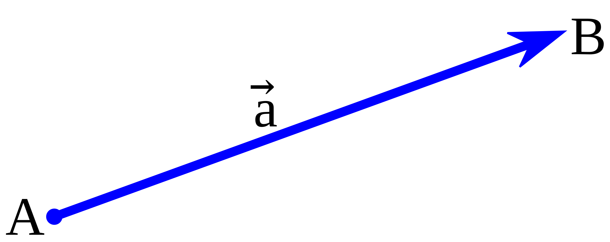
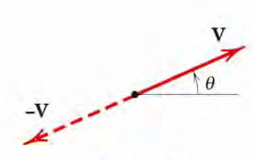
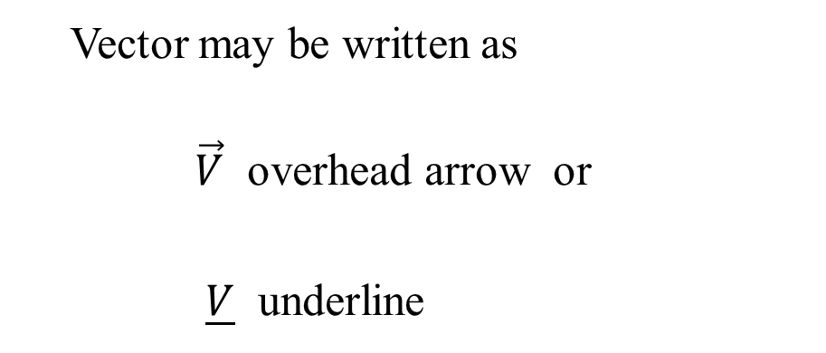

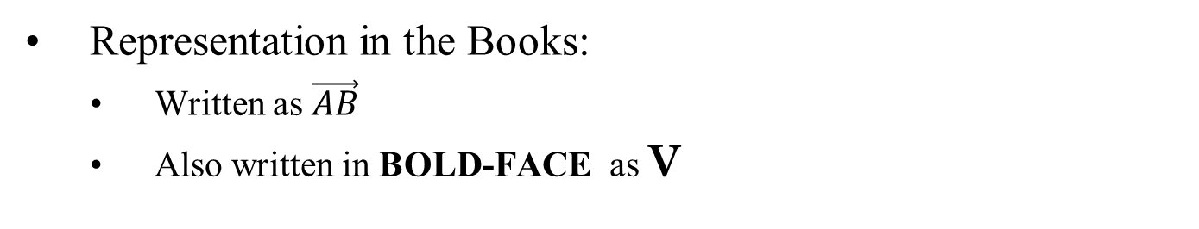


Definition of a Vector (Euclidean Vector)
A vector is a segment of a straight line (line segment) regarded as having definite length and direction
  Directed line segment
V
$$\vec{V}$$
Representation in the Books:
  Written as $\vec{AB}$
  Also written in BOLD-FACE as V
$$\vec{V}$$
Vector may be written as
$\vec{V}$ overhead arrow or
$\underline{V}$ underline
$$−\vec{V}$$
Note: alphabet used is small or capital

Slide 6
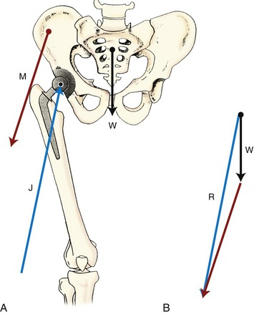

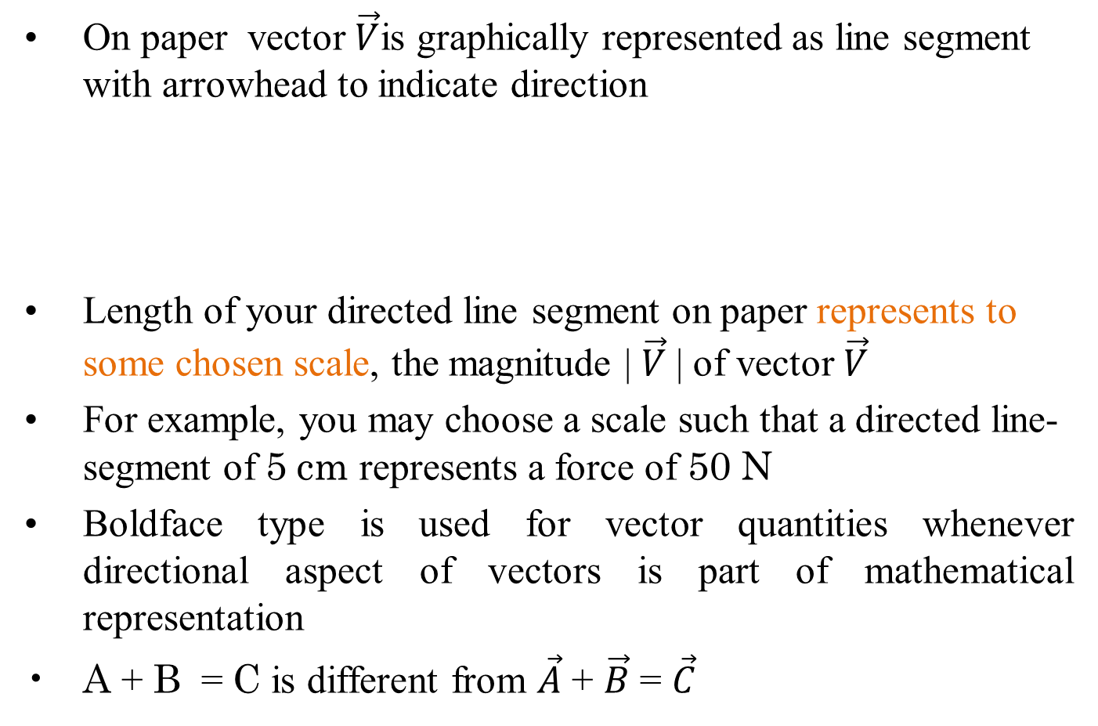

Diagnosis of A Vector
On paper vector $\vec{V}$is graphically represented as line segment with arrowhead to indicate direction
Length of your directed line segment on paper represents to some chosen scale, the magnitude | $\vec{V}$| of vector $\vec{V}$
For example, you may choose a scale such that a directed line-segment of 5 cm represents a force of 50 N
Boldface type is used for vector quantities whenever directional aspect of vectors is part of mathematical representation
A + B = C is different from $\vec{A}$ + $\vec{B}$ = $\vec{C}$
$$\vec{V}$$
$$−\vec{V}$$

Slide 7
Working with Vectors
Rules for mathematical manipulation of vectors do not involve location; therefore, from the mathematical point of view, the only quantities of interest are magnitude and directions
Vectors are treated as free vectors for mathematical manipulations
Let us look into some things (mathematical) we do with vectors.

Slide 8

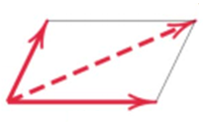
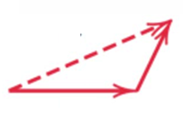












Working with Vectors
Direction
Measured by angle θ from some known reference direction
Angular orientation of is θ + π
$$\vec{V}$$
$$−\vec{V}$$
$$−\vec{V}$$
Parallelogram Law and Triangle Law of Addition
$${\vec{V}}_{2}$$
$${\vec{V}}_{3}$$
$${\vec{V}}_{3}$$
$${\vec{V}}_{2}$$
$${\vec{V}}_{2}$$
$${\vec{V}}_{1}$$
$${\vec{V}}_{1}$$
$${\vec{V}}_{1}$$

Slide 9
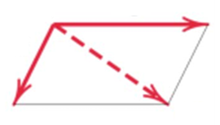
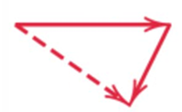
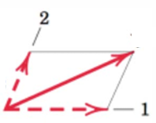


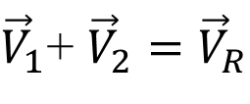








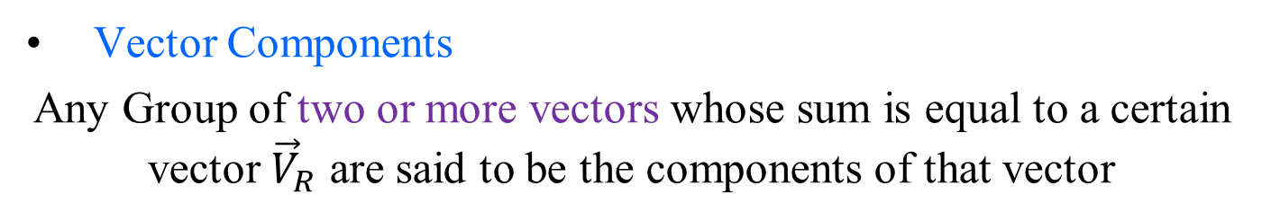

Working with Vectors
Triangle Law of Vector Subtraction
$${\vec{V}}_{2}$$
$${\vec{V}}_{1}$$
$${\vec{V}}_{1}$$
$${\vec{V}}_{2}$$
$${\vec{V}}_{3}$$
$${\vec{V}}_{2}$$
$${\vec{V}}_{3}$$
$${\vec{V}}_{1}$$
Vector Components
Any Group of two or more vectors whose sum is equal to a certain vector ${\vec{V}}_{R}$ are said to be the components of that vector
$${\vec{V}}_{R}$$
$${\vec{V}}_{2}$$
${\vec{V}}_{1}$+ ${\vec{V}}_{2}={\vec{V}}_{R}$
$${\vec{V}}_{1}$$

Slide 10
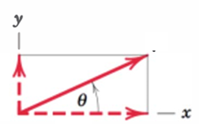
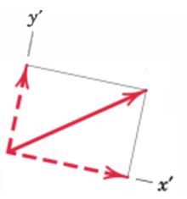








Working with Vectors
Rectangular (Cartesian) Components in Two-Dimensional (2D)Space
$${\vec{V}}_{2D−space}$$
$${\vec{V}}_{2D−space′}$$
$${\vec{V}}_{y′}$$
$${\vec{V}}_{y}$$
$${\vec{V}}_{x′}$$
$${\vec{V}}_{x}$$
$${\vec{V}}_{2D−space}={\vec{V}}_{x}+{\vec{V}}_{y}$$
$${\vec{V}}_{2D−space′}={\vec{V}}_{x′}+{\vec{V}}_{y′}$$
Vectors can be referred to any basis!

Slide 11

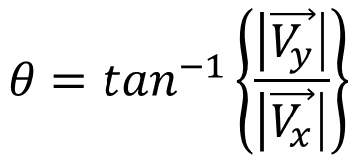





Working with Vectors
Rectangular (Cartesian) Components in Two-Dimensional (2D)Space
$${\vec{V}}_{2D−space}$$
$${\vec{V}}_{2D−space′}$$
$${\vec{V}}_{y′}$$
$${\vec{V}}_{y}$$
$${\vec{V}}_{x′}$$
$${\vec{V}}_{x}$$
Vectors can be referred to any basis!
When expressed in rectangular (Cartesian) components, the direction of the vector with respect to, say, the x-axis is clearly specified by the angle θ, where
$$θ=\tan^{−1}\left\{\frac{\left|\vec{V_{y}}\right|}{\left|\vec{V_{x}}\right|}\right\}$$

