Slide 1


Equilibrium Analysis Methodology – 2D Statics
P M V Subbarao
Professor & Head
Mechanical Engineering Department
Training to Create Static Solutions for Real-World Loads …..

Slide 2

Basic Skills in 2-D/3-D Equilibrium Analysis
System Isolation
Identification of Constraints thru Supports.
Creation of A Free-Body Diagram
Modeling the Action of each support/mechanical element.
Identification of Equilibrium Conditions
Treatment of Two & Three-Force Members.
Formulation of Equilibrium Equations.

Slide 3
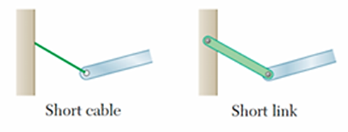
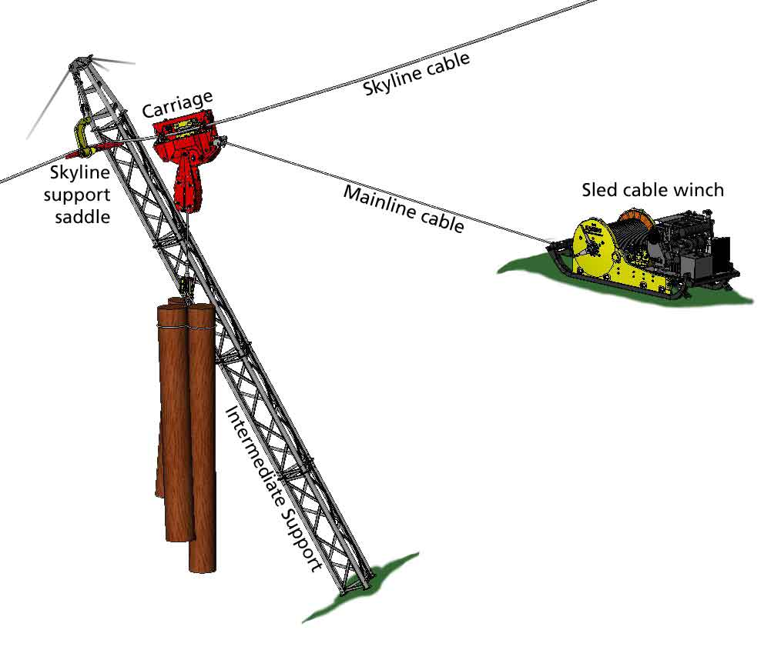
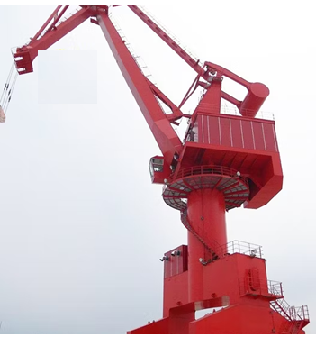
Support Reactions in 2D structures

Slide 4
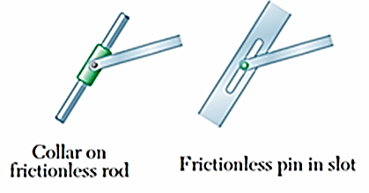
Support reactions in 2D structures

Slide 5
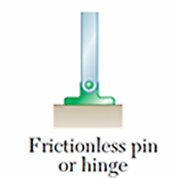
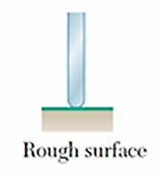
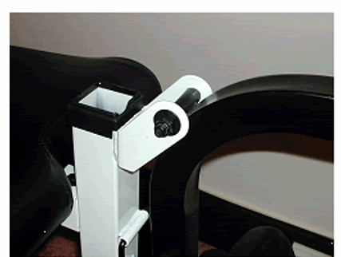

Support Reactions in 2D structures
$$≅$$

Slide 6
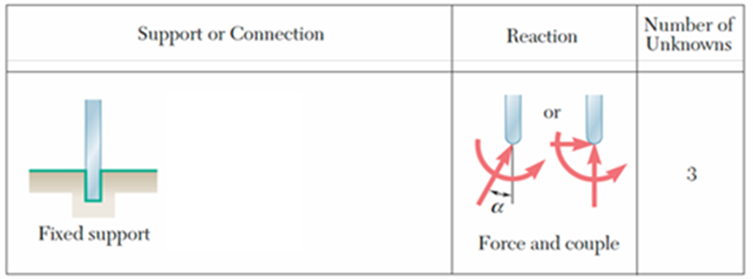
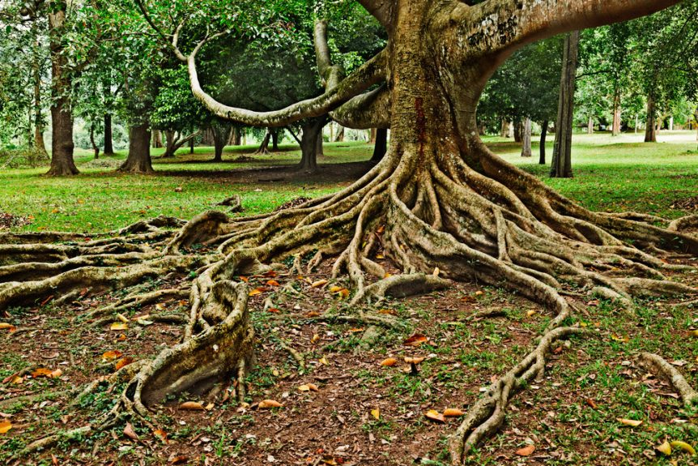
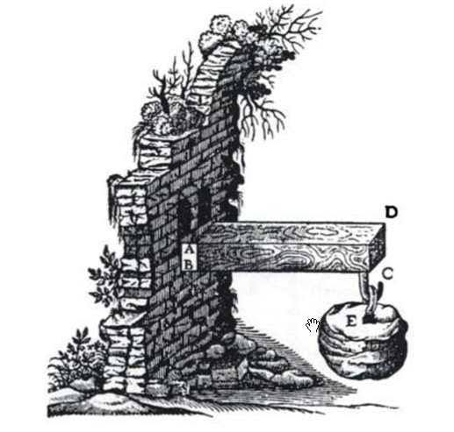
Support reactions in 2D structures
Leonhard Euler & Daniel Bernoulli (c. 1750)

Slide 7
Free-body Diagram (FBD)
The Free-body Diagram is the most important single step in the solution of problems in mechanics.
Zoom in on a given component of a structure.
Means replace supports (connections) with the corresponding reactions.
Replace kinematic constraints with corresponding reactions.
FBD shows all forces applied to the system by mechanical contact with other bodies. which are imagined to be removed.
If appreciable body forces are present, such as gravitational or magnetic attraction, then these forces must also be shown on the free-body diagram of the isolated system.
Equilibrium equations must be applied only after creating FBD.

Slide 8
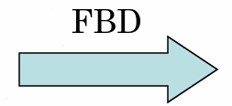
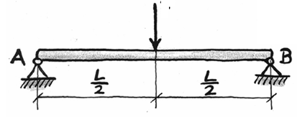
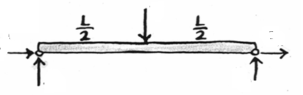
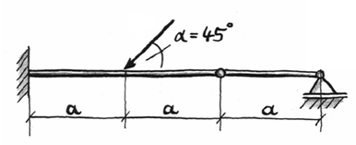
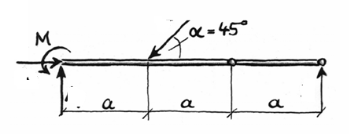
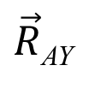

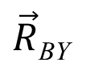
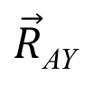


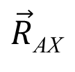

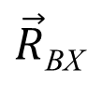
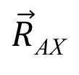
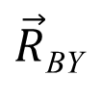
FBDs for Simple Systems
$$\vec{F}$$
$$\vec{F}$$
$\vec{R}$_{AX}
$\vec{R}$_{BX}
$\vec{R}$_{AY}
$\vec{R}$_{BY}
A loaded beam with pinned supports
$$\vec{F}$$
$$\vec{F}$$
$\vec{R}$_{AX}
$$\vec{M}$$
A loaded beam with pinned & Fixed supports
$\vec{R}$_{AY}
$\vec{R}$_{BY}

Slide 9
Key Steps in Construction of FBDs
Step 1. Decide which system to be isolated.
The system chosen should usually involve one or more of the desired unknown quantities.
Step 2. Next isolate the chosen system by drawing a diagram which represents its complete external boundary.
This boundary defines the isolation of the system from all other attracting or contacting bodies, which are considered removed.
This step is often the most crucial of all.
It must be Made certain that a system under study is completely isolated before proceeding with the next step.

Slide 10
Step 3 : Construction of FBDs
Step 3. Identify all forces which act on the isolated system as applied by the removed contacting and attracting bodies.
Represent them in their proper positions on the diagram of the isolated system.
A systematic traversing of the entire boundary must be done to identify all contact forces.
Body forces must be included such as weights, where appreciable.
Each unknown force should be represented by a vector arrow with the unknown magnitude or direction indicated by symbol.

Slide 11
Step 3 : Construction of FBDs
If the sense of the vector is also unknown, an arbitrarily sense is to be assigned.
The subsequent calculations with the equilibrium equations will yield a positive quantity if the correct sense was as summed and a negative quantity if the incorrect sense was assumed.
It is necessary to be consistent with the assigned characteristics of unknown forces throughout all the calculations.
If you are consistent, the solution of the equilibrium equations will reveal the correct senses.

Slide 12
Step 4 : Construction of FBDs
Step 4. The choice of coordinate axes must be directly shown on the diagram.
Pertinent dimensions may also be represented for convenience.
The free-body diagram serves the purpose of focusing attention on the action of the external forces.
Therefore, the diagram should not be cluttered with excessive extraneous information.
Clearly distinguish force arrows from arrows representing quantities other than forces.

Slide 13
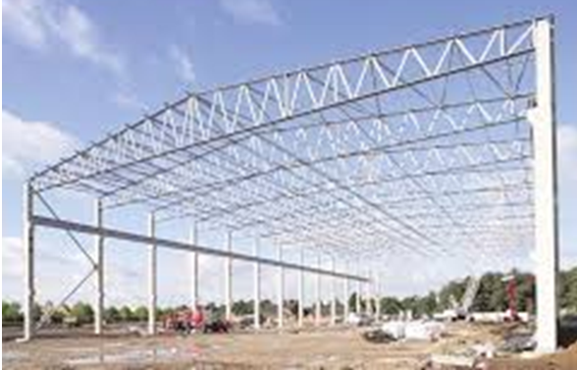
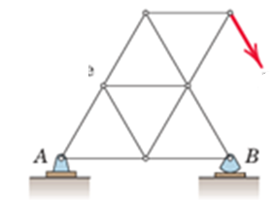
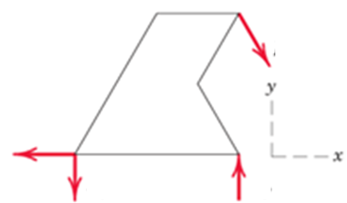





Examples of Free-Body Diagrams
1. Plane truss
$$\text{Weight} \text{of} \text{truss} \text{assumed} \text{negligible} \text{compared} \text{with} \vec{P}$$
$$\vec{P}$$
$$\vec{P}$$
$${\vec{A}}_{x}$$
$${\vec{A}}_{y}$$
$${\vec{B}}_{y}$$

Slide 14
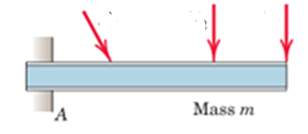
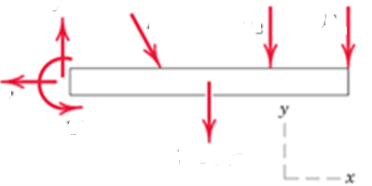










Examples of Free-Body Diagrams
2. Cantilever beam
$${\vec{F}}_{3}$$
$${\vec{F}}_{2}$$
$${\vec{F}}_{1}$$
$${\vec{F}}_{2}$$
$${\vec{F}}_{1}$$
$$\vec{F}V$$
$${\vec{F}}_{3}$$
$$\vec{F}H$$
$$\vec{M}$$
$$\vec{W}=m\vec{g}$$

Slide 15
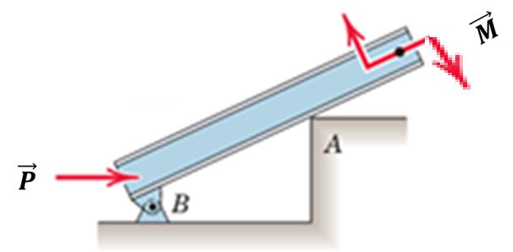
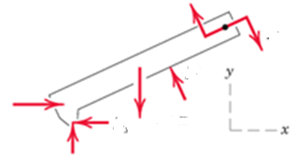






Examples of Free-Body Diagrams
3. Beam
Smooth surface contact at A. Mass, m
Free-body Diagram
of Isolated Body
$$\vec{M}$$
$$\vec{P}$$
$$\vec{N}$$
$$\vec{W}$$
$${\vec{B}}_{y}$$
$${\vec{B}}_{x}$$

Slide 16
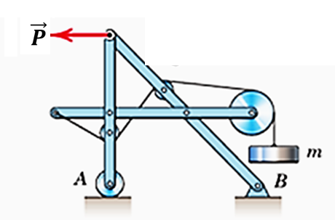
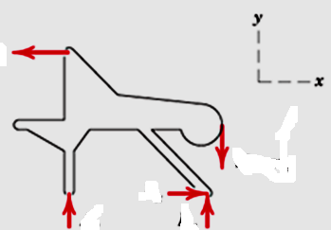





Examples of Free-Body Diagrams
4. Rigid system of interconnected bodies analyzed as a single unit
Free-body Diagram
of Isolated Body
$$\vec{P}$$
$$\vec{W}$$
$${\vec{B}}_{x}$$
$${\vec{A}}_{y}$$
$${\vec{B}}_{y}$$

