Slide 1

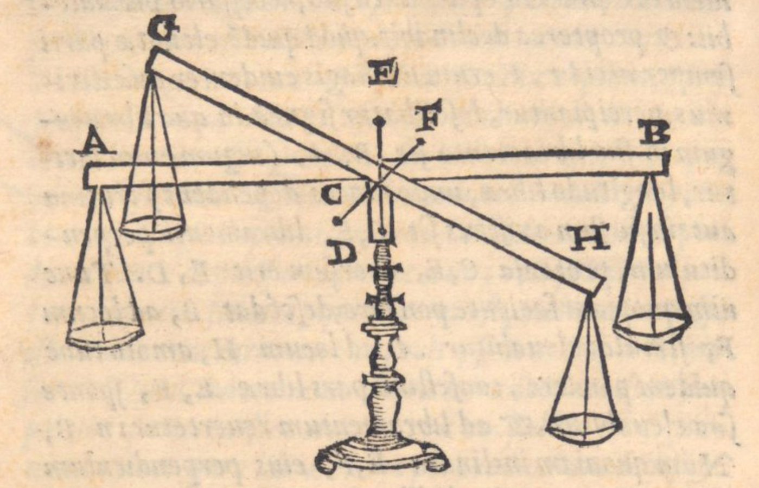

Equilibrium Analysis in Statics
P M V Subbarao
Professor & Head
Mechanical Engineering Department
The Art of Translational and Rotational Balance…..

Slide 2

Equilibrium Analysis
Balance and equilibrium in a wider sense are fundamental to the human condition.
What about the real, physical balance and its equilibrium?
The idea of equilibrium captured the attention of philosophers, scholars, engineers, and scientists for almost two millennia.
Started from Greek antiquity to the sixteenth century …
Guidobaldo, the most influential writer on mechanics of the sixteenth century, was proud to have reconciled the Archimedean theory of equilibrium.

Slide 3
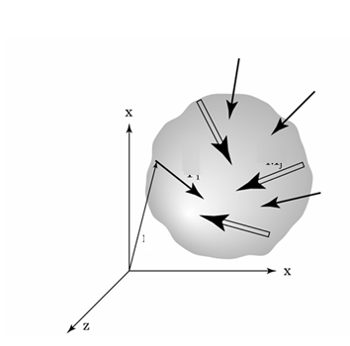


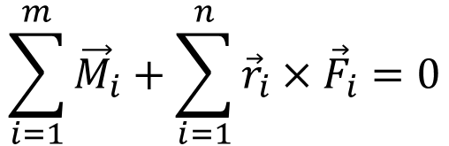
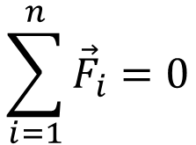

Equilibrium & Statics
Statics deals primarily with the description of the force conditions necessary and sufficient to maintain the equilibrium of engineering structures.
System is in equilibrium if and only if the sum of all the forces and sum of all the moments (about any point) equals zero.
$$\sum_{i=1}^{n}{{\vec{F}}_{i}}=0$$
$${\vec{F}}_{i}$$
$${\vec{M}}_{i}$$
$$\sum_{i=1}^{m}{{\vec{M}}_{i}}+\sum_{i=1}^{n}{{\vec{r}}_{i}×{\vec{F}}_{i}}=0$$
$${\vec{r}}_{i}$$

Slide 4
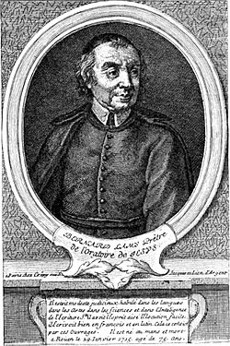
Analysis of Static Equilibrium
General Engineering Systems are three-dimensional.
Many of ES can be treated as two-dimensional for equilibrium analysis when the forces acting on ES are in a single plane or can be transmitted onto a single plane.
Few of the ES can not be simplified as 2-D systems and hence these systems must be treated as three dimensional for equilibrium analysis.

Slide 5
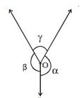

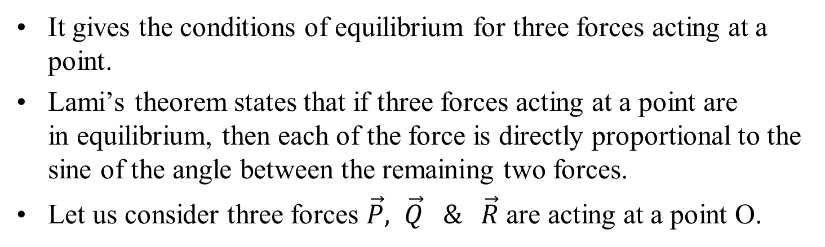


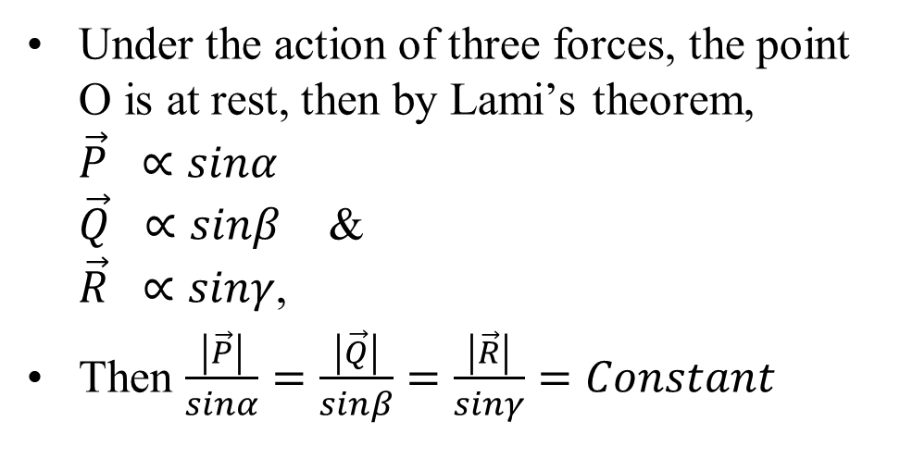
Equilibrium of A Point & Lami’s theorem
It gives the conditions of equilibrium for three forces acting at a point.
Lami’s theorem states that if three forces acting at a point are in equilibrium, then each of the force is directly proportional to the sine of the angle between the remaining two forces.
Let us consider three forces $\vec{P}, \vec{Q} \& \vec{R}$ are acting at a point O.
Under the action of three forces, the point O is at rest, then by Lami’s theorem,
$\vec{P} ∝sinα$
$\vec{Q} ∝sinβ$ &
$\vec{R} ∝sinγ$,
Then $\frac{\left|\vec{P}\right|}{sinα}=\frac{\left|\vec{Q}\right|}{sinβ}=\frac{\left|\vec{R}\right|}{sinγ}=Constant$
$$\vec{P}$$
$$\vec{Q}$$
$$\vec{R}$$

Slide 6
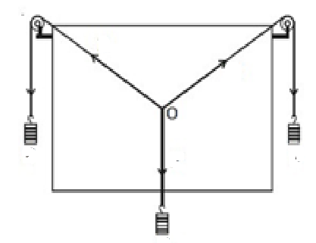
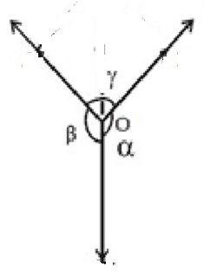









Experimental Verification of
Lami’s theorem
$$\vec{P}$$
$$\vec{Q}$$
$$\vec{P}$$
$$\vec{Q}$$
$$\vec{R}$$
$${\vec{w}}_{P}$$
$${\vec{w}}_{Q}$$
$${\vec{w}}_{R}$$
$$\vec{P}$$
Pedagogy of Equilibrium of A Point to An Engineering Structure???

Slide 7
Basic Skills in 2-D/3-D Equilibrium Analysis
System Isolation
Identification of Constraints thru Supports
Creation of A Free-Body Diagram
Modeling the Action of each support/mechanical element.
Identification of Equilibrium Conditions
Treatment of Two & Three-Force Members.
Formulation of Equilibrium Equations.

Slide 8
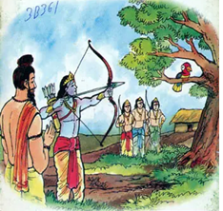
System Isolation
A mechanical system is defined as a body or group of bodies which can be conceptually isolated from all other bodies.
A system may be a single body or a combination of connected bodies.
The bodies may be rigid or nonrigid.
The system may also be an identifiable fluid mass, either liquid or gas, or a combination of fluids and solids.
In statics we study primarily forces which act on rigid bodies at rest.
Forces acting on incompressible fluids in equilibrium are also considered.

Slide 9
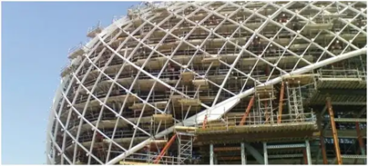
Supports in A Mechanical Structure
Any structure is made of many components.
The integrity of a structure is achieved by connecting components thru linkages.
Different component of structure communicate to each other via linkages.
The structure should be globally supported to prevent it from falling over.
Supports are required to maintain system in equilibrium.
Too few supports makes system unstable general loading.
Too many supports make the system over-rigid

Slide 10
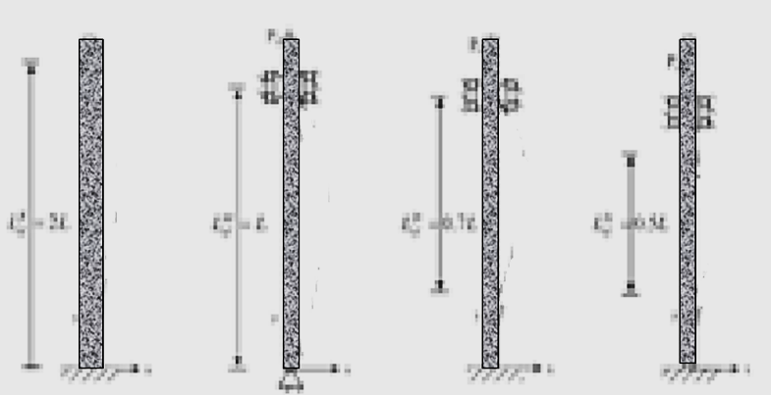
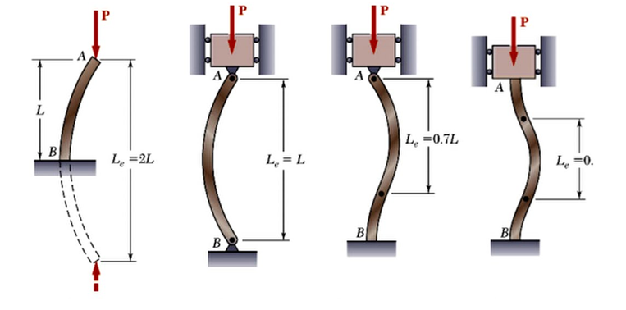


Development of Columns &
Surprising Accidents
$$\vec{P}$$
$$\vec{P}$$
$$\vec{P}$$
$$\vec{P}$$
0.5L

Slide 11
Theory of Columns
Buckling theory began with Leonhard Euler's groundbreaking work in the 1740s, establishing the critical load for slender columns

Slide 12
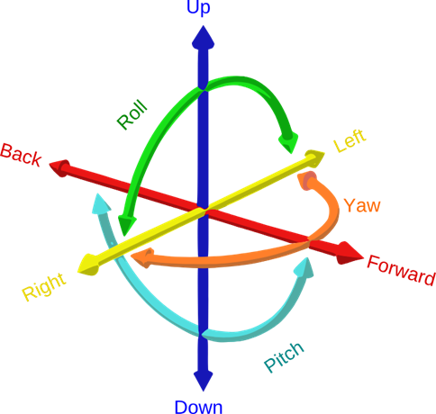
Constraints and Reactions
There exist an intricate relationship between kinematics (motion) and reactions (forces).
It is always important note that in the case of supports displacement (rotation) and force (torque) in any given direction are complementary.
Degrees of Freedom

Slide 13
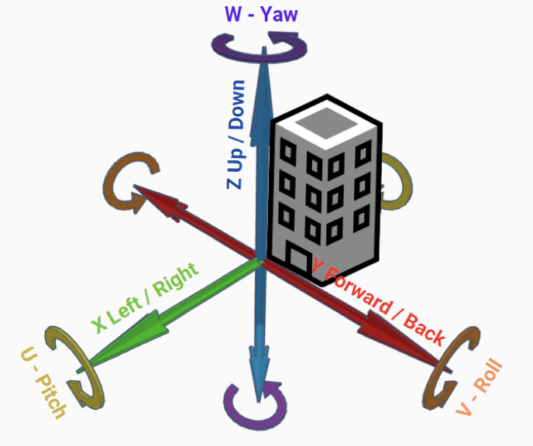
Constraints and Reactions
If a support rigidly constrains a given degree of freedom (DOF) for a rigid body, then it gives rise to a reaction corresponding to that DOF.
Similarly, if a support freely allows motion of particular DOF then there is no reaction from the support in that direction.

Slide 14
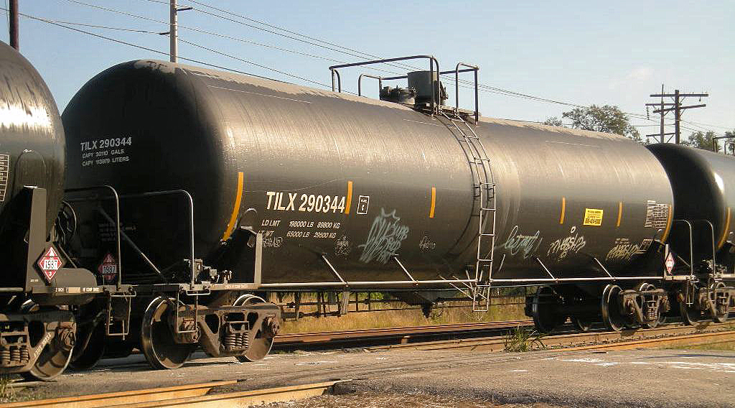
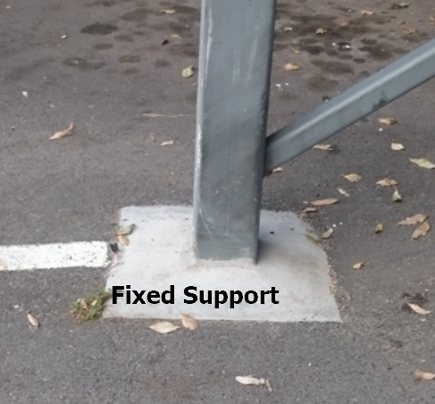
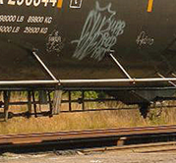
Fixed Support
A fixed support is the most rigid type of support or connection. It constrains the member in all translations and rotations

Slide 15

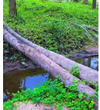
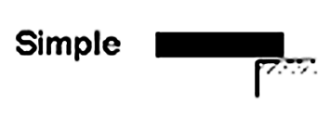
Simple Supports for Onset of Civilization
Support as a Constraint

Slide 16
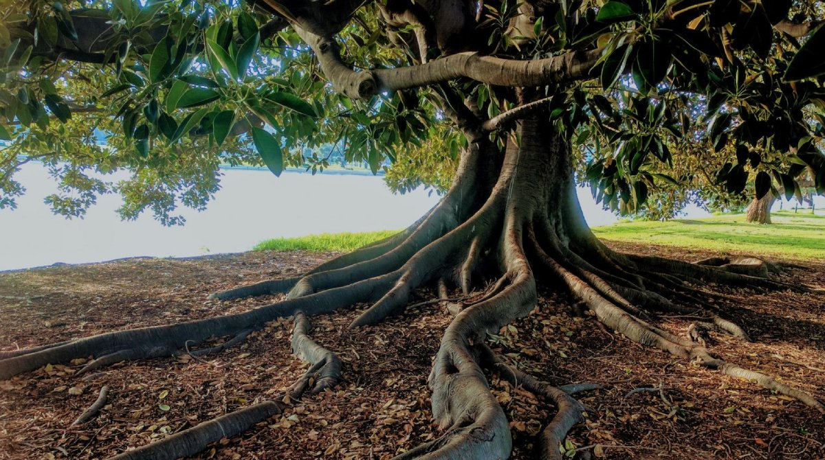
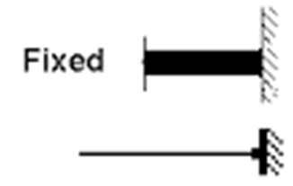
Hard Supports
Support as a Constraint

Slide 17
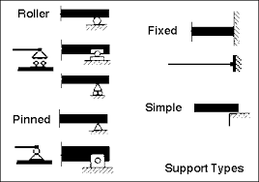
Types of Supports to Create Familiar Constraints
It is usually necessary to idealize the behaviour of a support in order to facilitate an analysis.

Slide 18
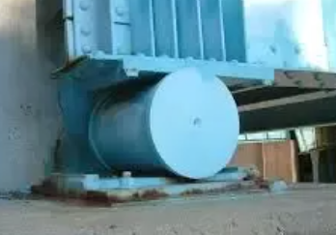
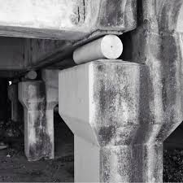
Types of Supports : Roller Support
Roller supports, essential for allowing structures like bridges to expand and contract.
Evolved from basic concepts of rolling friction to sophisticated engineered components.
James Fussell's 1800 carried out groundwork for wider application in accommodating thermal movement and reducing stress in large structures.
Roller supports can resist a vertical force but not a horizontal force.

Slide 19
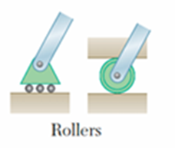
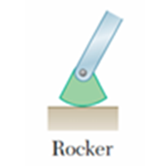
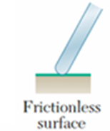
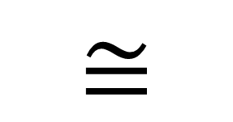
Support Reactions in 2D structures
$$≅$$
An early example is the Green River Bridge in Kentucky (1857–1859), which used rockers to allow the bridge to expand without damaging the substructure.

